Slide 1

Algorithms and Data Structures 2 CS 1501
Fall 2021
Sherif Khattab
ksm73@pitt.edu
(Slides are adapted from Dr. Ramirez’s and Dr. Farnan’s CS1501 slides.)

Slide 2
Announcements
Upcoming deadlines:
2/26: Lab 4 and Homework 5
3/12: Assignment 2
Tophat questions are due one week after each lecture
Expectations regarding help from TAs
Office hours
Piazza
Midterm on 3/3
2-3 days time-window to start the exam
Ungraded homework assignments on string matching and hashing
Self-care!
Study spaces on campus are back open.
Research Summer Work
Mascaro Center for Sustainable Innovation at the School of Engineering
Applications due 2/24

Slide 3
Last lecture …
Symbol Table ADT
Running-time comparison:
Array (sorted and unsorted)
linked-list (sorted and unsorted)
binary search tree (BST)
Red-black BST
Digital search trees

Slide 4
Muddiest points (1/2)
Bit length vs n
Could you please repeat how we are able to define an "average case"? Wouldn't you only be sure of the best and worst?
DST
I understand the worst case and average case of DST are theta(b) and theta(logn). But can you explain again why b>=logn? and when b is greater than logn? and when they are equal? Still a bit confused about this part.
why the worst case is theta(b). What is n in “b >= logn”
DST insert
when to use digital search trees
how to locate the node according to its key in digital search tree
BST/RB-BST
could you specify again how the delete work in BST in pictures? Like giving us an example please? Sorry
how to know when to use Red-Black BST ops
Why do we need a symbol table ADT? Just curios what they are used for
Why is windows bad?

Slide 5
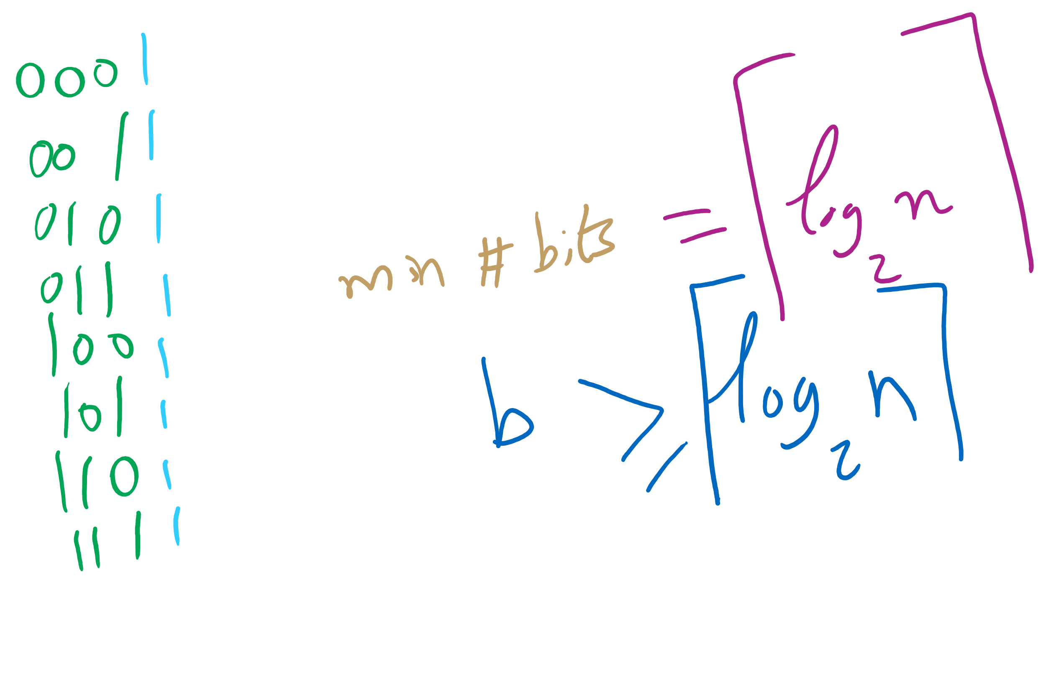
n vs. bit length

Slide 6
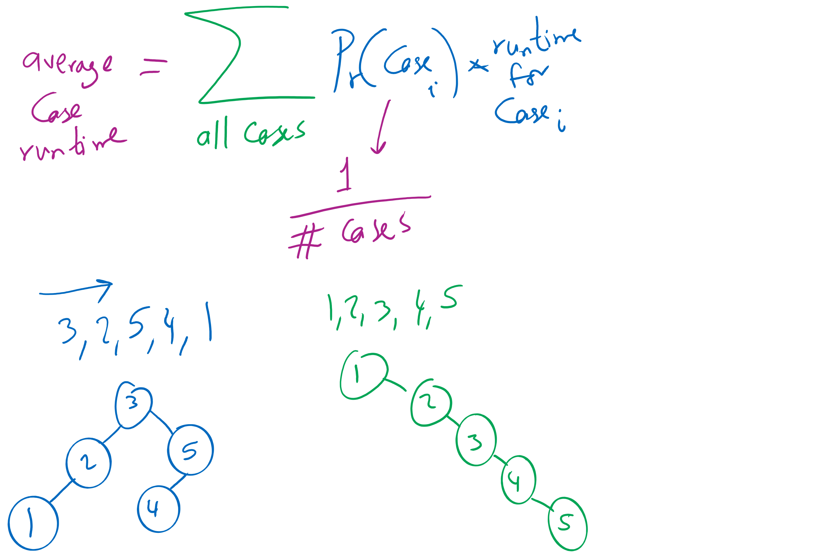
Average-case Analysis

Slide 7
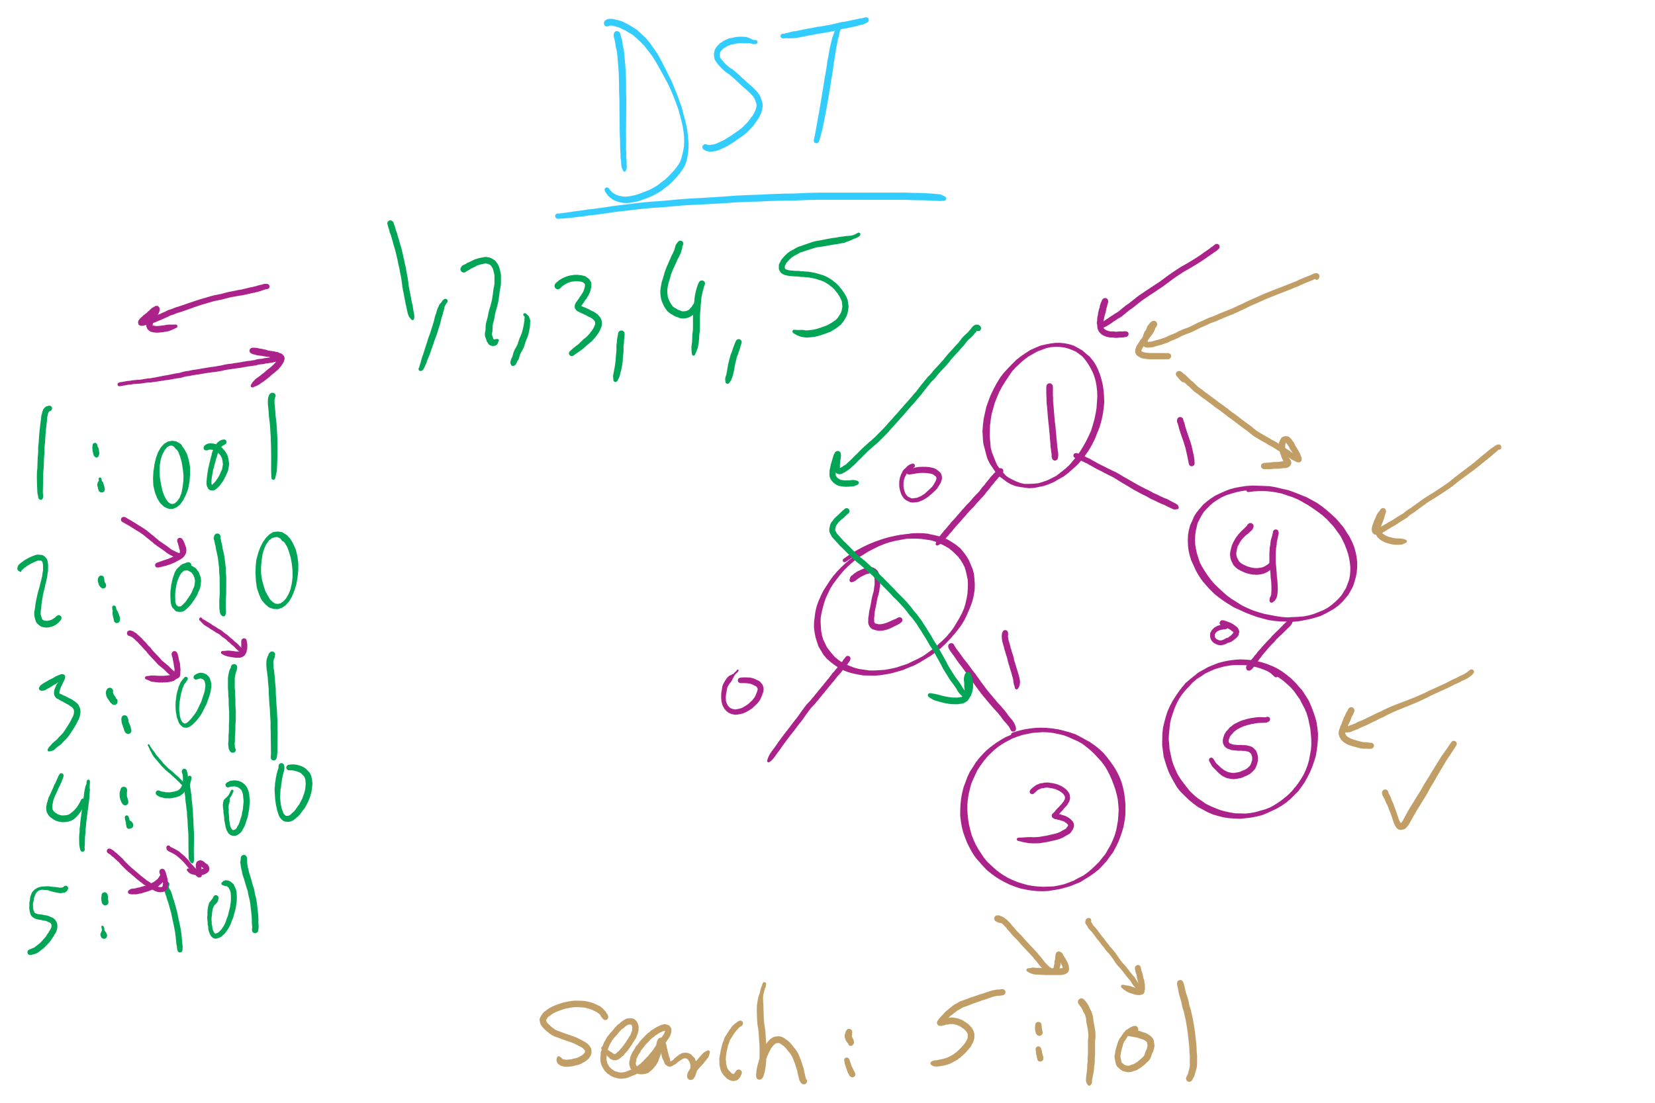
DST Operations

Slide 8
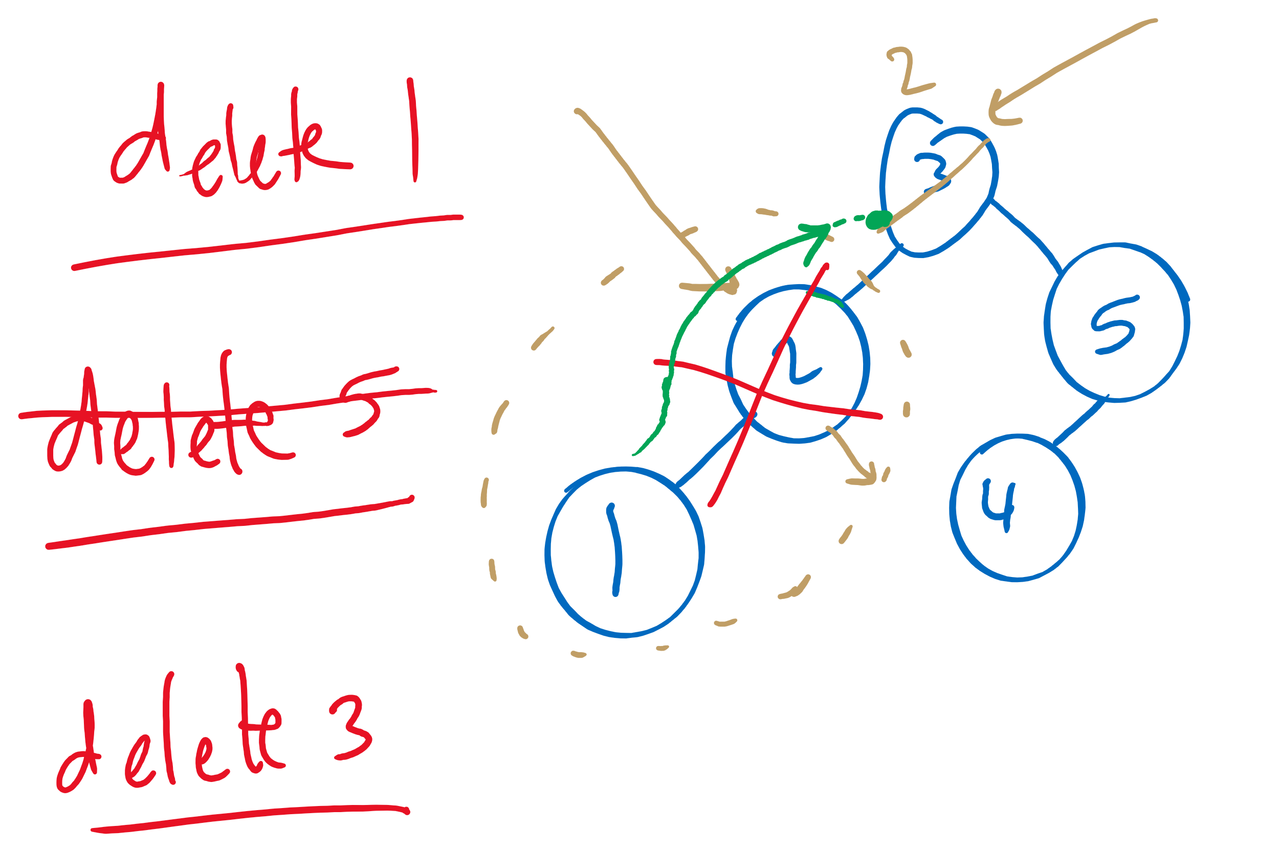
BST Delete

Slide 9
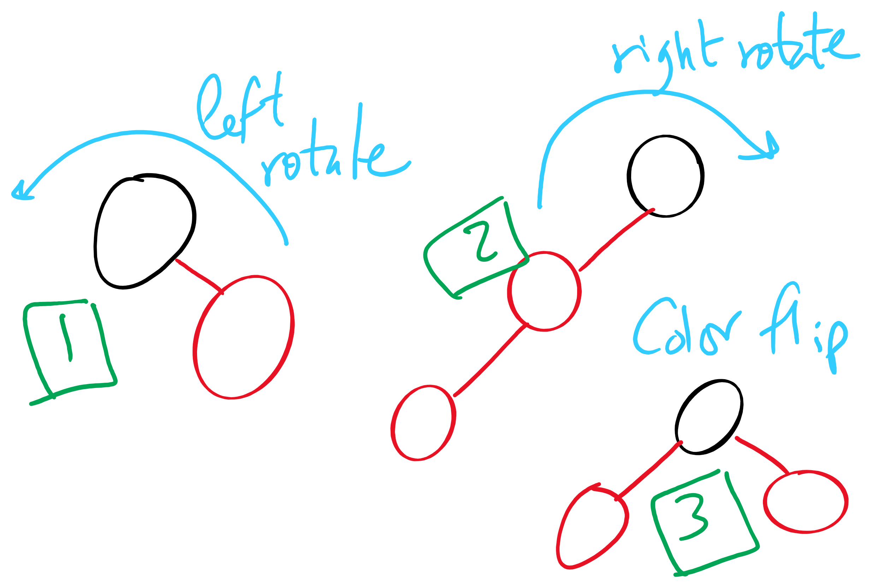
Red-Black BST Operations

Slide 10
This Lecture
radix search tries
multiway tries

Slide 11
Radix search tries (RSTs)
Trie as in retrieve, pronounced the same as “try”
Instead of storing keys as nodes in the tree, we store them implicitly as paths down the tree
Interior nodes of the tree only serve to direct us according to the bitstring of the key
Values can then be stored at the end of key’s bit string path

Slide 12
RST example
Insert:
4
0100
0
1
3
0011
2
0010
0
1
6
0110
0
1
0
1
5
0101
Search:
0
1
0
1
0
1
3
0011
V
V
V
V
V
7
0111
Notes:
V's just stand for values added as part of the symbol table

Slide 13
RST analysis
Runtime?
Would this structure work as well for other key data types?
Characters?
Strings?
Notes:
b, the bit length of the key
Worst case from DSTs
However, this time we don’t have full key comparisons
Characters are exactly the same as 8 bit ints (assuming simple ascii)
Strings would have huge bit lengths (go back to prev slide to hit this home)
Also vary in length, which we could handle with RSTs

Slide 14
Muddiest points (2/2)
Radix Search Trie
how are they built/purpose of them
is rst a radix search trie?
sorting RST
Is radix search tree the same as digital search tree?
When to use radix search tries
storing in RST
where to store values in RST
how to search RST
determining where internal values should go in rst
general node operations in rst
Difference btwn storing key vs value in RST
Difference between radix and digital search trees
how can dst and rst be used on strings

Slide 15
Larger branching factor tries
In our binary-based Radix search trie, we considered one bit at a time
What if we applied the same method to characters in a string?
What would this new structure look like?
Let’s try inserting the following strings into an trie:
she, sells, sea, shells, by, the, sea, shore

Slide 16
Another trie example
b
s
t
y
e
h
h
a
l
e
o
e
l
l
r
s
l
e
s
Notes:
Instead of 1 bit per level, now looking at 8
How do we know where a string ends?
How do we know what keys are in the trie?
How do we store values in the trie?

Slide 17
Analysis
Runtime?
Notes:
Θ(w) where w is the character length of the string
Still constant!
So what do we really gain over RSTs?
For strings, w < b, and overall tree height is reduced

Slide 18
Further analysis
Miss times
Require an average of log_{R}(n) nodes to be examined
Where R is the size of the alphabet being considered
Proof in Proposition H of Section 5.2 of the text
Average # of checks with 2²⁰ keys in an RST?
With 2²⁰ keys in a large branching factor trie, assuming 8-bits at a time?
Notes:
Average # of checks with 2²⁰ keys in an RST?
lg(2²⁰) = 20
With 2²⁰ keys in an R-way trie, assuming 8-bit ASCII?
log₂₅₆(2²⁰) = 2.5

Slide 19
Implementation Concerns
See TrieSt.java
Implements an R-way trie
Basic node object:
private static class Node { private Object val; private Node[] next = new Node[R]; }
Where R is the branching factor
Non-null val means we have traversed to a valid key
Again, note that keys are not directly stored in the trie at all

