Slide 1

Algorithms and Data Structures 2 CS 1501
Fall 2021
Sherif Khattab
ksm73@pitt.edu
(Slides are adapted from Dr. Ramirez’s and Dr. Farnan’s CS1501 slides.)

Slide 2
Announcements
Upcoming deadlines:
3/5: Lab 5 and Homework 6
3/12: Assignment 2
Tophat questions are due one week after each lecture
Midterm Exam on 3/3 until 3/5
3-day time-window to start the exam

Slide 3
Last lecture …
de la Briandais trees
Introduction to Compression

Slide 4
Muddiest points (1/3)
DLB
why exactly is RST with array faster than DLB?
DLB Runtime
why DLB has a run time of search hit insert theta(w*R) ? what does w mean?
application of DLB
When to use DLB versus R-way tries
to what extend is few/many keys
Does the last node (leaf) with the terminating symbol contain all the important information?
a refresher on the code of linked lists would be helpful
Will we learn about removing nodes?
DLB trees - specifically where to store a value if we have a valid word
search miss performance for DLBs

Slide 5
Muddiest Points (2/3)
traversing DLBs
how prefix words are linked to the rest of words in DLBs
i'm confused about how child links in a DLB work
how to know when to go down to a child node vs over to sibling node of LL when traversing a DLB
How can a node point to another character and a child in DLB
traversing dlbs, why is the second character skipped?

Slide 6
Muddiest Points (3/3)
the top-hat question about having k bits & how that relates to going through strings
branching factor of multi way RST
compare the different types of trees and tries and their runtimes and uses. like when to use which one
DST Runtimes
compression
fixed variable compression
Huffman compression
How can a block store more information than what is being stored
how does lossy compression choose what to cut out

Slide 7
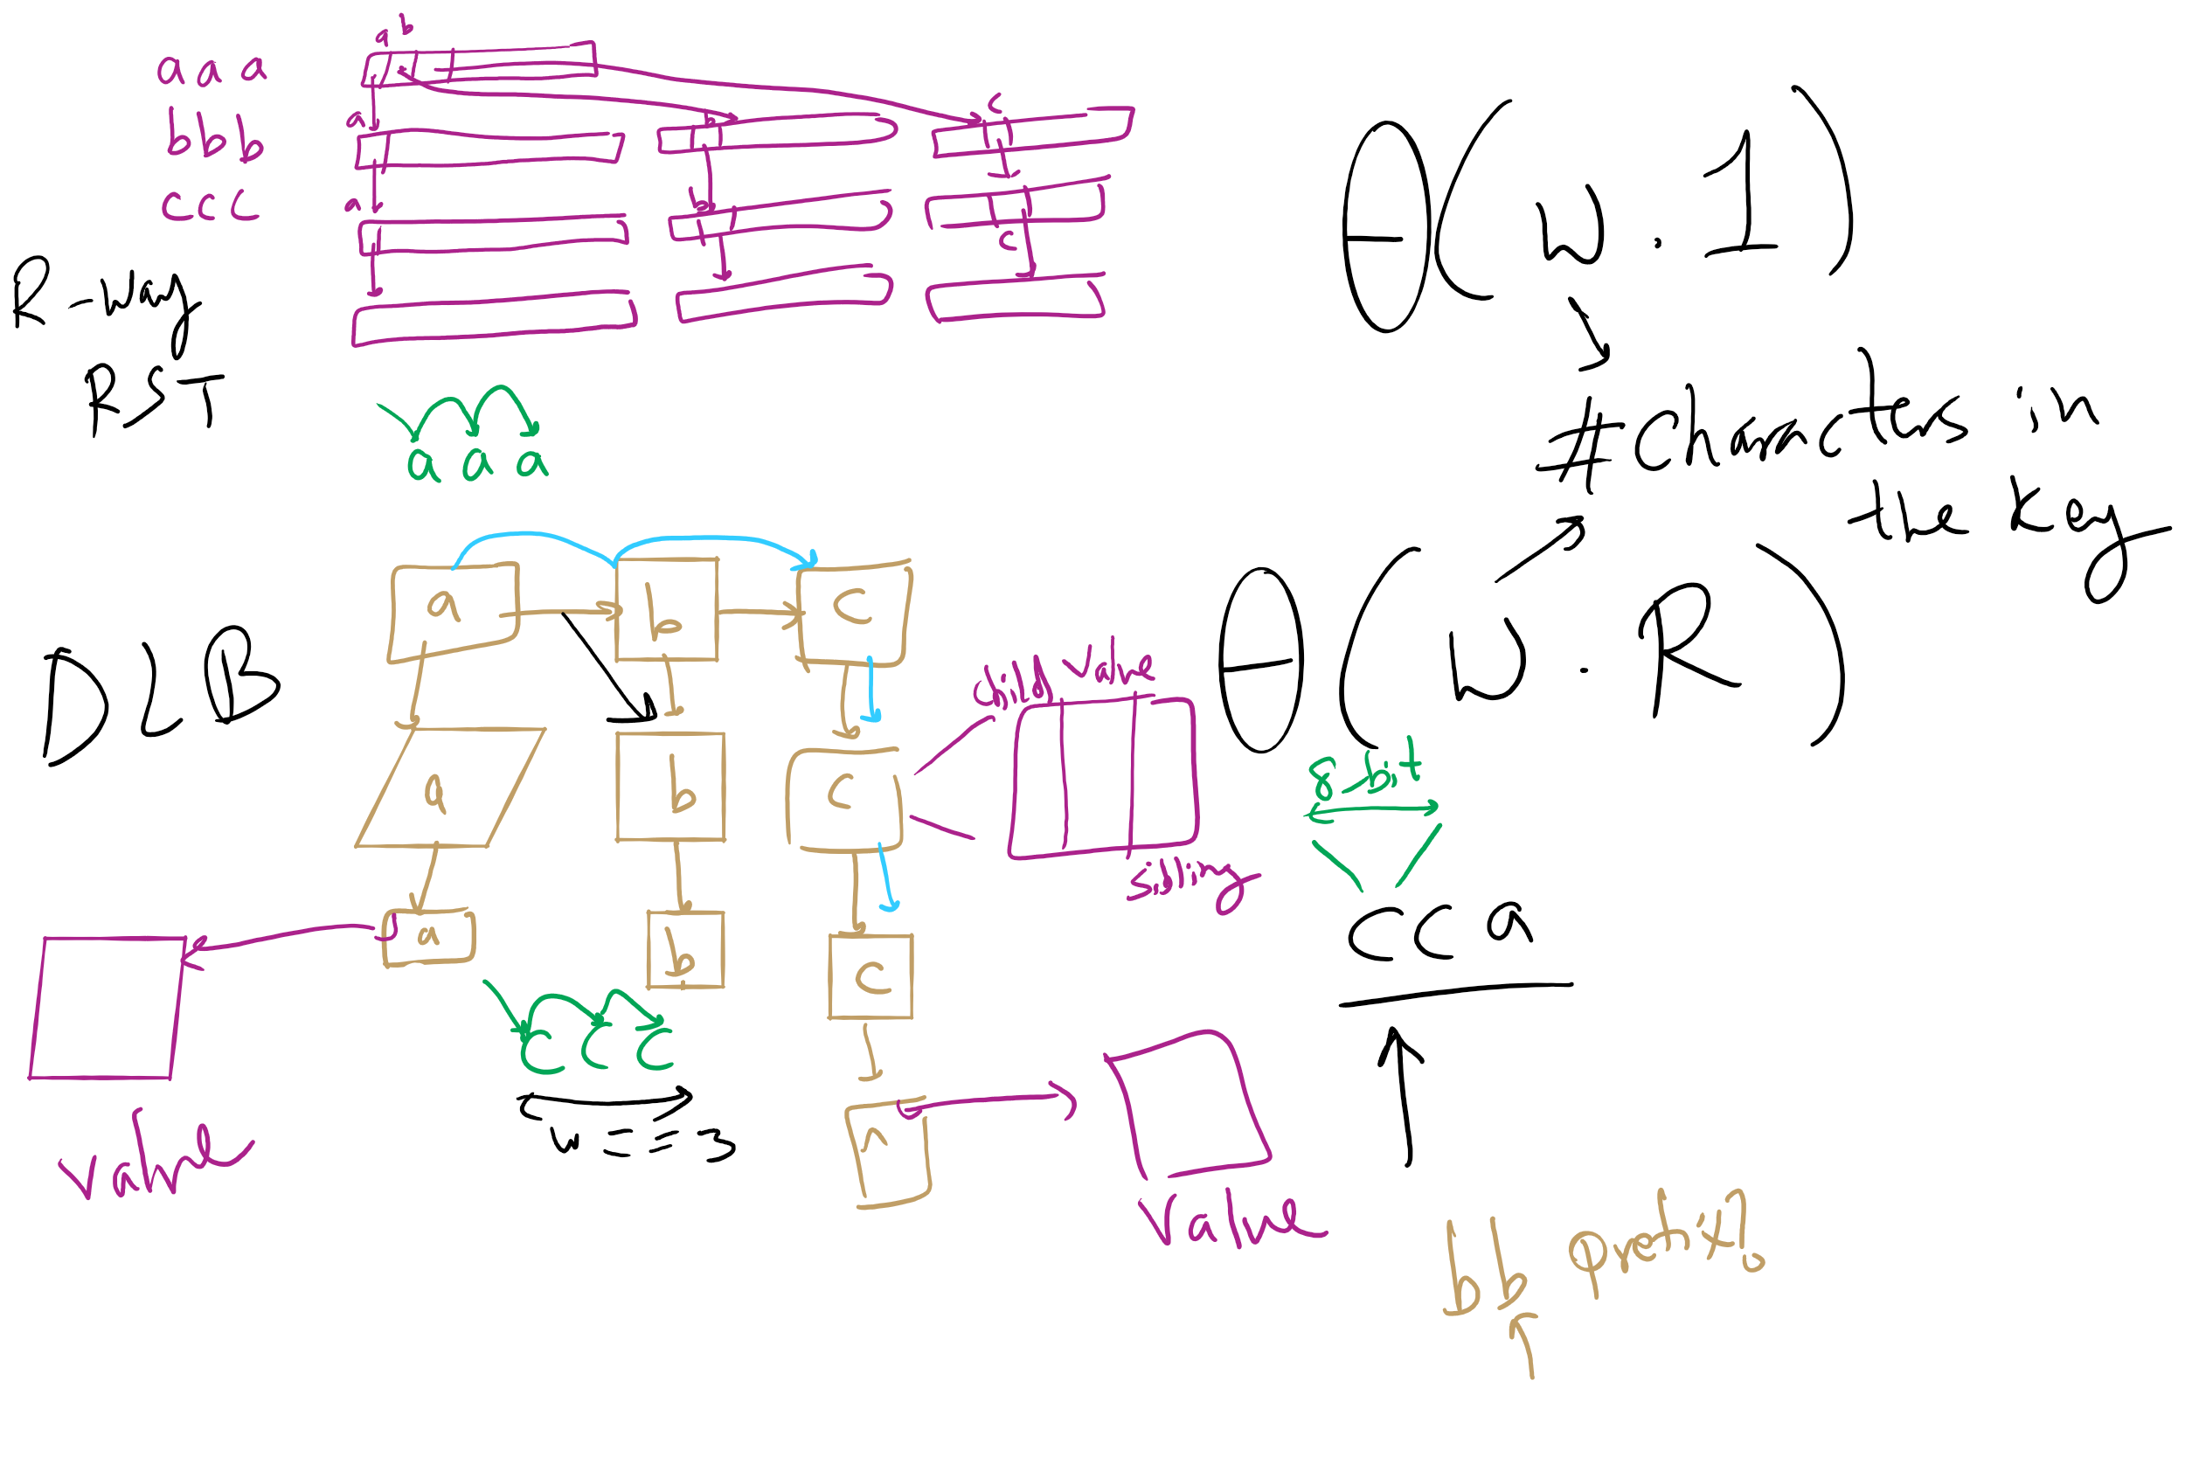
R-way RST vs. DLB

Slide 8
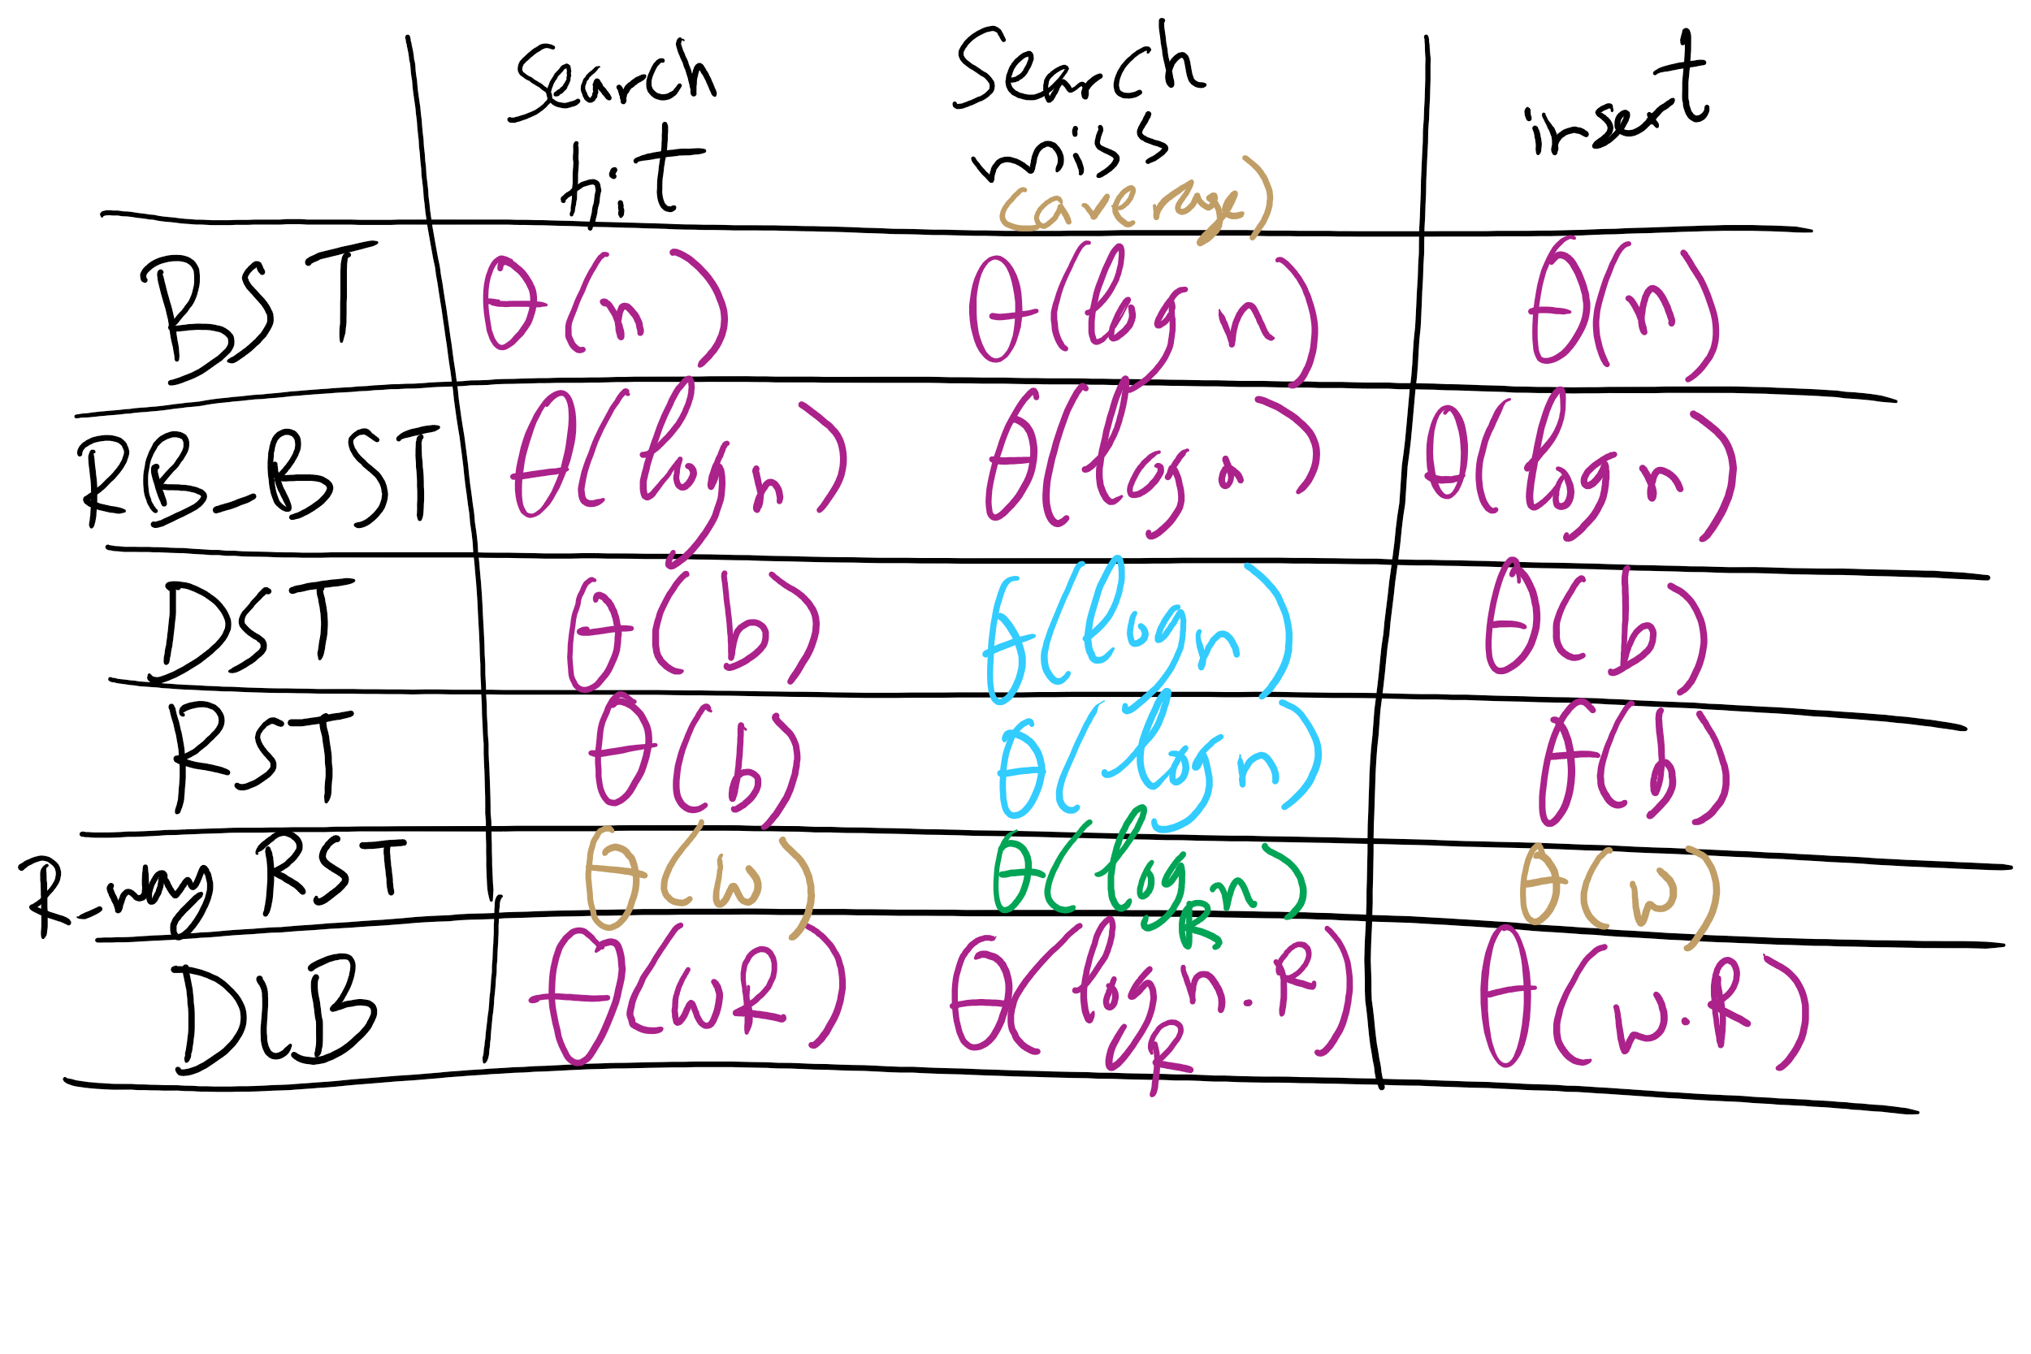
Runtime Comparison for Search Trees

Slide 9
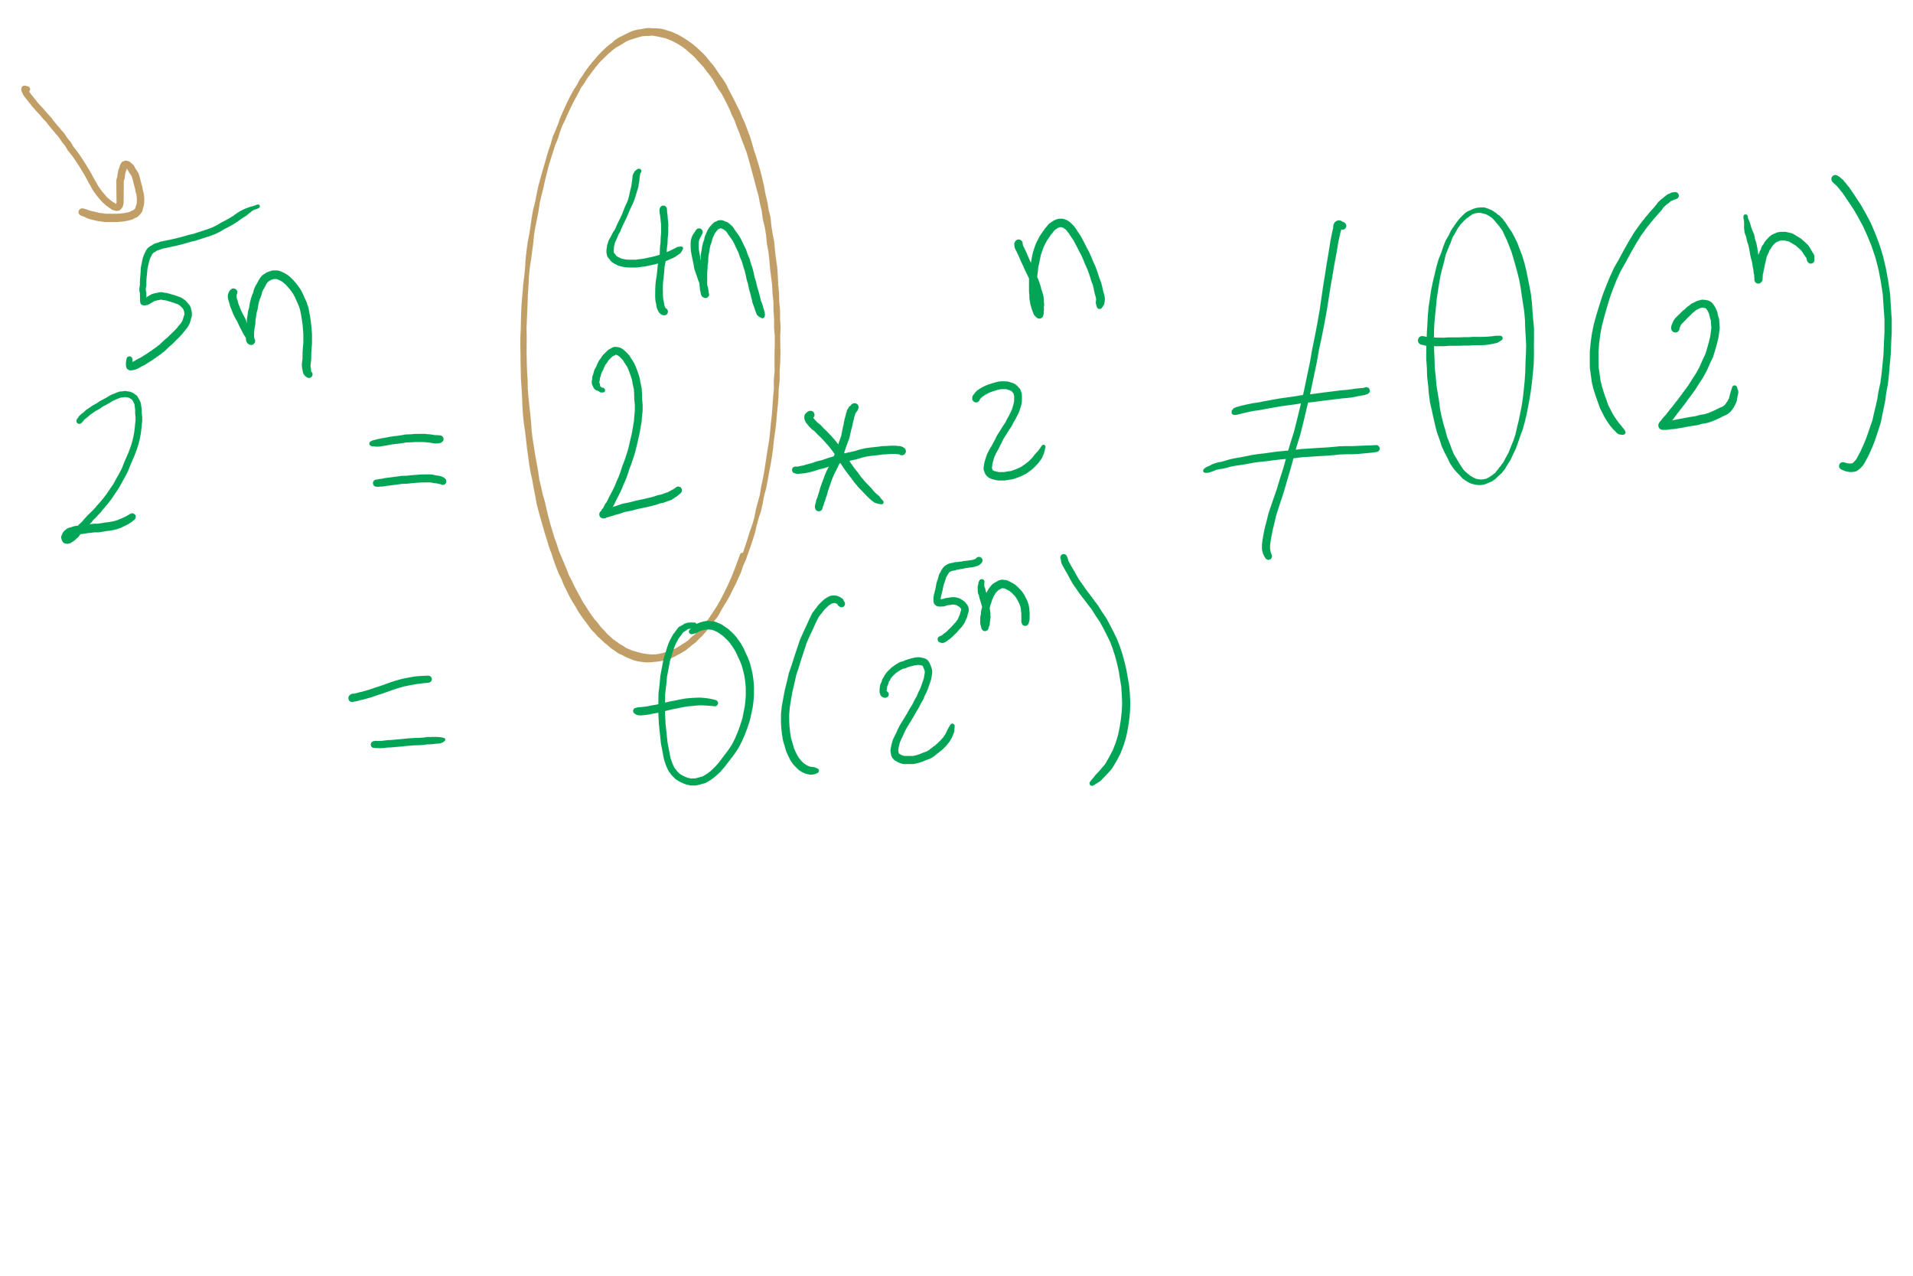
Big O Approximation

Slide 10
This Lecture
Huffman Compression
Run-length encoding
LZW

Slide 11
Considerations for compressing ASCII
What if we used variable length codewords instead of the constant 8? Could we store the same info in less space?
Different characters are represented using codes of different bit lengths
If all characters in the alphabet have the same usage frequency, we can’t beat block storage
On a character by character basis…
What about different usage frequencies between characters?
In English, R, S, T, L, N, E are used much more than Q or X

Slide 12
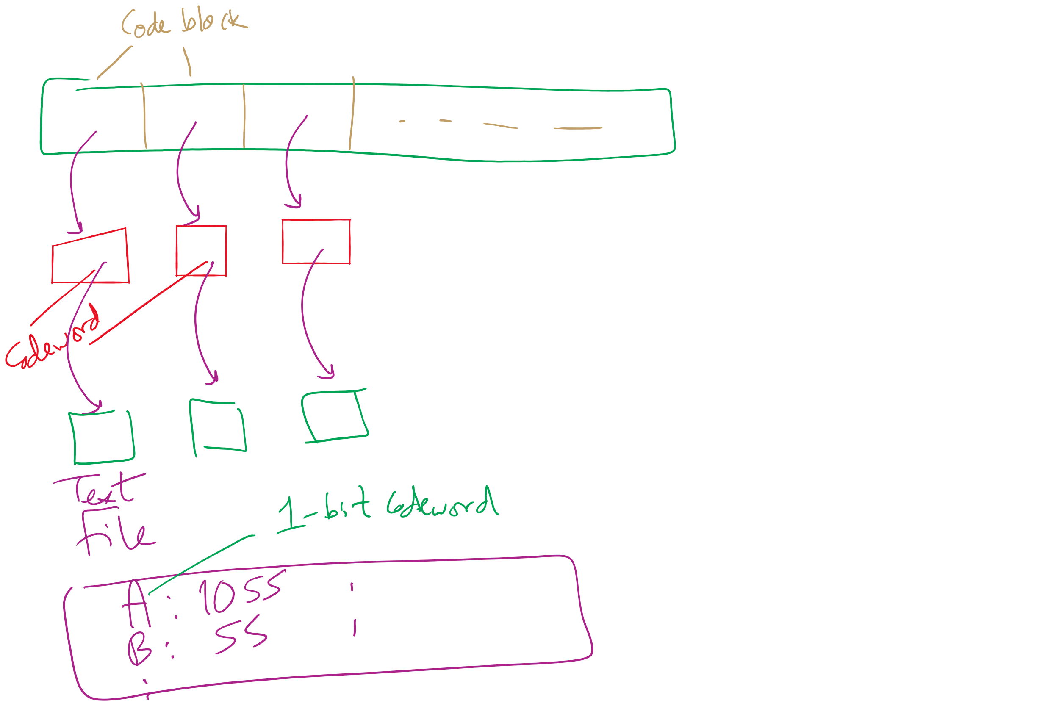
Variable size codewords

Slide 13
Variable length encoding
Decoding was easy for block codes
Grab the next 8 bits in the bitstring
How can we decode a bitstring that is made of variable length code words?
BAD example of variable length encoding:
1
00
01
001
100
101
10101
A
T
K
U
R
C
N
Notes:
delimiters are wasteful
Example on board:
General sends message: 10000110101
Is that: 1, 00, 00, 1, 101, 01 (A, T, T, A, C, K)
or: 100, 001, 10101 (R, U, N)

Slide 14
Variable length encoding for lossless compression
Codes must be prefix free
No code can be a prefix of any other in the scheme
Using this, we can achieve compression by:
Using fewer bits to represent more common characters
Using longer codes to represent less common characters

Slide 15
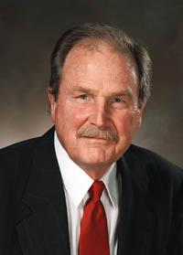
How can we create these prefix-free codes?
Huffman encoding!

Slide 16
Generating Huffman codes
Assume we have K characters that are used in the file to be compressed and each has a weight (its frequency of use)
Create a forest, F, of K single-node trees, one for each character, with the single node storing that char’s weight
while |F| > 1:
Select T1, T2 ∈ F that have the smallest weights in F
Create a new tree node N whose weight is the sum of T1 and T2’s weights
Add T1 and T2 as children (subtrees) of N
Remove T1 and T2 from F
Add the new tree rooted by N to F
Build a tree for “ABRACADABRA!”
Notes:
build tree for abracadabra, use it to construct compressed string,

Slide 17
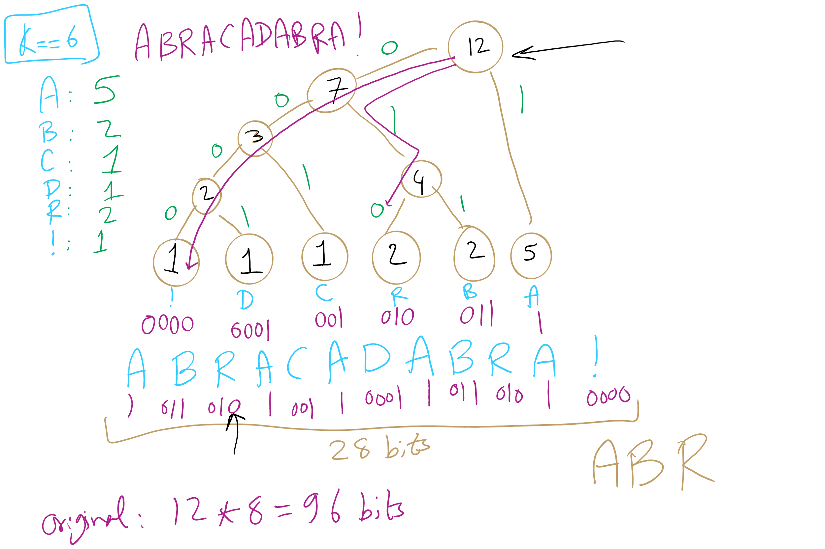
Huffman Tree Construction Example

Slide 18
Implementation concerns
To encode/decode, we'll need to read in characters and output codes/read in codes and output characters
…
Sounds like we'll need a symbol table!
What implementation would be best?
Same for encoding and decoding?
Note that this means we need access to the trie to expand a compressed file!
Notes:
Probably best to create a lookup table for encoding…
Traverse the tree and construct the table
Then you can simply lookup and output the appropriate code for each character in the input string!
Here, we’ll use the trie we constructed earlier
Descend the trie according to the bits of the compressed file
When you hit a leaf, output the appropriate character
Return to the root and repeat…

Slide 19
Further implementation concerns
Need to efficiently be able to select lowest weight trees to merge when constructing the trie
Can accomplish this using a priority queue
Need to be able to read/write bitstrings!
Unless we pick multiples of 8 bits for our codewords, we will need to read/write fractions of bytes for our codewords
We’re not actually going to do I/O on fraction of bytes
We’ll maintain a buffer of bytes and perform bit processing on this buffer
See BinaryStdIn.java and BinaryStdOut.java
Notes:
priority queues will be the subject of a lecture yet to come...

Slide 20
Binary I/O
private static void writeBit(boolean bit) { // add bit to buffer buffer <<= 1; if (bit) buffer |= 1; // if buffer is full (8 bits), write out as a single byte N++; if (N == 8) clearBuffer();
}
writeBit(true);
writeBit(false);
????????
???????0
???????1
??????10
?????100
?????101
????1010
???10100
??101000
?1010000
10100000
10100001
buffer:
00000000
writeBit(true);
writeBit(false);
writeBit(false);
0
1
2
3
4
5
6
7
8
writeBit(false);
N:
0
writeBit(false);
writeBit(true);

Slide 21
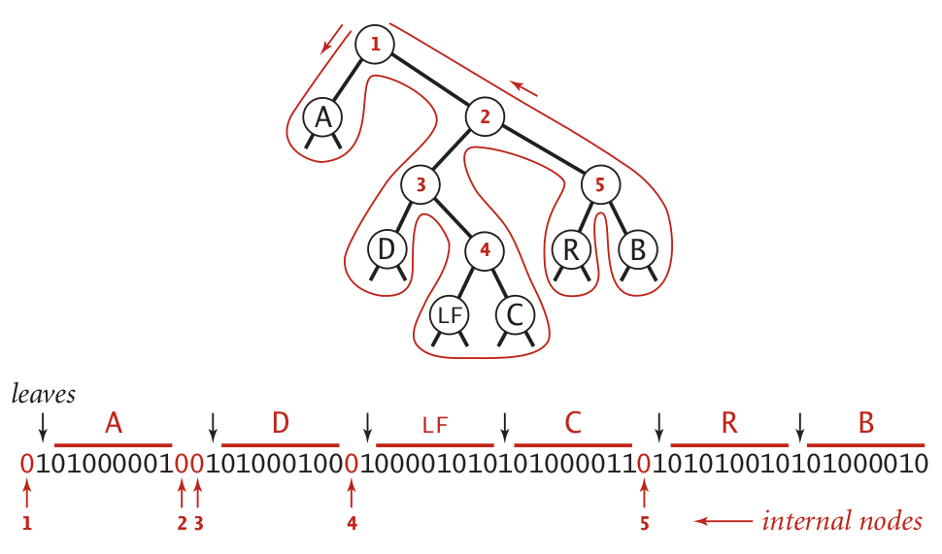
Representing tries as bitstrings

Slide 22
Binary I/O
private static void writeTrie(Node x){
if (x.isLeaf()) {
BinaryStdOut.write(true);
BinaryStdOut.write(x.ch);
return;
}
BinaryStdOut.write(false);
writeTrie(x.left);
writeTrie(x.right);
}
private static Node readTrie() {
if (BinaryStdIn.readBoolean())
return new Node(BinaryStdIn.readChar(), 0, null, null);
return new Node('\0', 0, readTrie(), readTrie());
}
Notes:
tracing through to verify that this code works is left as an exercise to the students

