Slide 1

Algorithms and Data Structures 2 CS 1501
Fall 2021
Sherif Khattab
ksm73@pitt.edu
(Slides are adapted from Dr. Ramirez’s and Dr. Farnan’s CS1501 slides.)

Slide 2
Announcements
Upcoming deadlines:
3/12: Assignment 2, Lab 6, and Homework 7
Tophat questions are due one week after each lecture
Midterm Exam grades have been posted
Average: 76.47%
Comment on each other’s muddiest points
Women in Data Science Conference
http://www.stat.cmu.edu/wids/

Slide 3
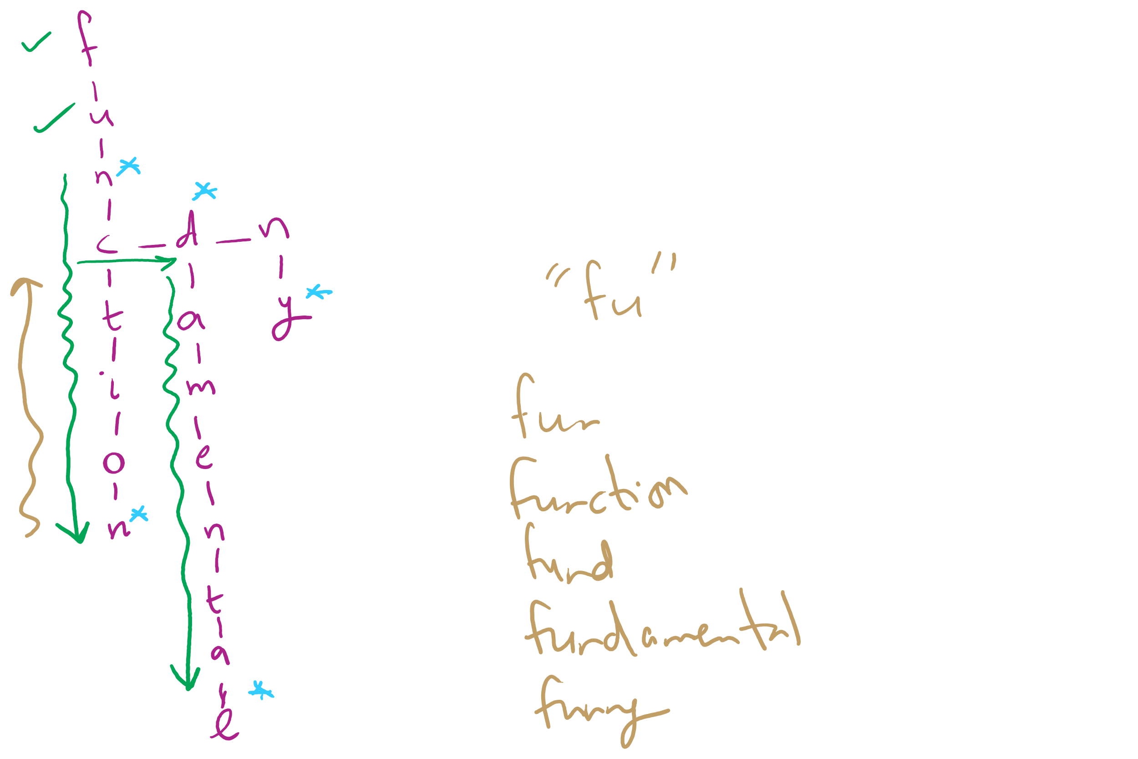
Assignment 2 Hints

Slide 4
Last lecture …
Huffman Compression (contd.)
Run-length encoding

Slide 5
Muddiest points
Too many N/A!
Run-length encoding
use cases
in what scenarios is run length encoding useful since it relies on very specific requirements
when to use run length encoding vs Huffman
run length encoding and why its not effective
How run length encoding works when the repeated patterns are not the same size
Code implementation of run length encoding.
Variable-length Huffman
Adaptive Huffman
pros and cons of the different compressions we've seen
i/o
representing tries as bitstrings, the example you gave was confusing because i didnt understand where the internal nodes were represented

Slide 6
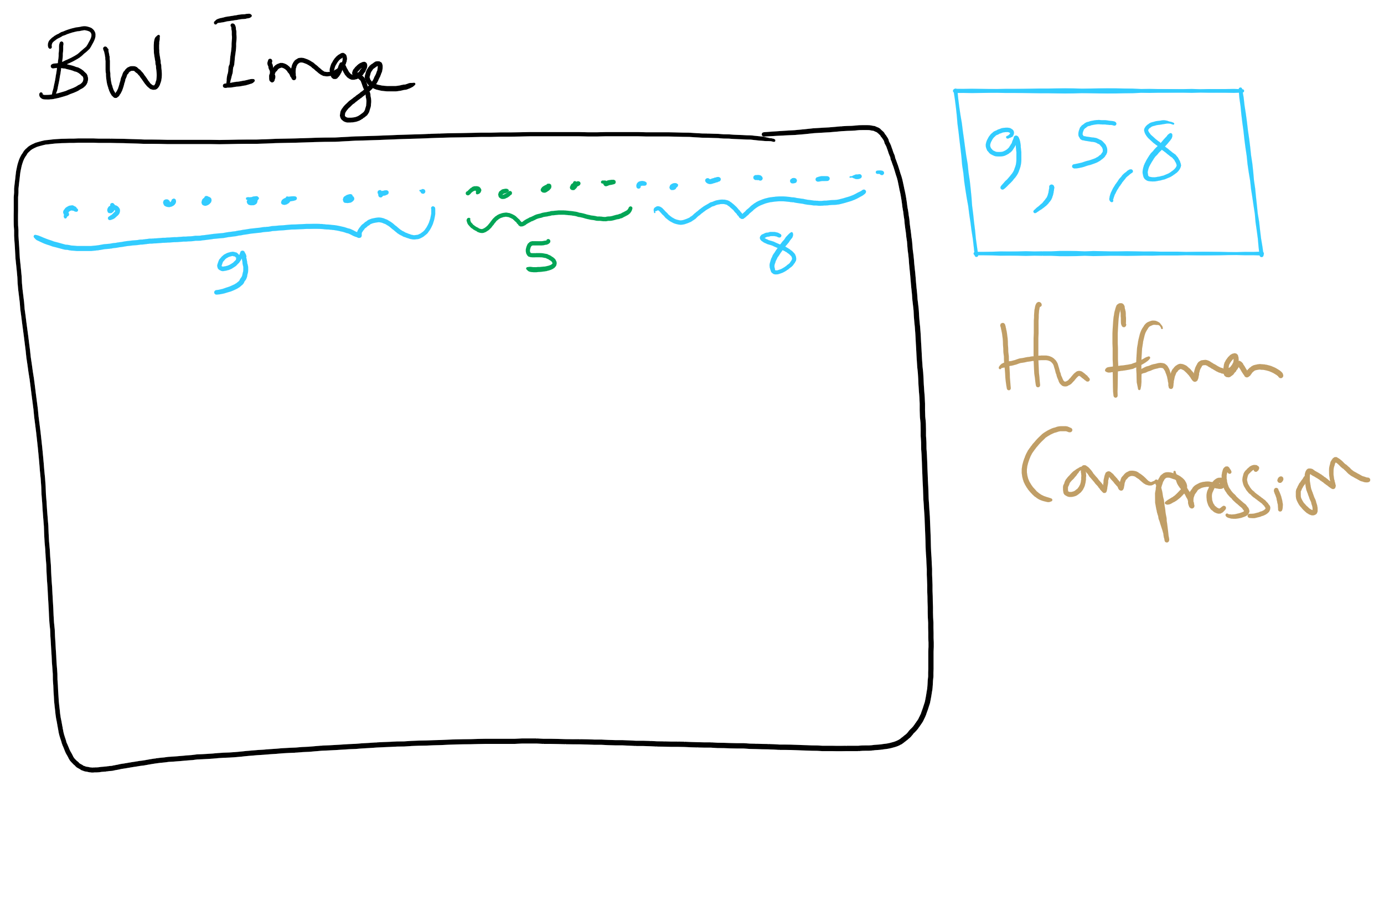
Run-length Encoding

Slide 7
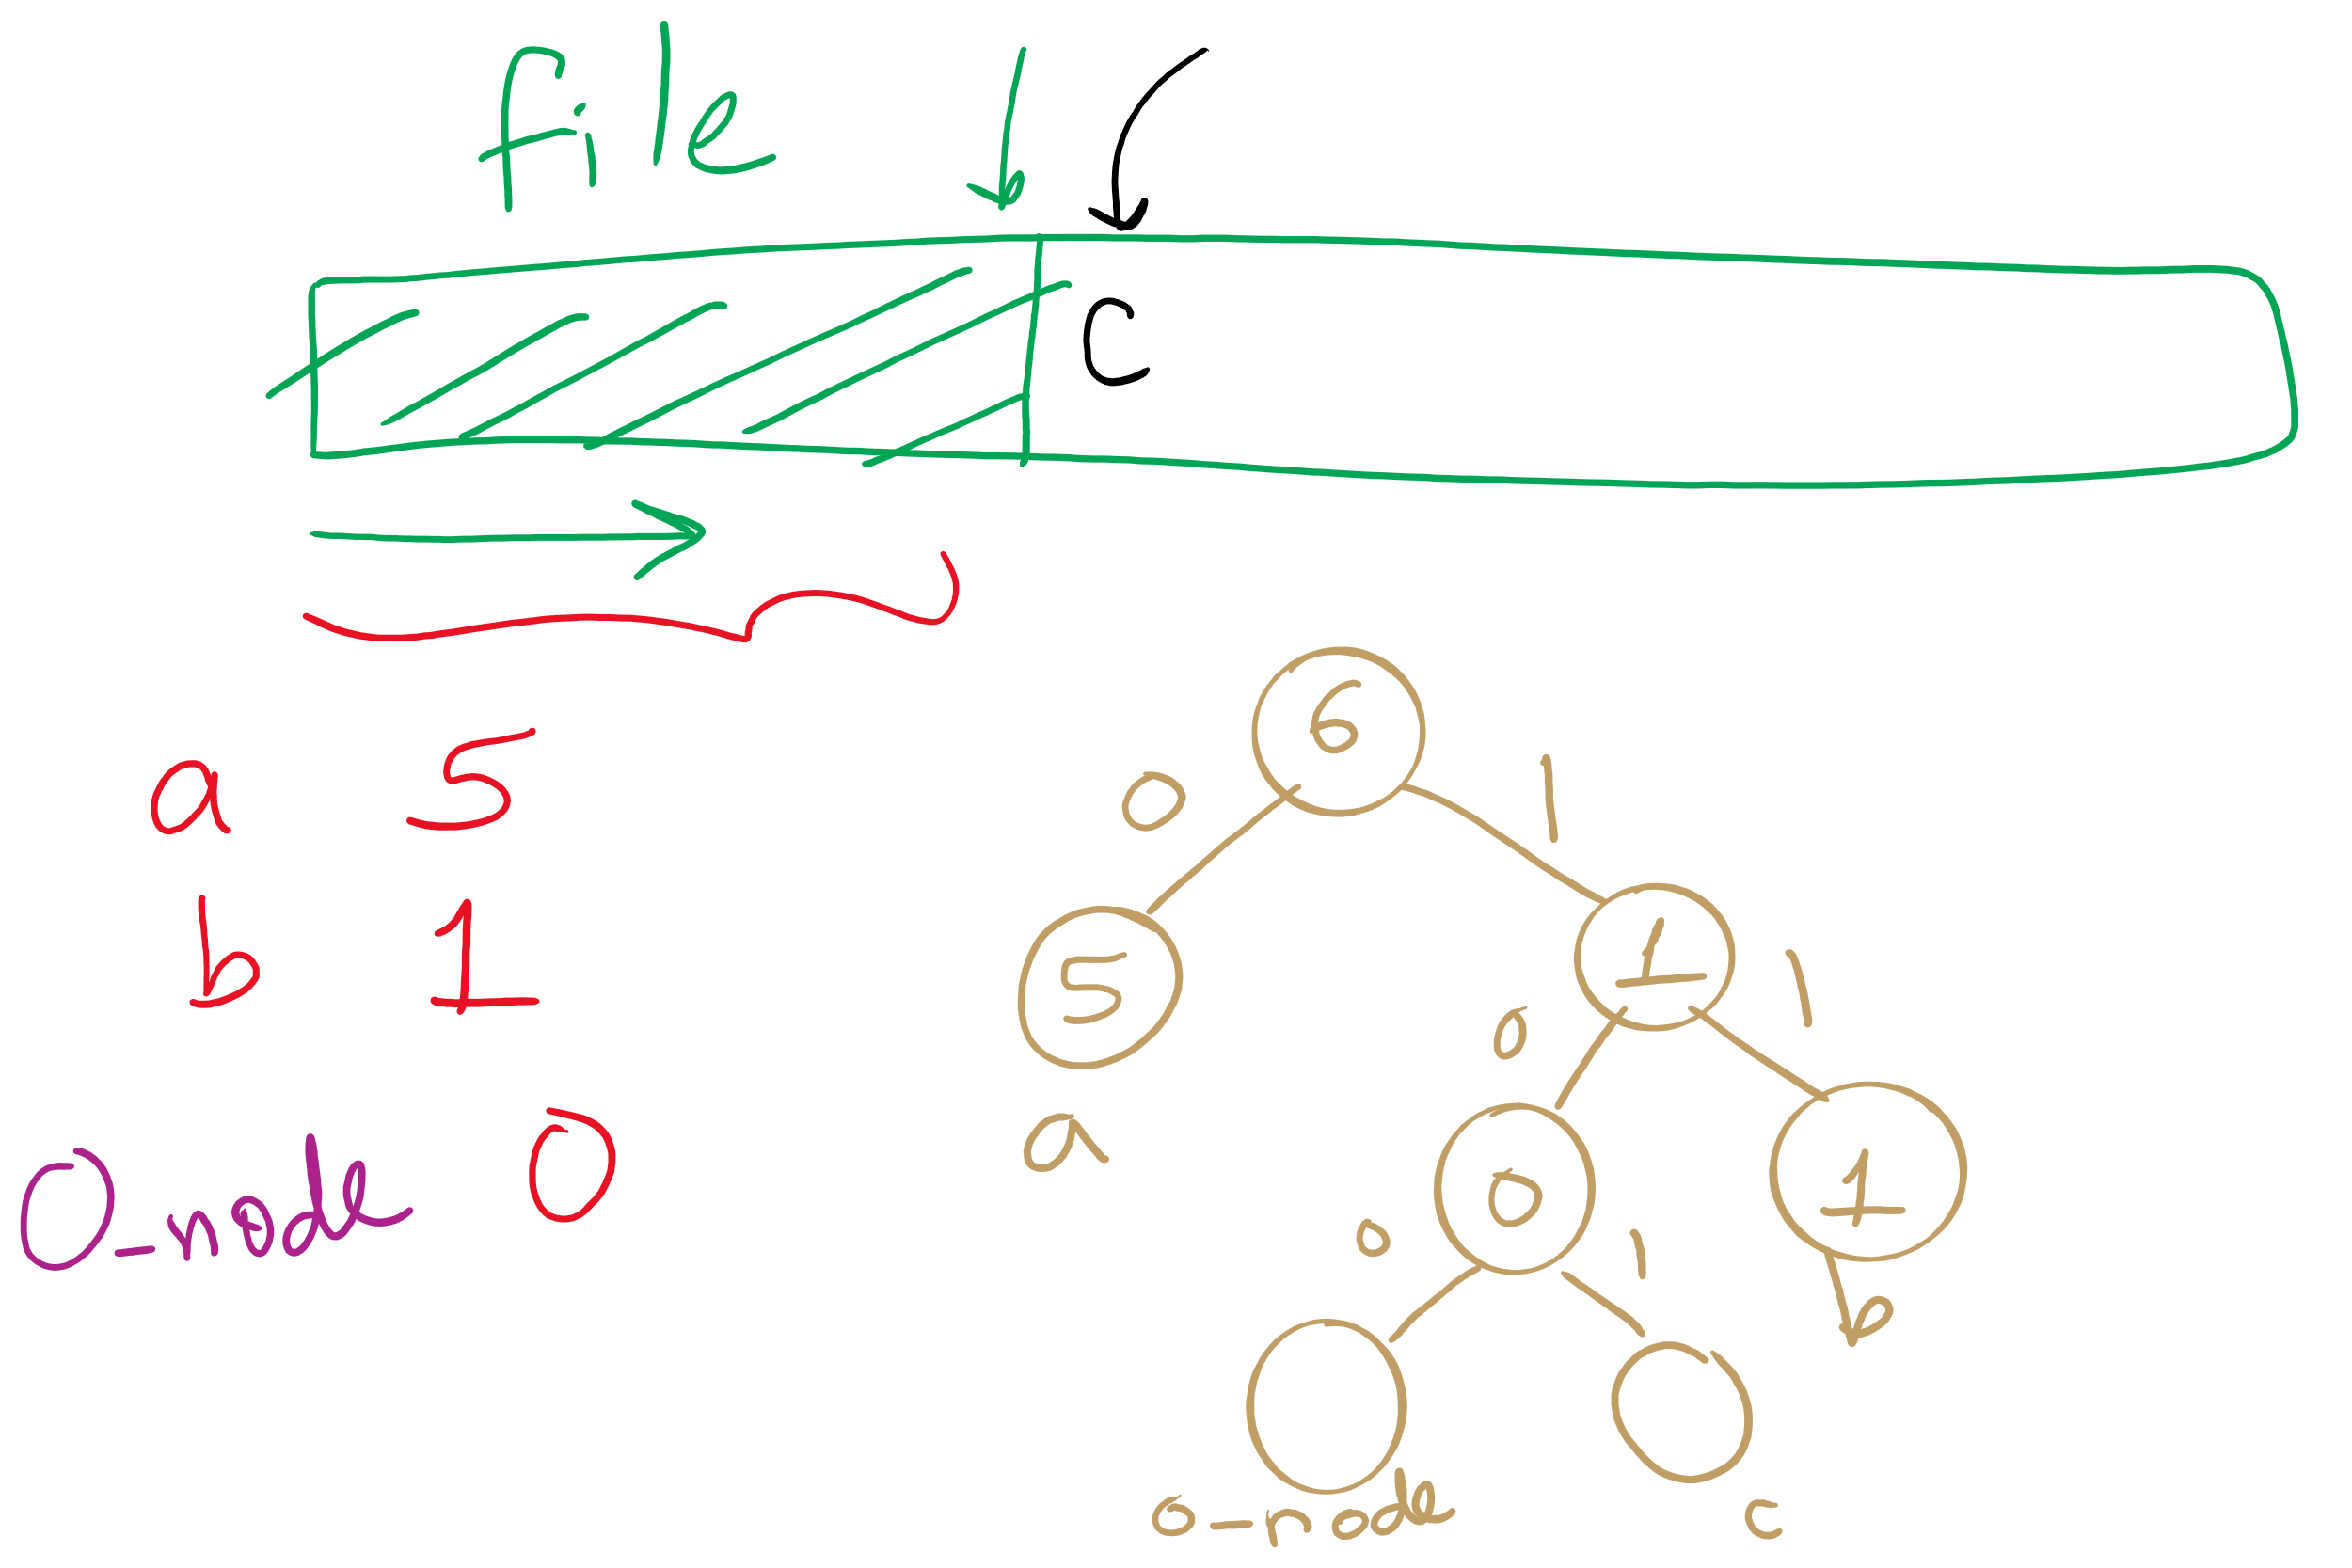
Adaptive Huffman

Slide 8
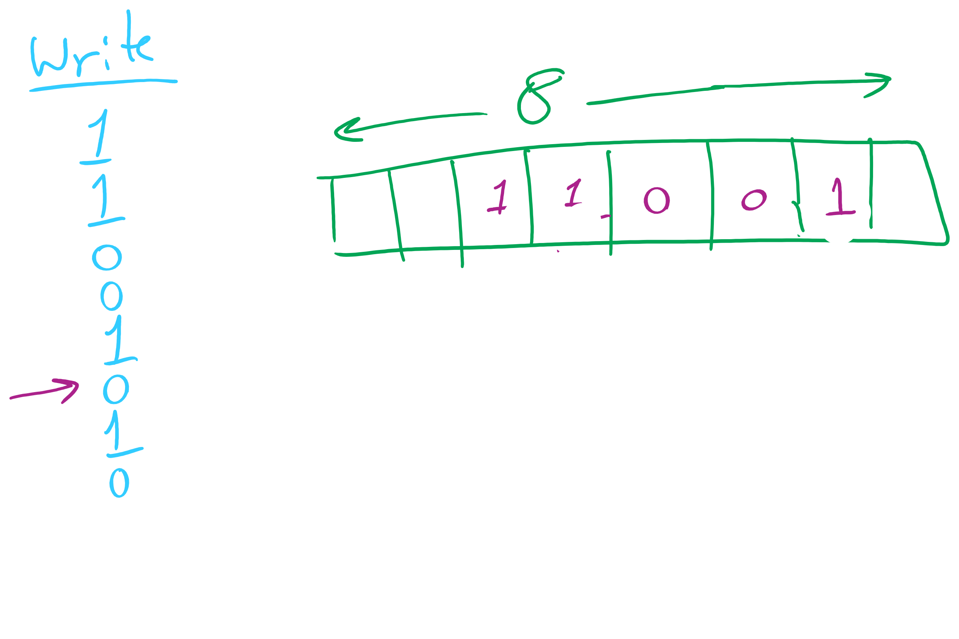
Binary I/O

Slide 9
This Lecture
Compression
LZW
Theoretical limits

Slide 10
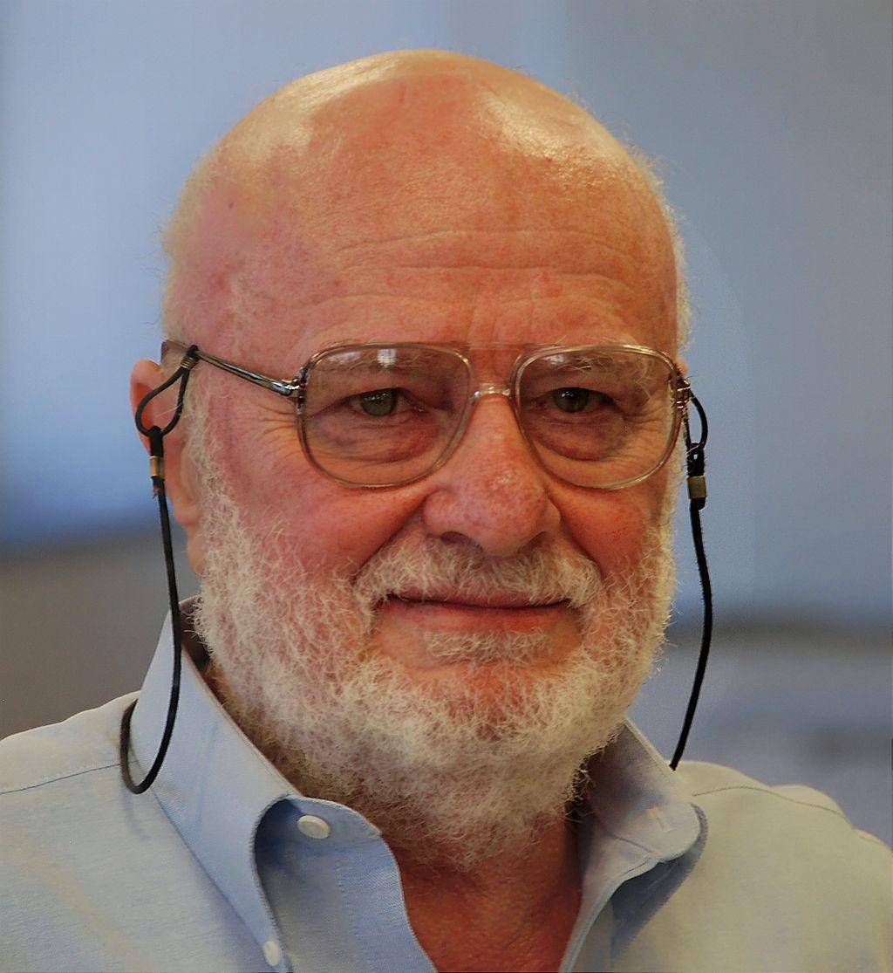
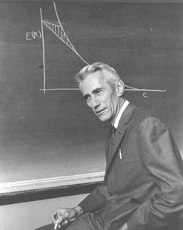
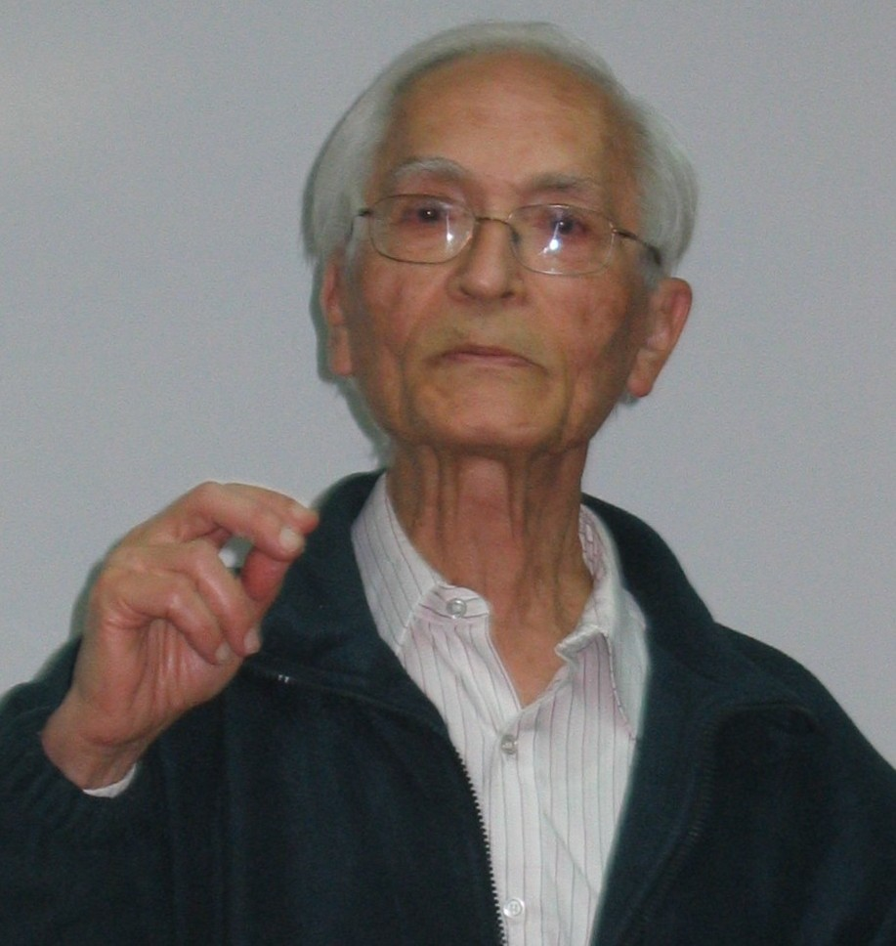
What else can we do to compress files?
Notes:
left to right:
Abraham Lempel, Jacob Ziv, and Claude Shannon

Slide 11
Patterns are compressible, need a general approach
Huffman used variable-length codewords to represent fixed-length portions of the input…
Let’s try another approach that uses fixed-length codewords to represent variable-length portions of the input
Idea: the more characters can be represented in a single codeword, the better the compression
Consider “the”: 24 bits in ASCII
Representing “the” with a single 12 bit codeword cuts the used space in half
Similarly, representing longer strings with a 12 bit codeword would mean even better savings!

Slide 12
How do we know that “the” will be in our file?
Need to avoid the same problems as the use of a static trie for Huffman encoding…
So use an adaptive algorithm and build up our patterns and codewords as we go through the file

Slide 13
LZW compression
Initialize codebook to all single characters
e.g., character maps to its ASCII value
While !EOF:
Match longest prefix in codebook
Output codeword
Take this longest prefix, add the next character in the file, and add the result to the dictionary with a new codeword

Slide 14
LZW compression example
Compress, using 12 bit codewords:
TOBEORNOTTOBEORTOBEORNOT
Cur
Output
Add
T
84
TT:264
T
84
TO:256
TO
256
TOB:265
O
79
OB:257
BE
258
BEO:266
B
66
BE:258
OR
260
ORT:267
E
69
EO:259
TOB
265
TOBE:268
O
79
OR:260
EO
259
EOR:269
R
82
RN:261
RN
261
RNO:270
N
78
NO:262
OT
263
--
O
79
OT:263

Slide 15
LZW expansion
Initialize codebook to all single characters
e.g., ASCII value maps to its character
While !EOF:
Read next codeword from file
Lookup corresponding pattern in the codebook
Output that pattern
Add the previous pattern + the first character of the current pattern to the codebook
Note this means no codebook addition after first pattern output!

Slide 16
LZW expansion example
Cur
Output
Add
84
T
263:OT
84
T
--
256
TO
264:TT
79
O
256:TO
258
BE
265:TOB
66
B
257:OB
260
OR
266:BEO
69
E
258:BE
265
TOB
267:ORT
79
O
259:EO
259
EO
268:TOBE
82
R
260:OR
261
RN
269:EOR
78
N
261:RN
263
OT
270:RNO
79
O
262:NO

Slide 17
How does this work out?
Both compression and expansion construct the same codebook!
Compression stores character string → codeword
Expansion stores codeword → character string
They contain the same pairs in the same order
Hence, the codebook doesn’t need to be stored with the compressed file, saving space

Slide 18
Just one tiny little issue to sort out...
Expansion can sometimes be a step ahead of compression…
If, during compression, the (pattern, codeword) that was just added to the dictionary is immediately used in the next step, the decompression algorithm will not yet know the codeword.
This is easily detected and dealt with, however

Slide 19
LZW corner case example
Compress, using 12 bit codewords: AAAAAA
Cur
Output
Add
A
65
AA:256
AA
256
AAA:257
AAA
257
--
Expansion:
Cur
Output
Add
65
A
--
256
AA
256:AA
257
AAA
257:AAA
Notes:
If a codeword is encountered that is not in the codebook, it must be:
prev_pattern + prev_pattern[0]

Slide 20
LZW implementation concerns: codebook
How to represent/store during:
Compression
Expansion
Considerations:
What operations are needed?
How many of these operations are going to be performed?
Discuss
Notes:
ENCODE: Two most likely candidates:
Trie or Hash Table
Both allow lookups in time proportional to string length, independent of the number of strings
Since the new keys are all prefixes already in the tree, and plus one additional character, and since we are searching for prefixes
The Trie would be a great choice
However, memory issues would make us prefer the DLB
Text LZW.java uses a ternary search trie (TST).
DECODE:
Now codewords are the key values, and the strings are returned
We can simply use the codeword values to index an array of strings
Gives us constant time lookup of the codewords
See LZW.java

Slide 21
Further implementation issues: codeword size
How long should codewords be?
Use fewer bits:
Gives better compression earlier on
But, leaves fewer codewords available, which will hamper compression later on
Use more bits:
Delays actual compression until longer patterns are found due to large codeword size
More codewords available means that greater compression gains can be made later on in the process

Slide 22
Variable width codewords
This sounds eerily like variable length codewords…
Exactly what we set out to avoid!
Here, we’re talking about a different technique
Example:
Start out using 9 bit codewords
When codeword 512 is inserted into the codebook, switch to outputting/grabbing 10 bit codewords
When codeword 1024 is inserted into the codebook, switch to outputting/grabbing 11 bit codewords…
Etc.

Slide 23
Even further implementation issues: codebook size
What happens when we run out of codewords?
Only 2^{n} possible codewords for n bit codes
Even using variable width codewords, they can’t grow arbitrarily large…
Two primary options:
Stop adding new keywords, use the codebook as it stands
Maintains long already established patterns
But if the file changes, it will not be compressed as effectively
Throw out the codebook and start over from single characters
Allows new patterns to be compressed
Until new patterns are built up, though, compression will be minimal

Slide 24
The showdown you’ve all been waiting for...
HUFFMAN vs LZW
In general, LZW will give better compression
Also better for compression archived directories of files
Why?
Very long patterns can be built up, leading to better compression
Different files don’t “hurt” each other as they did in Huffman
Remember our thoughts on using static tries?

Slide 25
So lossless compression apps use LZW?
Well, gifs can use it
And pdfs
Most dedicated compression applications use other algorithms:
DEFLATE (combination of LZ77 and Huffman)
Used by PKZIP and gzip
Burrows-Wheeler transforms
Used by bzip2
LZMA
Used by 7-zip
brotli
Introduced by Google in Sept. 2015
Based around a " … combination of a modern variant of the LZ77 algorithm, Huffman coding[,] and 2nd order context modeling … "
Notes:
also: lz4, lzham, bitknit as a close competitor to brotli

Slide 26
DEFLATE et al achieve even better general compression?
How much can they compress a file?
Better question:
How much can a file be compressed by any algorithm?
No algorithm can compress every bitstream
Assume we have such an algorithm
We can use to compress its own output!
And we could keep compressing its output until our compressed file is 0 bits!
Clearly this can’t work
Proofs in Proposition S of Section 5.5 of the text

Slide 27
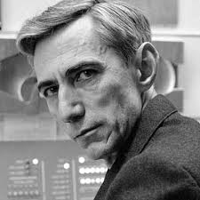
Can we reason about how much a file can be compressed?
Yes! Using Shannon Entropy
Notes:
brief bio:
1937 MIT masters thesis showed electromechanical telephone switching relays could be used to solve boolean algebra
foundation of digital circuit design
1940 PhD from MIT, became a researcher at Institute for Advanced Study in Princeton
WWII moved to Bell Labs to work on fire-control systems and crypto
Proved security of one-time pad ciphers here
1948 A Mathematical Theory of Communication
Developed High-Low blackjack card counting method with Ed Thorp
Credited with creating the first wearable computer to help calculate roulette odds
Shannon's Maxim is counterpoint of security through obscurity

Slide 28
Information theory in a single slide...
Founded by Claude Shannon in his paper “A Mathematical Theory of Communication”
Entropy is a key measure in information theory
Slightly different from thermodynamic entropy
A measure of the unpredictability of information content
By losslessly compressing data, we represent the same information in less space
Hence, 8 bits of uncompressed text has less entropy than 8 bits of compressed data
Notes:
1948

