Slide 1

Algorithms and Data Structures 2 CS 1501
Fall 2021
Sherif Khattab
ksm73@pitt.edu
(Slides are adapted from Dr. Ramirez’s and Dr. Farnan’s CS1501 slides.)

Slide 2
Announcements
Upcoming deadlines:
3/19: Lab 7 and Homework 8
3/30: Assignment 3
Tophat questions are due one week after each lecture

Slide 3
Last lecture …
Graph Traversal
BFS
DFS
Articulation points

Slide 4
Muddiest points (1/2)
BFS/DFS
How to choose out of the set of vertices which one to start the traversal at.
even though DFS and BFS have the same runtime for adj lists and adj matricies, is either more efficient than the other?
runtime comparisons
when we were searching through graphs, we would connect the node we were on to its parent. why were we doing that instead of connecting to children?
The use of a distance array in BFS
Finding components
Content of queue in the level order
Pseudo code for wrapper class
Pro's and cons of different search methods for the graphs.

Slide 5
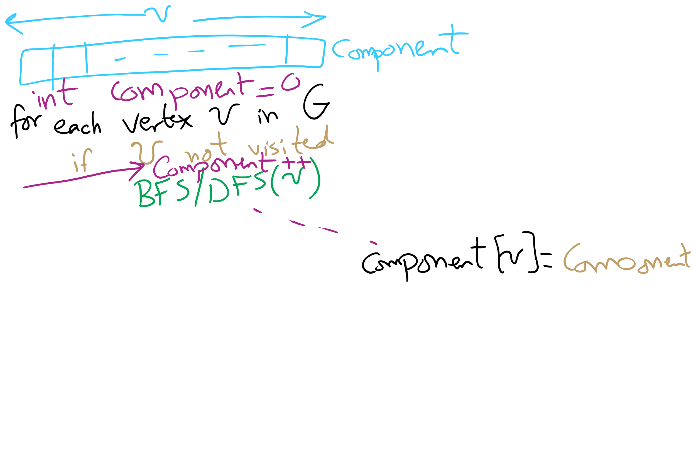
Wrapper function for DFS/BFS

Slide 6
Muddiest points (2/2)
Articulation Points
figuring out what an articulation point is
How a biconnected graph looks like and how to find articulation points
how are graphs visualized from their data structures
When is finding the shortest distance between vertices useful? Could you also talk about the Traveling Salesman Problem and why it is such a difficult problem?
Finding shortest path

Slide 7
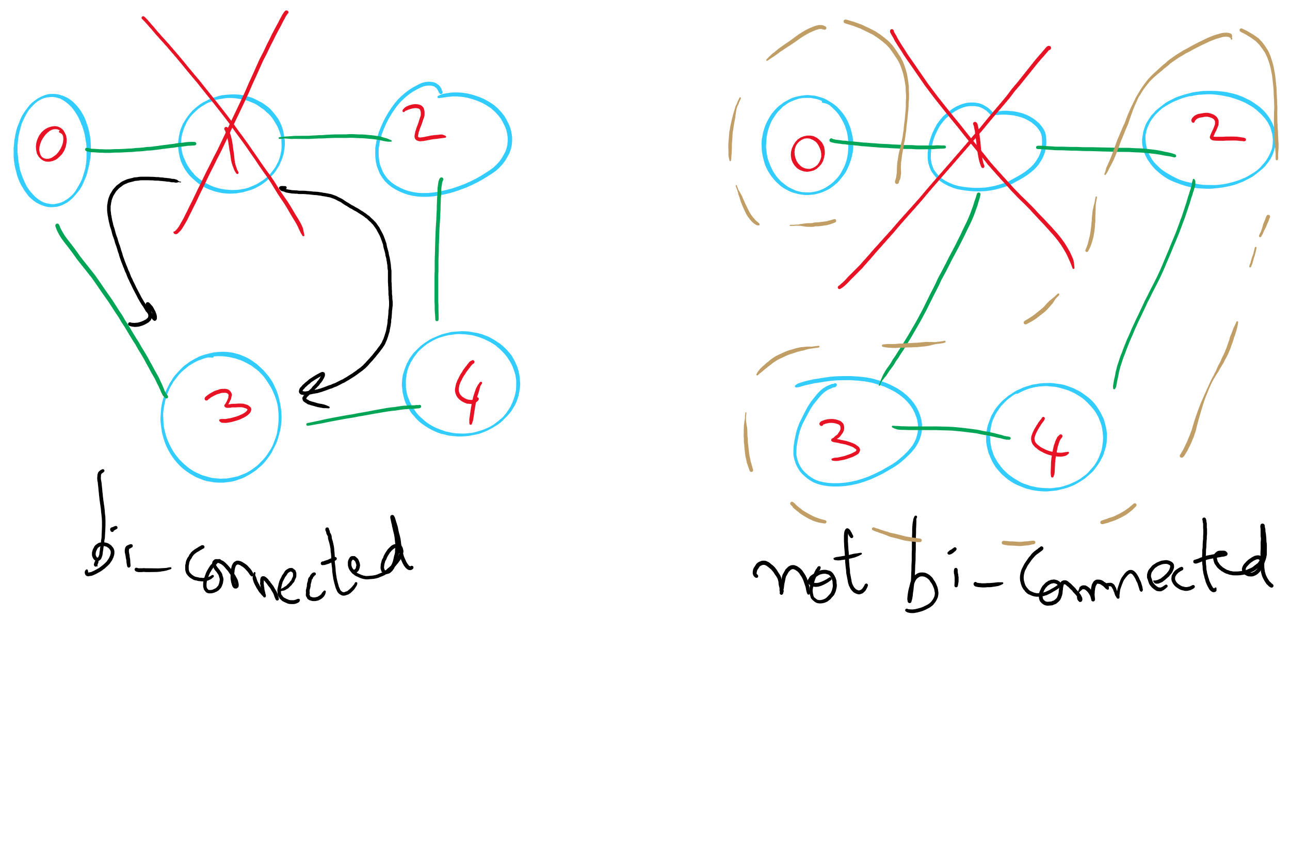
Bi-connected Graph

Slide 8
This Lecture
Articulation Points using DFS
Minimum Spanning Tree
Prim’s
Priority Queue
Kruskal’s
Union-Find
Weighted Shortest Paths
Dijkstra’s

Slide 9
Finding articulation points example
num
low
0
0
F
E
D
E
1
0
A
A
C
B
2
0
B
3
0
C
4
0
D
5
5
F
Notes:
what type of a traversal do we do to define low() values?
post-order
we're mapping out where there are multiple paths between vertices with back edges
there is a path 4 → 0 → 1 → 2, and 2 → 3 → 4 in this graph
what if we started at 3? how would the result change
root of spanning tree would have 2 children

Slide 10
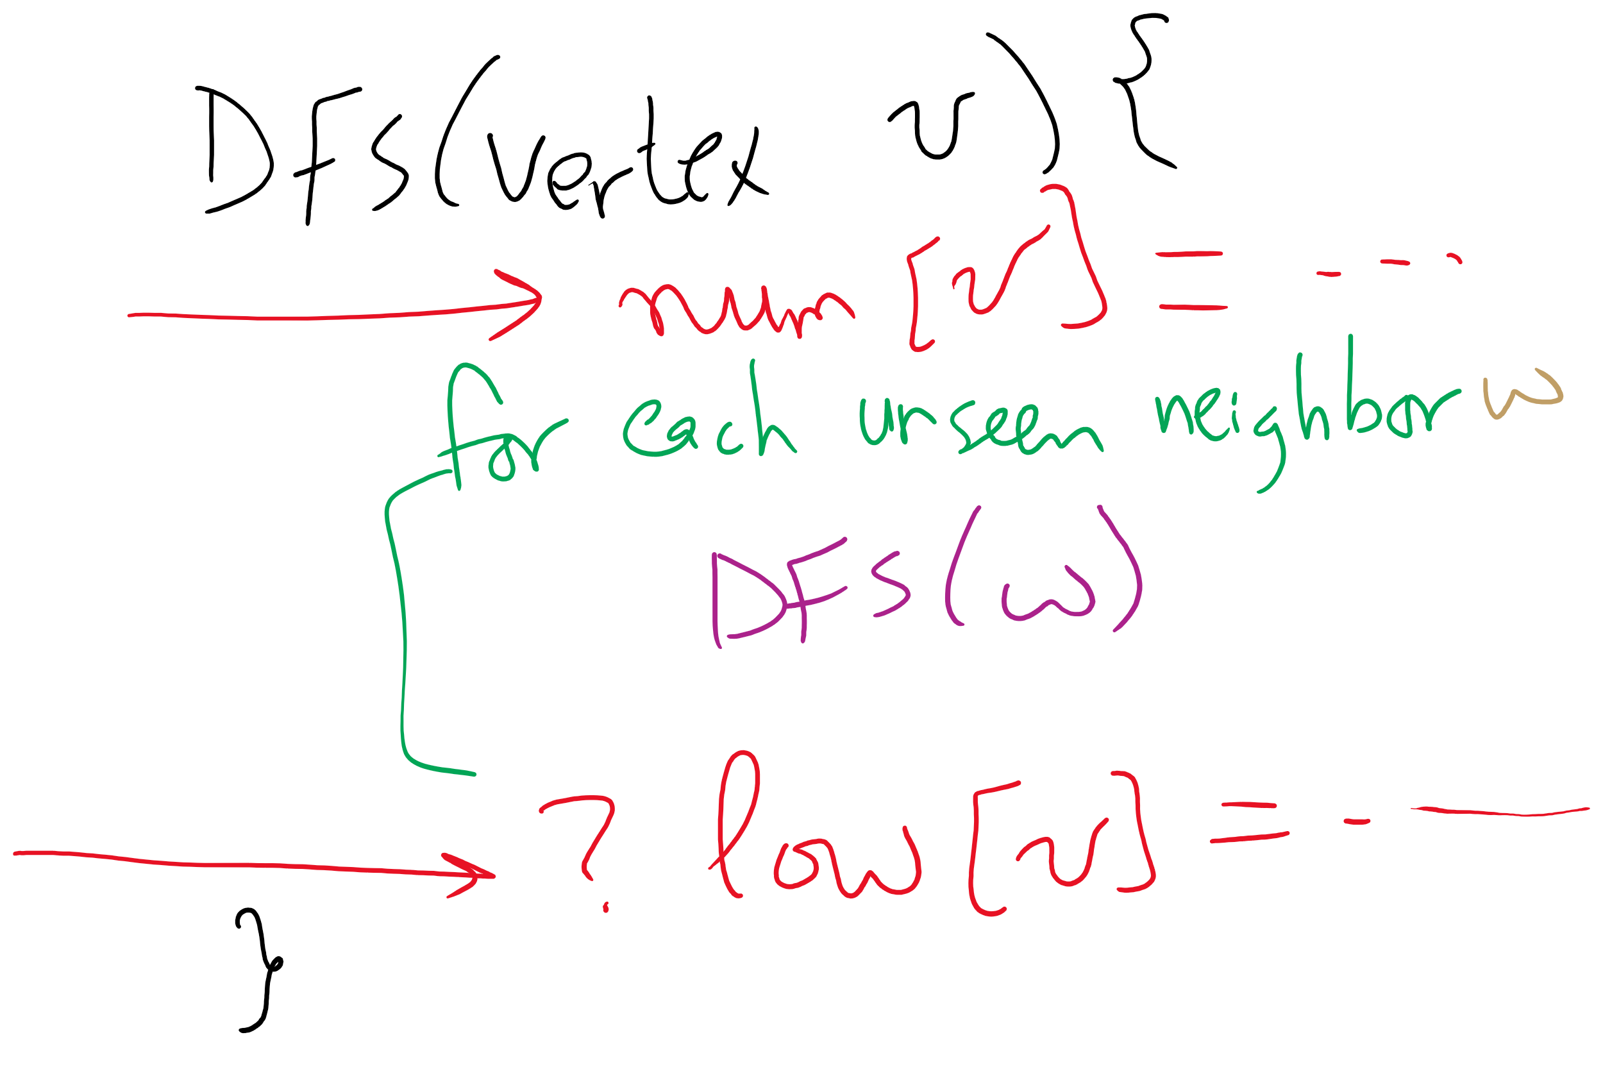
Using DFS to find articulation points

Slide 11
So where are the articulation points?
If any (non-root) vertex v has some child w such that low(w) ≥ num(v), v is an articulation point
What about if we start at an articulation point?
If the root of the spanning tree has more than one child, it is an articulation point
Notes:
does it matter if we add back edges that mirror spanning tree edges (e.g., 3 → 3, or 5 → 3)?
no, because we define low(w) must be less than or equal to num(v)

Slide 12
We said spatial layouts of graphs were irrelevant
We define graphs as sets of vertices and edges
However, we’ll certainly want to be able to reason about bandwidth, distance, capacity, etc. of the real world things our graph represents
Whether a link is 1 gigabit or 10 megabit will drastically affect our analysis of traffic flowing through a network
Having a road between two cities that is a 1 lane country road is very different from having a 4 lane highway
If two airports are 2000 miles apart, the number of flights going in and out between them will be drastically different from airports 200 miles apart

Slide 13
We can represent such information with edge weights
How do we store edge weights?
Adjacency matrix?
Adjacency list?
Do we need a whole new graph representation?
How do weights affect finding spanning trees/shortest paths?
The weighted variants of these problems are called finding the minimum spanning tree and the weighted shortest path
Notes:
Adjacency matrix:
Instead of 1, store the edge weight for all edges that exist
Adjacency list:
Add a field to list verticies to store the weight

Slide 14
Minimum spanning trees (MST)
Graphs can potentially have multiple spanning trees
MST is the spanning tree that has the minimum sum of the weights of its edges

Slide 15
Prim’s algorithm
Initialize T to contain the starting vertex
T will eventually become the MST
While there are vertices not in T:
Find minimum edge weight edge that connects a vertex in T to a vertex not yet in T
Add the edge with its vertex to T

Slide 16
Prim’s algorithm
10
1
4
1
4
4
6
8
7
0
9
5
0
3
6
3
6
2
9
8
2
2
2
5
5
1
Notes:
Green verticies/red edges in T
be sure to highlight the set of edges that could possibly be used to bring a vertex into T
grey edges that connect two green vertices dont need to be considered, thing to come back to when we talk about implementation, should we try to remove them from consideration?
not really, no asymptotic improvement for parent and best edge implementation
even with eager prims, that would just be more updates to try and avoid unneccesary removals, but both have the same asymptotic cost

Slide 17
Runtime of Prim’s
At each step, check all possible edges
For a complete graph:
First iteration:
v - 1 possible edges
Next iteration:
2(v - 2) possibilities
Each vertex in T shared v-1 edges with other vertices, but the edges they shared with each other already in T
Next:
3(v - 3) possibilities
…
Runtime:
Σ_{i = 1 to v} (i * (v - i))
Evaluates to Θ(v³)
Notes:
naively what we did on the previous slide looking at the images

Slide 18
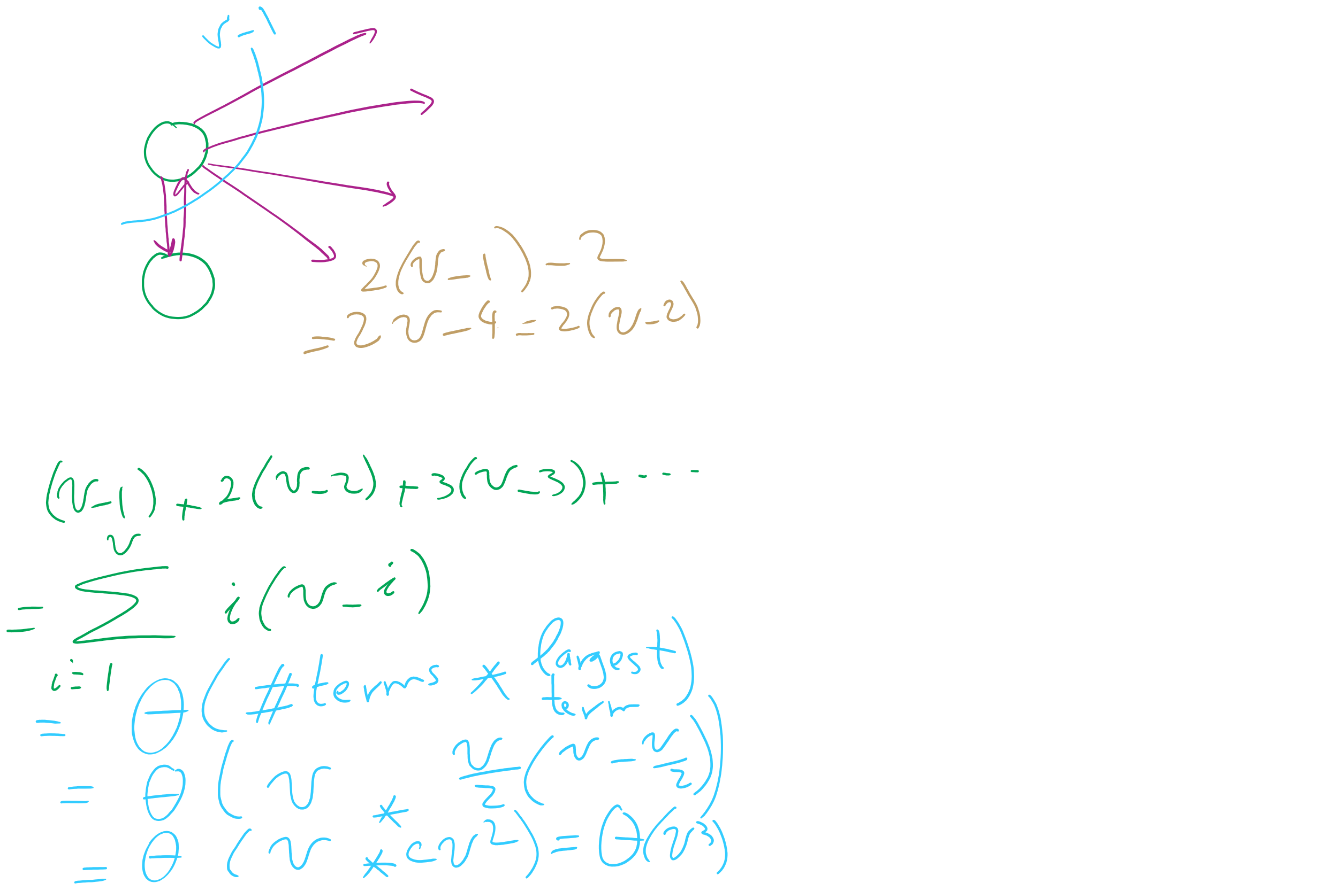
Analysis of Naïve implementation of Prim’s MST Algorithm

Slide 19
Do we need to look through all remaining edges?
No! We only need to consider the best edge possible for each vertex!

Slide 20
Prim’s algorithm
10
1
4
1
4
4
6
8
7
0
9
5
0
3
6
3
6
2
9
8
2
2
2
5
5
1
0
1
2
3
4
5
6
Parent:
--
--
--
--
--
--
--
0
0
2
1
1
5
2
5
Best Edge:
∞
0
∞
∞
∞
∞
∞
∞
4
8
2
8
10
5
1
2
Notes:
Green verticies/red edges in T

Slide 21
OK, so what's our runtime?
For every vertex we add to T, we’ll need to check all of its neighbors to check for edges to add to T next
Let's assume we use an adjacency matrix:
Takes Θ(v) to check the neighbors of a given vertex
Time to update parent/best edge arrays?
Time to pick next vertex?
What about with an adjacency list?
Notes:
v vertices will be added to T, so we do the following v times:
Search through the neighbors of the next vertex to adjust the parent and best edge arrays as needed
Constant time to update parent/best edge arrays
Neighbor enumeration:
Matrix:
Θ(v)
List:
Θ(degree)
Search through the best_edge array to find the next addition to T
Θ(v)
So, matrix:
We do v * 2 * Θ(v) work
Θ(v²)
List:
We do v * Θ(v) * degree work
Θ(v²)

