Slide 1

Algorithms and Data Structures 2 CS 1501
Fall 2021
Sherif Khattab
ksm73@pitt.edu
(Slides are adapted from Dr. Ramirez’s and Dr. Farnan’s CS1501 slides.)

Slide 2
Announcements
Upcoming deadlines:
4/2: Lab 8 and Homework 10
4/2: Assignment 3 (extended deadline)
4/9: Lab 9
Tophat questions are due one week after each lecture

Slide 3
Last lecture …
Minimum Spanning Tree
Kruskal’s
Union-Find

Slide 4
Muddiest points
Prim’s
lazy vs eager prim's
Could you show an eager prim's example/animation?
Kruskal’s
how do you use the Union ID array to determine cycles? If you set the ID of multiple indices to the same number, doesn't that mean they form a cycle?
How to find if an edge creates a cycle
what indexable PQ does
how to create the indirection structure initially?
Union-Find
Union method
change the ID to which vertex's ID? It seems like sometimes you change the larger one's and sometimes the smaller one’s
for the union method, how does the algorithm work if there are more than 2 nodes to update?
Maybe a table with all the runtimes would be helpful
The difference between e and v (missed that part)

Slide 5
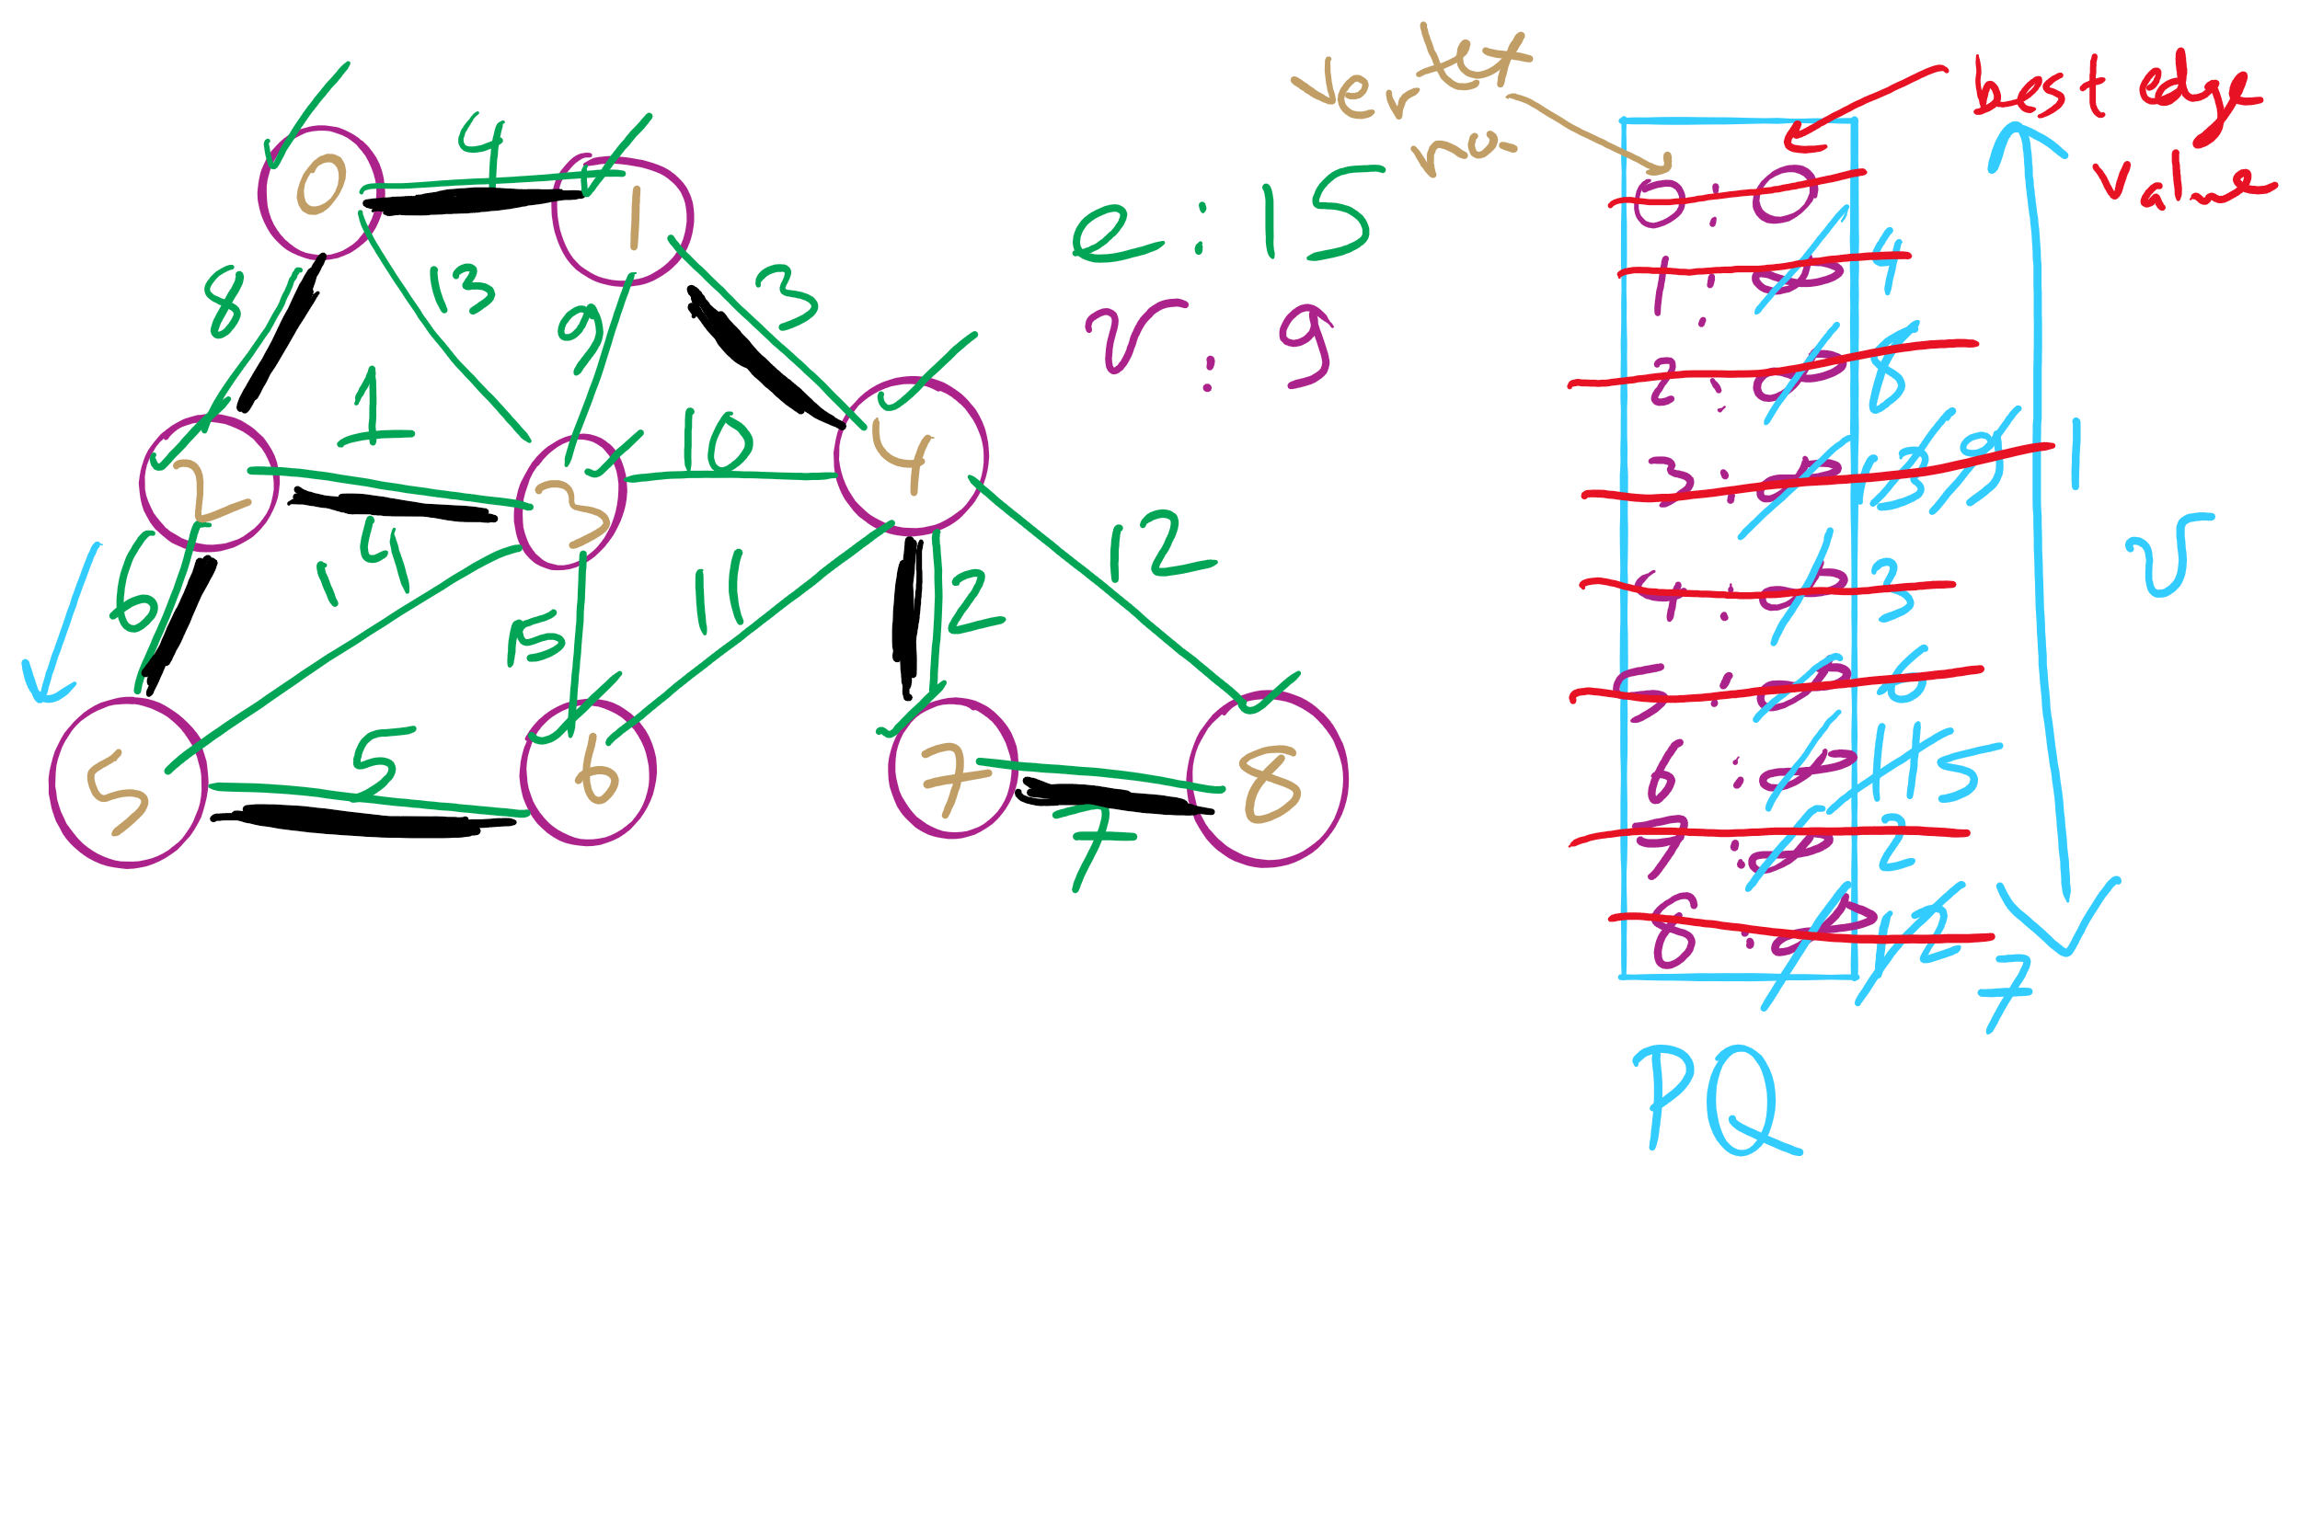
Eager Prim’s Example 1

Slide 6
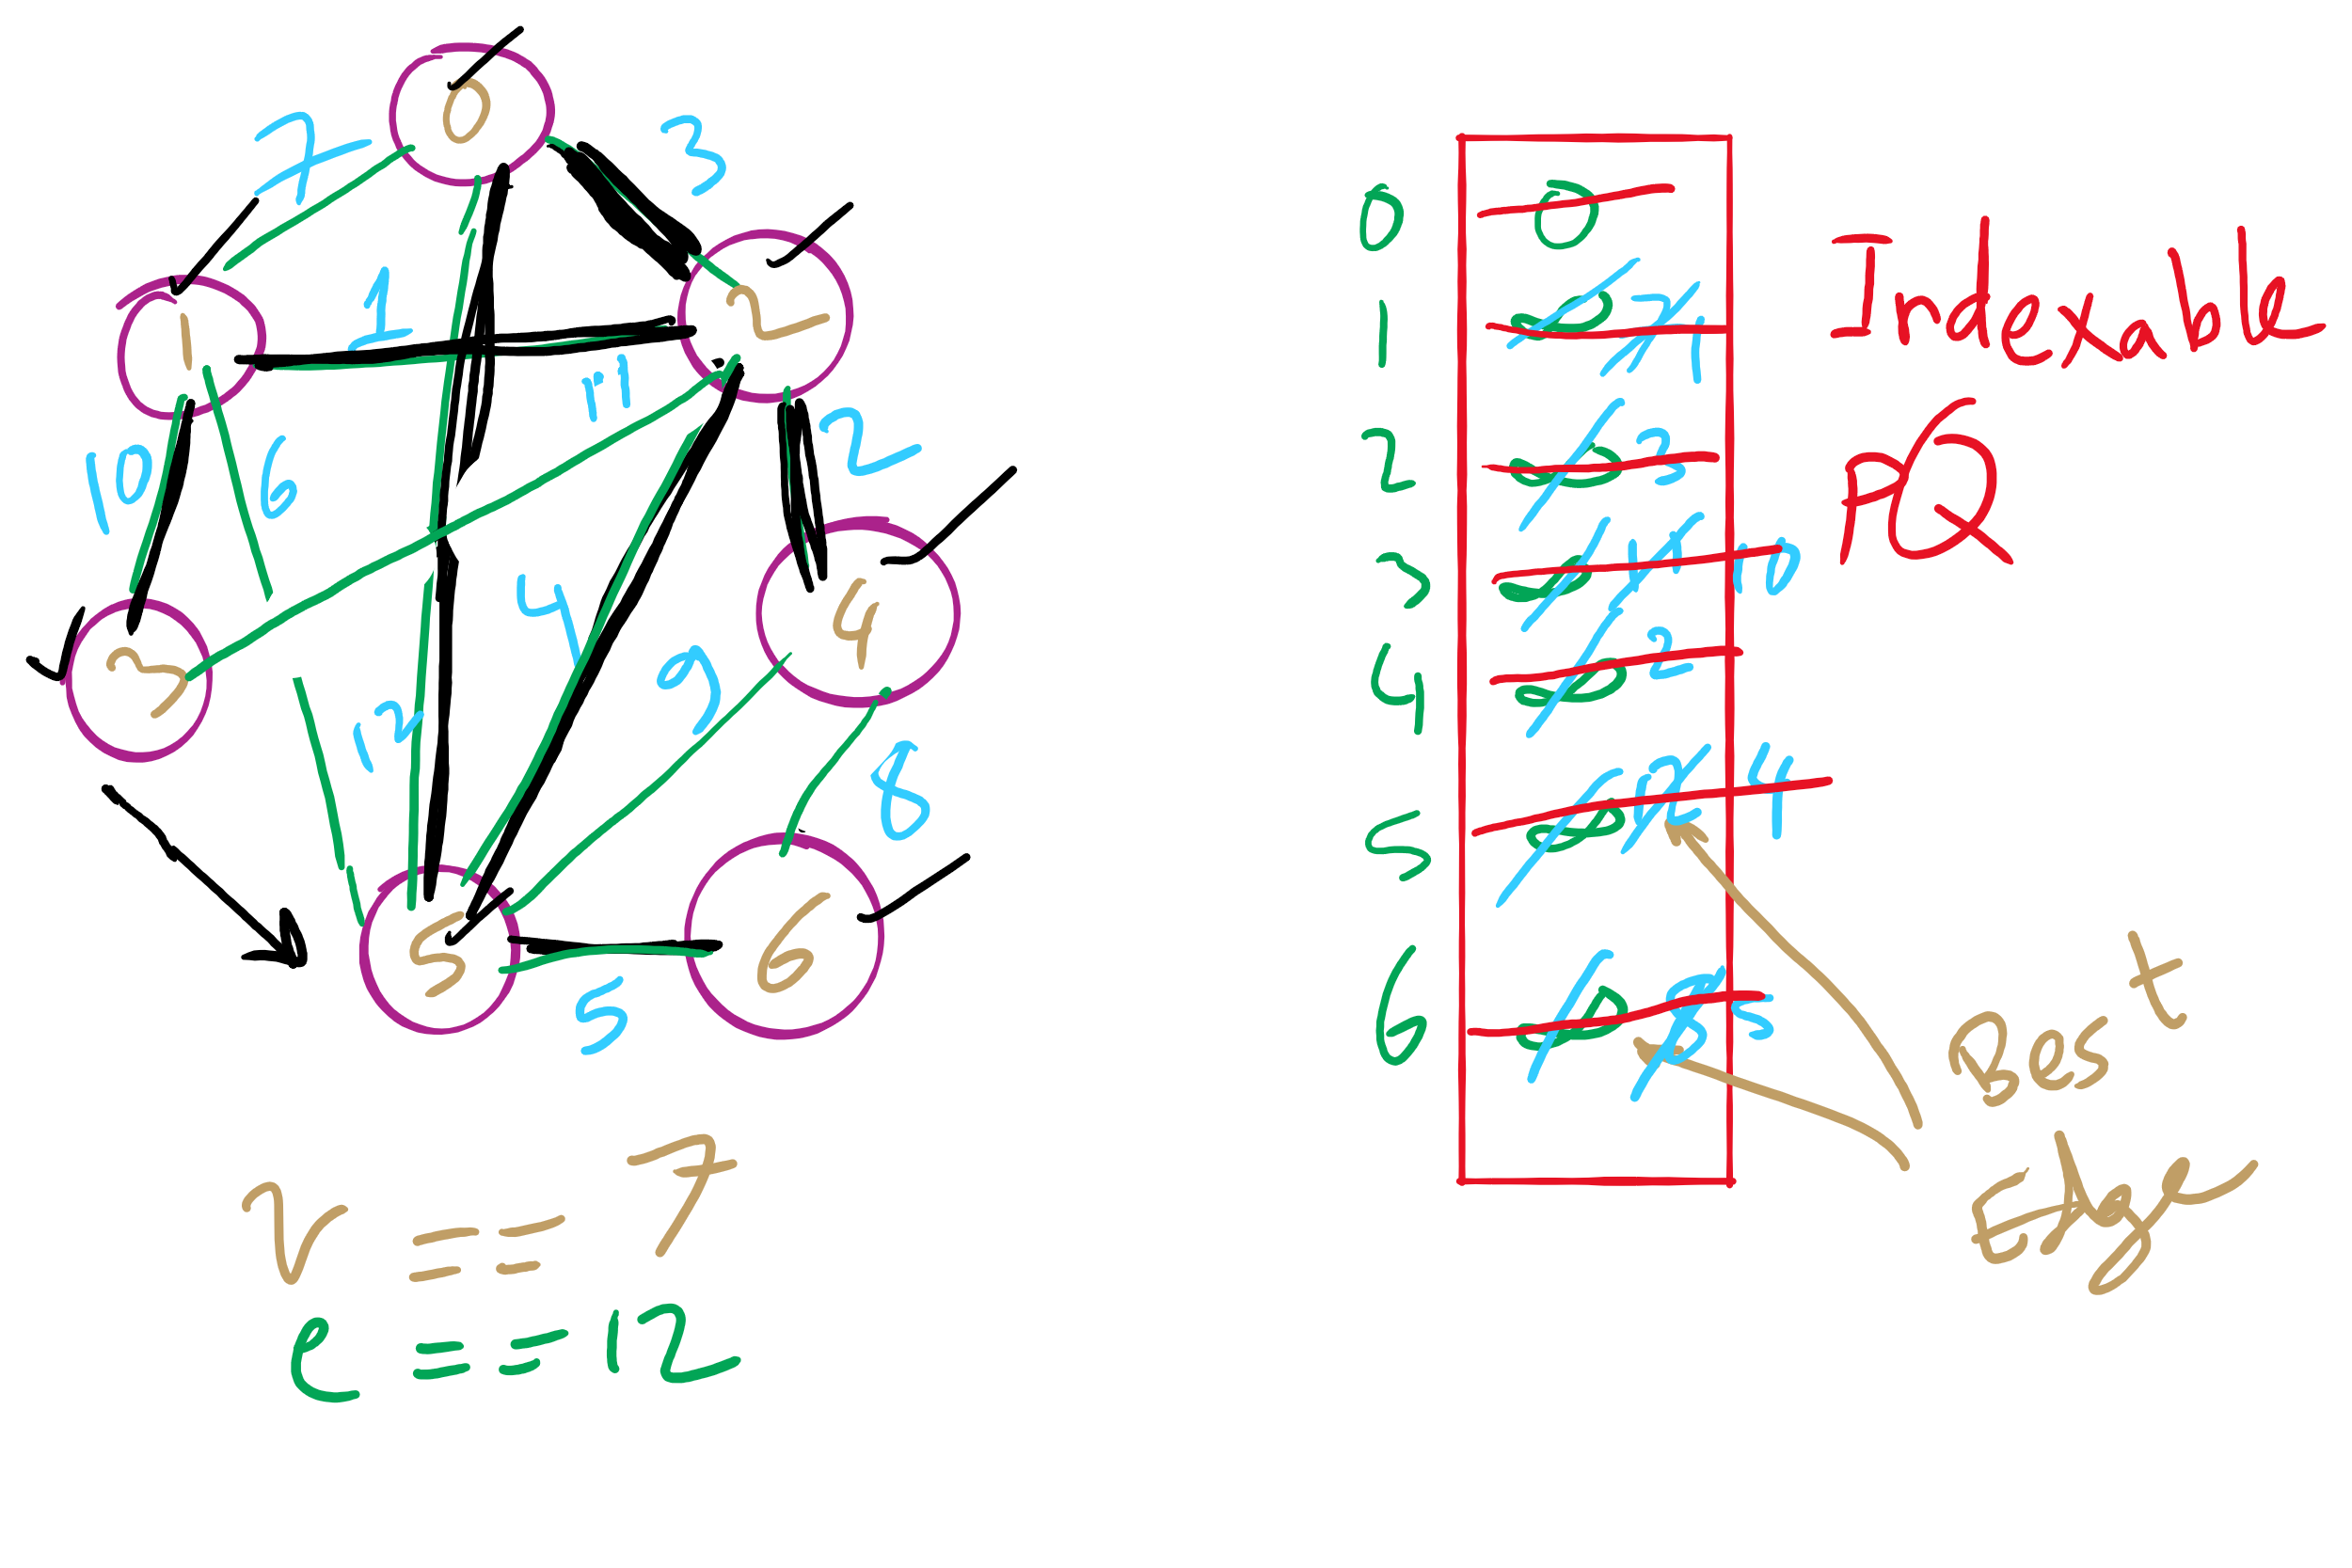
Eager Prim’s Example 2

Slide 7
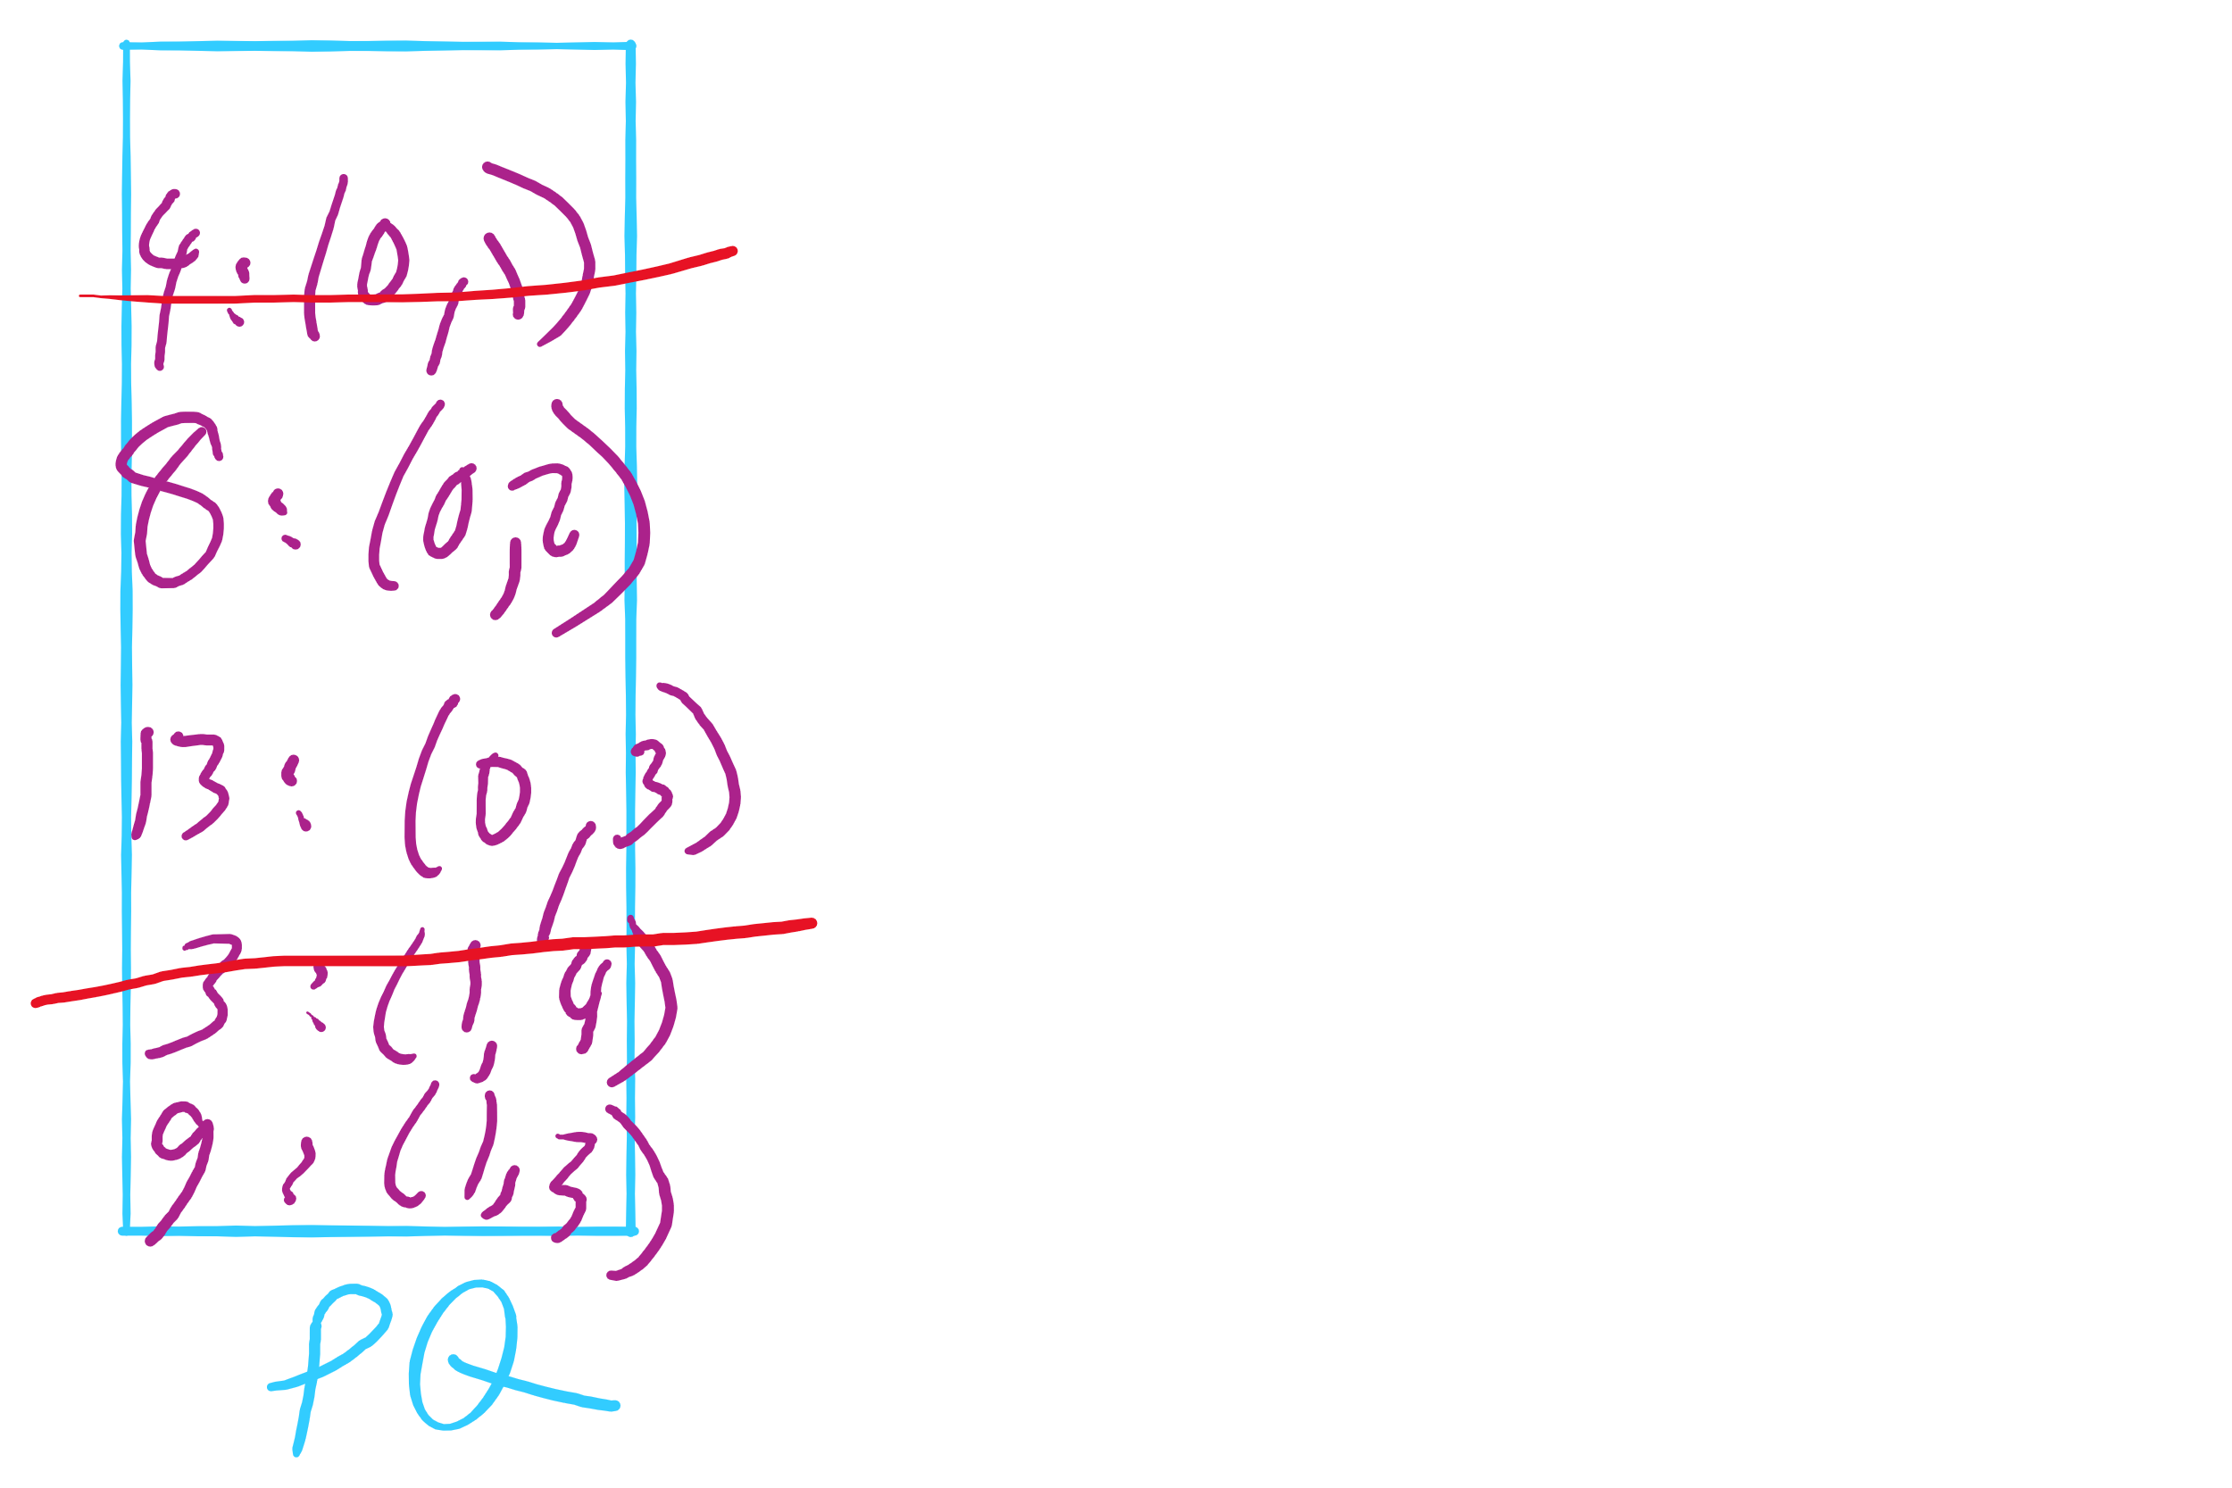
Lazy Prim’s Partial Example

Slide 8
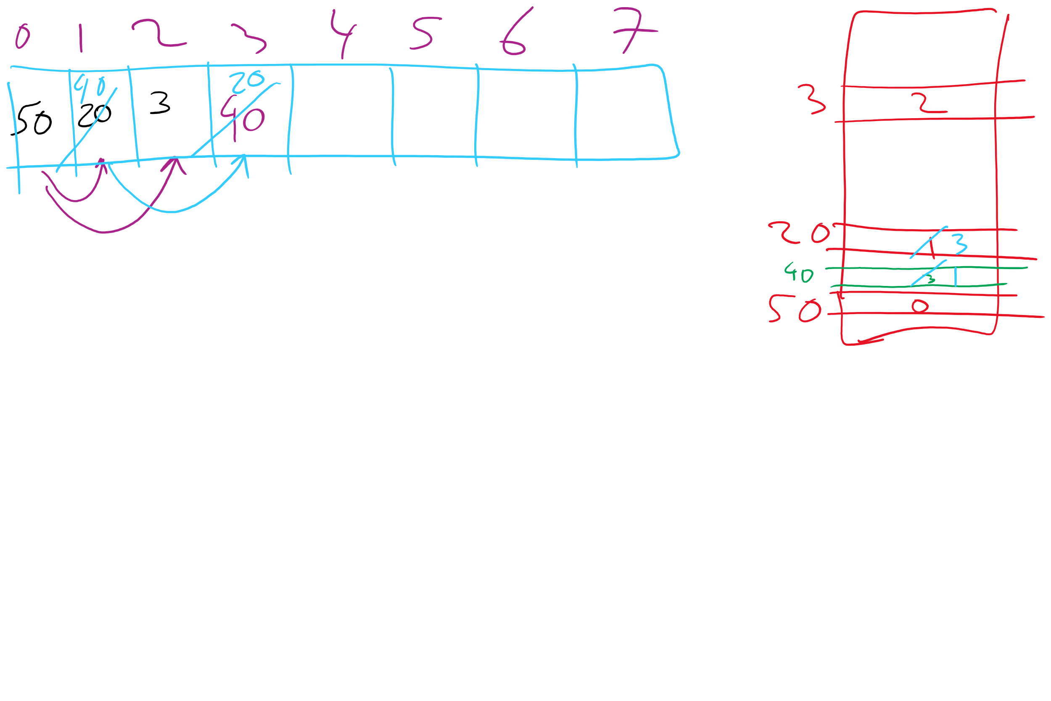
Indexable PQ Example

Slide 9
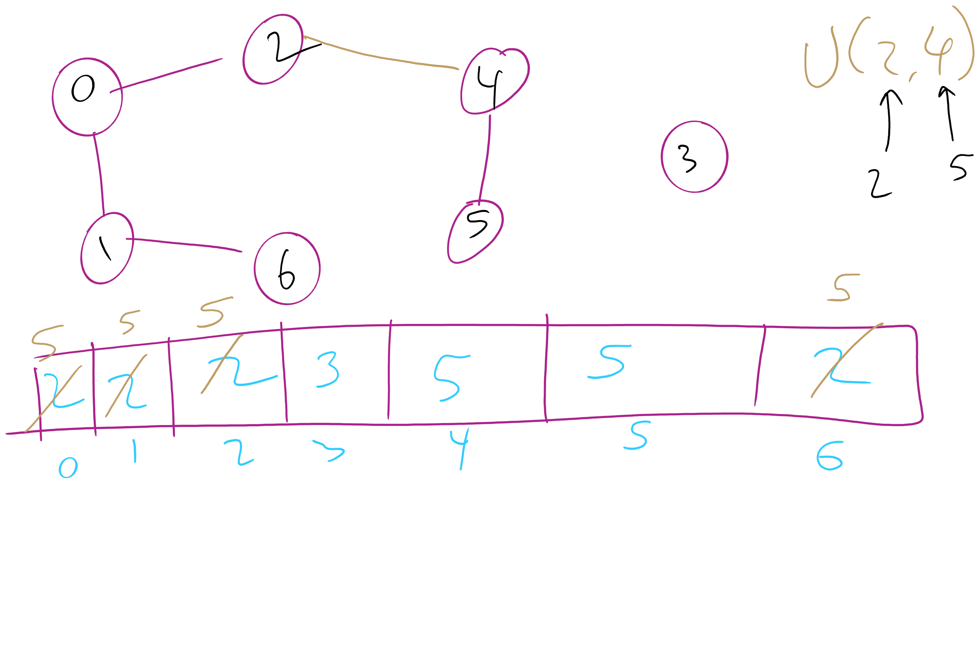
Union-Find Example 1

Slide 10
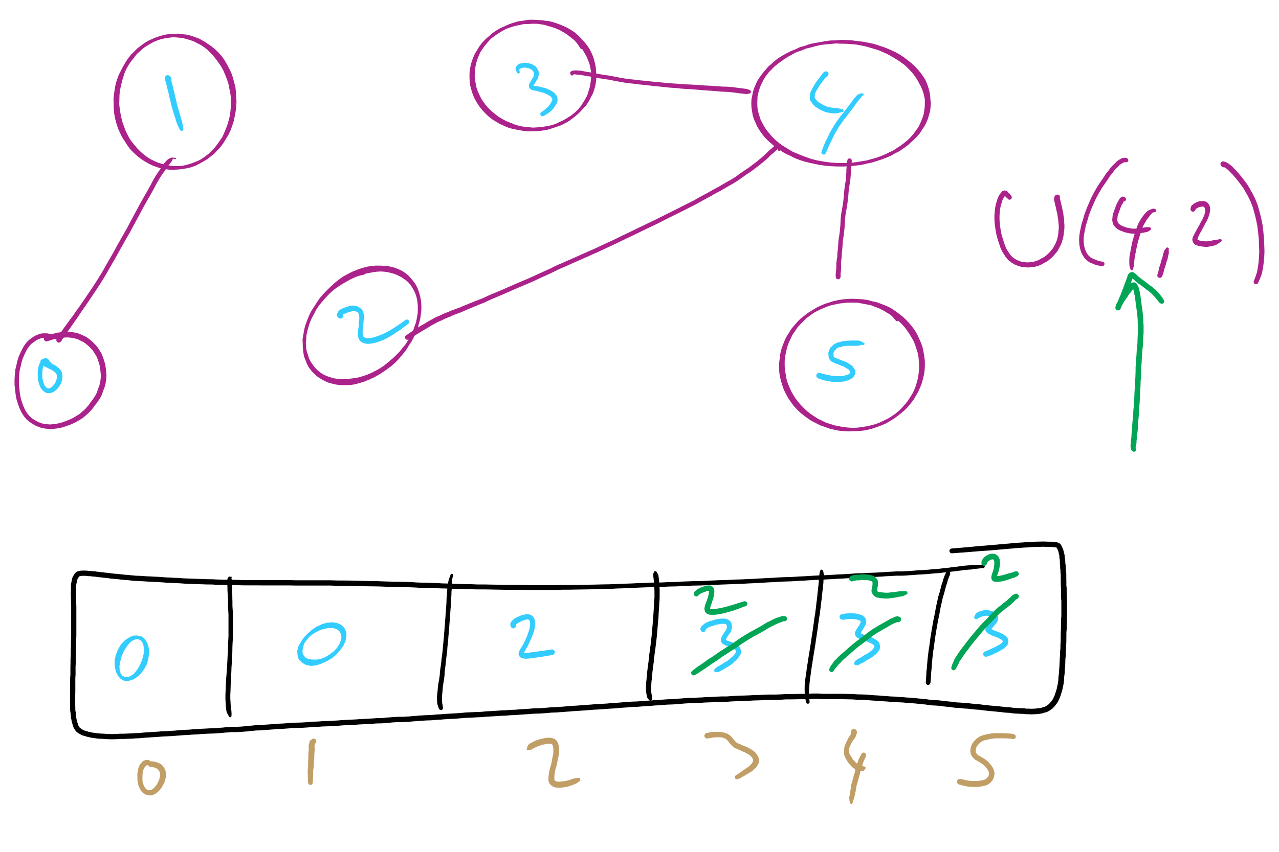
Union-Find Example 2

Slide 11
This Lecture
Union-Find Data Structure
Kruskal’s run-time with Union-Find DS
Weighted Shortest Paths
Dijkstra’s

Slide 12
Can we improve on union()’s runtime?
What if we store our connected components as a forest of trees?
Each tree representing a different connected component
Every time a new connection is made, we simply make one tree the child of another

Slide 13
Tree example
1
4
3
0
2
5
7
1
3
6
2
7
0
1
2
3
4
5
6
7

Slide 14
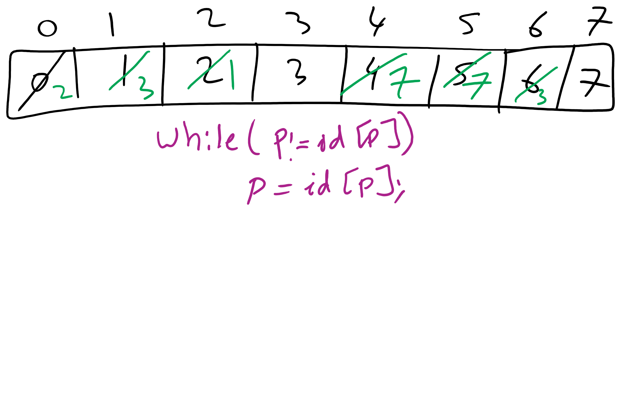
Forest of Trees Implementation

Slide 15
Implementation using the same id array
public int find(int p) {
while (p != id[p]) p = id[p];
return p;
}
public void union(int p, int q) {
int i = find(p);
int j = find(q);
if (i == j) return;
id[i] = j;
count--;
}

Slide 16
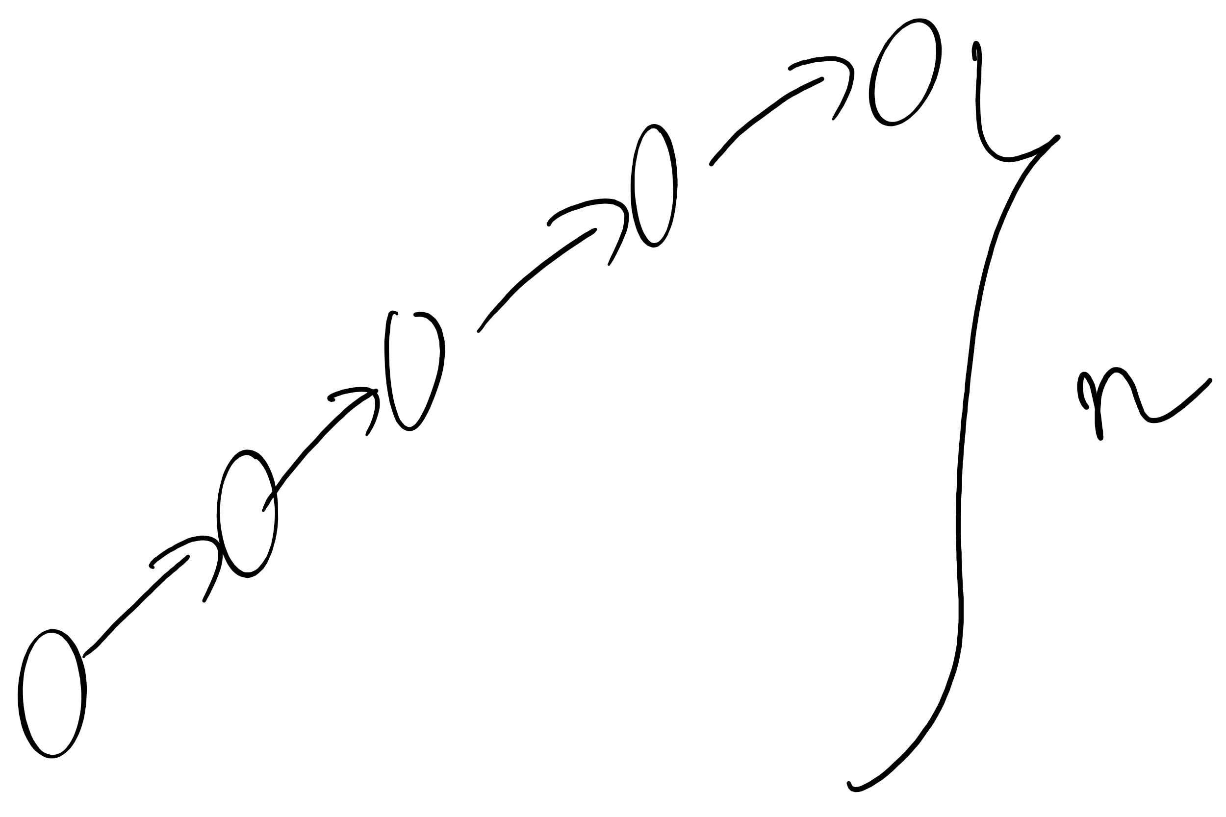
Forest of trees implementation analysis
Runtime?
find():
Bound by the height of the tree
union():
Bound by the height of the tree
What is the max height of the tree?
Can we modify our approach to cap its max height?

Slide 17
Weighted tree example
1
4
0
2
5
7
3
6
2
7
0
1
2
3
4
5
6
7

Slide 18
Weighted trees
public UF(int n) {
count = n;
id = new int[n];
sz = new int[n];
for (int i = 0; i < n; i++) { id[i] = i; sz[i] = 1; }
}
public void union(int p, int q) {
int i = find(p), j = find(q);
if (i == j) return;
if (sz[i] < sz[j]) { id[i] = j; sz[j] += sz[i]; }
else { id[j] = i; sz[i] += sz[j]; }
count--;
}

Slide 19
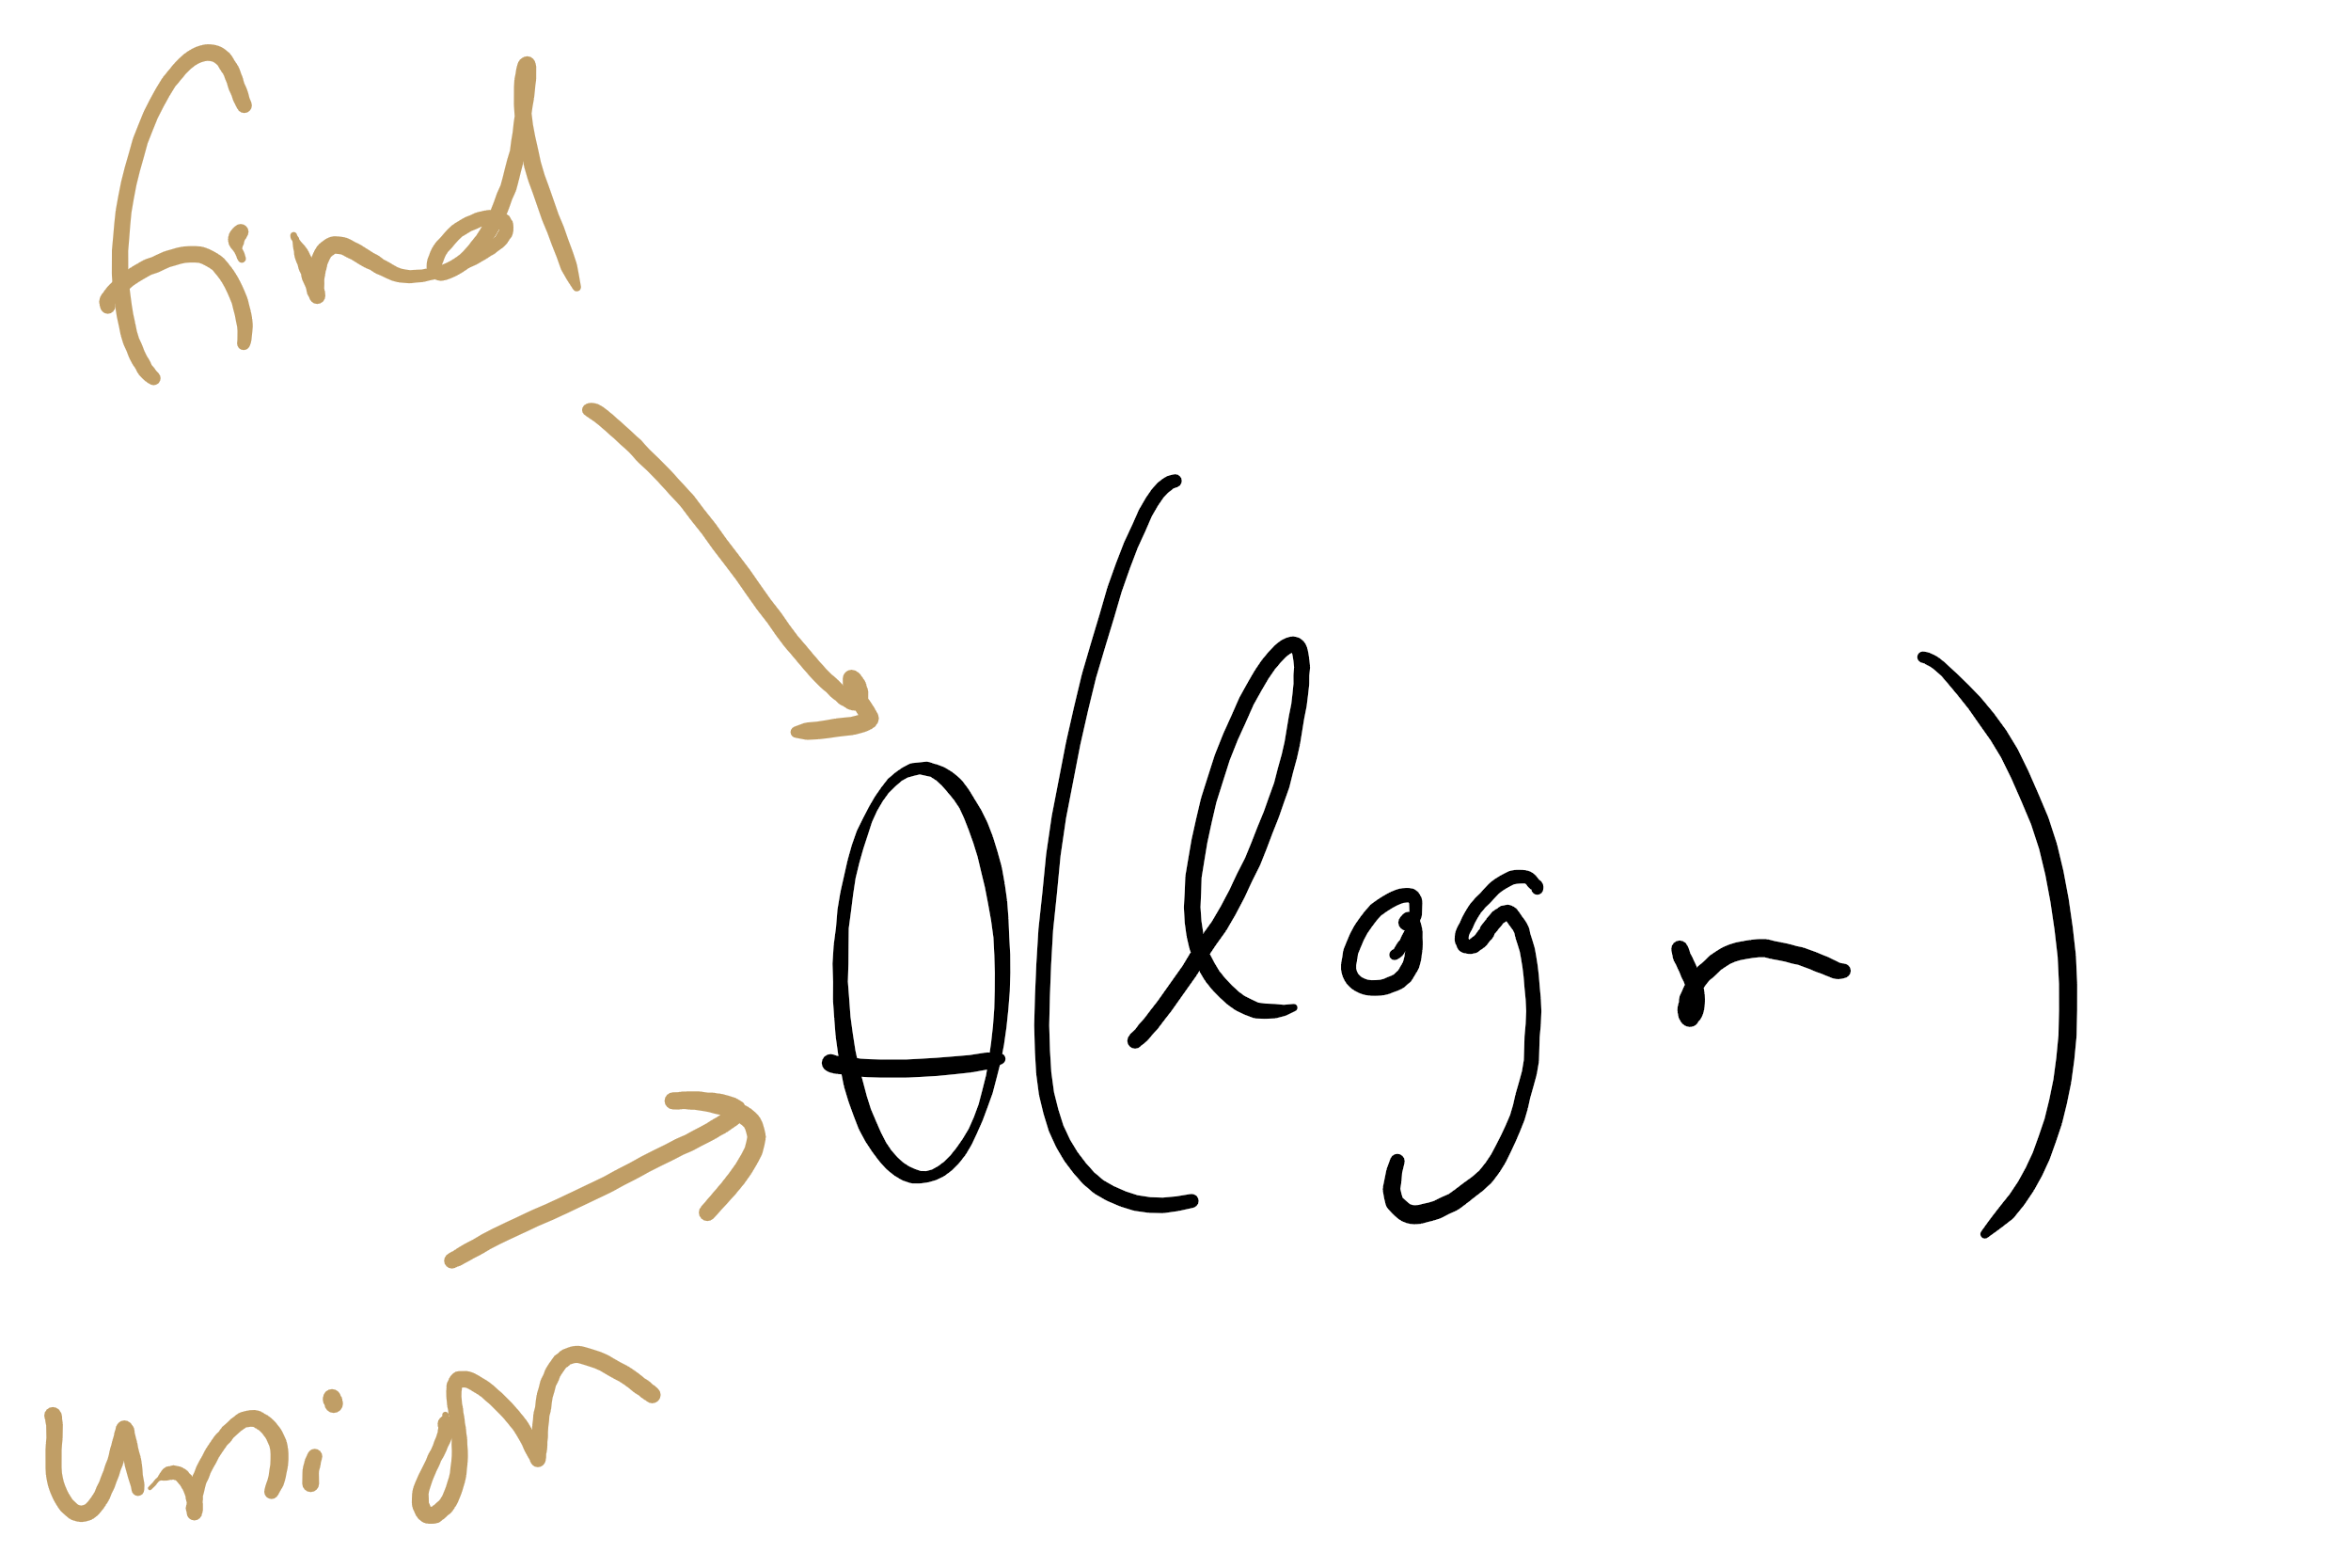
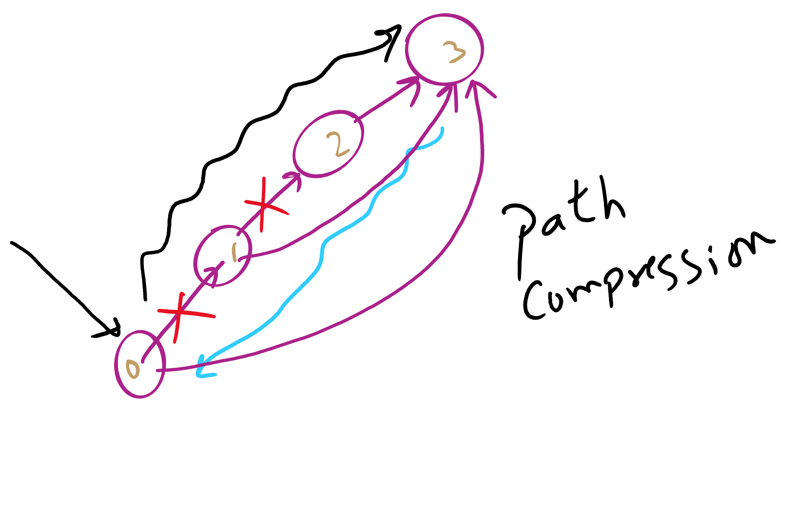
Weighted tree approach analysis
Runtime?
find()?
union()?
Can we do any better?
Notes:
Both find and union:
Θ(log v)
Trees were so flat in this example, why log v?
Because we didn't build up independent connected components
Can do better with path compression, where another loop is added to find() to link everything we come across directly back to the root
this is optimal, but not quite constant time
direct students to exercised in section 1.5 of the text

Slide 20
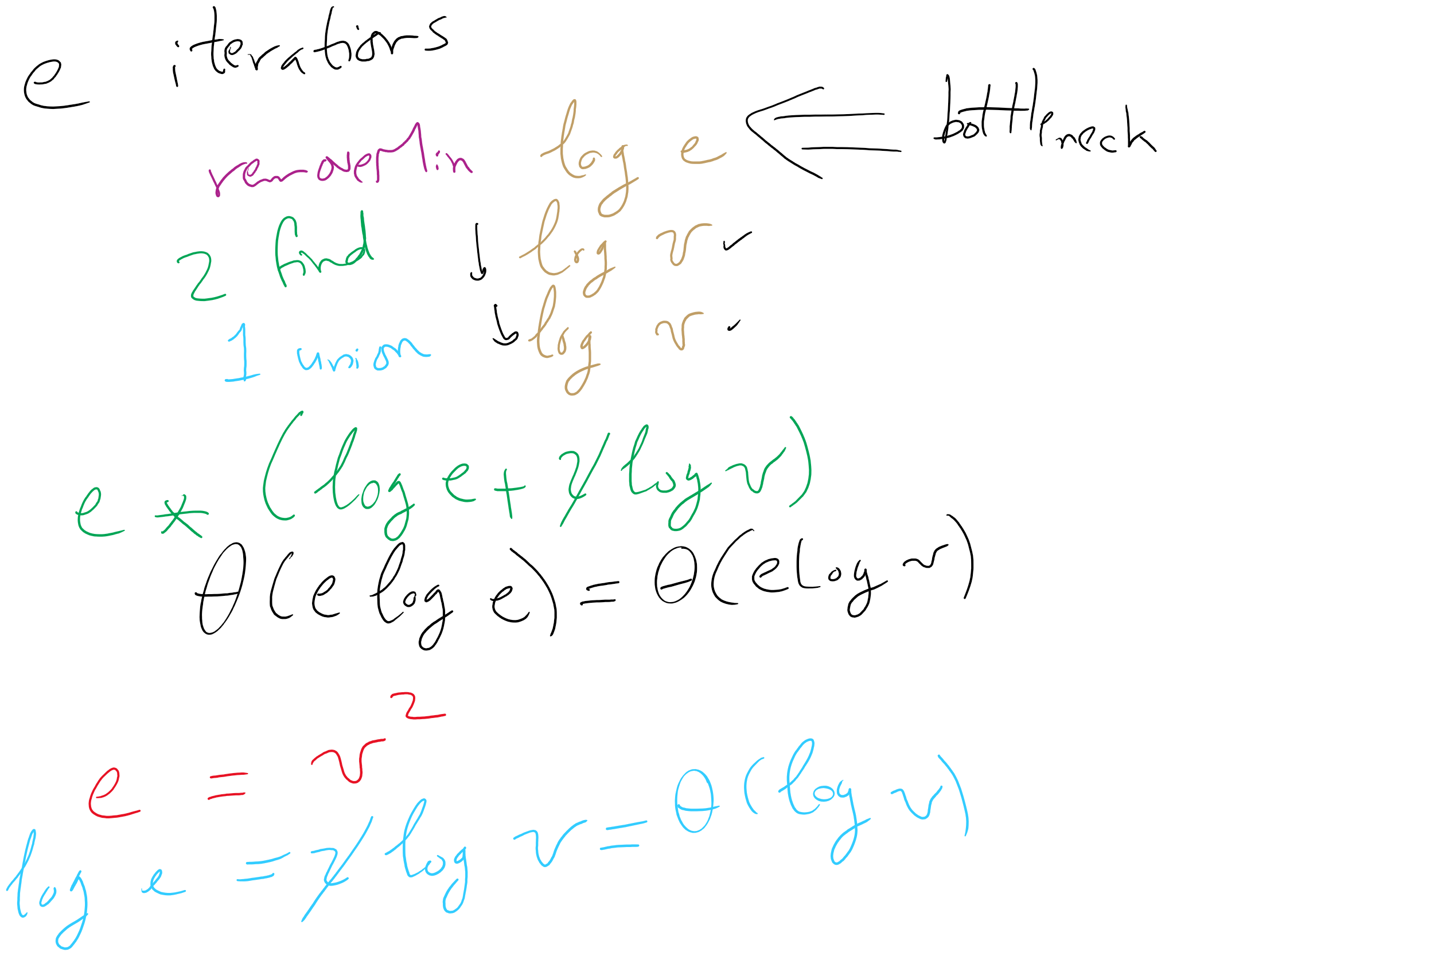
Kruskal’s algorithm, once again
What is the runtime of Kruskal’s algorithm??

Slide 21
Weighted shortest path
Dijkstra’s algorithm:
Set a distance value of MAX_INT for all vertices but start
Set cur = start
While destination is not visited:
For each unvisited neighbor of cur:
Compute tentative distance from start to the unvisited neighbor through cur
Update any vertices for which a lesser distance is computed
Mark cur as visited
Let cur be the unvisited vertex with the smallest tentative distance from start

Slide 22
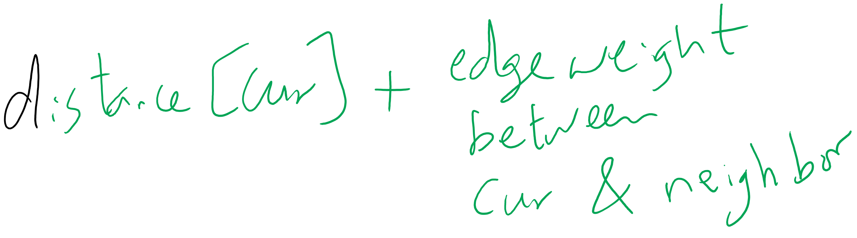
Tentative Distance

Slide 23
Dijkstra's example
0
0
Distance
Via
7
14
0
0
--
1
9
3
1
3
1
∞
7
--
0
2
∞
9
--
10
2
0
2
2
3
11
∞
14
2
--
15
0
9
4
22
21
∞
1
2
--
12
13
5
∞
22
20
--
2
3
4
5
4
5
2

Slide 24
Analysis of Dijkstra’s algorithm
How to implement?
Best path/parent array?
Runtime?
PQ?
Turns out to be very similar to Eager Prims
Storing paths instead of edges
Runtime?

Slide 25
Defining network flow
Consider a directed, weighted graph G(V, E)
Weights are applied to edges to state their capacity
c(u, w) is the capacity of edge (u, w)
if there is no edge from u to w, c(u, w) = 0
Consider two vertices, a source s and a sink t
Let’s determine the maximum flow that can run from s to t in the graph G

Slide 26
Flow
Let the f(u, w) be the amount of flow being carried along the edge (u, w)
Some rules on the flow running through an edge:
∀(u, w) ∈ E f(u, w) <= c(u, w)
∀u ∈ (V - {s,t}) (Σ_{w∈V} f(w, u) - Σ_{w∈V} f(u, w)) = 0

Slide 27
Ford Fulkerson
Let all edges in G have an allocated flow of 0
While there is path p from s to t in G s.t. all edges in p have some residual capacity (i.e., ∀(u, w) ∈ p f(u, w) < c(u, w)):
(Such a path is called an augmenting path)
Compute the residual capacity of each edge in p
Residual capacity of edge (u, w) is c(u, w) - f(u, w)
Find the edge with the minimum residual capacity in p
We’ll call this residual capacity new_flow
Increment the flow on all edges in p by new_flow

Slide 28
Ford Fulkerson example
5
/5
s
10
A
B
t
/10
5
/10
5
/10
5
10
/5
5

