Slide 1

Algorithms and Data Structures 2 CS 1501
Fall 2021
Sherif Khattab
ksm73@pitt.edu
(Slides are adapted from Dr. Ramirez’s and Dr. Farnan’s CS1501 slides.)

Slide 2
Announcements
Homework 1 is due this Friday at 11:59 pm
(special) late deadline: Monday 2/8 at 11:59 pm
Tophat questions assigned as homework
(special) late deadline: Monday 2/8 at 11:59 pm
Lab 1 will be posted this week
Explained in recitations
We will use Github Classroom
Slack channel(s) for student-to-student communications?

Slide 3
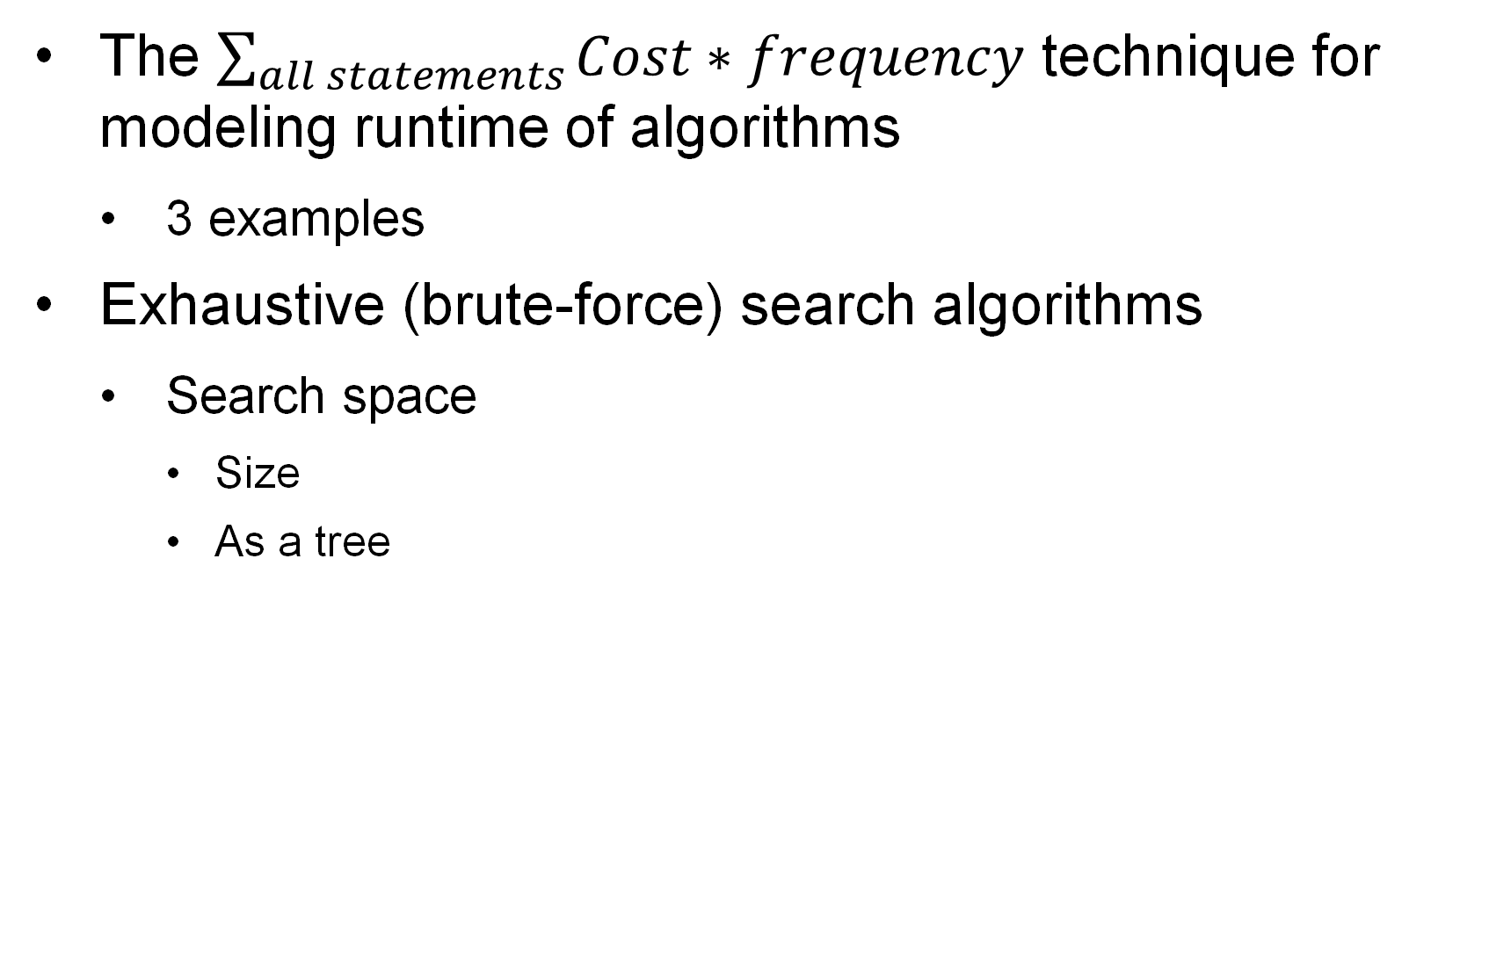
Last lecture …
The $\sum_{all statements}{Cost∗frequency}$ technique for modeling runtime of algorithms
3 examples
Exhaustive (brute-force) search algorithms
Search space
Size
As a tree

Slide 4
Muddiest points
Determining big O, theta, and omega based on f(n)
Worst case vs Best case runtime
More practice
knowing which discrete math model to apply to stacked algorithmic structures
The series calculation to figure out the number of times it ran, I think I need to brush up on this.
Understanding different layers when analyzing an algorithm... like the different colors. Like if the outside is n then the will also impact the inside?
Understanding how to tell if you are determining big O, big theta etc.
Run time of each block, and how to combine them in whole
using theta vs big o
The frequency of each statement in BubbleSort and Improved BubbleSort
I think I need more explanation on the “improved” bubble sort slide

Slide 5
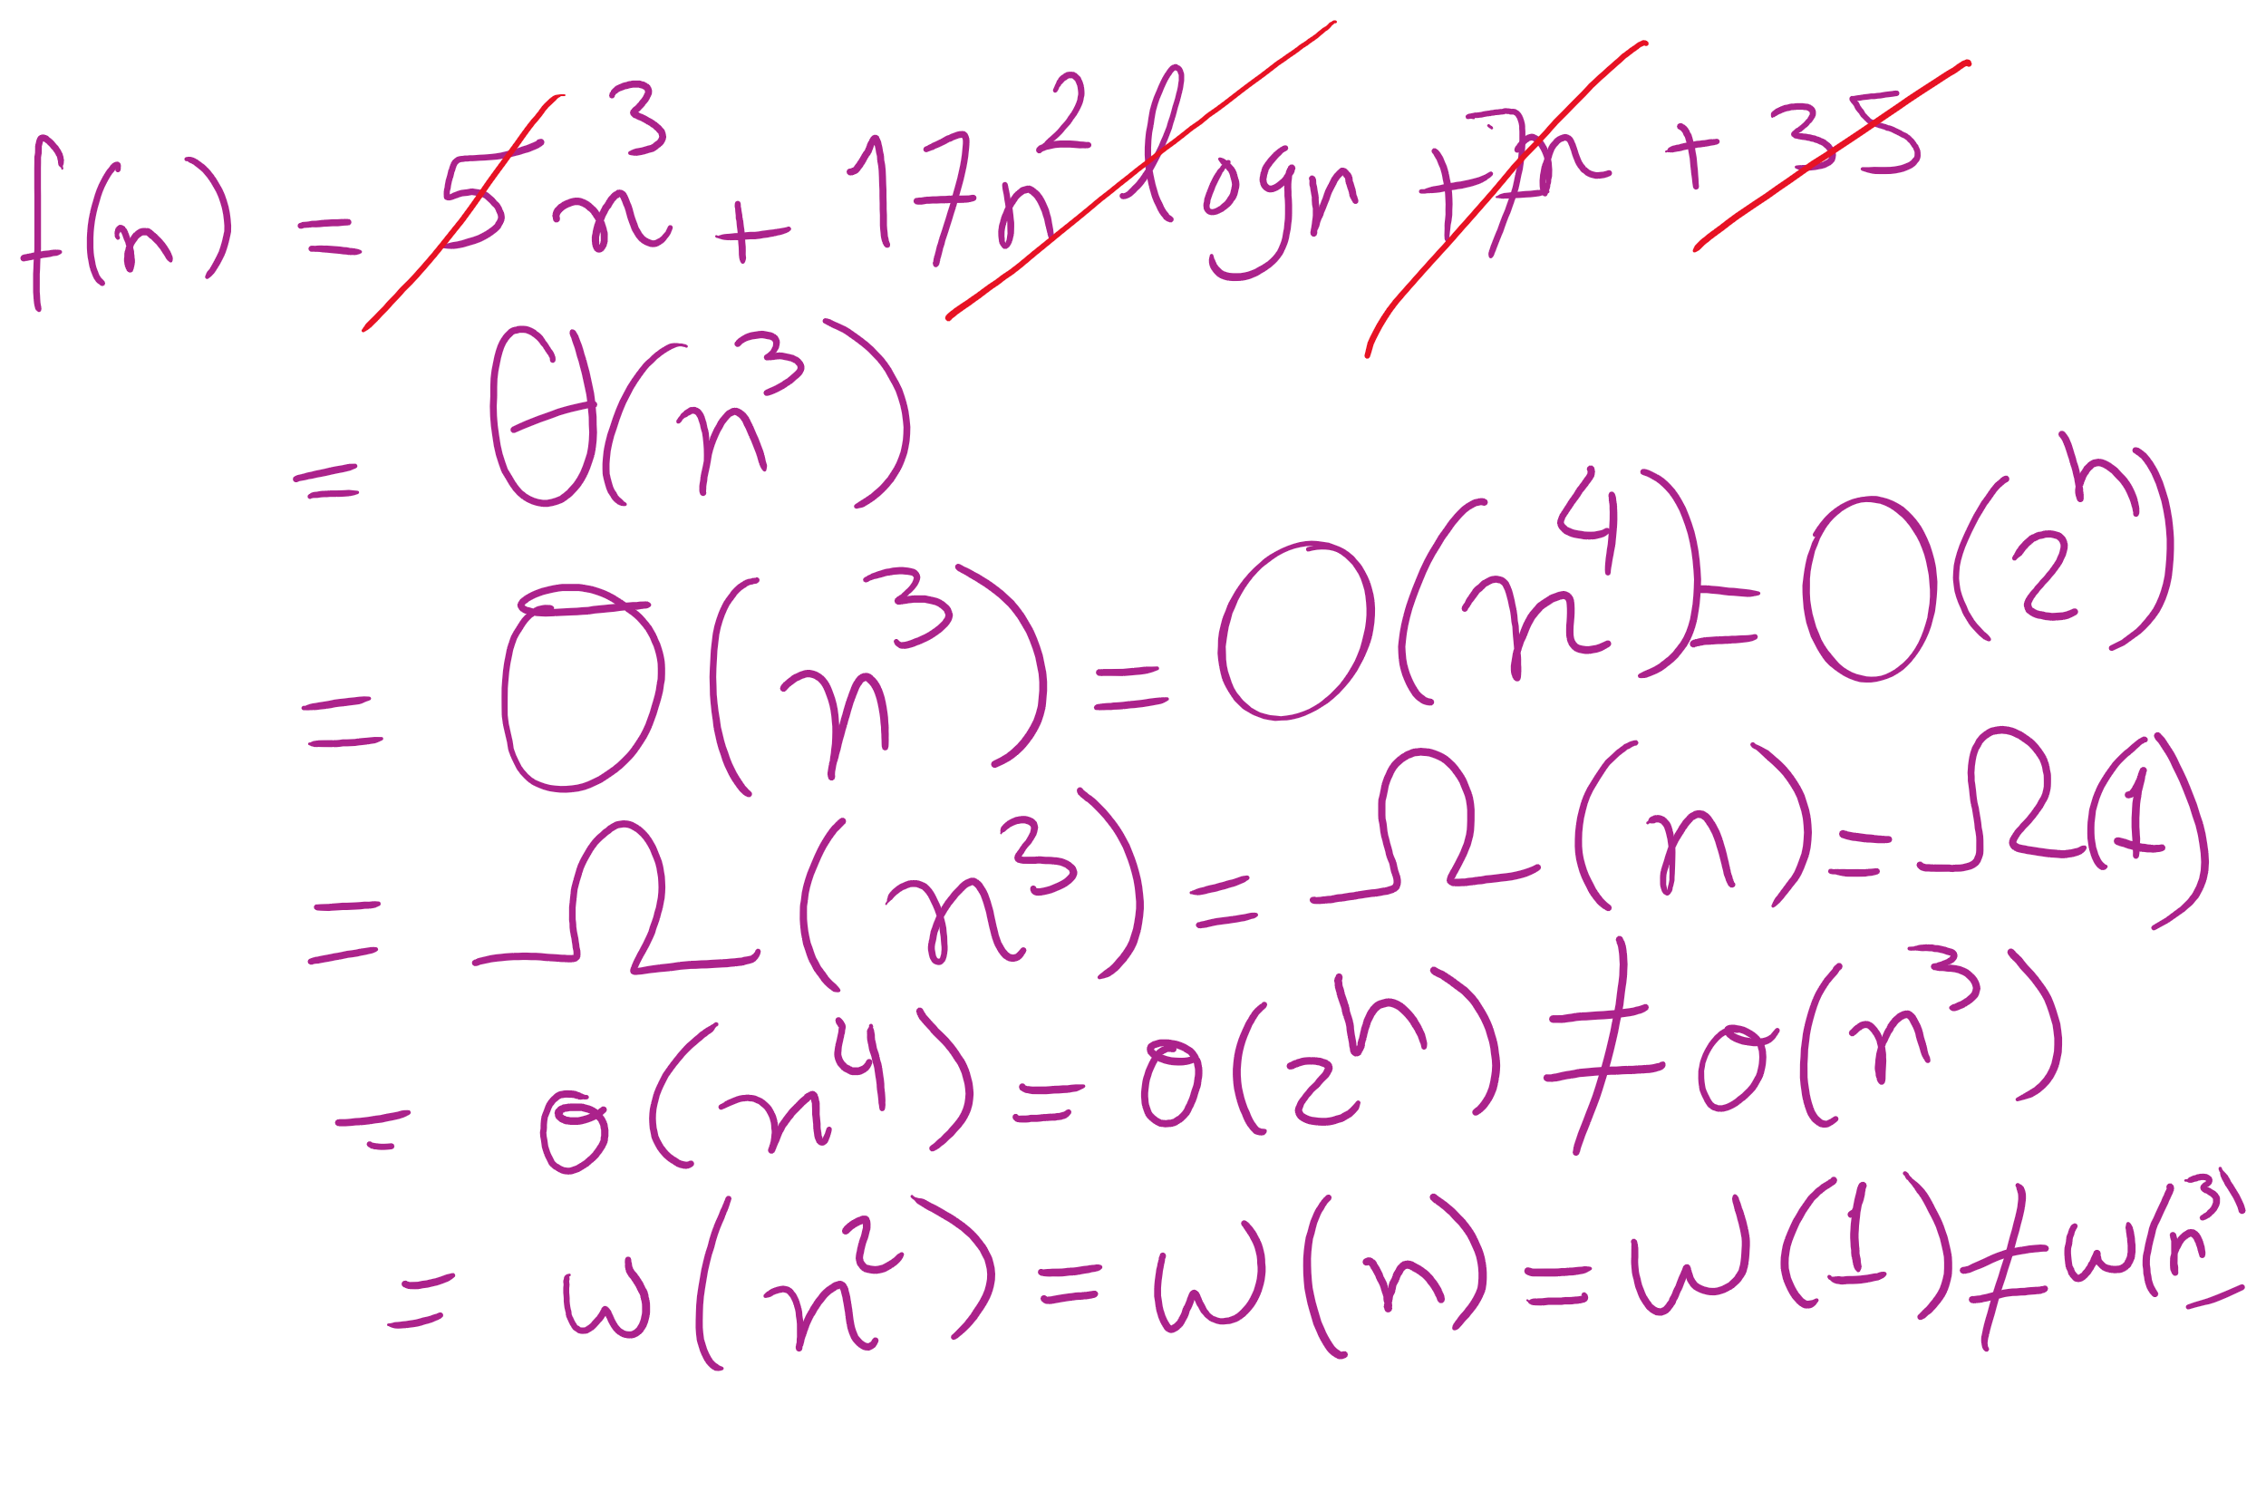
Big O vs Theta

Slide 6
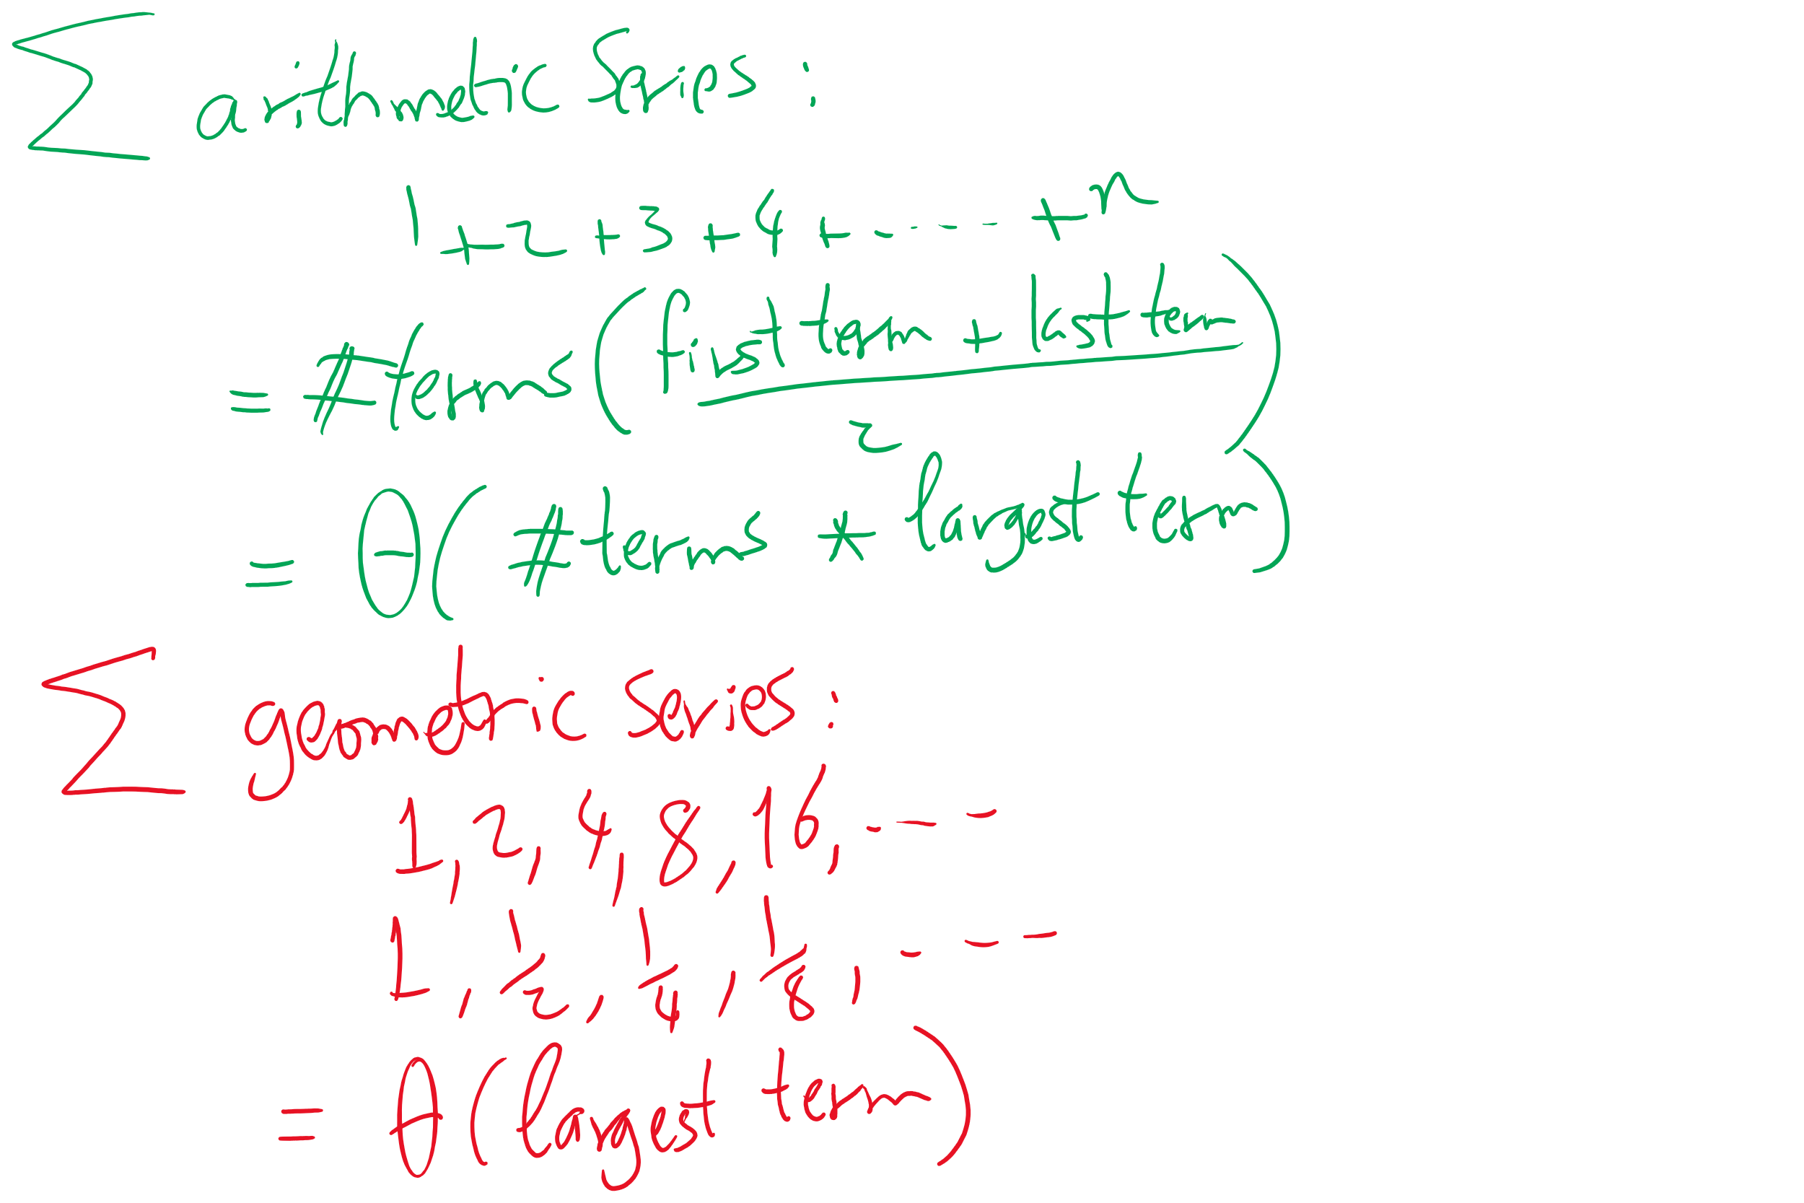
A couple useful Math formulae

Slide 7
“Improved” bubble sort
void bubbleSort(Comparable[] a) {
boolean swapped;
int to_sort = a.length;
do {
swapped = false;
for(int j = 1; j < to_sort; j++) {
if (less(a[j], a[j-1]))
{ exch(a, j-1, j); swapped = true; }
}
to_sort--;
} while(swapped);
}
Notes:
grey
t₃
1
yellow
t₂
x (x varies from 0 .. n)
red
t₁
sum i=1 to x (sum j=1 to n-i (1))
= n²/2 - n/2 (assuming x == n)
purple
t₀
y (y varies from 0 .. n²/2 - n/2)

Slide 8
In today’s lecture …
Pruning to reduce search space size
Backtracking algorithm
Overall (recursive) structure
Relationship to the search space tree
More examples
8 Queens
Boggle game

Slide 9
A better algorithm for ThreeSum
What if we sorted the array first?
Pick two numbers, then binary search for the third one that will make a sum of zero
a[i] = 10, a[j] = -7, binary search for -3
Still have two for loops, but we replace the third with a binary search
Runtime now?
What if the input data isn't sorted?
What about the sorting time?
Notes:
New runtime:
Θ(n² log n)
Sort time:
O(n log n)
done before our search, dominated by search time
Asymptotically insignificant

Slide 10
Bubble sort
Simply go through the array comparing pairs of items, swap them if they are out of order
Repeat until you make it through the array with 0 swaps
<T extends Comparable<? super T>> void bubbleSort(T [] a) {
boolean swapped;
do {
swapped = false;
for(int j = 1; j < a.length; j++) {
if (less(a[j], a[j-1]))
{ exch(a, j-1, j); swapped = true; }
}
} while(swapped);
}
Notes:
grey
t₃
1
yellow
t₂
x (x varies from 0 .. n)
red
t₁
sum i=1 to x (sum j=1 to n (1))
= n² (assuming x == n)
purple
t₀
y (y varies from 0 .. n²)

Slide 11
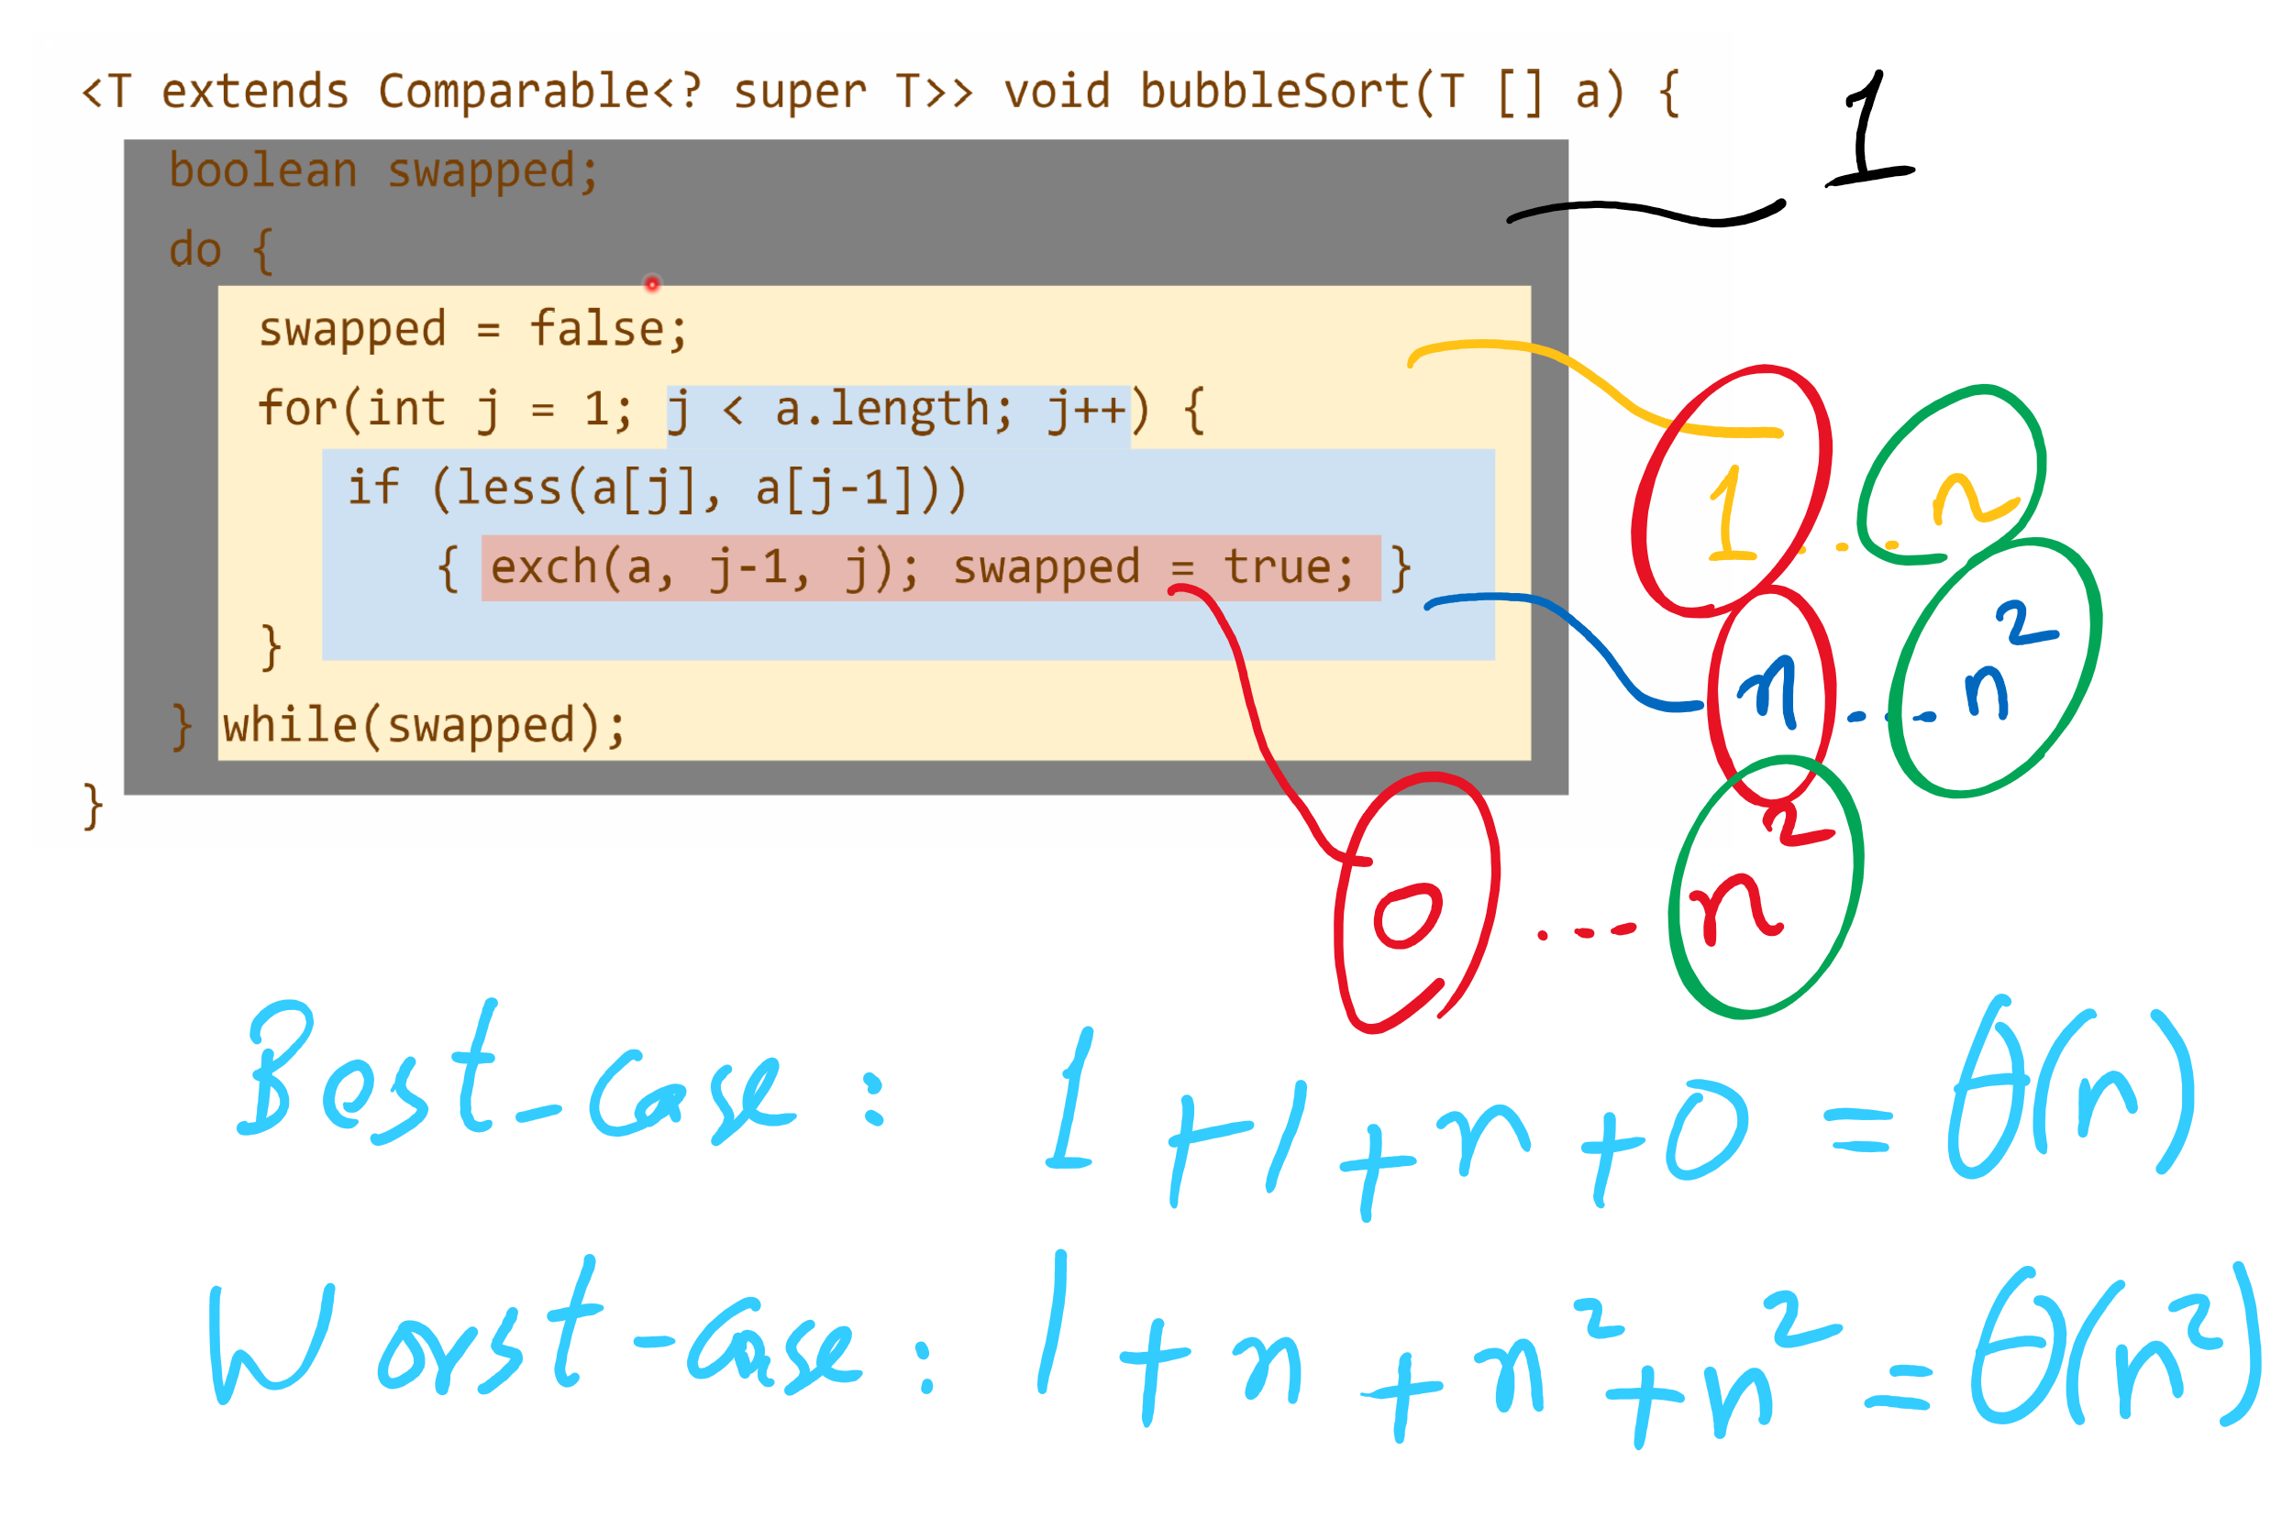
Runtime Modeling

Slide 12
Bubble sort example
SWAPPED!
1
5
3
3
5
3
1
4
1
4
5
4
1
5
10

Slide 13
“Improved” bubble sort
void bubbleSort(Comparable[] a) {
boolean swapped;
int to_sort = a.length;
do {
swapped = false;
for(int j = 1; j < to_sort; j++) {
if (less(a[j], a[j-1]))
{ exch(a, j-1, j); swapped = true; }
}
to_sort--;
} while(swapped);
}
Notes:
grey
t₃
1
yellow
t₂
x (x varies from 0 .. n)
red
t₁
sum i=1 to x (sum j=1 to n-i (1))
= n²/2 - n/2 (assuming x == n)
purple
t₀
y (y varies from 0 .. n²/2 - n/2)

Slide 14
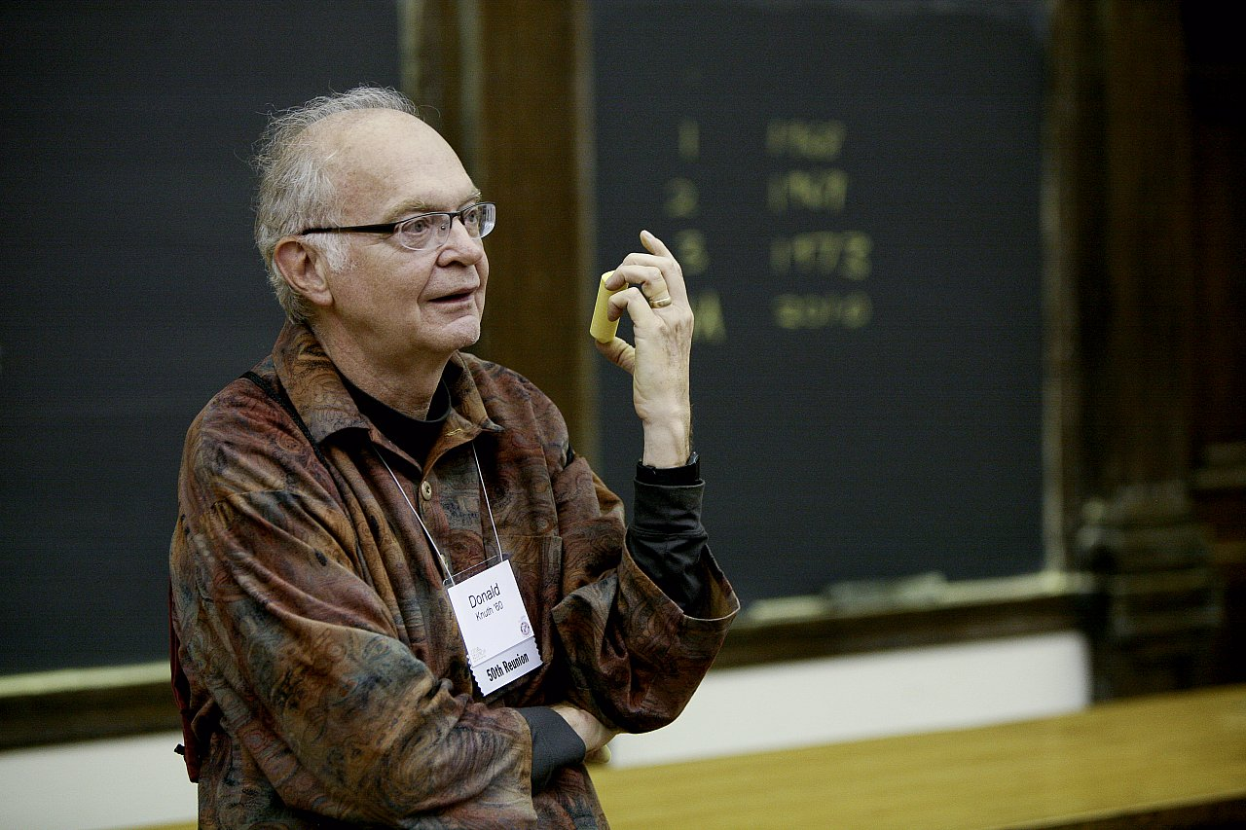
How bad is it?
Runtime:
O(n²)
"[A]lthough the techniques used in the calculations [to analyze the bubble sort] are instructive, the results are disappointing since they tell us that the bubble sort isn't really very good at all."
Donald Knuth
The Art of Computer Programming

Slide 15
Brute-force (or exhaustive) search
Find the solution to a problem by considering all potential solutions and selecting the correct one(s)
Run-time is bounded by the number of potential solutions
n³ potential solutions means cubic run-time
2^{n} potential solutions means exponential run-time

Slide 16
Password cracking
Brute force password attacks depend on the length of the password, hence the insecurity of short passwords
We can view the series of guesses we make as a tree
Each path from root to leaf is an attempted solution

Slide 17
PIN cracking example
Root
0
1
2
...
9
00
01
02
...
09
000
001
002
...
009
0000
0001
0002
...
0009

Slide 18
Search space size
This tree will enumerate 10^{n} different PINs
n is the length of the PIN
So for our case 10⁴ = 10,000 different PINs
Note that this is (for a computer) tiny
What would be a long password for a computer?
Say 128 bits long
2^{n} different passwords
2¹²⁸ = 340282366920938463463374607431768211456
Assuming a supercomputer can check 33860000000000 passwords per second...
And we’ll on average find the correct password after guessing half the possibilities…
We should be able to crack a 128 bit password on our supercomputer in 1.59 x 10¹⁷ years using brute force
Notes:
39-digit number
33 x 10¹²
Not all of those strings contain all valid characters though, so how can we cut down the number of checks?

Slide 19
PIN cracking example
Root
0
1
2
...
9
00
01
02
...
09
000
001
002
...
009
0000
0001
0002
...
0009

Slide 20
Back to our PIN cracking example
What if we have background knowledge that the PIN we’re trying to crack doesn’t have more than one 0?
Root
0
1
2
...
9
00
01
02
...
09
010
011
012
...
019
...

Slide 21
Pruning!
Removes entire subtrees of our search space exploration
When we can use it, it makes our algorithm practical for much larger values of n
Does not, however, affect the asymptotic performance of an algorithm
Still exponential time requirement for our PIN example
Notes:
For 128-bit binary password, if 8 bits are newline character, can prune since most won’t allow newline characters in password

Slide 22
How to enumerate all these possibilities?
For the PIN example a whole bunch of for loops would do
In general, exhaustive search trees can be easily traversed via recursion and backtracking
Recurse until its apparent no solution can be achieved along the current path
Undo the path to the point that you can start to move forward again

Slide 23
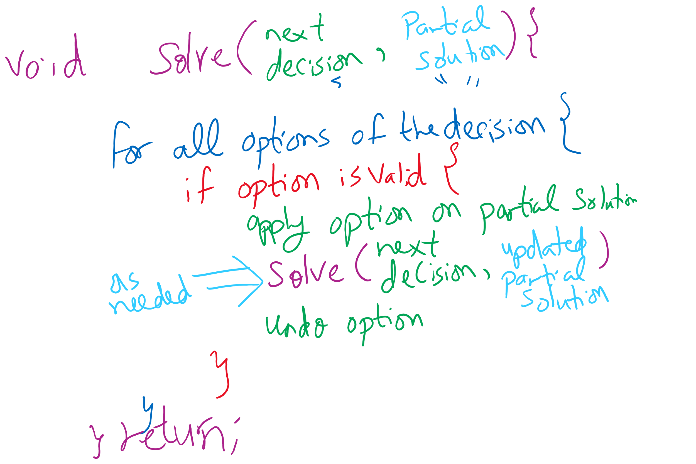
Backtracking Algorithm

Slide 24
8 queens problem
Place 8 queens on a chessboard such that no queen can take another
Queens can move horizontally, vertically, and diagonally
How many ways can you place 8 pieces on a chess board?
64 C 8
= 64! / (8! * (64-8)!)
= 4,426,165,368
Meaning 35,409,322,944 total queen placements
Do we really need to look through all of these options?

Slide 25
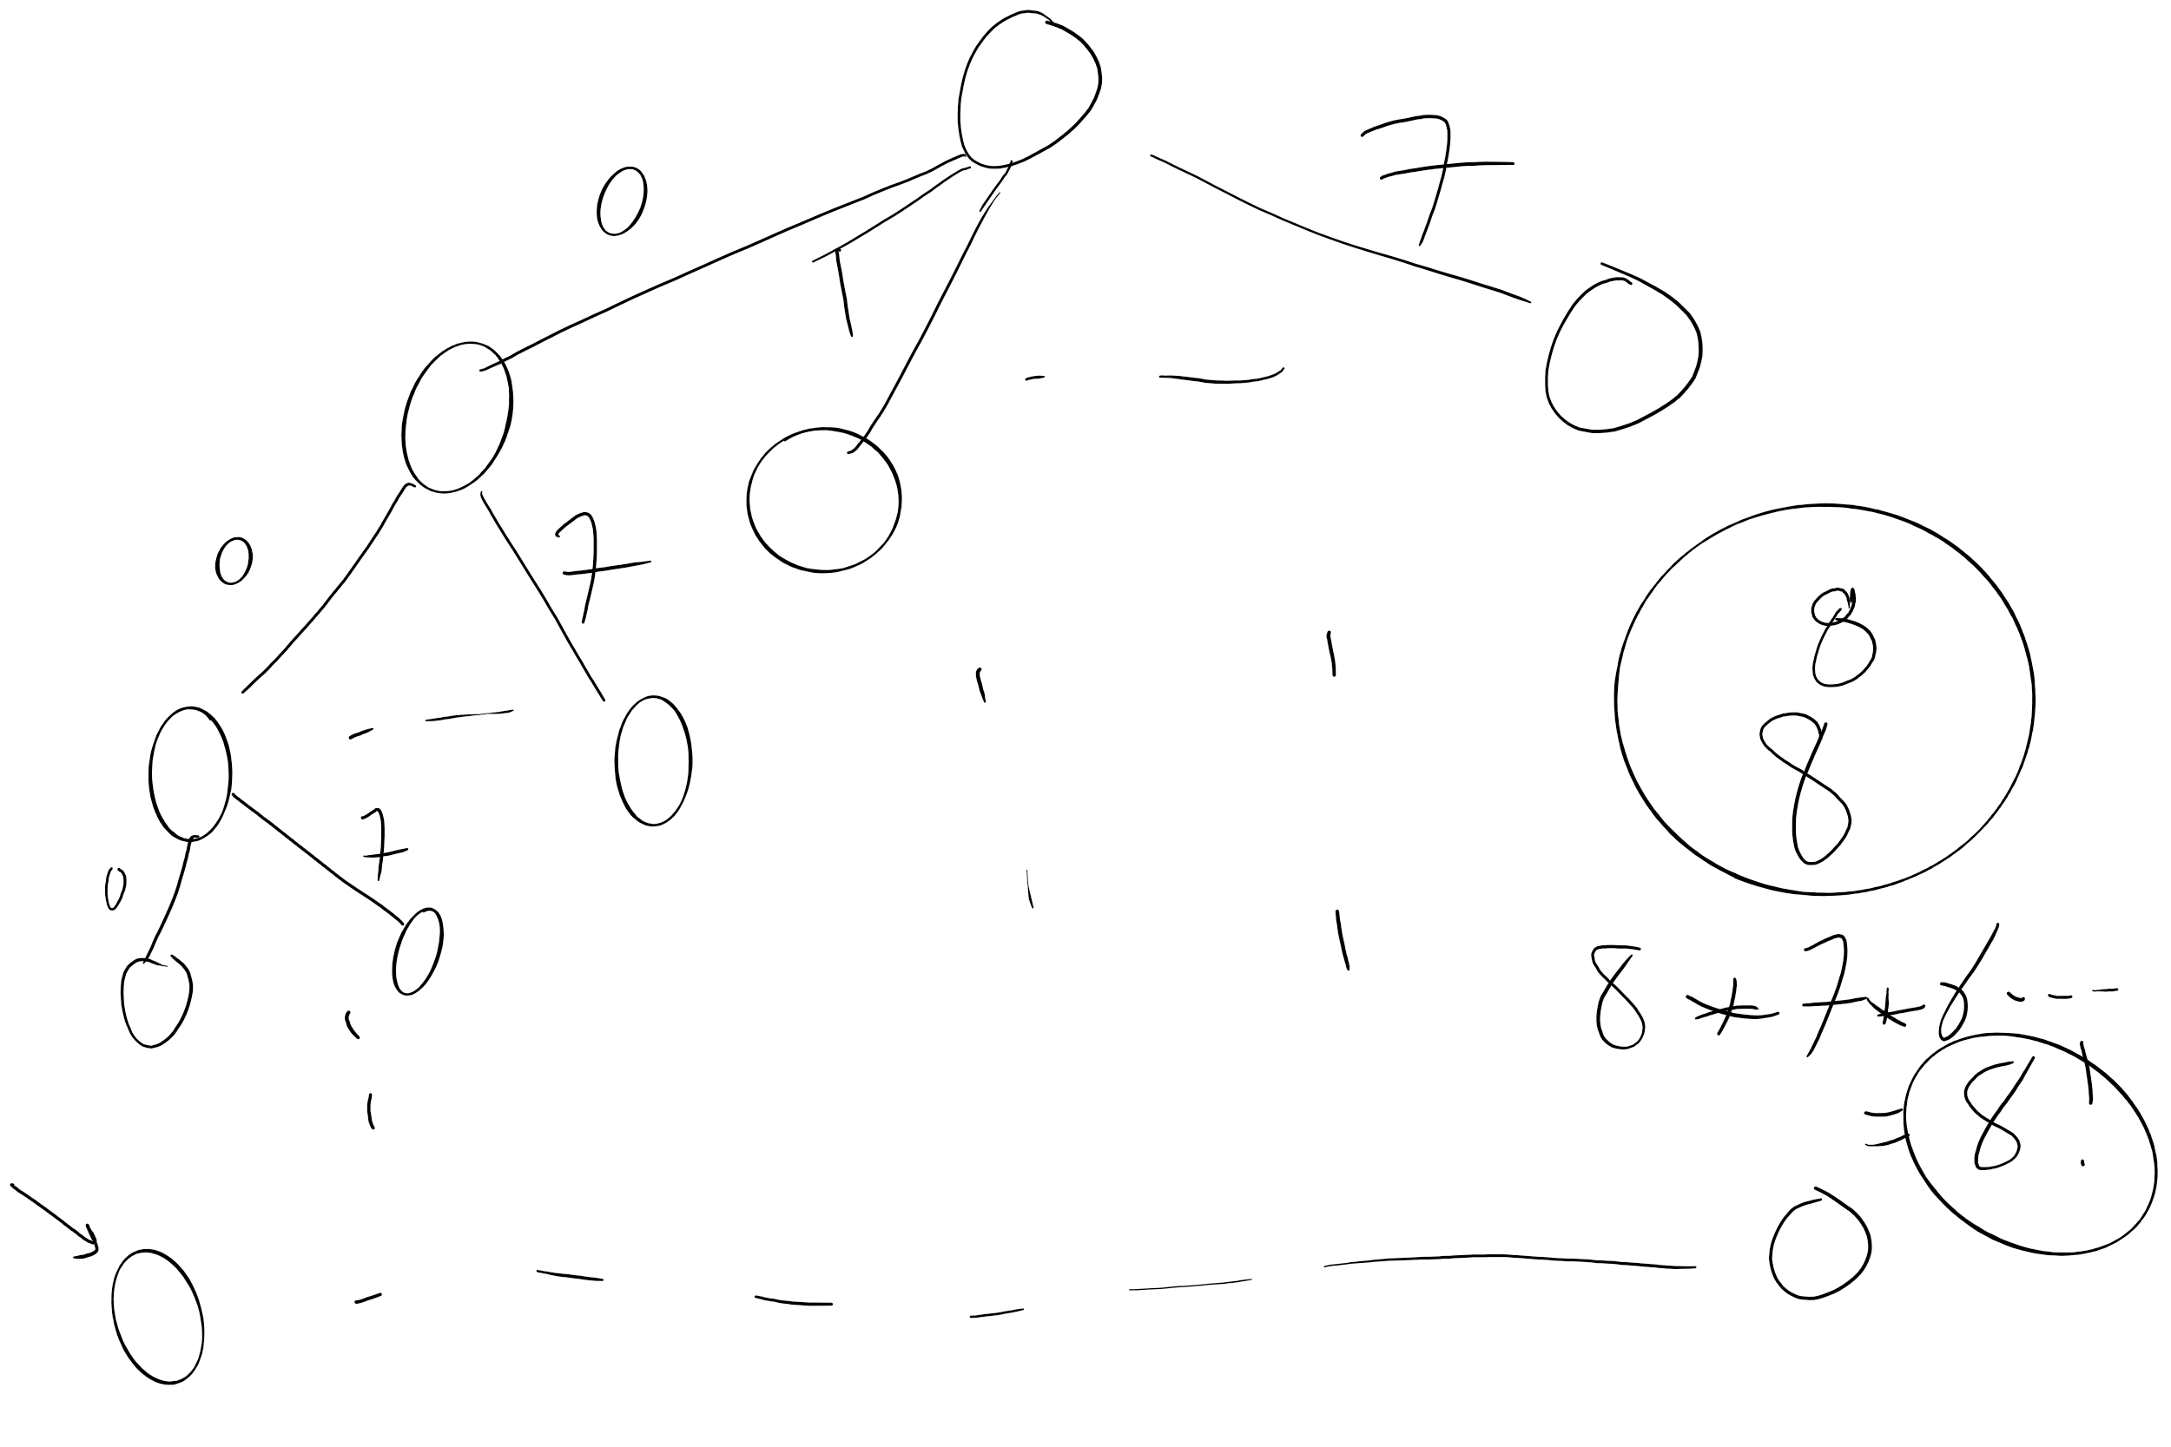
Search Space

Slide 26
8 queens problem
Solutions only have one queen per column
Still 8⁸ = 16,777,216 possible combinations
Solutions only have one queen per row
Combining these two observations, only 8! = 40,320
Looking quite feasible!
Finally, prune subtrees with queens on the same diagonal

Slide 27
Backtracking Solution to 8 Queens
Basic idea:
Recurse over columns of the board
Each recursive call iterates through the rows of the board
Check rows/diagonals
Are they currently safe?
Place a queen in the current row/col
If you are at the end of the board, you've found a solution!
Otherwise, try recursive call for the next column
If they are not currently safe
Continue to the next row in the current recursive call

Slide 28
8 Queens
8
Q
7
Q
6
Q
5
Q
4
Q
3
2
1
Q
A
B
C
D
E
F
G
H

Slide 29

Another problem: Boggle
Words at least 3 adjacent letters long must be assembled from a 4x4 grid
Adjacent letters are horizontally, vertically, or diagonally neighboring
Any cube in the grid can only be used once per word

Slide 30
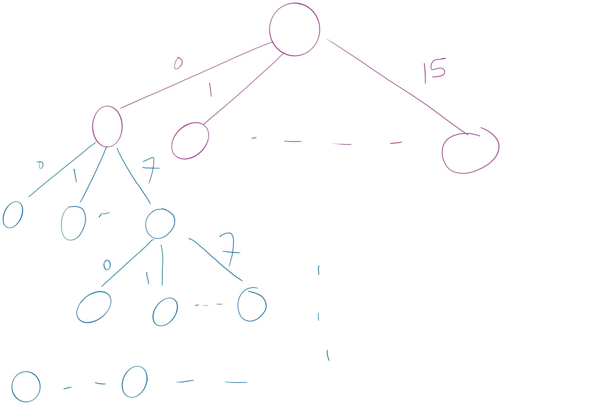
Search Space

Slide 31
Recursing through Boggle letters
Have 8 different options from each cube
From B[i][j]:
B[i-1][j-1]
B[i-1][j]
B[i-1][j+1]
B[i][j-1]
B[i][j+1]
B[i+1][j-1]
B[i+1][j]
B[i+1][j+1]
Naively, the runtime here would be 16!
= 20,922,789,888,000

Slide 32
Where do we prune?
Can’t go past the edge of the board
Can’t reuse the same cells in the board
Each letter added must lead to the prefix of an actual word
Check the dictionary for each letter recursed to, if there is no word with the currently constructed string as a prefix, backtrack
Practically, this can be used for huge savings
Notes:
Need to define pruning rules
Can’t go past the edge of the board
Can’t reuse the same cells in the board
Each letter added must lead to the prefix of an actual word
Check the dictionary for each letter recursed to, if there is no word with the currently constructed string as a prefix, backtrack
Practically, this can be used for huge savings

Slide 33
Please submit your reflections by using the CourseMIRROR App
If you are having a problem with CourseMIRROR, please send an email to coursemirror.development@gmail.com
Notes:
All right!
Upcoming Due Dates at A Glance

