Slide 1

Algorithms and Data Structures 2 CS 1501
Fall 2021
Sherif Khattab
ksm73@pitt.edu
(Slides are adapted from Dr. Ramirez’s and Dr. Farnan’s CS1501 slides.)

Slide 2
Announcements
Upcoming deadlines:
4/9: Lab 9
4/12: Homework 11
4/19: Assignment 4 (to be posted today)
5/2: Assignment 5 (to be posted today)
Tophat questions are due one week after each lecture

Slide 3
Last lecture …
Union-Find Data Structure
Kruskal’s run-time with Union-Find DS
Weighted Shortest Paths
Dijkstra’s
Ford-Fulkerson Maximum Flow “Algorithm”

Slide 4
Muddiest points
Ford Fulkerson
what exactly is “flow”? what is “flowing”?
Implementation
I got a bit confused with flow, Ford Fulkerson and residuals
how to find augmenting paths and how do bottlenecks affect the max network flow problem
Determining the next residual capacity to calculate in ford fulkerson
I think in class you said that Ford Fulkerson was a framework for working with flow. Are there other frameworks?
the rules given for flow
U/F
weighted tree & path compression implementations of U/F
Don’t really understand union find and how it related to the code
Slightly confused about how many different ways of implementing union find there are and which is the best.
dijkstra's
could we go through another example of dijkstras algorithm, got confused when updating distance and via
implementation
Can you build a flow chart illustrating the gradual optimization of Prim & Kruskal's & DijKstra's algorithm

Slide 5
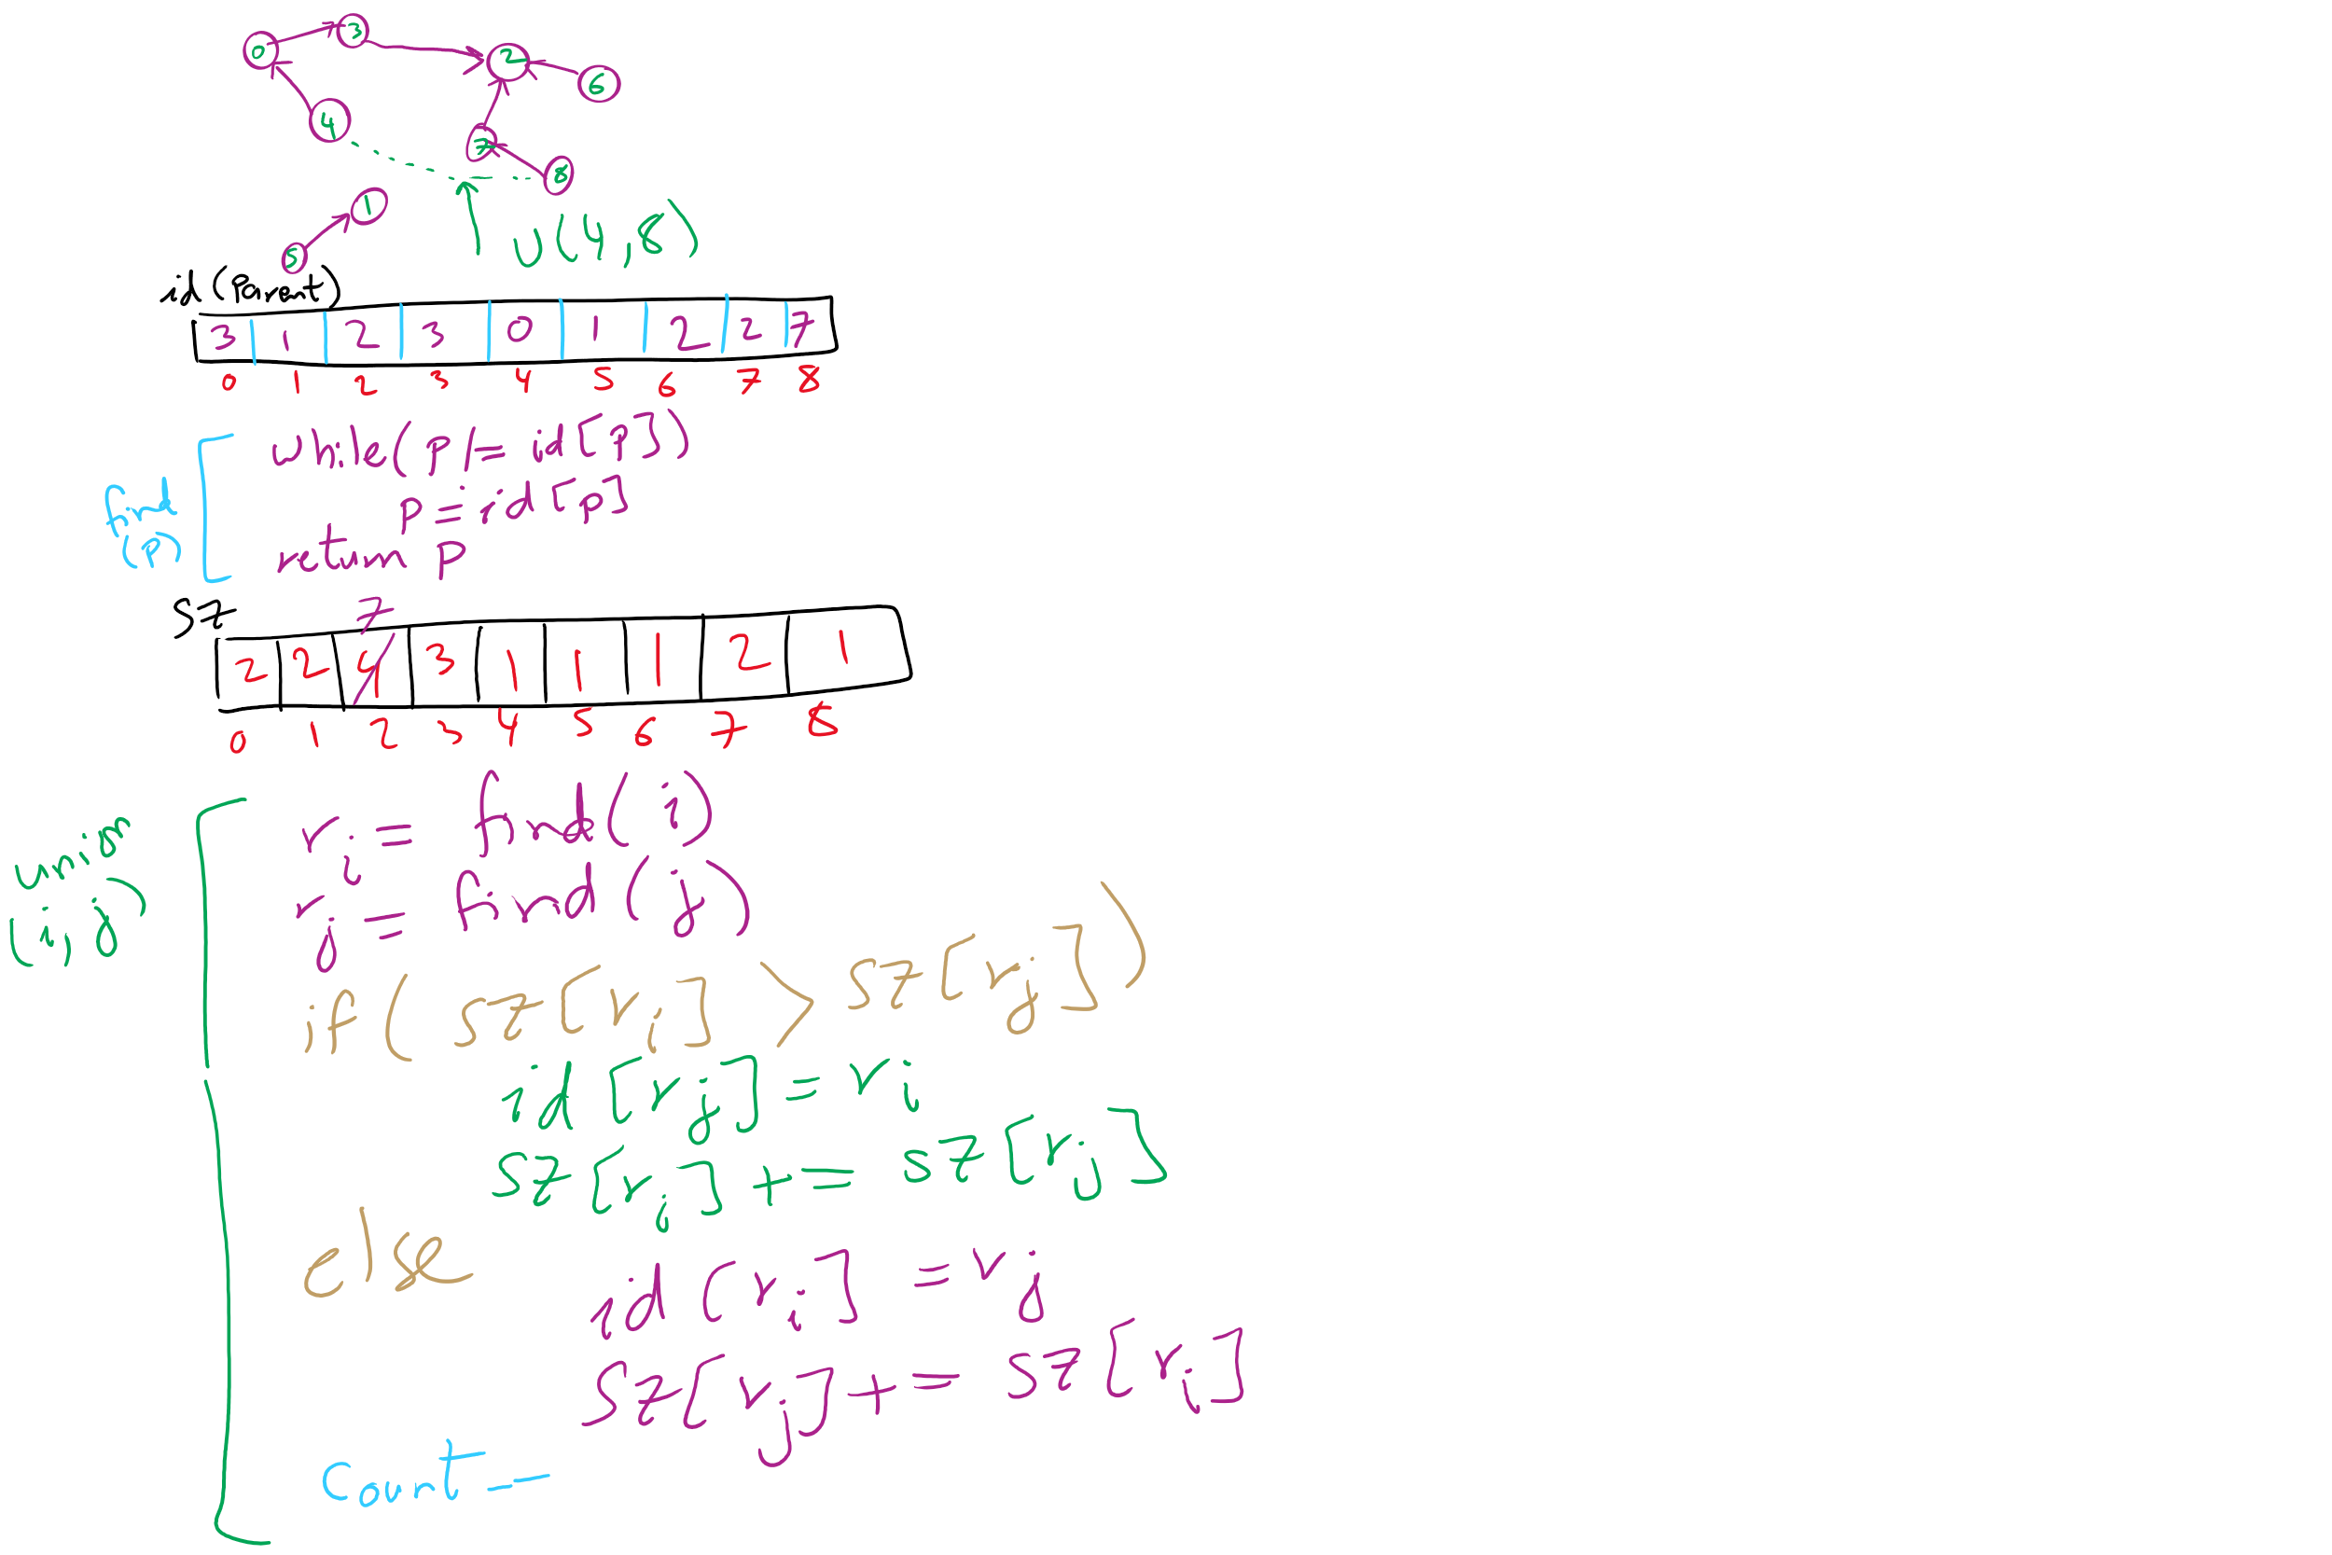
Weighted Trees Union-Find Example

Slide 6
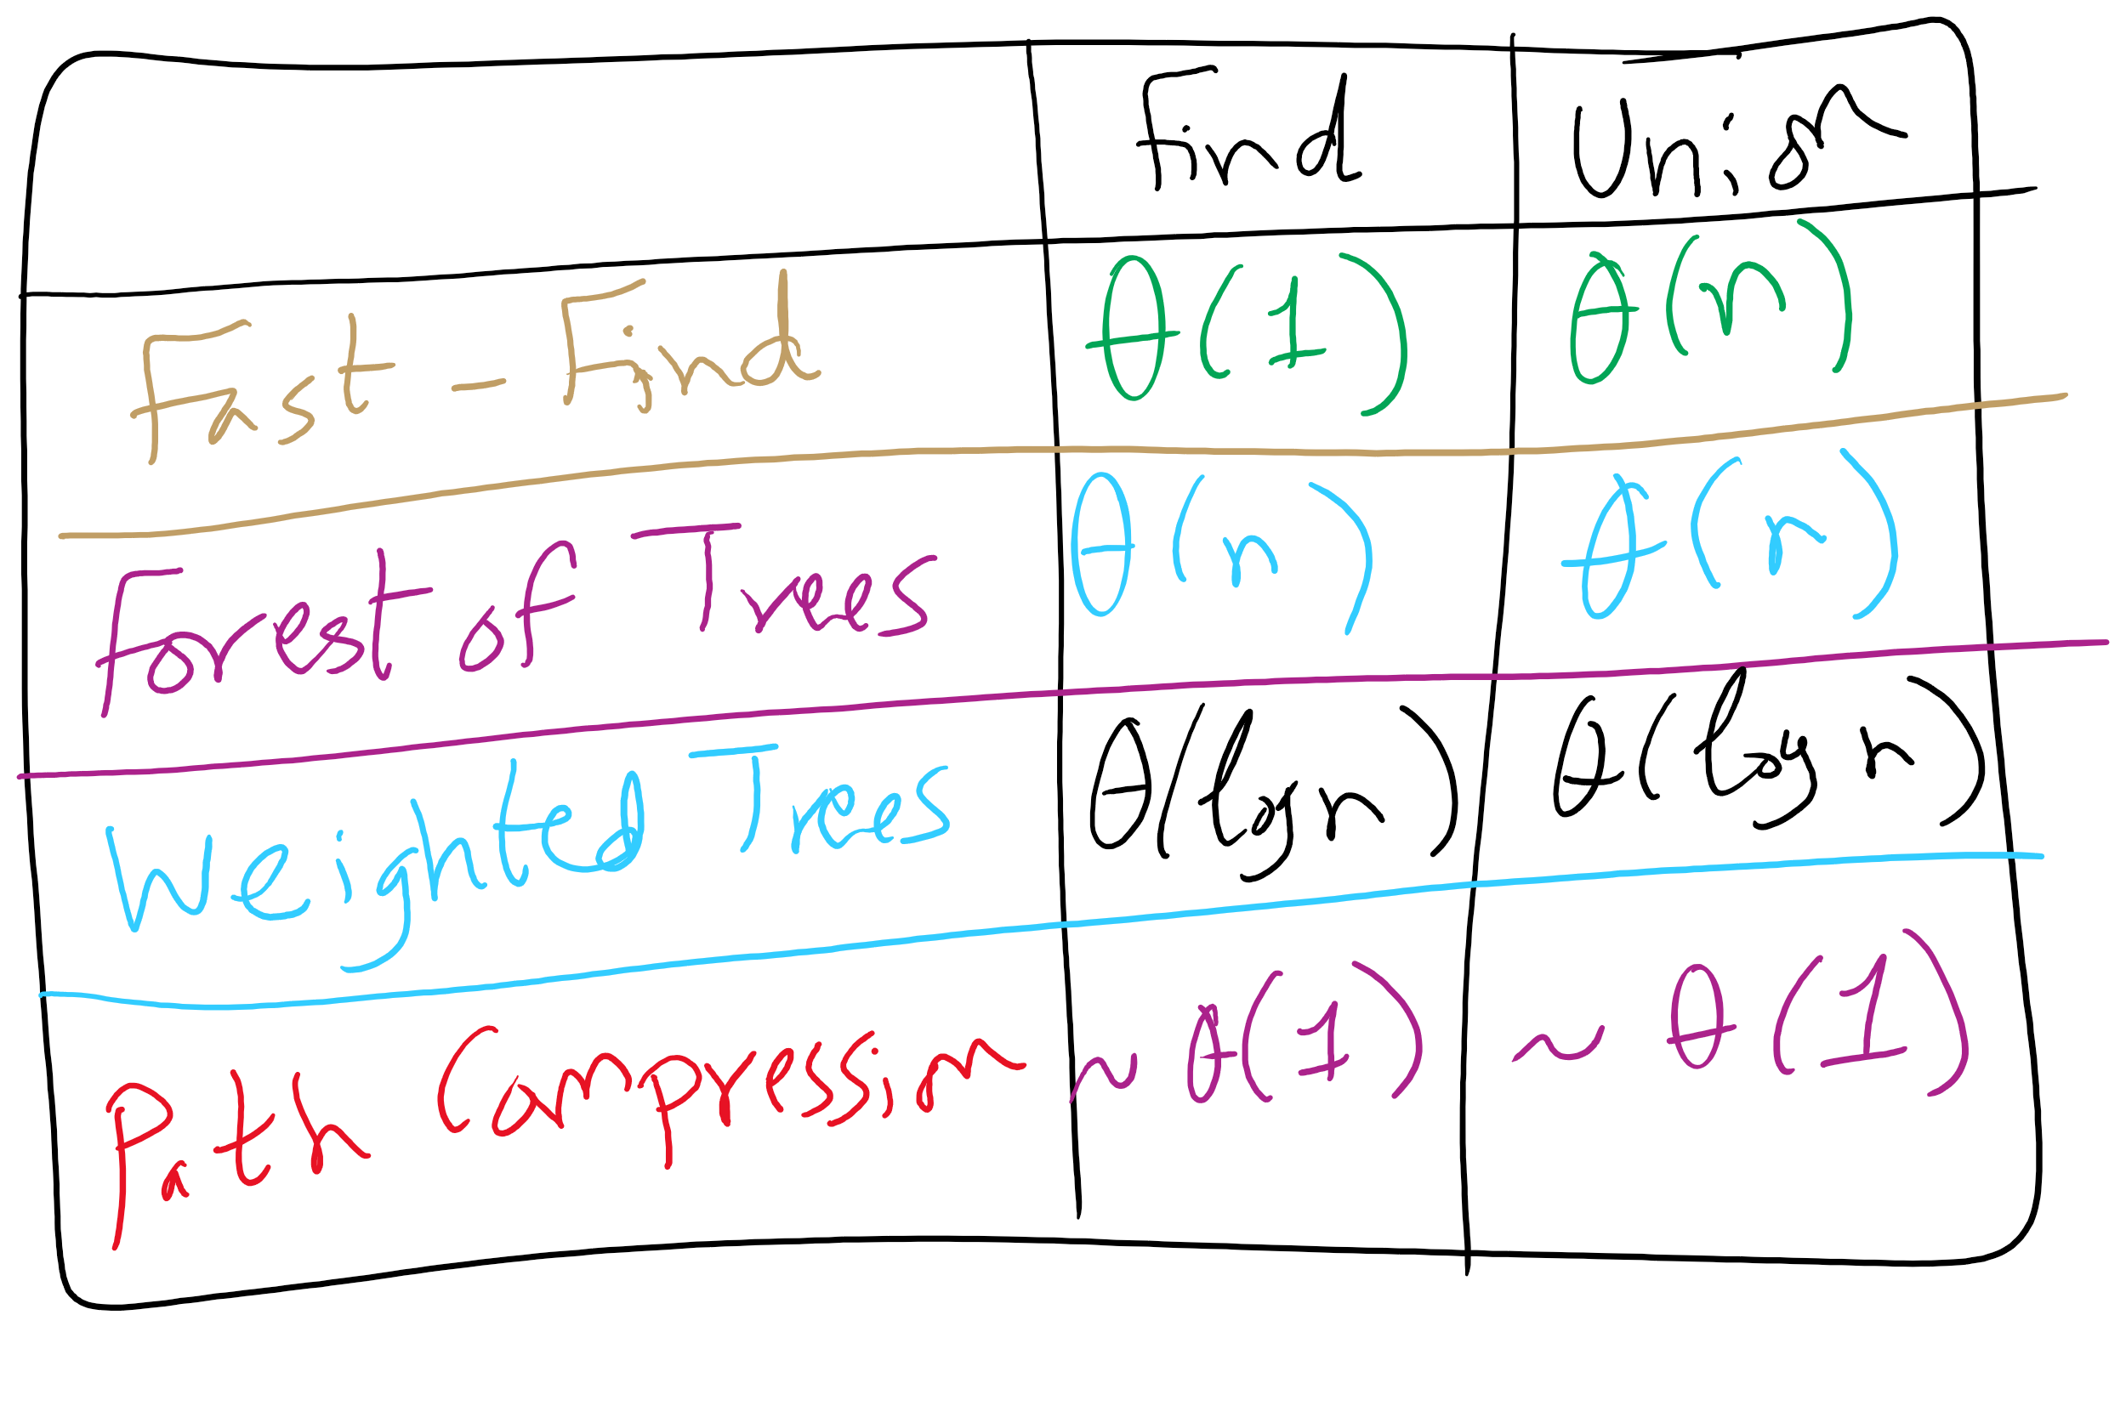
Union-Find Implementations

Slide 7
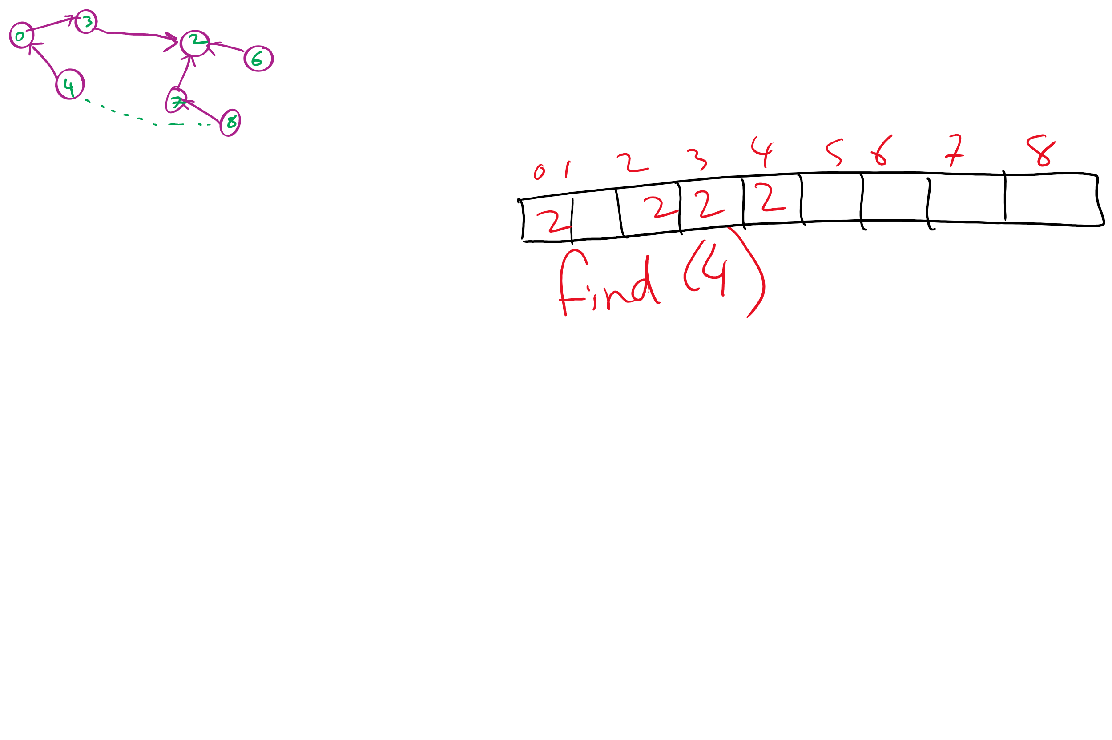
Path Compression Example

Slide 8
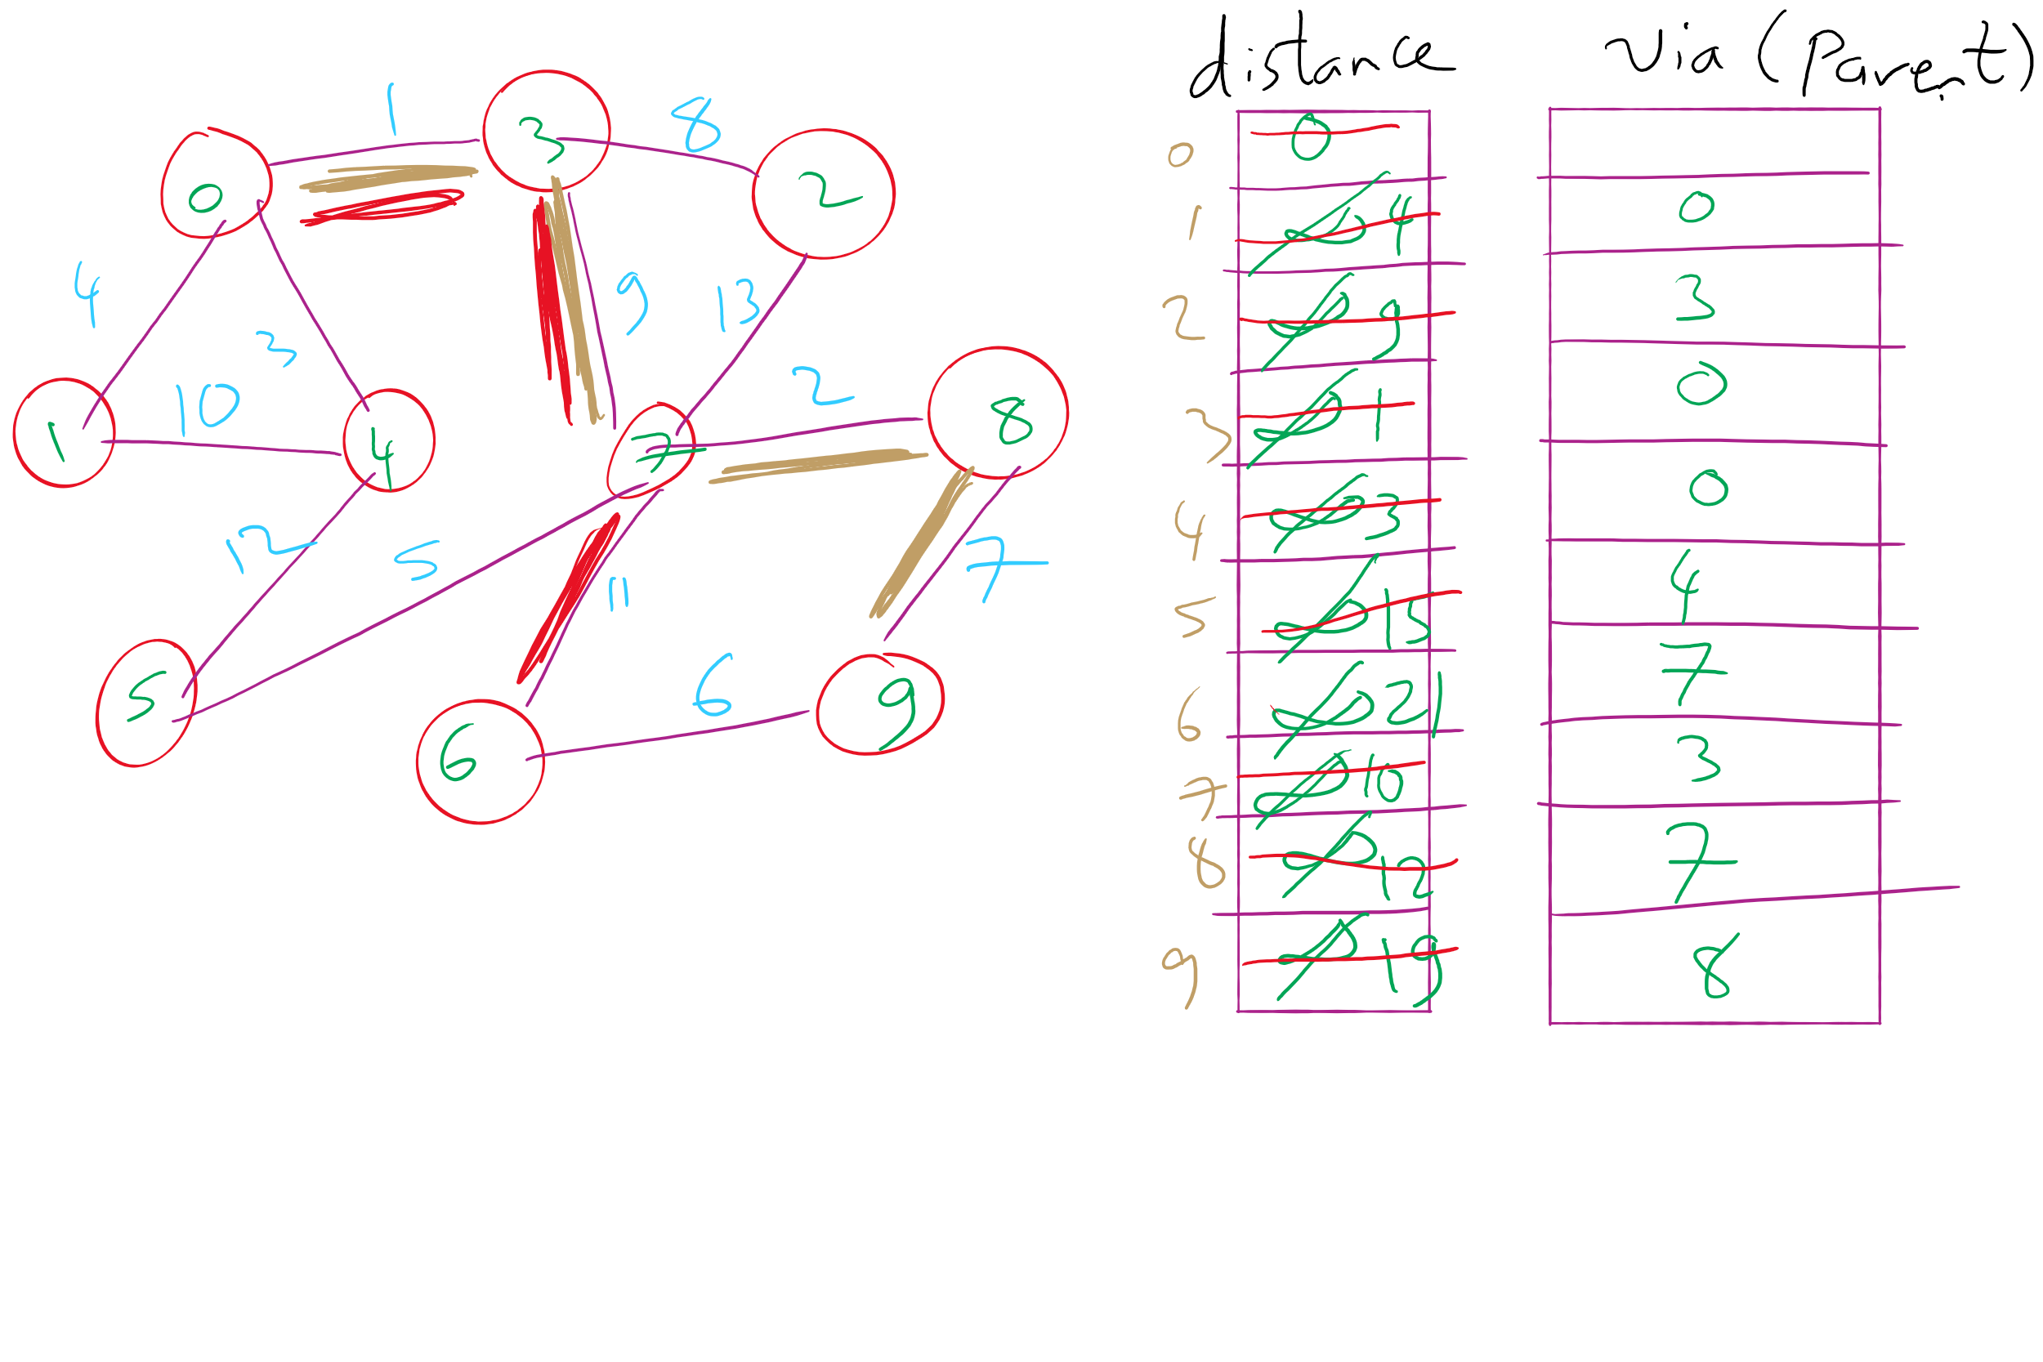
Dijkstra’s Shortest Paths Example 1

Slide 9
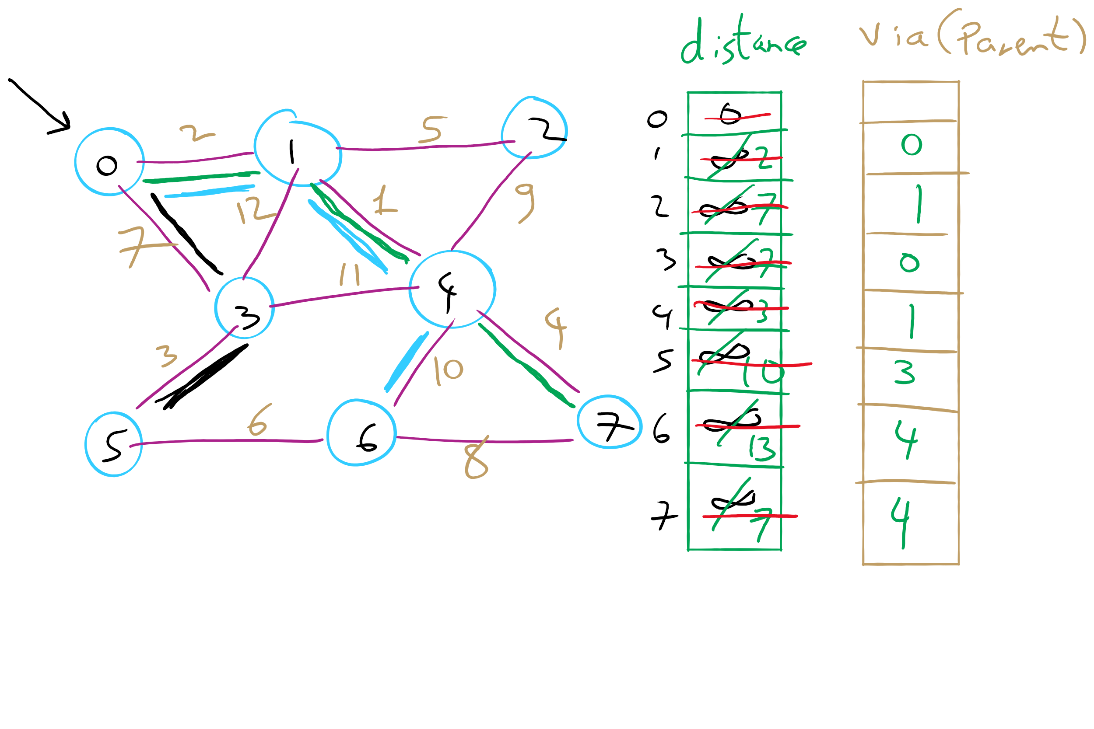
Dijkstra’s Shortest Paths Example 2

Slide 10
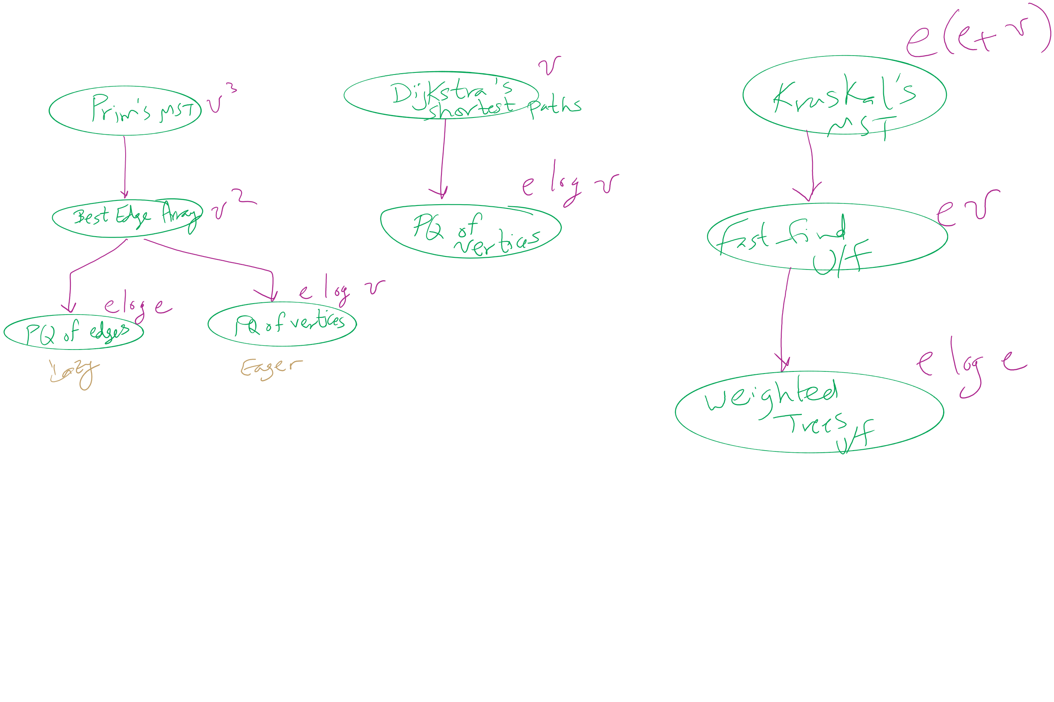
Algorithm Optimizations

Slide 11
This Lecture
Backwards Edges
Edmonds Karp
Priority-First Search
Min Cut

Slide 12
Another Ford Fulkerson example
/5
s
/10
A
B
t
10
/10
10
/10
10
/5
Notes:
Are we screwed?

Slide 13
Expanding on residual capacity
To find the max flow we will have to consider re-routing flow we had previously allocated
This means, when finding an augmenting path, we will need to look not only at the edges of G, but also at backwards edges that allow such re-routing
For each edge (u, w) ∈ E, a backwards edge (w, u) must be considered during pathfinding if f(u, w) > 0
The capacity of a backwards edge (w, u) is equal to f(u, w)

Slide 14
The residual graph
We will perform searches for an augmenting path not on G, but on a residual graph built using the current state of flow allocation on G
The residual graph is made up of:
V
An edge for each (u, w) ∈ E where f(u, w) < c(u, w)
(u, w)'s mirror in the residual graph will have 0 flow and a capacity of c(u, w) - f(u, w)
A backwards edge for each (u, w) ∈ E where f(u, w) > 0
(u, w)'s backwards edge has a capacity of f(u, w)
All backwards edges have 0 flow

Slide 15
Residual graph example
/5
0
5
/5
s
/10
A
B
t
10
/10
10
/10
5
10
/10
0
/10
/ 5
0
/10
0
/5
5
/5
0

Slide 16
Another example
A
1
1
2
/1000
/1000
s
/1
t
1
0
1
2
/1000
1
/1000
B
Notes:
sABt
sBAt
sABt
…
runtime is bound to the max flow of the graph!

Slide 17
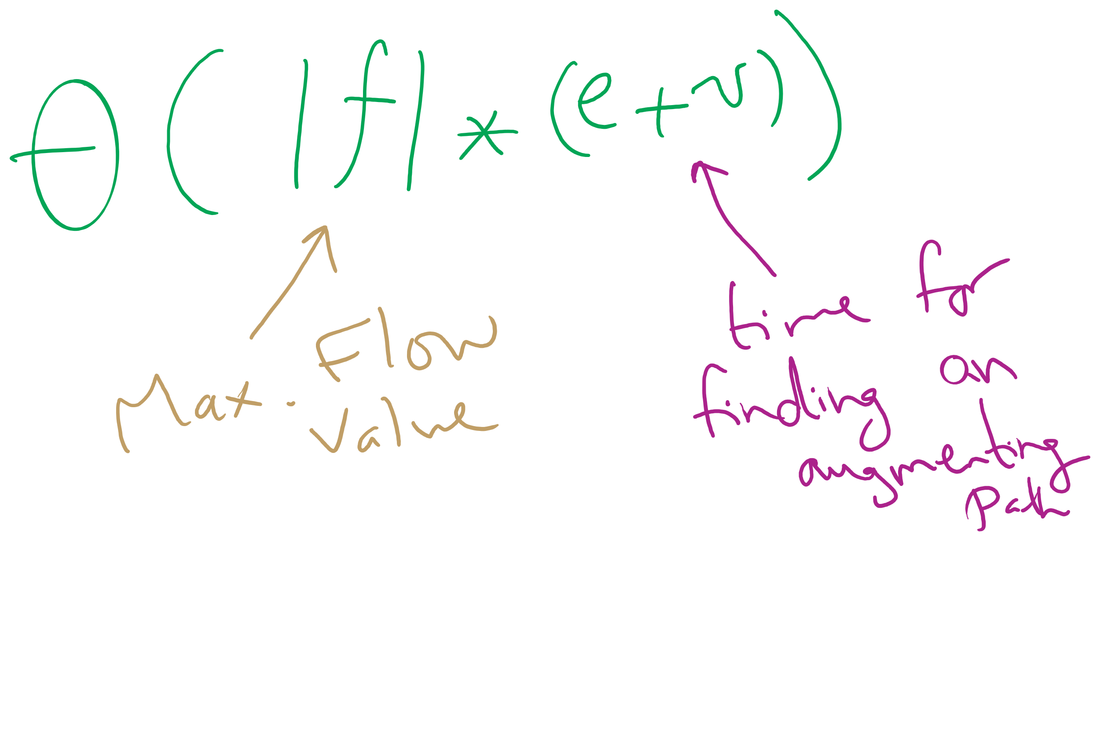
Worst-case Runtime of Ford-Fulkerson

Slide 18
Edmonds Karp
How the augmenting path is chosen affects the performance of the search for max flow
Edmonds and Karp proposed a shortest path heuristic for Ford Fulkerson
Use BFS to find augmenting paths
Notes:
note that FF is an "algorithm" because path finding details are not defined

Slide 19
Another example
A
1000
/1000
/1000
1000
s
/1
t
/1000
1000
/1000
1000
B
Notes:
Use BFS to find paths, and its all good

Slide 20
But our flow graph is weighted...
Edmonds-Karp only uses BFS
Used to find spanning trees and shortest paths for unweighted graphs
Why do we not use some measure of priority to find augmenting paths?
Notes:
We could…
Book discusses a modified version of Dijkstra's
Advantages?
Disadvantages?
Which is the best?
Currently unknown, but Edmonds-Karp is pg

