Slide 1

Algorithms and Data Structures 2 CS 1501
Fall 2021
Sherif Khattab
ksm73@pitt.edu
(Slides are adapted from Dr. Ramirez’s and Dr. Farnan’s CS1501 slides.)

Slide 2
Announcements
Homework 2, Lab 1, Assignment 1, and Tophat questions were posted
Slack channel(s) for student-to-student communications
Code handouts

Slide 3
Last lecture …
Backtracking
Outline
Pruning
Examples

Slide 4
Muddiest points
Code implementation
Boggle question

Slide 5
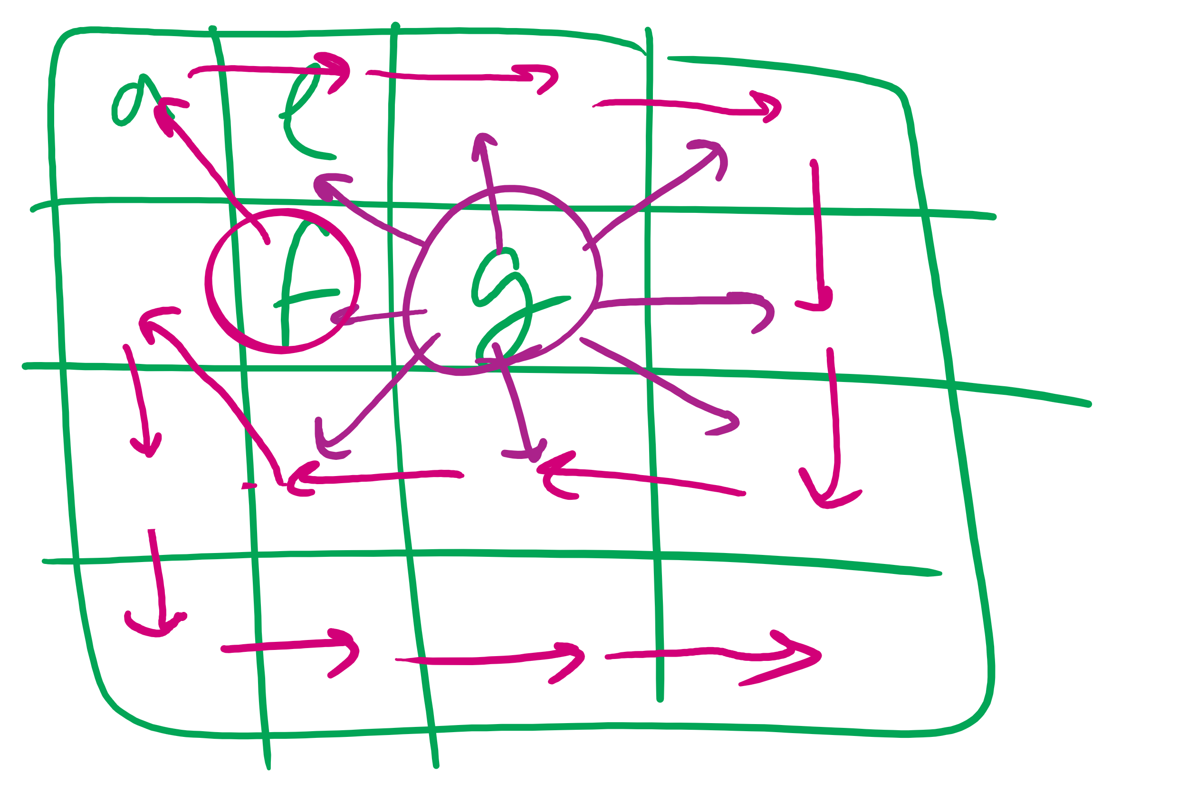
Boggle Question

Slide 6
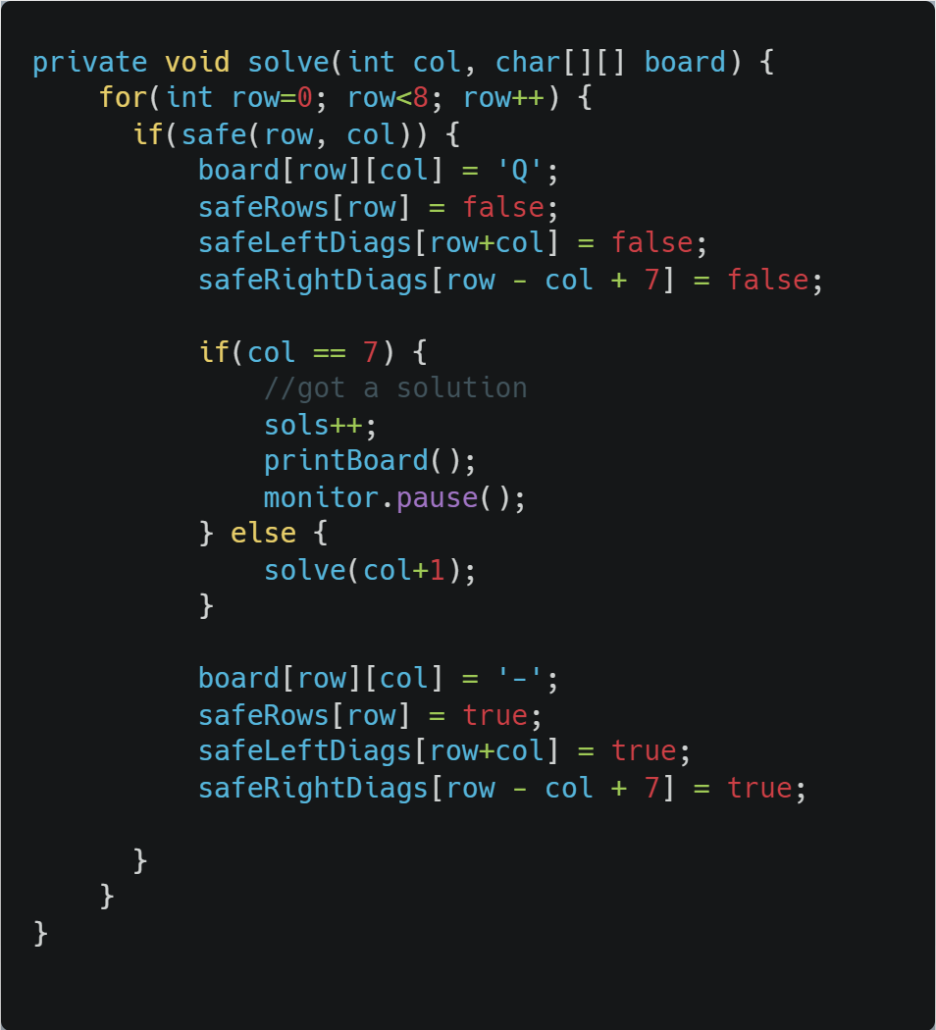
Eight Queens

Slide 7
This Lecture
Implementation issue in Boggle
Tree ADT

Slide 8
Implementation concerns with Boggle
Constructing the words over the course of recursion will mean building up and tearing down strings
Moving forward adds a new character to the current word string
Backtracking removes the most recent character
Basically pushing/popping to/from a string stack
Push/Pop stack operations are generally Θ(1)
Unless you need to resize, but that cost can be amortized
Java Strings, however, are immutable
s = new String(“Here is a basic string”);
s = s + “ this operation allocates and initializes all over again”;
Becomes essentially a Θ(n) operation
Where n is the length of the string

Slide 9
StringBuilder to the rescue
append() and deleteCharAt() can be used to push and pop
Back to Θ(1)!
Still need to account for resizing, though…
StringBuffer can also be used for this purpose
Differences?
Notes:
StringBuffer is synchronized
StringBuilder is not

Slide 10
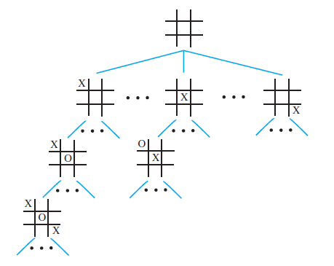
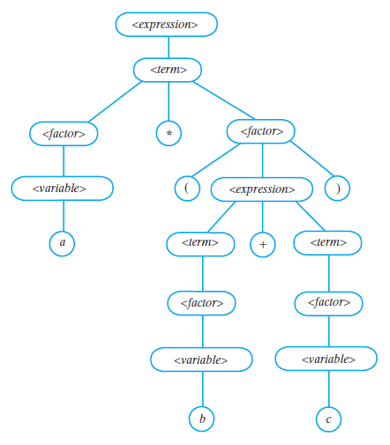
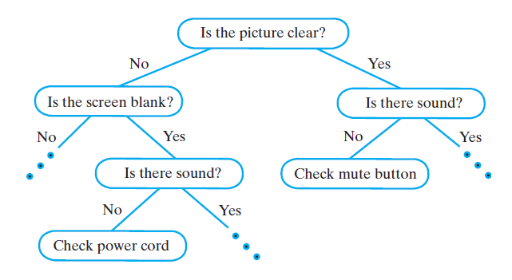
Examples of Trees
Game Tree
Parse Tree
Decision Tree

Slide 11
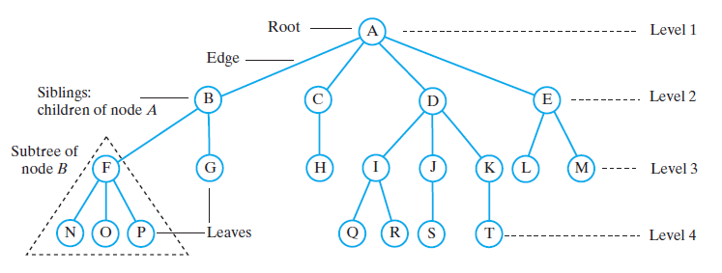
Tree Terminology

Slide 12
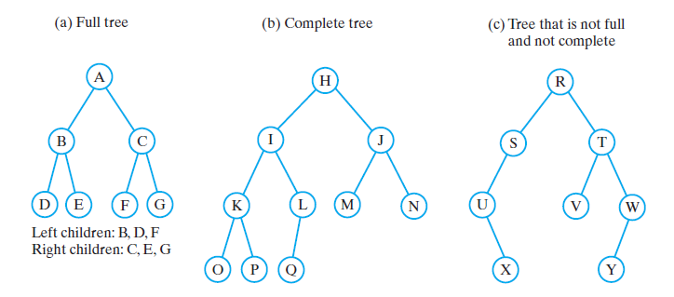
Binary Trees

Slide 13
Traversals of a Binary Tree
Preorder traversal
Visit root before we visit root’s subtrees
Inorder traversal
Visit root of a binary tree between visiting nodes in root’s subtrees.
Postorder traversal
Visit root of a binary tree after visiting nodes in root’s subtrees
Level-order traversal
Begin at root and visit nodes one level at a time

Slide 14
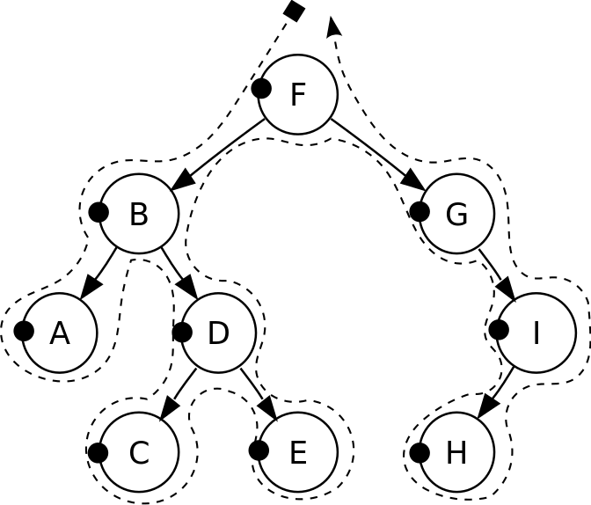
Pre-order traversal
Notes:
F, B, A, D, C, E, G, I, H
Seen before when we talked about marshalling huffman tries to the compressed file
Good for evaluating Polish notation

Slide 15
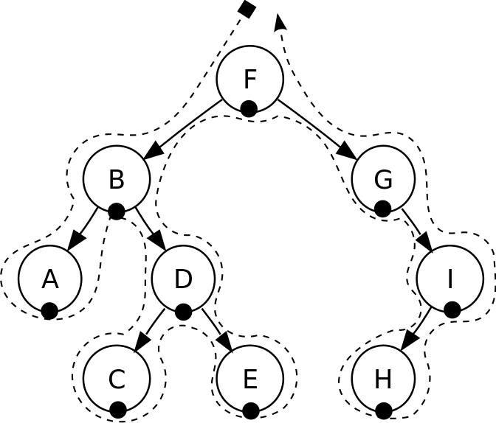
In-order traversal
Notes:
A, B, C, D, E, F, G, H, I
Seen when we wanted to enumerate all values stored in a B-tree (motivating the need for a B+tree)
Good for sorted ordering (if dealing with sorted data structure)

Slide 16
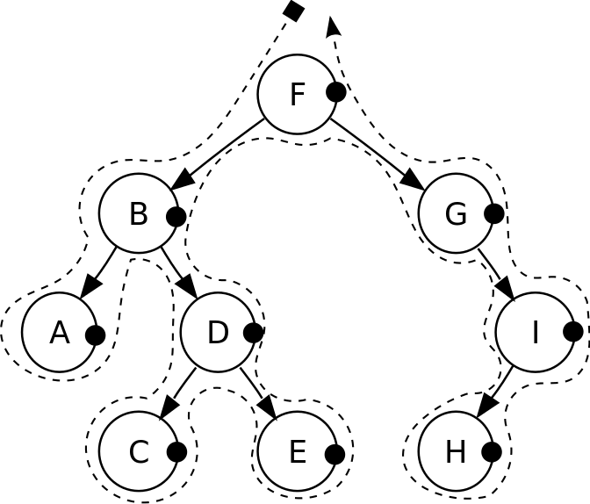
Post-order traversal
Notes:
A, C, E, D, B, H, I, G, F
Good for reverse Polish notation

Slide 17
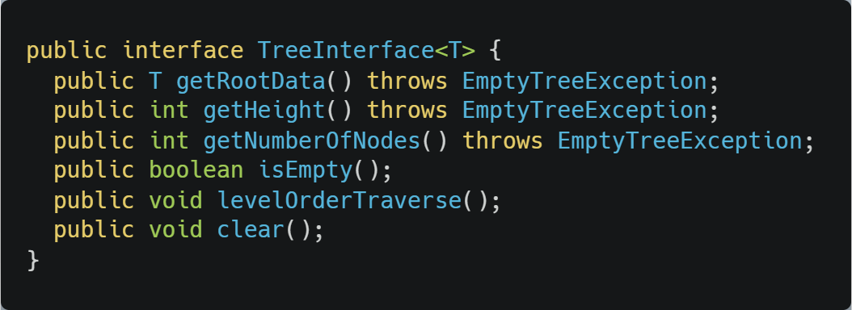
Tree Interface

