Slide 1

Algorithms and Data Structures 2 CS 1501
Fall 2021
Sherif Khattab
ksm73@pitt.edu
(Slides are adapted from Dr. Ramirez’s and Dr. Farnan’s CS1501 slides.)

Slide 2
Announcements
Upcoming deadlines:
2/12: Homework 3
2/19: Assignment 1
Tophat questions are due one week after each lecture
3-day balance of free extension days on homework assignments and labs
Career fair reminder

Slide 3
Last lecture …
BinaryTree (continued)
privateBuildTree and its cases
BinarySearchTree
SearchTreeInterface
Search, add, delete (to be completed today)

Slide 4
Muddiest points
BinaryTree
special cases in privateBuildTrer
the first special case when the root is pointing to the same object.
BinarySearchTree remove
removeFromRoot
cases
envelope
What happens to the grandchildren nodes in removing a node
balancing tree after deletion
how a node can be set to the grandparent's child
If we always find the largest node and remove it, how can we remove not largest node like node 10 in the example?
removing entry, why would you replace node with left child
BinarySearchTree
search
add
Adding nodes in a binary treat using a search helper method
adding to BST when the new node wouldn't be a leaf
beginning of lecture with all the arrows and boxes... so much info lol
can you go over command line arguments and how to read them in?

Slide 5
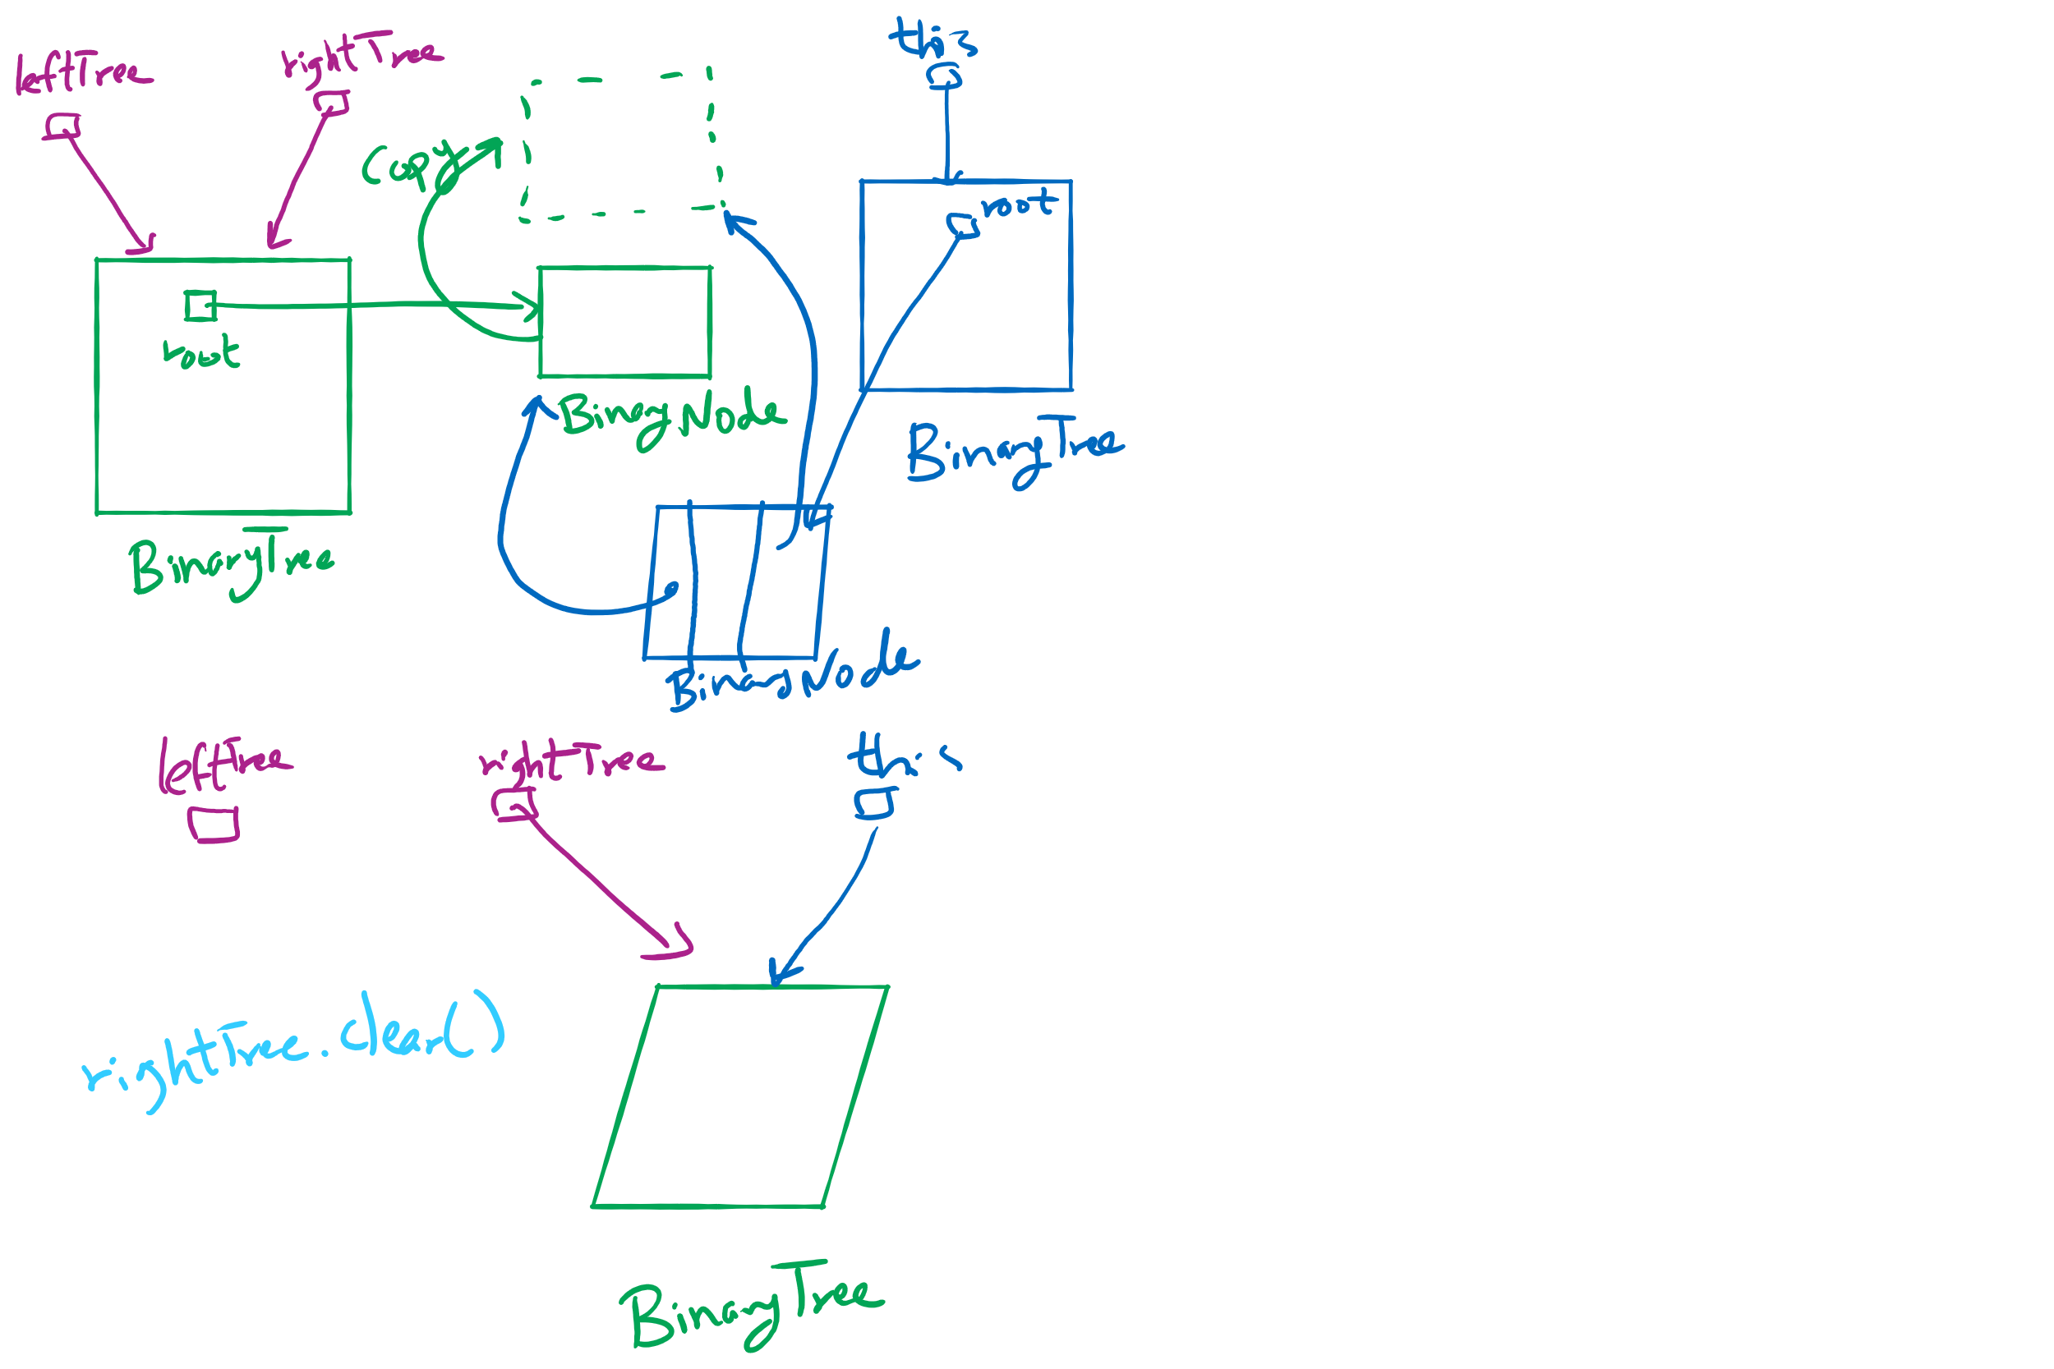
privateBuildTree Special Cases

Slide 6
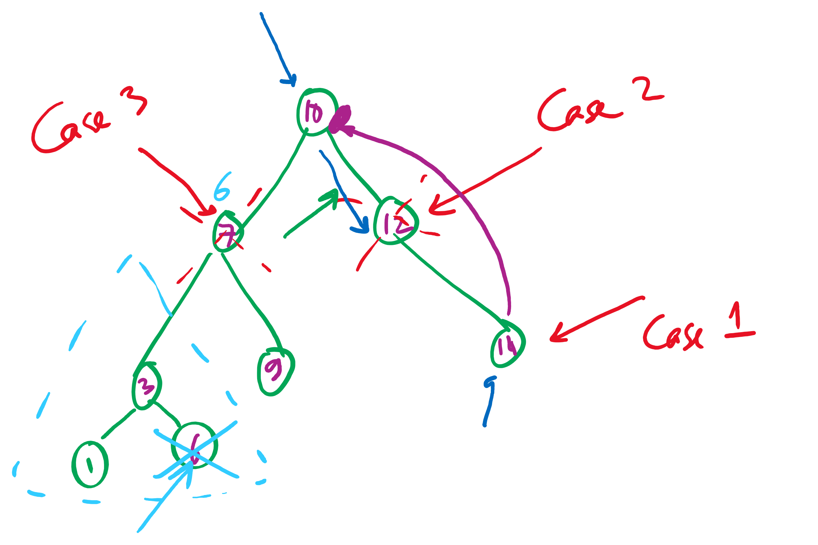
3 cases of deleting from a BST

Slide 7
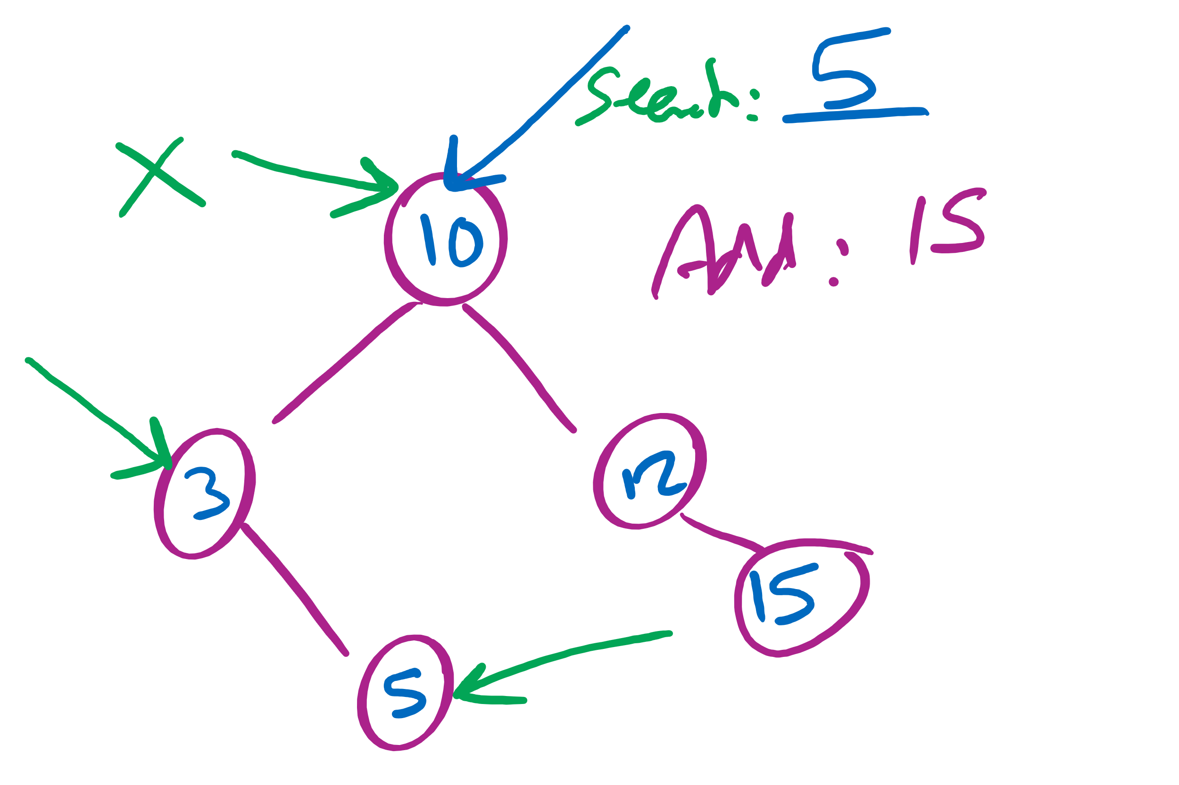
Searching in and insertion to a BST

Slide 8
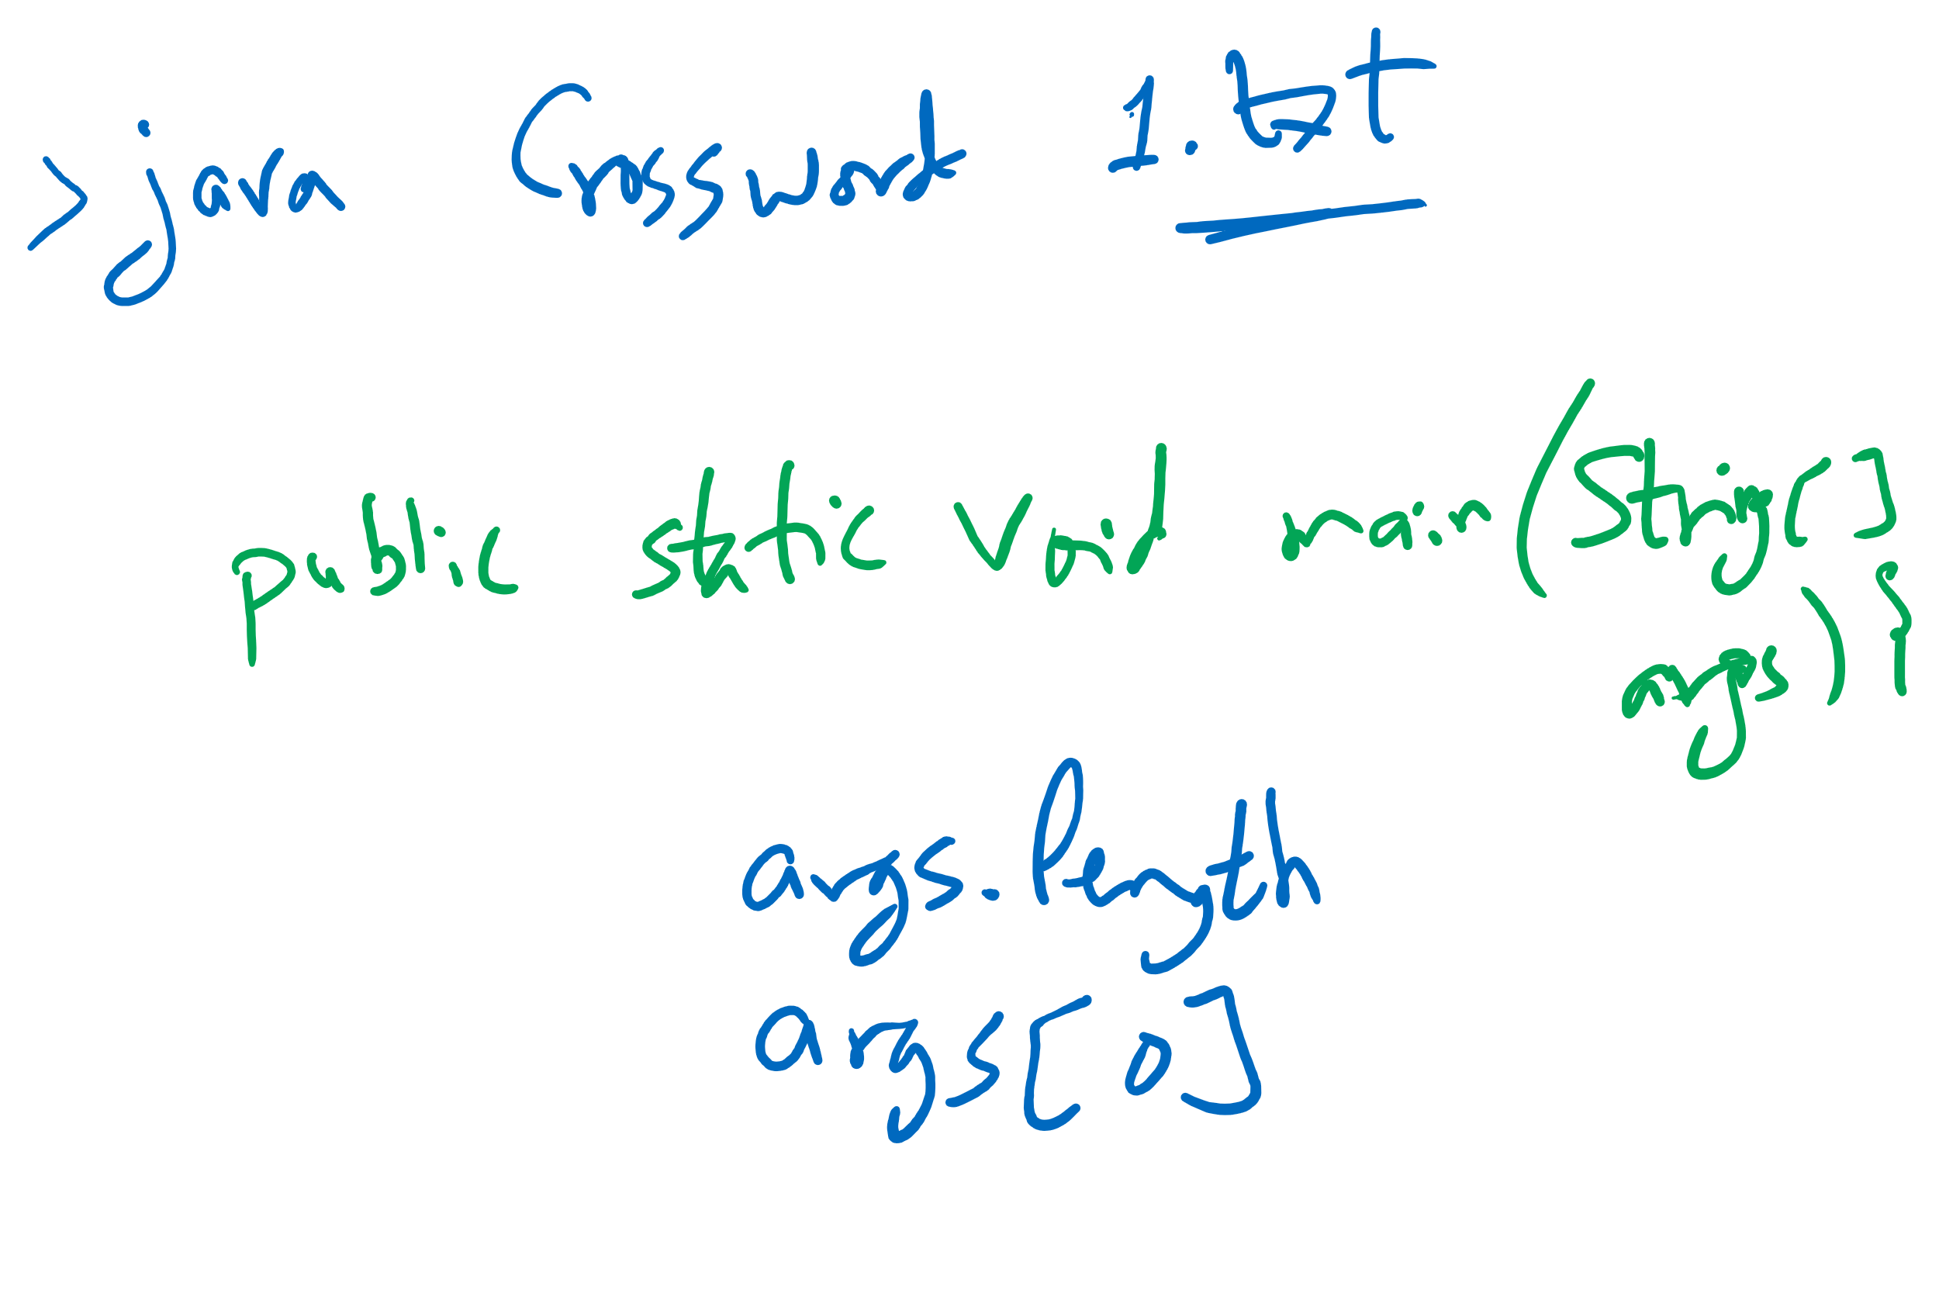
Java command-line arguments

Slide 9
This Lecture
BinarySearchTree (BST)
delete (continued)
Run-time of search, add, and delete
Order operations overview
rank, select, range query
Red-Black BST (Balanced BST)
definition and basic operations
run-time of search, add, and delete
add
delete overview

Slide 10
Code Walkthrough
Available online at:
https://cs1501-2214.github.io/handouts/TreeADT/Slides/
The slides are under the TreeADT/slides folder in the handout repository
https://github.com/cs1501-2214/handouts

Slide 11
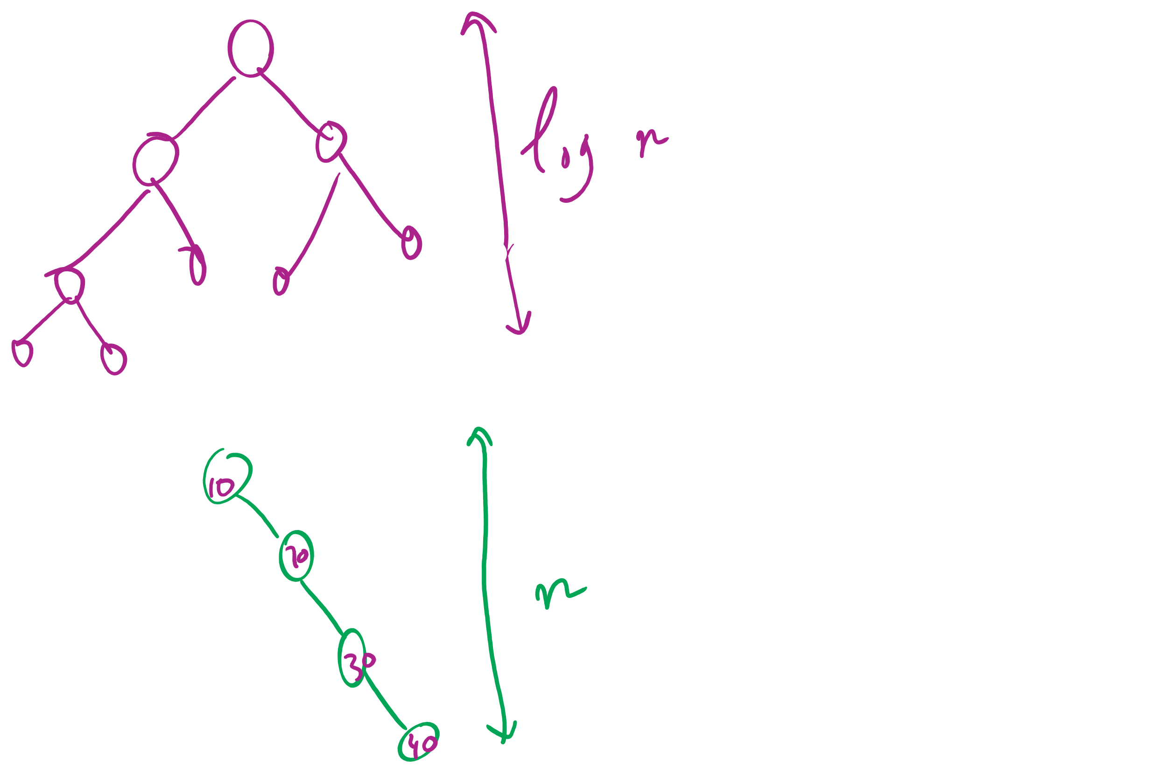
BSTs with varying heights

Slide 12
Red-Black BST
Definition
two colors for links (nodes)
red links are always to the left children
at most one red-link per node
all black-link paths are the same
root node is always black
Why?
maximum height = 2*log n !!
Basic operations
rotate left
rotate right
flip color
preserve the properties of the red-black BST!

Slide 13
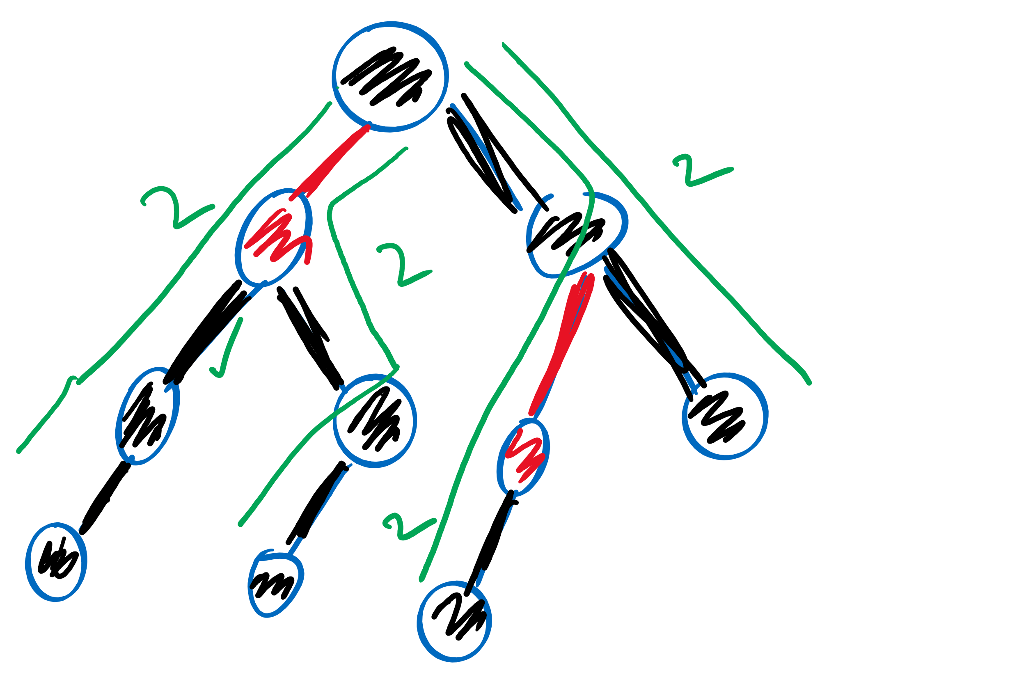
Red-black BST example

Slide 14
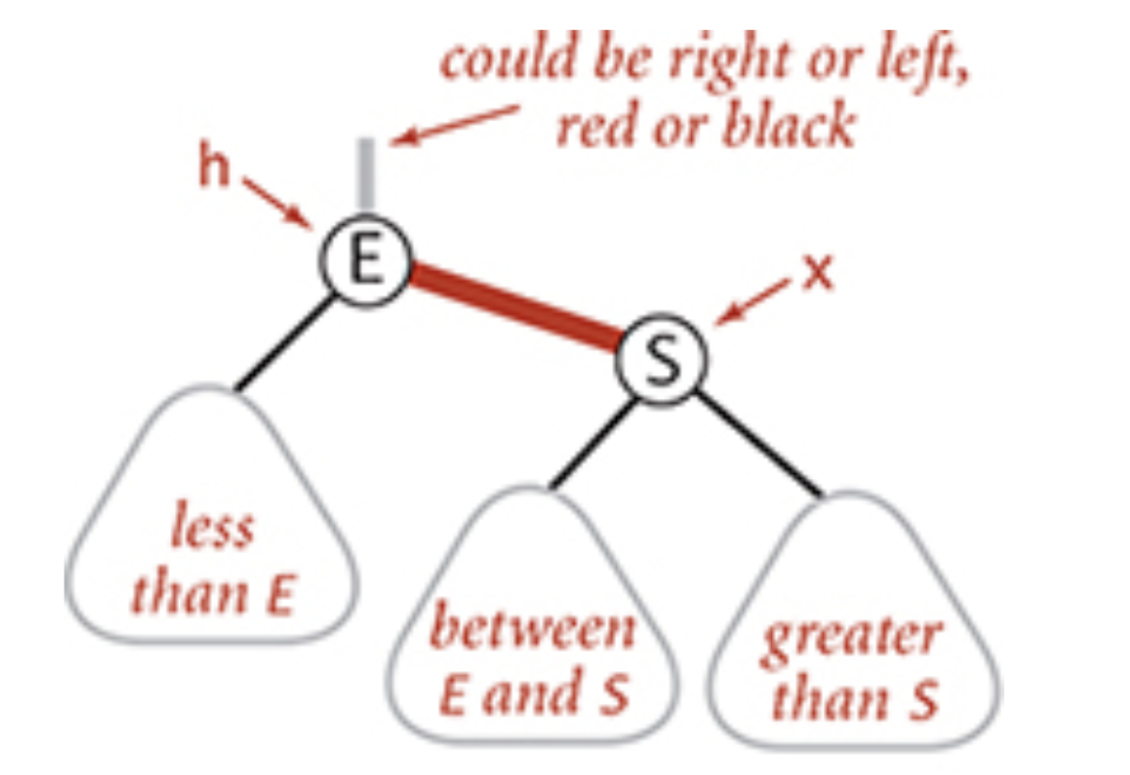
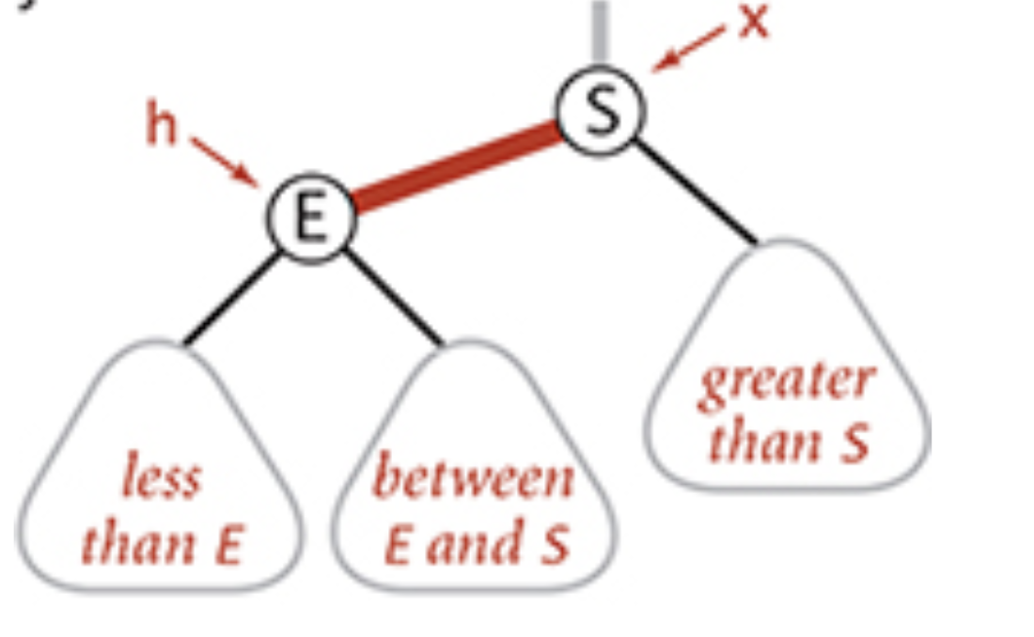
rotateLeft

Slide 15
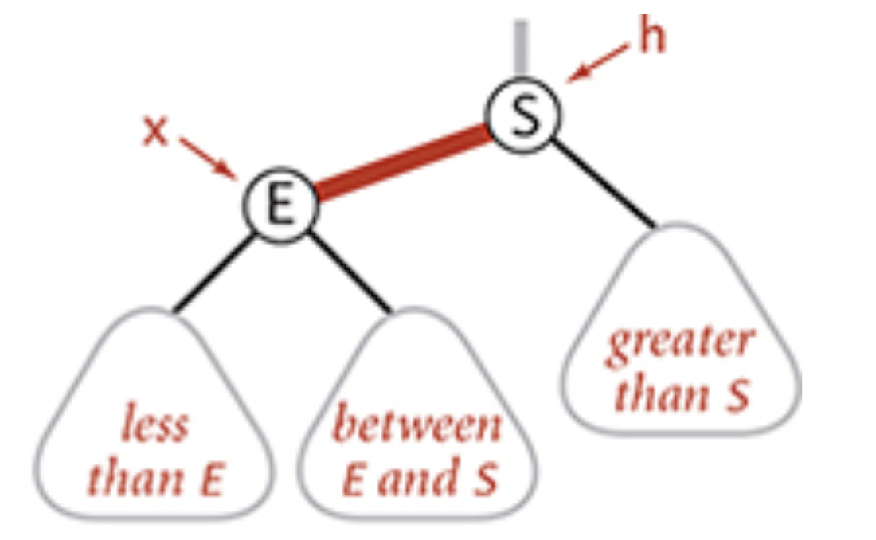
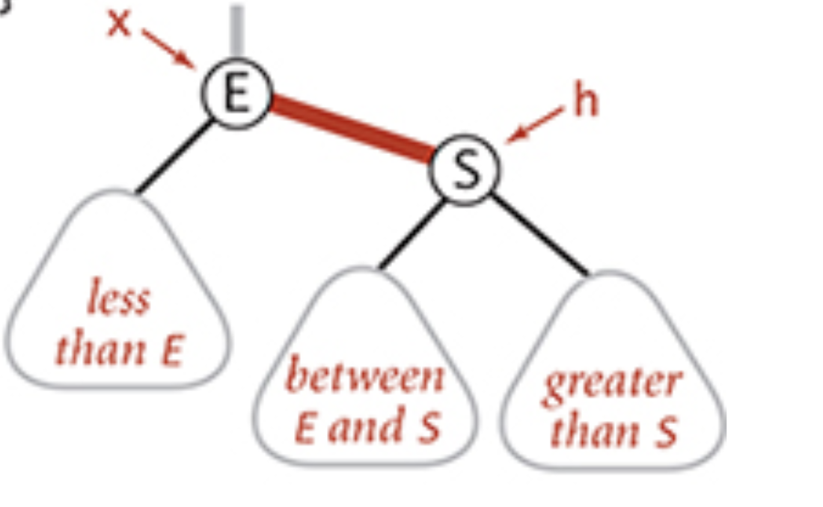
rotateRight

Slide 16
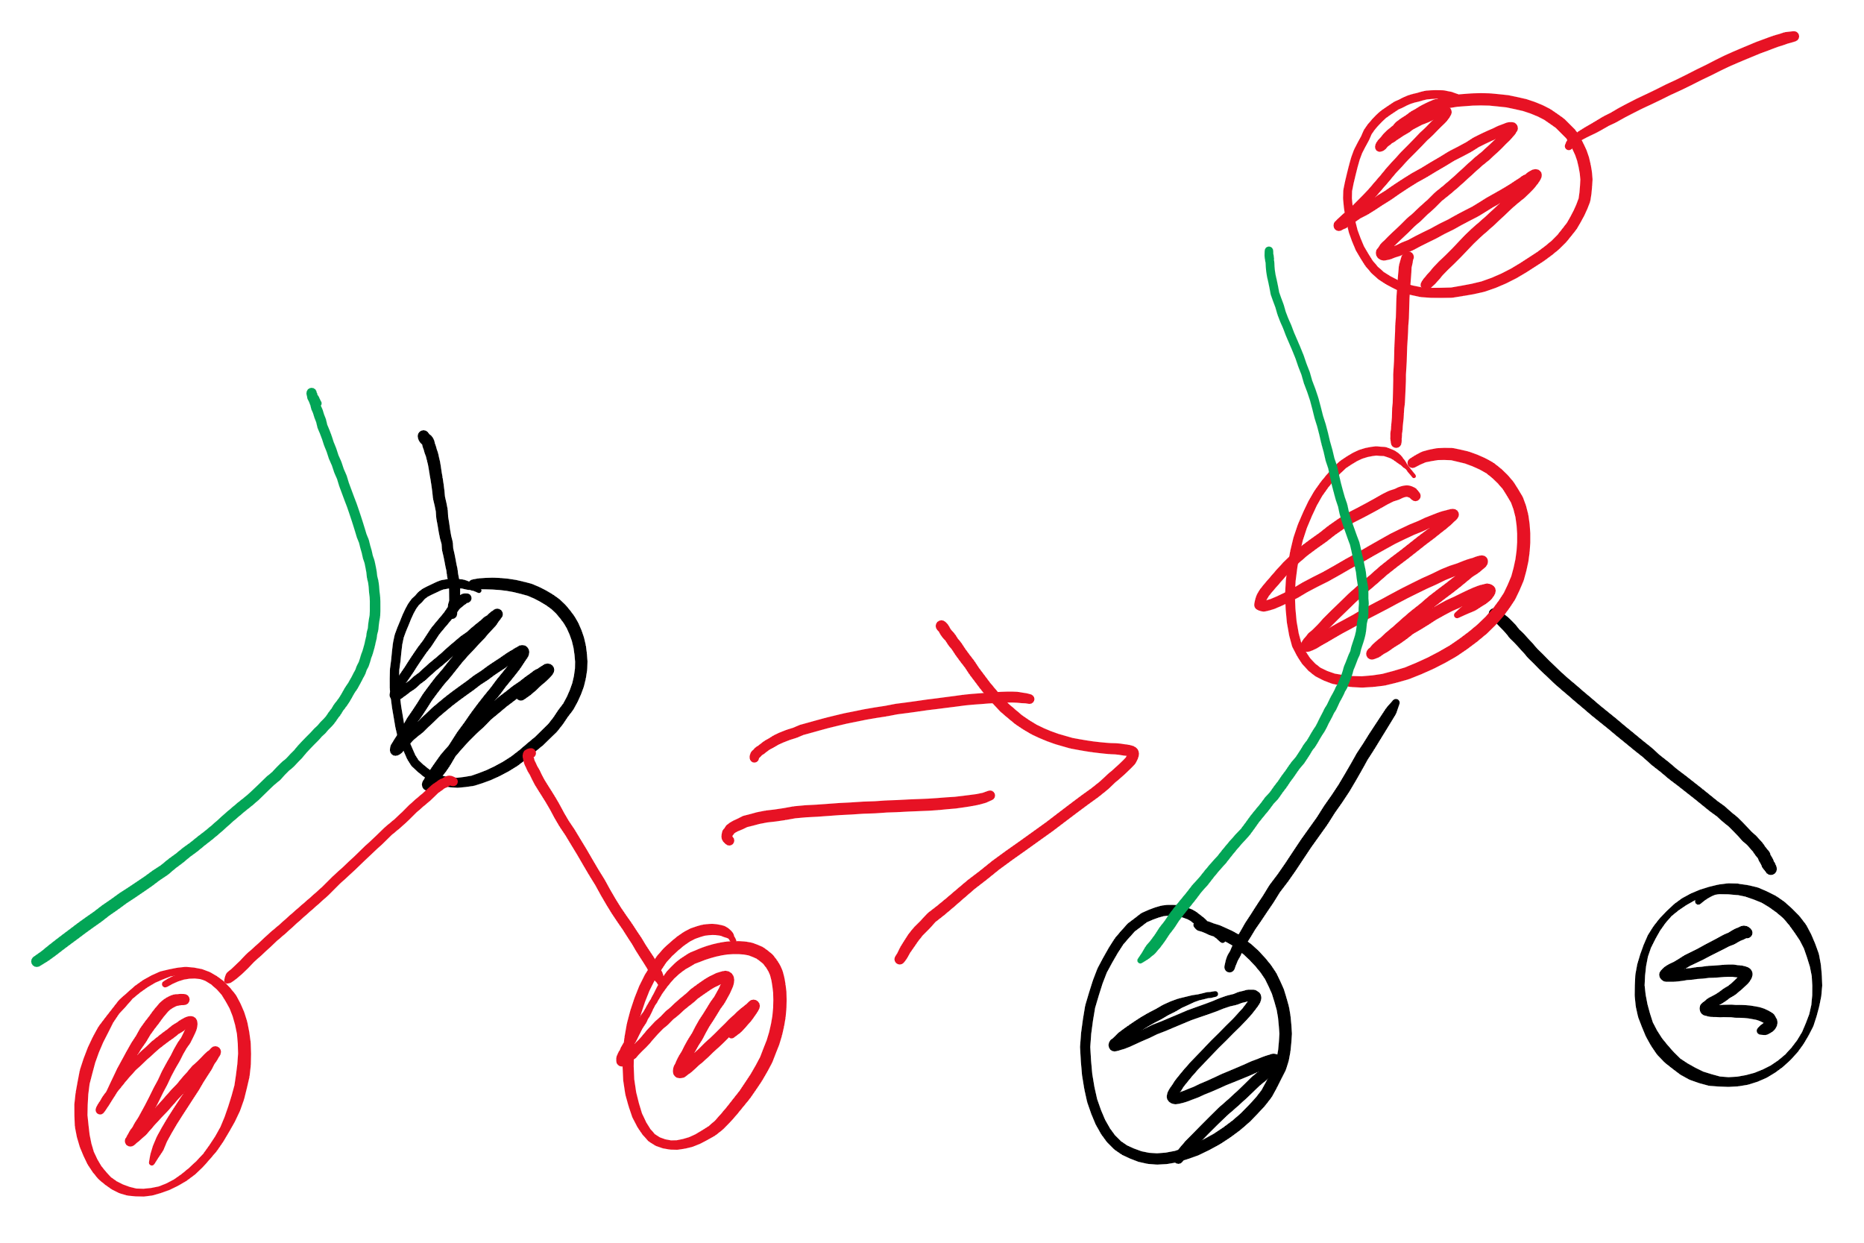
colorFlip

Slide 17
Adding to a red-black BST
new node is always red (at least initially)
if properties violated, correct using one or more of the basic operations
Violations that can happen:
red link to the right child
two red links connected to the same node
root node is red
Correcting a violation may result in a violation up the tree
Corrections happen as we climb back up the tree
That is, after the recursive call

Slide 18
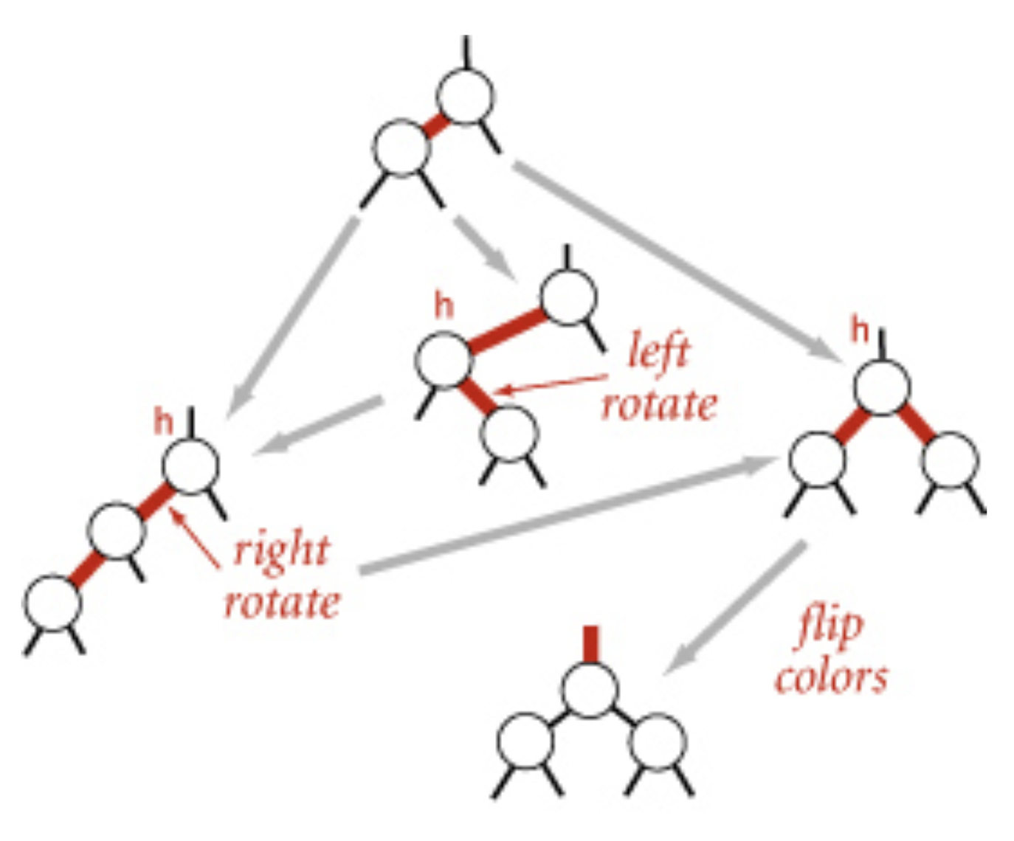
Dependencies between corrections!

Slide 19
Which violations to check for first?

Slide 20
Deleting a node
Make sure that we are not deleting a black node
as we go down the tree, make sure that the next down down is red
using certain operations
as we go back up the tree, correct any violations
same as we did while adding
if deleting a node with 2 children
replace with minimum of right subtree
similar trick to delete in regular BST

Slide 21
Other operations
rank, select, range query, …
Same code as regular BST!
worst-case runtime = Theta(log n)!!

