Slide 1

Algorithms and Data Structures 2 CS 1501
Fall 2021
Sherif Khattab
ksm73@pitt.edu
(Slides are adapted from Dr. Ramirez’s and Dr. Farnan’s CS1501 slides.)

Slide 2
Announcements
Upcoming deadlines:
2/19: Assignment 1, Lab 3, and Homework 4
Tophat questions are due one week after each lecture
Debugging using JDB
SteelHacks (https://steelhacks.com/) is happening this weekend (Friday-Sunday). Registration is still open!

Slide 3
Last lecture …
Using iteration instead of recursion for Tree operations
Find in BST
Preorder traversal
Inorder traversal
Postorder traversal

Slide 4
Muddiest points (1/2)
Red-black BST
why can we delete a red node and not a black one
how to get deletion of BST working as a whole
would like a definitive list of the runtime ranges of all BST Ops we learned up to this point things were going too fast for me when this came up
can you review what “this” is

Slide 5
Muddiest points (2/2)
Iterative post-order
tracing the stack: the concept of popping and then knowing what to do next is a little confusing
calls in the stack while doing the different traversals
traversal using stack, and can we do it using a Queue? Which has lower overhead?
recursive traversal feels more intuitive and is easier to code, so in what case do we want to use the iterative traversal?
how would you skip the leftmost leaf line
what is the purpose of the stack in traversals
coding the stack (push and pop)
When is recursive method "better" (less overhead) than iterative? .. or is not but just easier so not a big deal if you aren't using the operation that much ?
Fixing red/black trees
bst search
confused which one you visit

Slide 6
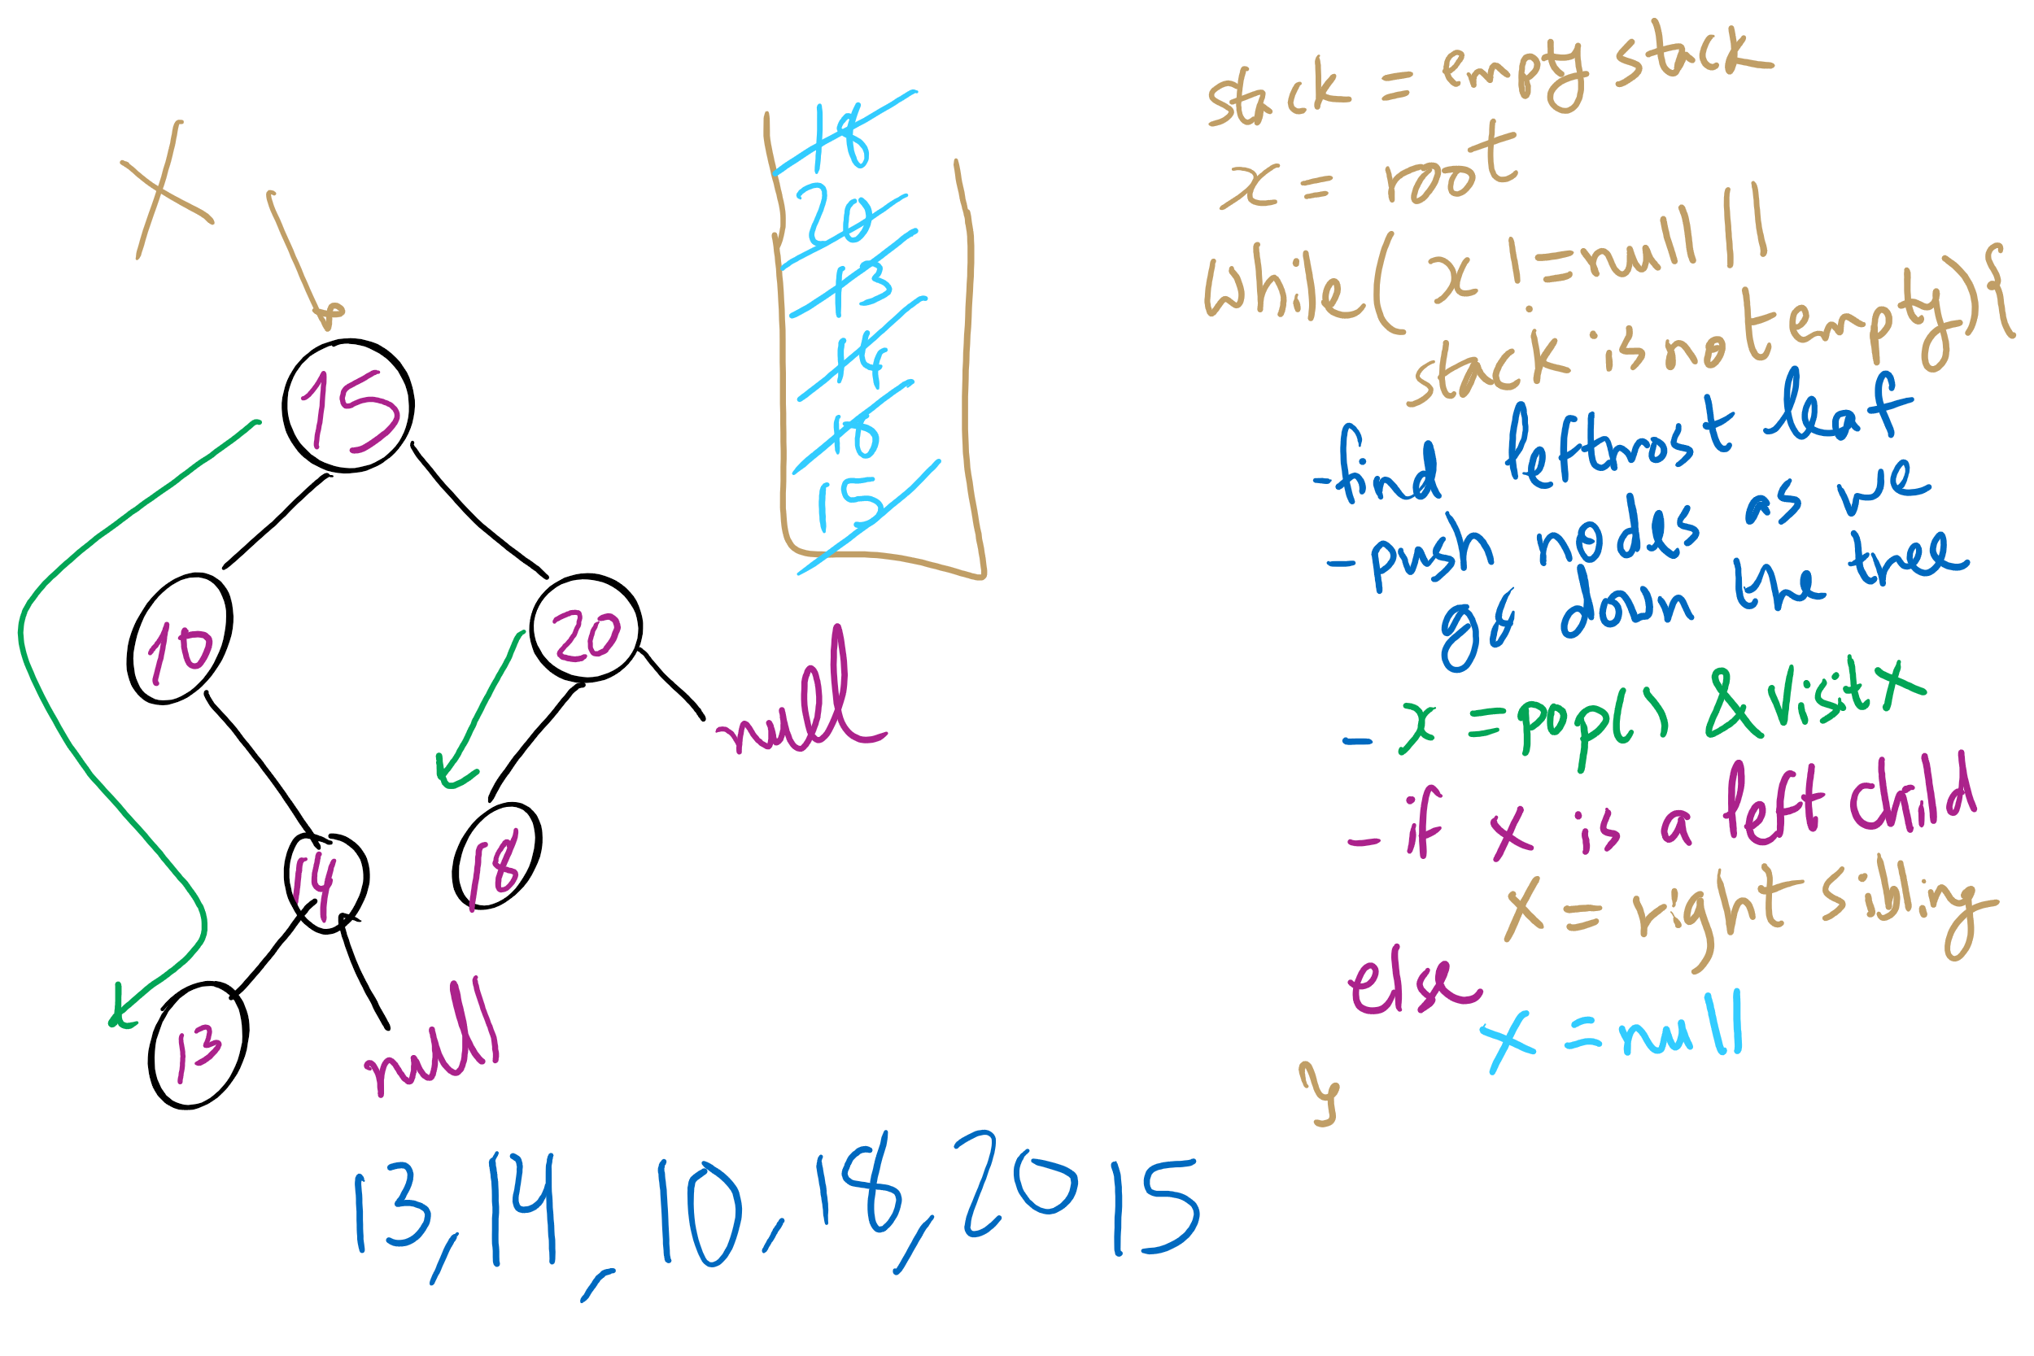
Iterative Post-order Traversal

Slide 7
This Lecture
Symbol Table ADT
Running-time comparison:
Array (sorted and unsorted)
linked-list (sorted and unsorted)
binary search tree (BST)
Red-black BST
Digital search trees
radix search tries
multiway tries
de la Briandais trees

Slide 8
Symbol tables
Abstract structures that link keys to values
Key is used to search the data structure for a value
Described as a class in the text, but probably more accurate to think of the concept of a symbol table in general as an interface
Key functions:
put()
contains()

Slide 9
Comparing Implementations
Given a collection of keys C, how to we search for a given key k?
Store collection in an array
Unsorted
Sorted
Linked list
Unsorted
Sorted
Binary search tree (BST)
Red-black BST
Differences?
Runtimes?
Notes:
BST is more involved to implement
Runtimes:
UA: sequential search, Theta(n)
SA: binary search, Theta(lg n)
UL: sequential search, Theta(n)
SL: sequential search, Theta(n)
BST: worst case: Theta(n), avg: Theta(lg n)
RB-BST: worst case: Theta(log n)

Slide 10
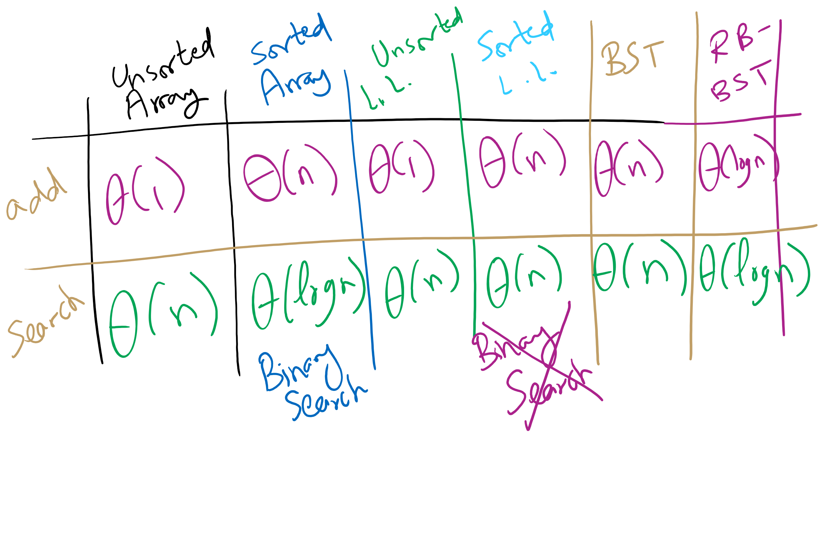
Symbol Table Implementations

Slide 11
A closer look
Can we do better than these?
These methods depend on comparisons against other keys
I.e., k is compared against other keys in the data structure
4 options at each node in a BST:
Node ref is null, k not found
k is equal to the current node's key, k is found
k is less than current key, continue to left child
k is greater than the current key, continue to right child

Slide 12
Digital Search Trees (DSTs)
Instead of looking at less than/greater than, lets go left right based on the bits of the key, so we again have 4 options:
Node ref is null, k not found
k is equal to the current node's key, k is found
current bit of k is 0, continue to left child
current bit of k is 1, continue to right child

Slide 13
DST example
Insert:
4
0100
4
3
0011
0
1
2
0010
3
6
0110
0
1
2
6
5
0101
Search:
0
1
0
1
5
3
0011
0
1
7
0111
Notes:
how to turn this into a symbol table?

Slide 14
Analysis of digital search trees
Runtime?
We end up doing many comparisons against the full key, can we improve on this?
Notes:
Average case is the same as BST: lg(n)
Given a truly random set of n keys, branching according to a 0 or 1 is equally likely and the tree should be well balanced
What about the worst case?
Bound by the bit length, b, of the key
Constant lookup time in the number of bits, an improvement over BST
How is this OK?
Compare log(n) with b over all possible values of n
Harken back to radix sort discussion

Slide 15
Radix search tries (RSTs)
Trie as in retrieve, pronounced the same as “try”
Instead of storing keys as nodes in the tree, we store them implicitly as paths down the tree
Interior nodes of the tree only serve to direct us according to the bitstring of the key
Values can then be stored at the end of key’s bit string path

Slide 16
RST example
Insert:
4
0100
0
1
3
0011
2
0010
0
1
6
0110
0
1
0
1
5
0101
Search:
0
1
0
1
0
1
3
0011
V
V
V
V
V
7
0111
Notes:
V's just stand for values added as part of the symbol table

Slide 17
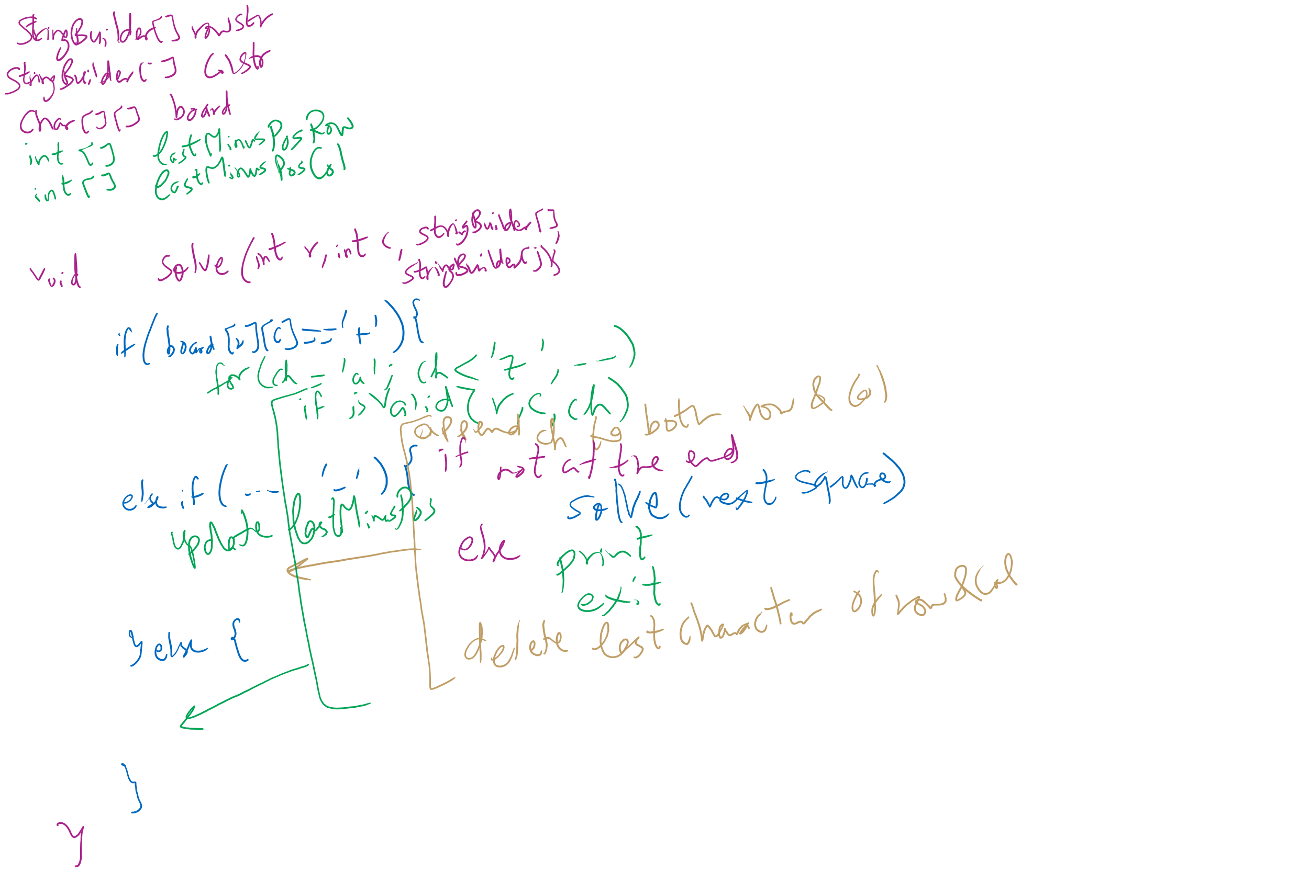
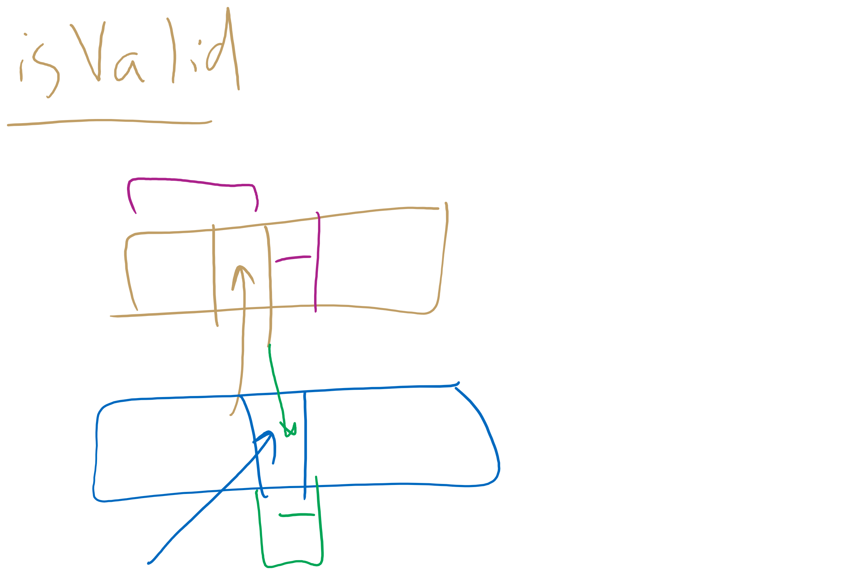
Assignment 1 Hints

Slide 18
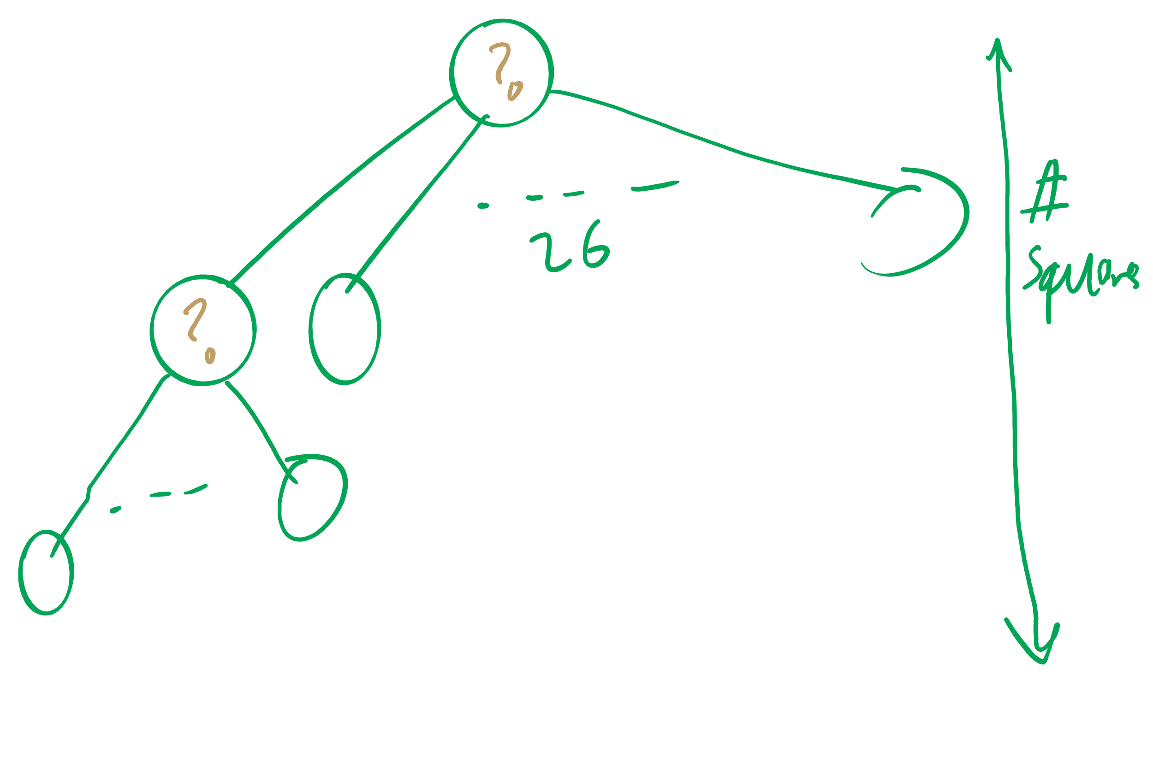
Assignment 1 Runtime Analysis

