Slide 1

Algorithms and Data Structures 2 CS 1501
Fall 2021
Sherif Khattab
ksm73@pitt.edu
(Slides are adapted from Dr. Ramirez’s and Dr. Farnan’s CS1501 slides.)

Slide 2
Announcements
Upcoming deadlines:
Lab 11: Friday 12/10
Lab 12 and Homework 12: Monday 12/20 at 5:00 pm
Assignment 4 and 5: Monday 12/20 at 5:00 pm
Bonus Opportunities
Bonus Homework: Monday 12/20 at 5:00 pm
OMETs: 1 bonus point for entire class when response rate >= 80%

Slide 3
Previous lecture …
Ford-Fulkerson MaxFlow Framework
Edmonds-Karp algorithms
BFS
PFS

Slide 4
CourseMIRROR Reflections

Slide 5
Today …

Slide 6
Please submit your reflections by using the CourseMIRROR App
If you are having a problem with CourseMIRROR, please send an email to coursemirror.development@gmail.com
Notes:
All right!
Upcoming Due Dates at A Glance

Slide 7
Karatsuba Example 1

Slide 8
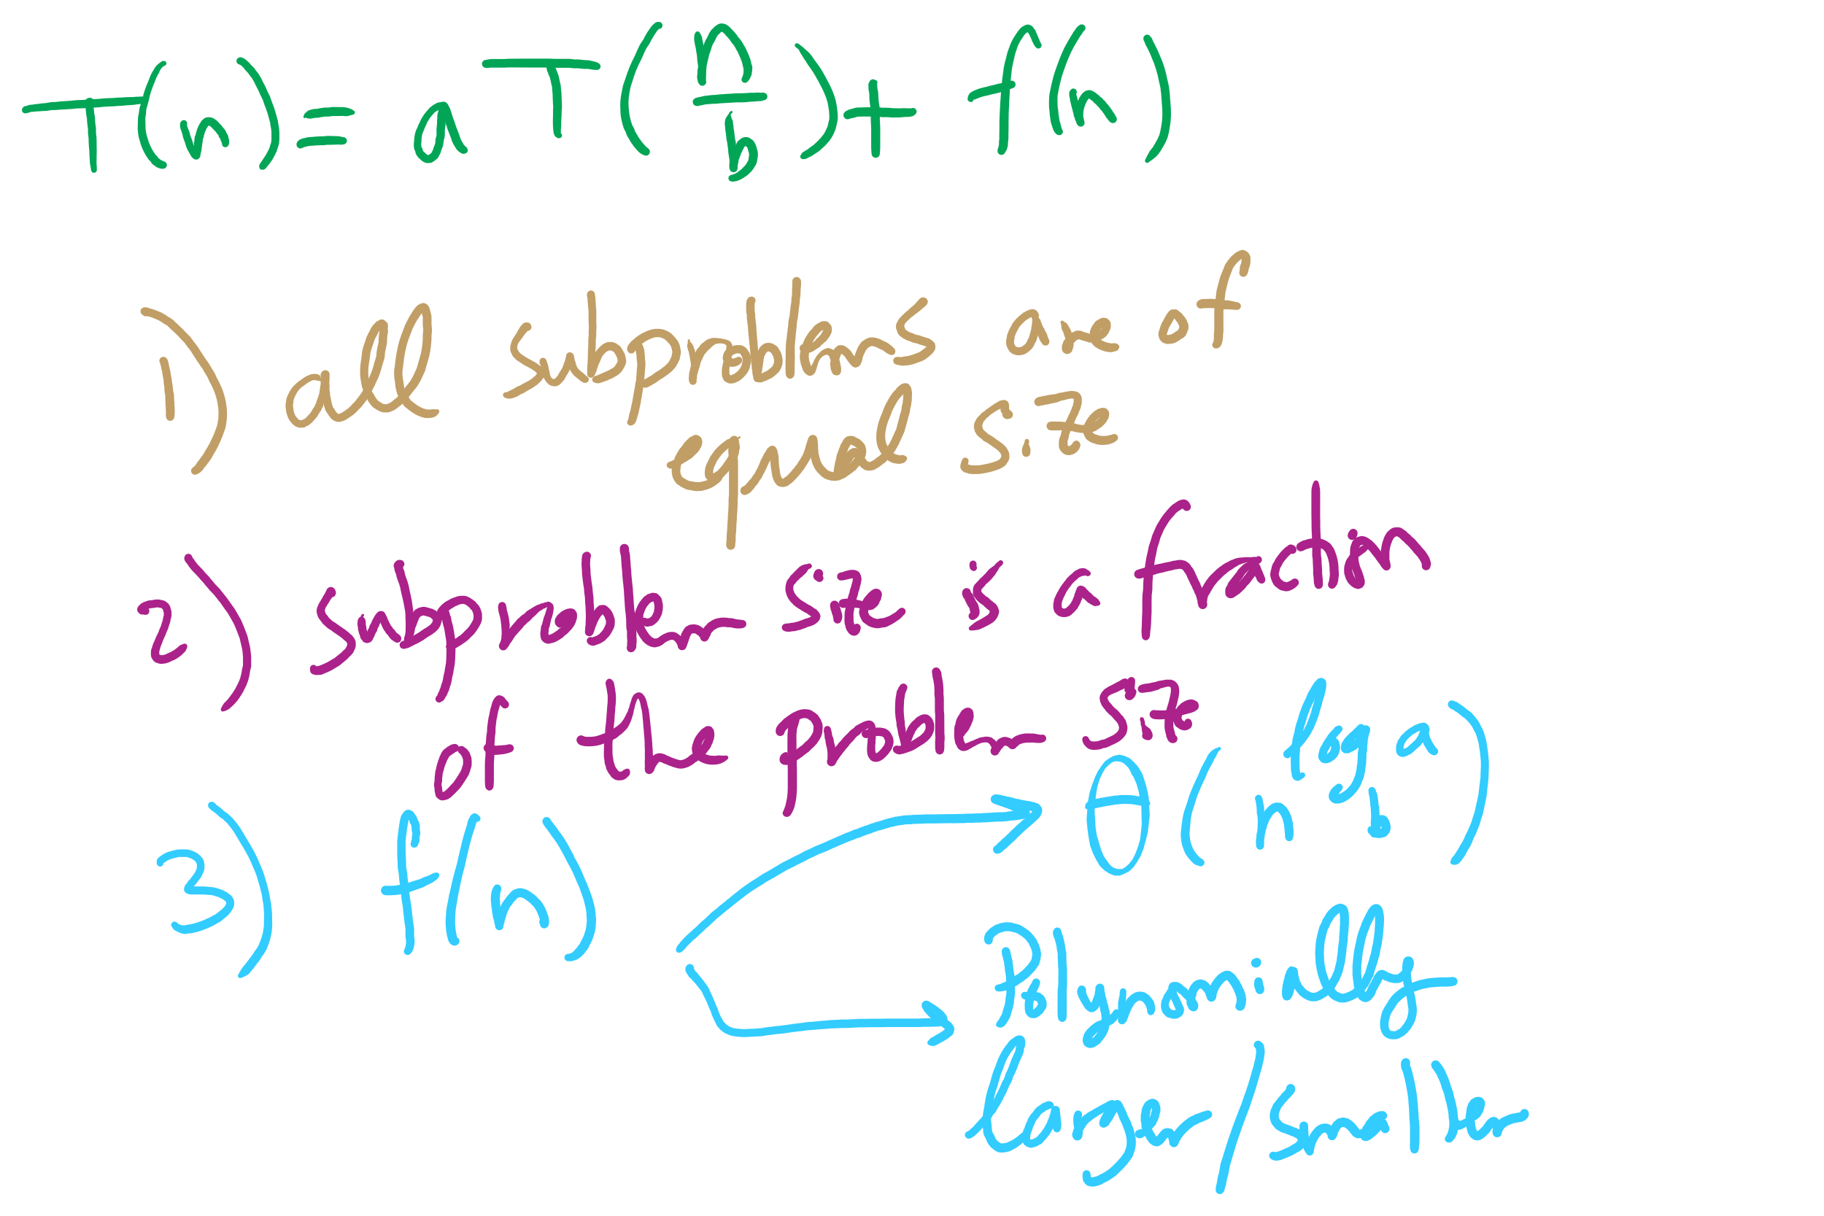
Master Theorem Conditions

Slide 9
This Lecture
(Big)Integer Algorithms
exponentiation
GCD
RSA encryption

Slide 10
Building another recurrence relation
x^{y} = (x^{(y/2)})² = x^{(y/2)} * x^{(y/2)}
Similarly, (x^{(y/2)})² * x = x^{(y/2)} * x^{(y/2)} * x
So, our recurrence relation is:
T(n) = T(n-1) + ?
How much work is done per call?
1 (or 2) multiplication(s)
Examined runtime of multiplication last lecture
But how big are the operands in this case?

Slide 11
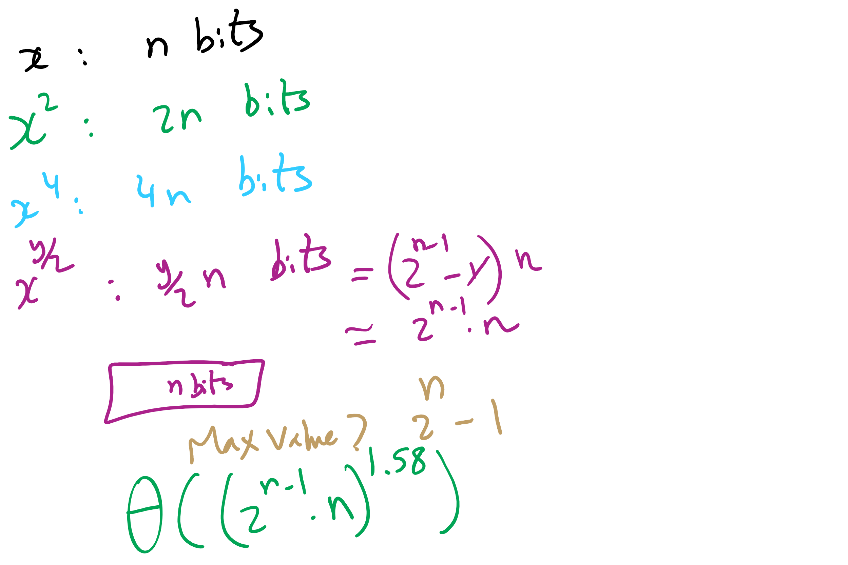
Non-recursive Work

Slide 12
Determining work done per call
Base case returns x
n bits
Base case results are multiplied: x * x
n bit operands
Result size?
2n
These results are then multiplied: x² * x²
2n bit operands
Result size?
4n bits
…
x^{(y/2)} * x^{(y/2)}?
(y / 2) * n bit operands = 2^{(n-1)} * n bit operands
Result size? y * n bits = 2^{n} * n bits

Slide 13
Multiplication input size increases throughout
Our recurrence relation looks like:
T(n) = T(n-1) + Θ((2^{(n-1)} * n)²)
squared from the use of the gradeschool algorithm
multiplication input size

Slide 14
Runtime analysis
Can we use the master theorem?
Nope, we don’t have a b > 1
OK, then…
How many times can y be divided by 2 until a base case?
lg(y)
Further, we know the max value of y
Relative to n, that is:
2^{n}
So, we have, at most lg(y) = lg(2^{n}) = n recursions

Slide 15
OK, but why?
This and all of our large integer algorithms will be handy when we look at algorithms for implementing…
CRYPTOGRAPHY

Slide 16
Introduction to crypto
Cryptography - enabling secure communication in the presence of third parties
Alice wants to send Bob a message without anyone else being able to read it
Alice
M
Encrypt
C
Decrypt
M
Bob

Slide 17
Enter the adversary
Consider the adversary to be anyone that could try to eavesdrop on Alice and Bob communicating
People in the same coffee shop as Alice or Bob as they talk over WiFi
Admins operating the network between Alice and Bob
And mirroring their traffic to the NSA…
Will have access to:
The ciphertext
The encrypted message
The encryption algorithm
At least Alice and Bob should assume the adversary does
The key material is the only thing Bob knows that the adversary does not

Slide 18
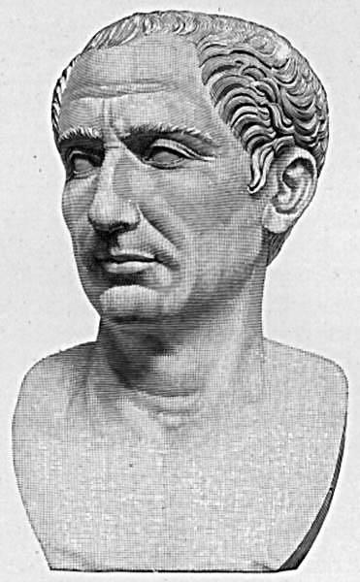
Cryptography has been around for some time
Early, classic encryption scheme:
Caesar cipher:
“Shift” the alphabet by a set amount
Use this shifted alphabet to send messages
The “key” is the amount the alphabet is shifted
Yes, that Caesar
Alphabet
ABCDEFGHIJKLMNOPQRSTUVWXYZ
XYZABCDEFGHIJKLMNOPQRSTUVW
Shift 3
Notes:
ROT3(OVALTINE) = LSXIQFKB

Slide 19
By modern standards, incredibly easy to crack
BRUTE FORCE
Try every possible shift
25 options for the English alphabet
255 for ASCII
OK, let's make it harder to brute force
Instead of using a shifted alphabet, let's use a random permutation of the alphabet
Key is now this permutation, not just a shift value
R size alphabet means R! possible permutations!

Slide 20
By modern standards, incredibly easy to crack
Just requires a bit more sophisticated of an algorithm
Analyzing encrypted English for example
Sentences have a given structure
Character frequencies are skewed
Essentially playing Wheel of Fortune

Slide 21
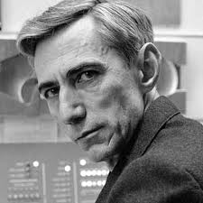
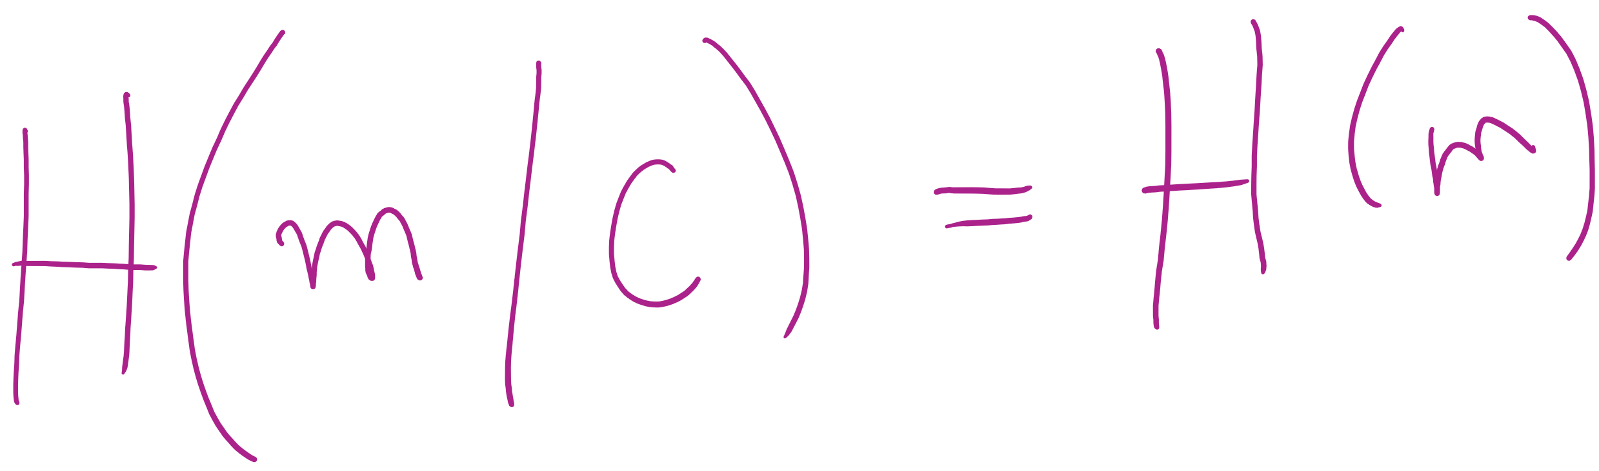
So what is a good cipher?
One-time pads
List of one-time use keys (called a pad) here
To send a message:
Take an unused pad
Use modular addition to combine key with message
For binary data, XOR
Send to recipient
Upon receiving a message:
Take the next pad
Use modular subtraction to combine key with message
For binary data, XOR
Read result
Proven to provide perfect secrecy

Slide 22
One-time pad example
Encoding:
0 1 2 3 4 5 6 7 8 9 10 11 12 13 14 15 16 17 18 19 20 21 22 23 24 25
A B C D E F G H I J K L M N O P Q R S T U V W X Y Z
Message:
H E L L O
Pad:
Q J C W T
7 4 11 11 14
16 9 2 22 19
+
16 9 2 22 19
(mod 26)
23 13 13 7 7
Encrypted Message:
X N N H H
23 13 13 7 7
-
16 9 2 22 19
(mod 26)
7 4 11 11 14
H E L L O
Notes:
Live demo perfect forward secrecy. Have students pick any other 5 character string and find the codeword.
Ex: WORLD = (22, 14, 17, 11, 3)
pad should be (1, 25, 22, 22, 4) = BZWWE

Slide 23
Difficulties with one-time pads
Pads must be truly random
Both sender and receiver must have a matched list of pads in the appropriate order
Once you run out of pads, no more messages can be sent

