Slide 1

Algorithms and Data Structures 2 CS 1501
Fall 2021
Sherif Khattab
ksm73@pitt.edu
(Slides are adapted from Dr. Ramirez’s and Dr. Farnan’s CS1501 slides.)

Slide 2
Announcements
Upcoming deadlines:
Homework 11 and Lab 10: Monday 11/29
Assignment 4 and 5: 12/20 at 5:00 pm

Slide 3
Previous lecture …
Union-Find Data Structure
Helps reduce Kruskal’s MST algorithm from Theta(e(v + e)) to Theta(e log e)
Network flow problem
Ford-Fulkerson framework (part of it)

Slide 4
CourseMIRROR Reflections

Slide 5
This Lecture
The full Network Flow algorithm

Slide 6
Ford Fulkerson example
5
/5
s
10
A
B
t
/10
5
/10
5
/10
5
10
/5
5

Slide 7
Another Ford Fulkerson example
/5
s
/10
A
B
t
10
/10
10
/10
10
/5
Notes:
Are we screwed?

Slide 8
Expanding on residual capacity
To find the max flow we will have to consider re-routing flow we had previously allocated
This means, when finding an augmenting path, we will need to look not only at the edges of G, but also at backwards edges that allow such re-routing
For each edge (u, w) ∈ E, a backwards edge (w, u) must be considered during pathfinding if f(u, w) > 0
The capacity of a backwards edge (w, u) is equal to f(u, w)

Slide 9
The residual graph
We will perform searches for an augmenting path not on G, but on a residual graph built using the current state of flow allocation on G
The residual graph is made up of:
V
An edge for each (u, w) ∈ E where f(u, w) < c(u, w)
(u, w)'s mirror in the residual graph will have 0 flow and a capacity of c(u, w) - f(u, w)
A backwards edge for each (u, w) ∈ E where f(u, w) > 0
(u, w)'s backwards edge has a capacity of f(u, w)
All backwards edges have 0 flow

Slide 10
Residual graph example
/5
0
5
/5
s
/10
A
B
t
10
/10
10
/10
5
10
/10
0
/10
/ 5
0
/10
0
/5
5
/5
0

Slide 11
Another example
A
1
1
2
/1000
/1000
s
/1
t
1
0
1
2
/1000
1
/1000
B
Notes:
sABt
sBAt
sABt
…
runtime is bound to the max flow of the graph!

Slide 12
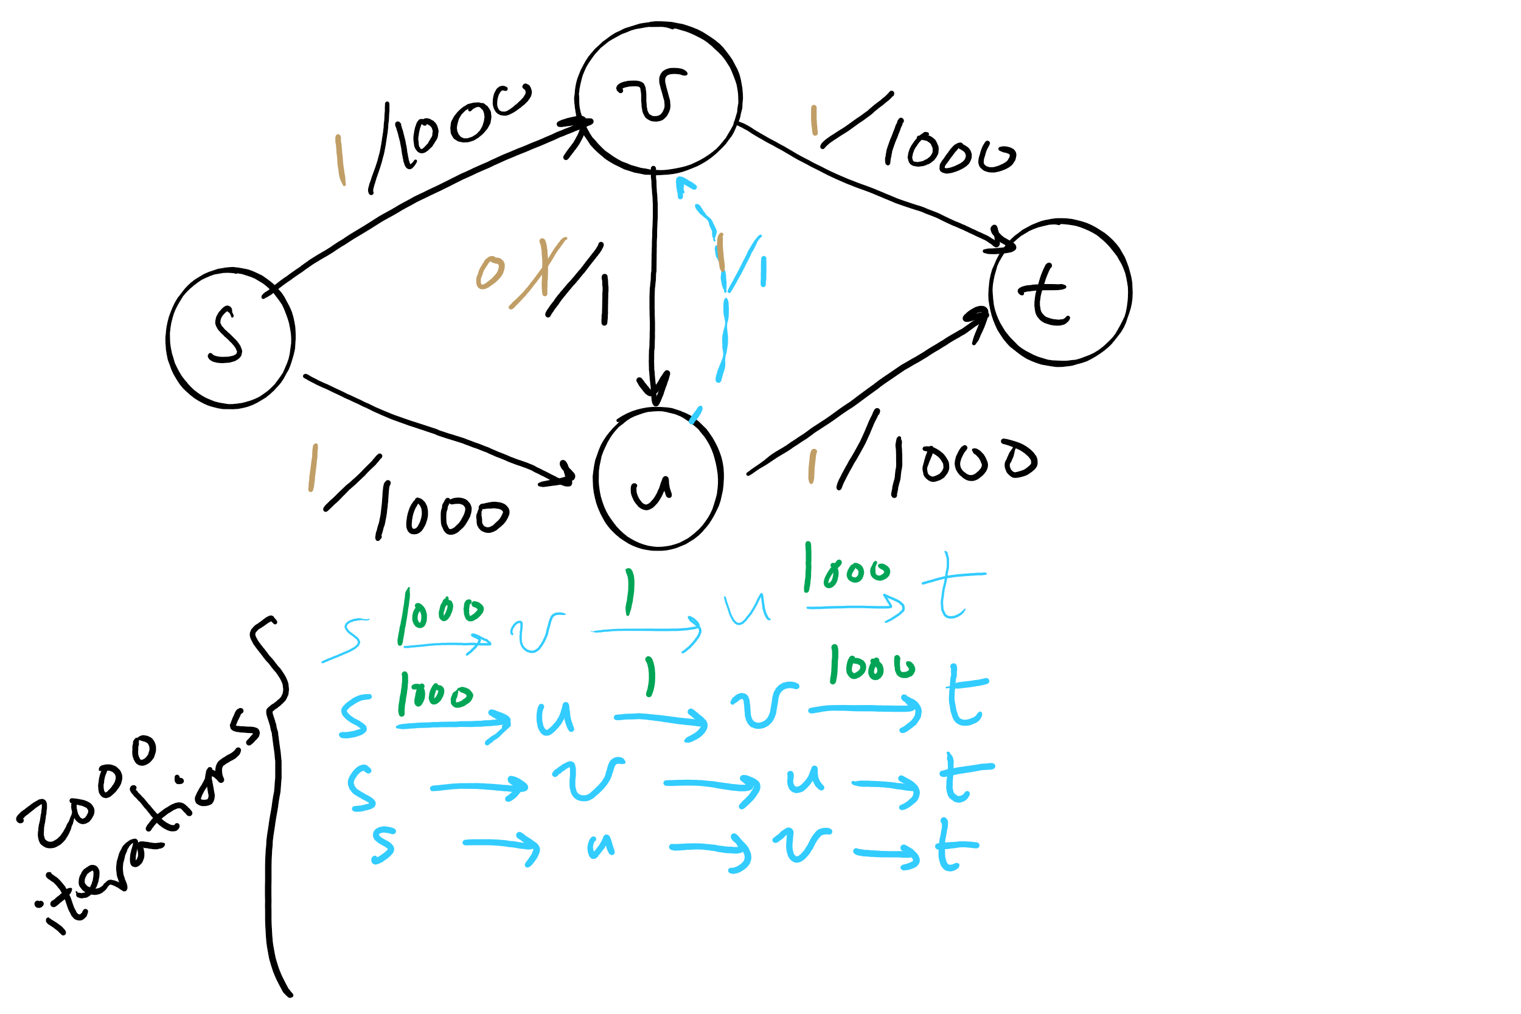
Worst-case runtime of Ford-Fulkerson

Slide 13
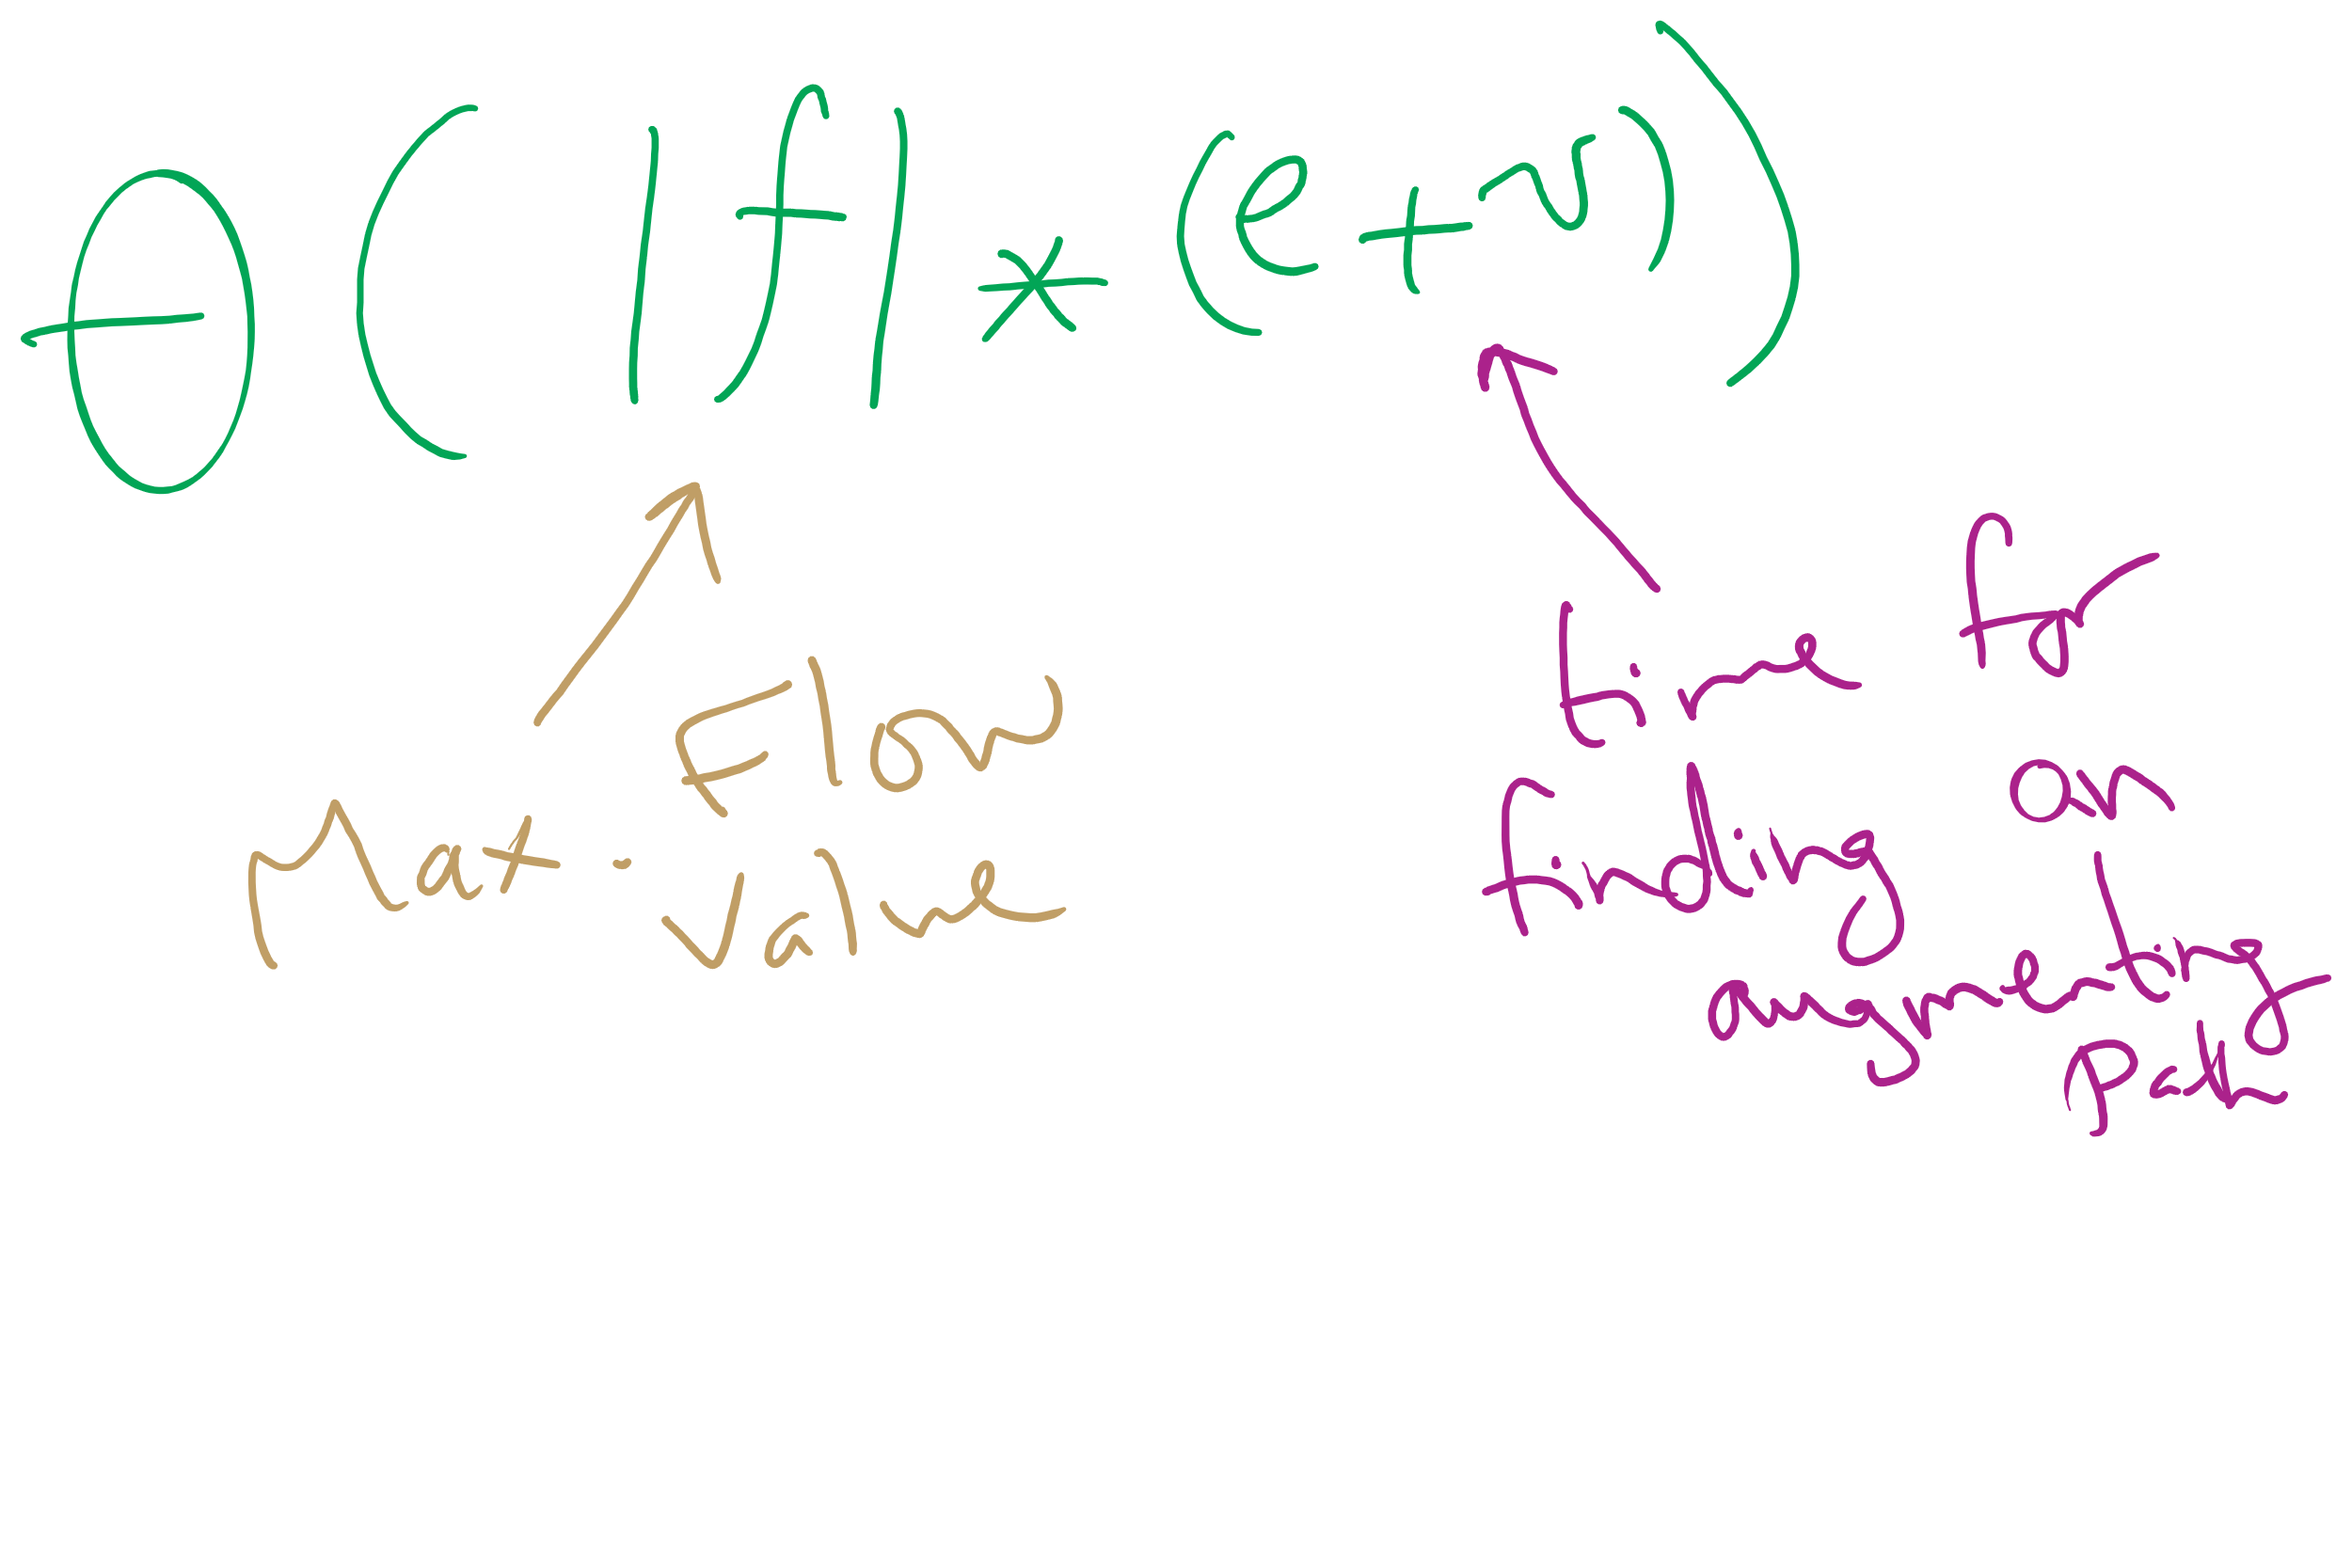
Worst-case Runtime of Ford-Fulkerson

Slide 14
Edmonds Karp
How the augmenting path is chosen affects the performance of the search for max flow
Edmonds and Karp proposed a shortest path heuristic for Ford Fulkerson
Use BFS to find augmenting paths
Notes:
note that FF is an "algorithm" because path finding details are not defined

Slide 15
Another example
A
1000
/1000
/1000
1000
s
/1
t
/1000
1000
/1000
1000
B
Notes:
Use BFS to find paths, and its all good

Slide 16
But our flow graph is weighted...
Edmonds-Karp only uses BFS
Used to find spanning trees and shortest paths for unweighted graphs
Why do we not use some measure of priority to find augmenting paths?
Notes:
We could…
Book discusses a modified version of Dijkstra's
Advantages?
Disadvantages?
Which is the best?
Currently unknown, but Edmonds-Karp is pg

Slide 17
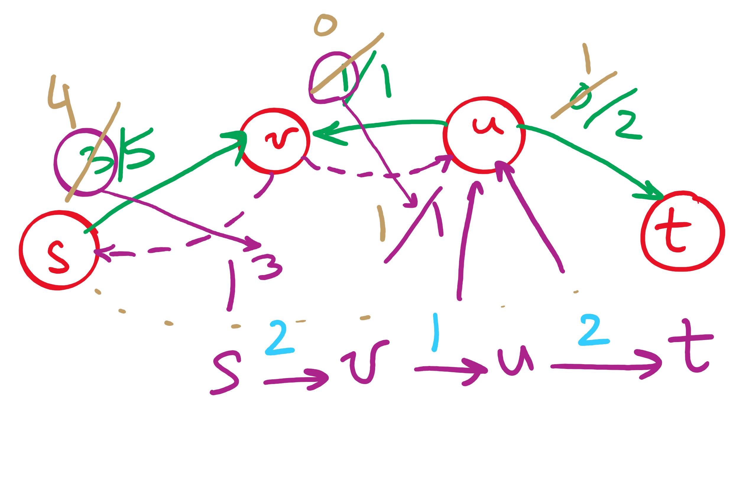
Backwards edges
Adding flow to a backwards edge means rerouting flow from the corresponding forward edge

Slide 18
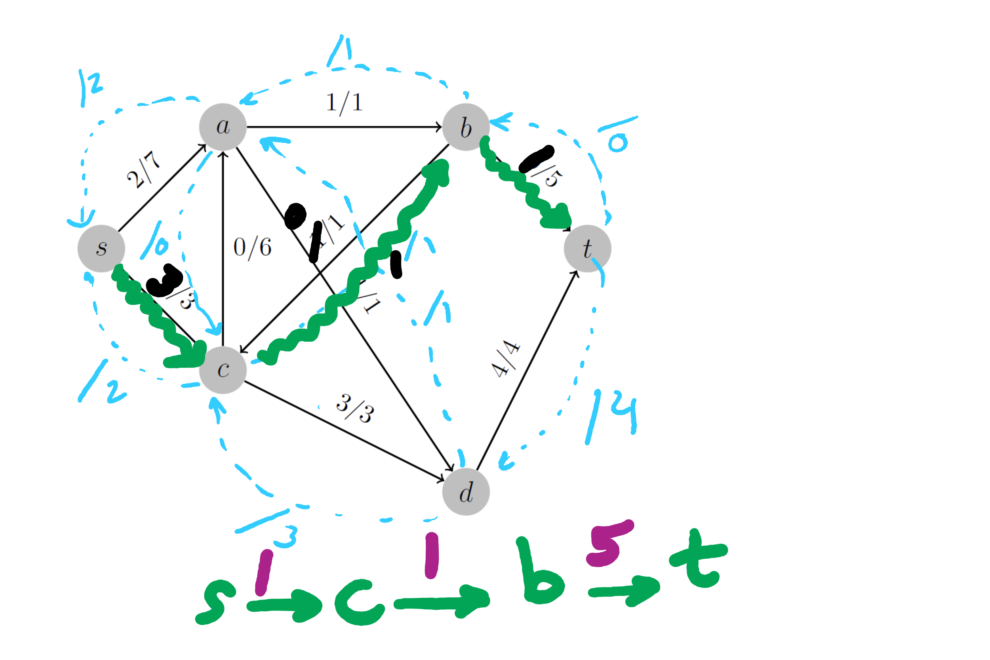
2nd Tophat Question

Slide 19
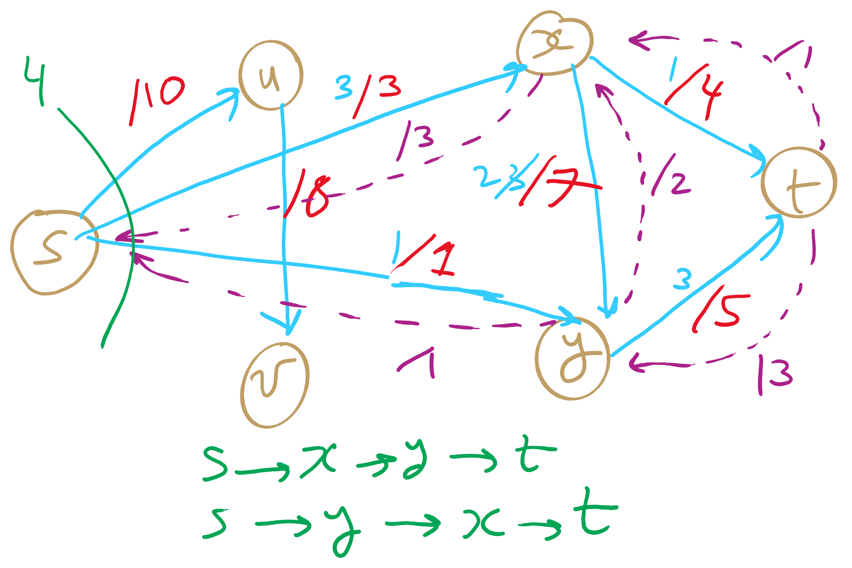
PFS Example 1

Slide 20
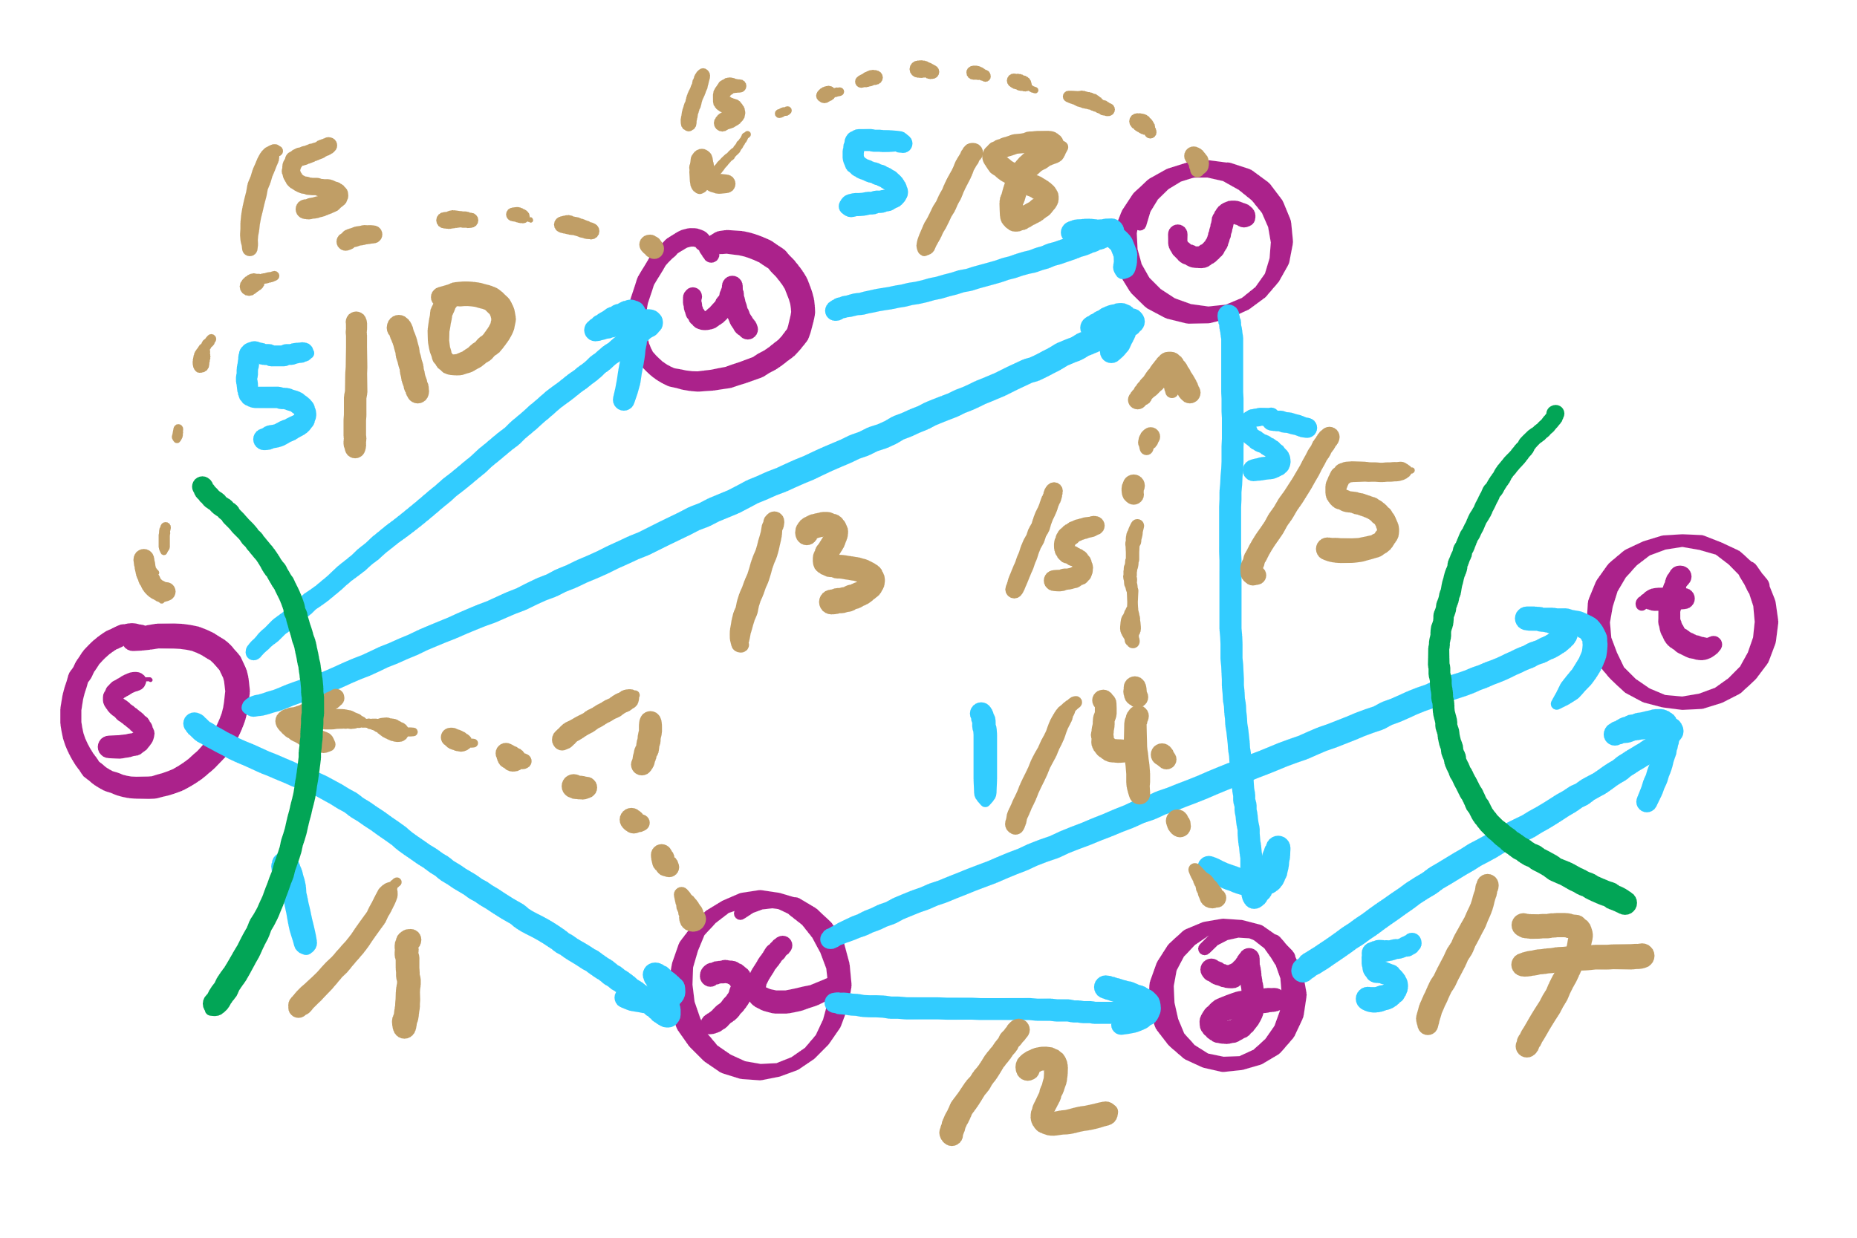
PFS Example 2

Slide 21
Please submit your reflections by using the CourseMIRROR App
If you are having a problem with CourseMIRROR, please send an email to coursemirror.development@gmail.com
Notes:
All right!
Upcoming Due Dates at A Glance

