Slide 1

Algorithms and Data Structures 2 CS 1501
Spring 2022
Sherif Khattab
ksm73@pitt.edu
(Slides are adapted from Dr. Ramirez’s and Dr. Farnan’s CS1501 slides.)

Slide 2
Announcements
Upcoming deadlines:
Homework 5 due on 2/21
Lab 5 due on 2/25
Homework 6 due on 2/28
Assignment 1 due on 3/14
Midterm exam on Wednesday 3/2
In-person, paper, closed book exam

Slide 3
Previous lecture …
DLB Trie
Lossless Compression
Huffman Compression

Slide 4
CourseMIRROR Reflections (most interesting)
The most interesting thing was the examples and exercises. They help a lot
I found the use of Linked lists in DLBs as a nice way to save space compared to Multi Branch RSTs
DLB tries were interesting and I liked their relation to linked lists
Nodelets are interesting! Looking forward to learning more about compression
the run time and space comparisons of all of the trees we’ve learned about
how dlb trees can store so much information
The different ways we can store the data in nodes along trees or tries
RSTs with linked lists
The different kinds of tries was most interesting.

Slide 5
CourseMIRROR Reflections (most confusing)
The lecture went very fast today.
How are nodelets converted into DLB nodes?
Could you go over how Huffman Codes work? The expansion at the end felt rushed
why we use a trie over the other trees. Or when we should use one.
Compression was went over quickly so Im not sure I grasped the basics yet
implementation of the multi-way RST
Id like to have a general overview of the different trees/tries and a code walkthrough

Slide 6
Problem of the Day: Lossless Compression
Input: A sequence of characters
n characters
each encoded as an 8-bit Extended ASCII
Output: A bit string
of length less than 8*n
the original sequence can be fully restored from the bitstring

Slide 7
Subproblem: Prefix-free Compression
Input: A sequence of n characters
Output: A codeword h_{i} for each character i such that
No codeword is a prefix of any other
When each character in the input sequence is replaced with each codeword
the length of that compressed sequence is minimum
the original sequence can be fully restored from the compressed bitstring

Slide 8
Generating Huffman codes
Assume we have K characters that are used in the file to be compressed and each has a weight (its frequency of use)
Create a forest, F, of K single-node trees, one for each character, with the single node storing that char’s weight
while |F| > 1:
Select T1, T2 ∈ F that have the smallest weights in F
Create a new tree node N whose weight is the sum of T1 and T2’s weights
Add T1 and T2 as children (subtrees) of N
Remove T1 and T2 from F
Add the new tree rooted by N to F
Build a tree for “ABRACADABRA!”
Notes:
build tree for abracadabra, use it to construct compressed string,

Slide 9
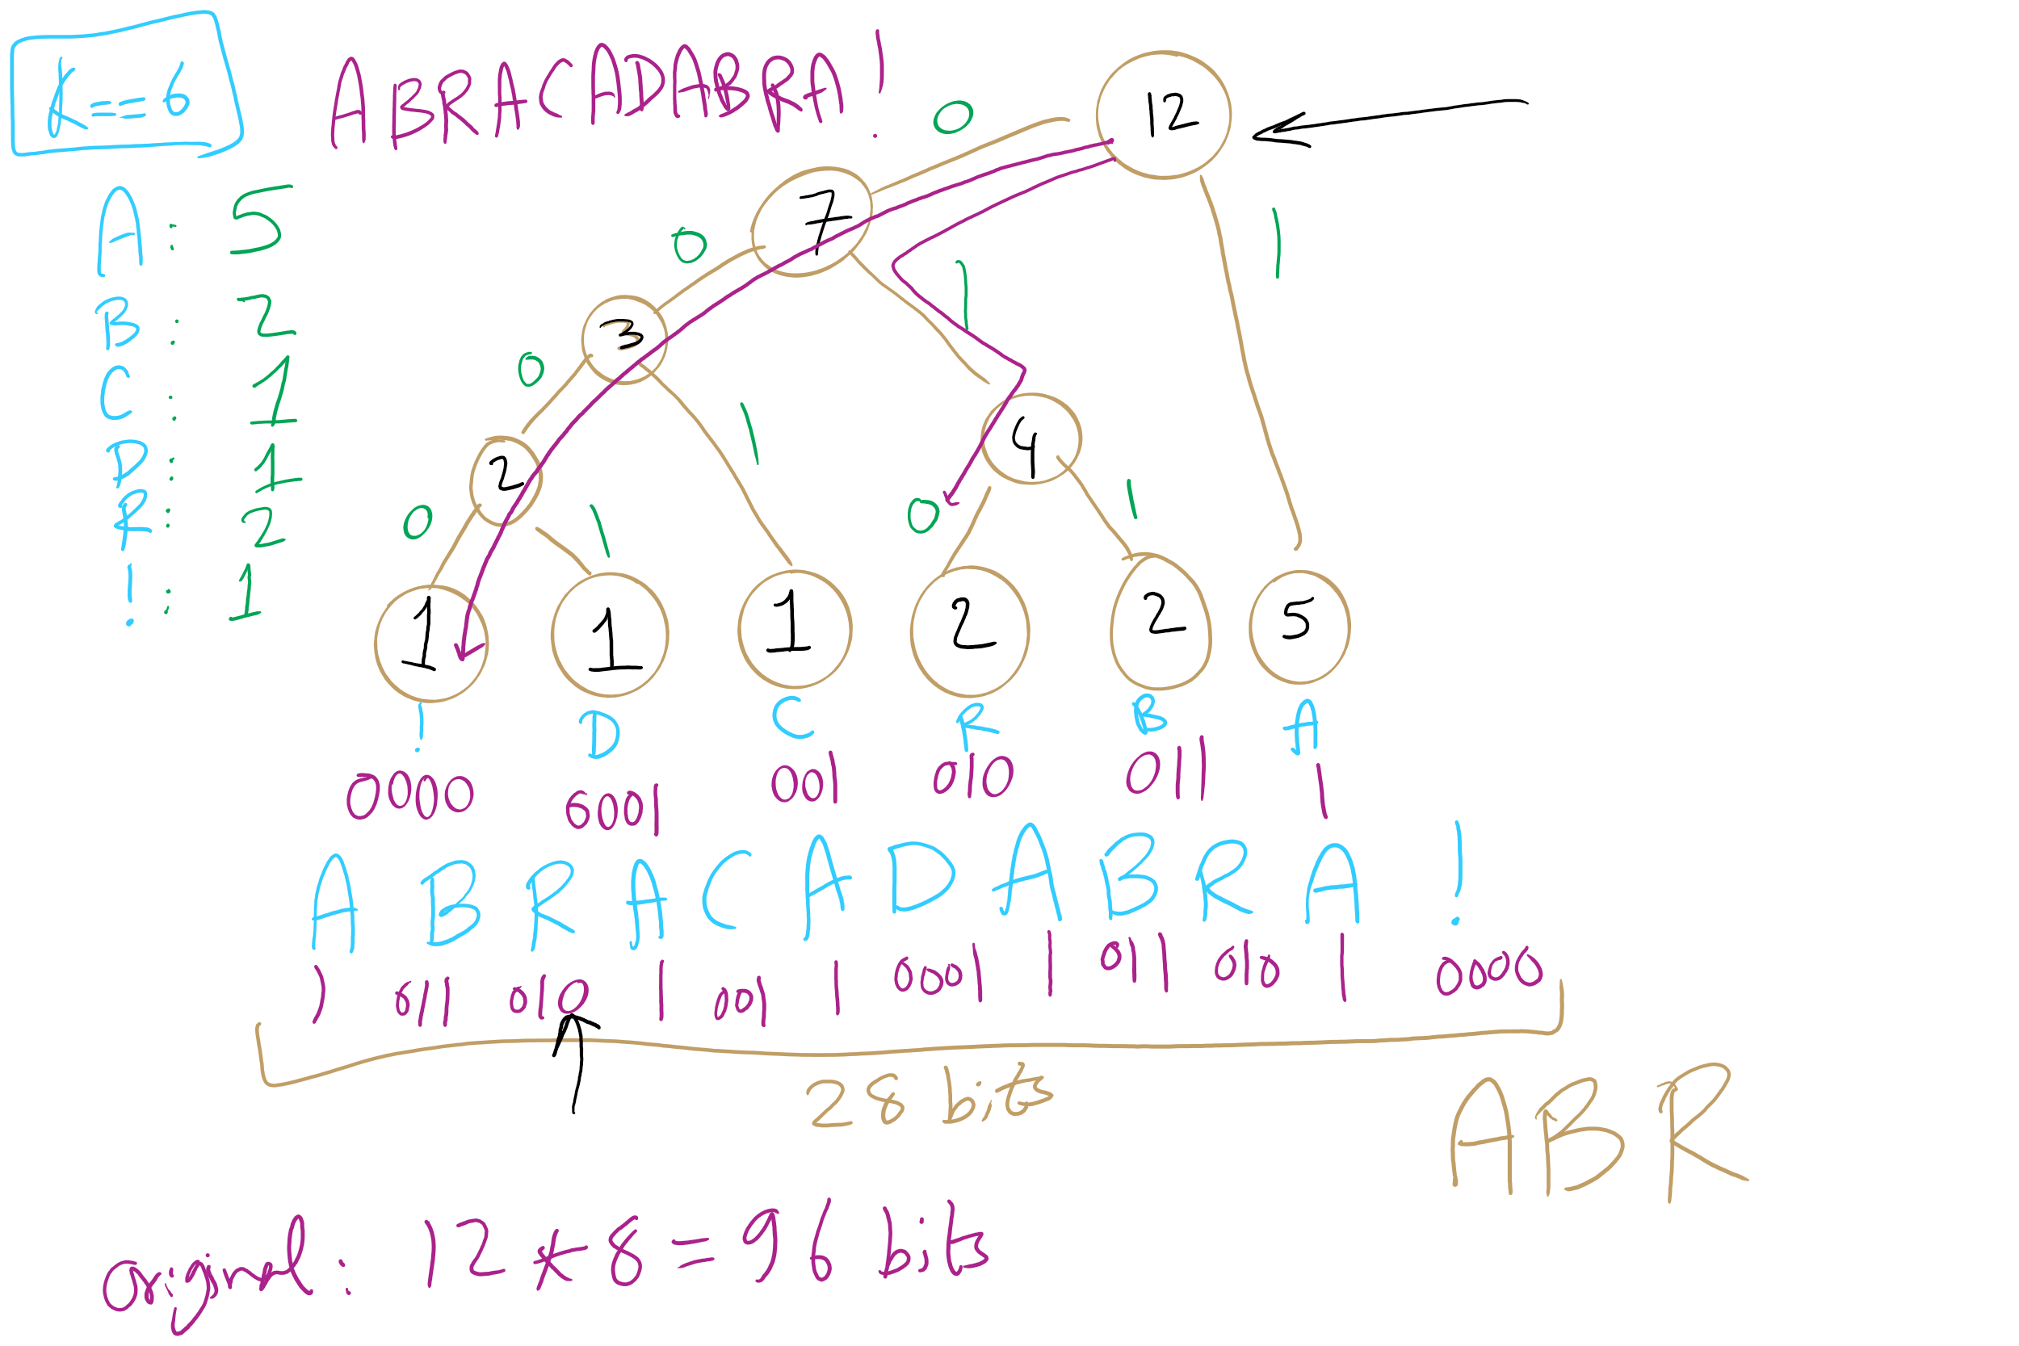
Huffman Tree Construction Example

Slide 10
Implementation concerns
To encode/decode, we'll need to read in characters and output codes/read in codes and output characters
…
Sounds like we'll need a symbol table!
What implementation would be best?
Same for encoding and decoding?
Note that this means we need access to the trie to expand a compressed file!
Notes:
Probably best to create a lookup table for encoding…
Traverse the tree and construct the table
Then you can simply lookup and output the appropriate code for each character in the input string!
Here, we’ll use the trie we constructed earlier
Descend the trie according to the bits of the compressed file
When you hit a leaf, output the appropriate character
Return to the root and repeat…

Slide 11
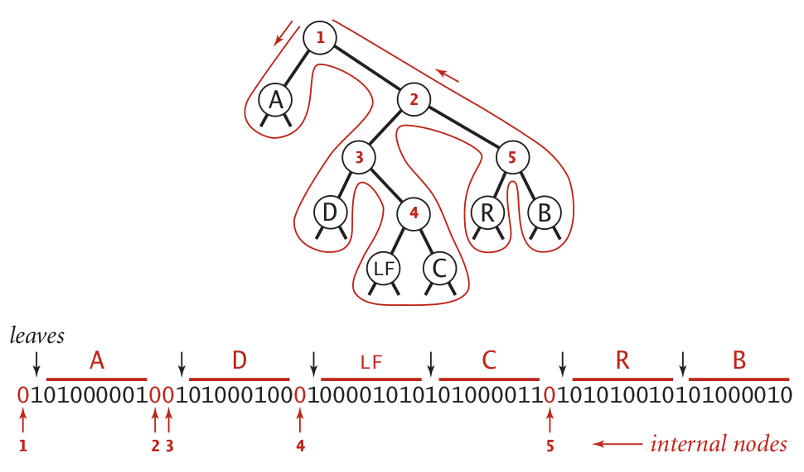
Representing tries as bitstrings

Slide 12
Binary I/O
private static void writeTrie(Node x){
if (x.isLeaf()) {
BinaryStdOut.write(true);
BinaryStdOut.write(x.ch);
return; } BinaryStdOut.write(false);
writeTrie(x.left);
writeTrie(x.right); }
private static Node readTrie() {
if (BinaryStdIn.readBoolean())
return new Node(BinaryStdIn.readChar(), 0, null, null);
return new Node('\0', 0, readTrie(), readTrie());
}
Notes:
tracing through to verify that this code works is left as an exercise to the students

Slide 13
Binary I/O
private static void writeBit(boolean bit) { // add bit to buffer buffer <<= 1; if (bit) buffer |= 1; // if buffer is full (8 bits), write out as a single byte N++; if (N == 8) clearBuffer();
}
writeBit(true);
writeBit(false);
????????
???????0
???????1
??????10
?????100
?????101
????1010
???10100
??101000
?1010000
10100000
10100001
buffer:
00000000
writeBit(true);
writeBit(false);
writeBit(false);
0
1
2
3
4
5
6
7
8
writeBit(false);
N:
0
writeBit(false);
writeBit(true);

Slide 14
Please submit your reflections by using the CourseMIRROR App
If you are having a problem with CourseMIRROR, please send an email to coursemirror.development@gmail.com
Notes:
All right!
Upcoming Due Dates at A Glance

