Slide 1

Algorithms and Data Structures 2 CS 1501
Fall 2021
Sherif Khattab
ksm73@pitt.edu
(Slides are adapted from Dr. Ramirez’s and Dr. Farnan’s CS1501 slides.)

Slide 2
Announcements
Upcoming deadlines:
10/25: Assignment 2 (Late penalty waived)
10/29: Lab 6 and Homework 7
11/15: Assignment 3

Slide 3
Previous Lecture …
LZW

Slide 4
Today…
LZW
Implementation issues
Shannon Entropy
Graph
definitions
representation

Slide 5
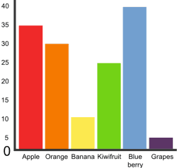
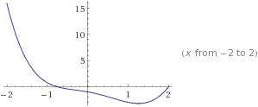
Graphs!
5
3
4
0
2
1

Slide 6
Graphs
A graph G = (V, E)
Where V is a set of vertices
E is a set of edges connecting vertex pairs
Example:
V = {0, 1, 2, 3, 4, 5}
E = {(0, 1), (0, 4), (1, 2), (1, 4), (2, 3), (3, 4), (3, 5)}
5
3
4
0
2
1

Slide 7

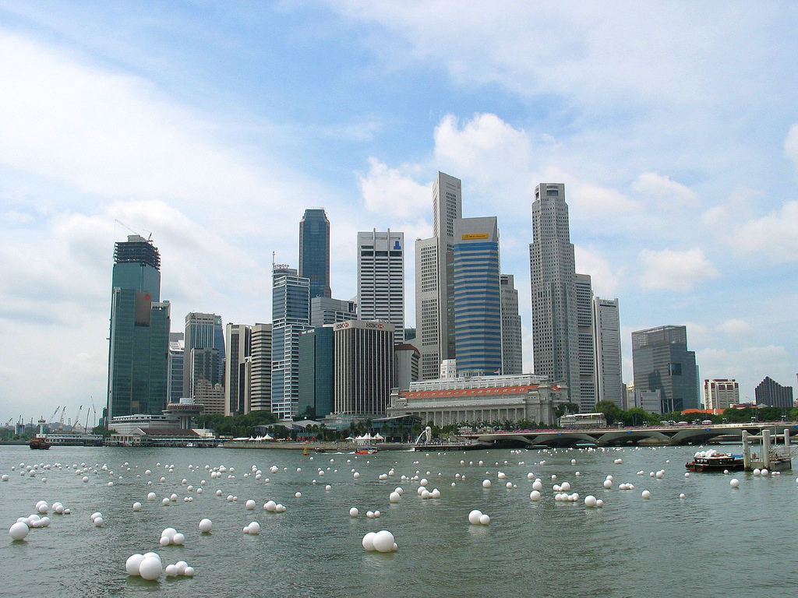
Why?
Can be used to model many different scenarios

Slide 8
Some definitions
Undirected graph
Edges are unordered pairs: (A, B) == (B, A)
Directed graph
Edges are ordered pairs: (A, B) != (B, A)
Adjacent vertices, or neighbors
Vertices connected by an edge

Slide 9
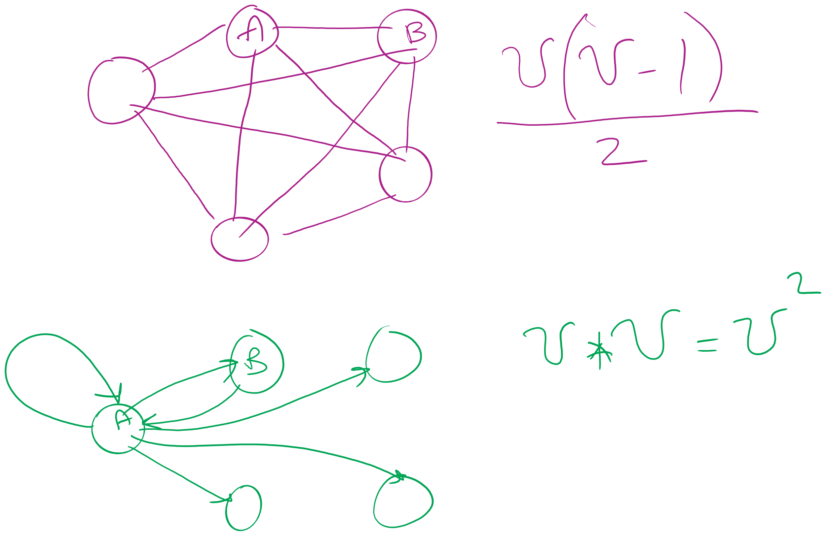
Graph sizes
Let v = |V|, and e = |E|
Given v, what are the minimum/maximum sizes of e?
Minimum value of e?
Definition doesn’t necessitate that there are any edges…
So, 0
Maximum of e?
Depends…
Are self edges allowed?
Directed graph or undirected graph?
In this class, we'll assume directed graphs have self edges while undirected graphs do not
Notes:
directed (w/ self edges)
v vertices each with edges to v vertices
v²
undirected (no self edges)
v vertices with edges to v-1 vertices
BUT remember for undirected, (1, 2) == (2, 1)
v(v - 1) / 2
(v² - v) / 2

Slide 10
More definitions
A graph is considered sparse if:
e <= v lg v
A graph is considered dense as it approaches the maximum number of edges
I.e., e == MAX - ε
A complete graph has the maximum number of edges
Notes:
v² - ε for directed
((v² - v) / 2) - ε for undirected
Have we seen “sparse” and dense before?
yes -- with tries, for sparse tries DLB is better; for dense, R-way tries are better

Slide 11
Question:
5
5
==
or
!=
3
4
4
3
0
0
2
1
1
2
?
Notes:
Different spatial representations of the same vertices/edges are considered the same graph

Slide 12
Representing graphs
Trivially, graphs can be represented as:
List of vertices
List of edges
Performance?
Assume we're going to be analyzing static graphs
I.e., no insert and remove
So what operations should we consider?
Notes:
We haven’t talked about problems to solve yet, but can you imagine tasks you might want to do with graphs?

Slide 13
Using an adjacency matrix
Rows/columns are vertex labels
M[i][j] = 1 if (i, j) ∈ E
M[i][j] = 0 if (i, j) ∉ E
 | 0 | 1 | 2 | 3 | 4 | 5
0 | 0 | 1 | 0 | 0 | 1 | 0
1 | 1 | 0 | 1 | 0 | 1 | 0
2 | 0 | 1 | 0 | 1 | 0 | 0
3 | 0 | 0 | 1 | 0 | 1 | 1
4 | 1 | 1 | 0 | 1 | 0 | 0
5 | 0 | 0 | 0 | 1 | 0 | 0

Slide 14
Please submit your reflections by using the CourseMIRROR App
If you are having a problem with CourseMIRROR, please send an email to coursemirror.development@gmail.com
Notes:
All right!
Upcoming Due Dates at A Glance

