Slide 1

Algorithms and Data Structures 2 CS 1501
Spring 2022
Sherif Khattab
ksm73@pitt.edu
(Slides are adapted from Dr. Ramirez’s and Dr. Farnan’s CS1501 slides.)

Slide 2
Announcements
Upcoming deadlines:
Homework 8 due on 3/21
Lab 8 due on 3/25
Homework 9 due on 3/28
Assignment 2 due on 3/28

Slide 3
Previous lecture …
Minimum Spanning Tree Problem

Slide 4
CourseMIRROR Reflections (most confusing)
how to assign the value for each edge
The process for finding an articulation point algorithmically was most confusing
Why low is the minimum of num(v), num(w), lowest low(w)
The method of visiting every node of a weighted graph using the path with the lightest weight was most confusing.

Slide 5
CourseMIRROR Reflections (most interesting)
Tracing through Depth First and Breadth First Searches
Low value tracking
Algorithm for finding articulation points
The idea of a weighted graph was most interesting.
I found it interesting how back edges helped with finding articulation nodes
The simplicity and correctness of Prim’s algorithm
The articulation point algorithm and minimizing costs with connections

Slide 6
Problem of the Day
Neighborhood connectivity project
We want to keep a set of neighborhoods connected with the minimum cost possible
Input: A set of neighborhoods and a file with the following format:
neighborhood i, neighborhood j, cost of connecting the two neighborhoods
…
Output: A set of neighborhood pairs to be connected and a total cost
We can go from any neighborhood to any other (connected)
The total cost should be minimum (i.e., as small as it can be) (minimal cost)

Slide 7
Prim’s algorithm
10
1
4
1
4
4
6
8
7
0
9
5
0
3
6
3
6
2
9
8
2
2
2
5
5
1
Notes:
Green verticies/red edges in T
be sure to highlight the set of edges that could possibly be used to bring a vertex into T
grey edges that connect two green vertices dont need to be considered, thing to come back to when we talk about implementation, should we try to remove them from consideration?
not really, no asymptotic improvement for parent and best edge implementation
even with eager prims, that would just be more updates to try and avoid unneccesary removals, but both have the same asymptotic cost

Slide 8
Runtime of Prim’s
At each step, check all possible edges
For a complete graph:
First iteration:
v - 1 possible edges
Next iteration:
2(v - 2) possibilities
Each vertex in T shared v-1 edges with other vertices, but the edges they shared with each other already in T
Next:
3(v - 3) possibilities
…
Runtime:
Σ_{i = 1 to v} (i * (v - i))
Evaluates to Θ(v³)
Notes:
naively what we did on the previous slide looking at the images

Slide 9
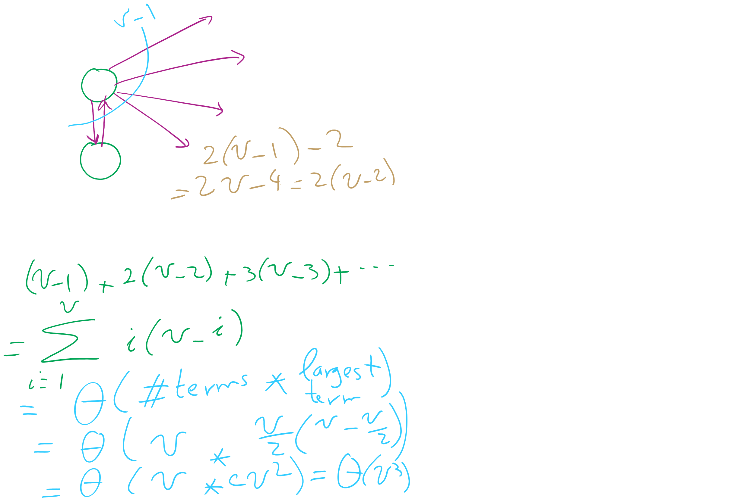
Analysis of Naïve implementation of Prim’s MST Algorithm

Slide 10
Do we need to look through all remaining edges?
No! We only need to consider the best edge possible for each vertex!

Slide 11
Prim’s algorithm
10
1
4
1
4
4
6
8
7
0
9
5
0
3
6
3
6
2
9
8
2
2
2
5
5
1
0
1
2
3
4
5
6
Parent:
--
--
--
--
--
--
--
0
0
2
1
1
5
2
5
Best Edge:
∞
0
∞
∞
∞
∞
∞
∞
4
8
2
8
10
5
1
2
Notes:
Green vertices/red edges in T

Slide 12
OK, so what's our runtime?
For every vertex we add to T, we’ll need to check all of its neighbors to check for edges to add to T next
Let's assume we use an adjacency matrix:
Takes Θ(v) to check the neighbors of a given vertex
Time to update parent/best edge arrays?
Time to pick next vertex?
What about with an adjacency list?
Notes:
v vertices will be added to T, so we do the following v times:
Search through the neighbors of the next vertex to adjust the parent and best edge arrays as needed
Constant time to update parent/best edge arrays
Neighbor enumeration:
Matrix:
Θ(v)
List:
Θ(degree)
Search through the best_edge array to find the next addition to T
Θ(v)
So, matrix:
We do v * 2 * Θ(v) work
Θ(v²)
List:
We do v * Θ(v) * degree work
Θ(v²)

Slide 13
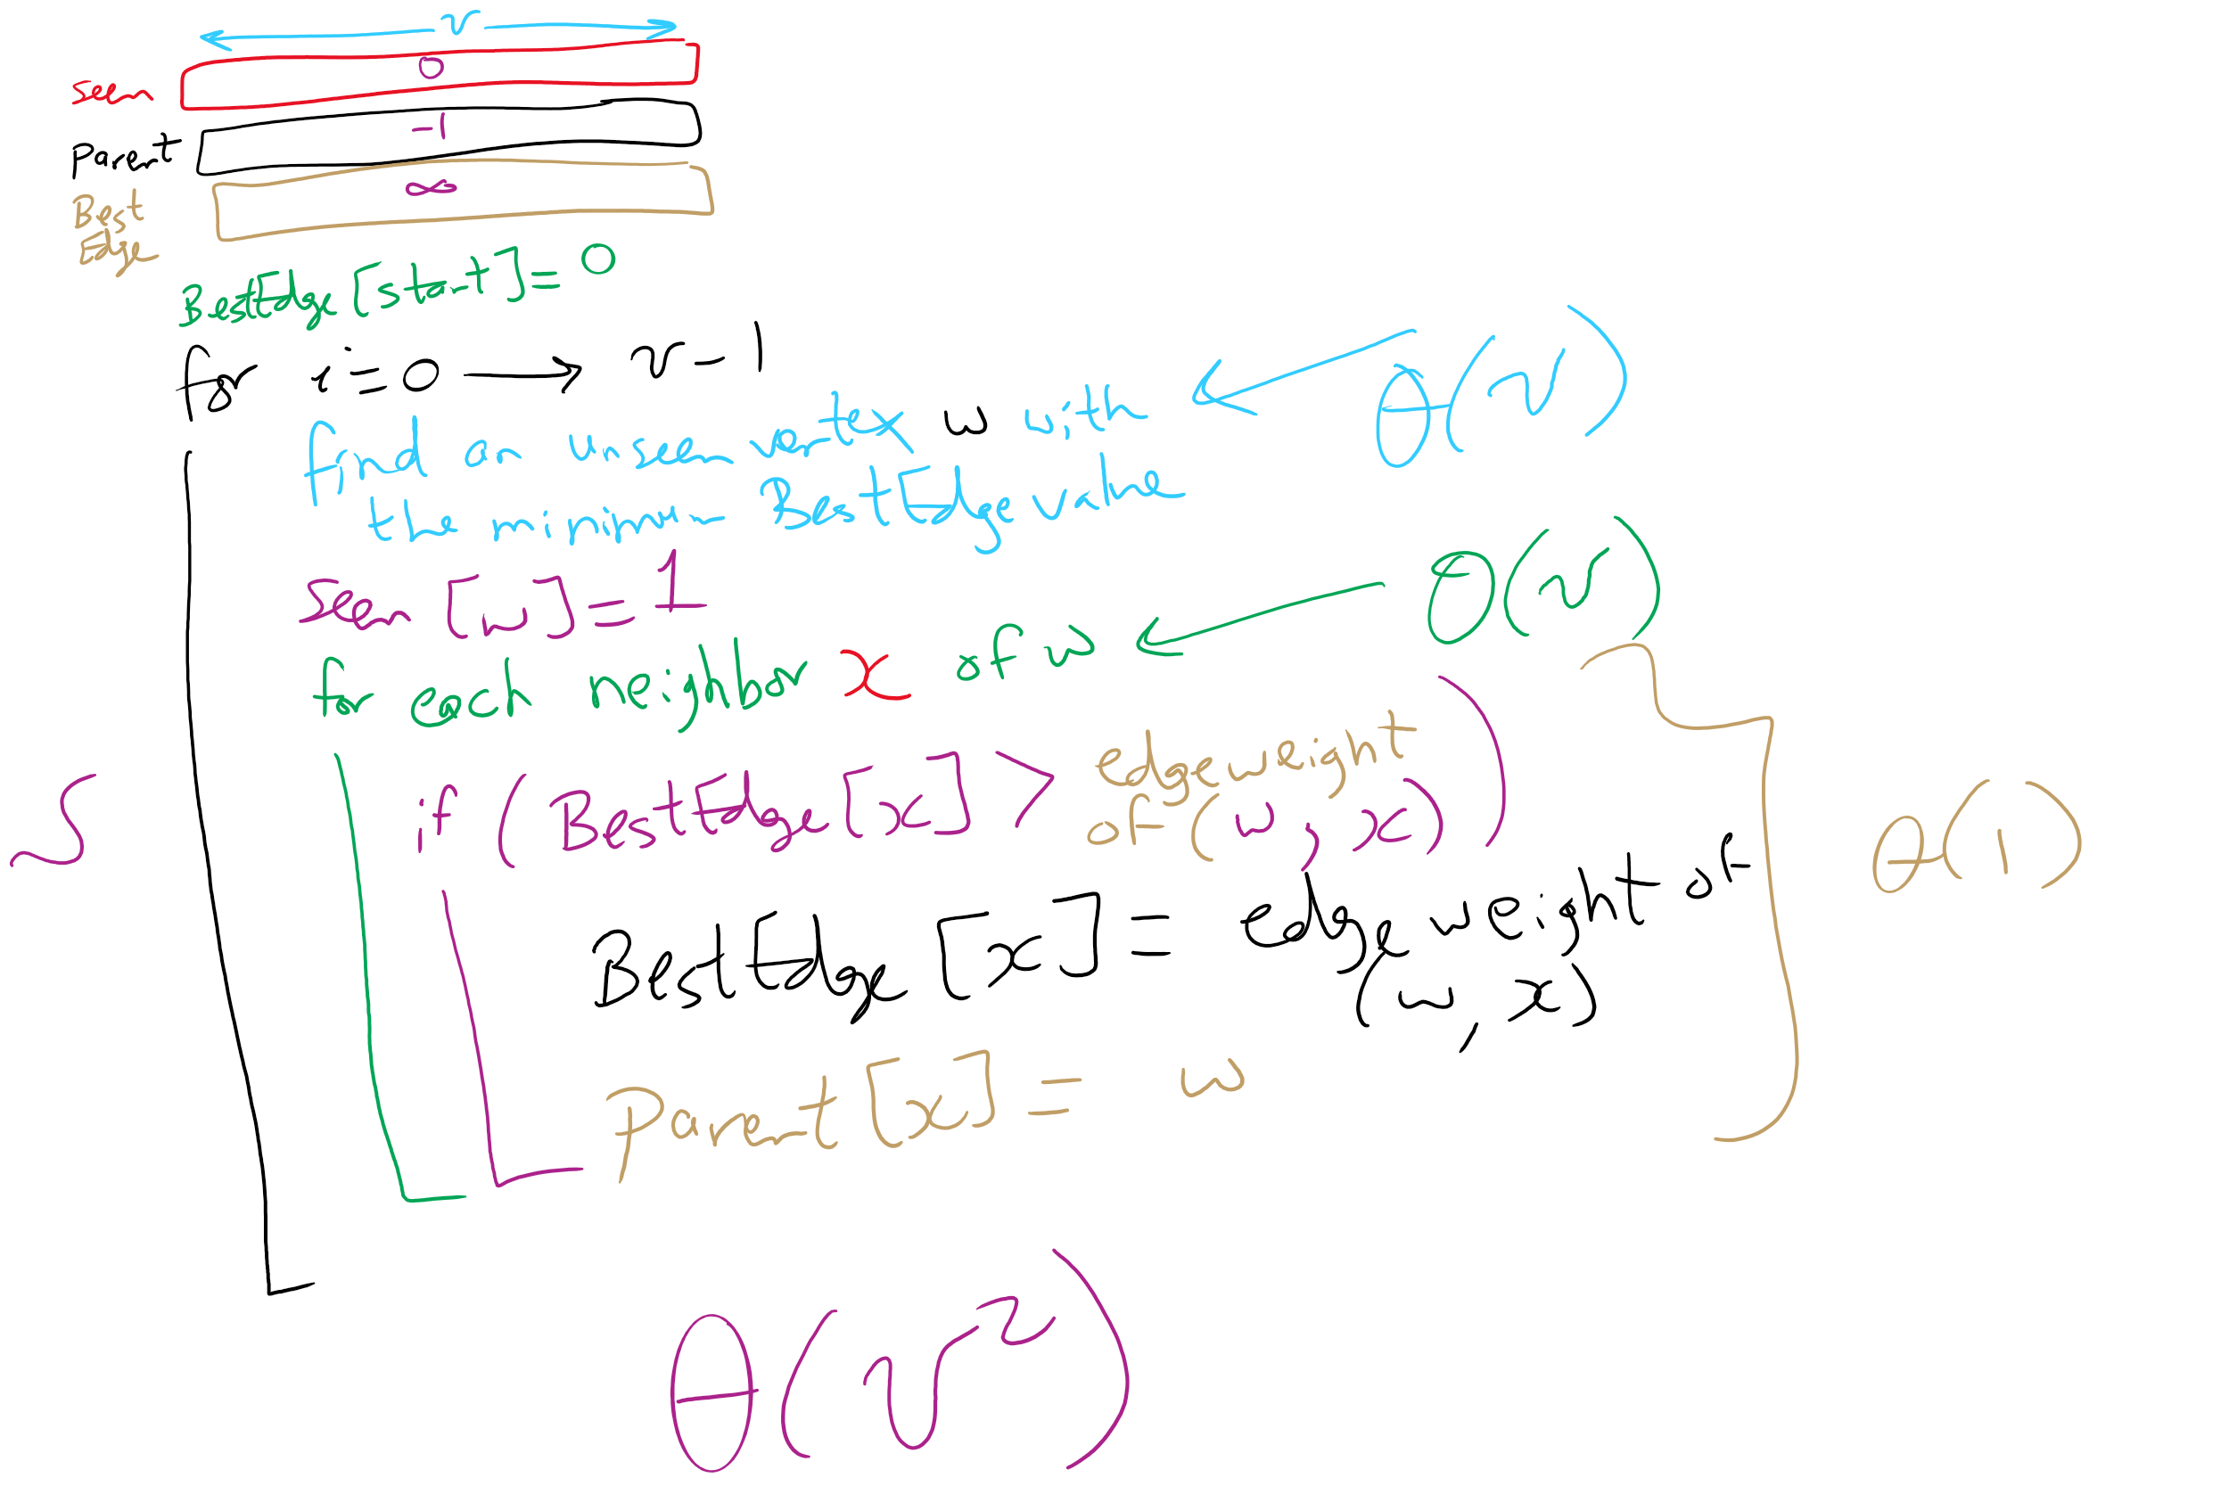
Prim’s MST Algorithm

Slide 14
Another MST algorithm
Kruskal’s MST:
Insert all edges into a PQ
Grab the min edge from the PQ that does not create a cycle in the MST
Remove it from the PQ and add it to the MST

Slide 15
Kruskal's example
0
PQ:
6
5
1
1
3
1: (0, 2)
2: (3, 5)
5
5
3: (1, 4)
2
3
2
4: (2, 5)
6
4
5: (2, 3)
5: (0, 3)
4
5
6
5: (1, 2)
6: (0, 1)
6: (2, 4)
6: (4, 5)
Notes:
note that we can stop after we add (1, 2)
get the students to realize why
its connected, adding any more edges would create a cycle
do we have to stop or can we keep popping and doing cycle detection?
is it better to stop or keep going and doing cycle check for each remove?
why?
depends on time to do connected detection vs time to continue popping/cycle detection

Slide 16
Kruskal’s runtime
Instead of building up the MST starting from a single vertex, we build it up using edges all over the graph
How do we efficiently implement cycle detection?

Slide 17
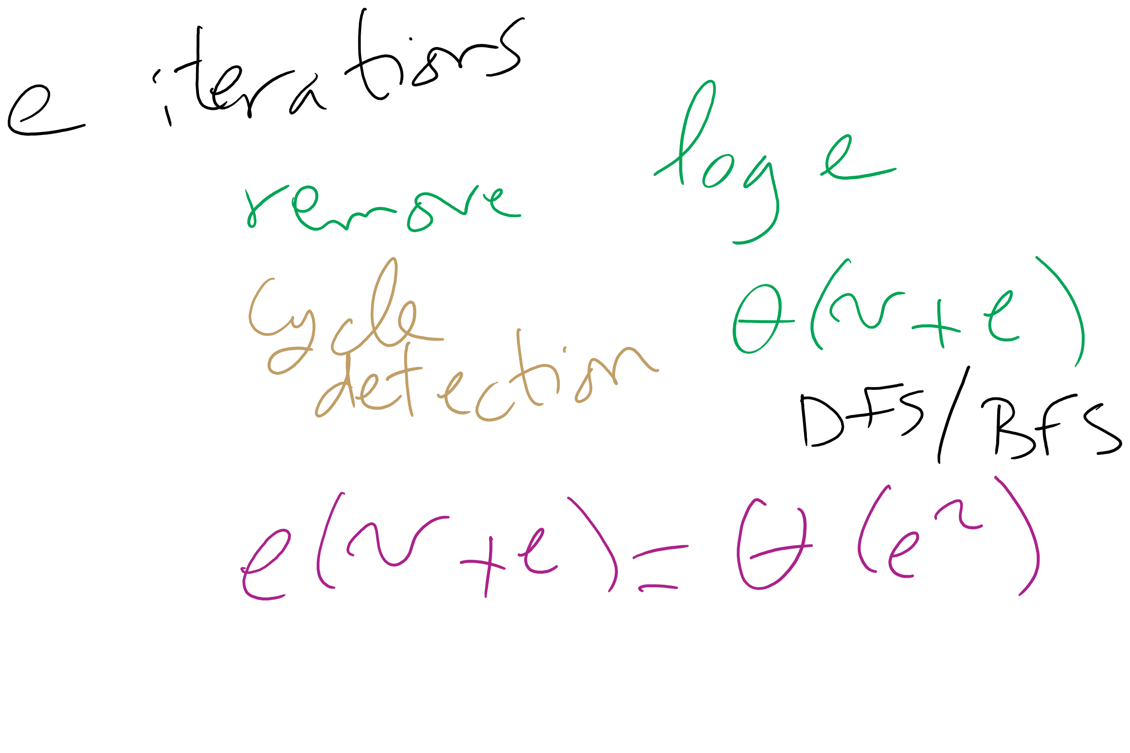
Kruskal’s Runtime: Take 1

Slide 18
Please submit your reflections by using the CourseMIRROR App
If you are having a problem with CourseMIRROR, please send an email to coursemirror.development@gmail.com
Notes:
All right!
Upcoming Due Dates at A Glance

