Slide 1

Algorithms and Data Structures 2 CS 1501
Fall 2021
Sherif Khattab
ksm73@pitt.edu
(Slides are adapted from Dr. Ramirez’s and Dr. Farnan’s CS1501 slides.)

Slide 2
Announcements
Upcoming deadlines:
9/24: Homework 3
10/1: Assignment 1

Slide 3
Last lecture …
TreeADT
Basic definitions
Tree traversal

Slide 4
This Lecture
TreeADT Implementation
TreeInterface and BinaryTreeInterface
Linked Implementation
BinaryNode
BinaryTree
BinarySearchTree
SearchTreeInterface
BinarysearchTree

Slide 5
Tree Search Take 1
What is the runtime?

Slide 6
Traversals of a Binary Tree
Preorder traversal
Visit root before we visit root’s subtrees

Slide 7
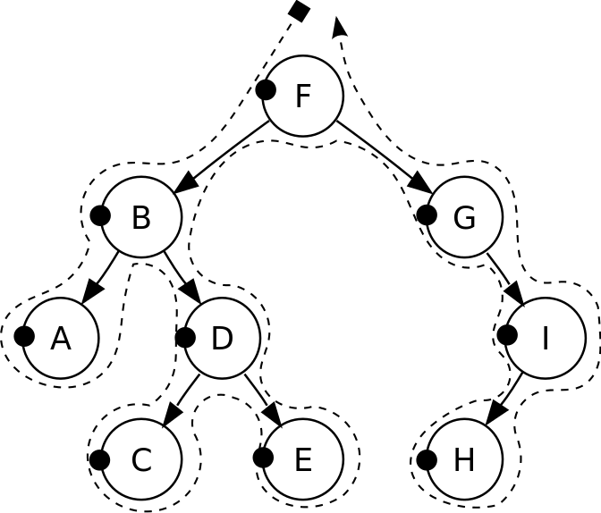
Pre-order traversal
Notes:
F, B, A, D, C, E, G, I, H
Seen before when we talked about marshalling huffman tries to the compressed file
Good for evaluating Polish notation

Slide 8
Traversals of a Binary Tree
Preorder traversal
Visit root before we visit root’s subtrees
Inorder traversal
Visit root of a binary tree between visiting nodes in root’s subtrees.

Slide 9
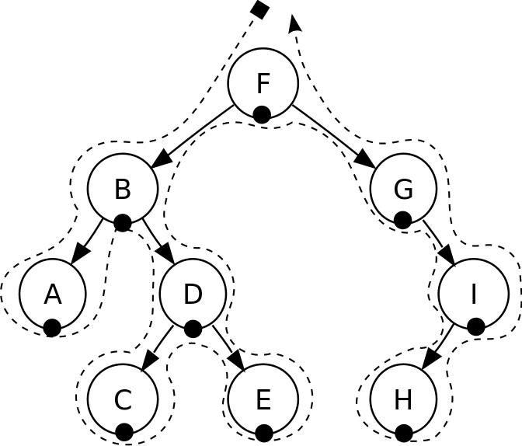
In-order traversal
Notes:
A, B, C, D, E, F, G, H, I
Seen when we wanted to enumerate all values stored in a B-tree (motivating the need for a B+tree)
Good for sorted ordering (if dealing with sorted data structure)

Slide 10
Traversals of a Binary Tree
Preorder traversal
Visit root before we visit root’s subtrees
Inorder traversal
Visit root of a binary tree between visiting nodes in root’s subtrees.
Postorder traversal
Visit root of a binary tree after visiting nodes in root’s subtrees
Level-order traversal
Begin at root and visit nodes one level at a time

Slide 11
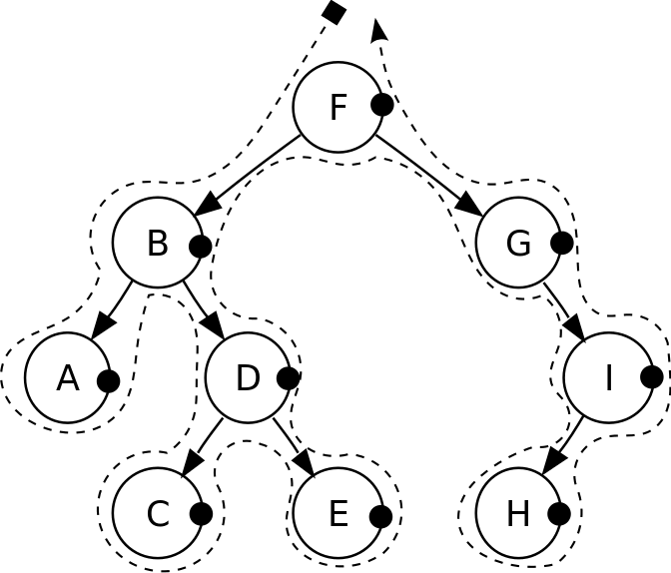
Post-order traversal
Notes:
A, C, E, D, B, H, I, G, F
Good for reverse Polish notation

Slide 12
Traversals of a Binary Tree
Preorder traversal
Visit root before we visit root’s subtrees
Inorder traversal
Visit root of a binary tree between visiting nodes in root’s subtrees.
Postorder traversal
Visit root of a binary tree after visiting nodes in root’s subtrees
Level-order traversal
Begin at root and visit nodes one level at a time

Slide 13
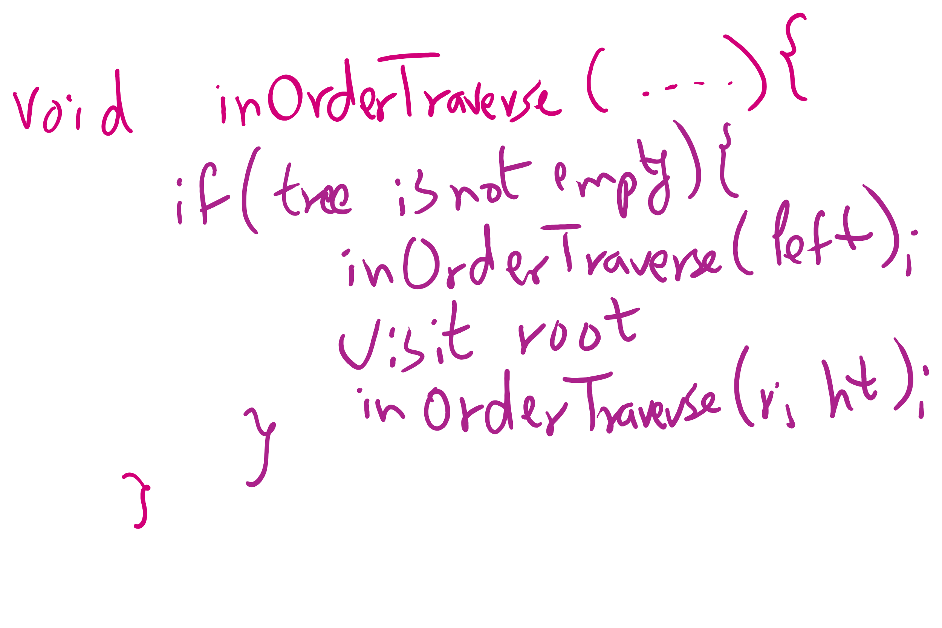
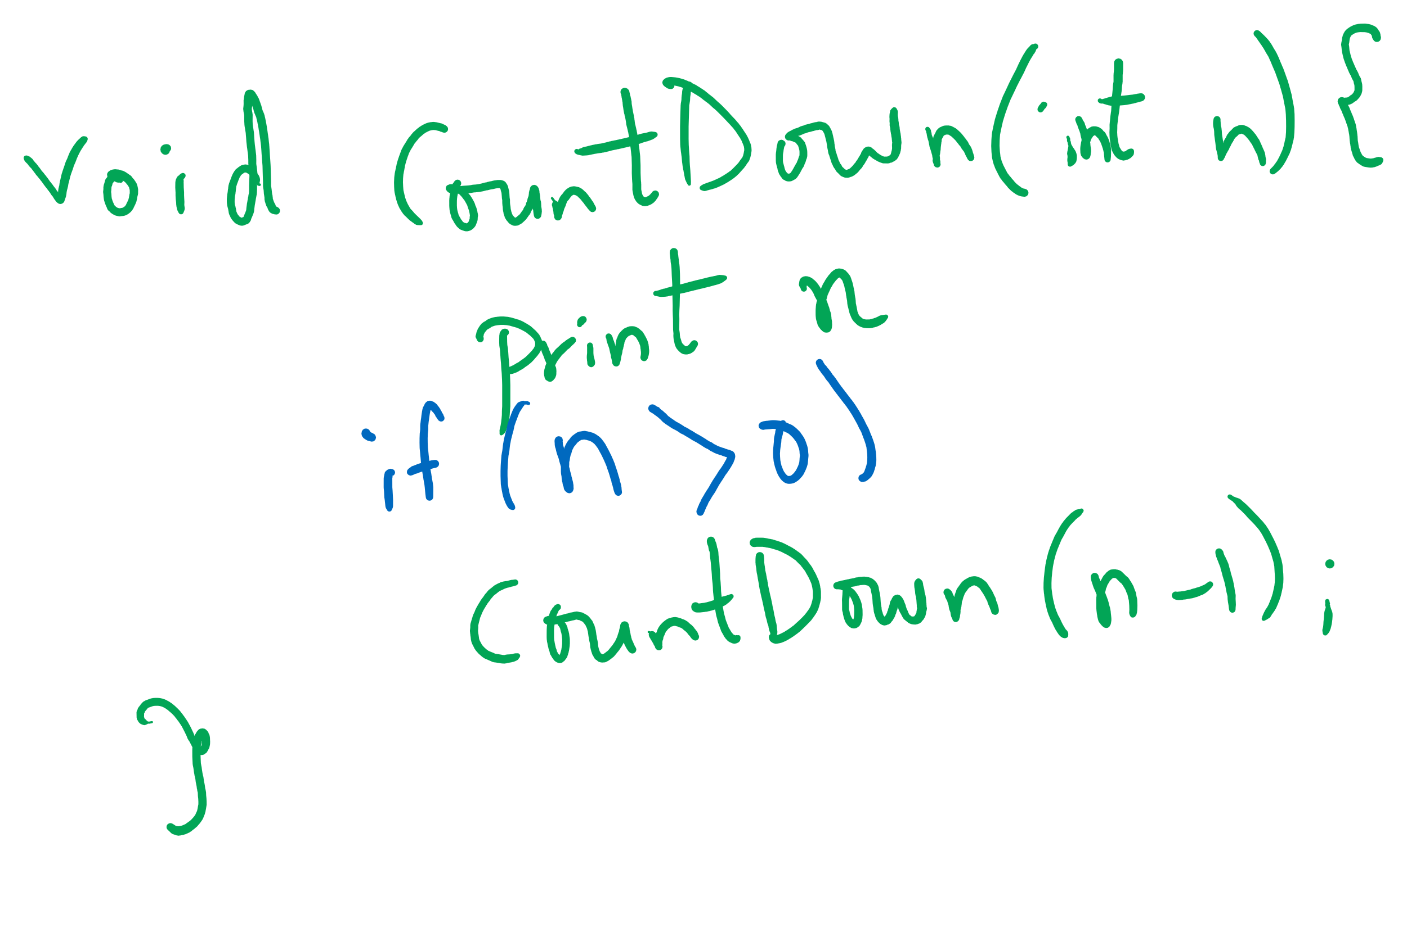
Tail-recursive Examples

Slide 14
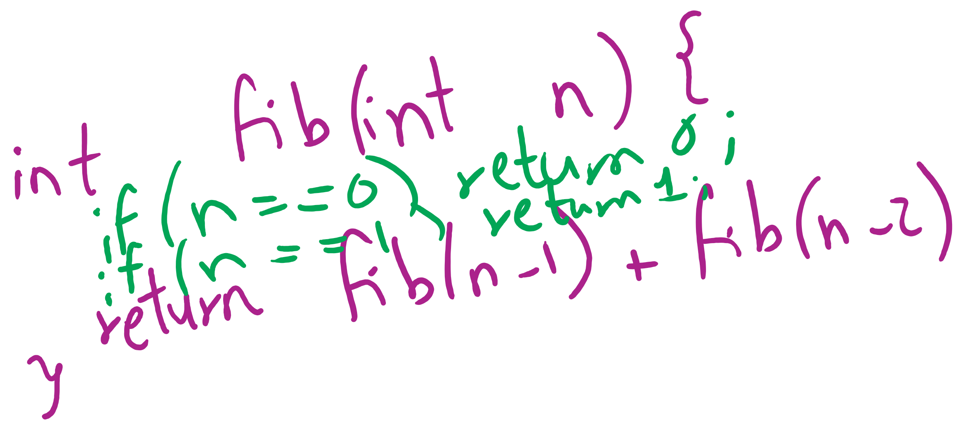
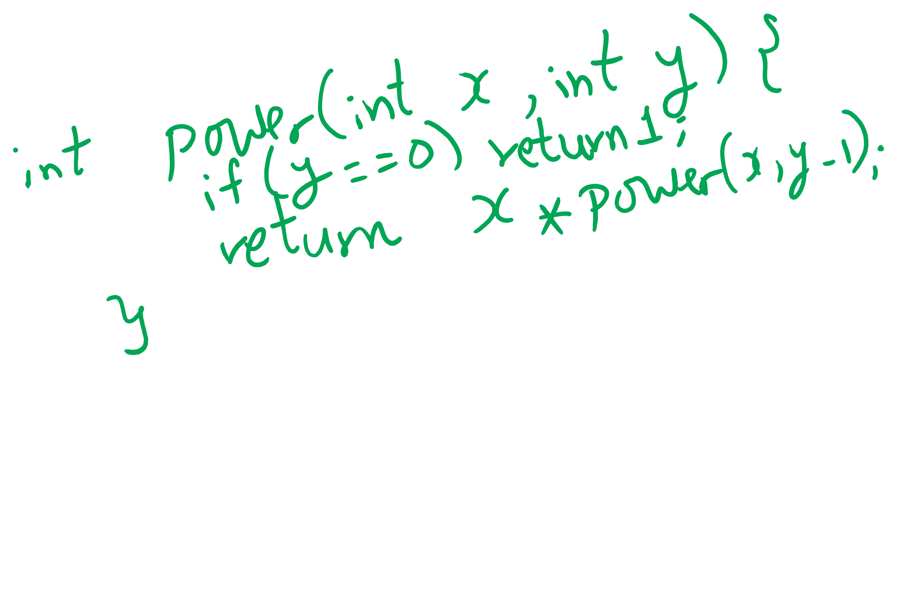
Non-tail recursive Examples

Slide 15
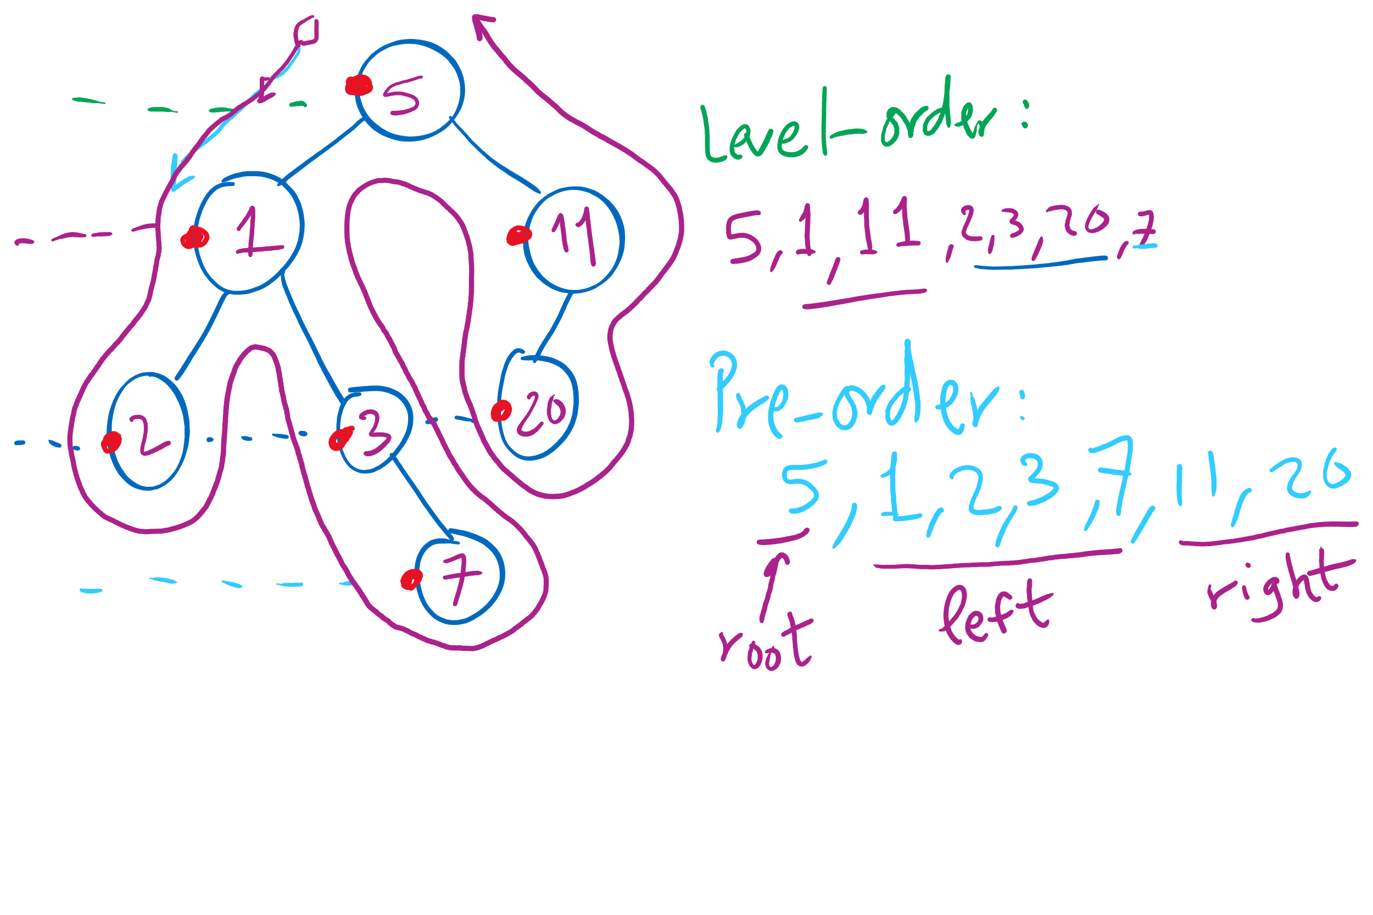
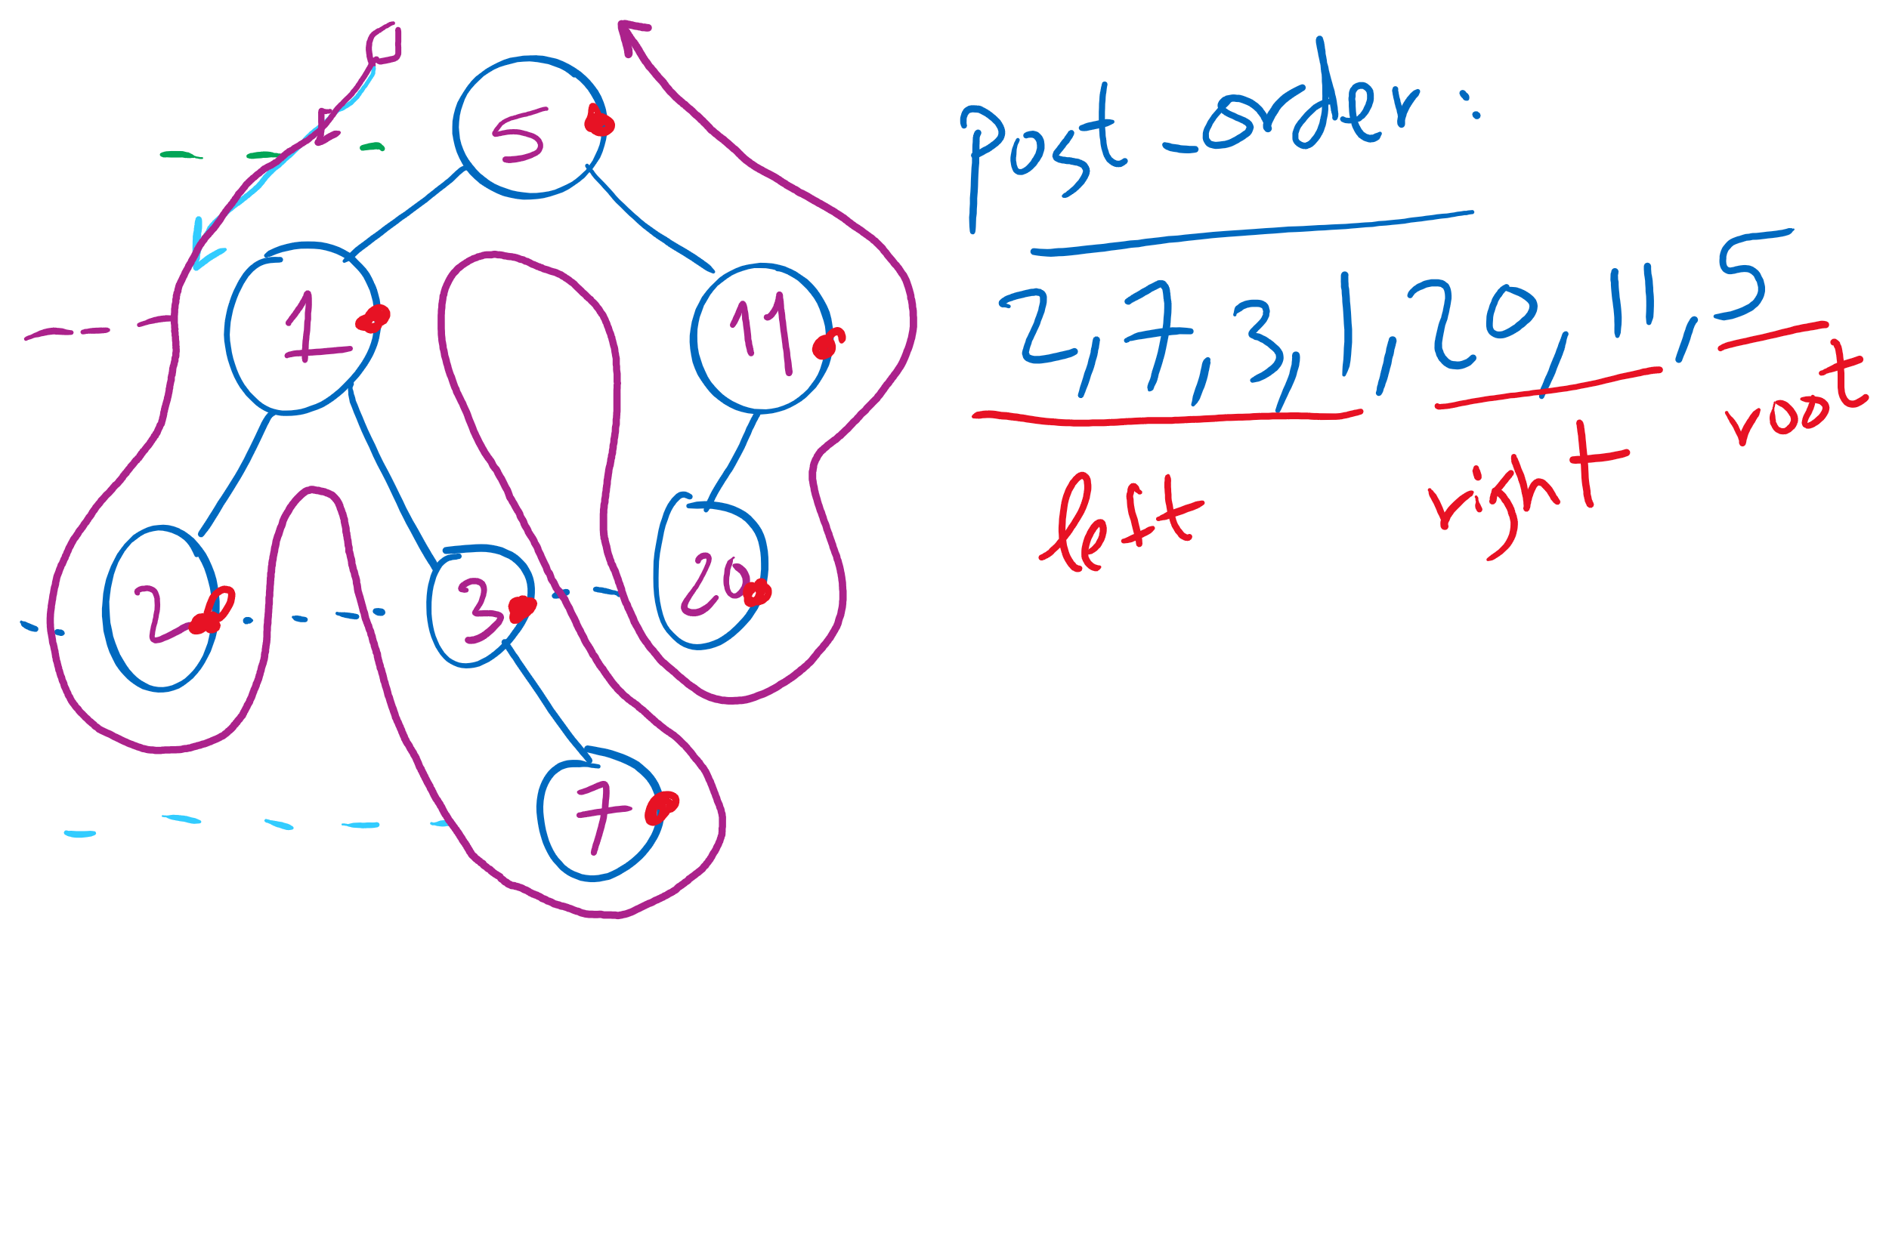
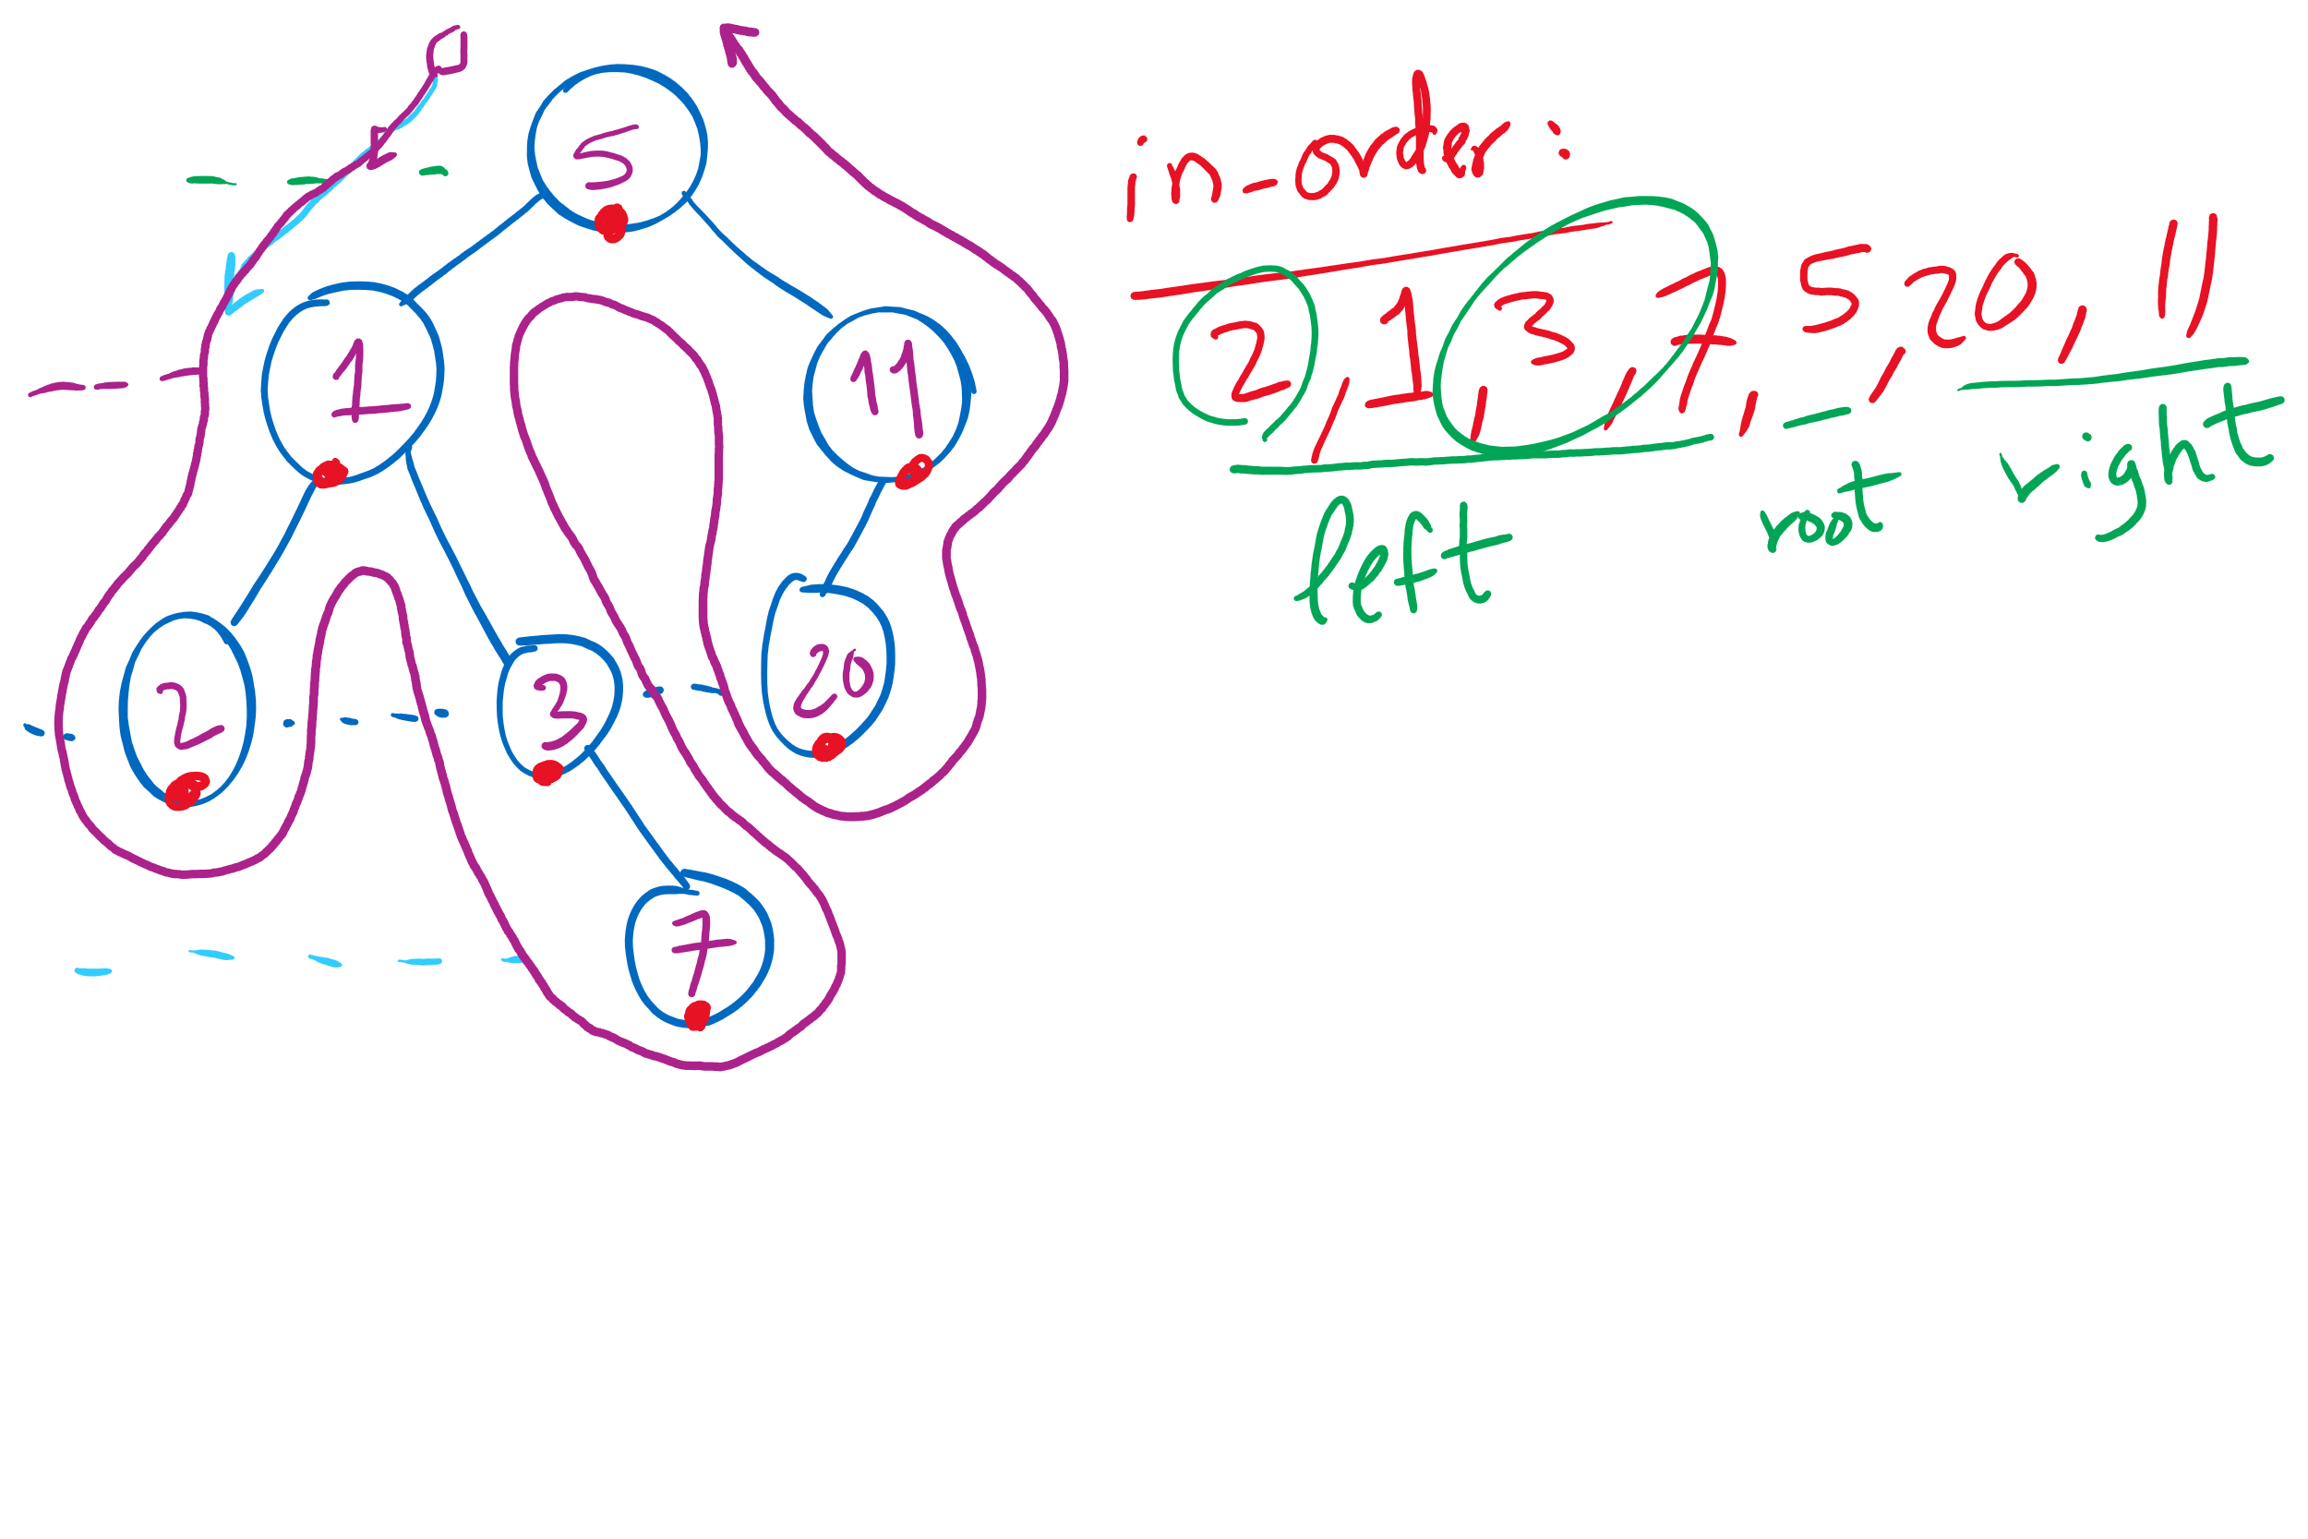
Tree Traversal Example 1

Slide 16
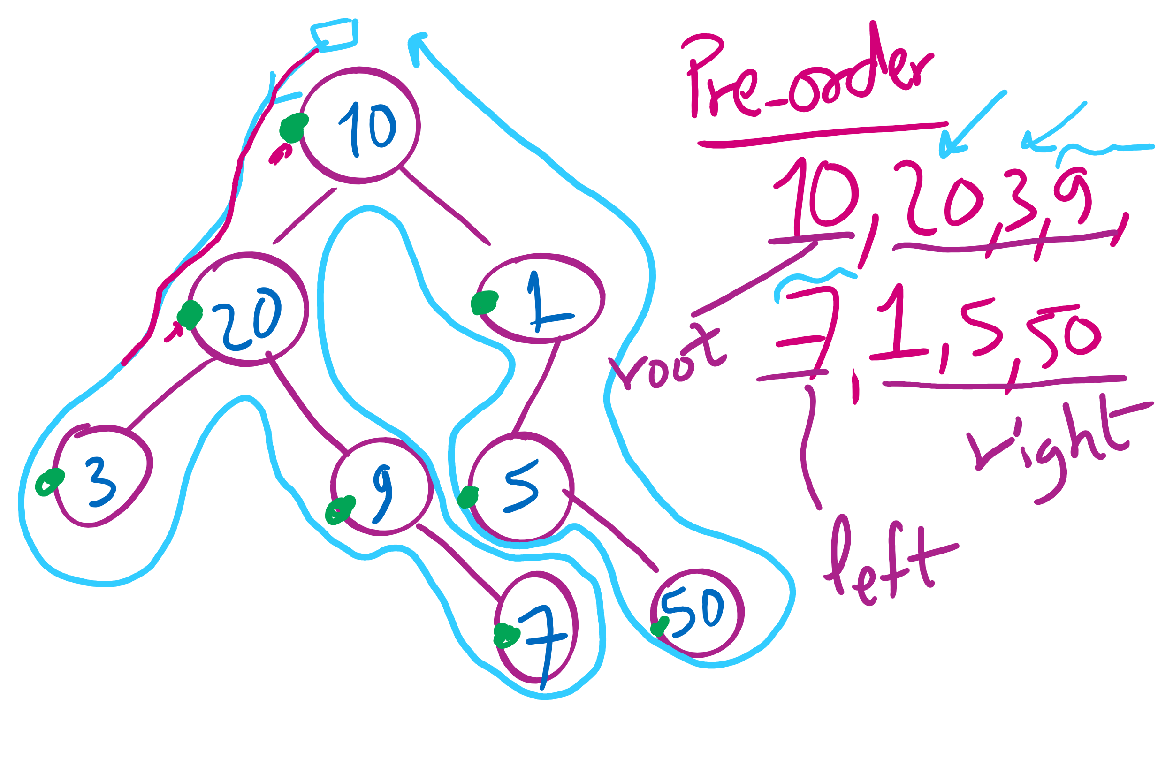
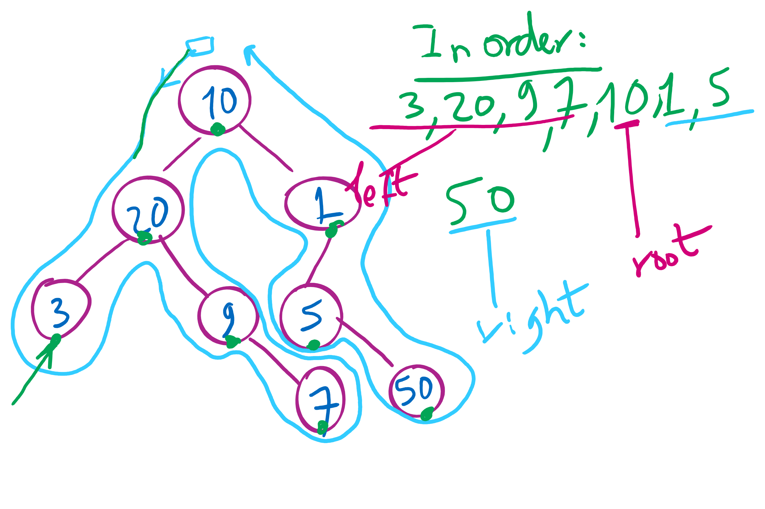
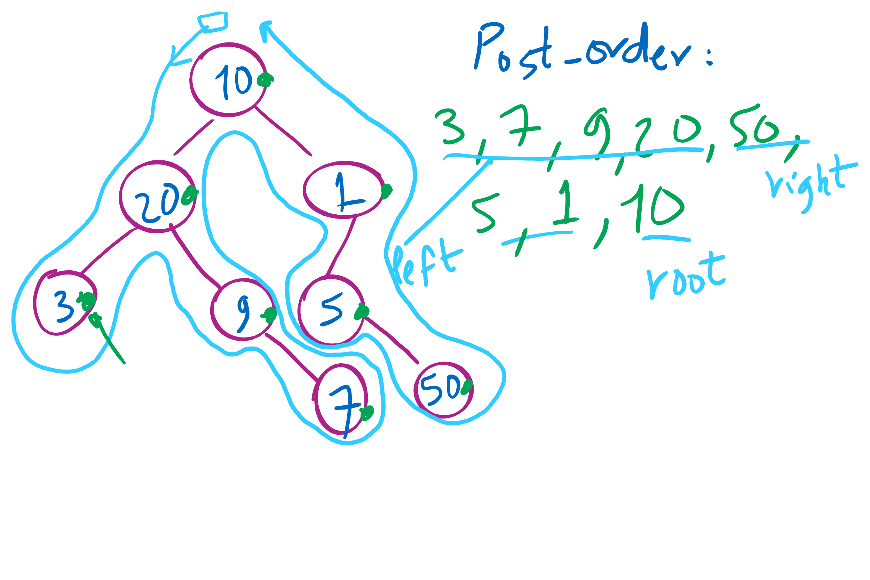
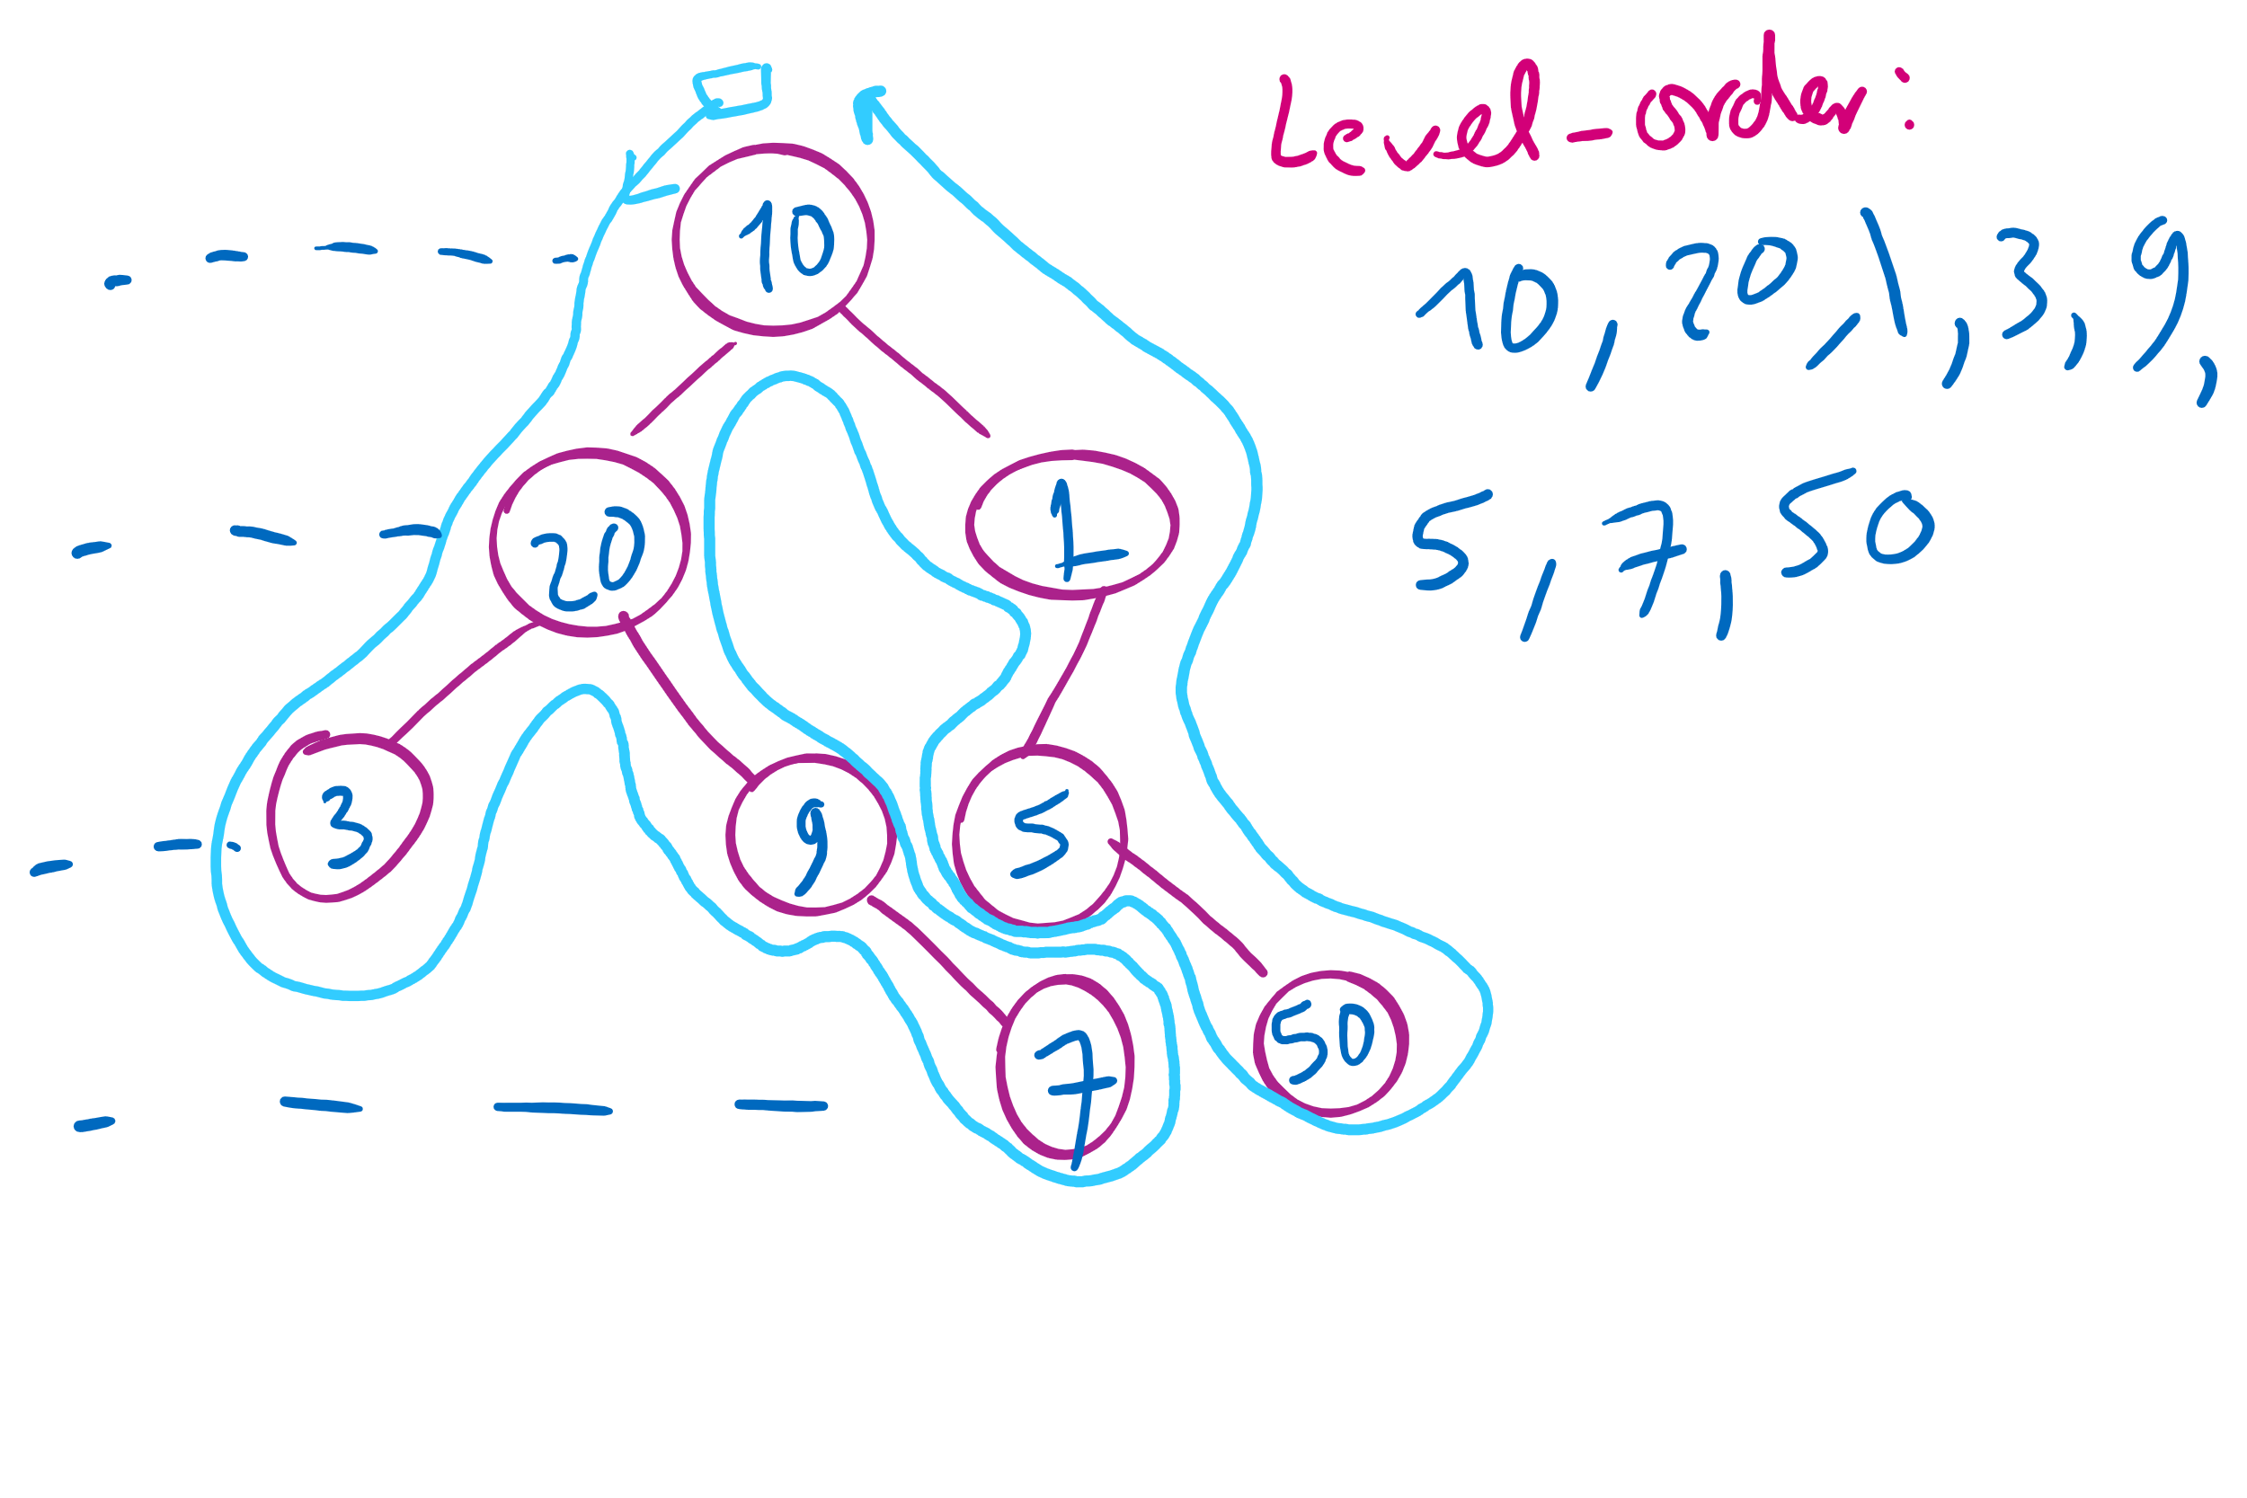
Tree Traversal Example 2

Slide 17
Please submit your reflections by using the CourseMIRROR App
If you are having a problem with CourseMIRROR, please send an email to coursemirror.development@gmail.com
Notes:
All right!
Upcoming Due Dates at A Glance

