Slide 1

Algorithms and Data Structures 2 CS 1501
Spring 2022
Sherif Khattab
ksm73@pitt.edu
(Slides are adapted from Dr. Ramirez’s and Dr. Farnan’s CS1501 slides.)

Slide 2
Announcements
Homework 1 is due on Monday 1/18 at 11:59 pm
Lab 1 posted on Canvas
Explained in recitations of this week
Github Classroom
Assignment 1 will be posted tonight

Slide 3

Last lecture …
3-sum problem
The $\sum_{all statements}{Cost∗frequency}$ technique for modeling runtime of algorithms
Asymptotic analysis
Boggle Game Problem

Slide 4
CourseMIRROR Reflections

Slide 5
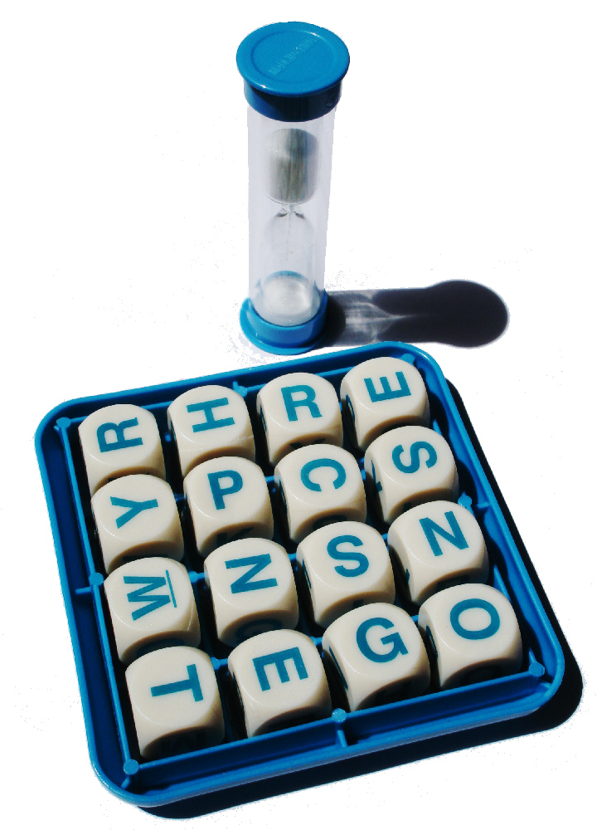
Boggle Game Problem (Recap)
Words at least 3 adjacent letters long must be assembled from a 4x4 grid
Adjacent letters are horizontally, vertically, or diagonally neighboring
Any cube in the grid can only be used once per word

Slide 6
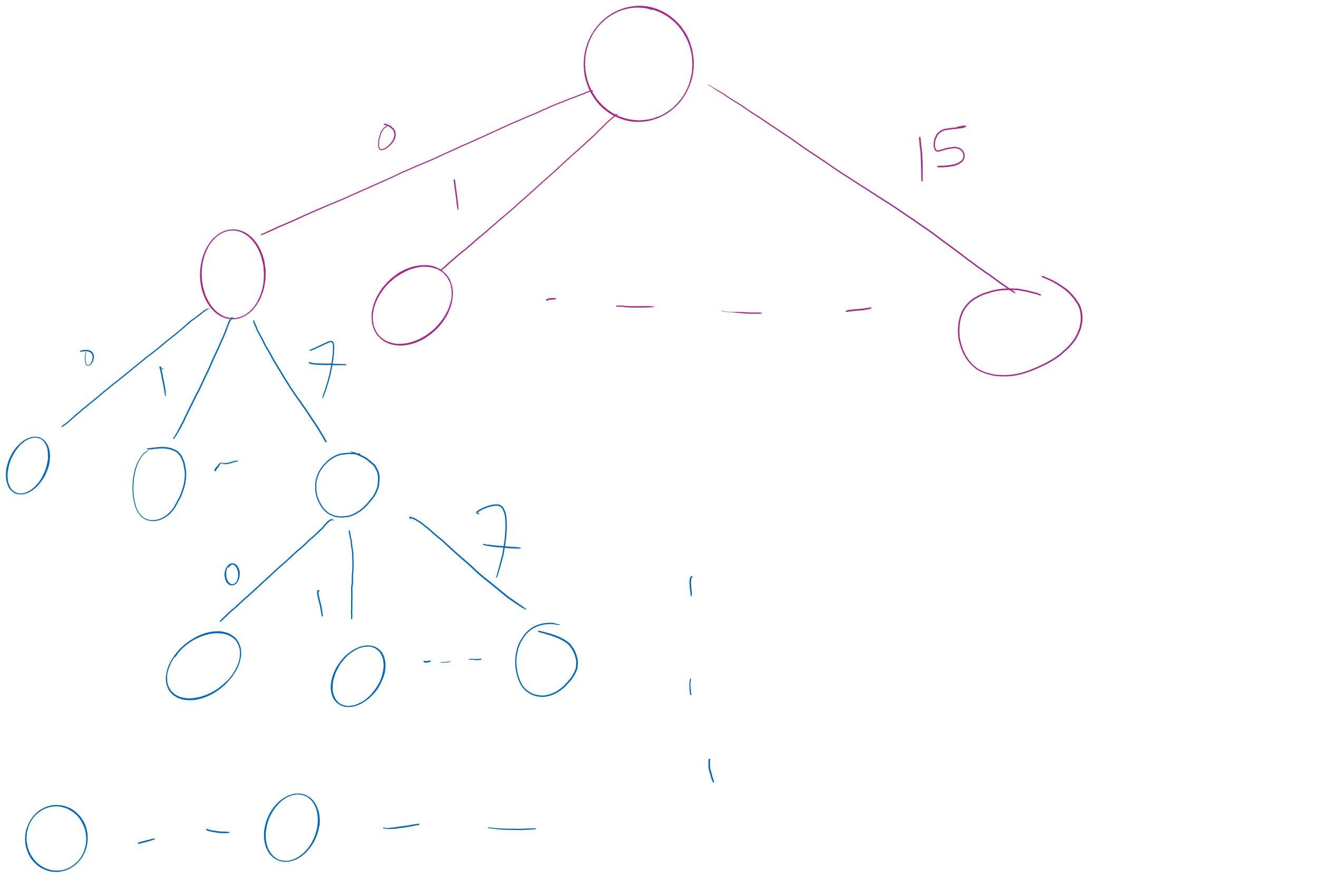
Search Space

Slide 7
Boggle Game: Decisions and Choices
For the first decision (which tile to start from), how many possible choices to choose from?
Starting from a tile, the next decision to make is which adjacent tile to move to.
There are at most 8 possible choices to choose from
There is a decision to make at each tile that we go through
A maximum of 15 decisions

Slide 8
First decision
Are all 16 choices valid?

Slide 9
Are all 8 choices valid?
Can’t go past the edge of the board
Can’t reuse the same cells in the board
Each letter added must lead to the prefix of an actual word
Check the dictionary as we add each letter, if there is no word with the currently constructed string as a prefix, don’t go further down this way
Practically, this can be used for huge savings
This is called pruning!
Notes:
Need to define pruning rules
Can’t go past the edge of the board
Can’t reuse the same cells in the board
Each letter added must lead to the prefix of an actual word
Check the dictionary for each letter recursed to, if there is no word with the currently constructed string as a prefix, backtrack
Practically, this can be used for huge savings

Slide 10
Then what?
How can we code up such exhaustive search with pruning?
The algorithm is called backtracking.

Slide 11
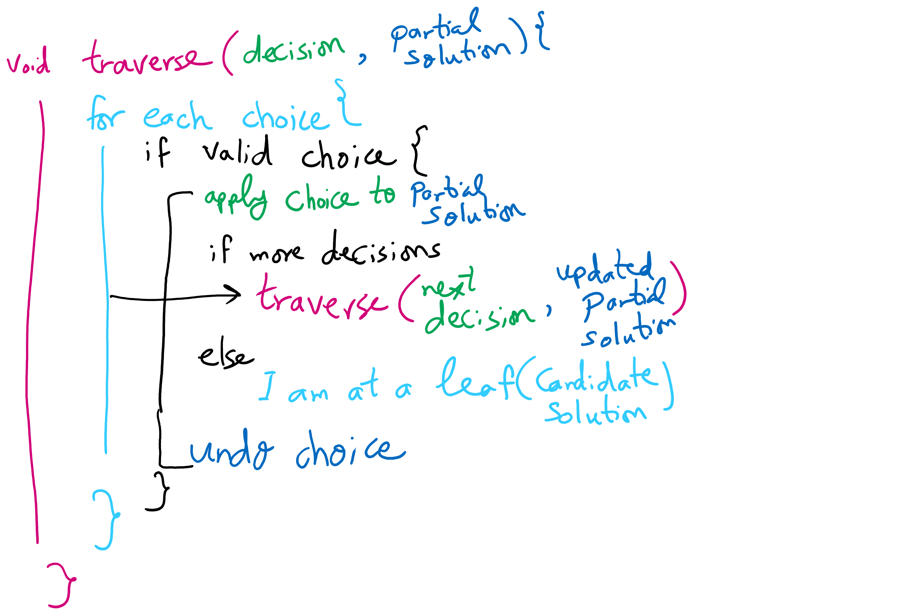
Backtracking Algorithm

Slide 12
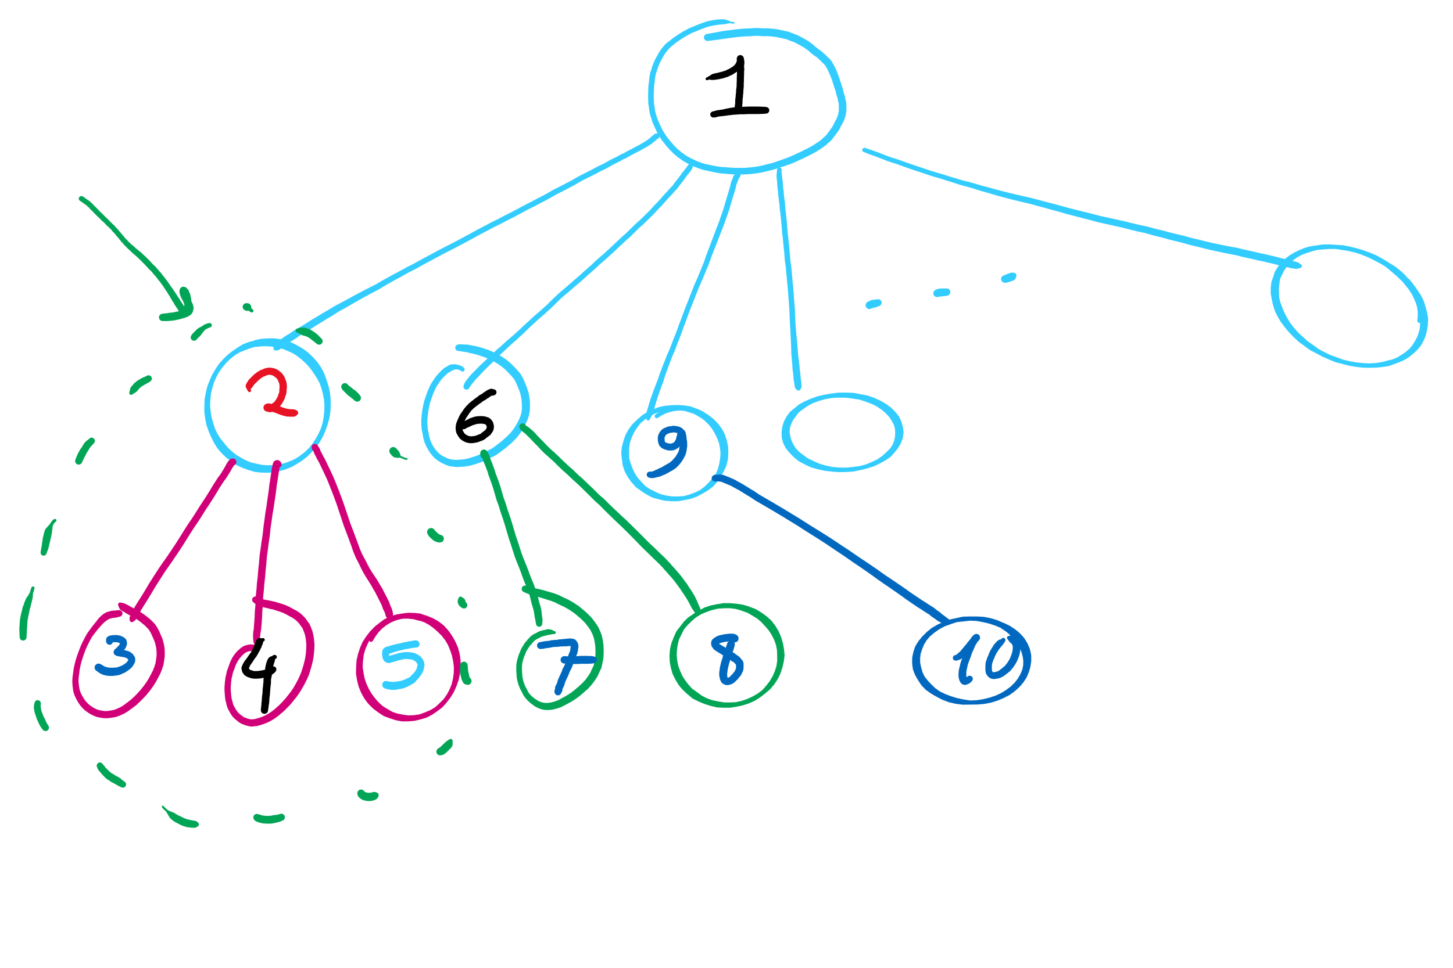
Search Tree Traversal Order in Backtracking

Slide 13
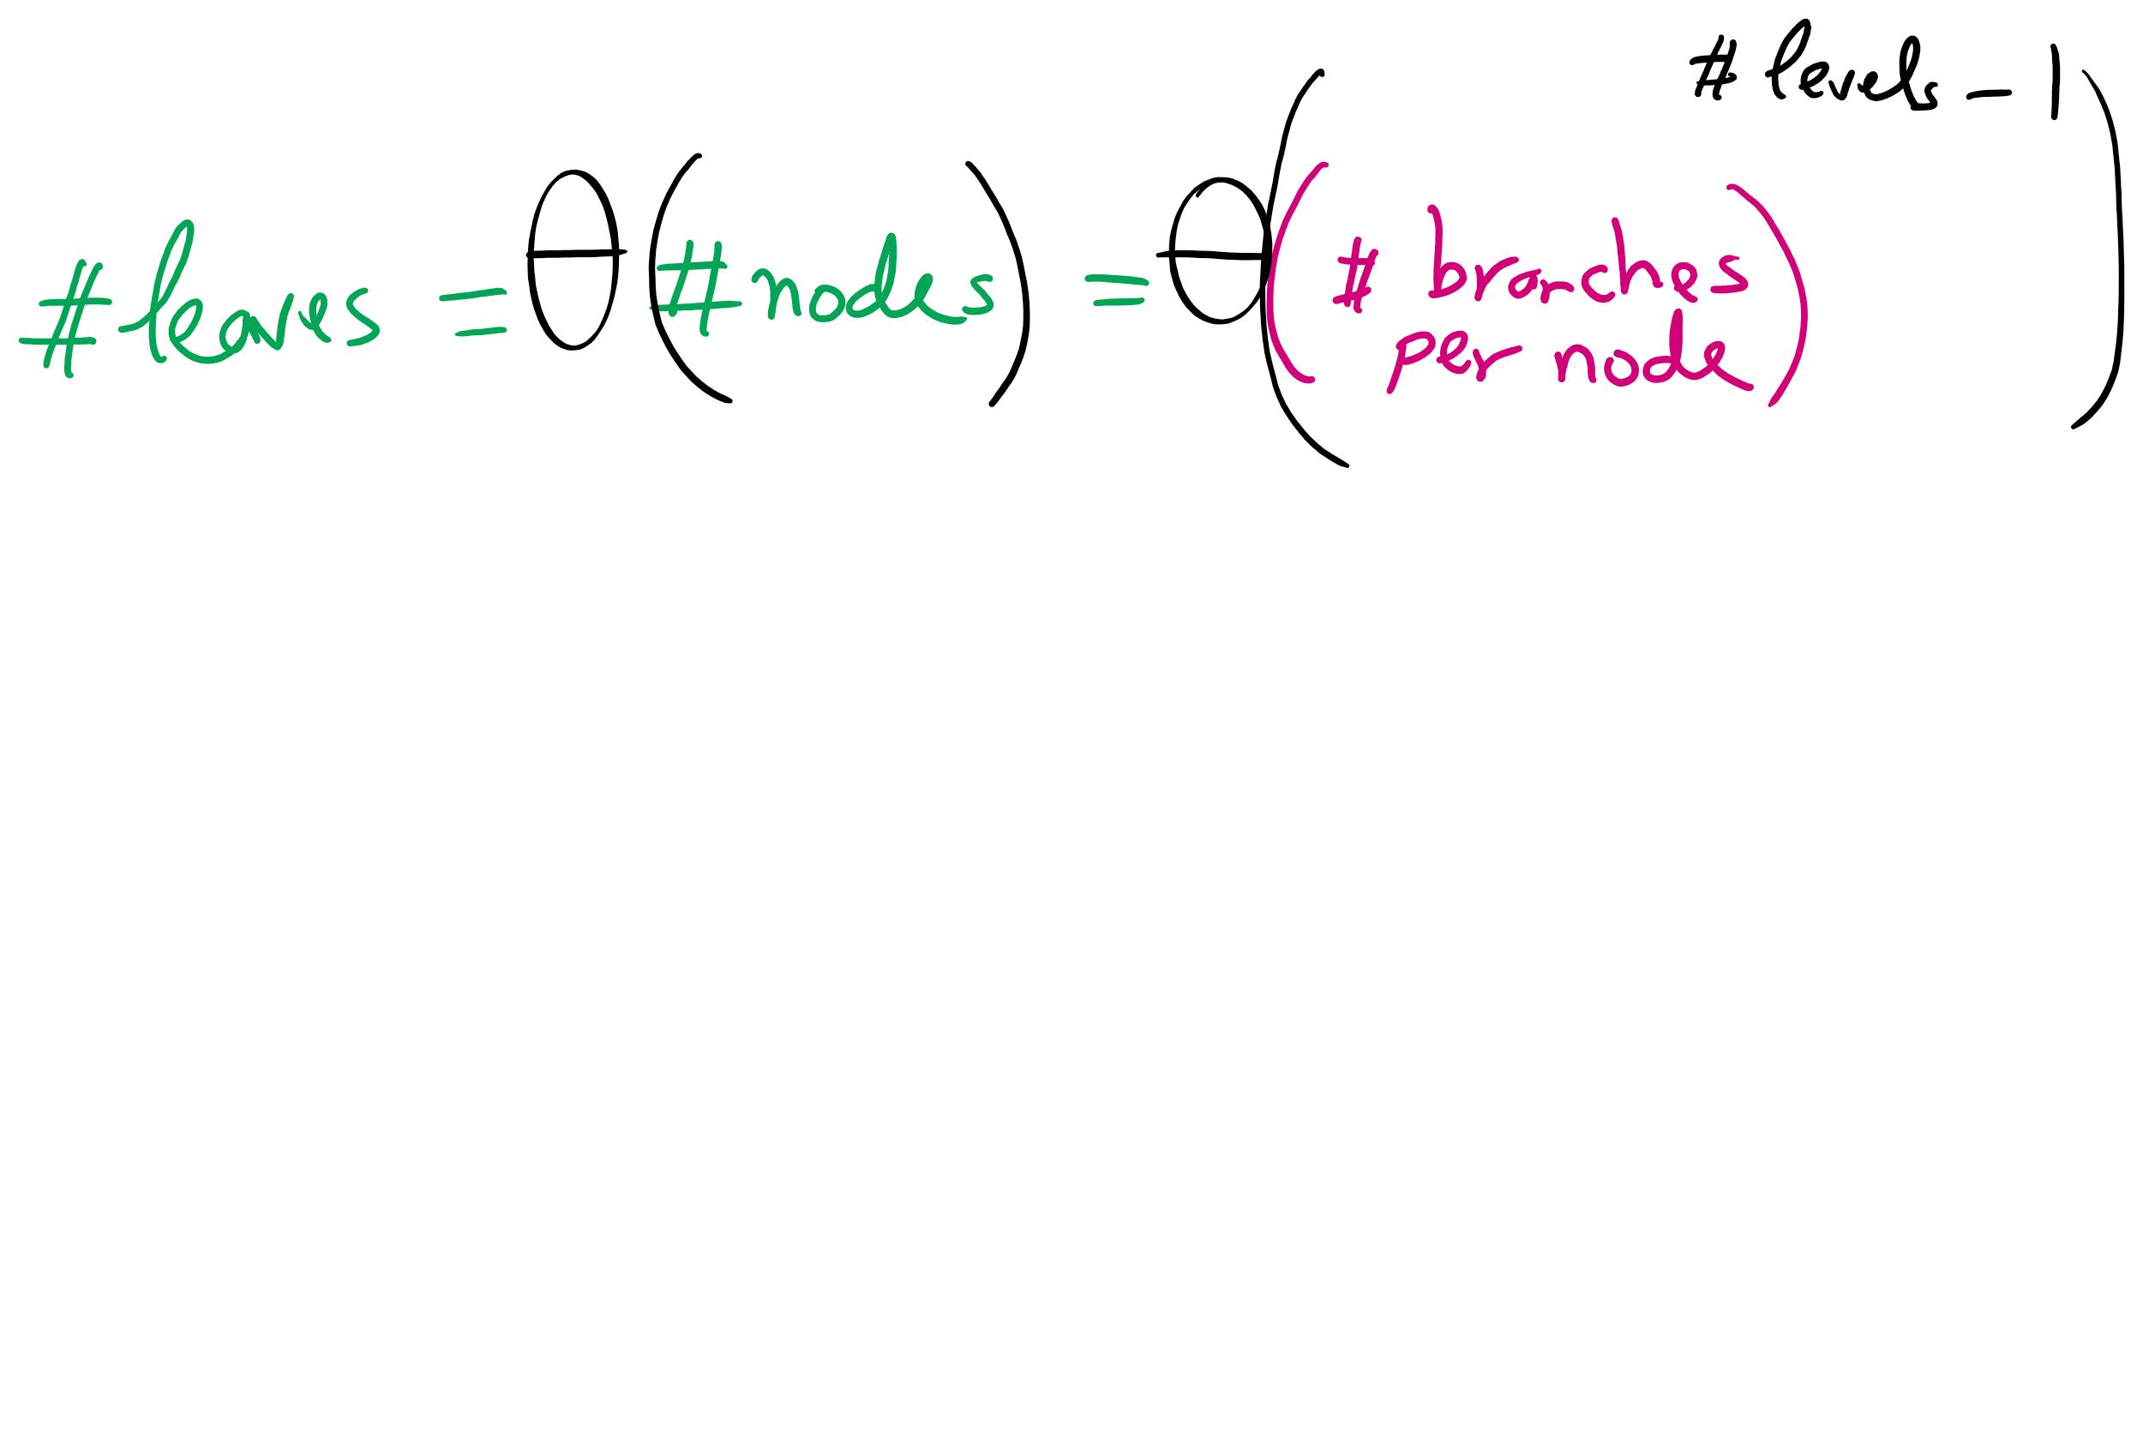
Search Tree Size

Slide 14
Implementation concerns with Boggle
Constructing the words over the course of recursion will mean building up and tearing down strings
Moving forward adds a new character to the current word string
Backtracking removes the most recent character
Basically pushing/popping to/from a string stack
Push/Pop stack operations are generally Θ(1)
Unless you need to resize, but that cost can be amortized
Java Strings, however, are immutable
s = new String(“Here is a basic string”);
s = s + “ this operation allocates and initializes all over again”;
Becomes essentially a Θ(n) operation
Where n is the length of the string

Slide 15
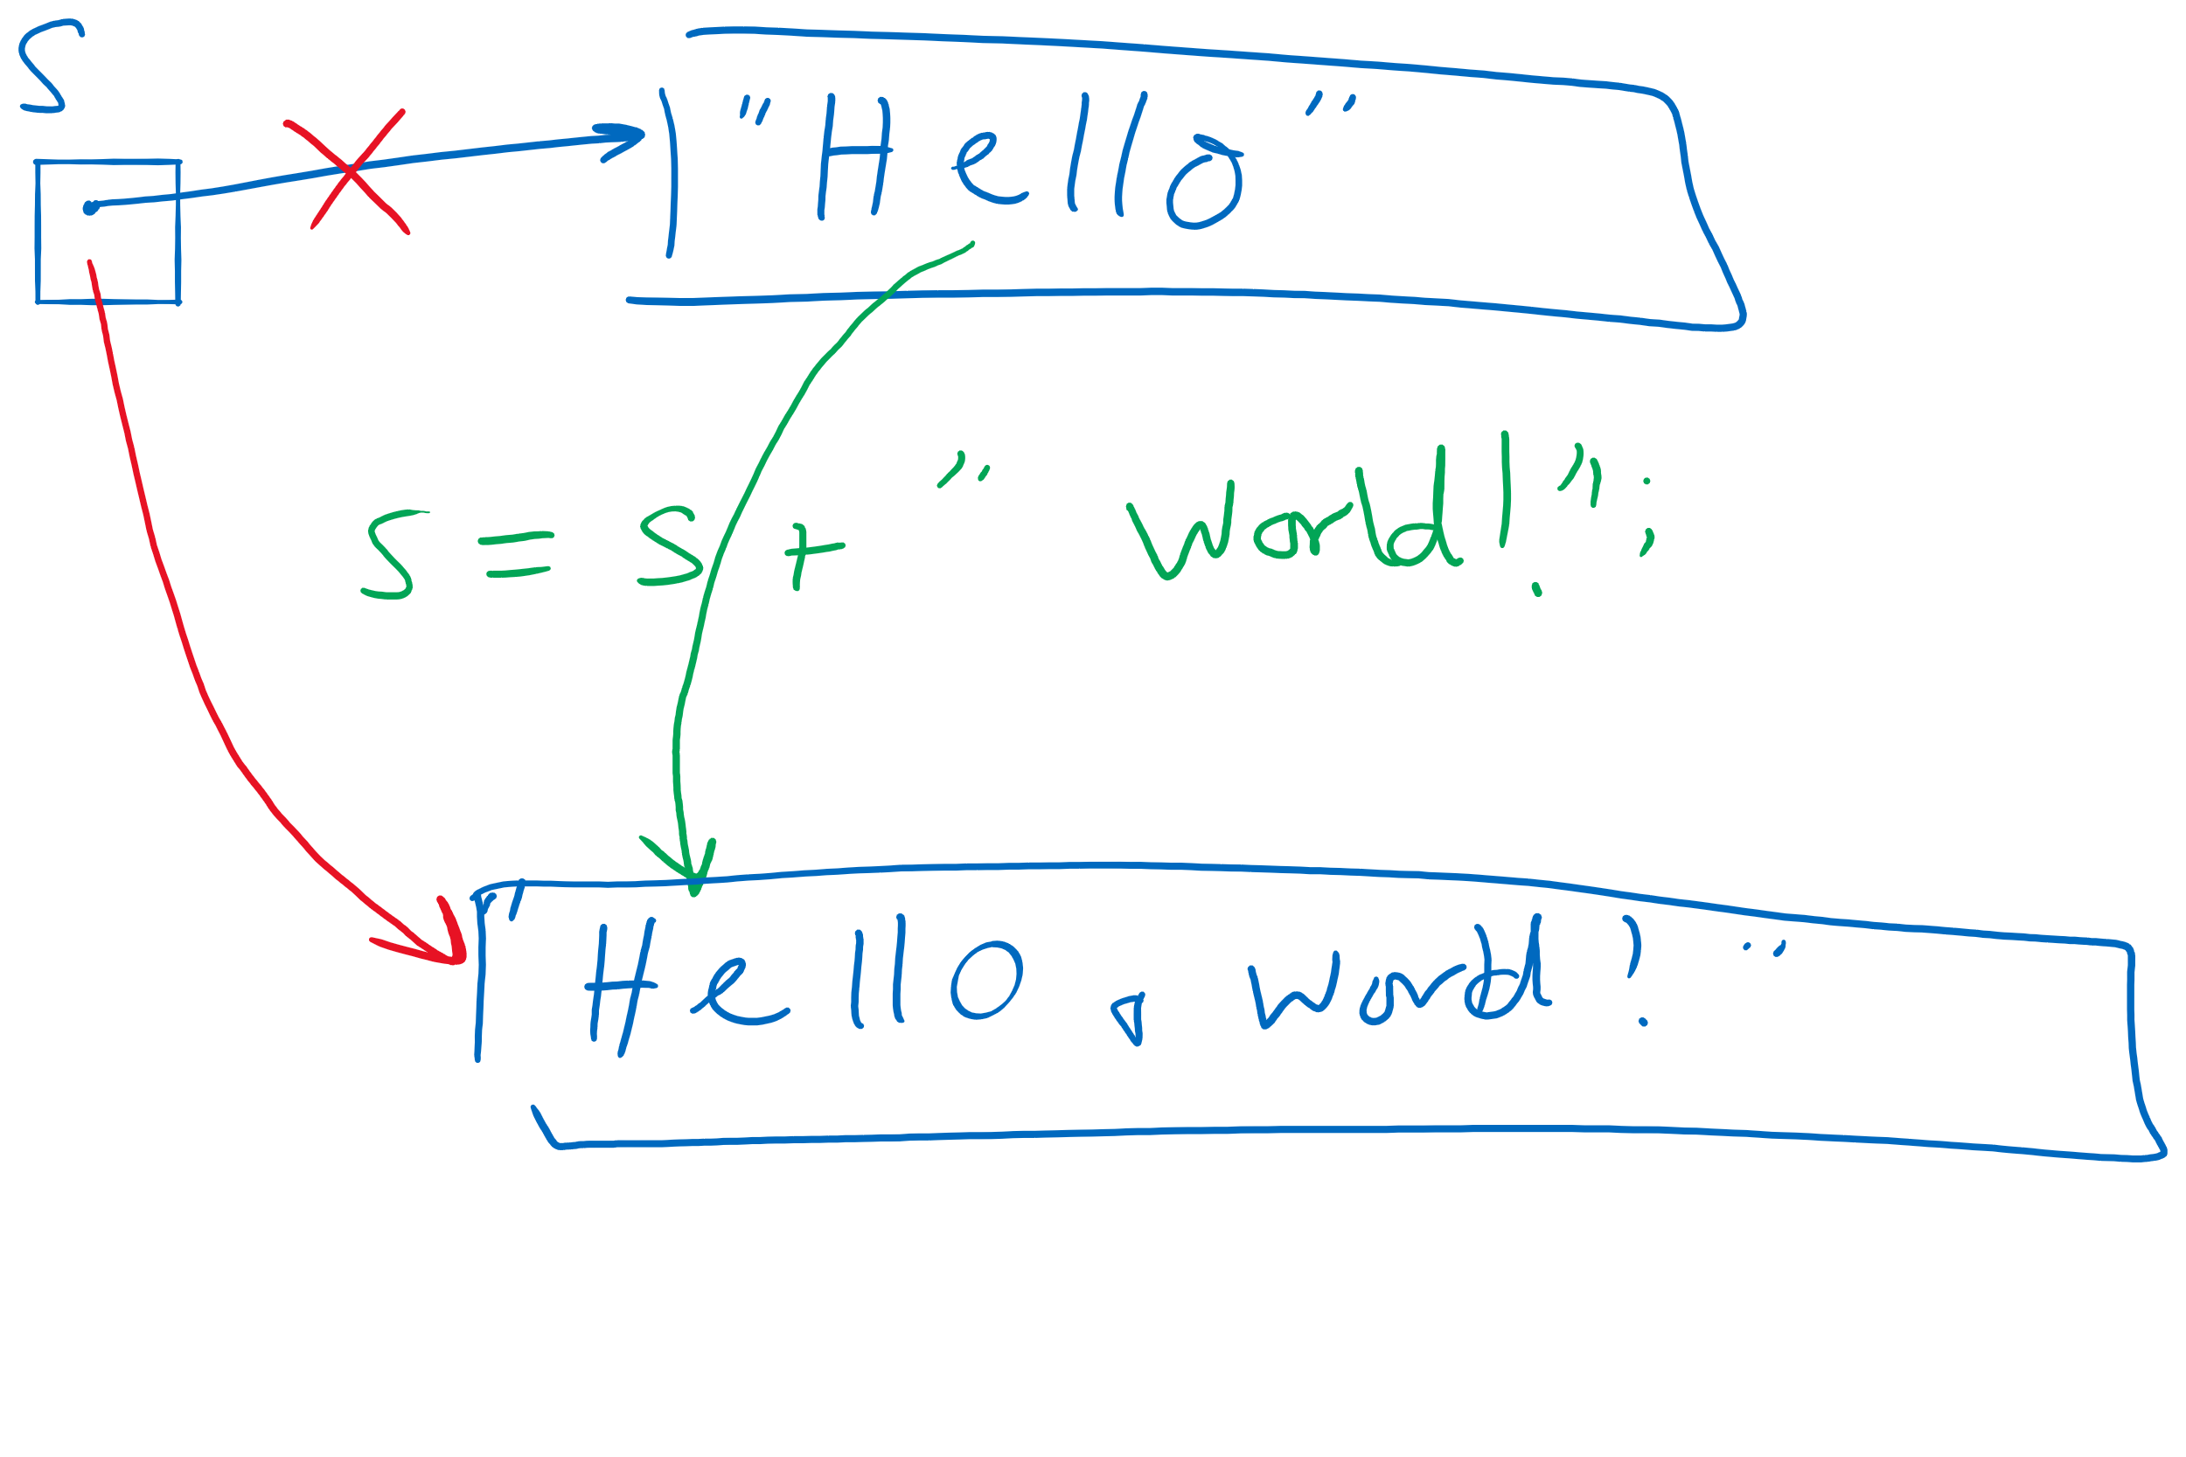
Concatenating to A String Object

Slide 16
StringBuilder to the rescue
append() and deleteCharAt() can be used to push and pop
Back to Θ(1)!
Still need to account for resizing, though…
StringBuffer can also be used for this purpose
Differences?
Notes:
StringBuffer is synchronized
StringBuilder is not

Slide 17
Please submit your reflections by using the CourseMIRROR App
If you are having a problem with CourseMIRROR, please send an email to coursemirror.development@gmail.com
Notes:
All right!
Upcoming Due Dates at A Glance

