Slide 1

Algorithms and Data Structures 2 CS 1501
Fall 2021
Sherif Khattab
ksm73@pitt.edu
(Slides are adapted from Dr. Ramirez’s and Dr. Farnan’s CS1501 slides.)

Slide 2
Announcements
Upcoming deadlines:
Lab 4 and Homework 5 due on 10/15
Homework 6 and Lab 5 due on 10/22
Assignment 2 due on 10/25
Midterm on 10/13
In-class, paper-based exam

Slide 3
Last lecture …
DST
RST
Multi-way RST

Slide 4
CourseMIRROR Reflections

Slide 5
Today …
de la Briandais trees
Introduction to Compression

Slide 6
That seems like a bit of a caveat...
Where does Huffman fall short?
What about repeated patterns of multiple characters?
Consider a file containing:
1000 A’s
1000 B’s
…
1000 of every ASCII character
Will this compress at all with Huffman encoding?
Nope!
But it seems like it should be compressible...

Slide 7
Run length encoding
Could represent the previously mentioned string as:
1000A1000B1000C, etc.
Assuming we use 10 bits to represent the number of repeats, and 8 bits to represent the character…
4608 bits needed to store run length encoded file
vs. 2048000 bits for input file
Huge savings!
Note that this incredible compression performance is based on a very specific scenario…
Run length encoding is not generally effective for most files, as they often lack long runs of repeated characters

Slide 8
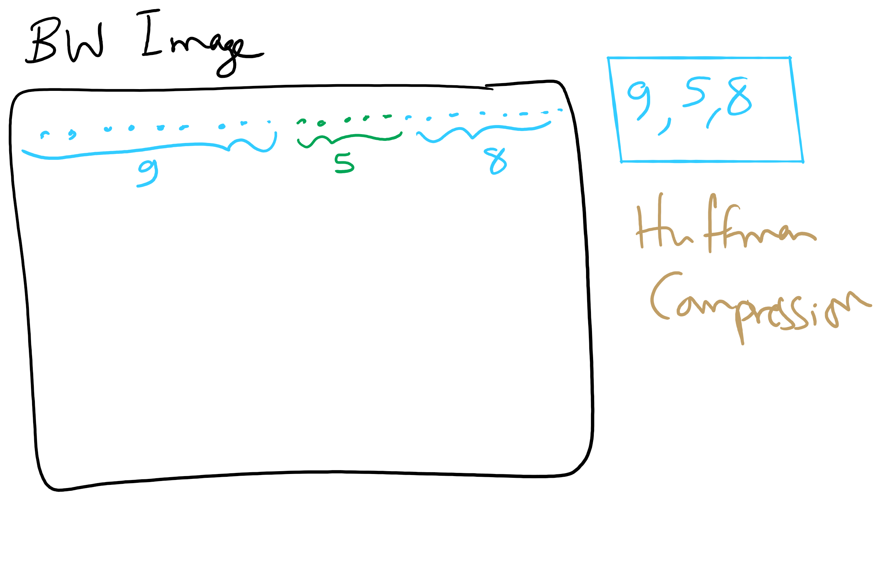
Run-length Encoding

Slide 9
Please submit your reflections by using the CourseMIRROR App
If you are having a problem with CourseMIRROR, please send an email to coursemirror.development@gmail.com
Notes:
All right!
Upcoming Due Dates at A Glance

