Slide 1

Algorithms and Data Structures 2 CS 1501
Spring 2022
Sherif Khattab
ksm73@pitt.edu
(Slides are adapted from Dr. Ramirez’s and Dr. Farnan’s CS1501 slides.)

Slide 2
Announcements
Upcoming deadlines:
Homework 10 due on 4/4
Lab 10 due on 4/8
Homework 11 due on 4/11
Assignment 3 and 4 due on 4/18
Used to be one assignment

Slide 3
Previous lecture …
Weighted Shortest Path
Dijkstra’s Single-source shortest-paths algorithm

Slide 4
CourseMIRROR Reflections (most confusing)
What exactly was meant by tentative distance
The Dijkstra algorithm was a bit confusing in regard to what order to visit each node
When do we need to check for a disconnected graph for Dijkstras Algorithm?
Why would dijkstra get his own algorithm named after him if it’s the same as prim’s? Or vice versa? Seems a bit trivial
Dijkstra’s: conceived 1956, published 1959
Prim’s: discovered in 1930 by Jarník, published 1957 and 1959, also called Dijkstra-Jarník-Prim (DJP)
how does dijkstra’s differ from prim’s?
Forest of trees implementation from last lecture is still a little confusing
why is find bound by the height of the tree?
Why does introducing a weighted tree make the runtimes LogN for union/find
I didn’t really follow path compression at all besides that it is constant time, how does path compression work?
The runtime analysis table

Slide 5
CourseMIRROR Reflections (most interesting)
Differences and similarities between dijkstras and Kruskals and between dijkstras algorithm and prims
Dijkstras algorithm, it’s clear and simple and useful.
The last example relates Dijkstra
algorithm optimizations
Working through dynamic connectivity problem and seeing difference in representation between array and tree
I found the path compression optimization to be interesting for Union/Find
The Union/Find ADT implementations were most interesting.
How to reduce the runtime of find and union both to log(n)
going over heap sorting and prim’s examples helped a lot

Slide 6
Problem of the Day: Finding Bottlenecks
Let’s assume that we want to send a large file from point A to point B over a computer network as fast as possible over multiple network links if needed
Input:
A computer network
Network nodes and links
Links are labeled by link capacity in Mbps
Starting node and destination node
Output:
The maximum network speed possible for sending a file from source to destination

Slide 7
Defining network flow
Consider a directed, weighted graph G(V, E)
Weights are applied to edges to state their capacity
c(u, w) is the capacity of edge (u, w)
if there is no edge from u to w, c(u, w) = 0
Consider two vertices, a source s and a sink t
Let’s determine the maximum flow that can run from s to t in the graph G

Slide 8
Flow
Let the f(u, w) be the amount of flow being carried along the edge (u, w)
Some rules on the flow running through an edge:
∀(u, w) ∈ E f(u, w) <= c(u, w)
∀u ∈ (V - {s,t}) (Σ_{w∈V} f(w, u) - Σ_{w∈V} f(u, w)) = 0

Slide 9
Ford Fulkerson
Let all edges in G have an allocated flow of 0
While there is path p from s to t in G s.t. all edges in p have some residual capacity (i.e., ∀(u, w) ∈ p f(u, w) < c(u, w)):
(Such a path is called an augmenting path)
Compute the residual capacity of each edge in p
Residual capacity of edge (u, w) is c(u, w) - f(u, w)
Find the edge with the minimum residual capacity in p
We’ll call this residual capacity new_flow
Increment the flow on all edges in p by new_flow

Slide 10
Ford Fulkerson example
5
/5
s
10
A
B
t
/10
5
/10
5
/10
5
10
/5
5

Slide 11
Ford Fulkerson example
5
/5
s
10
A
B
t
/10
5
/10
5
/10
5
10
/5
5

Slide 12
Another Ford Fulkerson example
/5
s
/10
A
B
t
10
/10
10
/10
10
/5
Notes:
Are we screwed?

Slide 13
Expanding on residual capacity
To find the max flow we will have to consider re-routing flow we had previously allocated
This means, when finding an augmenting path, we will need to look not only at the edges of G, but also at backwards edges that allow such re-routing
For each edge (u, w) ∈ E, a backwards edge (w, u) must be considered during pathfinding if f(u, w) > 0
The capacity of a backwards edge (w, u) is equal to f(u, w)

Slide 14
The residual graph
We will perform searches for an augmenting path not on G, but on a residual graph built using the current state of flow allocation on G
The residual graph is made up of:
V
An edge for each (u, w) ∈ E where f(u, w) < c(u, w)
(u, w)'s mirror in the residual graph will have 0 flow and a capacity of c(u, w) - f(u, w)
A backwards edge for each (u, w) ∈ E where f(u, w) > 0
(u, w)'s backwards edge has a capacity of f(u, w)
All backwards edges have 0 flow

Slide 15
Residual graph example
/5
0
5
/5
s
/10
A
B
t
10
/10
10
/10
5
10
/10
0
/10
/ 5
0
/10
0
/5
5
/5
0

Slide 16
Another example
A
1
1
2
/1000
/1000
s
/1
t
1
0
1
2
/1000
1
/1000
B
Notes:
sABt
sBAt
sABt
…
runtime is bound to the max flow of the graph!

Slide 17
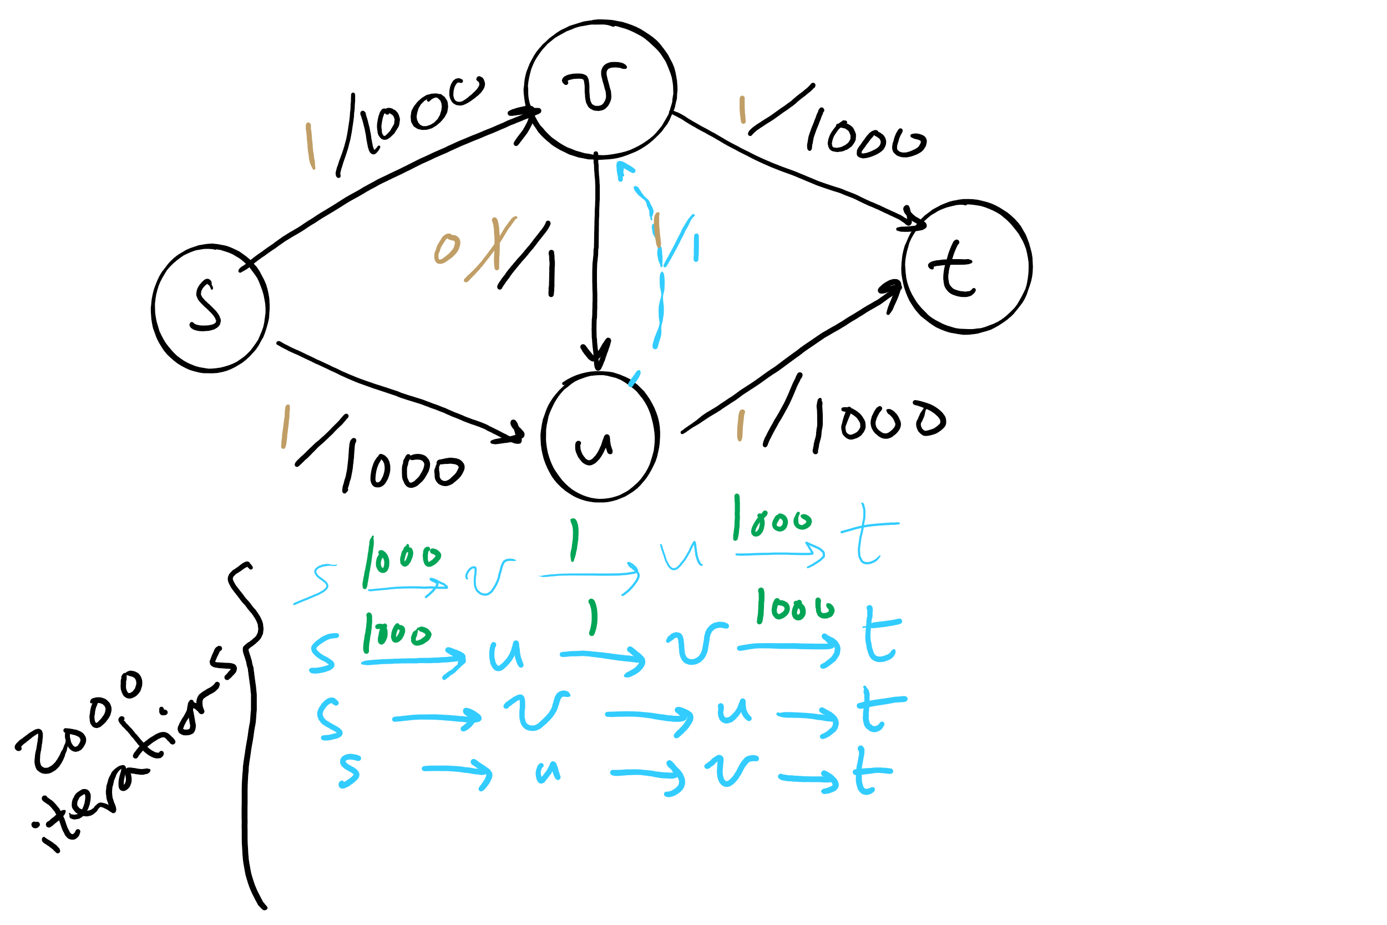
Worst-case runtime of Ford-Fulkerson

Slide 18
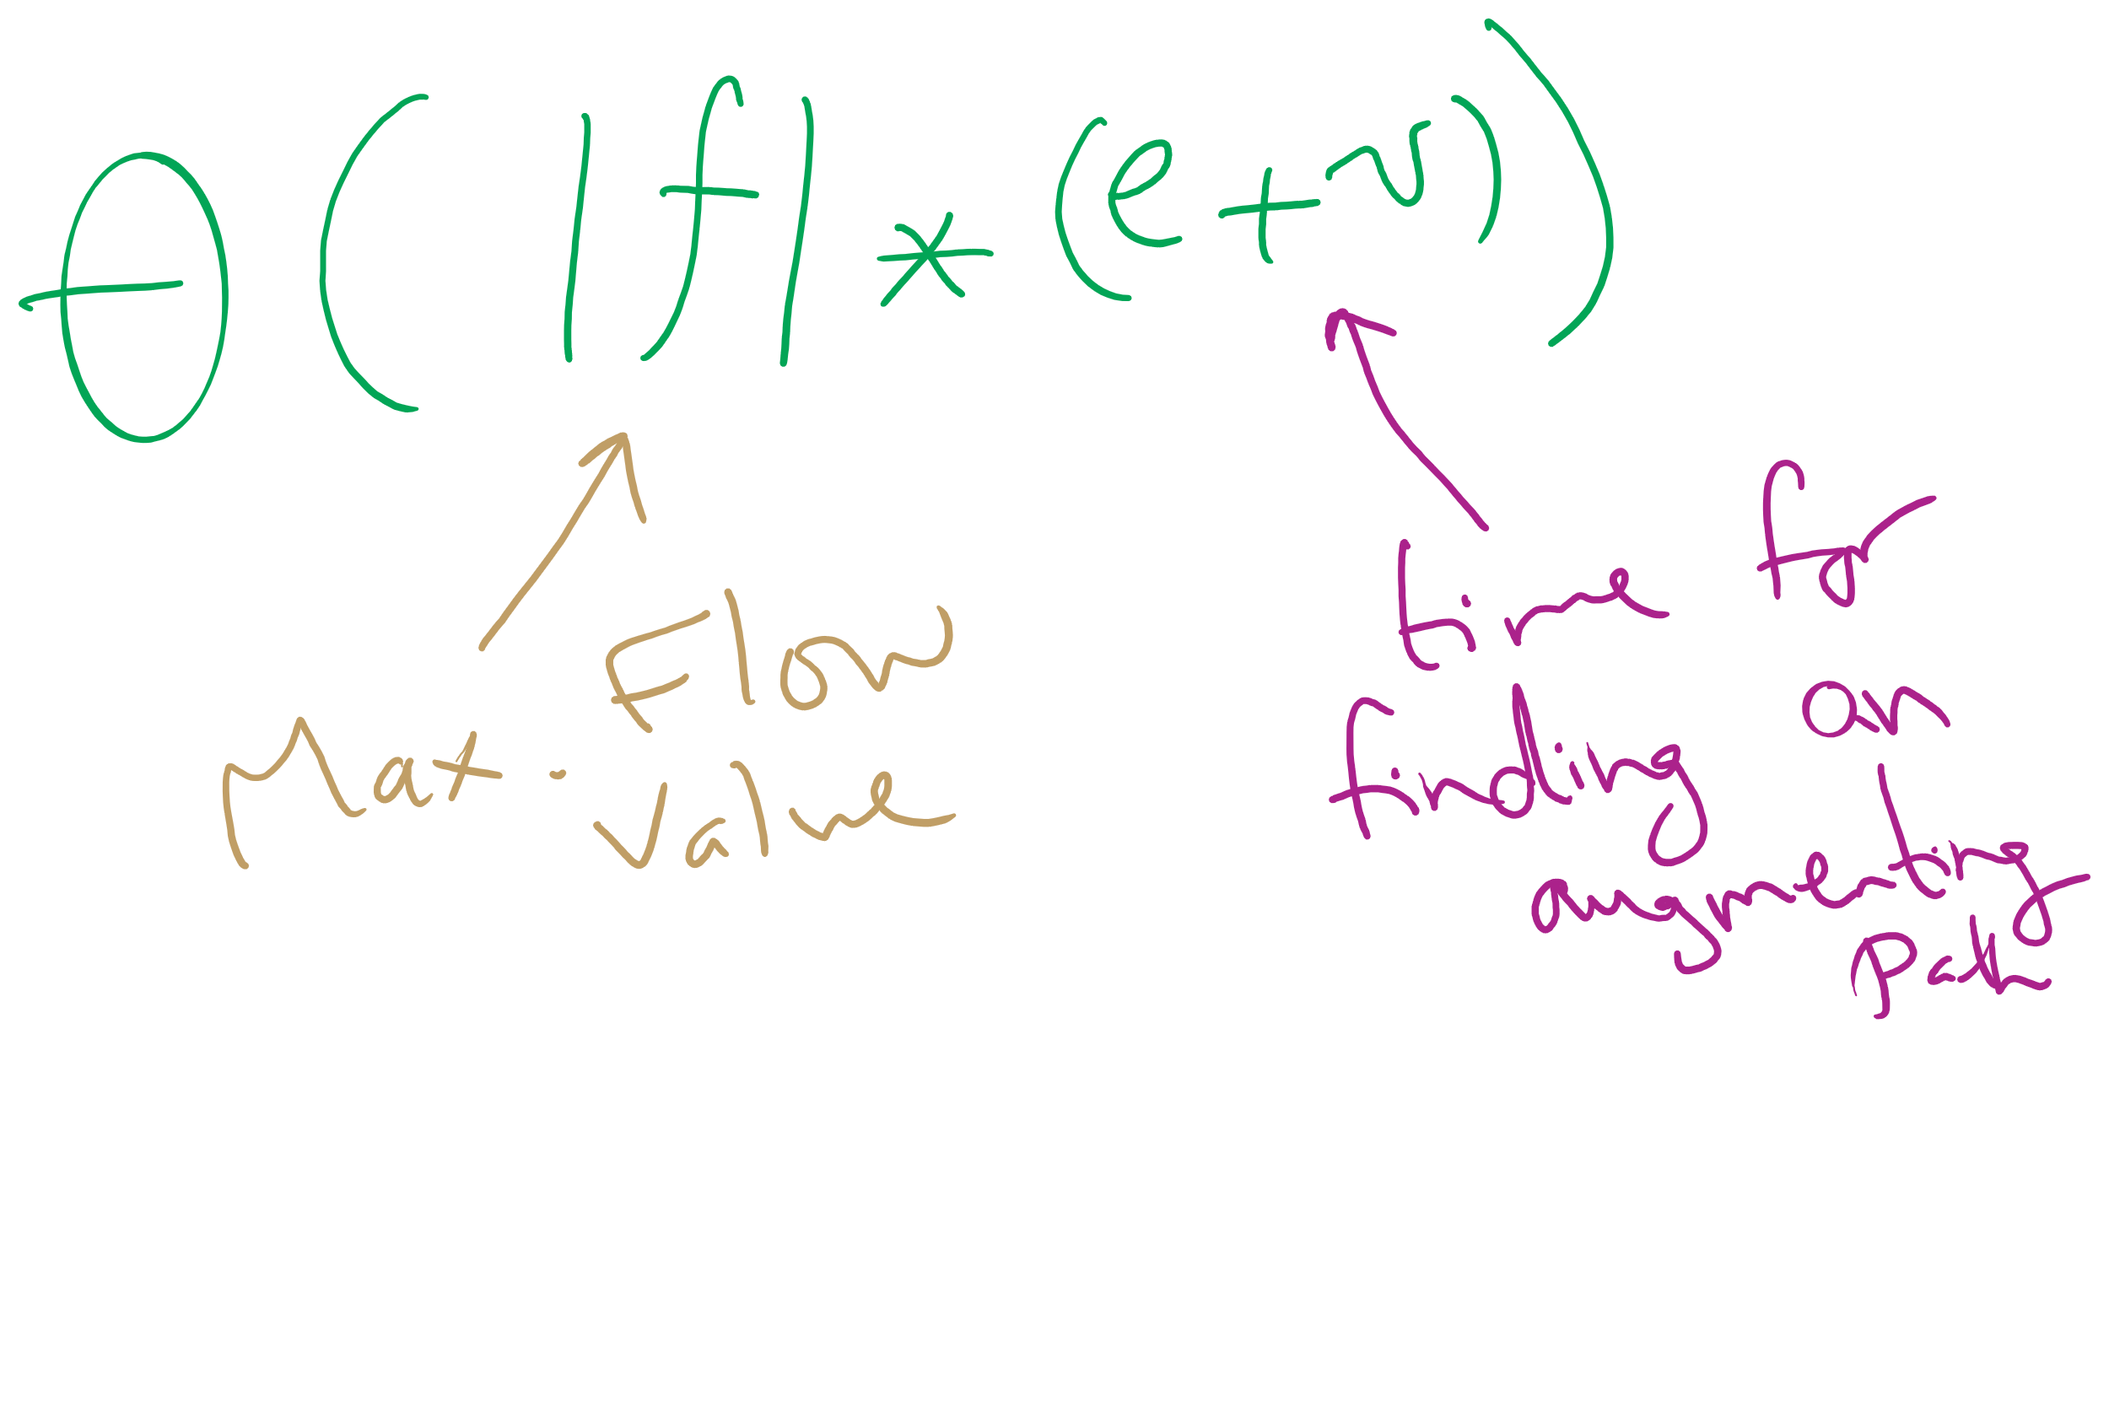
Worst-case Runtime of Ford-Fulkerson

Slide 19
Edmonds Karp
How the augmenting path is chosen affects the performance of the search for max flow
Edmonds and Karp proposed a shortest path heuristic for Ford Fulkerson
Use BFS to find augmenting paths
Notes:
note that FF is an "algorithm" because path finding details are not defined

Slide 20
Another example
A
1000
/1000
/1000
1000
s
/1
t
/1000
1000
/1000
1000
B
Notes:
Use BFS to find paths, and its all good

Slide 21
But our flow graph is weighted...
Edmonds-Karp only uses BFS
Used to find spanning trees and shortest paths for unweighted graphs
Why do we not use some measure of priority to find augmenting paths?
Notes:
We could…
Book discusses a modified version of Dijkstra's
Advantages?
Disadvantages?
Which is the best?
Currently unknown, but Edmonds-Karp is pg

Slide 22
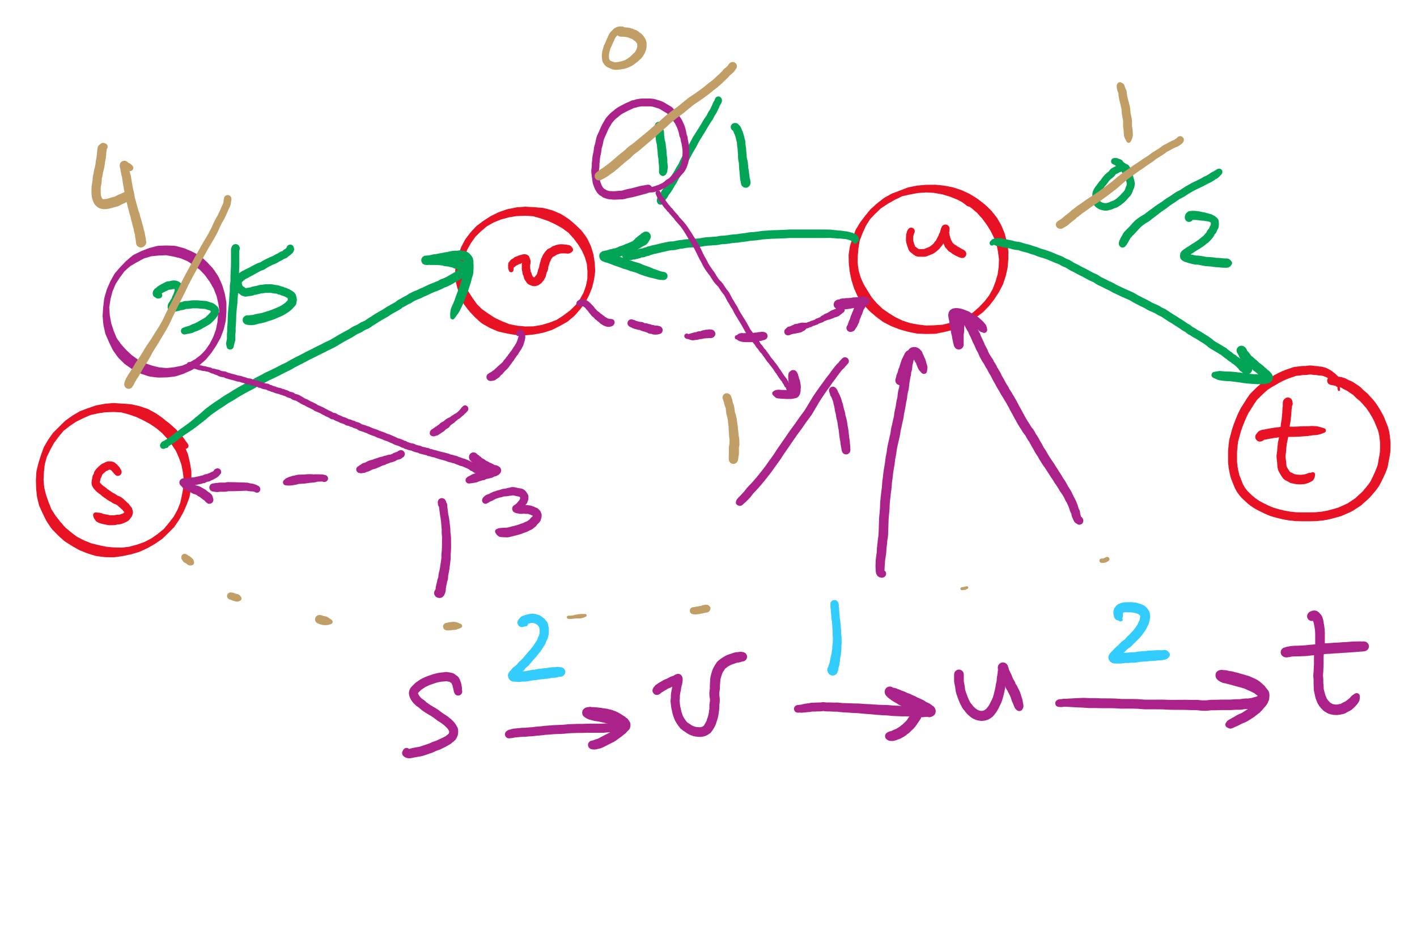
Backwards edges
Adding flow to a backwards edge means rerouting flow from the corresponding forward edge

Slide 23
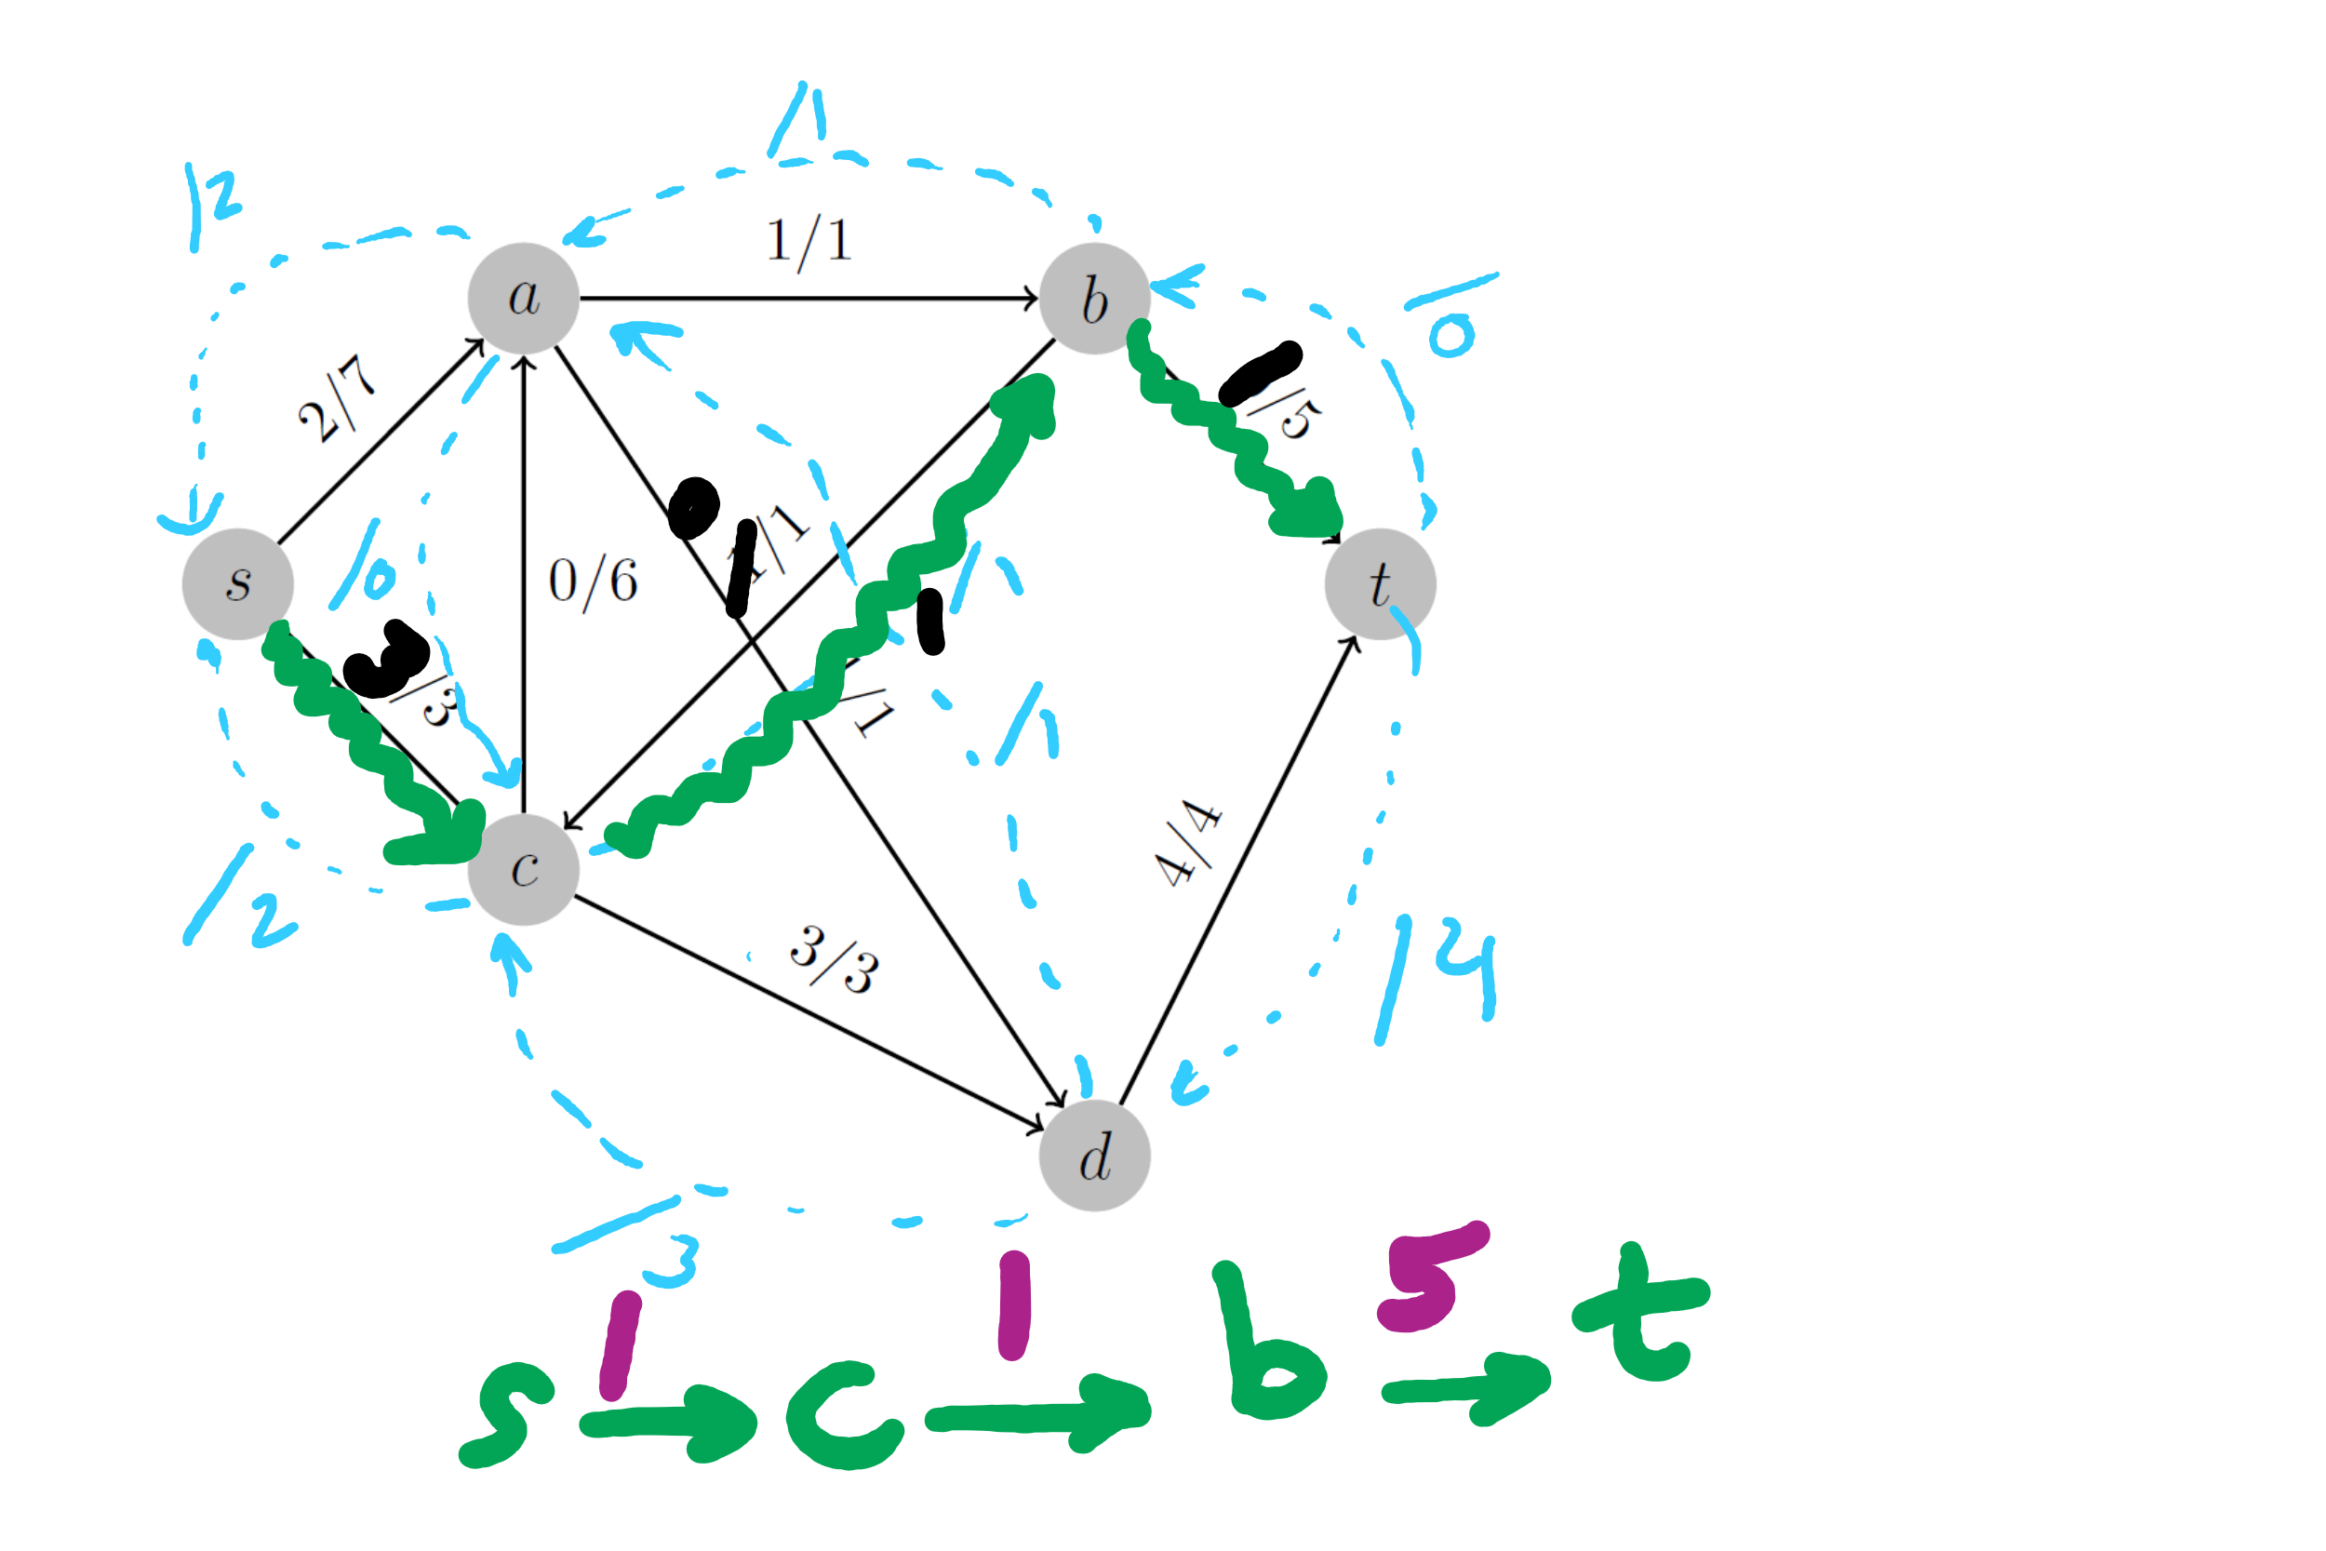
2nd Tophat Question

Slide 24
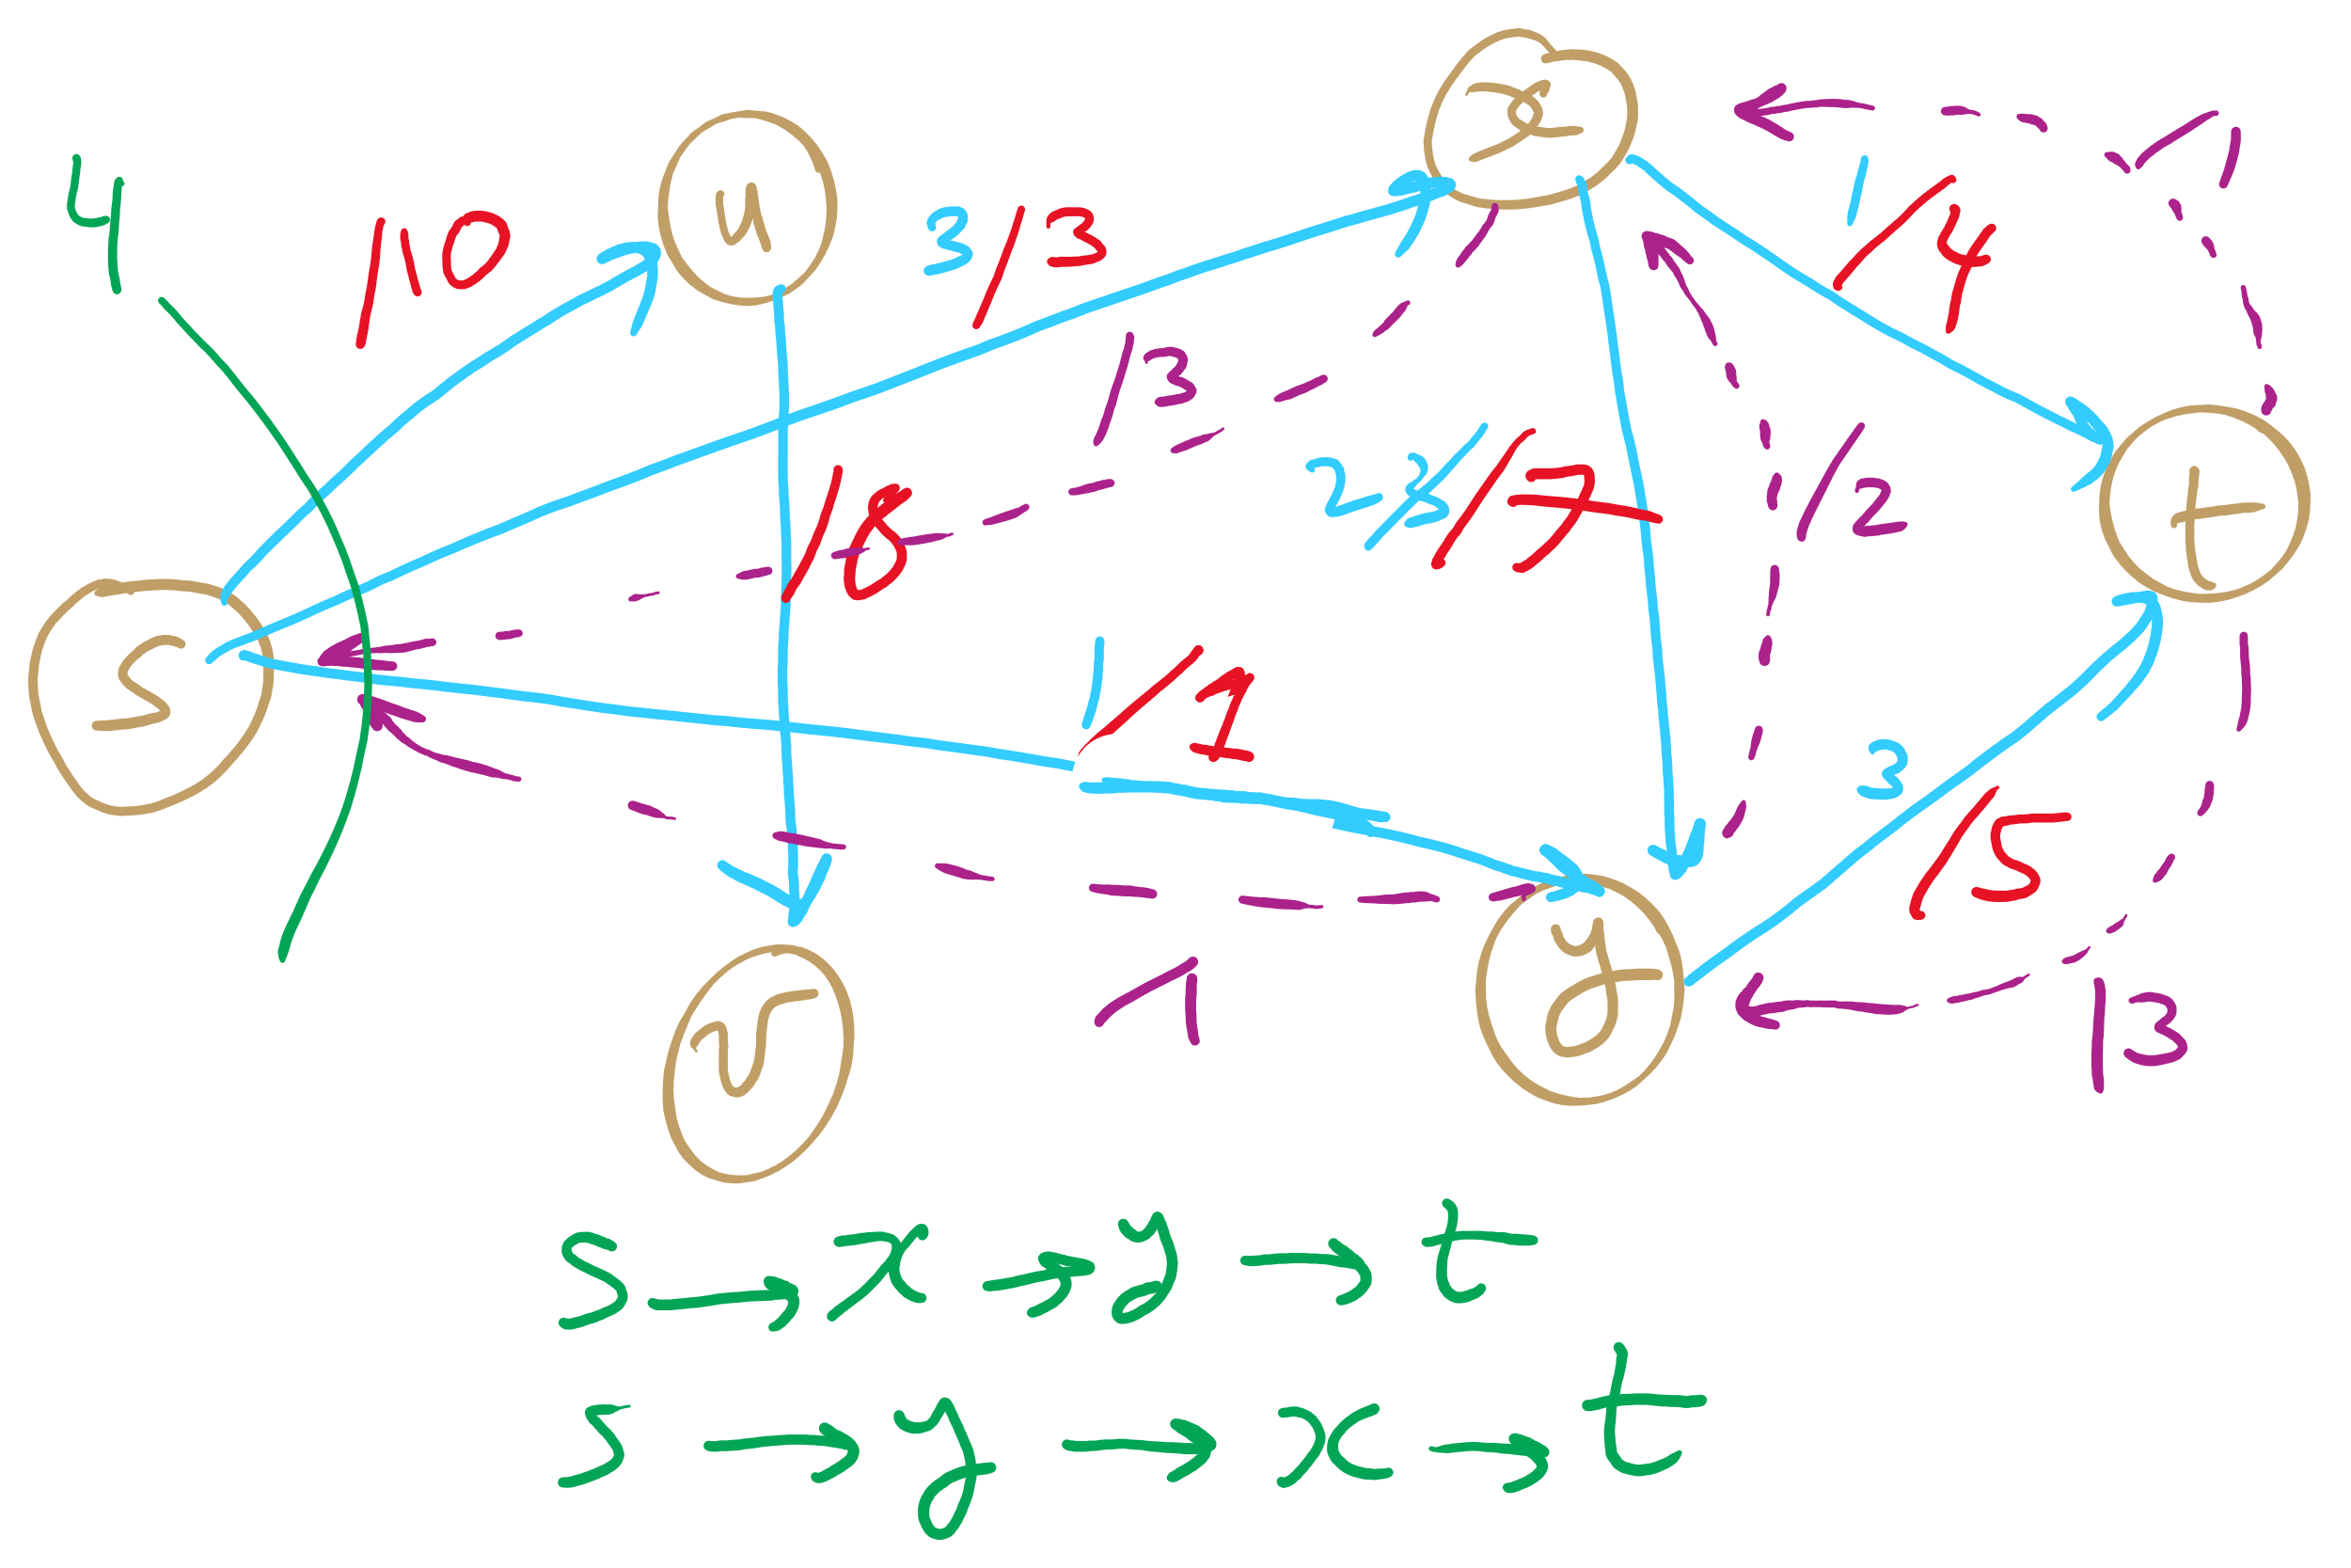
PFS Example 1

Slide 25
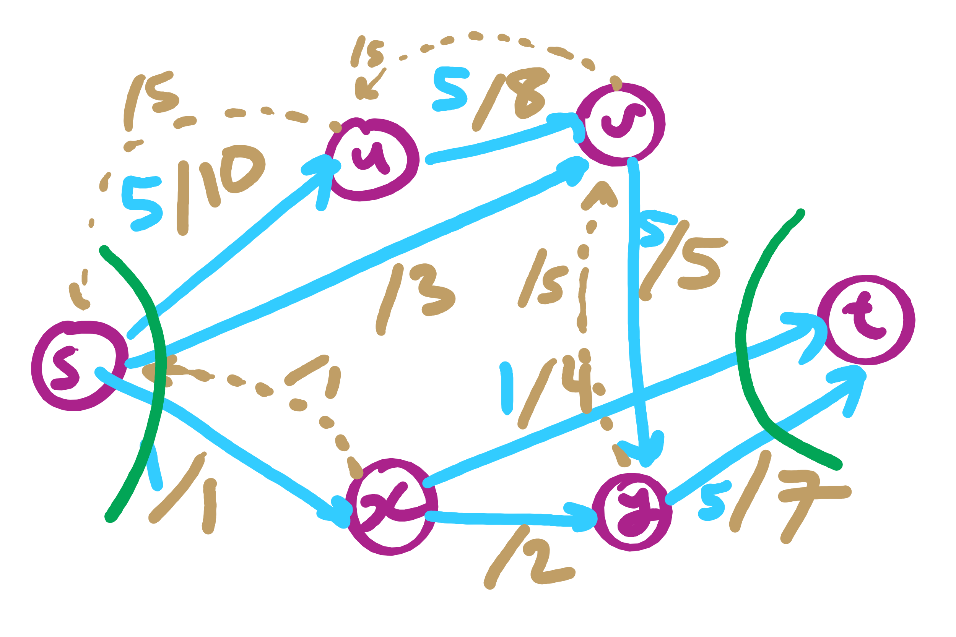
PFS Example 2

Slide 26
Flow edge implementation
For each edge, we need to store:
Start point, the from vertex
End point, the to vertex
Capacity
Flow
Residual capacities
For forwards and backwards edges

Slide 27
FlowEdge.java
public class FlowEdge {
private final int v; // from
private final int w; // to
private final double capacity; // capacity
private double flow; // flow
…
public double residualCapacityTo(int vertex) {
if (vertex == v) return flow;
else if (vertex == w) return capacity - flow;
else throw new
IllegalArgumentException("Illegal endpoint");
}
…
}

Slide 28
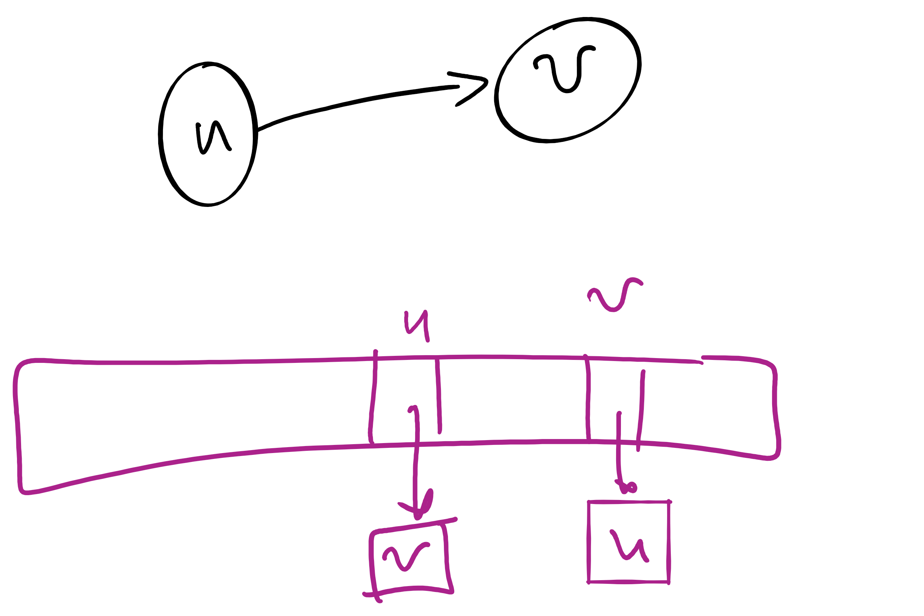
BFS search for an augmenting path (pseudocode)
edgeTo = [|V|]
marked = [|V|]
Queue q
q.enqueue(s)
marked[s] = true
while !q.isEmpty():
v = q.dequeue()
for each (v, w) in AdjList[v]:
if residualCapacity(v, w) > 0:
if !marked[w]:
edgeTo[w] = v;
marked[w] = true;
q.enqueue(w);
Each FlowEdge object is stored in the adjacency list twice:
Once for its forward edge
Once for its backward edge

Slide 29
Value of maxflow
Add up the flow increments in each iteration of Ford-Fulkerson
Add up the edge flows out of source
Add up the edge flows of the out of source

Slide 30
Let's separate the graph
An st-cut on G is a set of edges in G that, if removed, will partition the vertices of G into two disjoint sets
One contains s
One contains t
May be many st-cuts for a given graph
Let’s focus on finding the minimum st-cut
The st-cut with the smallest capacity
May not be unique

Slide 31
How do we find the min st-cut?
We could examine residual graphs
Specifically, try and allocate flow in the graph until we get to a residual graph with no existing augmenting paths
A set of saturated edges will make a minimum st-cut

Slide 32
Min cut example
A
1
/1
/3
1
3
/7
2
s
C
t
2
/5
5
/7
3
3
/9
B
Notes:
Will the max flow always be the edges going into or out of the source/sink?
No! get the students to imagine a graph where this is the case

Slide 33
Max flow == min cut
A special case of duality
I.e., you can look at an optimization problem from two angles
In this case to find the maximum flow or minimum cut
In general, dual problems do not have to have equal solutions
The differences in solutions to the two ways of looking at the problem is referred to as the duality gap
If the duality gap = 0, strong duality holds
Max flow/min cut uphold strong duality
If the duality gap > 0, weak duality holds

Slide 34
Determining a minimum st-cut
First, run Ford Fulkerson to produce a residual graph with no further augmenting paths
The last attempt to find an augmenting path will visit every vertex reachable from s
Edges with only one endpoint in this set comprise a minimum st-cut

Slide 35
Determining the min cut
A
A
/1
1
/3
2
3
/7
s
s
C
C
t
5
/5
/7
3
3
/9
Min Cut
B
B
Notes:
Green is the set of seen vertices reachable from s

Slide 36
Max flow / min cut on unweighted graphs
Is it possible?
How would we measure the Max flow / min cut?
What would an algorithm to solve this problem look like?

Slide 37
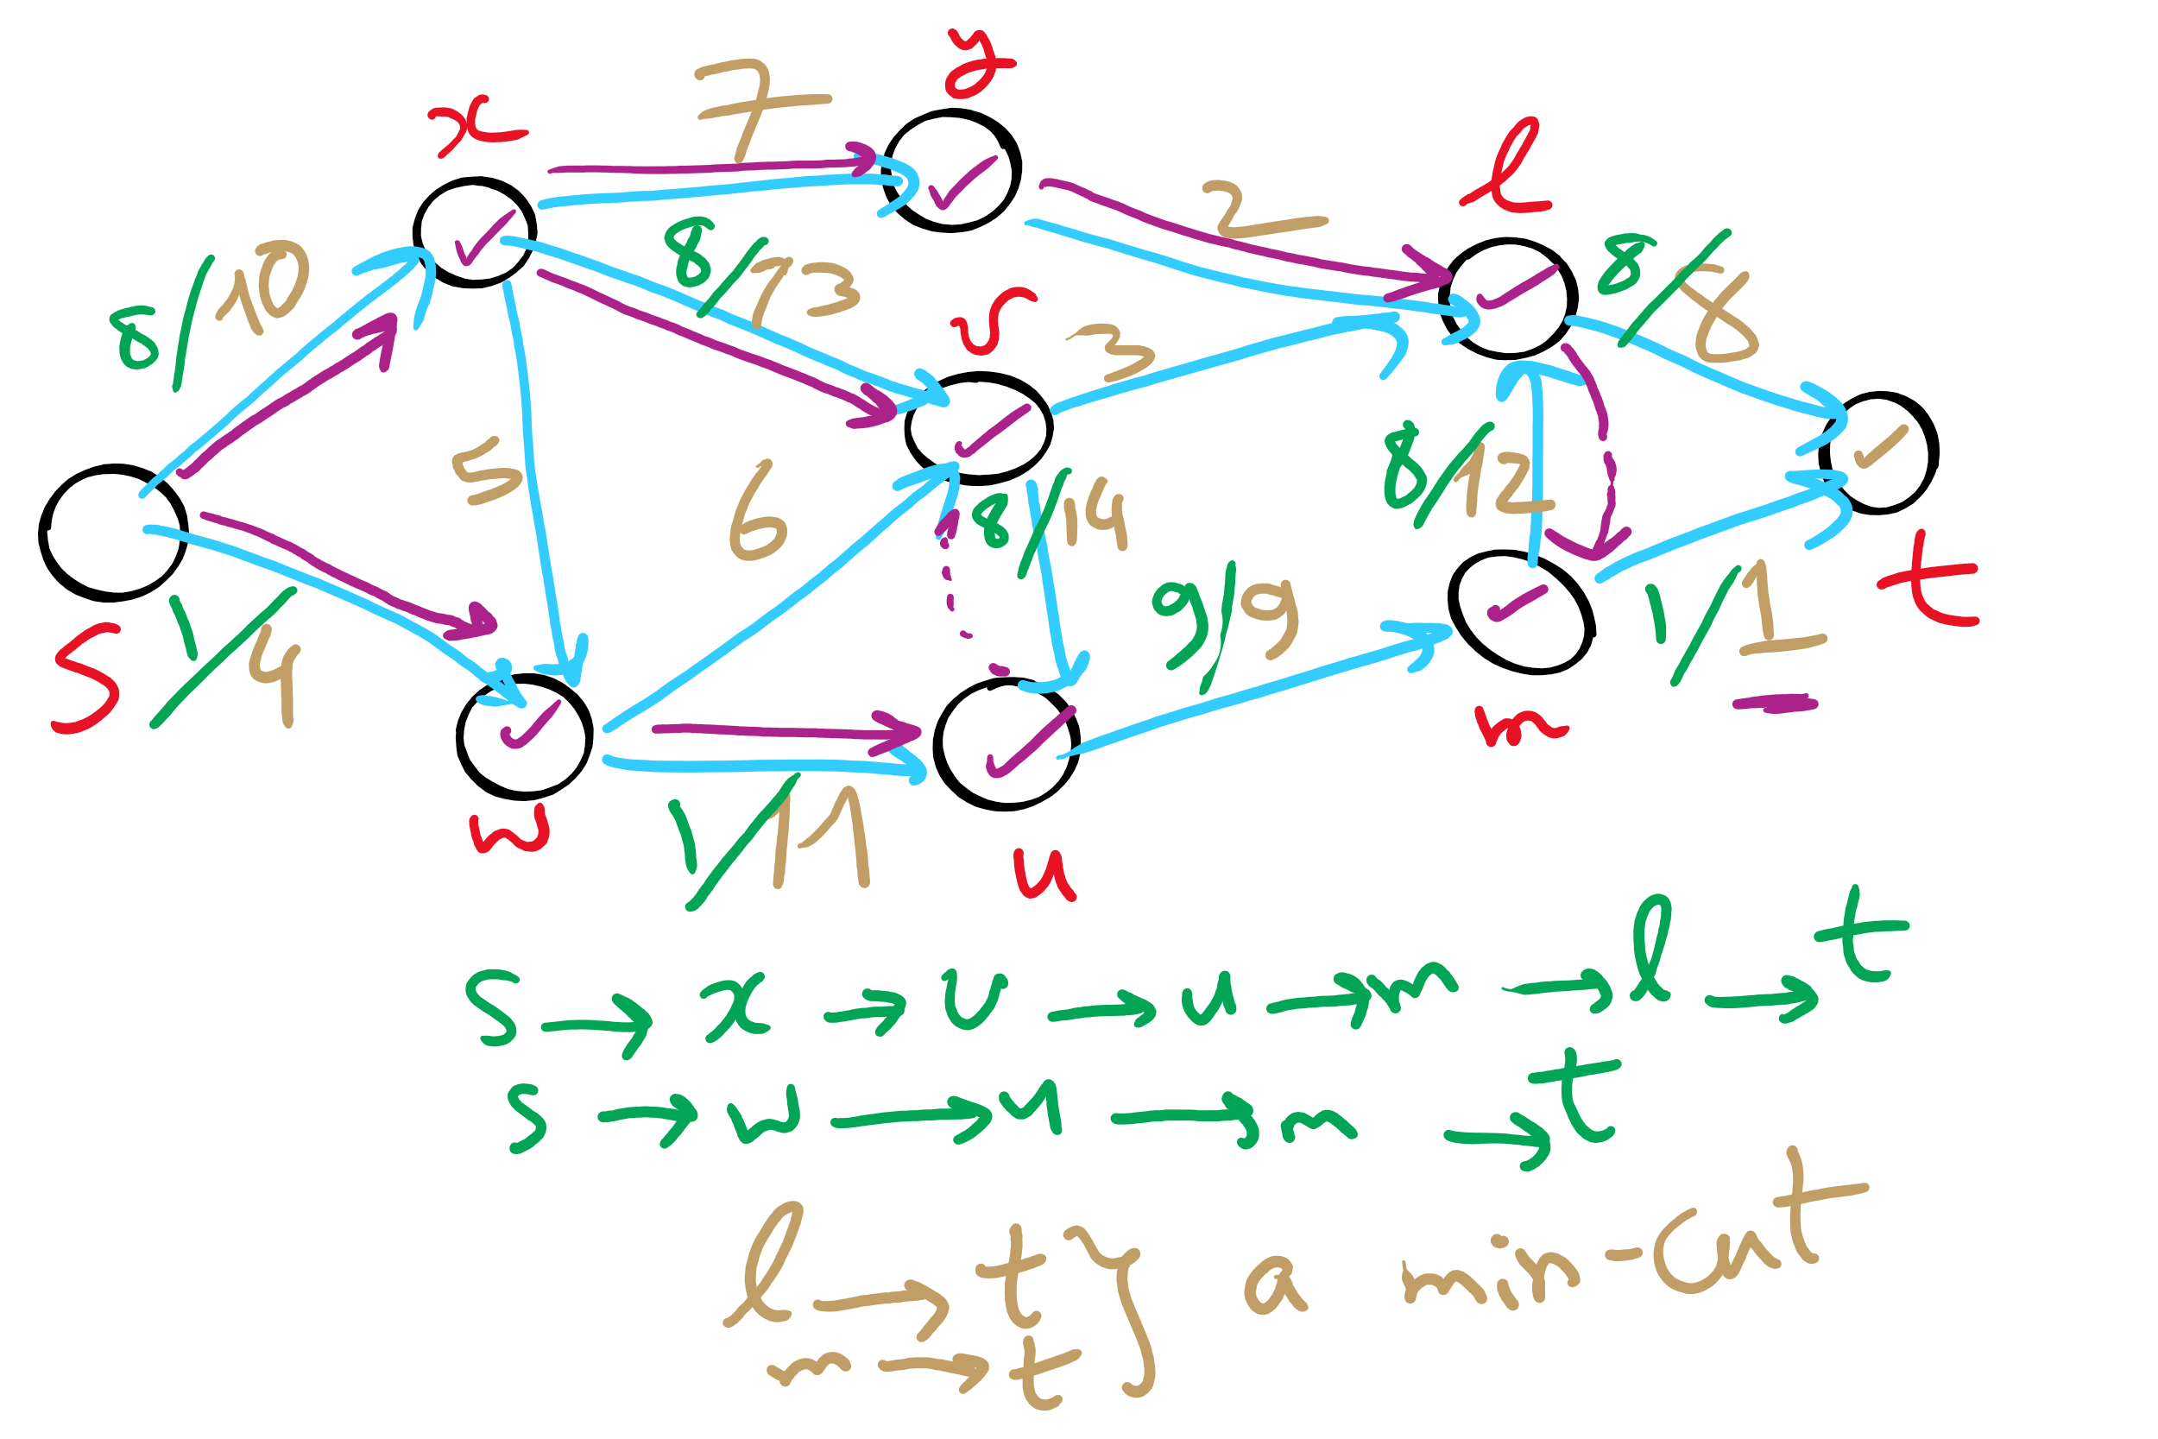
Min st-cut Example 1

Slide 38
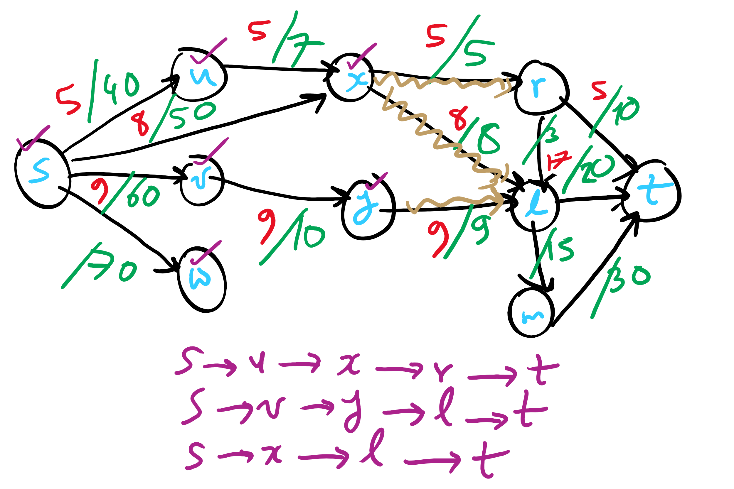
Min st-cut Example 2

Slide 39
Unweighted network flow
A
F
s
B
E
t
C
D
Notes:
Red: edge begin used in BFS pathfinding alg
Blue: edge has flow allocated to it

Slide 40
Please submit your reflections by using the CourseMIRROR App
If you are having a problem with CourseMIRROR, please send an email to coursemirror.development@gmail.com
Notes:
All right!
Upcoming Due Dates at A Glance

