Slide 1

Algorithms and Data Structures 2 CS 1501
Spring 2022
Sherif Khattab
ksm73@pitt.edu
(Slides are adapted from Dr. Ramirez’s and Dr. Farnan’s CS1501 slides.)

Slide 2
Announcements
In-person recitations this week (tomorrow)
In-person lectures starting from next week
Upcoming Deadlines
Homework 1: today at 11:59 pm
Homework 2: Monday 1/31 at 11:59 pm
Lab 1: Friday 1/28 at 11:59 pm
Assignment 1 not yet posted (sorry about that)
CourseMIRROR consent form and pre-survey

Slide 3
Previous lecture
Searching Problem
Symbol Table ADT implementations
Linear
array, linked list
Non-linear
tree
Tree terminology
Binary Tree
Binary Search Tree

Slide 4
CourseMIRROR Reflections

Slide 5
Searching Problem
Input?
Output?

Slide 6
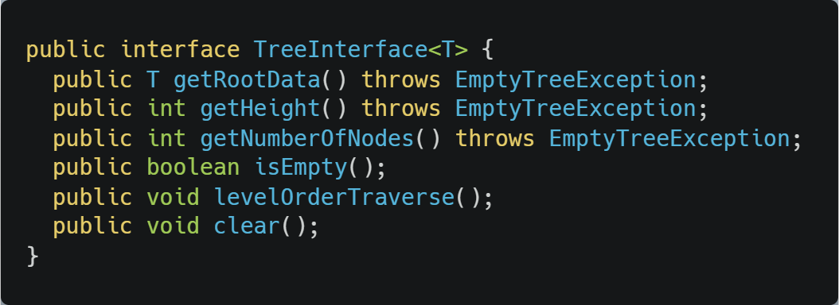
Tree Interface

Slide 7
Code Walkthrough
Available online at:
https://cs1501-2221.github.io/handouts/CodeHandouts/TreeADT/Slides
The slides are under the CodeHandouts/TreeADT/slides folder in the handout repository
https://github.com/cs1501-2221/handouts

Slide 8
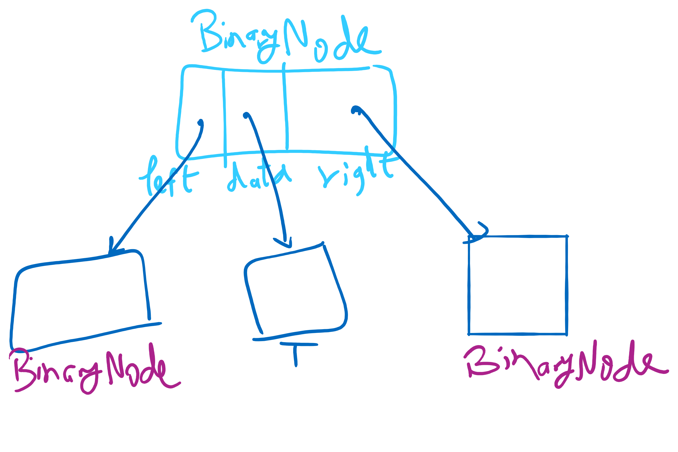
BinaryNode

Slide 9
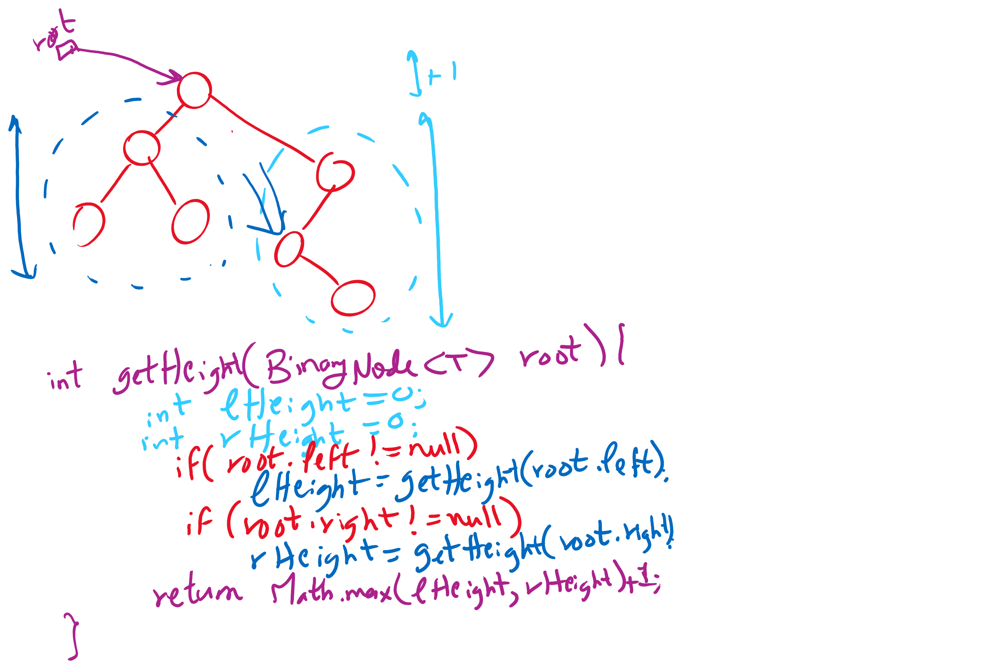
Another implementation of getHeight

Slide 10
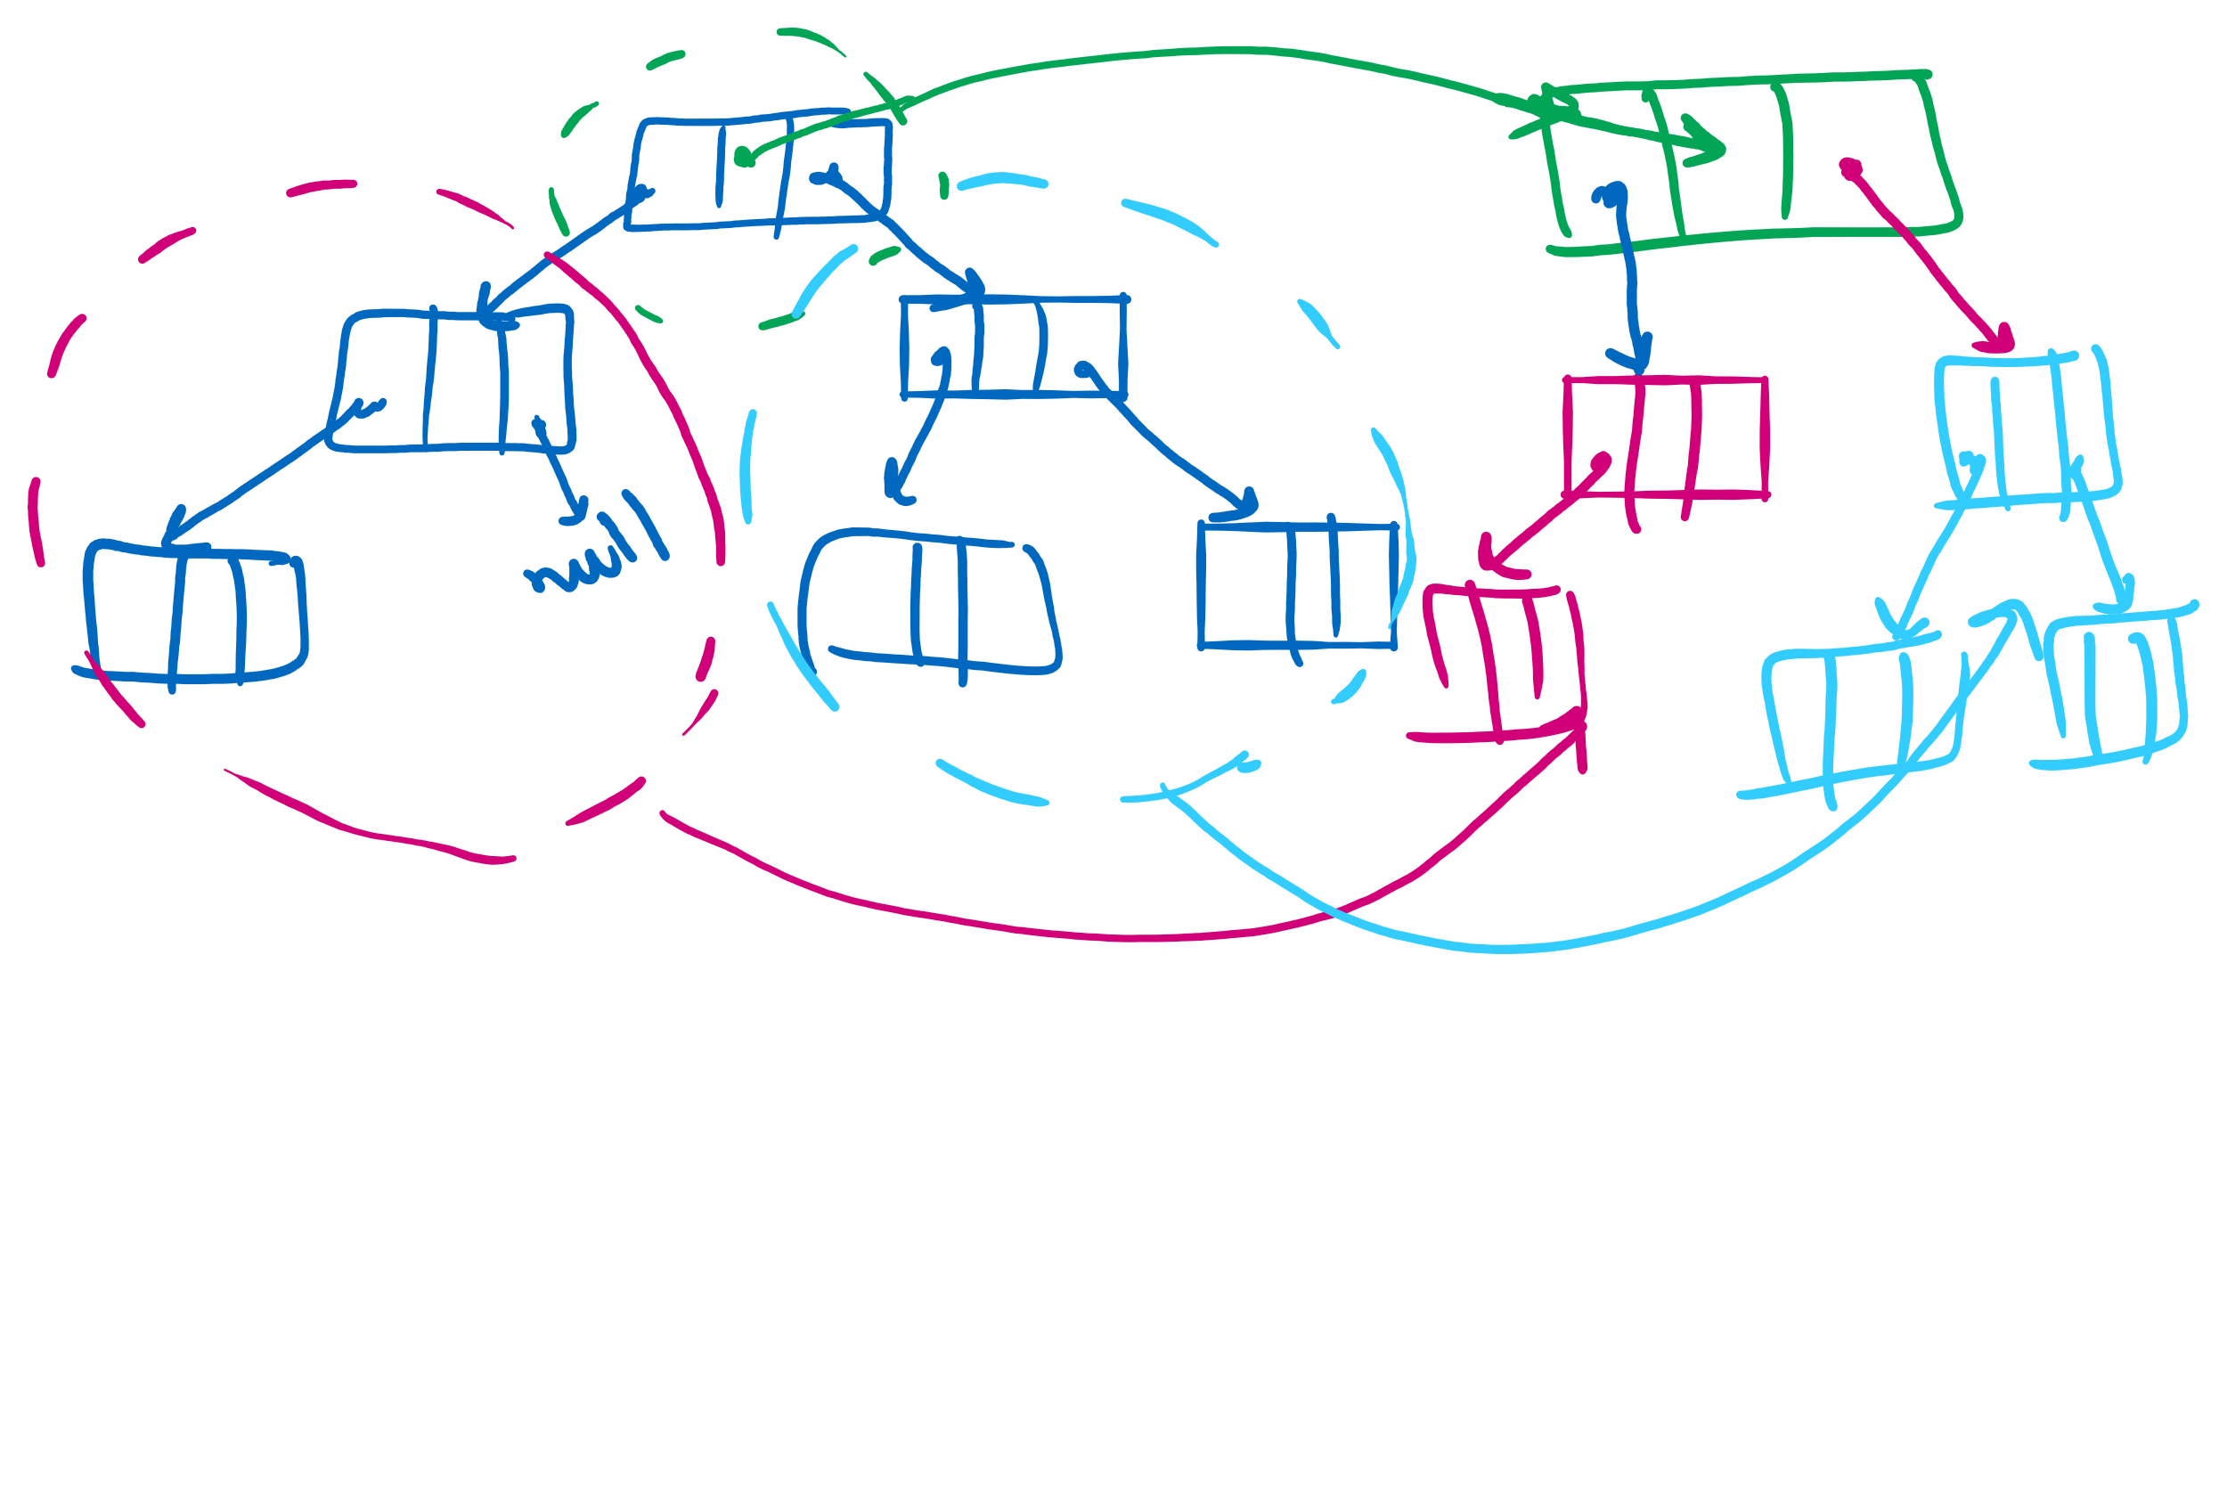
BinaryNode.copy

Slide 11
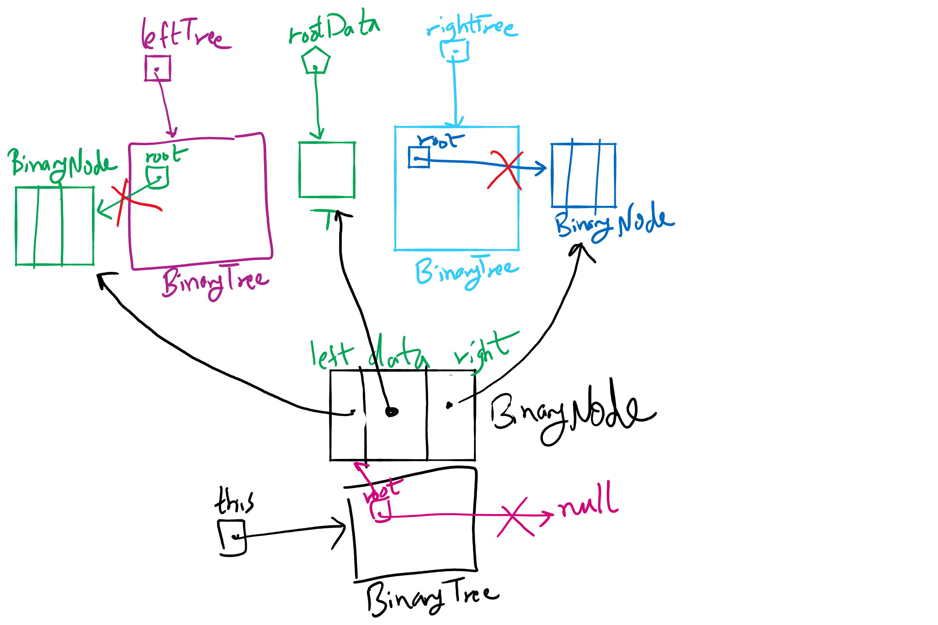
privateBuildTree Method

Slide 12
Please submit your reflections by using the CourseMIRROR App
If you are having a problem with CourseMIRROR, please send an email to coursemirror.development@gmail.com
Notes:
All right!
Upcoming Due Dates at A Glance

