Slide 1

Algorithms and Data Structures 2 CS 1501
Fall 2021
Sherif Khattab
ksm73@pitt.edu
(Slides are adapted from Dr. Ramirez’s and Dr. Farnan’s CS1501 slides.)

Slide 2
Announcements
Upcoming deadlines:
Homework 6 and Lab 5 due on 10/22
Assignment 2 due on 10/25

Slide 3
Last lecture …
DLB Tries

Slide 4
CourseMIRROR Reflections

Slide 5
This Lecture
Compression
Huffman Compression

Slide 6
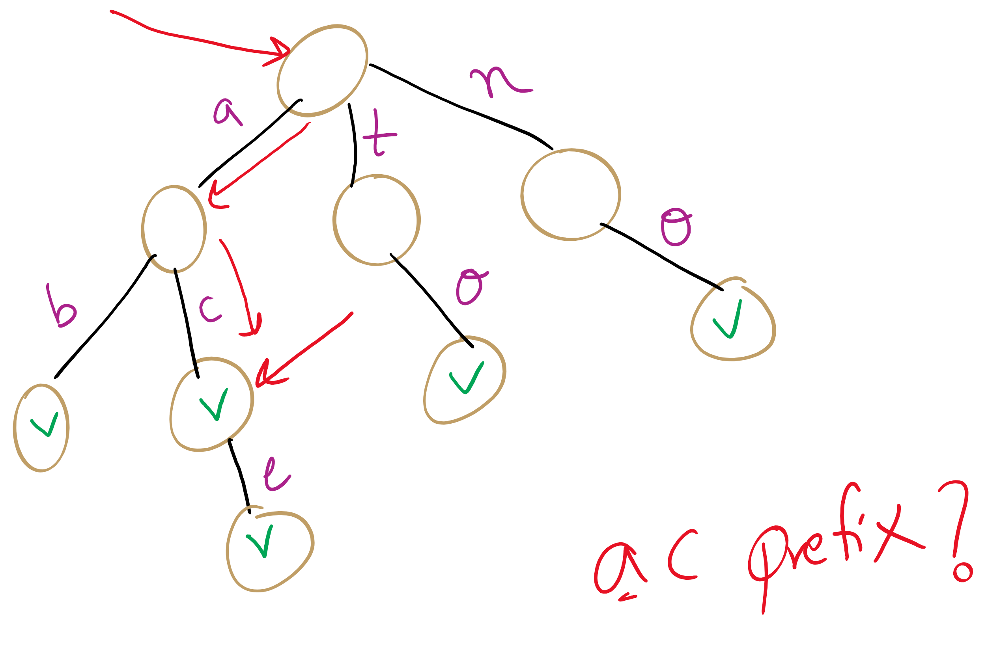
Searching
So far we’ve continually assumed each search would only look for the presence of a whole key
What about if we wanted to know if our search term was a prefix to a valid key?
Notes:
What structures would be amenable to this? Why?
Can implement another function that doesn’t require a non-null val, just a path through the entire key string
Are two functions really needed?
Could write a single function that returns 4 values
Word/prefix not found
Found as a prefix only, not a valid key
Found as a valid key, not a prefix to anything else
Found as a valid key, also a prefix

Slide 7
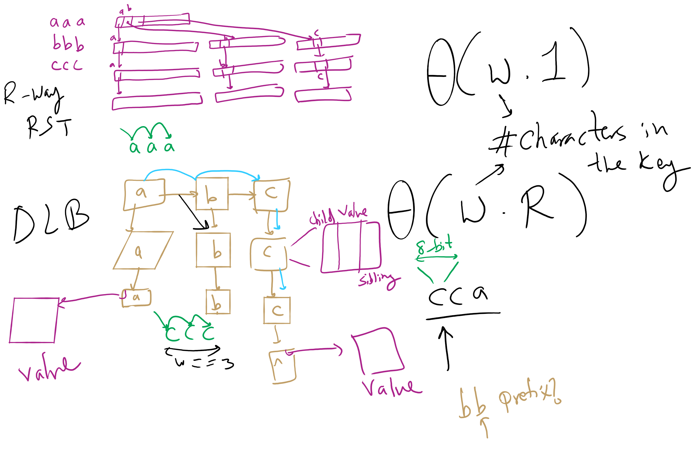
R-way RST vs. DLB

Slide 8
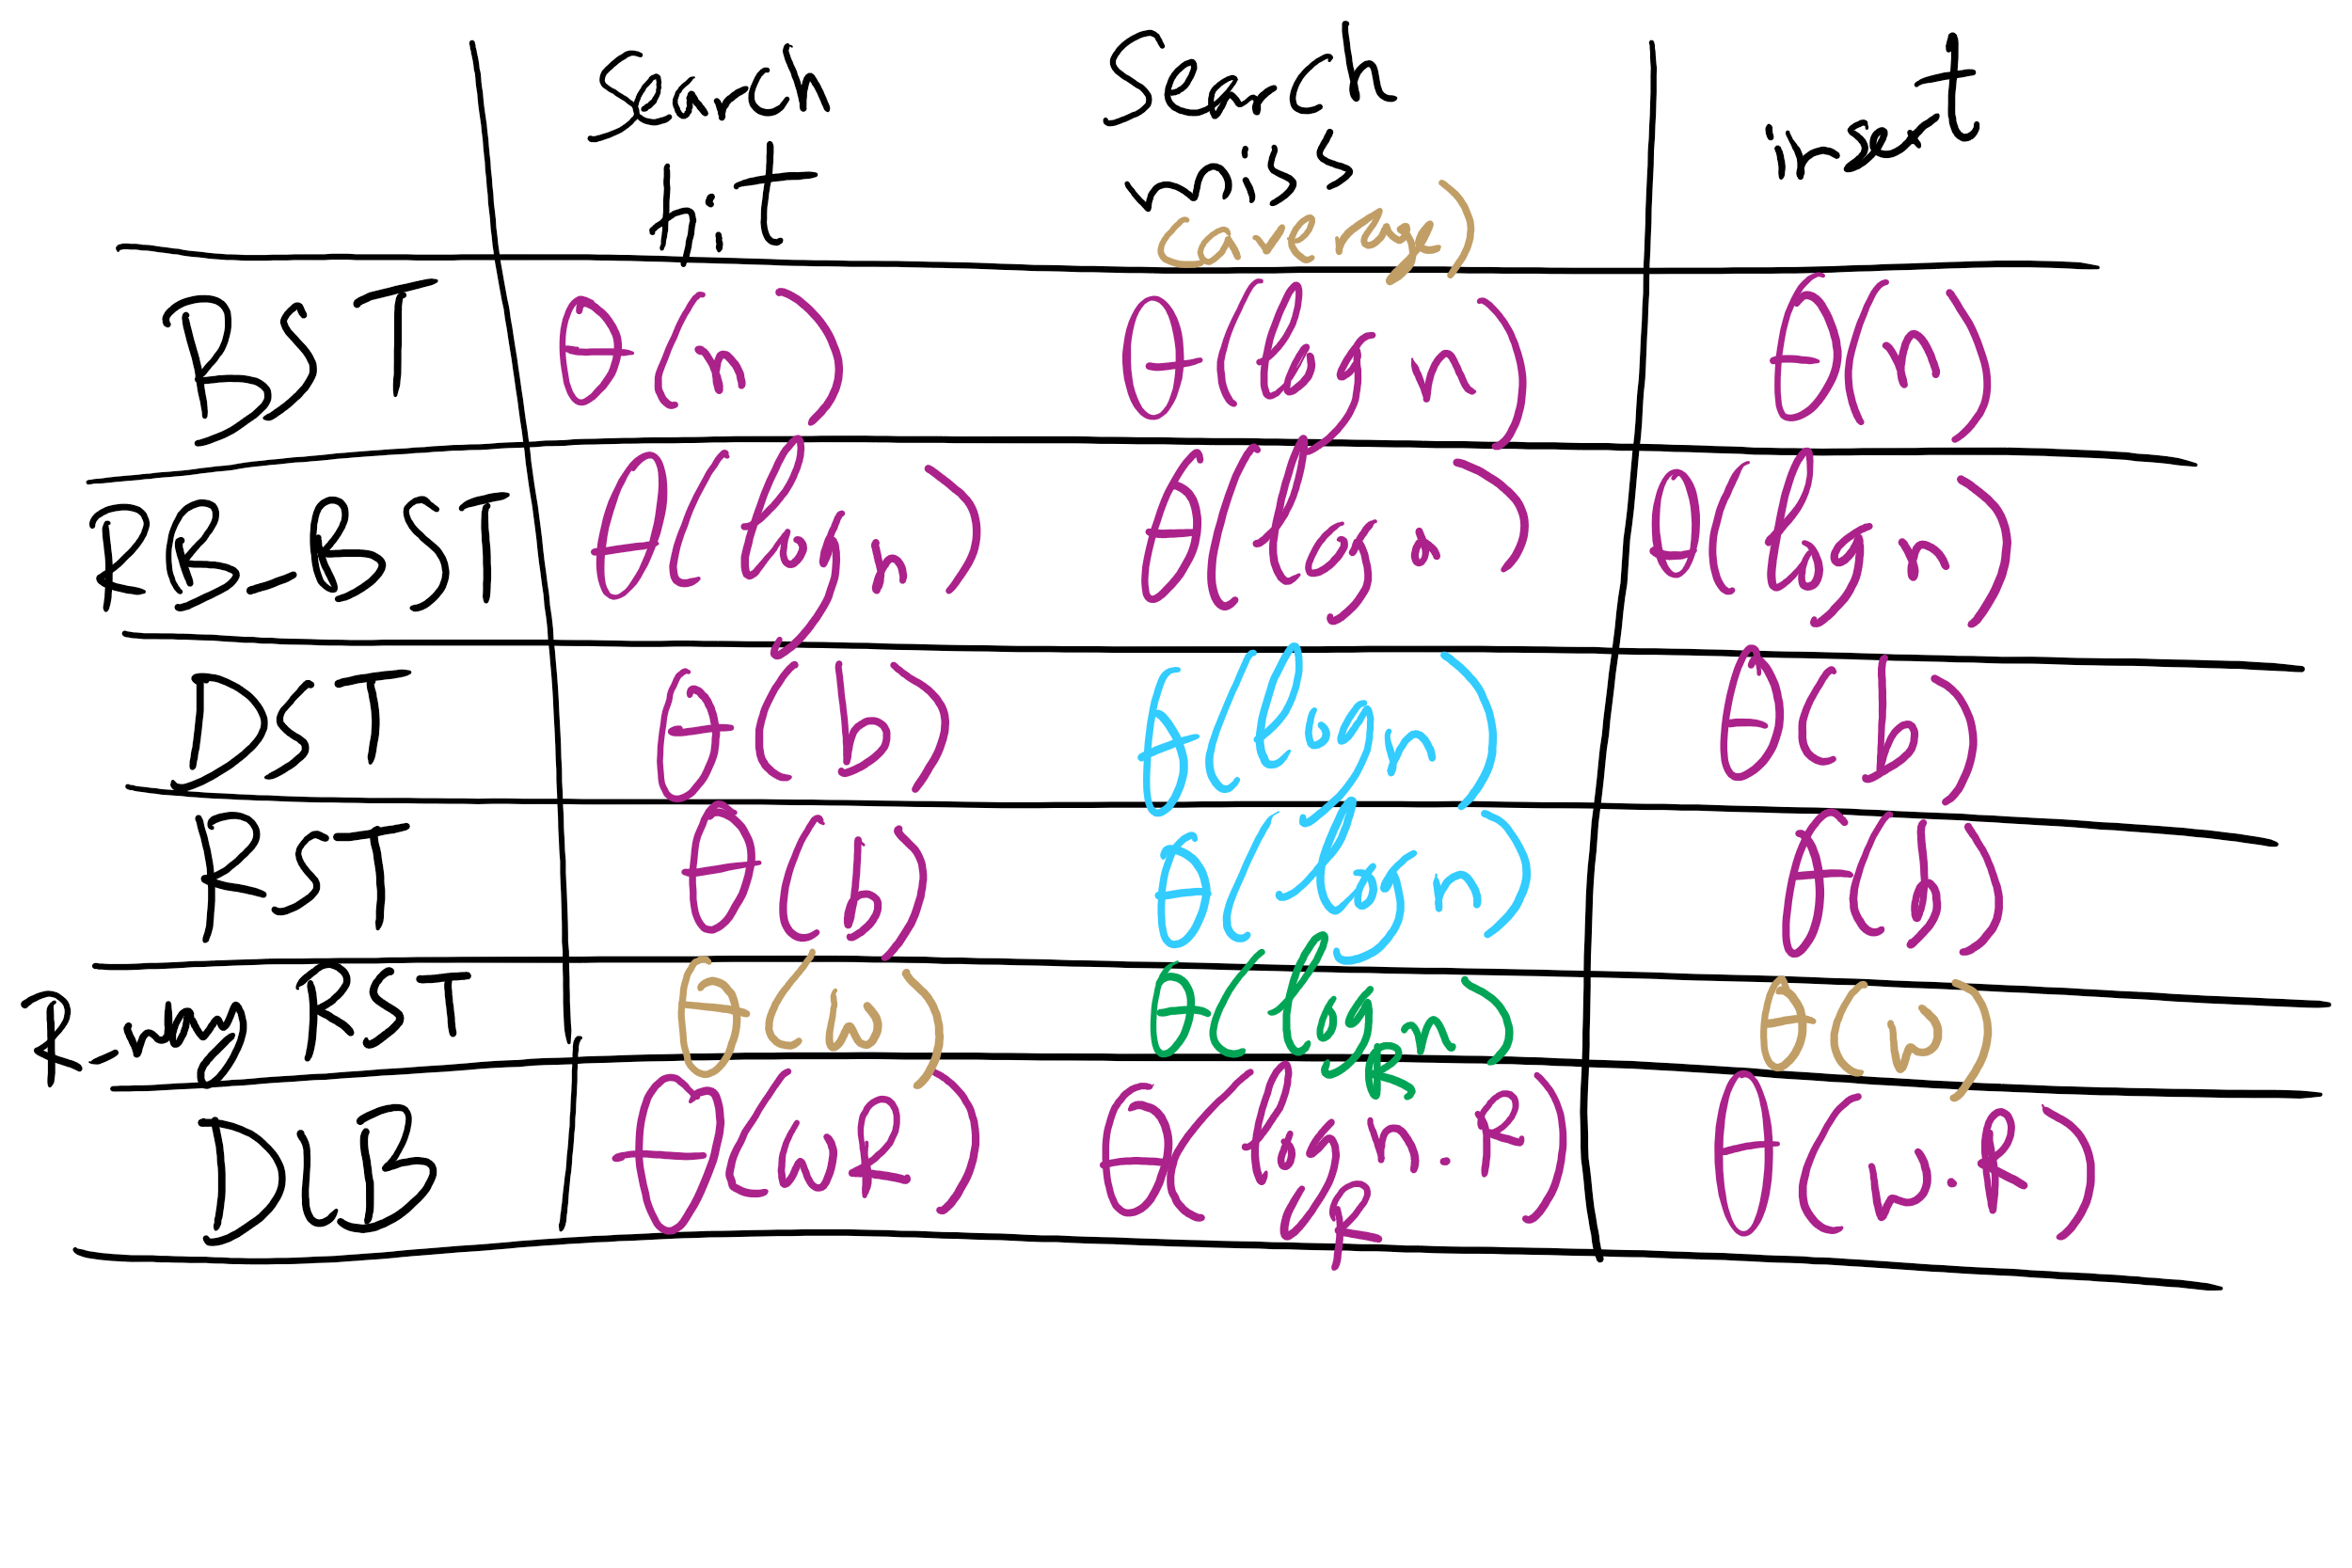
Runtime Comparison for Search Trees

Slide 9
Final notes on Search Tree/Tries
We did not present an exhaustive look at search trees/tries, just the sampling that we’re going to focus on
Many variations on these techniques exist and perform quite well in different circumstances
Ternary search Tries
R-way tries without 1-way branching
See the table at the end of Section 5.2 of the text

Slide 10
What is compression?
Represent the “same” data using less storage space
Can get more use out a disk of a given size
Can get more use out of memory
E.g., free up memory by compressing inactive sections
Faster than paging
Built in to OSX Mavericks and later
Can reduce the amount of data transmitted
Faster file transfers
Cut power usage on mobile devices
Two main approaches to compression...

Slide 11
Lossy Compression
D
Compress
C
Expand
D’
Information is permanently lost in the compression process
Examples:
MP3, H264, JPEG
With audio/video files this typically isn’t a huge problem as human users might not be able to perceive the difference

Slide 12
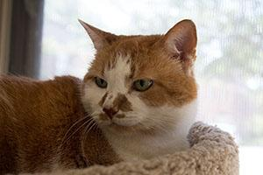
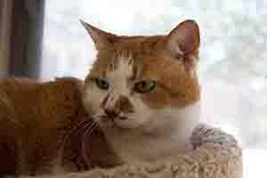
Lossy examples
MP3
“Cuts out” portions of audio that are considered beyond what most people are capable of hearing
JPEG
40K
28K

Slide 13
Lossless Compression
D
Compress
C
Expand
D
Input can be recovered from compressed data exactly
Examples:
zip files, FLAC
Notes:
differences? anecdotally, a 600MB cd compresses to ~80MB mp3 and ~250MB flac

Slide 14
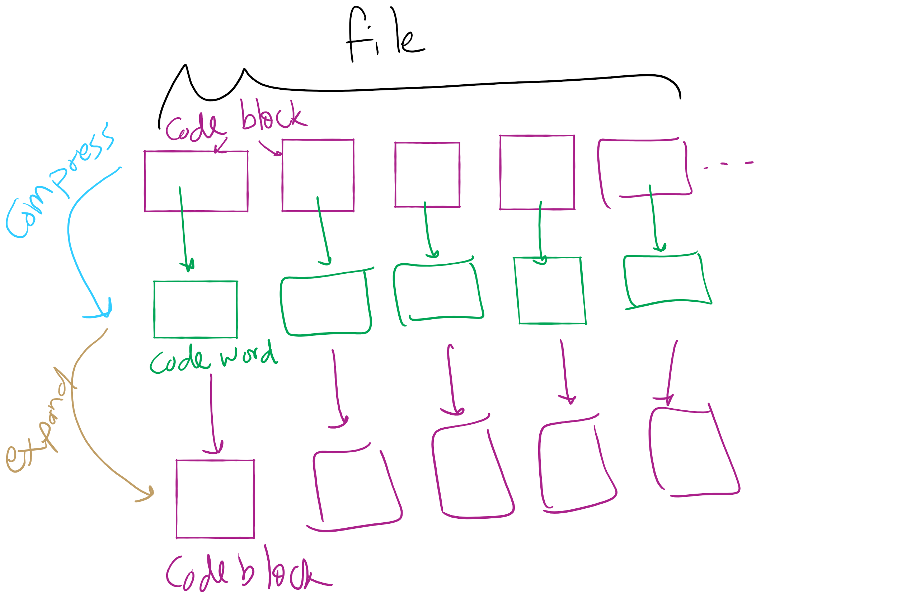
Lossless Compression Framework

Slide 15
Huffman Compression
Works on arbitrary bit strings, but pretty easily explained using characters
Consider the ASCII character set
Essentially blocks of codes
In general, to fit R potential characters in a block, you need lg R bits of storage per block
Consequently, n bits storage blocks represent 2^{n} characters
Each 8 bit code block represents one of 256 possible characters in extended ASCII
Easy to encode/decode

Slide 16
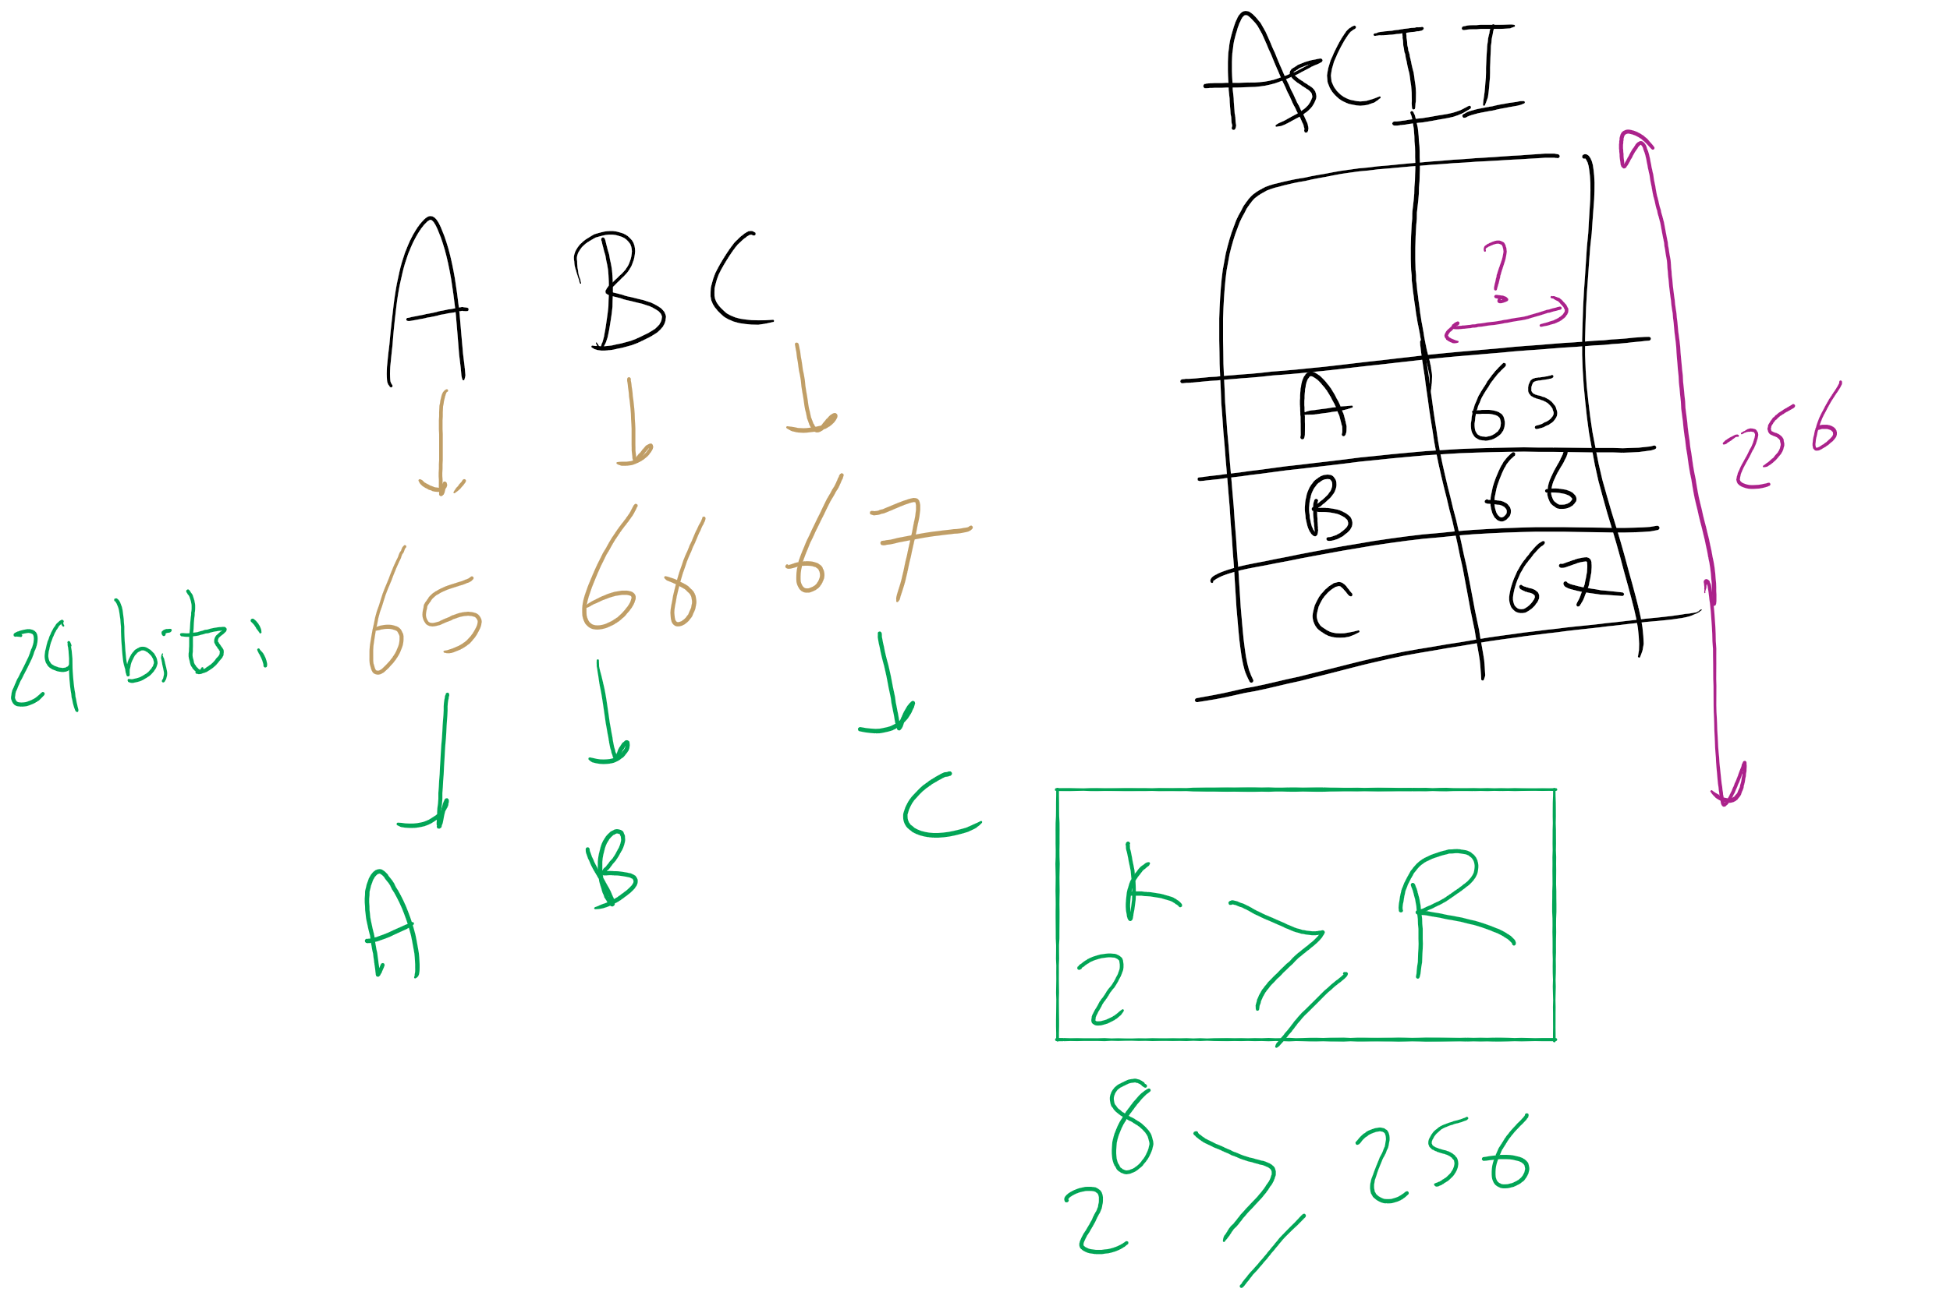
ASCII Encoding

Slide 17
Considerations for compressing ASCII
What if we used variable length codewords instead of the constant 8? Could we store the same info in less space?
Different characters are represented using codes of different bit lengths
If all characters in the alphabet have the same usage frequency, we can’t beat block storage
On a character by character basis…
What about different usage frequencies between characters?
In English, R, S, T, L, N, E are used much more than Q or X

Slide 18
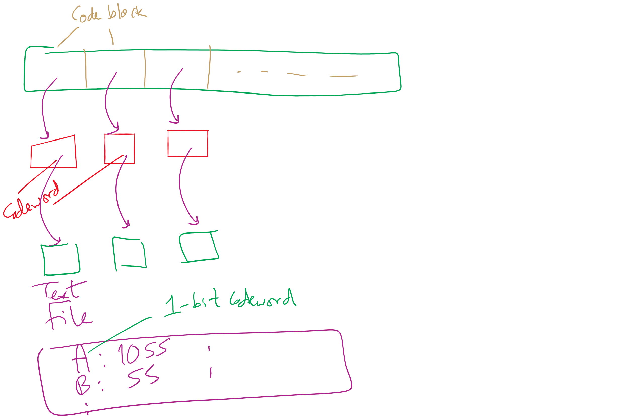
Variable size codewords

Slide 19
Variable length encoding
Decoding was easy for block codes
Grab the next 8 bits in the bitstring
How can we decode a bitstring that is made of variable length code words?
BAD example of variable length encoding:
1
00
01
001
100
101
10101
A
T
K
U
R
C
N
Notes:
delimiters are wasteful
Example on board:
General sends message: 10000110101
Is that: 1, 00, 00, 1, 101, 01 (A, T, T, A, C, K)
or: 100, 001, 10101 (R, U, N)

Slide 20
Variable length encoding for lossless compression
Codes must be prefix free
No code can be a prefix of any other in the scheme
Using this, we can achieve compression by:
Using fewer bits to represent more common characters
Using longer codes to represent less common characters

Slide 21
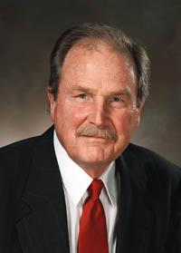
How can we create these prefix-free codes?
Huffman encoding!

Slide 22
Generating Huffman codes
Assume we have K characters that are used in the file to be compressed and each has a weight (its frequency of use)
Create a forest, F, of K single-node trees, one for each character, with the single node storing that char’s weight
while |F| > 1:
Select T1, T2 ∈ F that have the smallest weights in F
Create a new tree node N whose weight is the sum of T1 and T2’s weights
Add T1 and T2 as children (subtrees) of N
Remove T1 and T2 from F
Add the new tree rooted by N to F
Build a tree for “ABRACADABRA!”
Notes:
build tree for abracadabra, use it to construct compressed string,

Slide 23
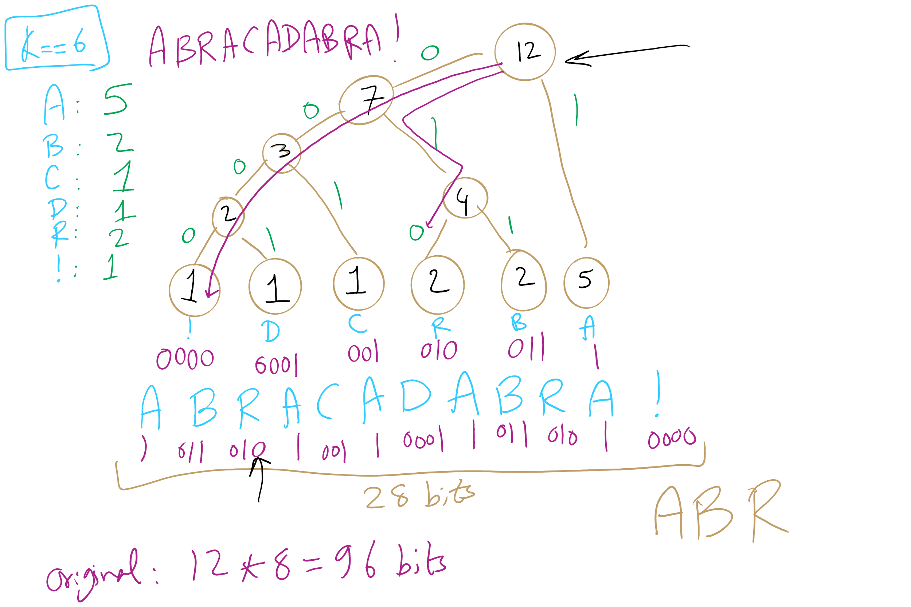
Huffman Tree Construction Example

