Slide 1

Algorithms and Data Structures 2 CS 1501
Fall 2021
Sherif Khattab
ksm73@pitt.edu
(Slides are adapted from Dr. Ramirez’s and Dr. Farnan’s CS1501 slides.)

Slide 2
Announcements
Upcoming deadlines:
Homework 6 and Lab 5 due on 10/22
Assignment 2 due on 10/25

Slide 3
Last lecture …
Huffman Compression

Slide 4
CourseMIRROR Reflections

Slide 5
This Lecture
Huffman Compression (contd.)
Run length Encoding
LZW

Slide 6
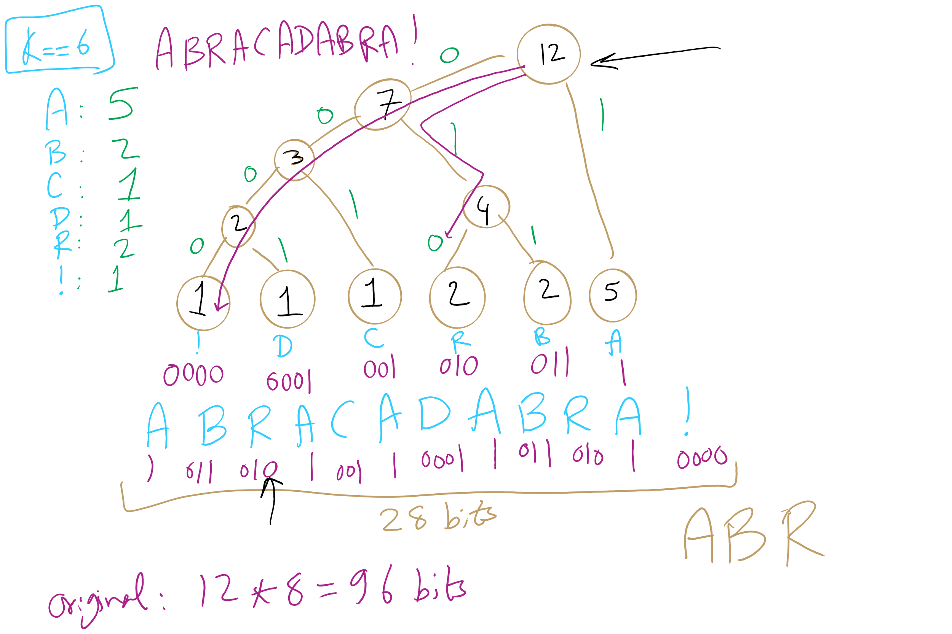
Huffman Tree Construction Example

Slide 7
Implementation concerns
To encode/decode, we'll need to read in characters and output codes/read in codes and output characters
…
Sounds like we'll need a symbol table!
What implementation would be best?
Same for encoding and decoding?
Note that this means we need access to the trie to expand a compressed file!
Notes:
Probably best to create a lookup table for encoding…
Traverse the tree and construct the table
Then you can simply lookup and output the appropriate code for each character in the input string!
Here, we’ll use the trie we constructed earlier
Descend the trie according to the bits of the compressed file
When you hit a leaf, output the appropriate character
Return to the root and repeat…

Slide 8
Further implementation concerns
Need to efficiently be able to select lowest weight trees to merge when constructing the trie
Can accomplish this using a priority queue
Need to be able to read/write bitstrings!
Unless we pick multiples of 8 bits for our codewords, we will need to read/write fractions of bytes for our codewords
We’re not actually going to do I/O on fraction of bytes
We’ll maintain a buffer of bytes and perform bit processing on this buffer
See BinaryStdIn.java and BinaryStdOut.java
Notes:
priority queues will be the subject of a lecture yet to come...

Slide 9
Binary I/O
private static void writeBit(boolean bit) { // add bit to buffer buffer <<= 1; if (bit) buffer |= 1; // if buffer is full (8 bits), write out as a single byte N++; if (N == 8) clearBuffer();
}
writeBit(true);
writeBit(false);
????????
???????0
???????1
??????10
?????100
?????101
????1010
???10100
??101000
?1010000
10100000
10100001
buffer:
00000000
writeBit(true);
writeBit(false);
writeBit(false);
0
1
2
3
4
5
6
7
8
writeBit(false);
N:
0
writeBit(false);
writeBit(true);

Slide 10
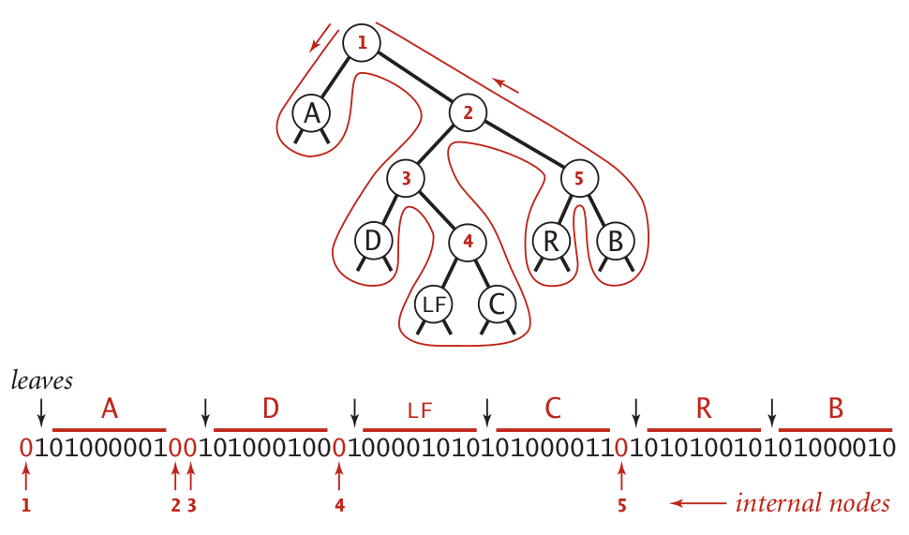
Representing tries as bitstrings

Slide 11
Binary I/O
private static void writeTrie(Node x){
if (x.isLeaf()) {
BinaryStdOut.write(true);
BinaryStdOut.write(x.ch);
return; } BinaryStdOut.write(false);
writeTrie(x.left);
writeTrie(x.right); }
private static Node readTrie() {
if (BinaryStdIn.readBoolean())
return new Node(BinaryStdIn.readChar(), 0, null, null);
return new Node('\0', 0, readTrie(), readTrie());
}
Notes:
tracing through to verify that this code works is left as an exercise to the students

Slide 12
Binary I/O
private static void writeBit(boolean bit) { // add bit to buffer buffer <<= 1; if (bit) buffer |= 1; // if buffer is full (8 bits), write out as a single byte N++; if (N == 8) clearBuffer();
}
writeBit(true);
writeBit(false);
????????
???????0
???????1
??????10
?????100
?????101
????1010
???10100
??101000
?1010000
10100000
10100001
buffer:
00000000
writeBit(true);
writeBit(false);
writeBit(false);
0
1
2
3
4
5
6
7
8
writeBit(false);
N:
0
writeBit(false);
writeBit(true);

Slide 13
Representing tries as bitstrings

Slide 14
Binary I/O
private static void writeTrie(Node x){
if (x.isLeaf()) {
BinaryStdOut.write(true);
BinaryStdOut.write(x.ch);
return;
}
BinaryStdOut.write(false);
writeTrie(x.left);
writeTrie(x.right);
}
private static Node readTrie() {
if (BinaryStdIn.readBoolean())
return new Node(BinaryStdIn.readChar(), 0, null, null);
return new Node('\0', 0, readTrie(), readTrie());
}
Notes:
tracing through to verify that this code works is left as an exercise to the students

Slide 15
Huffman pseudocode
Encoding approach:
Read input
Compute frequencies
Build trie/codeword table
Write out trie as a bitstring to compressed file
Write out character count of input
Use table to write out the codeword for each input character
Decoding approach:
Read trie
Read character count
Use trie to decode bitstring of compressed file

Slide 16
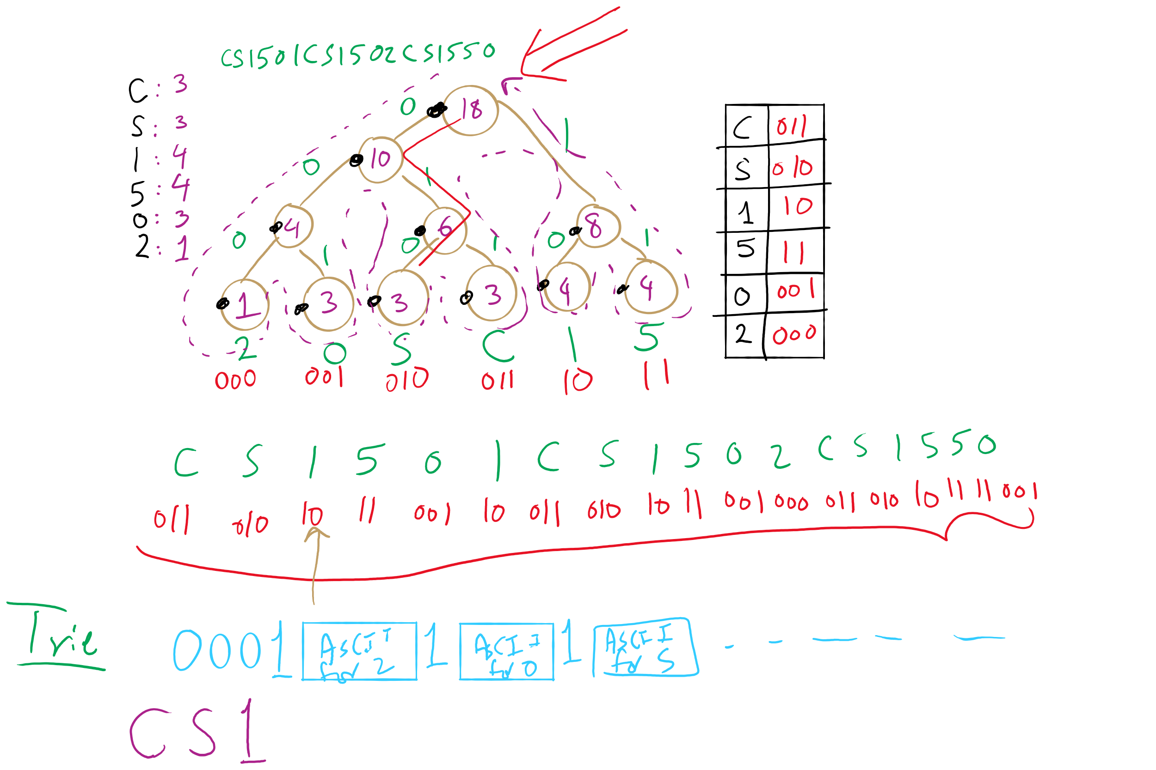
Huffman Compression Example

Slide 17
How do we determine character frequencies?
Option 1: Preprocess the file to be compressed
Upside: Ensure that Huffman’s algorithm will produce the best output for the given file
Downsides:
Requires two passes over the input, one to analyze frequencies/build the trie/build the code lookup table, and another to compress the file
Trie must be stored with the compressed file, reducing the quality of the compression
This especially hurts small files
Generally, large files are more amenable to Huffman compression
Just because a file is large, however, does not mean that it will compress well!

Slide 18
How do we determine character frequencies?
Option 2: Use a static trie
Analyze multiple sample files, build a single tree that will be used for all compressions/expansions
Saves on trie storage overhead…
But in general not a very good approach
Different character frequency characteristics of different files means that a code set/trie that works well for one file could work very poorly for another
Could even cause an increase in file size after “compression”!

Slide 19
How do we determine character frequencies?
Option 3: Adaptive Huffman coding
Single pass over the data to construct the codes and compress a file with no background knowledge of the source distribution
Not going to really focus on adaptive Huffman in the class, just pointing out that it exists...

Slide 20
Ok, so how good is Huffman compression
ASCII requires 8m bits to store m characters
For a file containing c different characters
Given Huffman codes {h₀, h₁, h₂, …, h_{(c-1)}}
And frequencies {f₀, f₁, f₂, …, f_{(c-1)}}
Sum from 0 to c-1: |h_{i}|* f_{i}
Total storage depends on the differences in frequencies
The bigger the differences, the better the potential for compression
Huffman is optimal for character-by-character prefix-free encodings
Proof in Propositions T and U of Section 5.5 of the text

Slide 21
That seems like a bit of a caveat...
Where does Huffman fall short?
What about repeated patterns of multiple characters?
Consider a file containing:
1000 A’s
1000 B’s
…
1000 of every ASCII character
Will this compress at all with Huffman encoding?
Nope!
But it seems like it should be compressible...

Slide 22
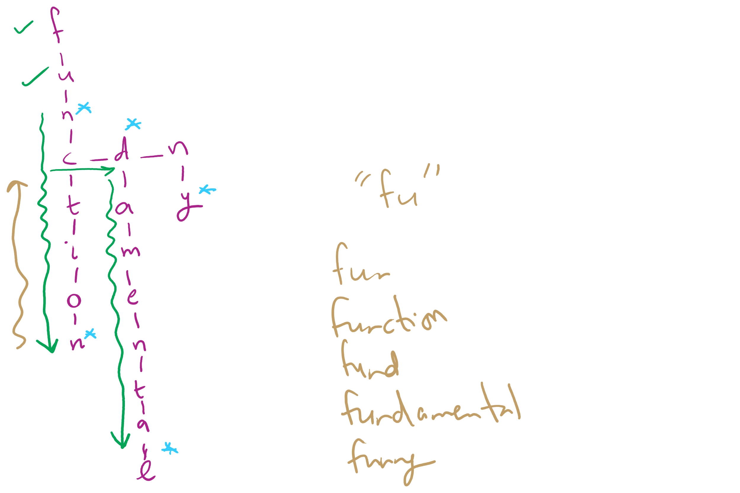
Assignment 2 Hints

Slide 23
Run length encoding
Could represent the previously mentioned string as:
1000A1000B1000C, etc.
Assuming we use 10 bits to represent the number of repeats, and 8 bits to represent the character…
4608 bits needed to store run length encoded file
vs. 2048000 bits for input file
Huge savings!
Note that this incredible compression performance is based on a very specific scenario…
Run length encoding is not generally effective for most files, as they often lack long runs of repeated characters

Slide 24
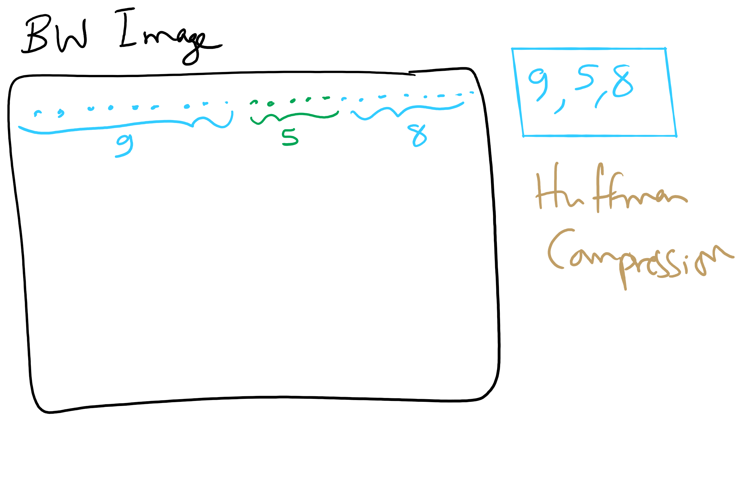
Run-length Encoding

Slide 25
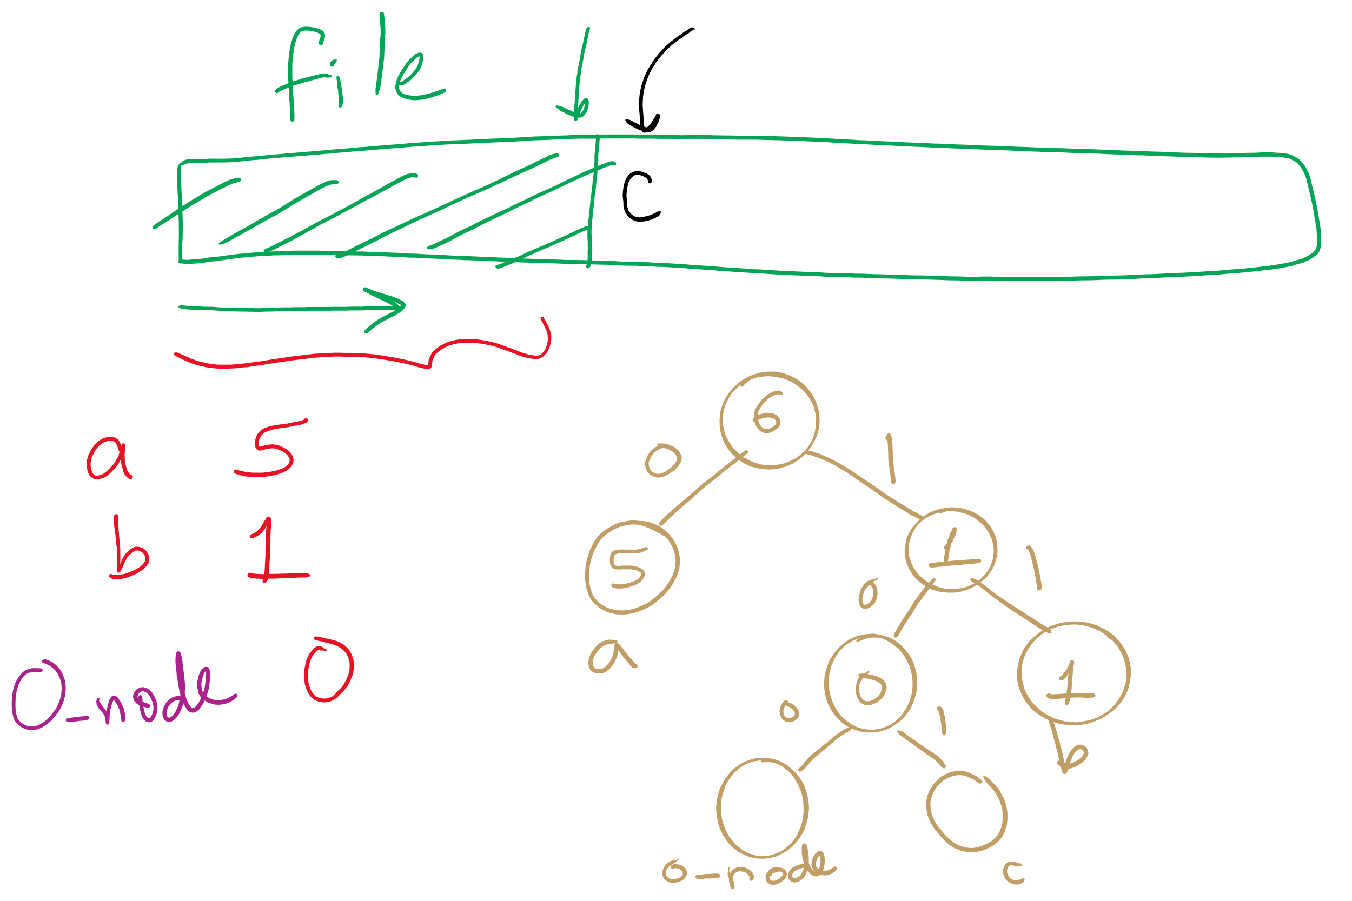
Adaptive Huffman

Slide 26
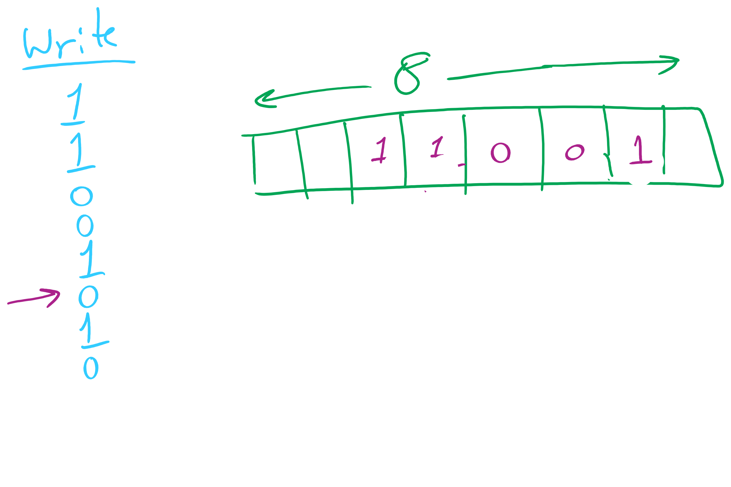
Binary I/O

Slide 27
Please submit your reflections by using the CourseMIRROR App
If you are having a problem with CourseMIRROR, please send an email to coursemirror.development@gmail.com
Notes:
All right!
Upcoming Due Dates at A Glance

