Slide 1

Algorithms and Data Structures 2 CS 1501
Fall 2021
Sherif Khattab
ksm73@pitt.edu
(Slides are adapted from Dr. Ramirez’s and Dr. Farnan’s CS1501 slides.)

Slide 2
Announcements
Upcoming deadlines:
11/19: Lab 9 and Homework 10
11/15 11/17: Assignment 3

Slide 3
Previous lecture …
Using Heap to improve the runtime of Prim’s MST algorithm
Lazy Prim’s (PQ of edges)
Every iteration, select the smallest possible edge
Eager Prim’s (indexable PQ of vertices)
Every iteration, select the smallest possible vertex

Slide 4
Today…
Weighted Shortest Paths
Dijkstra’s algorithm
Kruskal’s MST algorithm

Slide 5
Comparison of Prim’s implementations
Parent/Best Edge array Prim’s
Runtime: Θ(v²)
Space: Θ(v)
Lazy Prim’s
Runtime: Θ(e lg e)
Space: Θ(e)
Requires a PQ
Eager Prim’s
Runtime: Θ(e lg v)
Space: Θ(v)
Requires an indexable PQ
How do these compare?
Notes:
note that space requirements by these algorithms is space overhead on top of the input (how we represent the graph)

Slide 6
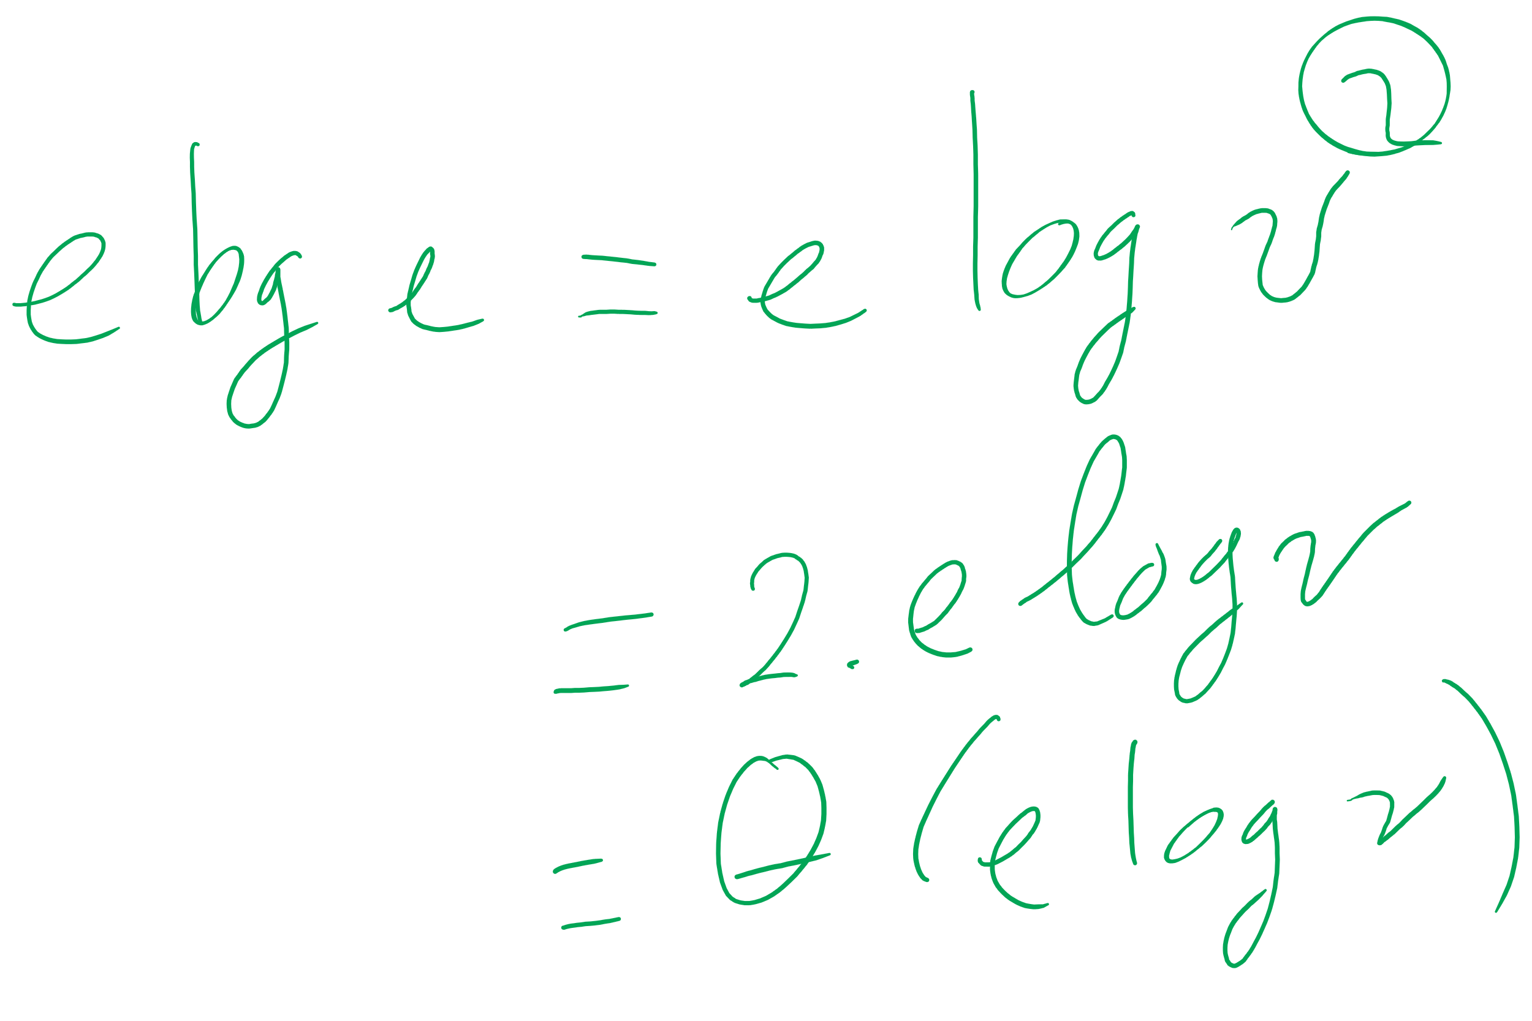
Eager vs. Lazy Prim’s

Slide 7
Weighted shortest path
Dijkstra’s algorithm:
Set a distance value of MAX_INT for all vertices but start
Set cur = start
While destination is not visited:
For each unvisited neighbor of cur:
Compute tentative distance from start to the unvisited neighbor through cur
Update any vertices for which a lesser distance is computed
Mark cur as visited
Let cur be the unvisited vertex with the smallest tentative distance from start

Slide 8
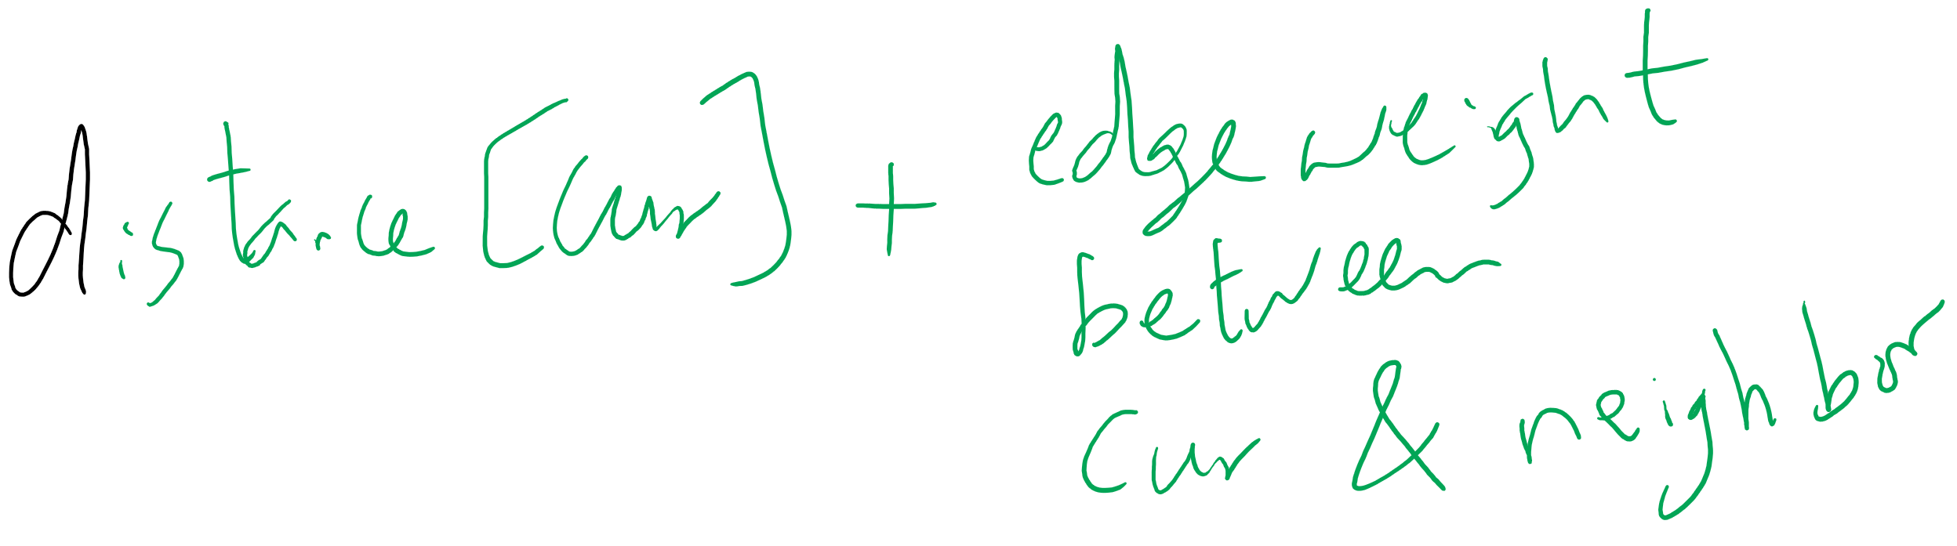
Tentative Distance

Slide 9
Dijkstra's example
0
0
Distance
Via
7
14
0
0
--
1
9
3
1
3
1
∞
7
--
0
2
∞
9
--
10
2
0
2
2
3
11
∞
14
2
--
15
0
9
4
22
21
∞
1
2
--
12
13
5
∞
22
20
--
2
3
4
5
4
5
2

Slide 10
Analysis of Dijkstra’s algorithm
How to implement?
Best path/parent array?
Runtime?
PQ?
Turns out to be very similar to Eager Prims
Storing paths instead of edges
Runtime?

Slide 11
Back to MST: Another MST algorithm
Kruskal’s MST:
Insert all edges into a PQ
Grab the min edge from the PQ that does not create a cycle in the MST
Remove it from the PQ and add it to the MST

Slide 12
Kruskal's example
0
PQ:
6
5
1
1
3
1: (0, 2)
2: (3, 5)
5
5
3: (1, 4)
2
3
2
4: (2, 5)
6
4
5: (2, 3)
5: (0, 3)
4
5
6
5: (1, 2)
6: (0, 1)
6: (2, 4)
6: (4, 5)
Notes:
note that we can stop after we add (1, 2)
get the students to realize why
its connected, adding any more edges would create a cycle
do we have to stop or can we keep popping and doing cycle detection?
is it better to stop or keep going and doing cycle check for each remove?
why?
depends on time to do connected detection vs time to continue popping/cycle detection

Slide 13
Kruskal’s runtime
Instead of building up the MST starting from a single vertex, we build it up using edges all over the graph
How do we efficiently implement cycle detection?

Slide 14
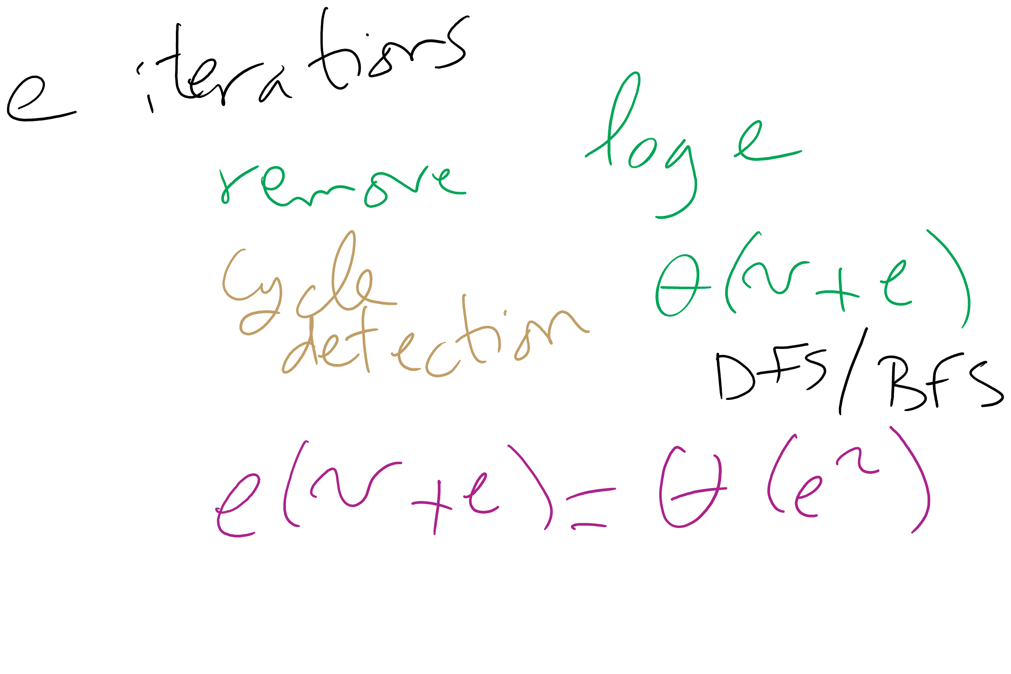
Kruskal’s Runtime: Take 1

Slide 15
Please submit your reflections by using the CourseMIRROR App
If you are having a problem with CourseMIRROR, please send an email to coursemirror.development@gmail.com
Notes:
All right!
Upcoming Due Dates at A Glance

