Slide 1

Algorithms and Data Structures 2 CS 1501
Fall 2021
Sherif Khattab
ksm73@pitt.edu
(Slides are adapted from Dr. Ramirez’s and Dr. Farnan’s CS1501 slides.)

Slide 2
Announcements
Upcoming deadlines:
11/9: Midterm-exam corrections
11/12: Lab 9 and Homework 9
11/15: Assignment 3

Slide 3
Previous lecture …
Using DFS to find articulation points in a graph
Prim’s Minimum Spanning Tree (MST) Algorithm

Slide 4
CourseMIRROR Reflections

Slide 5
Today…
Prim’s analysis
Priority Queue
Definition
Operations
Heap implementation
Heap Sort
Heapify

Slide 6
Kruskal’s runtime
Instead of building up the MST starting from a single vertex, we build it up using edges all over the graph
How do we efficiently implement cycle detection?

Slide 7
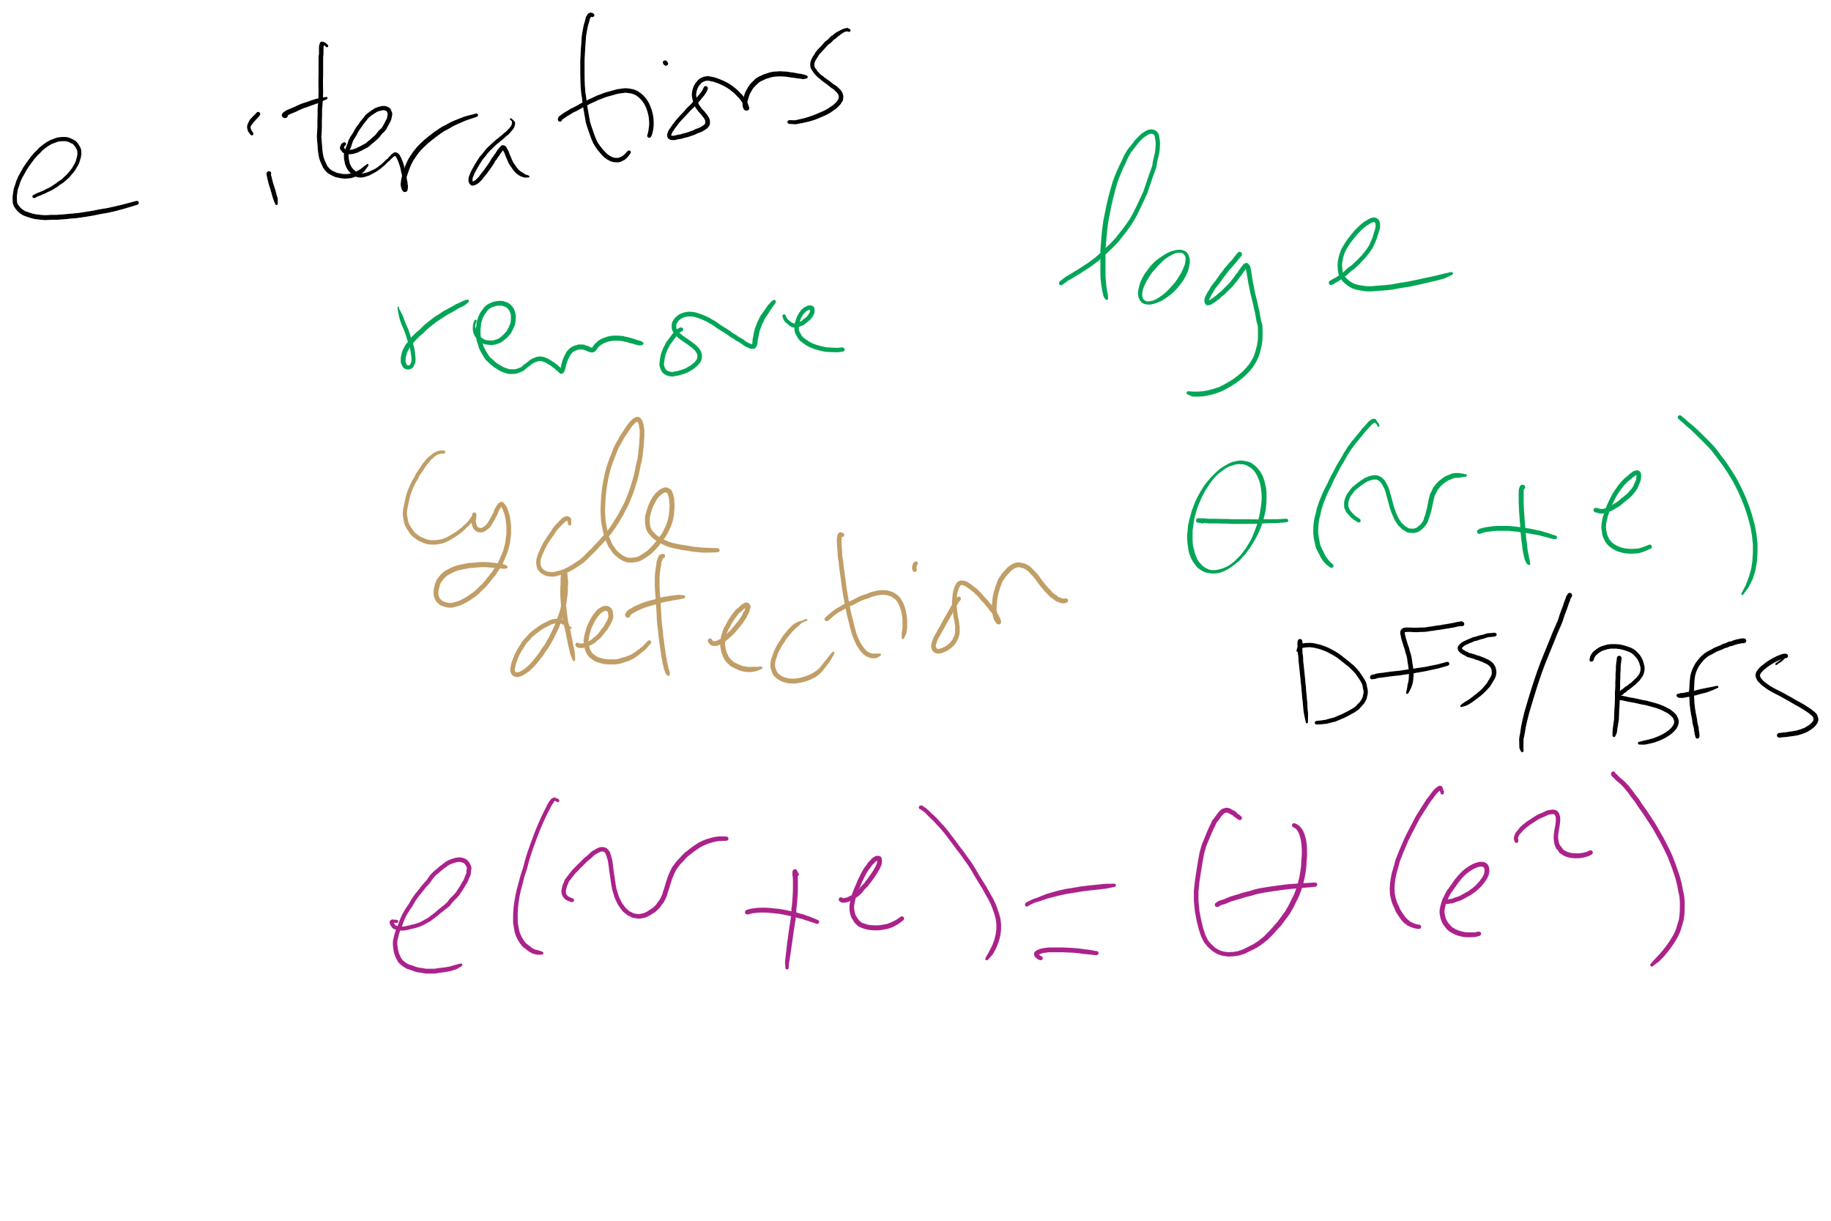
Kruskal’s Runtime: Take 1

Slide 8
Another MST algorithm
Kruskal’s MST:
Insert all edges into a PQ
Grab the min edge from the PQ that does not create a cycle in the MST
Remove it from the PQ and add it to the MST

Slide 9
Please submit your reflections by using the CourseMIRROR App
If you are having a problem with CourseMIRROR, please send an email to coursemirror.development@gmail.com
Notes:
All right!
Upcoming Due Dates at A Glance

