Slide 1

Algorithms and Data Structures 2 CS 1501
Fall 2021
Sherif Khattab
ksm73@pitt.edu
(Slides are adapted from Dr. Ramirez’s and Dr. Farnan’s CS1501 slides.)

Slide 2
Announcements
Upcoming Deadlines
Homework 1: today at 11:59 pm
Homework 2: Monday 1/31 at 11:59 pm
Lab 1: Friday 1/28 at 11:59 pm
Assignment 1 not yet posted (sorry about that)
CourseMIRROR consent form and pre-survey

Slide 3
Previous lecture
Backtracking solution for the Boggle Game problem
General backtracking template

Slide 4
CourseMIRROR Reflections

Slide 5
Searching Problem
Input:
a (large) dynamic set of data items in the form of
(key, value) pairs
What does dynamic mean?
a target key to search for
Output:
if key exists in the set: return the corresponding value
otherwise, return key not found

Slide 6
Let’s create an ADT!
The Symbol Table ADT
A set of (key, value) pairs
Operations of the ST ADT
insert
search
delete

Slide 7
Symbol Table Implementations
Array
Unsorted
Sorted
Linked List
Unsorted
Sorted
What if we use a non-linear data structure?
a Tree?

Slide 8
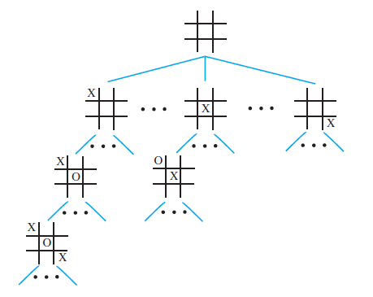
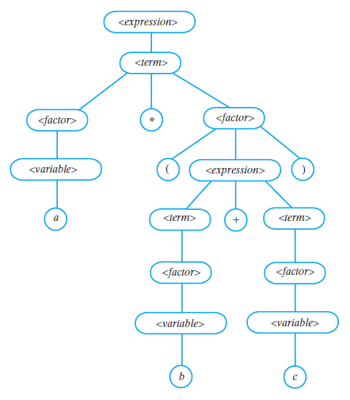
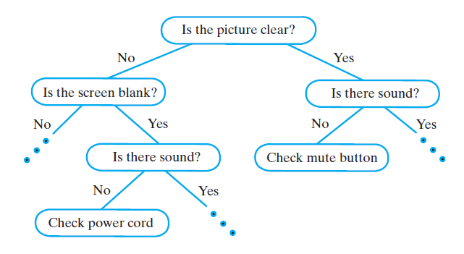
Examples of Trees
Game Tree
Parse Tree
Decision Tree

Slide 9
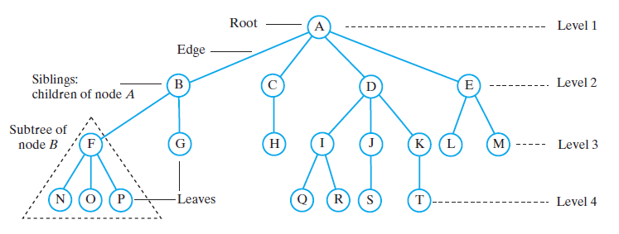
Tree Terminology

Slide 10
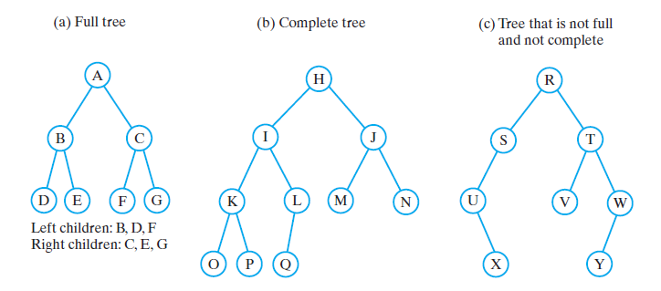
Binary Trees

Slide 11
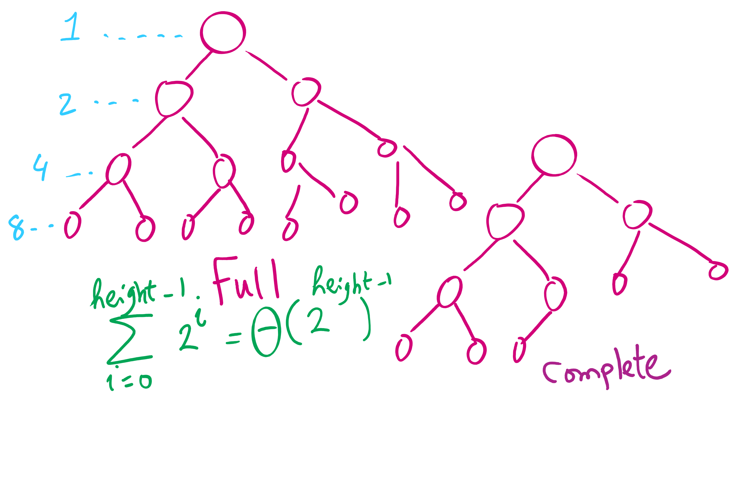
Full vs. Complete Tree

Slide 12
Tree Search Take 1
Traverse every node of the tree
Is the key inside the node equal to the target key?
How can we traverse the tree?

Slide 13
Traversals of a Binary Tree
Preorder traversal
Visit root before we visit root’s subtrees
Inorder traversal
Visit root of a binary tree between visiting nodes in root’s subtrees.
Postorder traversal
Visit root of a binary tree after visiting nodes in root’s subtrees
Level-order traversal
Begin at root and visit nodes one level at a time

Slide 14
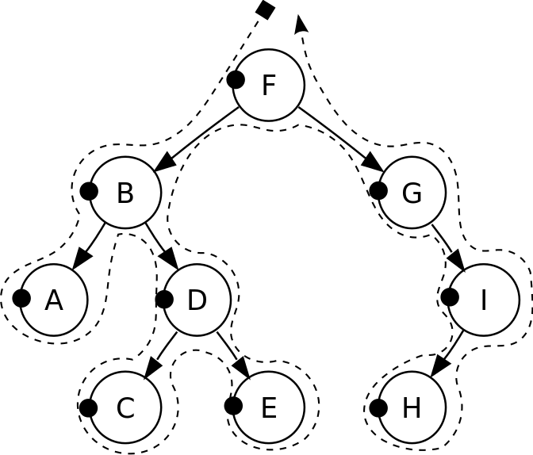
Pre-order traversal
Notes:
F, B, A, D, C, E, G, I, H
Seen before when we talked about marshalling huffman tries to the compressed file
Good for evaluating Polish notation

Slide 15
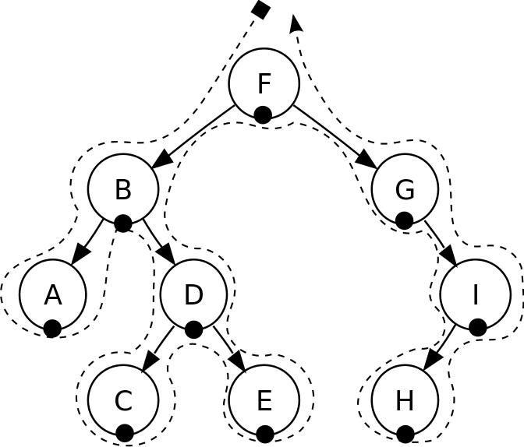
In-order traversal
Notes:
A, B, C, D, E, F, G, H, I
Seen when we wanted to enumerate all values stored in a B-tree (motivating the need for a B+tree)
Good for sorted ordering (if dealing with sorted data structure)

Slide 16
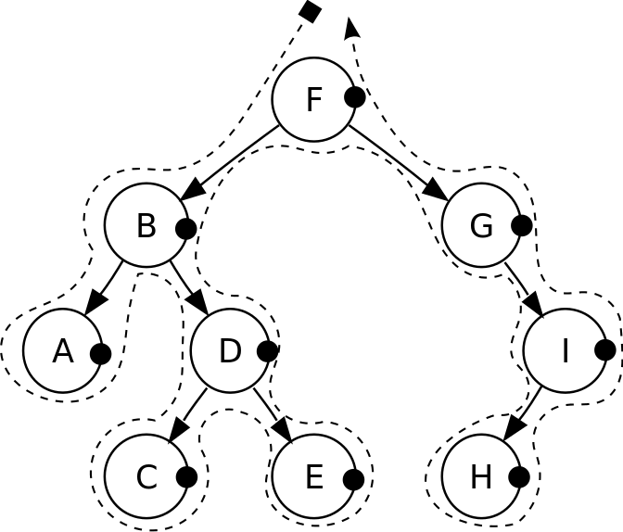
Post-order traversal
Notes:
A, C, E, D, B, H, I, G, F
Good for reverse Polish notation

Slide 17
Tree Search Take 1
What is the runtime?

Slide 18
Can we do better?
Can we traverse the tree more intelligently?

Slide 19
Tree Search Take 2: Binary Search Tree
Search Tree Property
left < root < right

Slide 20
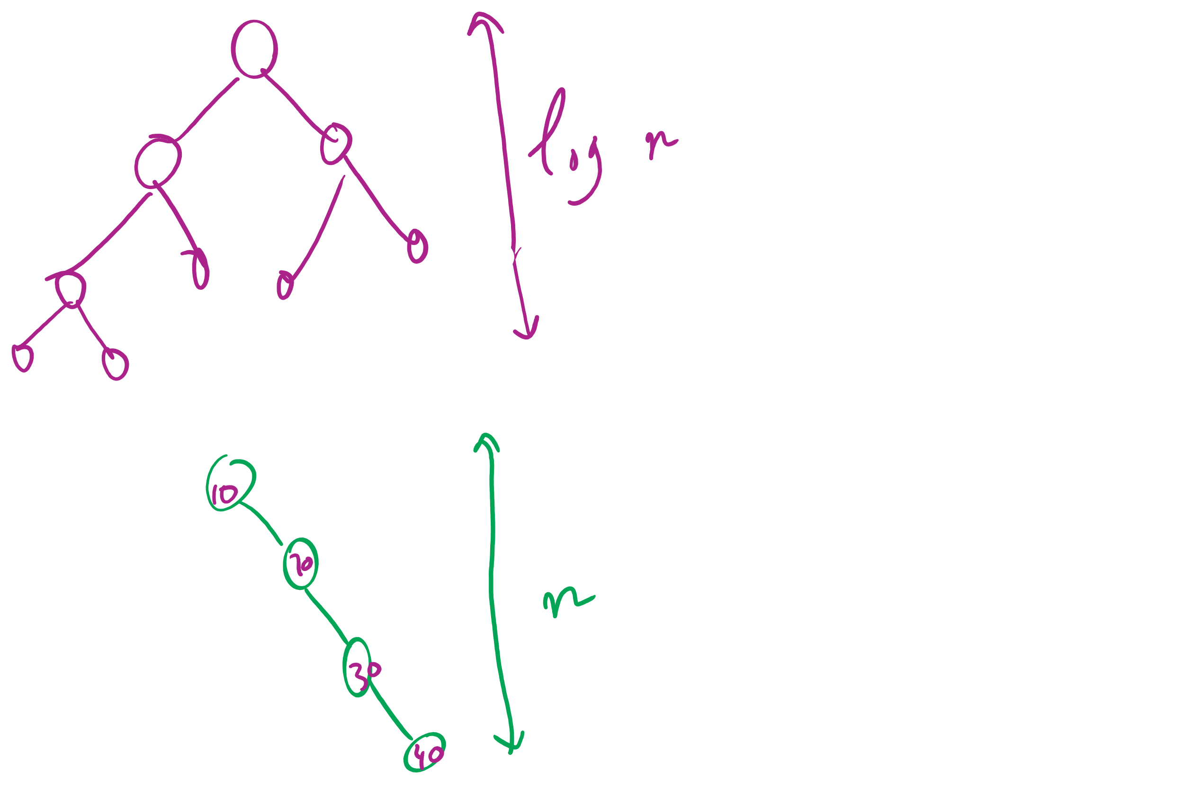
BSTs with varying heights

Slide 21
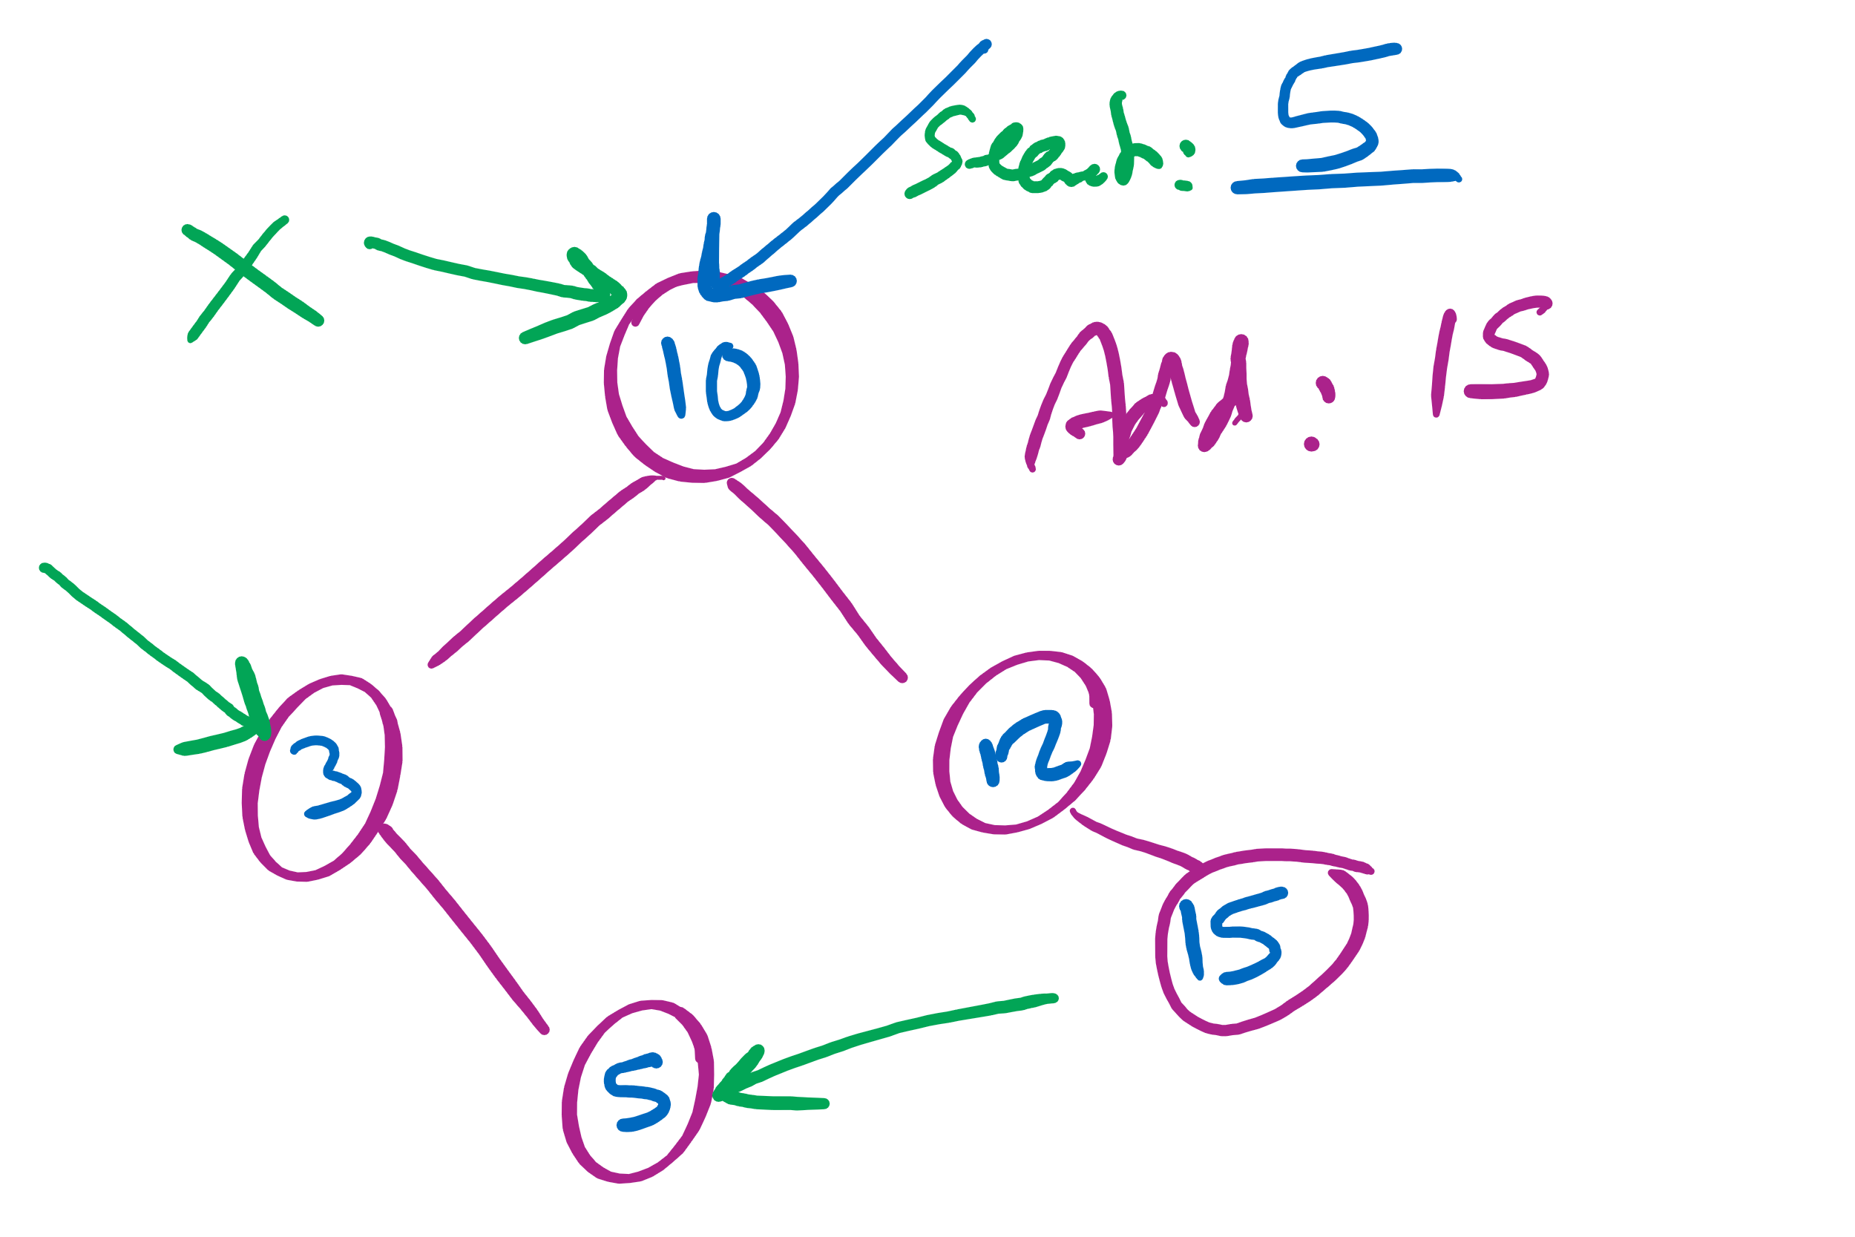
Searching in and insertion to a BST

Slide 22
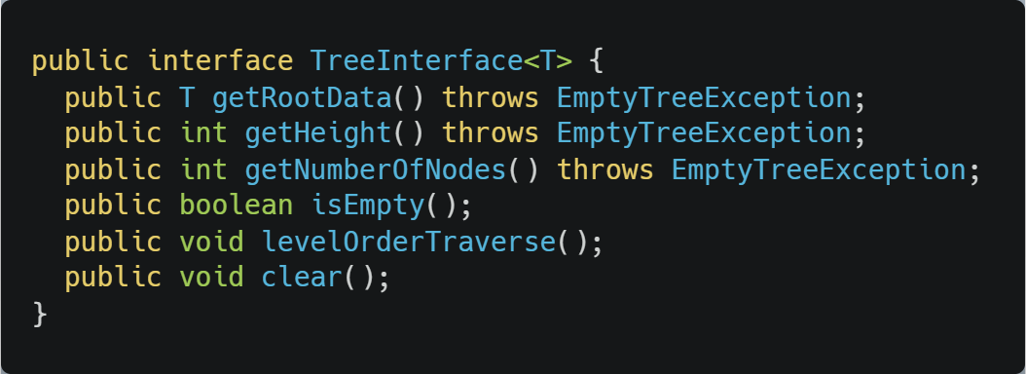
Tree Interface

Slide 23
Code Walkthrough
Available online at:
https://cs1501-2221.github.io/handouts/CodeHandouts/TreeADT/Slides
The slides are under the CodeHandouts/TreeADT/slides folder in the handout repository
https://github.com/cs1501-2221/handouts

Slide 24
Please submit your reflections by using the CourseMIRROR App
If you are having a problem with CourseMIRROR, please send an email to coursemirror.development@gmail.com
Notes:
All right!
Upcoming Due Dates at A Glance

