Slide 1

Algorithms and Data Structures 2 CS 1501
Spring 2022
Sherif Khattab
ksm73@pitt.edu
(Slides are adapted from Dr. Ramirez’s and Dr. Farnan’s CS1501 slides.)

Slide 2
Goals of the course
To learn to convert non-trivial algorithms into programs
Various issues will always pop-up during implementation
Such as?...
To see and understand differences in algorithms and how they affect the run-times of the associated programs
Different solutions can be compared using many metrics
Notes:
Input and output
Language being used and its features / limitations
Data structures to use
Debugging

Slide 3
Contact Info
Course website: http://www.cs.pitt.edu/~skhattab/cs1501/
Instructor: Sherif Khattab ksm73@pitt.edu
OH: https://khattab.youcanbook.me
TuTh: 16:30-19:30 (remote until Jan 26 then in-person/remote)
F: 16:00-18:00 (remote only for the entire term)
6307 Sennott Square, Virtual Office: https://pitt.zoom.us/my/khattab
Teaching Team:
TBD
Recitations start this week!
Communication
End of week newsletter
Piazza (Please expect a response within 72 hours)
Email not recommended!

Slide 4
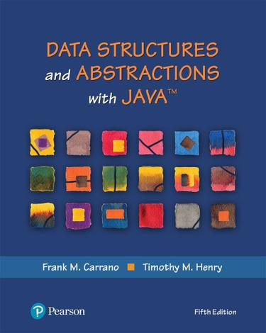
Textbook
Algorithms (4th Edition)
Robert Sedgewick and Kevin Wayne
Data Structures and Abstractions with Java (5th Edition)
Frank M. Carrano and Timothy M. Henry

Slide 5
Grades
40% on best four out of five programming assignments
posted on Canvas and submitted on Gradescope
20% homework assignments on Gradescope
20% exams: 12% on higher grade and 8% on lower
10% lab exercises; mostly autograded
10% mini-quizzes: on Top Hat during each lecture
Bonus Opportunities
1% Bonus on CourseMIRROR Reflections (to be explained later today)

Slide 6
Canvas Walkthrough
Lectures posted on Tophat
Lecture and recitation recordings
under Panopto Video
RedShelf Inclusive Access
Piazza for discussion and communication
Gradescope and autograding policies
Academic Integrity
NameCoach

Slide 7
Expectations
Your continuous feedback is important!
Anonymous Qualtrics survey
Midterm and Final OMET
Your engagement is valued and encouraged.

Slide 8
Lecture structure (mostly)
Time | Description
~5 min before and after class | Informal chat
~25 min | Announcements, review of reflections, and QA on assignments/labs/homework problems
~40 min | Lecturing
~5 min | Tophat questions and/or activities
~5 minutes | QA and muddiest points/reflections

Slide 9
Why is this class (notoriously) hard?
Lots of concepts
Attend lectures and recitations (if you absolutely cannot attend live, watch the video recordings)
Study often!
Put effort into the weekly homework assignments
Programming Assignments are relatively hard
Refresh your Java programming (CS 0445) and debugging skills
Start early and show up to office hours!

Slide 10
CourseMIRROR Mobile App
This semester we will use an educational technology tool, called CourseMIRROR.
CourseMIRROR is a mobile app that prompts student to reflect on their learning experiences.
You will receive 1% points of extra credit for your participation when the response rate is 60% or more.
If you have an iOS device (iPhone or iPad), please go to Apple App Store and search for “CourseMIRROR” and then install it to your device.
If you have an Android device (smartphone or tablet), please go to Google Play Store and search for ”CourseMIRROR v2” and then install it to your device.
After creating an account, you need to go to your email to confirm your account. (If you do not receive a confirmation email, please check your spam folder(s) too).
10

Slide 11
CourseMIRROR Mobile App
You will need a passcode to find our course within the CourseMIRROR app. Passcode for your class is tnxinh (all lower case).
Please watch the tutorial videos regarding how to install and use the app via https://www.youtube.com/channel/UC-DzfOmeS1l5fBDLL2qwYzQ
If you have any trouble with the app, you may send an email to coursemirror.development@gmail.com
11

