Slide 1

Algorithms and Data Structures 2
CS 1501
Fall 2021
Sherif Khattab
ksm73@pitt.edu
(Slides are adapted from Dr. Ramirez’s and Dr. Farnan’s CS1501 slides.)

Slide 2
Announcements
Upcoming deadlines:
  Lab 11: Friday 12/10
  Lab 12 and Homework 12: Monday 12/20 at 5:00 pm
  Assignment 4 and 5: Monday 12/20 at 5:00 pm
Bonus Opportunities
  Bonus Homework: Monday 12/20 at 5:00 pm
  OMETs: 1 bonus point for entire class when response rate >= 80%

Slide 3
Previous lecture …
Ford-Fulkerson Framework for solving the MaxFlow problem
  Edmonds-Karp algorithms
    BFS
    PFS

Slide 4
CourseMIRROR Reflections

Slide 5
Today …
MinCut Problem and how it relates to MaxFlow
The Master Theorem for runtime analysis of (some) recursive algorithms
(Big)Integer Algorithms
  multiplication
  exponentiation
  Encryption

Slide 6
Flow edge implementation
For each edge, we need to store:
  Start point, the from vertex
  End point, the to vertex
  Capacity
  Flow
  Residual capacities
    For forwards and backwards edges

Slide 7
FlowEdge.java
public class FlowEdge {
private final int v; // from
private final int w; // to
private final double capacity; // capacity
private double flow; // flow
…
public double residualCapacityTo(int vertex) {
if (vertex == v) return flow;
else if (vertex == w) return capacity - flow;
else throw new
IllegalArgumentException("Illegal endpoint");
}
…
}

Slide 8
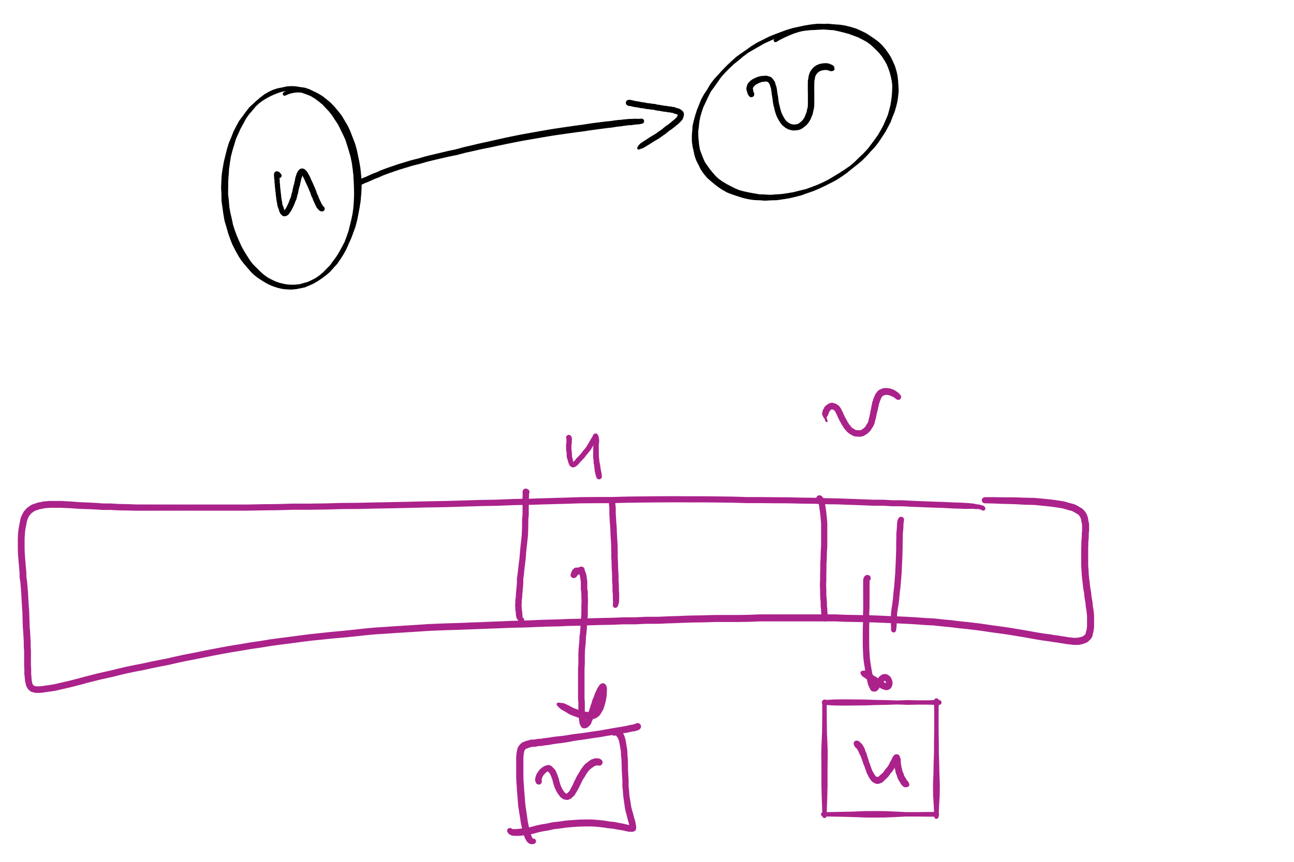
BFS search for an augmenting path (pseudocode)
edgeTo = [|V|]
marked = [|V|]
Queue q
q.enqueue(s)
marked[s] = true
while !q.isEmpty():
v = q.dequeue()
for each (v, w) in AdjList[v]:
if residualCapacity(v, w) > 0:
if !marked[w]:
edgeTo[w] = v;
marked[w] = true;
q.enqueue(w);
Each FlowEdge object is stored in the adjacency list twice:
Once for its forward edge
Once for its backward edge

Slide 9
Value of maxflow
One of the following:
  Add up the flow increments in each iteration of Ford-Fulkerson
  Add up the edge flows out of source
  Add up the edge flows into sink

Slide 10
Let's separate the graph
An st-cut on G is a set of edges in G that, if removed, will partition the vertices of G into two disjoint sets
  One contains s
  One contains t
May be many st-cuts for a given graph
Let’s focus on finding the minimum st-cut
  The st-cut with the smallest capacity
  May not be unique

Slide 11
How do we find the min st-cut?
We could examine residual graphs
  Specifically, try and allocate flow in the graph until we get to a residual graph with no existing augmenting paths
    A set of saturated edges will make a minimum st-cut

Slide 12
Determining a minimum st-cut
First, run Ford Fulkerson to produce a residual graph with no further augmenting paths
The last attempt to find an augmenting path will visit every vertex reachable from s
  Edges with only one endpoint in this set comprise a minimum st-cut

Slide 13
Determining the min cut
A
A
/1
1
/3
2
3
/7
s
s
C
C
t
5
/5
/7
3
3
/9
Min Cut
B
B
Notes:
Green is the set of seen vertices reachable from s

Slide 14
Max flow == min cut
A special case of duality
  i.e., you can look at an optimization problem from two angles
    In this case to find the maximum flow or minimum cut
  In general, dual problems do not have to have equal solutions
    The differences in solutions to the two ways of looking at the problem is referred to as the duality gap
      If the duality gap = 0, strong duality holds
        Max flow/min cut uphold strong duality
      If the duality gap > 0, weak duality holds

Slide 15
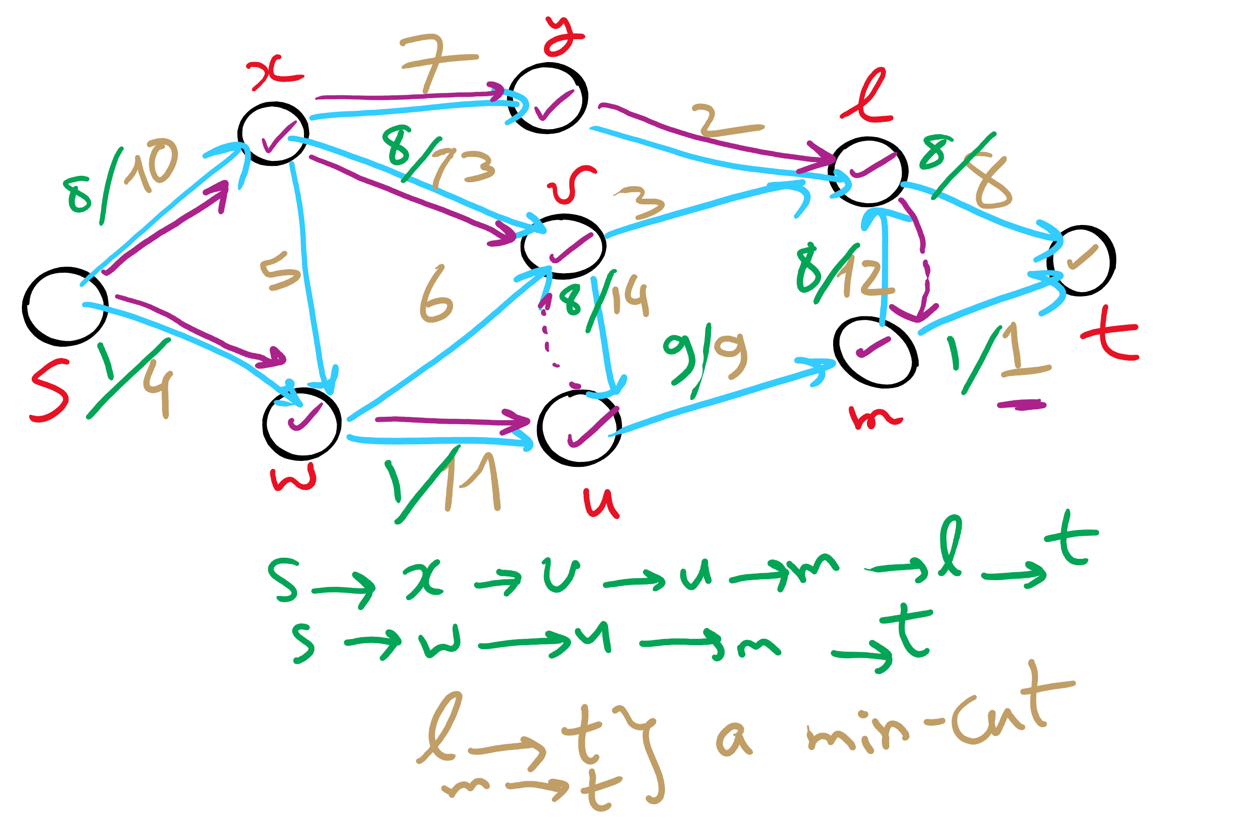
Min st-cut Example 1

Slide 16
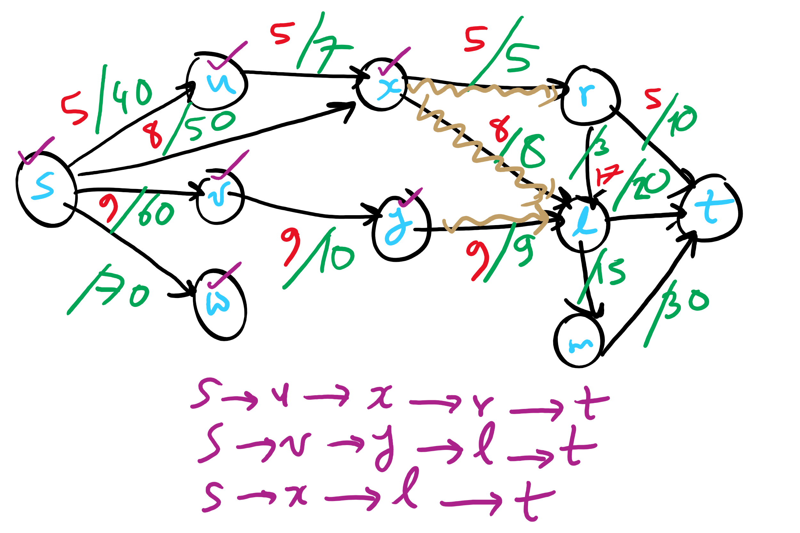
Min st-cut Example 2

Slide 17
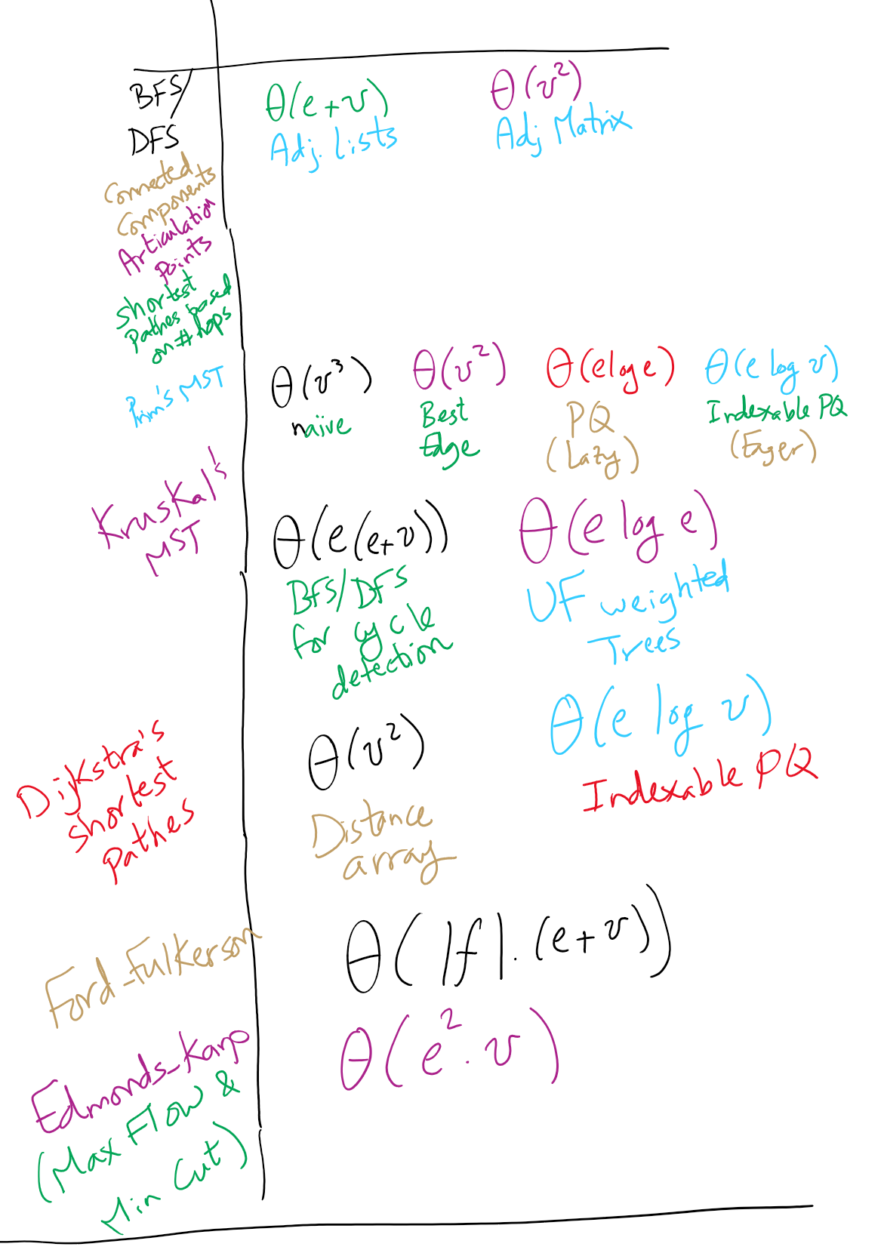
Graph Algorithms Runtime

Slide 18
Karatsuba’s Multiplication Algorithm
Problem:
  Multiply x*y
  x and y are n-bit integers

Slide 19
divide and conquer
Break our n-bit integers in half:
  x = 1001011011001000, n = 16
  Let the high-order bits be x_{H} = 10010110
  Let the low-order bits be x_{L} = 11001000
  x = 2^{n/2}x_{H} + x_{L}
  Do the same for y
x * y = (2^{n/2}x_{H} + x_{L}) * (2^{n/2}y_{H} + y_{L})
x * y = 2^{n}x_{H}y_{H} + 2^{n/2}(x_{H}y_{L} + x_{L}y_{H}) + x_{L}y_{L}

Slide 20
So what does this mean?
4 multiplications of n/2 bit integers
3 additions of n-bit integers
2^{n}x_{H}y_{H} + 2^{n/2}(x_{H}y_{L} + x_{L}y_{H}) + x_{L}y_{L}
A couple shifts of up to n positions
Actually 16 multiplications of n/4 bit integers
(plus additions/shifts)
Actually 64 multiplications of n/8 bit integers
(plus additions/shifts)
...

Slide 21
Karatsuba’s algorithm
x * y = 2^{n}x_{H}y_{H} + 2^{n/2}(x_{H}y_{L} + x_{L}y_{H}) + x_{L}y_{L}
M1
M2
M3
M4
We don’t actually need to do both M2 and M3
  We just need the sum of M2 and M3
    If we can find this sum using only 1 multiplication, we decrease the number of recursive calls and hence improve our runtime

Slide 22
Karatsuba craziness
M1 = x_{h}y_{h}; M2 = x_{h}y_{l}; M3 = x_{l}y_{h}; M4 = x_{l}y_{l};
The sum of all of them can be expressed as a single mult:
  M1 + M2 + M3 + M4
  = x_{h}y_{h} + x_{h}y_{l} + x_{l}y_{h} + x_{l}y_{l}
  = (x_{h} + x_{l}) * (y_{h} + y_{l})
Lets call this single multiplication M5:
  M5 = (x_{h} + x_{l}) * (y_{h} + y_{l}) = M1 + M2 + M3 + M4
Hence, M5 - M1 - M4 = M2 + M3
So: x * y = 2^{n}M1 + 2^{n/2}(M5 - M1 - M4) + M4
  Only 3 multiplications required!
  At the cost of 2 more additions, and 2 subtractions

Slide 23
So what's the runtime???
Recursion really complicates our analysis…
We’ll use a recurrence relation to analyze the recursive runtime
  Goal is to determine:
    How much work is done in the current recursive call?
    How much work is passed on to future recursive calls?
    All in terms of input size

Slide 24
Recurrence relation for divide and conquer multiplication
Assuming we cut integers exactly in half at each call
  i.e., input bit lengths are a power of 2
Work in the current call:
  Shifts and additions are Θ(n)
Work left to future calls:
  3 more multiplications on half of the input size
T(n) = 3T(n/2) + Θ(n)

Slide 25
Soooo… what’s the runtime?
Need to solve the recurrence relation
  Remove the recursive component and express it purely in terms of n
    A “cookbook” approach to solving recurrence relations:
      The master theorem

Slide 26
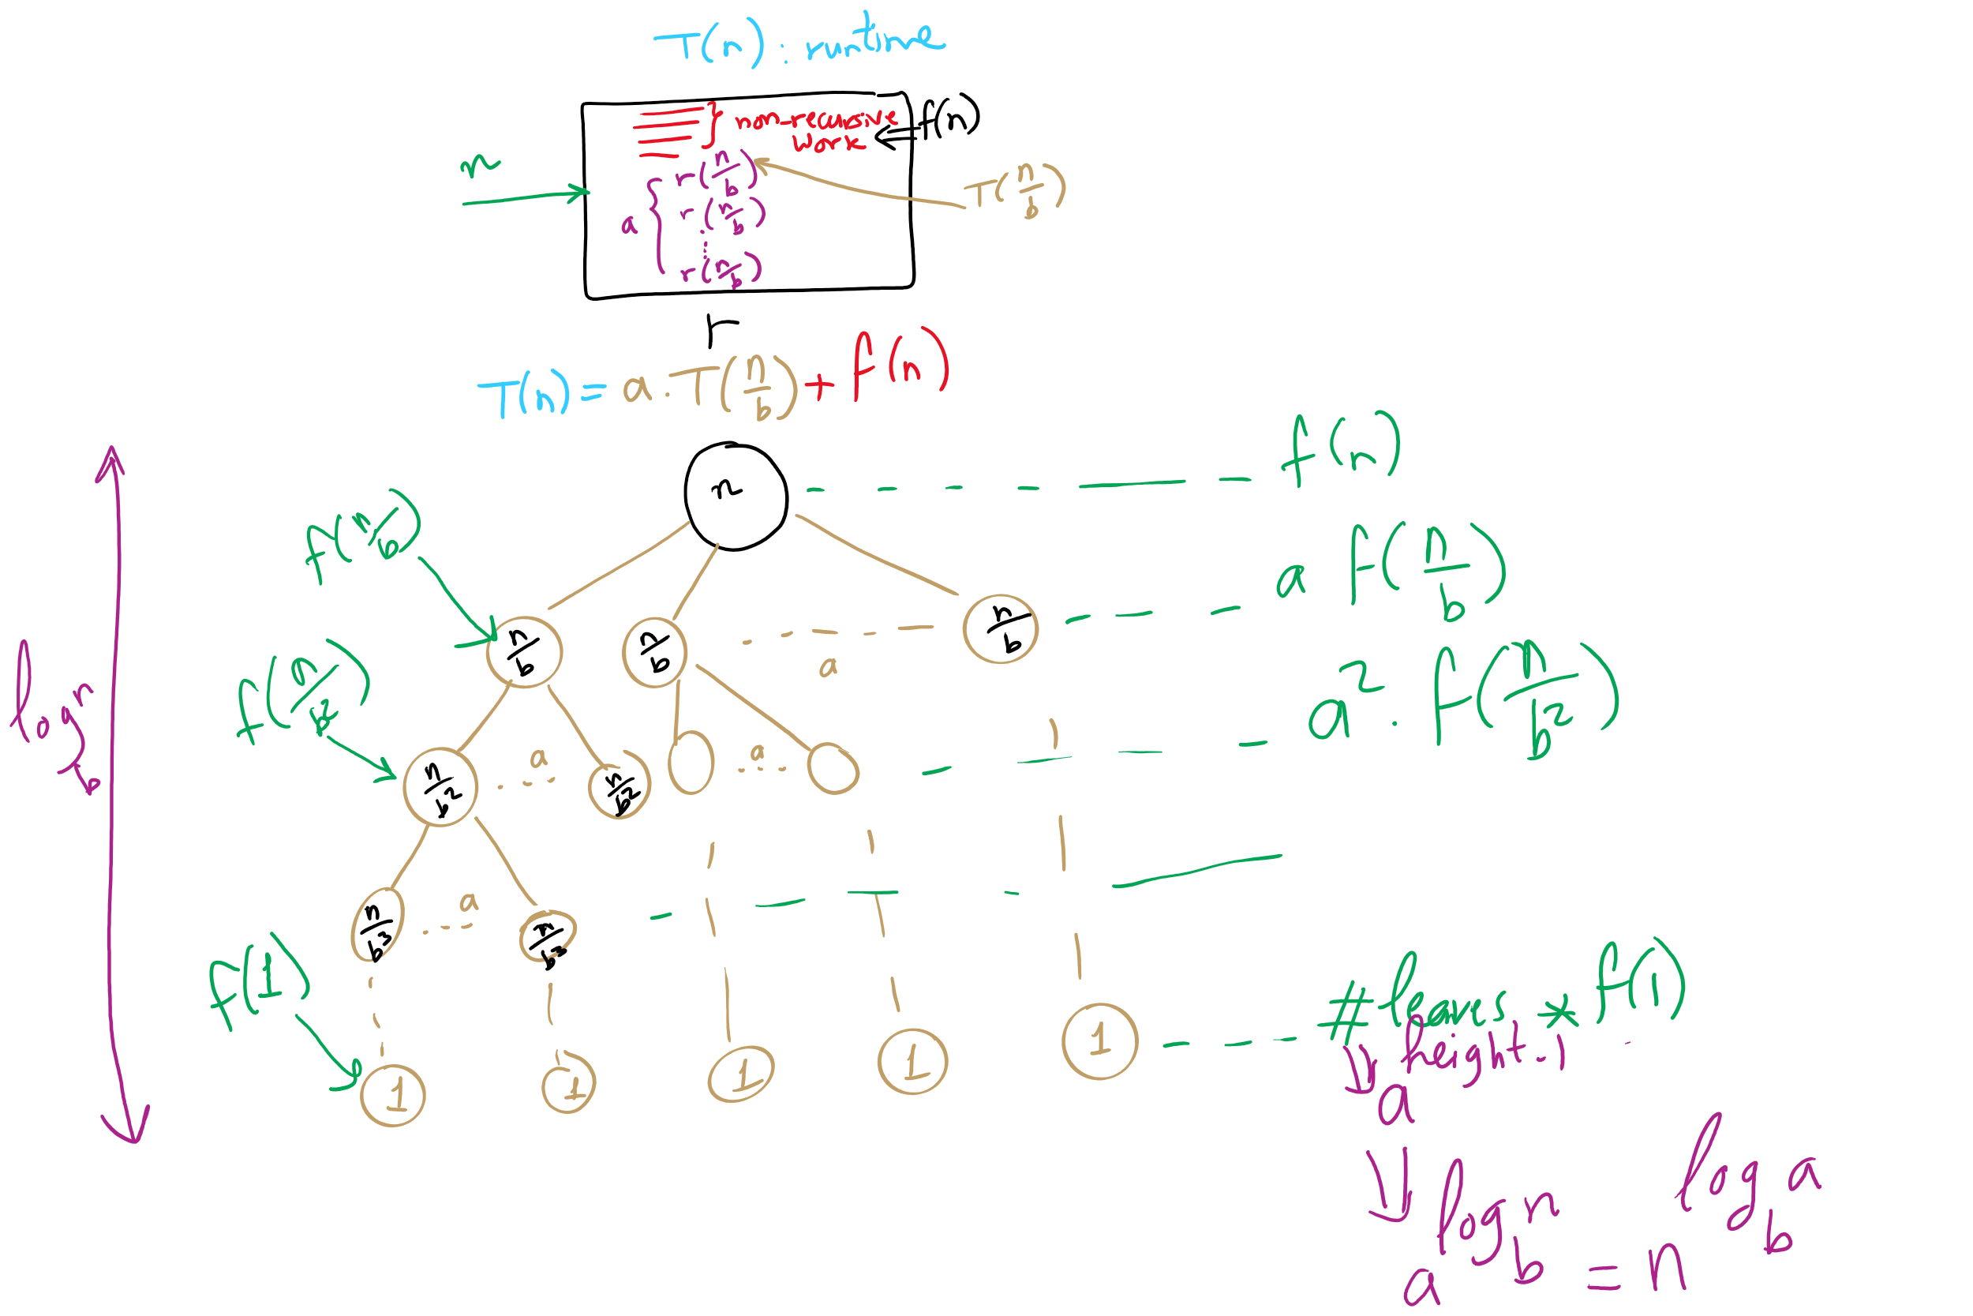
Recurrence Relation
a way of representing the runtime of recursive functions

Slide 27
The master theorem
Usable on recurrence relations of the following form:
T(n) = aT(n/b) + f(n)
Where:
  a is a constant >= 1
  b is a constant > 1
  and f(n) is an asymptotically positive function
Notes:
Note this does NOT cover nearly all possible recurrence relations, just really handy for alot of them
We will need more different techniques for more problematic recurrences

Slide 28
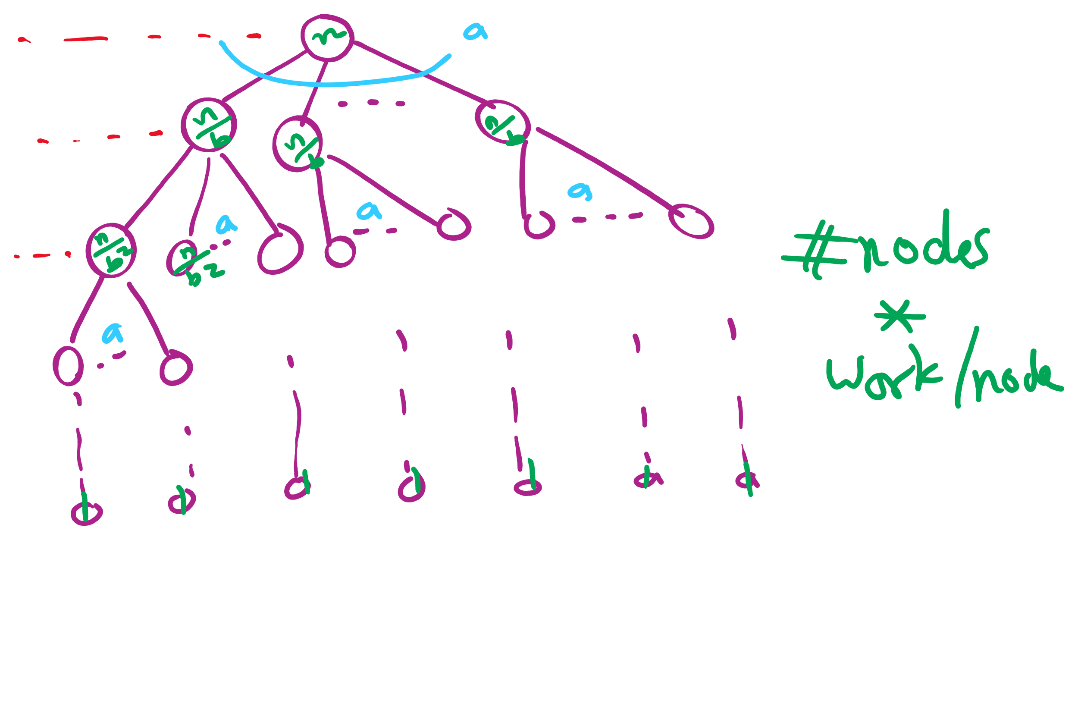
Recursion Tree

Slide 29
Recurrence vs. Recursion Tree

Slide 30
The 3 cases of the Master Theorem
Case 1: work at leaves is dominant
  dominant here means polynomially larger than the work at any other level including the root
  Total work = Theta(# leaves)
Case 2: work at leaves = work at root
  = work at each other level of the recursion tree
  Total work = Theta(# levels * work at leaves)
Case 3: work at root is dominant and work steeply reduces as we go down the tree
  work at a level is a fraction of work at the previous level
  Total work = Theta(work at root) = Theta(f(n))

Slide 31
Applying the master theorem
T(n) = aT(n/b) + f(n)
If f(n) is O(n^{log_b(a) - ε}):
  T(n) is Θ(n^{log_b(a)})
If f(n) is Θ(n^{log_b(a)})
  T(n) is Θ(n^{log_b(a)} lg n)
If f(n) is Ω(n^{log_b(a) + ε}) and (a * f(n/b) <= c * f(n)) for some c < 1:
  T(n) is Θ(f(n))
Notes:
T(n) = 2T(n/2) + n lg n
falls into a gap
n lg n is asymptotically larger than n, but not polynomially larger

Slide 32
Master Theorem Cases
It is all about comparing
  work at root: f(n) vs.
  work at leaves: O(n^{log_b(a)} )

Slide 33
Mergesort master theorem analysis
Recurrence relation for mergesort?
T(n) = 2T(n/2) + Θ(n)
T(n) = 2T(n/2) + Θ(n)
If f(n) is O(n^{log_b(a) - ε}):
  T(n) is Θ(n^{log_b(a)})
If f(n) is Θ(n^{log_b(a)})
  T(n) is Θ(n^{log_b(a)} lg n)
If f(n) is Ω(n^{log_b(a) + ε})
and (a * f(n/b) <= c * f(n)) for some c < 1:
  T(n) is Θ(f(n))
a = 2
b = 2
f(n) is Θ(n)
So...
  n^{log_b(a)} = …
    n^{lg 2} = n
  Being Θ(n) means f(n) is Θ(n^{log_b(a)})
  T(n) = Θ(n^{log_b(a)} lg n) = Θ(n^{lg 2} lg n) = Θ(n lg n)

Slide 34
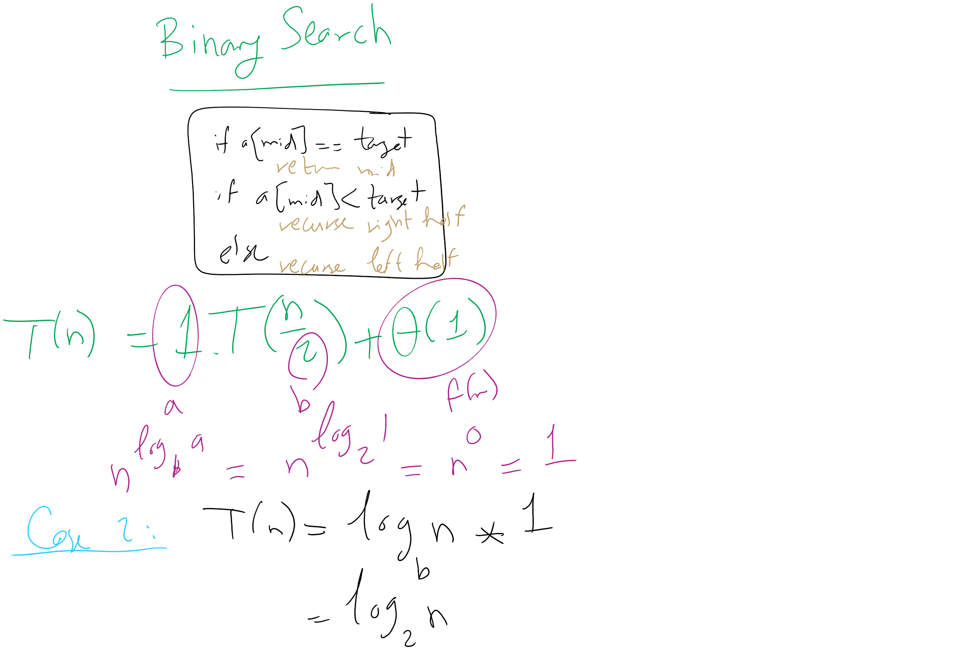
Binary Search Master Theorem Analysis

Slide 35
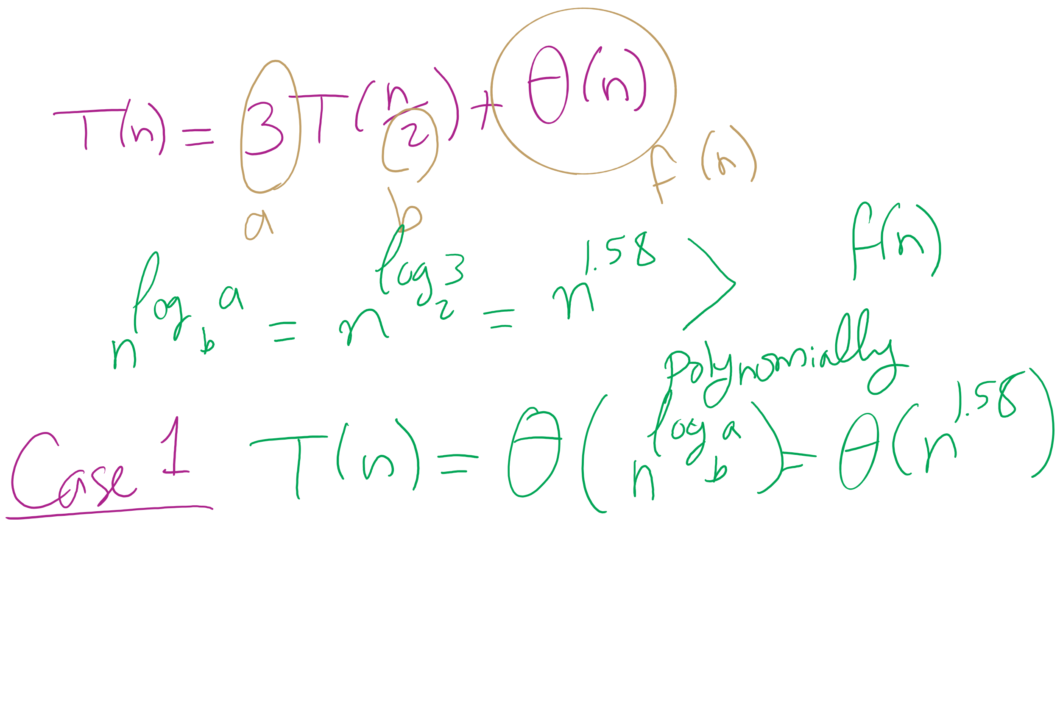
Karatsuba Runtime

Slide 36
Please submit your reflections by using the CourseMIRROR App
If you are having a problem with CourseMIRROR, please send an email to coursemirror.development@gmail.com
Notes:
All right!
Upcoming Due Dates at A Glance

