Slide 1

Algorithms and Data Structures 2 CS 1501
Fall 2021
Sherif Khattab
ksm73@pitt.edu
(Slides are adapted from Dr. Ramirez’s and Dr. Farnan’s CS1501 slides.)

Slide 2
Announcements
Upcoming deadlines:
Lab 11: Friday 12/10
Lab 12 and Homework 12: Monday 12/20 at 5:00 pm
Assignment 4 and 5: Monday 12/20 at 5:00 pm
Final Exam
In-person, paper-based, 110 minutes
Similar structure to the midterm
Non-cumulative
Study guide and practice exams
Date, time, and location as in PeopleSoft
Bonus Opportunities
Bonus Homework: Monday 12/20 at 5:00 pm
OMETs: 1 bonus point for entire class when response rate >= 80%
Currently at 20%

Slide 3
Last lecture …
MinCut
(Big) Integer Algorithms
Multiplication
Master Theorem
``cookbook’’ for runtime analysis of some recursive algorithms

Slide 4
Today …
Exponentiation
Encryption
One-time Pads
RSA

Slide 5
CourseMIRROR Reflections

Slide 6
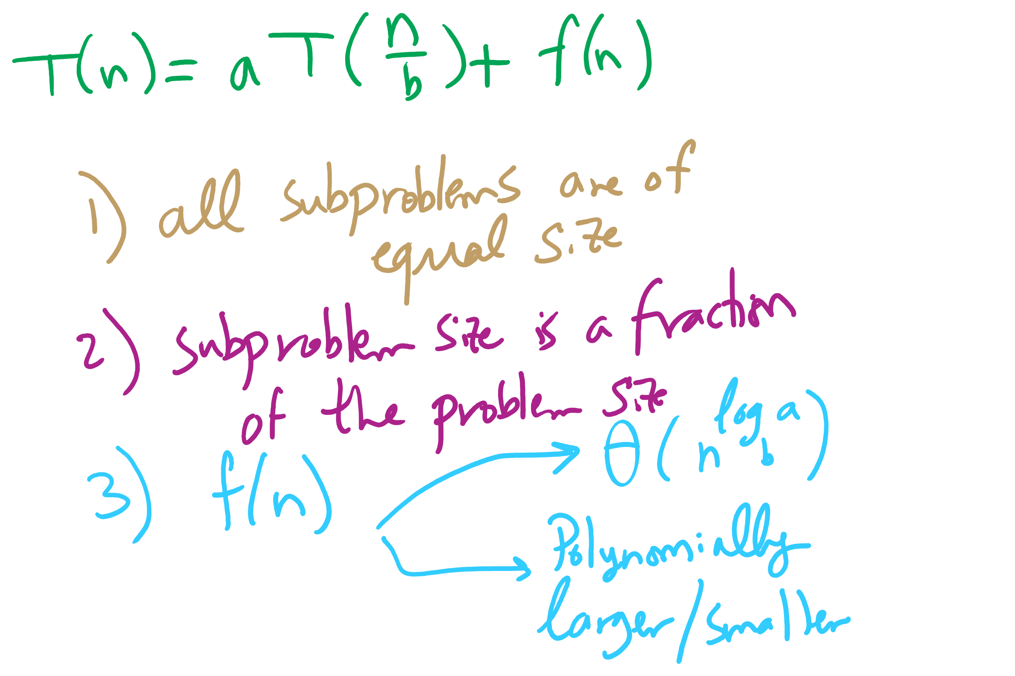
Master Theorem Conditions

Slide 7
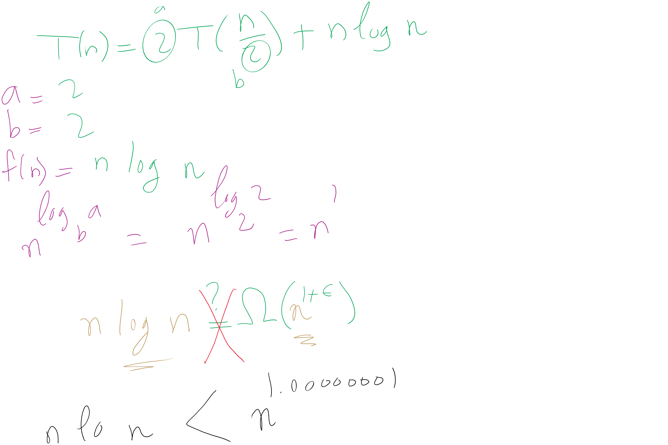
When Master Theorem doesn’t apply: Example

Slide 8
Exponentiation
x^{y}
Can easily compute with a simple algorithm:
ans = 1
i = y
while i > 0:
ans = ans * x
i--
Runtime?
Notes:
looking for θ(y) or "linear"

Slide 9
Just like with multiplication, let's consider large integers...
Runtime = # of iterations * cost to multiply
We just covered the cost to multiply
So how many iterations?
Single loop from 1 to y, so linear, right?
What is the size of our input?
n
The bitlength of y…
So, linear in the value of y…
But, increasing n by 1 doubles the number of iterations
Θ(2^{n})
Exponential in the bitlength of y
Notes:
What is the size of our input?
Cost to multiple using gradeschool: n^2

Slide 10
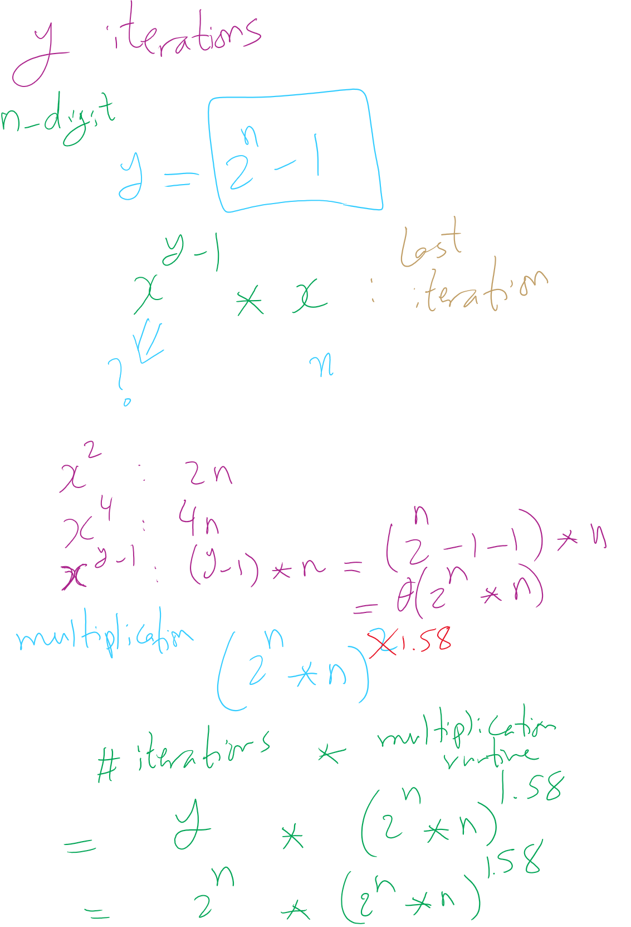
Runtime Analysis
y is n-bit integer

Slide 11
Runtime Analysis

Slide 12
This is way too long to do exponentiations!
So how do we do better?
Let’s try divide and conquer!
x^{y} = (x^{(y/2)})²
When y is even, (x^{(y/2)})² * x when y is odd
Analyzing a recursive approach:
Base case?
When y is 1, x^{y} is x; when y is 0, x^{y} is 1
Runtime?

Slide 13
Building another recurrence relation
x^{y} = (x^{(y/2)})² = x^{(y/2)} * x^{(y/2)}
Similarly, (x^{(y/2)})² * x = x^{(y/2)} * x^{(y/2)} * x
So, our recurrence relation is:
T(n) = T(n-1) + ?
How much work is done per call?
1 (or 2) multiplication(s)
Examined runtime of multiplication last lecture
But how big are the operands in this case?

Slide 14
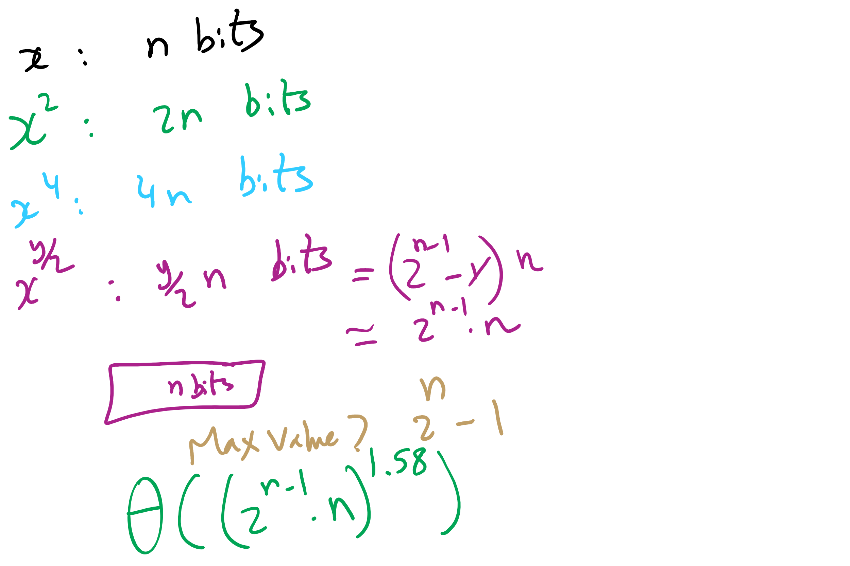
Non-recursive Work

Slide 15
Determining work done per call
Base case returns x
n bits
Base case results are multiplied: x * x
n bit operands
Result size?
2n
These results are then multiplied: x² * x²
2n bit operands
Result size?
4n bits
…
x^{(y/2)} * x^{(y/2)}?
(y / 2) * n bit operands = 2^{(n-1)} * n bit operands
Result size? y * n bits = 2^{n} * n bits

Slide 16
Multiplication input size increases throughout
Our recurrence relation looks like:
T(n) = T(n-1) + Θ((2^{(n-1)} * n)^{1.58})
Karatsuba’s multiplication
multiplication input size

Slide 17
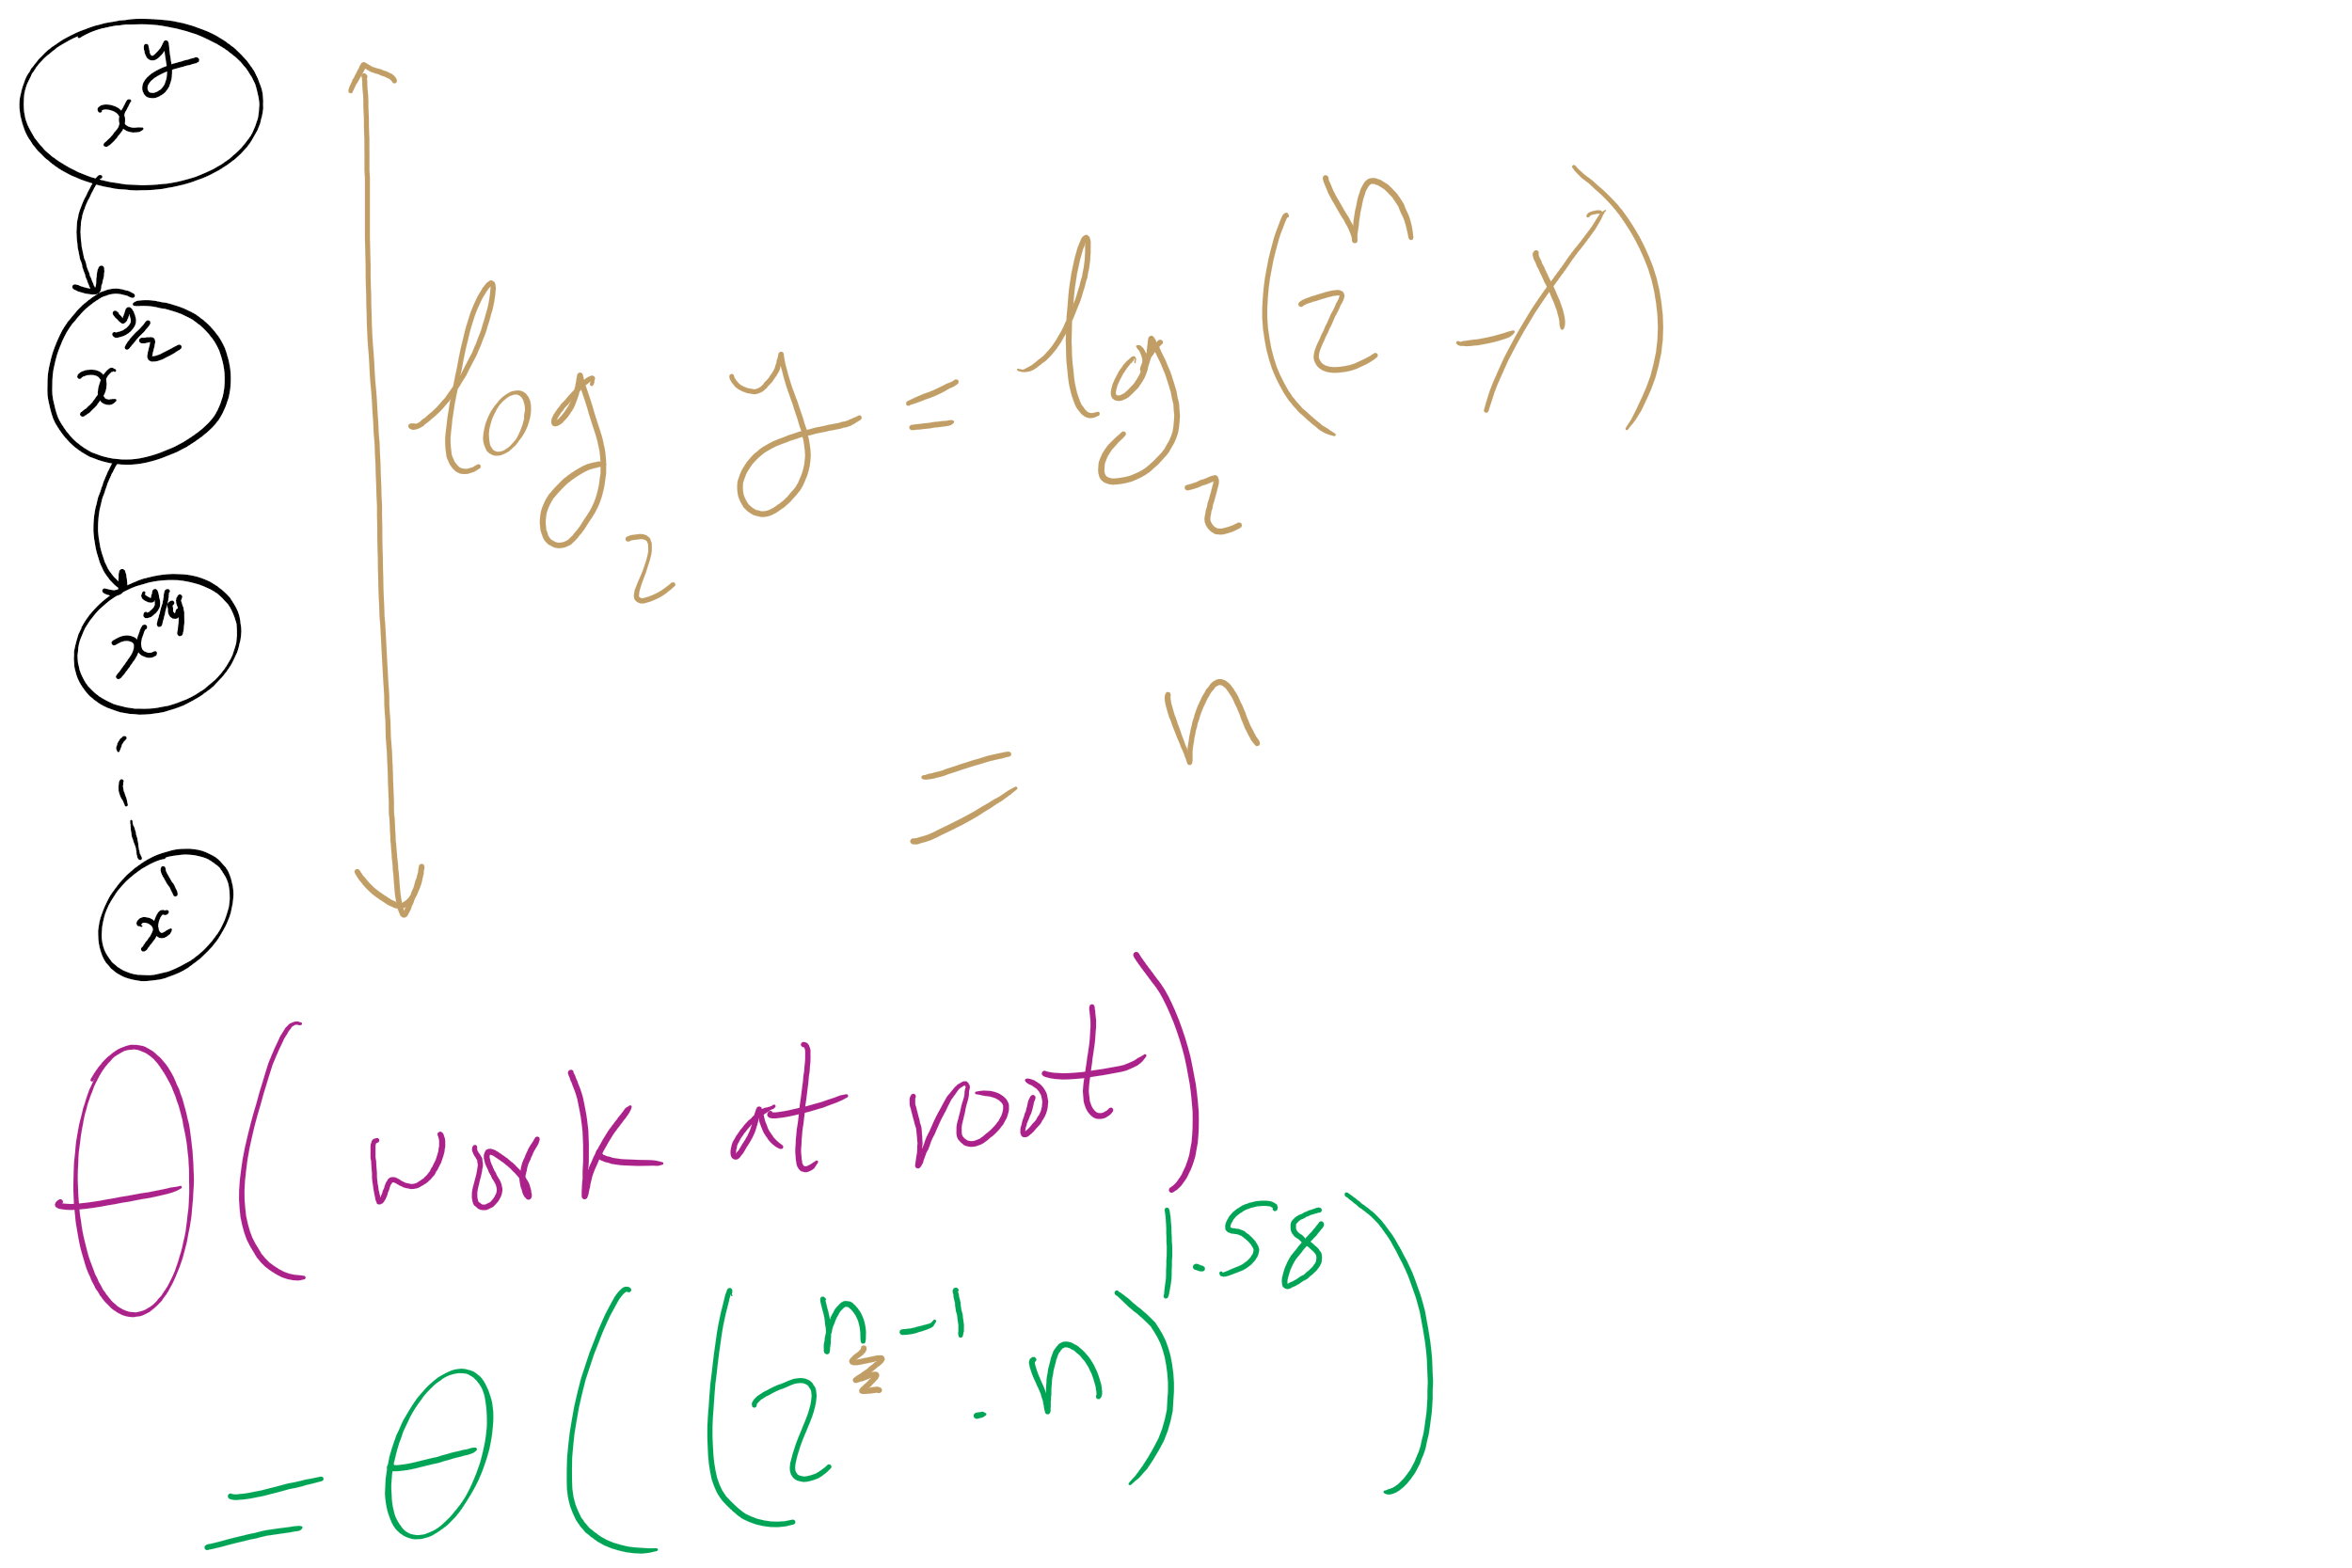
Runtime Analysis

Slide 18
OK, but why?
This and all of our large integer algorithms will be handy when we look at algorithms for implementing…
CRYPTOGRAPHY

Slide 19
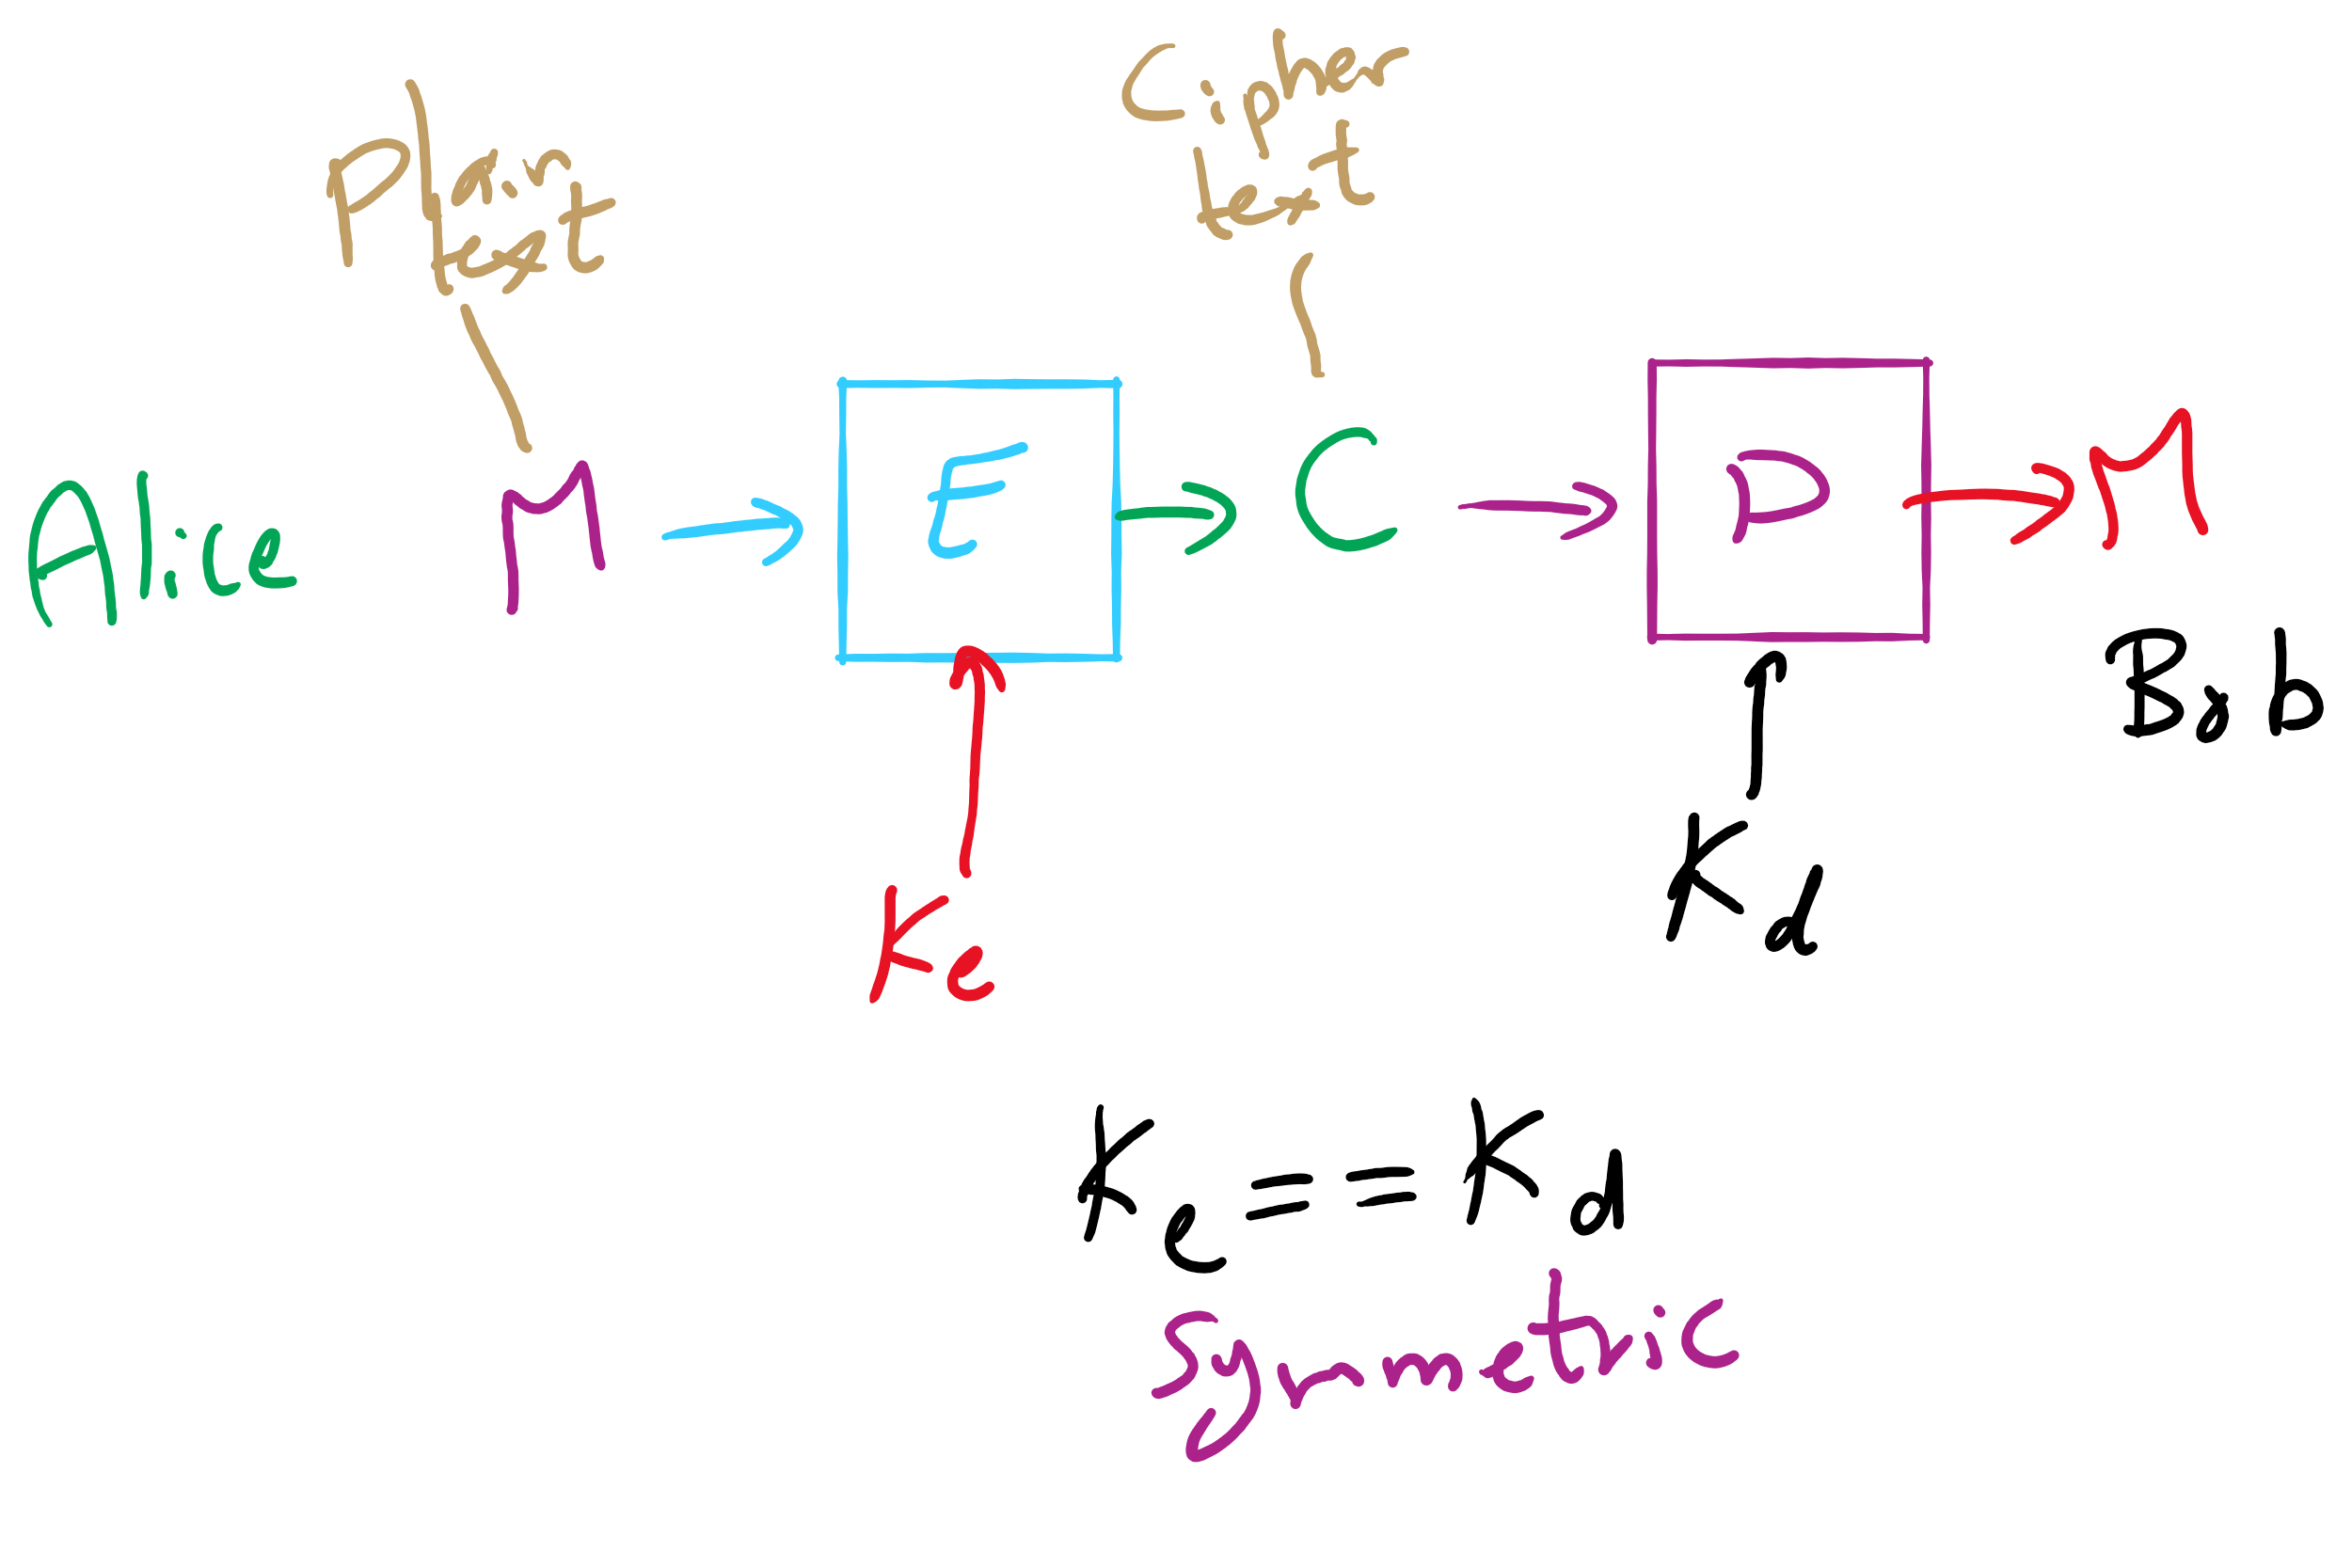
Encryption Model

Slide 20
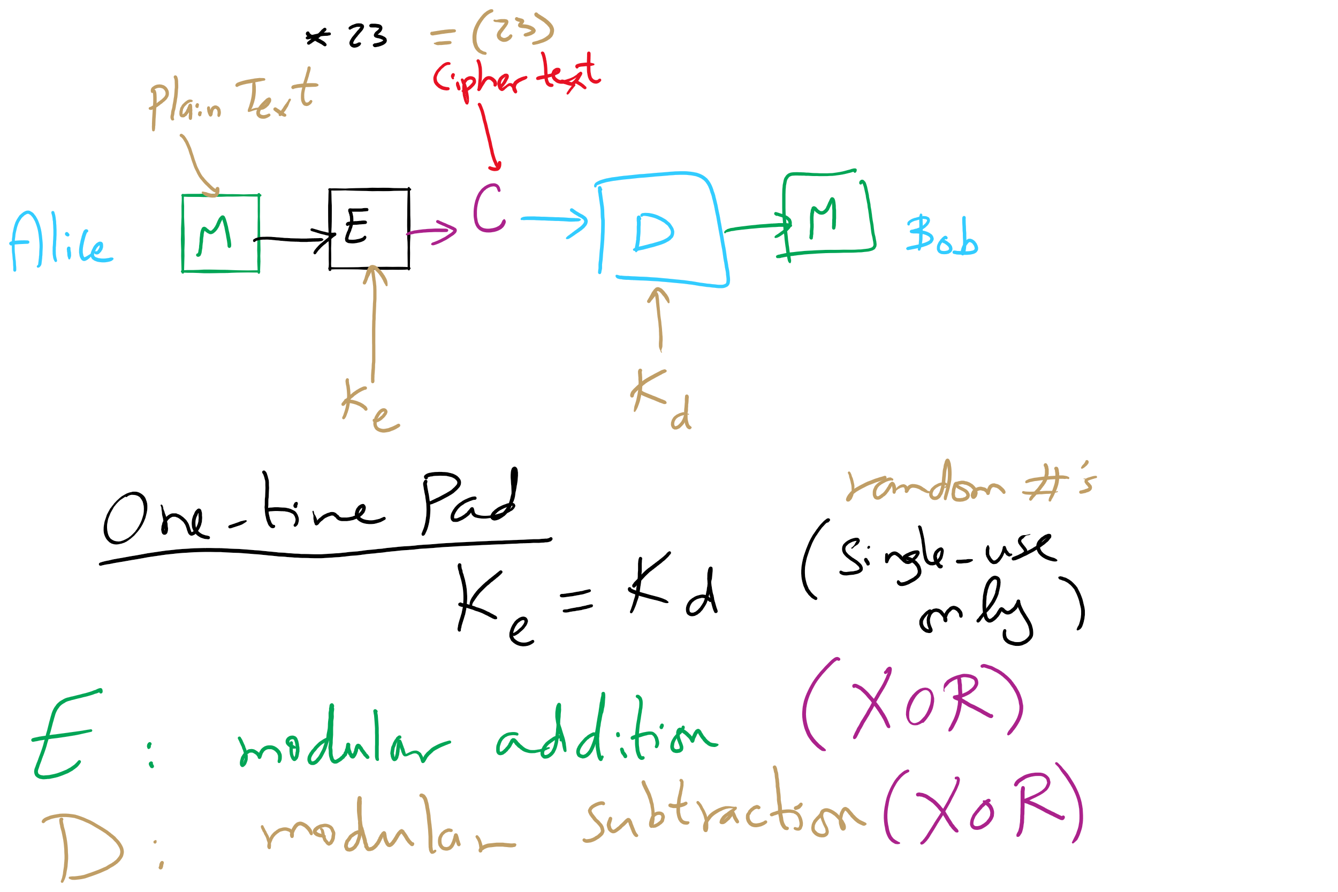
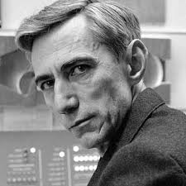
One-Time Pad

Slide 21
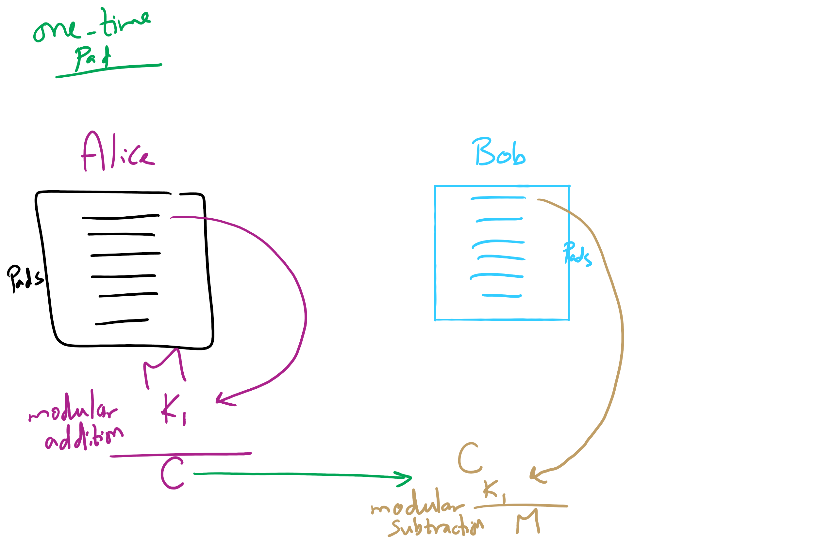
One-Time Pad

Slide 22
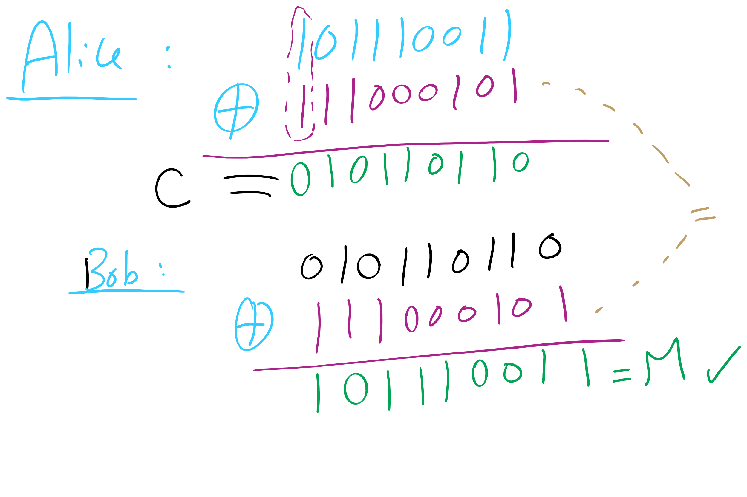
One-Time Pad Example 1

Slide 23
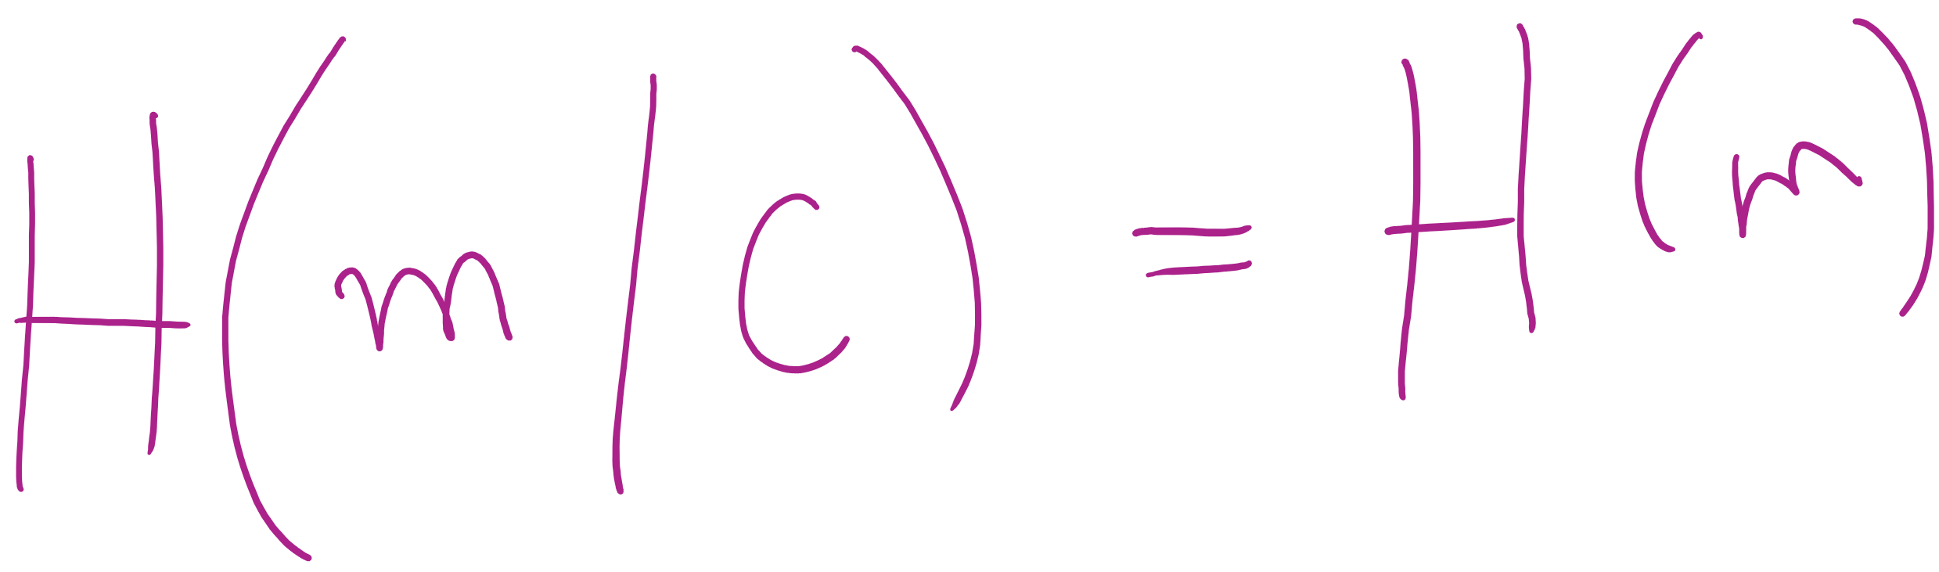
One-time Pad is perfectly secure!
H(.) is Shannon’s entropy

Slide 24
Difficulties with one-time pads
Pads must be truly random
Both sender and receiver must have a matched list of pads in the appropriate order
Once you run out of pads, no more messages can be sent

Slide 25
Symmetric ciphers
Alice
M
Encrypt
C
Decrypt
M
Bob
K
K
E.g., DES, AES, Blowfish
Users share a single key
Numbers of a given bitlength (e.g., 128, 256)
Key is used to encrypt/decrypt many messages back and forth
Encryptions/decryptions will be fast
Typically linear in the size the input
Ciphertext should appear random
Best way to recover plaintext should be a brute force attack on the encryption key
Which we have shown to be infeasible for 128bit AES keys

Slide 26
Problems with symmetric ciphers
Alice and Bob have to both know the same key
How can you securely transmit the key from Alice to Bob?
Further, if Alice also wants to communicate with Charlie, her and Charlie will need to know the same key, a different key from the key Alice shares with Bob
Alice and Danielle will also have to share a different key…
etc.

Slide 27
Enter public-key encryption
Each user has their own pair of keys
A public key that can be revealed to anyone
A private key that only they should know
How does this solve our problem?
Public key can simply be published/advertised
Posted repositories of public keys
Added to an email signature
Each user is responsible only for their own keypair
Let's look at a public-key crypto scheme in detail...

Slide 28
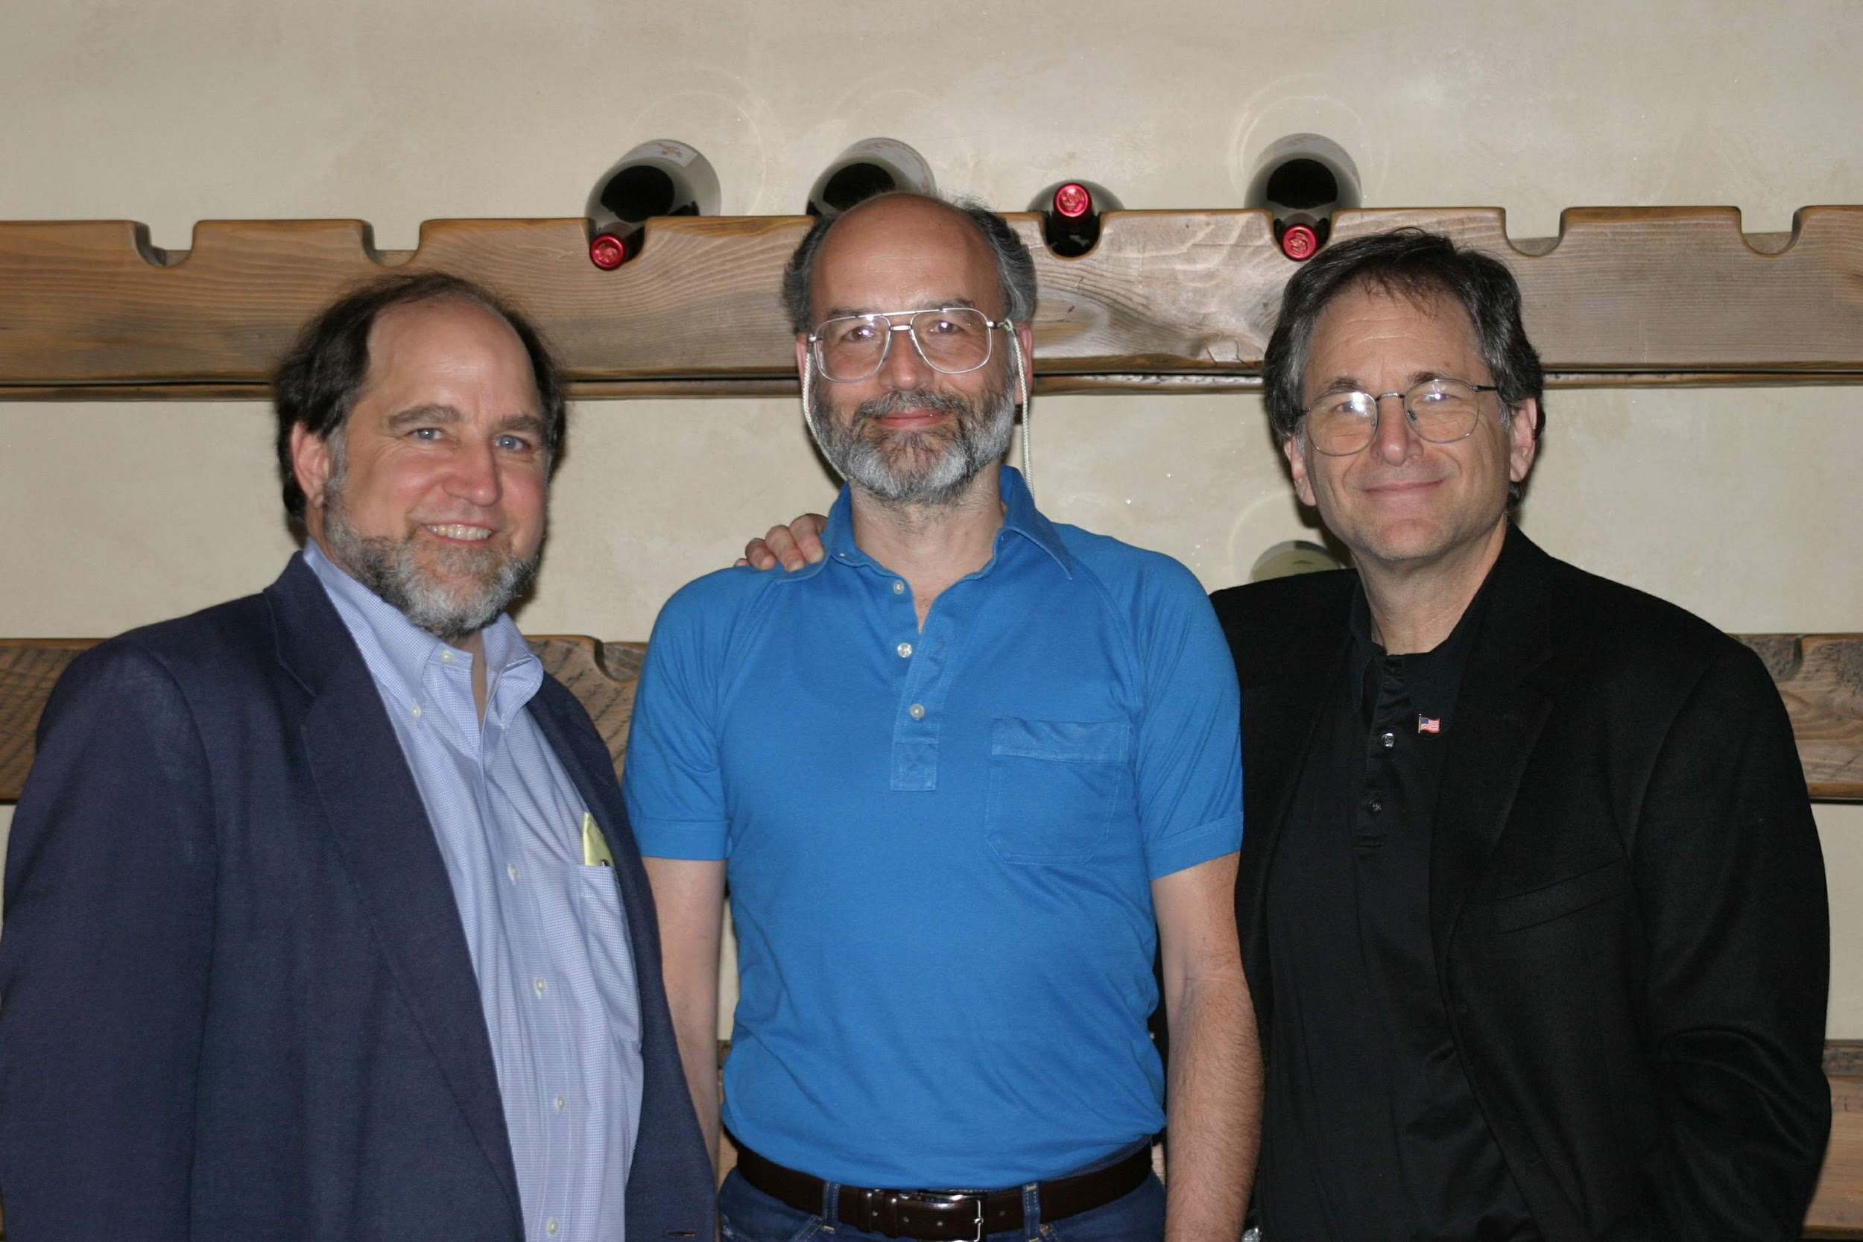
RSA
Notes:
Ronald Rivest, Adi Shamir, Leonard Adleman

Slide 29
RSA Cryptosystem in-depth
What are RSA keypairs?
How messages encrypted?
How are messages decrypted?
How are keys generated?
Why is it secure?
How is it used?

Slide 30
RSA keypairs
Public key is two numbers, which we will call n and e
Private key is a single number we will call d
The length of n in bits is the key length
I.e., 2048 bit RSA keys will have a 2048 bit n value
Note that "n" will be used to indicate the RSA public key component for our discussion of RSA...

Slide 31
Encryption
Say Alice wants to send a message to Bob
Looks up Bob’s public key
Convert the message into an integer: m
Compute the ciphertext c as:
c = m^{e} (mod n)
Send c to Bob

Slide 32
Decryption
Bob can simply:
Compute m as:
m = c^{d} (mod n)
Convert m into Alice’s message

Slide 33
Please submit your reflections by using the CourseMIRROR App
If you are having a problem with CourseMIRROR, please send an email to coursemirror.development@gmail.com
Notes:
All right!
Upcoming Due Dates at A Glance

