Slide 1

Algorithms and Data Structures 2 CS 1501
Fall 2021
Sherif Khattab
ksm73@pitt.edu
(Slides are adapted from Dr. Ramirez’s and Dr. Farnan’s CS1501 slides.)

Slide 2
Announcements
Lab 0 is due next Friday (not graded)
Recitations start this week
Homework 1 will be assigned this Friday
JDB Example available on Canvas
Draft slides and handouts available on Canvas

Slide 3
CourseMIRROR Reflections

Slide 4
Muddiest points
The Big O and why the rest of the family is important
knowing which of the Big O family to use for different situations
The wording when we talk about faster runtime versus faster rate of growth

Slide 5
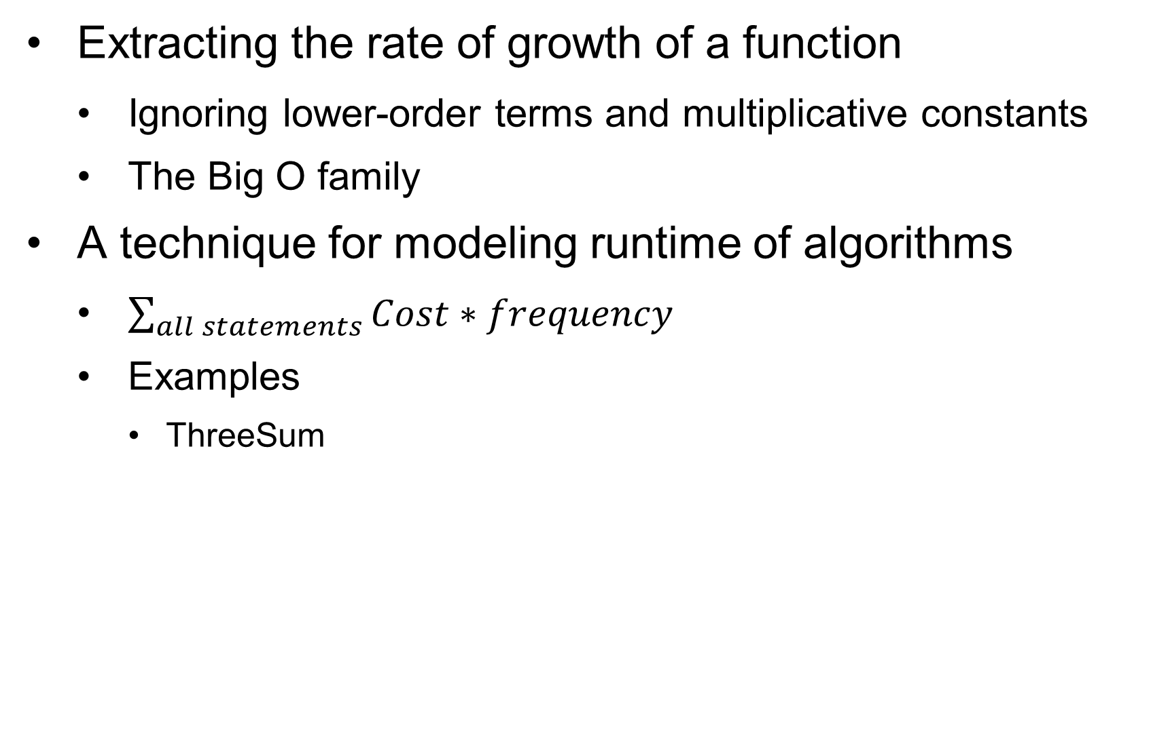
Today’s Agenda
Extracting the rate of growth of a function
Ignoring lower-order terms and multiplicative constants
The Big O family
A technique for modeling runtime of algorithms
$\sum_{all statements}{Cost∗frequency}$
Examples
ThreeSum

Slide 6
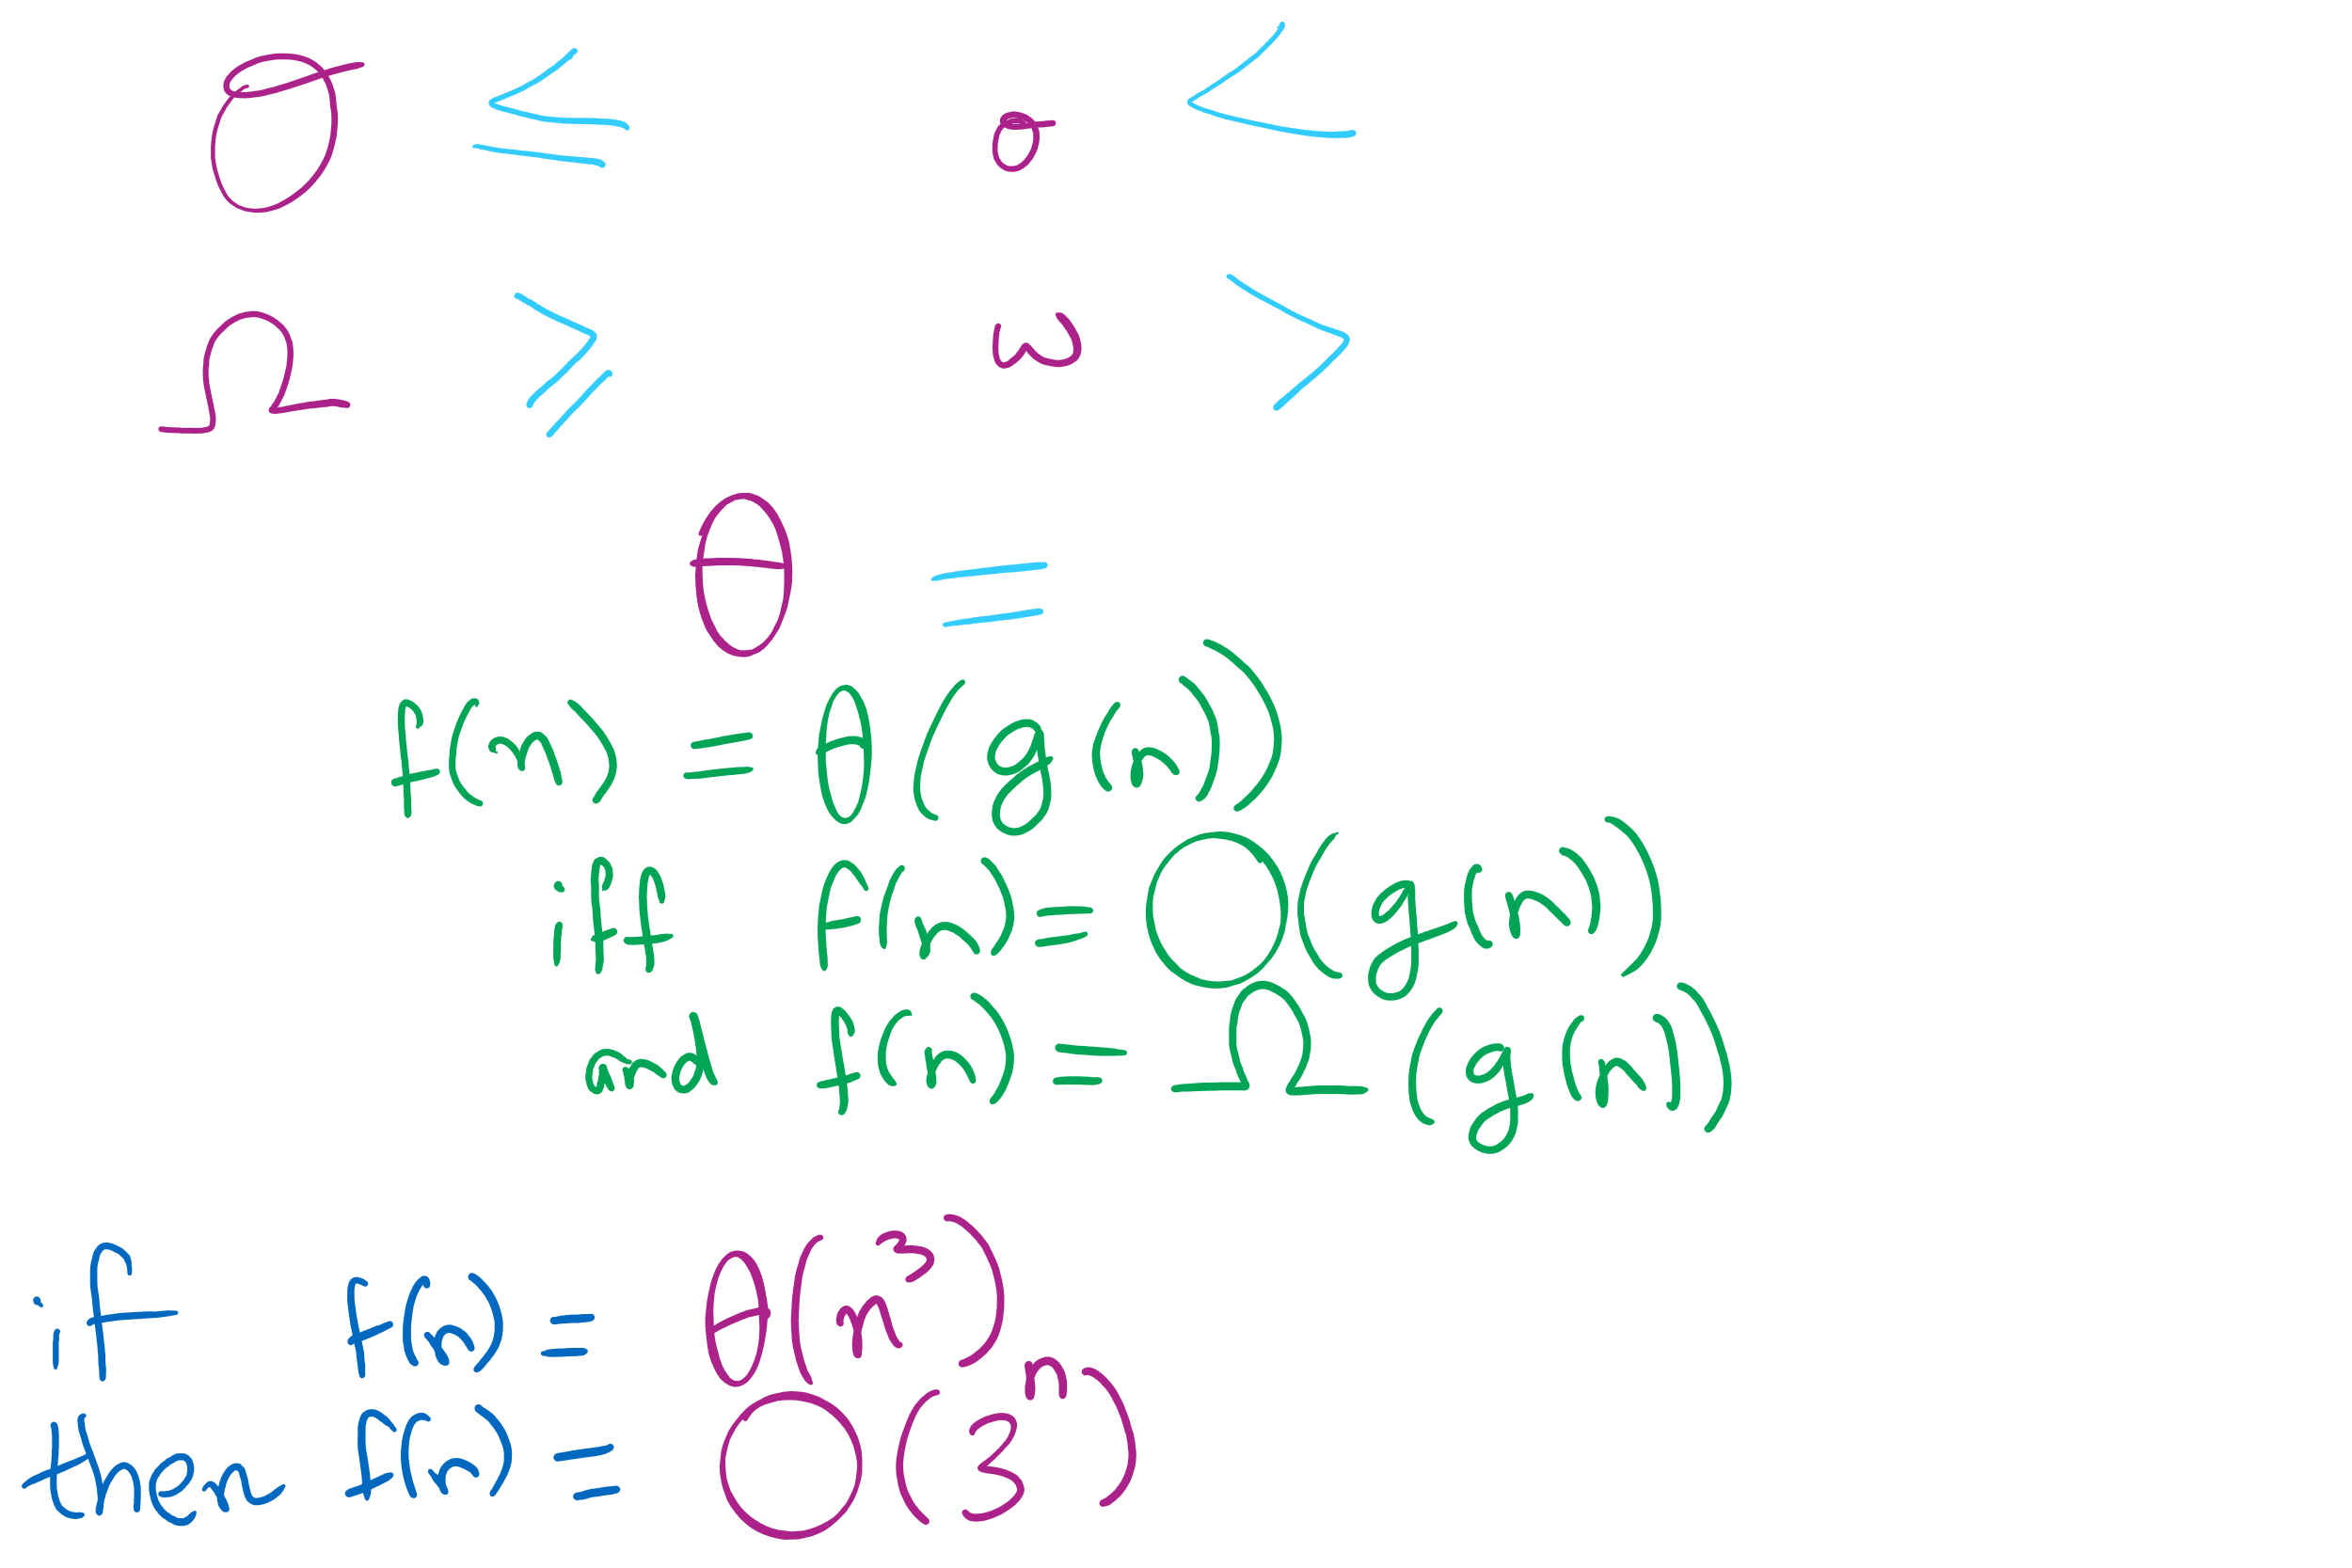
Big O Family

Slide 7
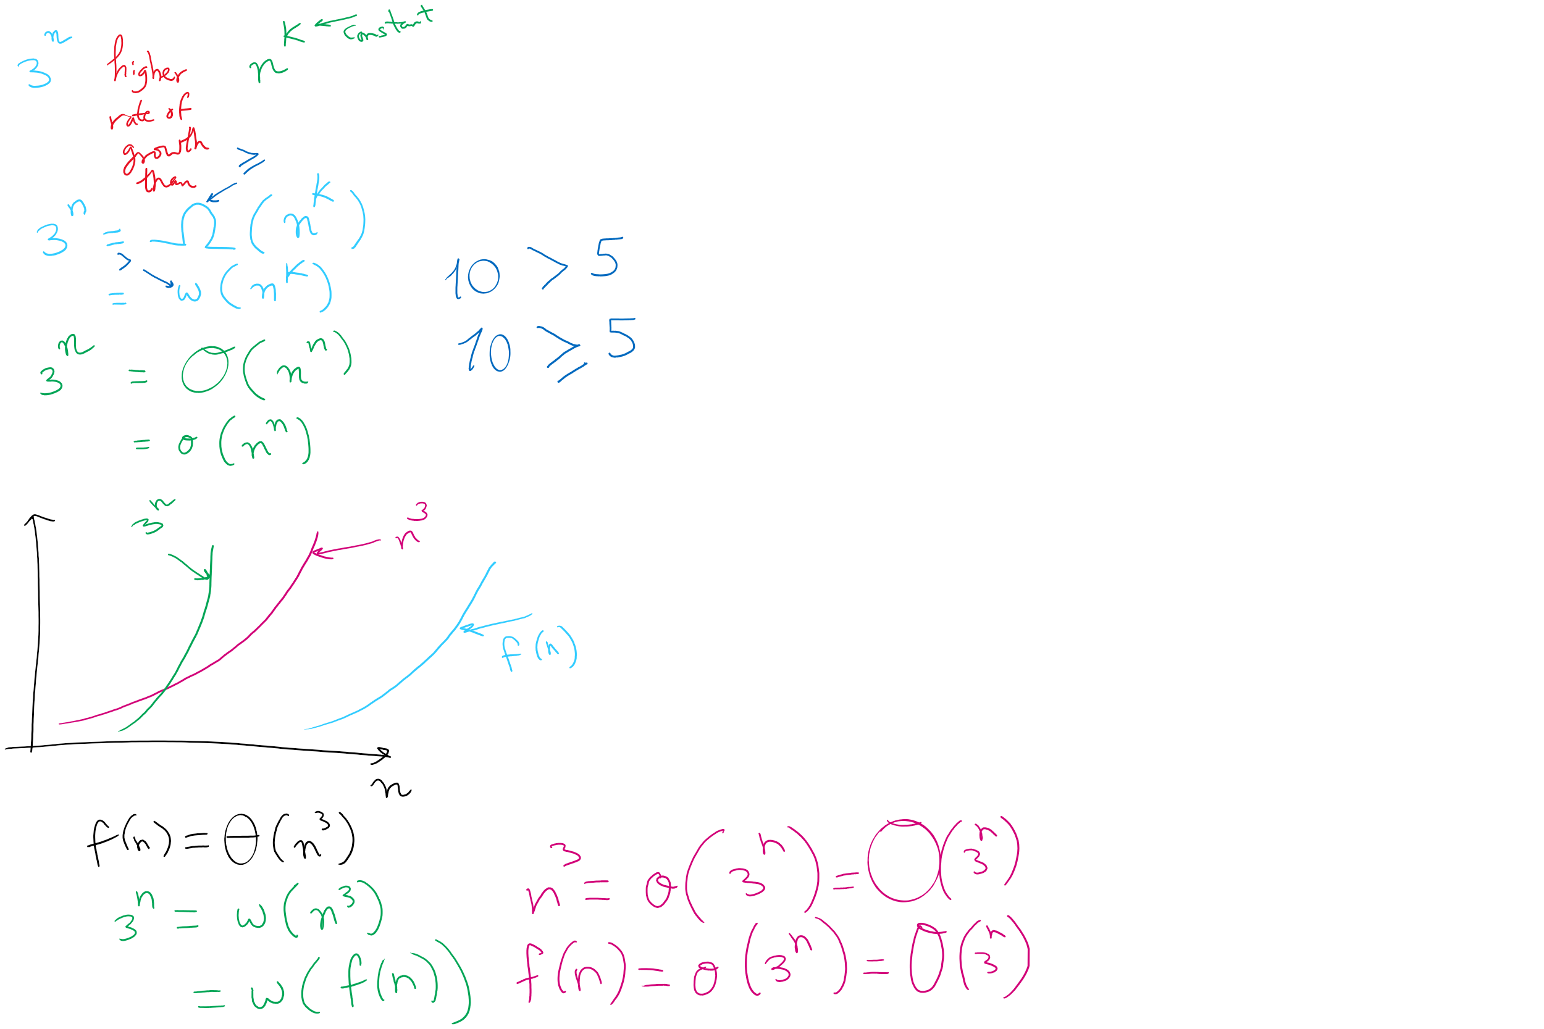
Examples

Slide 8
Formal definitions
f(x) is O(g(x)) if constants c and x₀ exist such that:
|f(x)| <= c * |g(x)| ∀x > x₀
f(x) is Ω(g(x)) if constants c and x₀ exist such that:
|f(x)| >= c * |g(x)| ∀x > x₀
if f(x) is O(g(x)) and Ω(g(x)), then f(x) is Θ(g(x))
c₁, c₂, and x₀ exist such that:
c₁ * |g(x)| <= |f(x)| <= c₂ * |g(x)| ∀x > x₀
Notes:
So O, Ω, and θ are ways to compare the asymptotic properties of different functions…
In our ThreeSum example, n³ was g(x)...
What was f(x)?

Slide 9
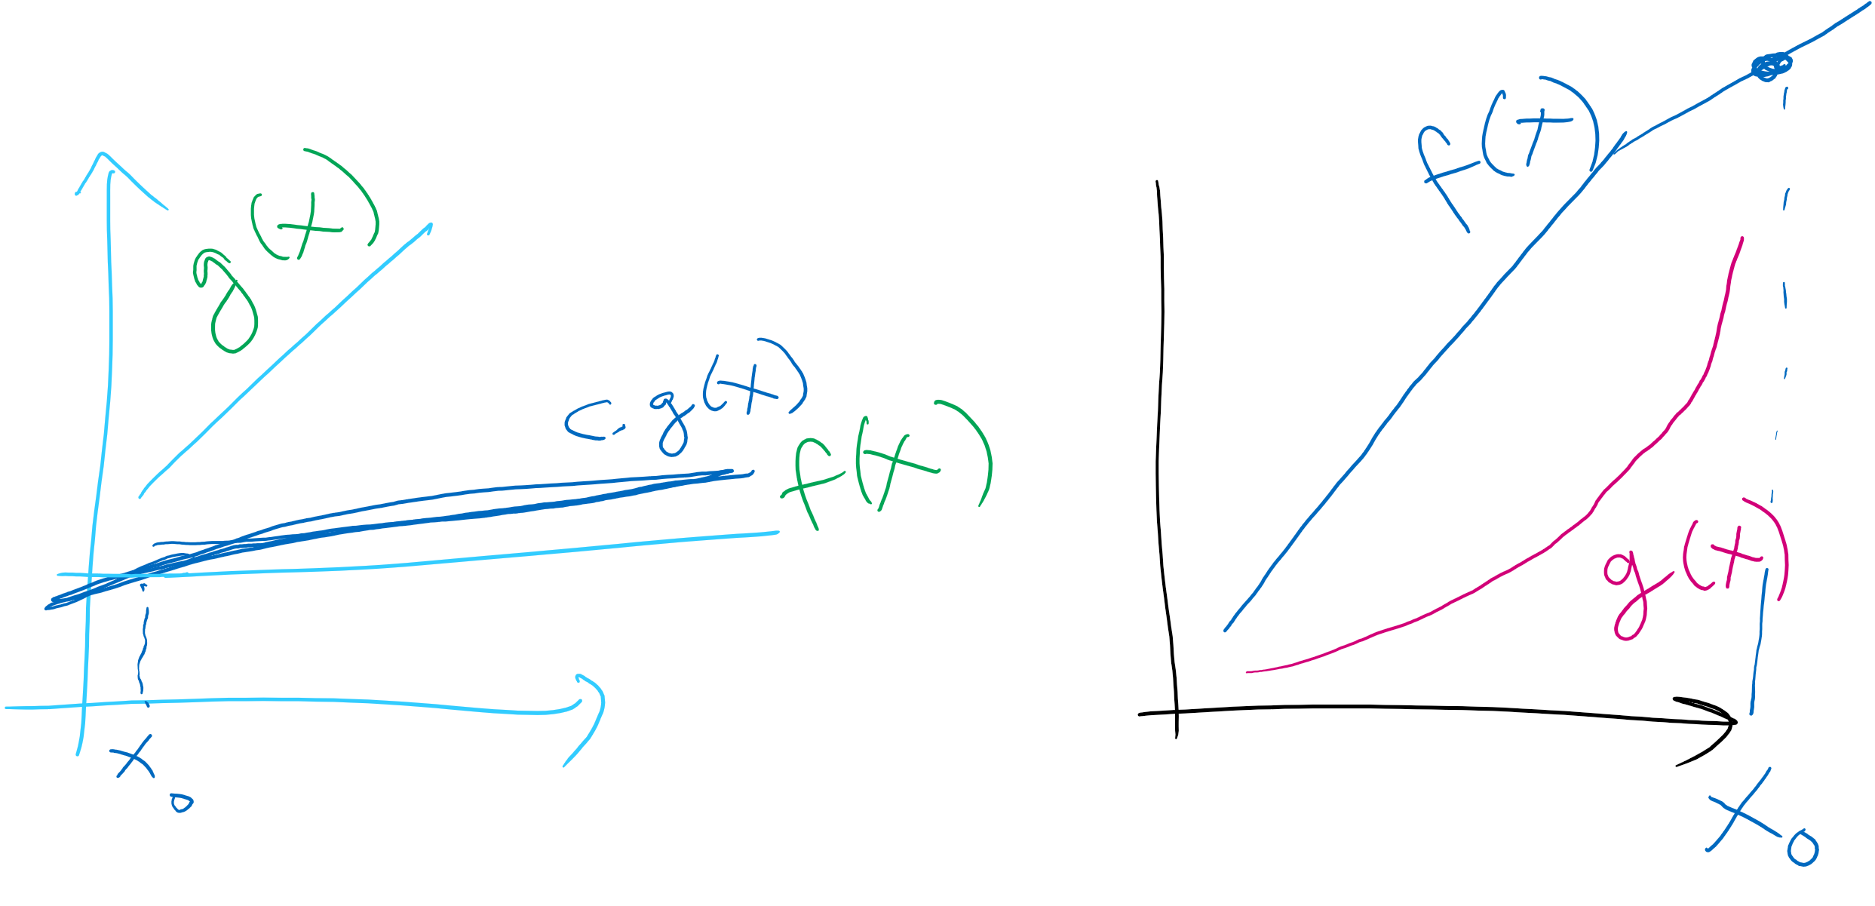
Formal Definitions

Slide 10
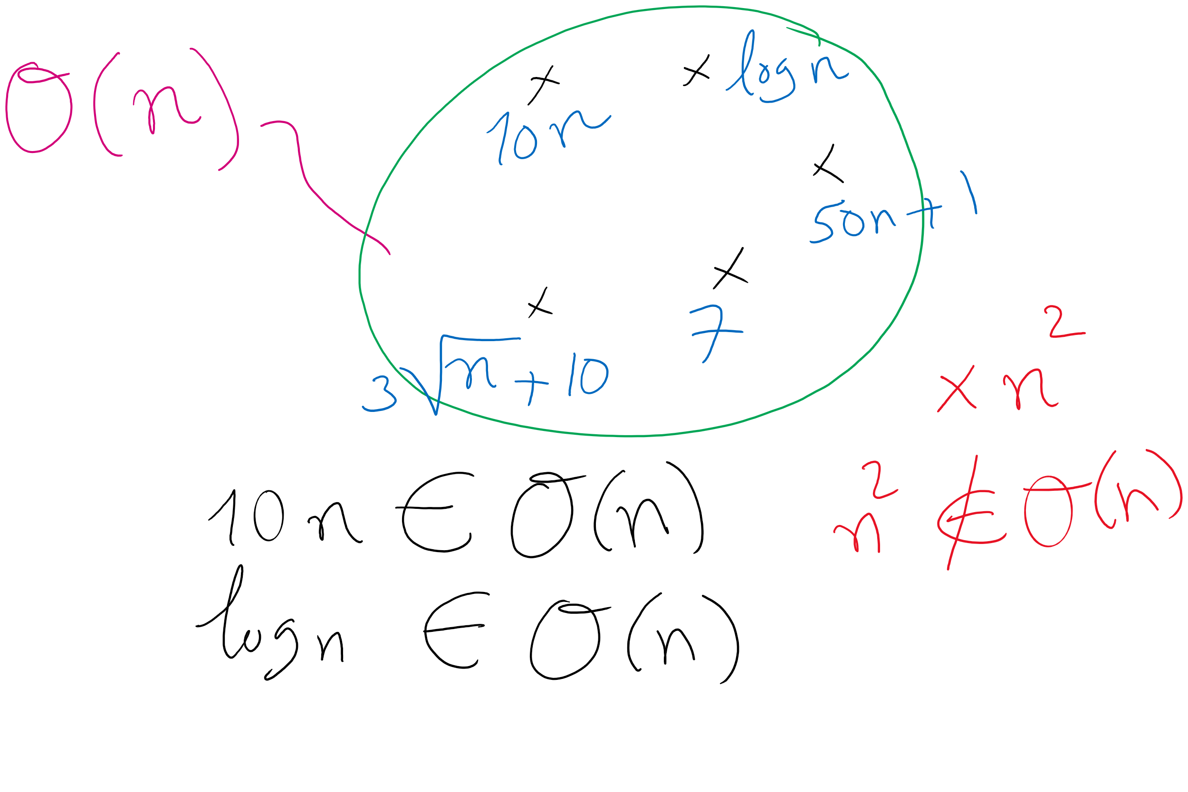
Formal Definitions
May also see f(x) ∈ O(g(x)) or f(x) = O(g(x)) used to mean that f(x) is O(g(x))
Same for Ω and Θ

Slide 11
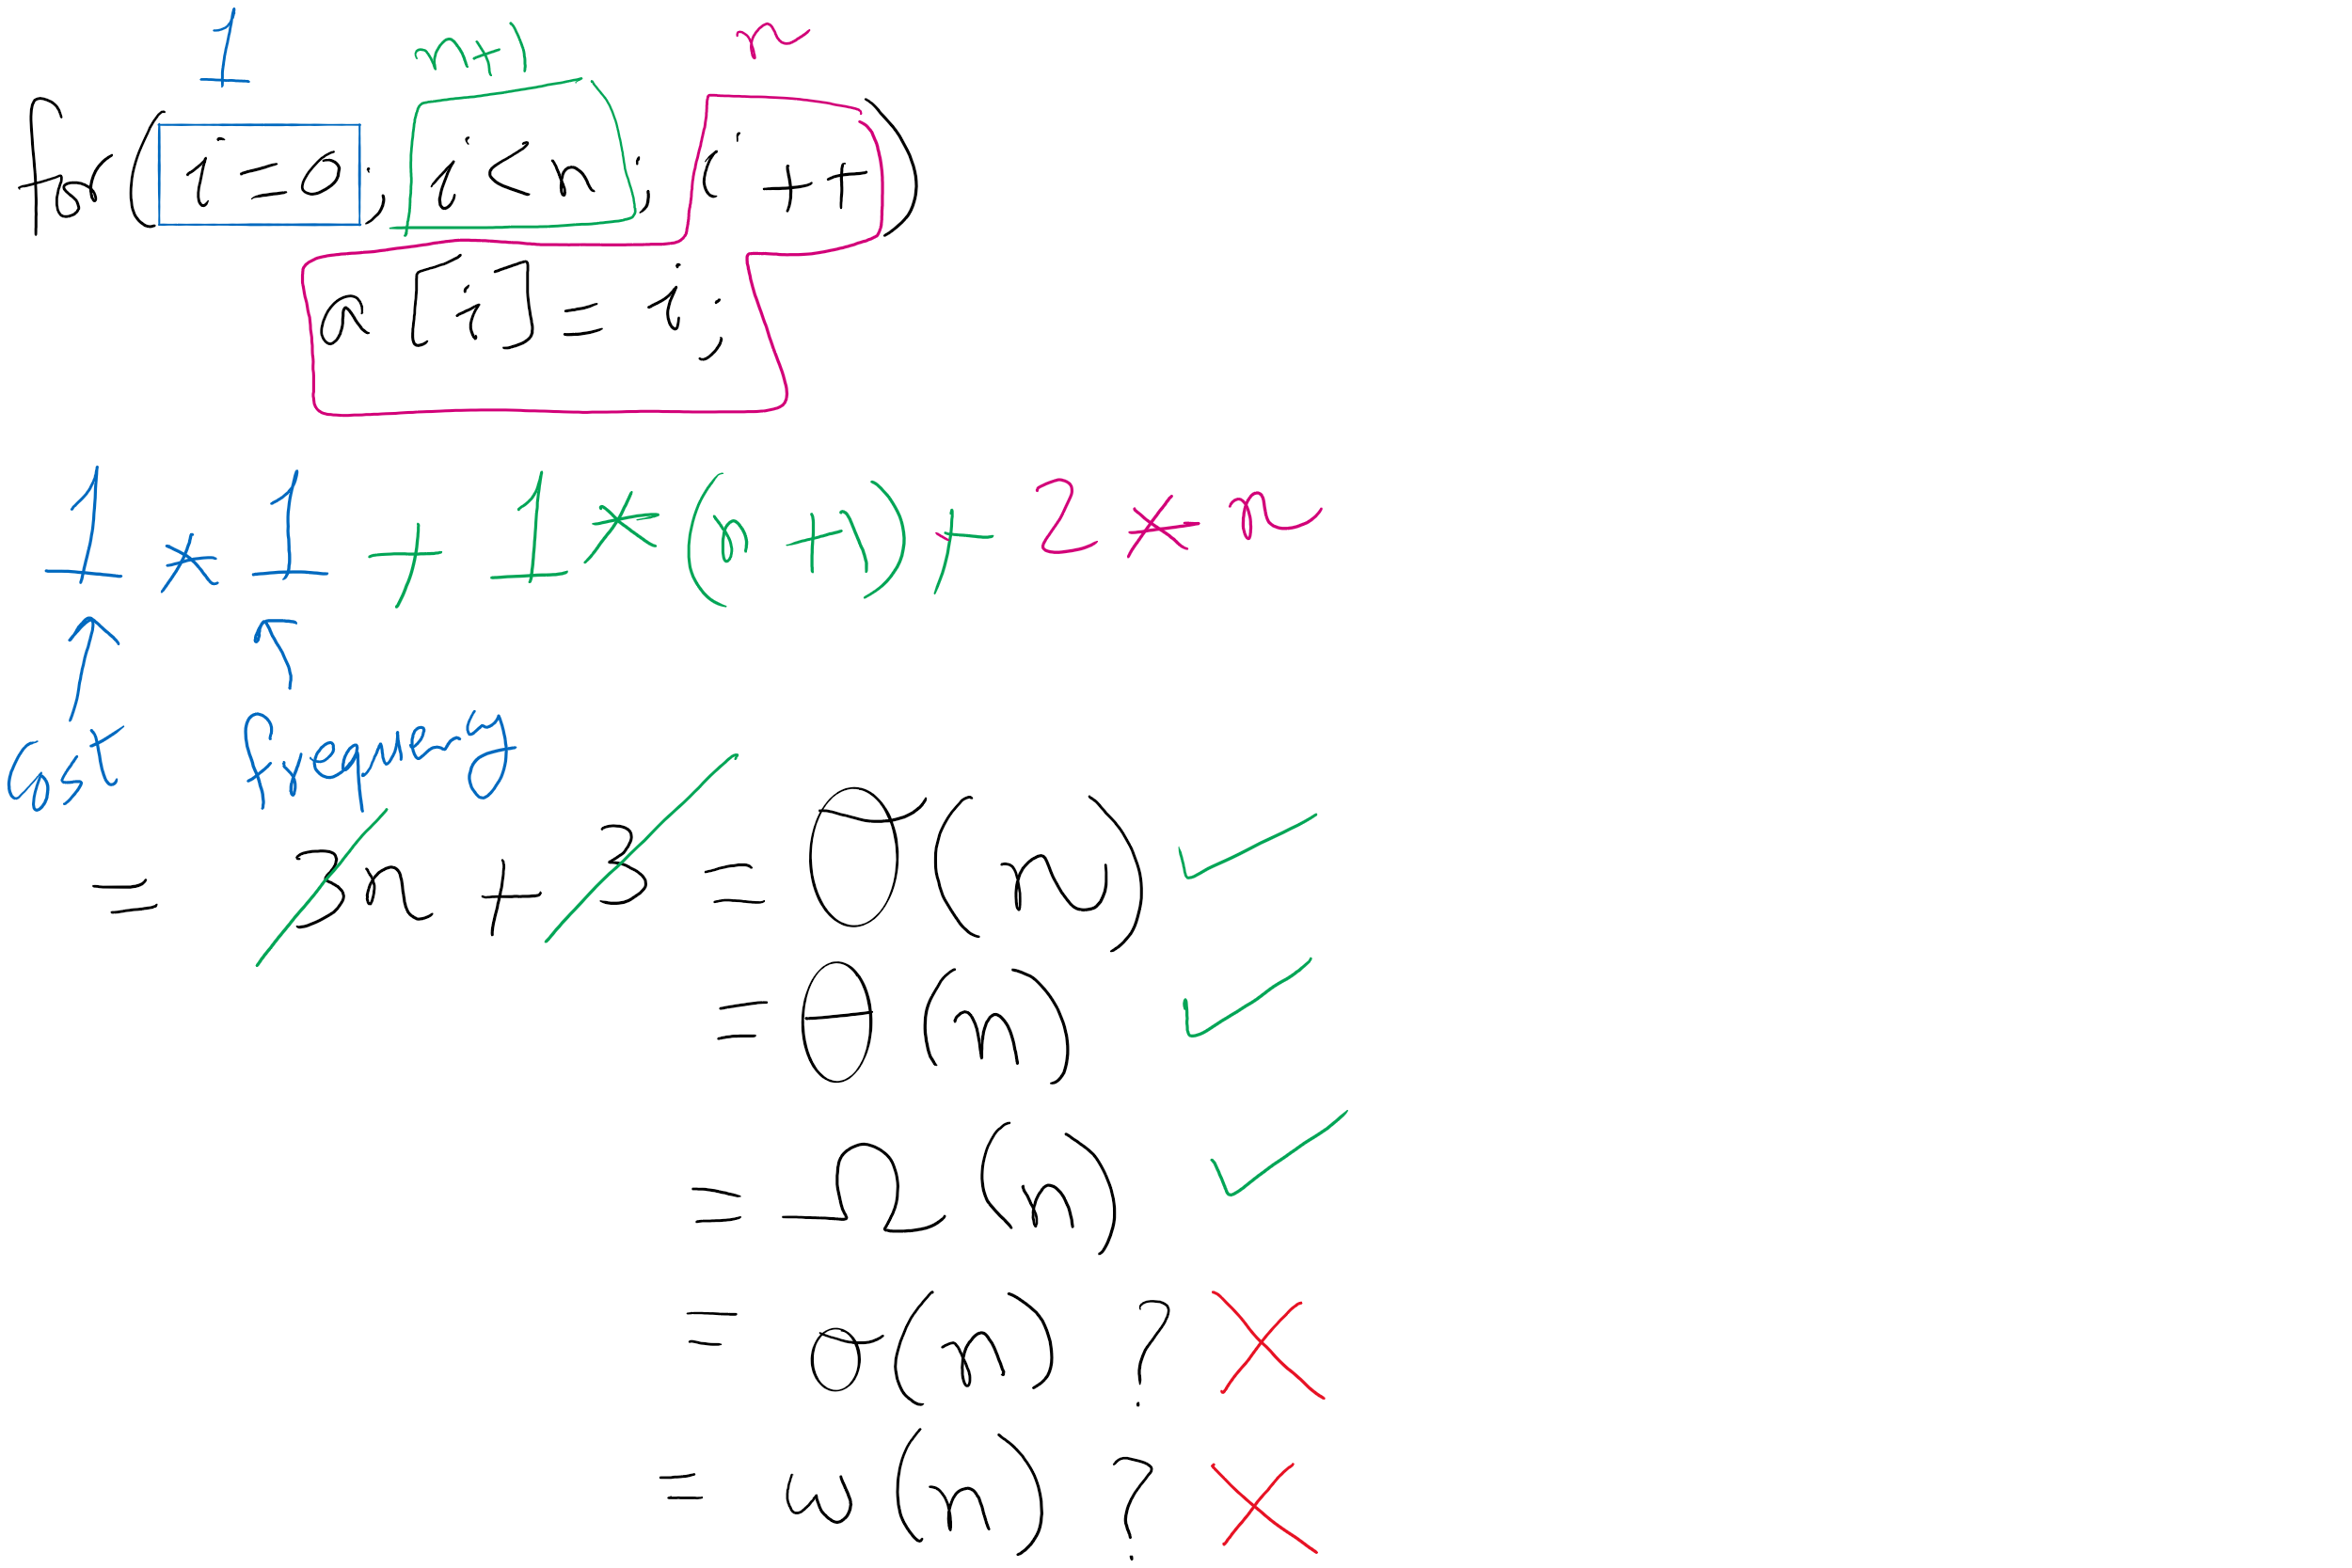
Algorithm Analysis Example 1

Slide 12
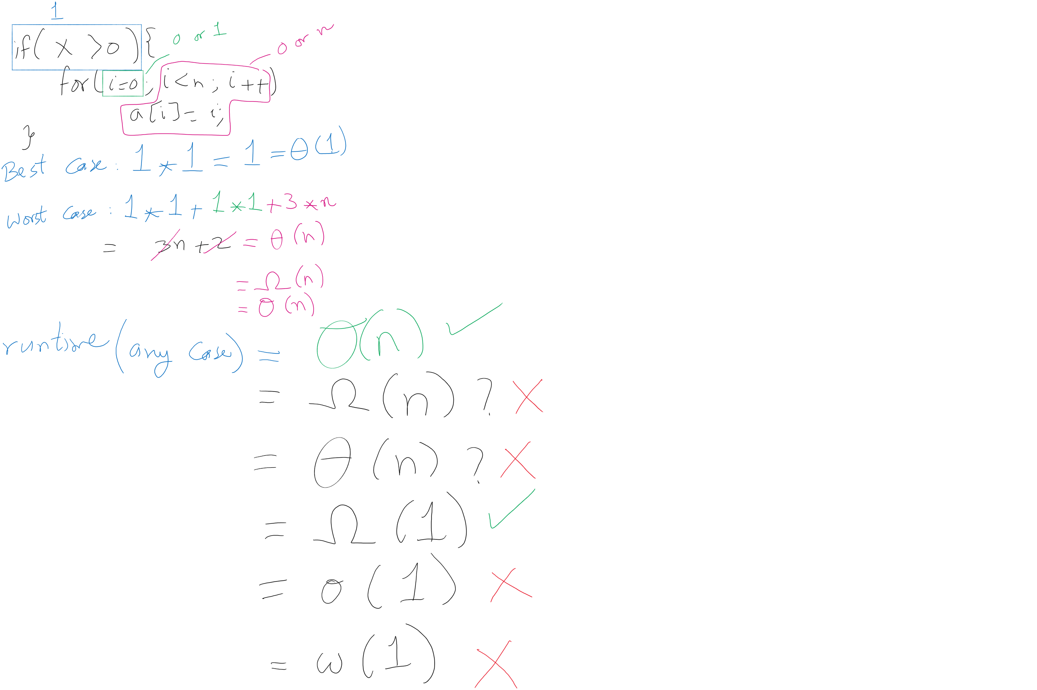
Algorithm Analysis Example 2

Slide 13
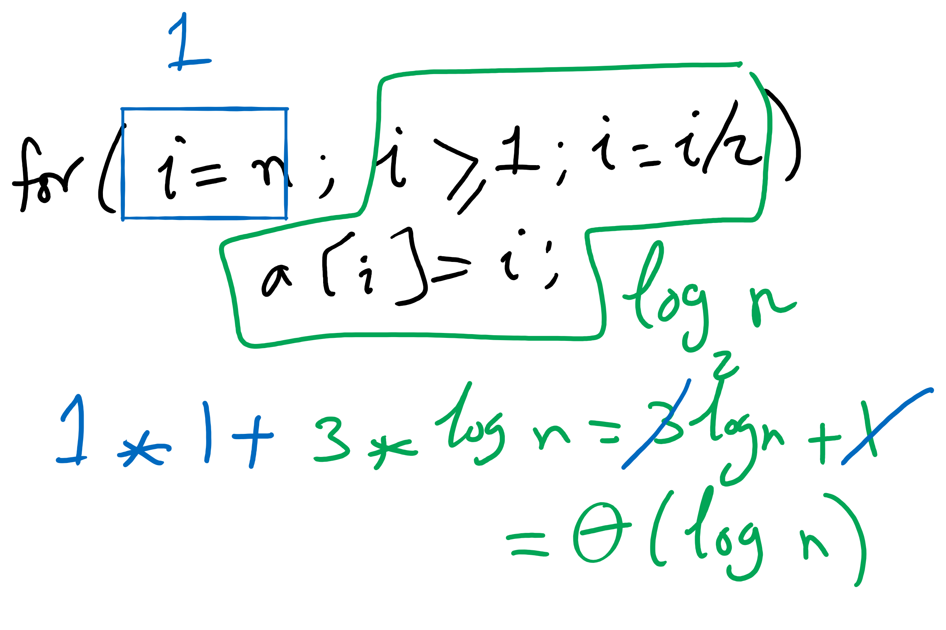
Algorithm Analysis Example 3

Slide 14
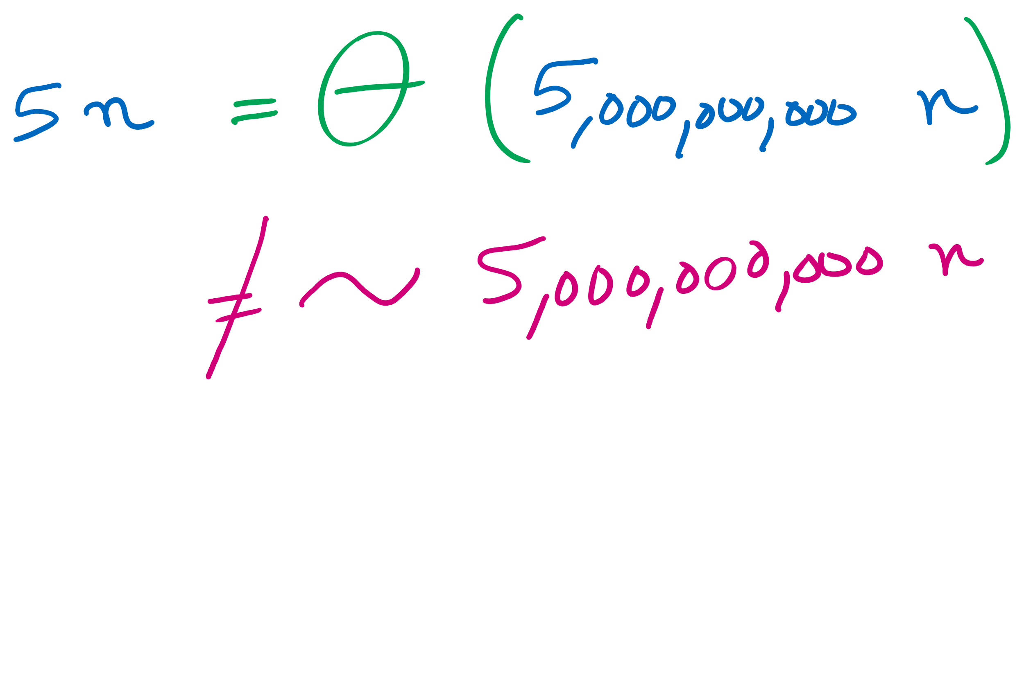
Big O vs. Tilde
Tilde approximation
Same as Theta but with constant factors

Slide 15
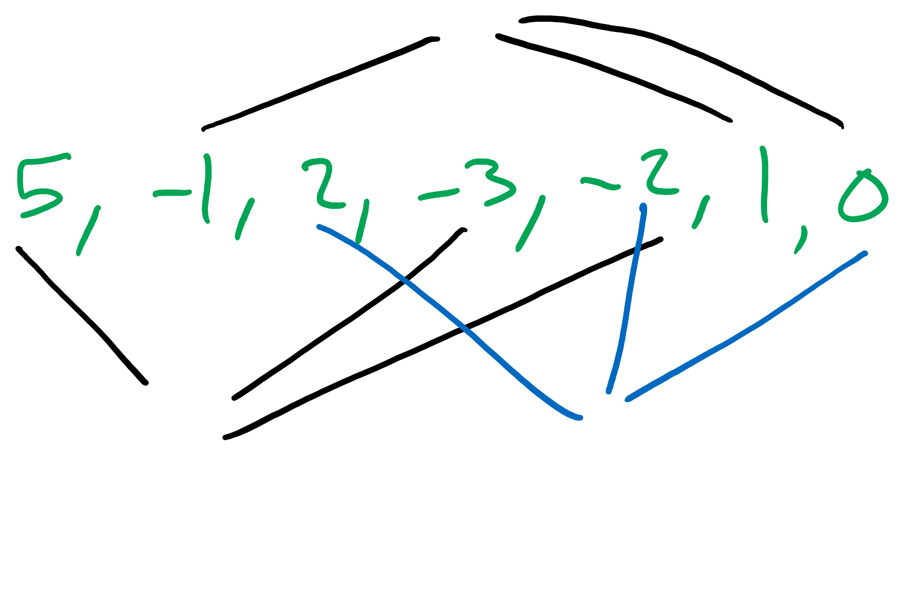
Let’s consider ThreeSum example from text
Problem:
Given a set of arbitrary integers (could be negative), find out how many distinct triples sum to exactly zero
Simple solution: triple for loops!
public static int count(int[] a) { int n = a.length; int cnt = 0; for (int i = 0; i < n; i++) { for (int j = i+1; j < n; j++) { for (int k = j+1; k < n; k++) { if (a[i] + a[j] + a[k] == 0) { cnt++; } } } } return cnt; }
Notes:
What's your analysis of this algorithm?
O(n³)?
Runtime?
How do we measure memory usage?
Wait, not all 3 loops go 0 to n…
Still O(n³)?
How???

Slide 16
Let’s consider ThreeSum example from text
public static int count(int[] a) { int n = a.length; int cnt = 0; for (int i = 0; i < n; i++) { for (int j = i+1; j < n; j++) { for (int k = j+1; k < n; k++) { if (a[i] + a[j] + a[k] == 0) { cnt++; } } } } return cnt; }
Notes:
grey:
time: t₄
freq: 1
yellow:
time: t₃
freq: n
blue:
time: t₂
freq: sum i=0 to n-1 ( sum j=i+1 to n-1 (1))
= n²/2 - n/2
red:
time: t₁
freq: sum i=0 to n-1 ( sum j=i+1 to n-1 ( sum k=j+1 to n-1 (1)))
= n³/6 - n²/2 + n/3
purple
time: t₀
freq: x (depends on if statement, min 0 max same as red)
SUM UPPER BOUNDS: INCLUSIVE

Slide 17
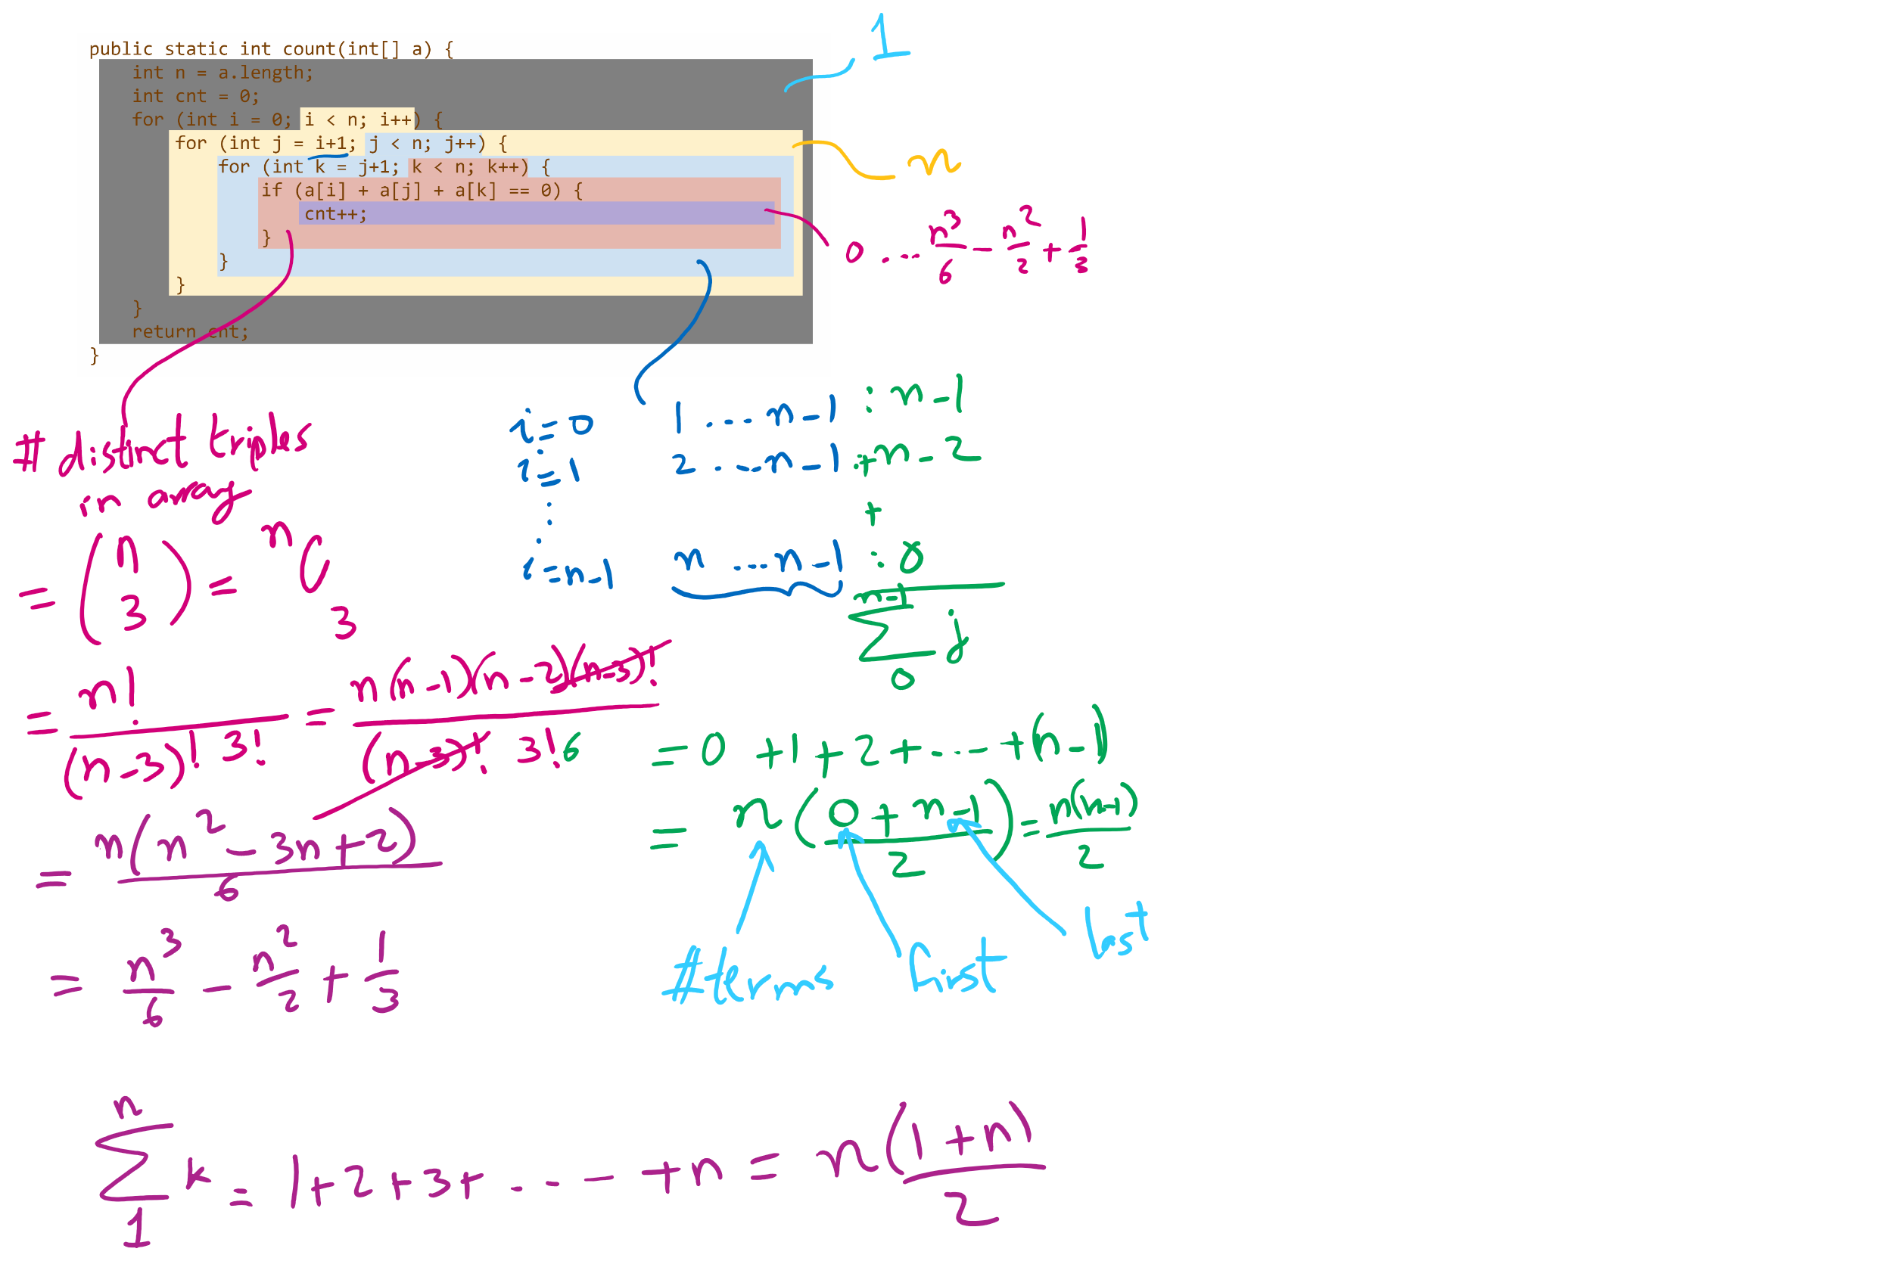
Runtime Modeling (1)

Slide 18
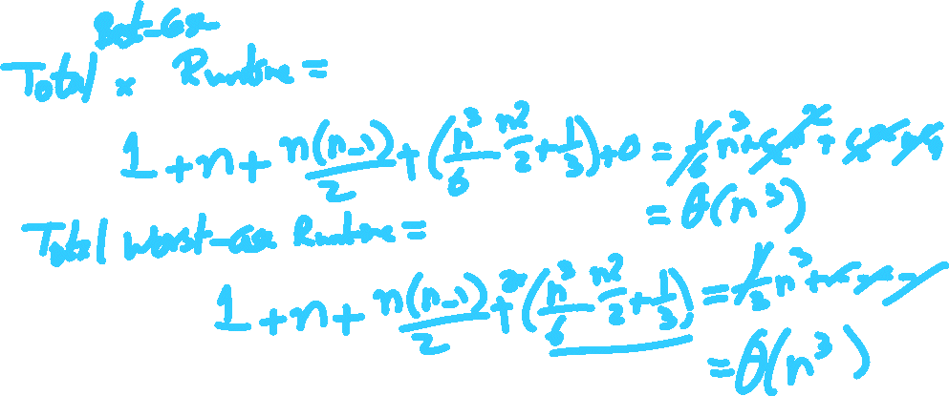
Runtime Modeling (2)

Slide 19
Wait…
Assuming that definition…
Is ThreeSum O(n⁴)?
What about O(n⁵)?
What about O(3^{n})??
If all of these are true, why was O(n³) what we jumped to to start?
Notes:
Yes!
Yes!
YES!
That's the tightest upper bound we can trivially see to be true

Slide 20
O(n³)
Θ(n³)
Ω(n³)
Ω(n)
Resource Usage
Input Size (n)
Notes:
Note big O can be used on worst, best, or average case
Same with big Omega, big Theta
Need to be more precise than just stating "upper bound" and "lower bound", though...

Slide 21
Mathematically modelling runtime
Runtime primarily determined by two factors:
Cost of executing each statement
Determined by machine used, environment running on the machine
Frequency of execution of each statement
Determined by program and input
Notes:
Knuth's approach to modelling runtime

Slide 22
Please submit your reflections by using the CourseMIRROR App
If you are having a problem with CourseMIRROR, please send an email to coursemirror.development@gmail.com
Notes:
All right!
Upcoming Due Dates at A Glance

