Slide 1

Algorithms and Data Structures 2 CS 1501
Fall 2021
Sherif Khattab
ksm73@pitt.edu
(Slides are adapted from Dr. Ramirez’s and Dr. Farnan’s CS1501 slides.)

Slide 2
Announcements
Upcoming deadlines:
Homework 4 due on 10/8
Assignment 2 due on 10/25
Midterm on 10/13
In-class, paper-based exam

Slide 3
Last lecture …
Iterative search and traversals

Slide 4
CourseMIRROR Reflections

Slide 5
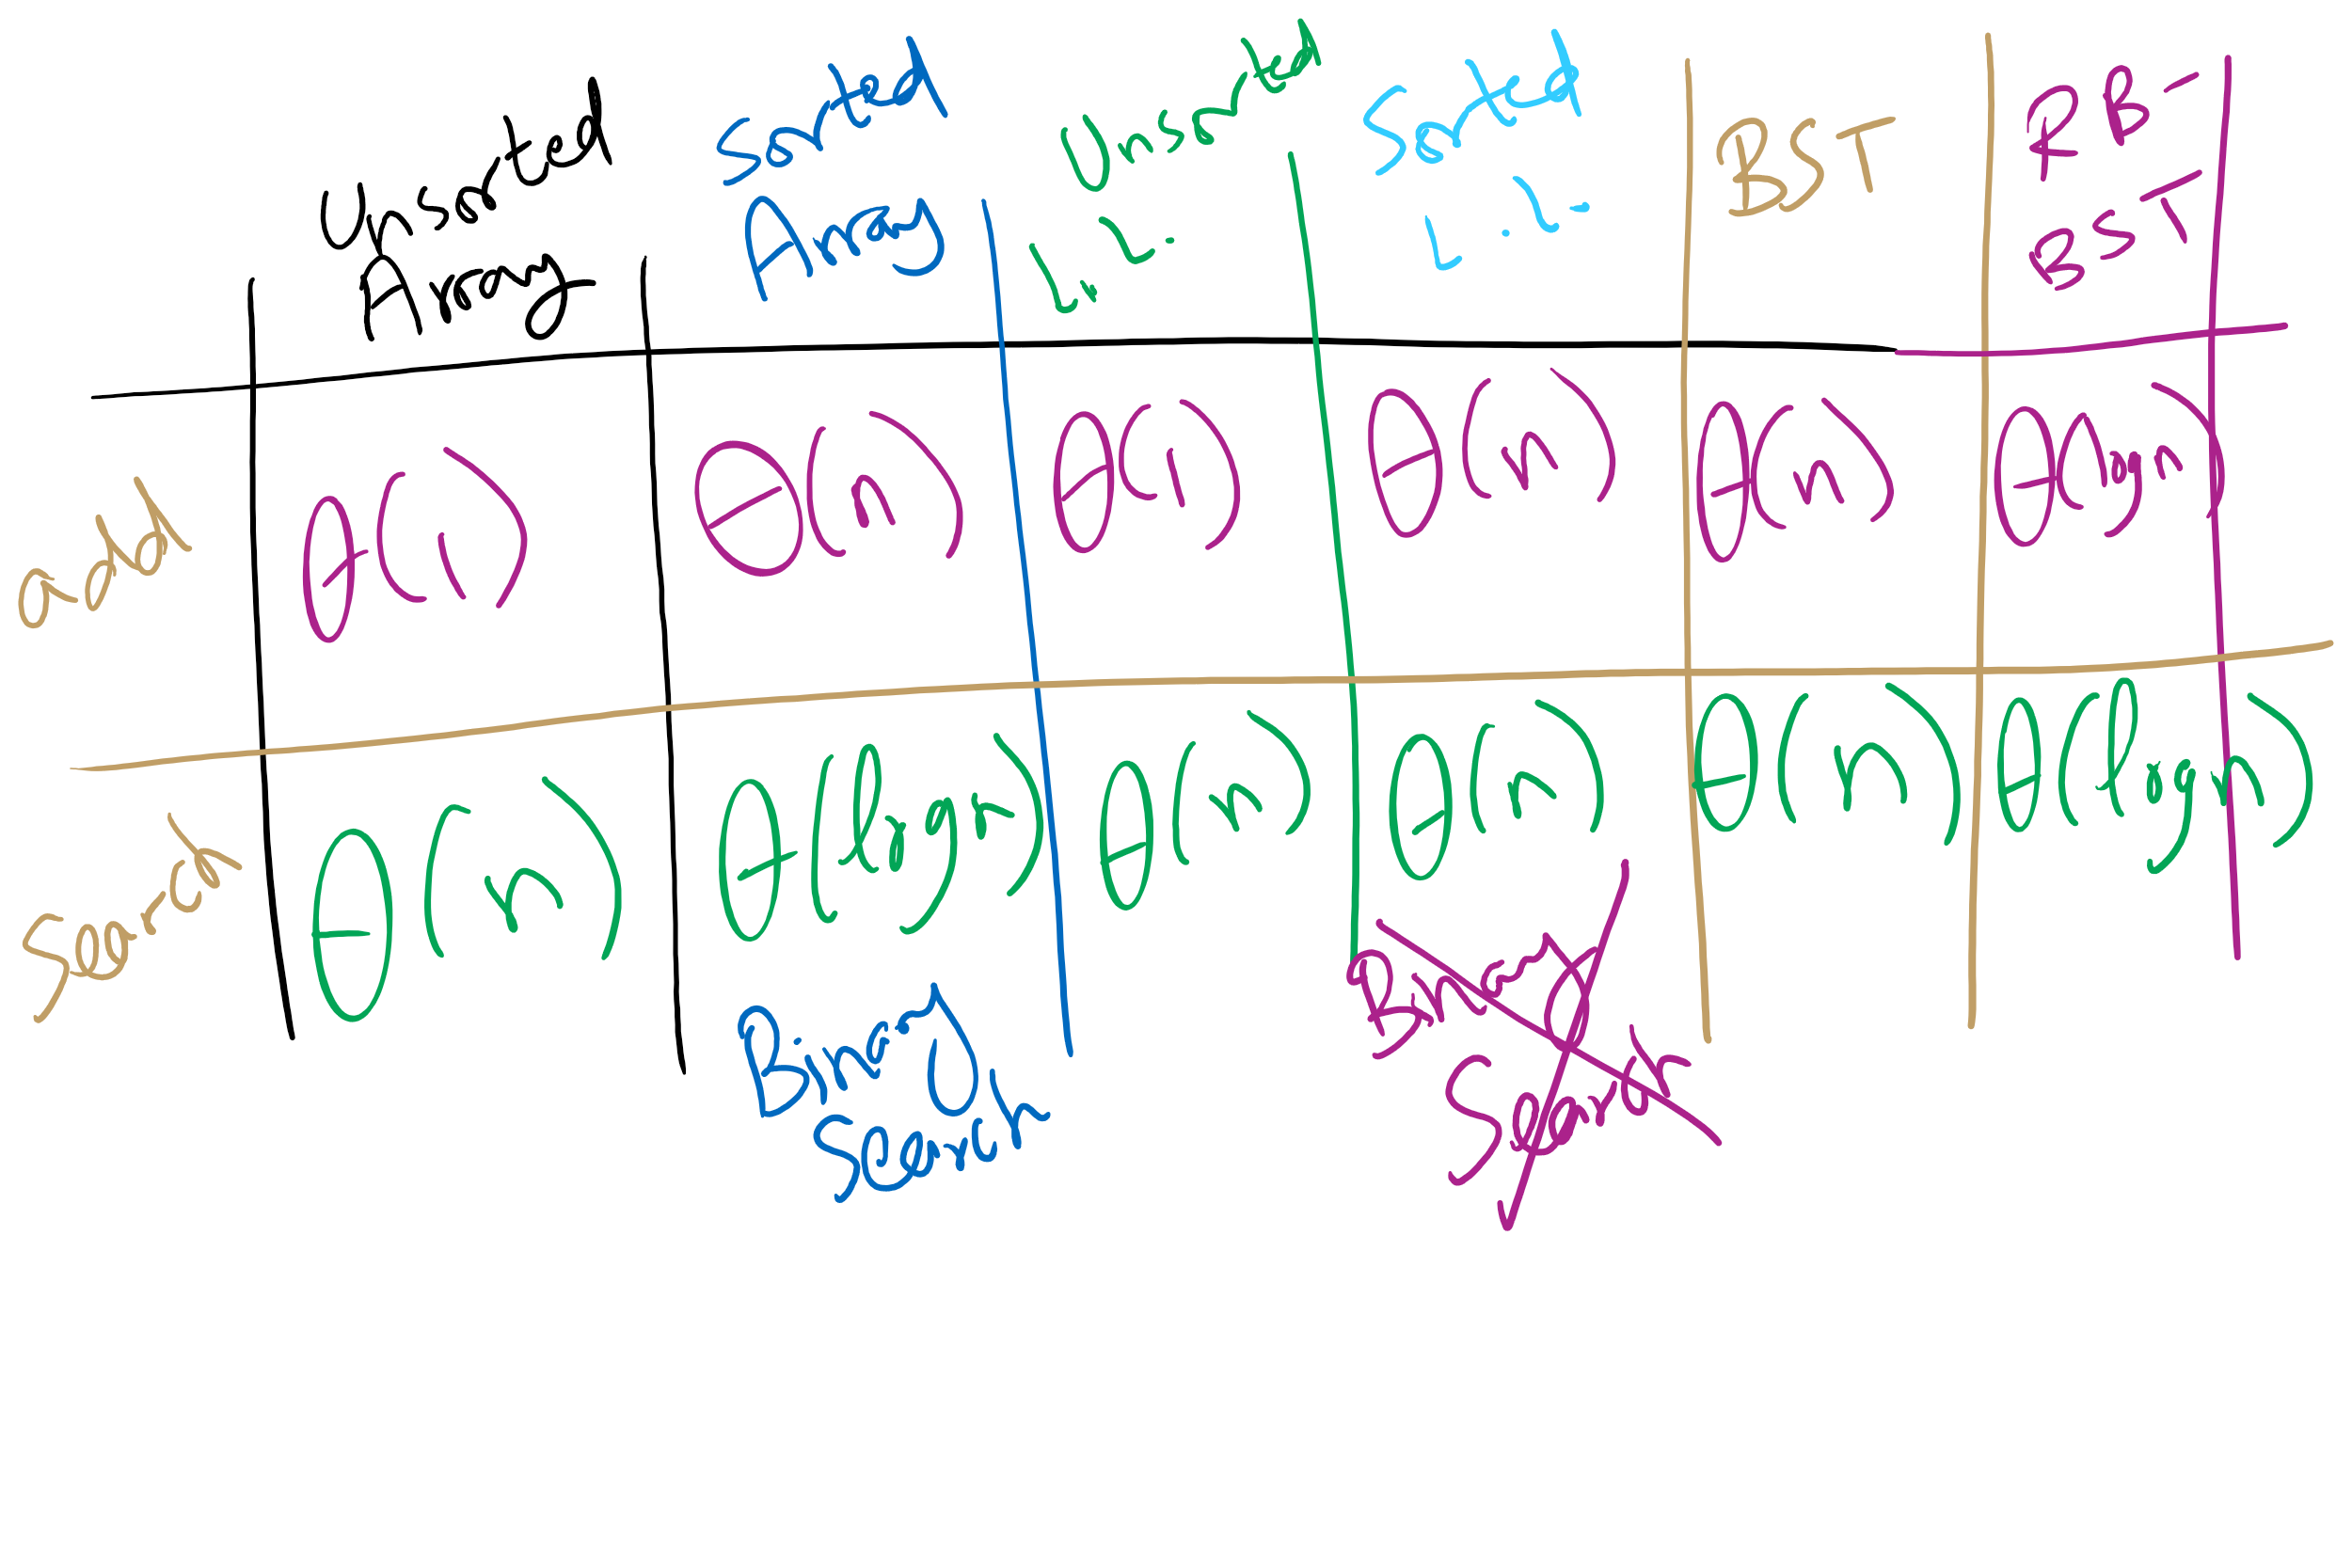
Symbol Table Implementations

Slide 6
A closer look
Can we do better than these?
These methods depend on comparisons against other keys
I.e., k is compared against other keys in the data structure
4 options at each node in a BST:
Node ref is null, k not found
k is equal to the current node's key, k is found
k is less than current key, continue to left child
k is greater than the current key, continue to right child

Slide 7
Digital Search Trees (DSTs)
Instead of looking at less than/greater than, lets go left right based on the bits of the key, so we again have 4 options:
Node ref is null, k not found
k is equal to the current node's key, k is found
current bit of k is 0, continue to left child
current bit of k is 1, continue to right child

Slide 8
DST example
Insert:
4
0100
4
3
0011
0
1
2
0010
3
6
0110
0
1
2
6
5
0101
Search:
0
1
0
1
5
3
0011
0
1
7
0111
Notes:
how to turn this into a symbol table?

Slide 9
Analysis of digital search trees
Runtime?
We end up doing many comparisons against the full key, can we improve on this?
Notes:
Average case is the same as BST: lg(n)
Given a truly random set of n keys, branching according to a 0 or 1 is equally likely and the tree should be well balanced
What about the worst case?
Bound by the bit length, b, of the key
Constant lookup time in the number of bits, an improvement over BST
How is this OK?
Compare log(n) with b over all possible values of n
Harken back to radix sort discussion

Slide 10
Radix search tries (RSTs)
Trie as in retrieve, pronounced the same as “try”
Instead of storing keys as nodes in the tree, we store them implicitly as paths down the tree
Interior nodes of the tree only serve to direct us according to the bitstring of the key
Values can then be stored at the end of key’s bit string path

Slide 11
RST example
Insert:
4
0100
0
1
3
0011
2
0010
0
1
6
0110
0
1
0
1
5
0101
Search:
0
1
0
1
0
1
3
0011
V
V
V
V
V
7
0111
Notes:
V's just stand for values added as part of the symbol table

Slide 12
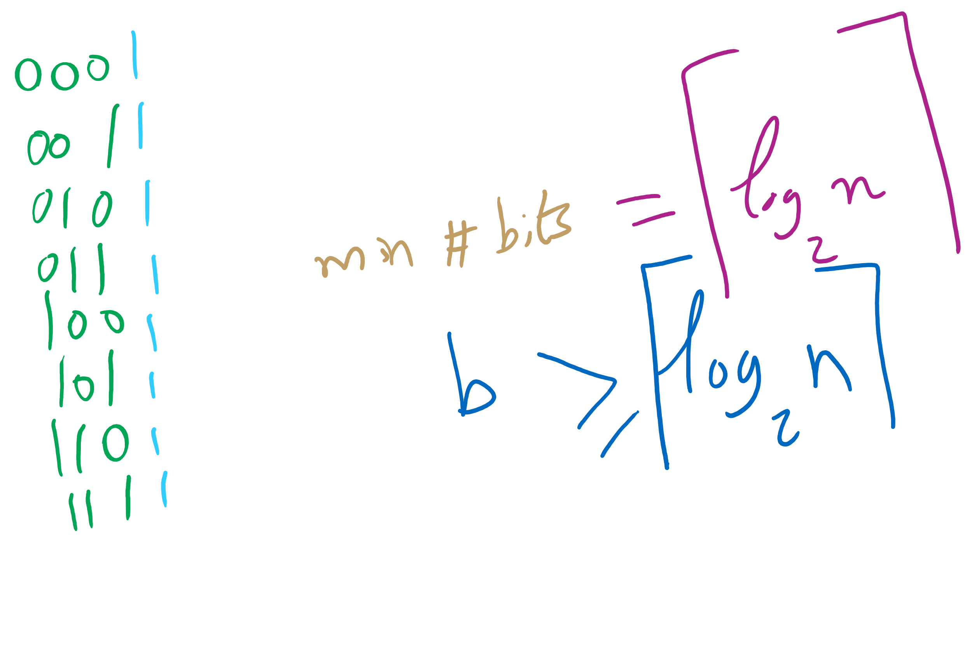
n vs. bit length

Slide 13
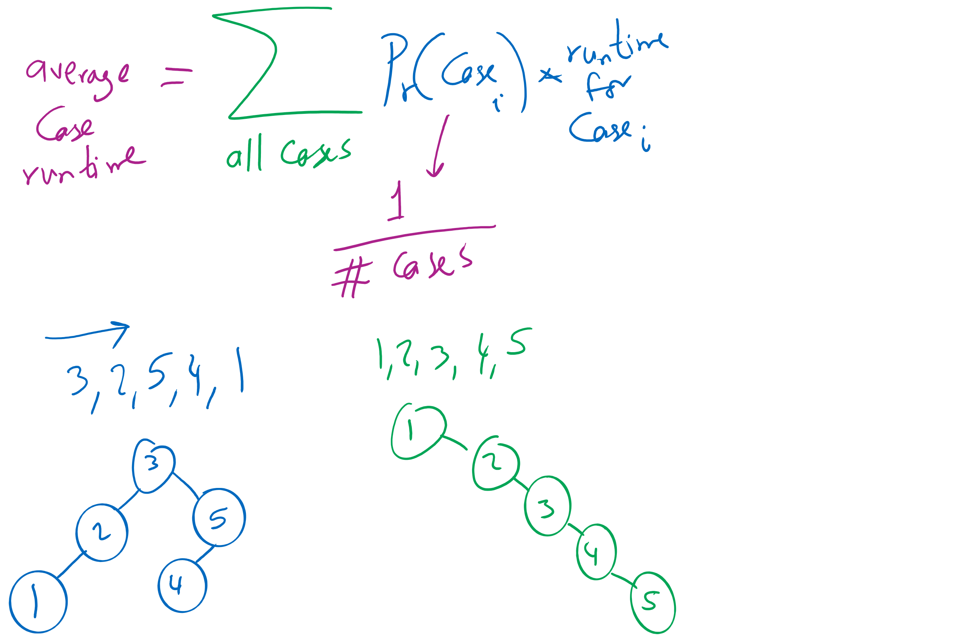
Average-case Analysis

Slide 14
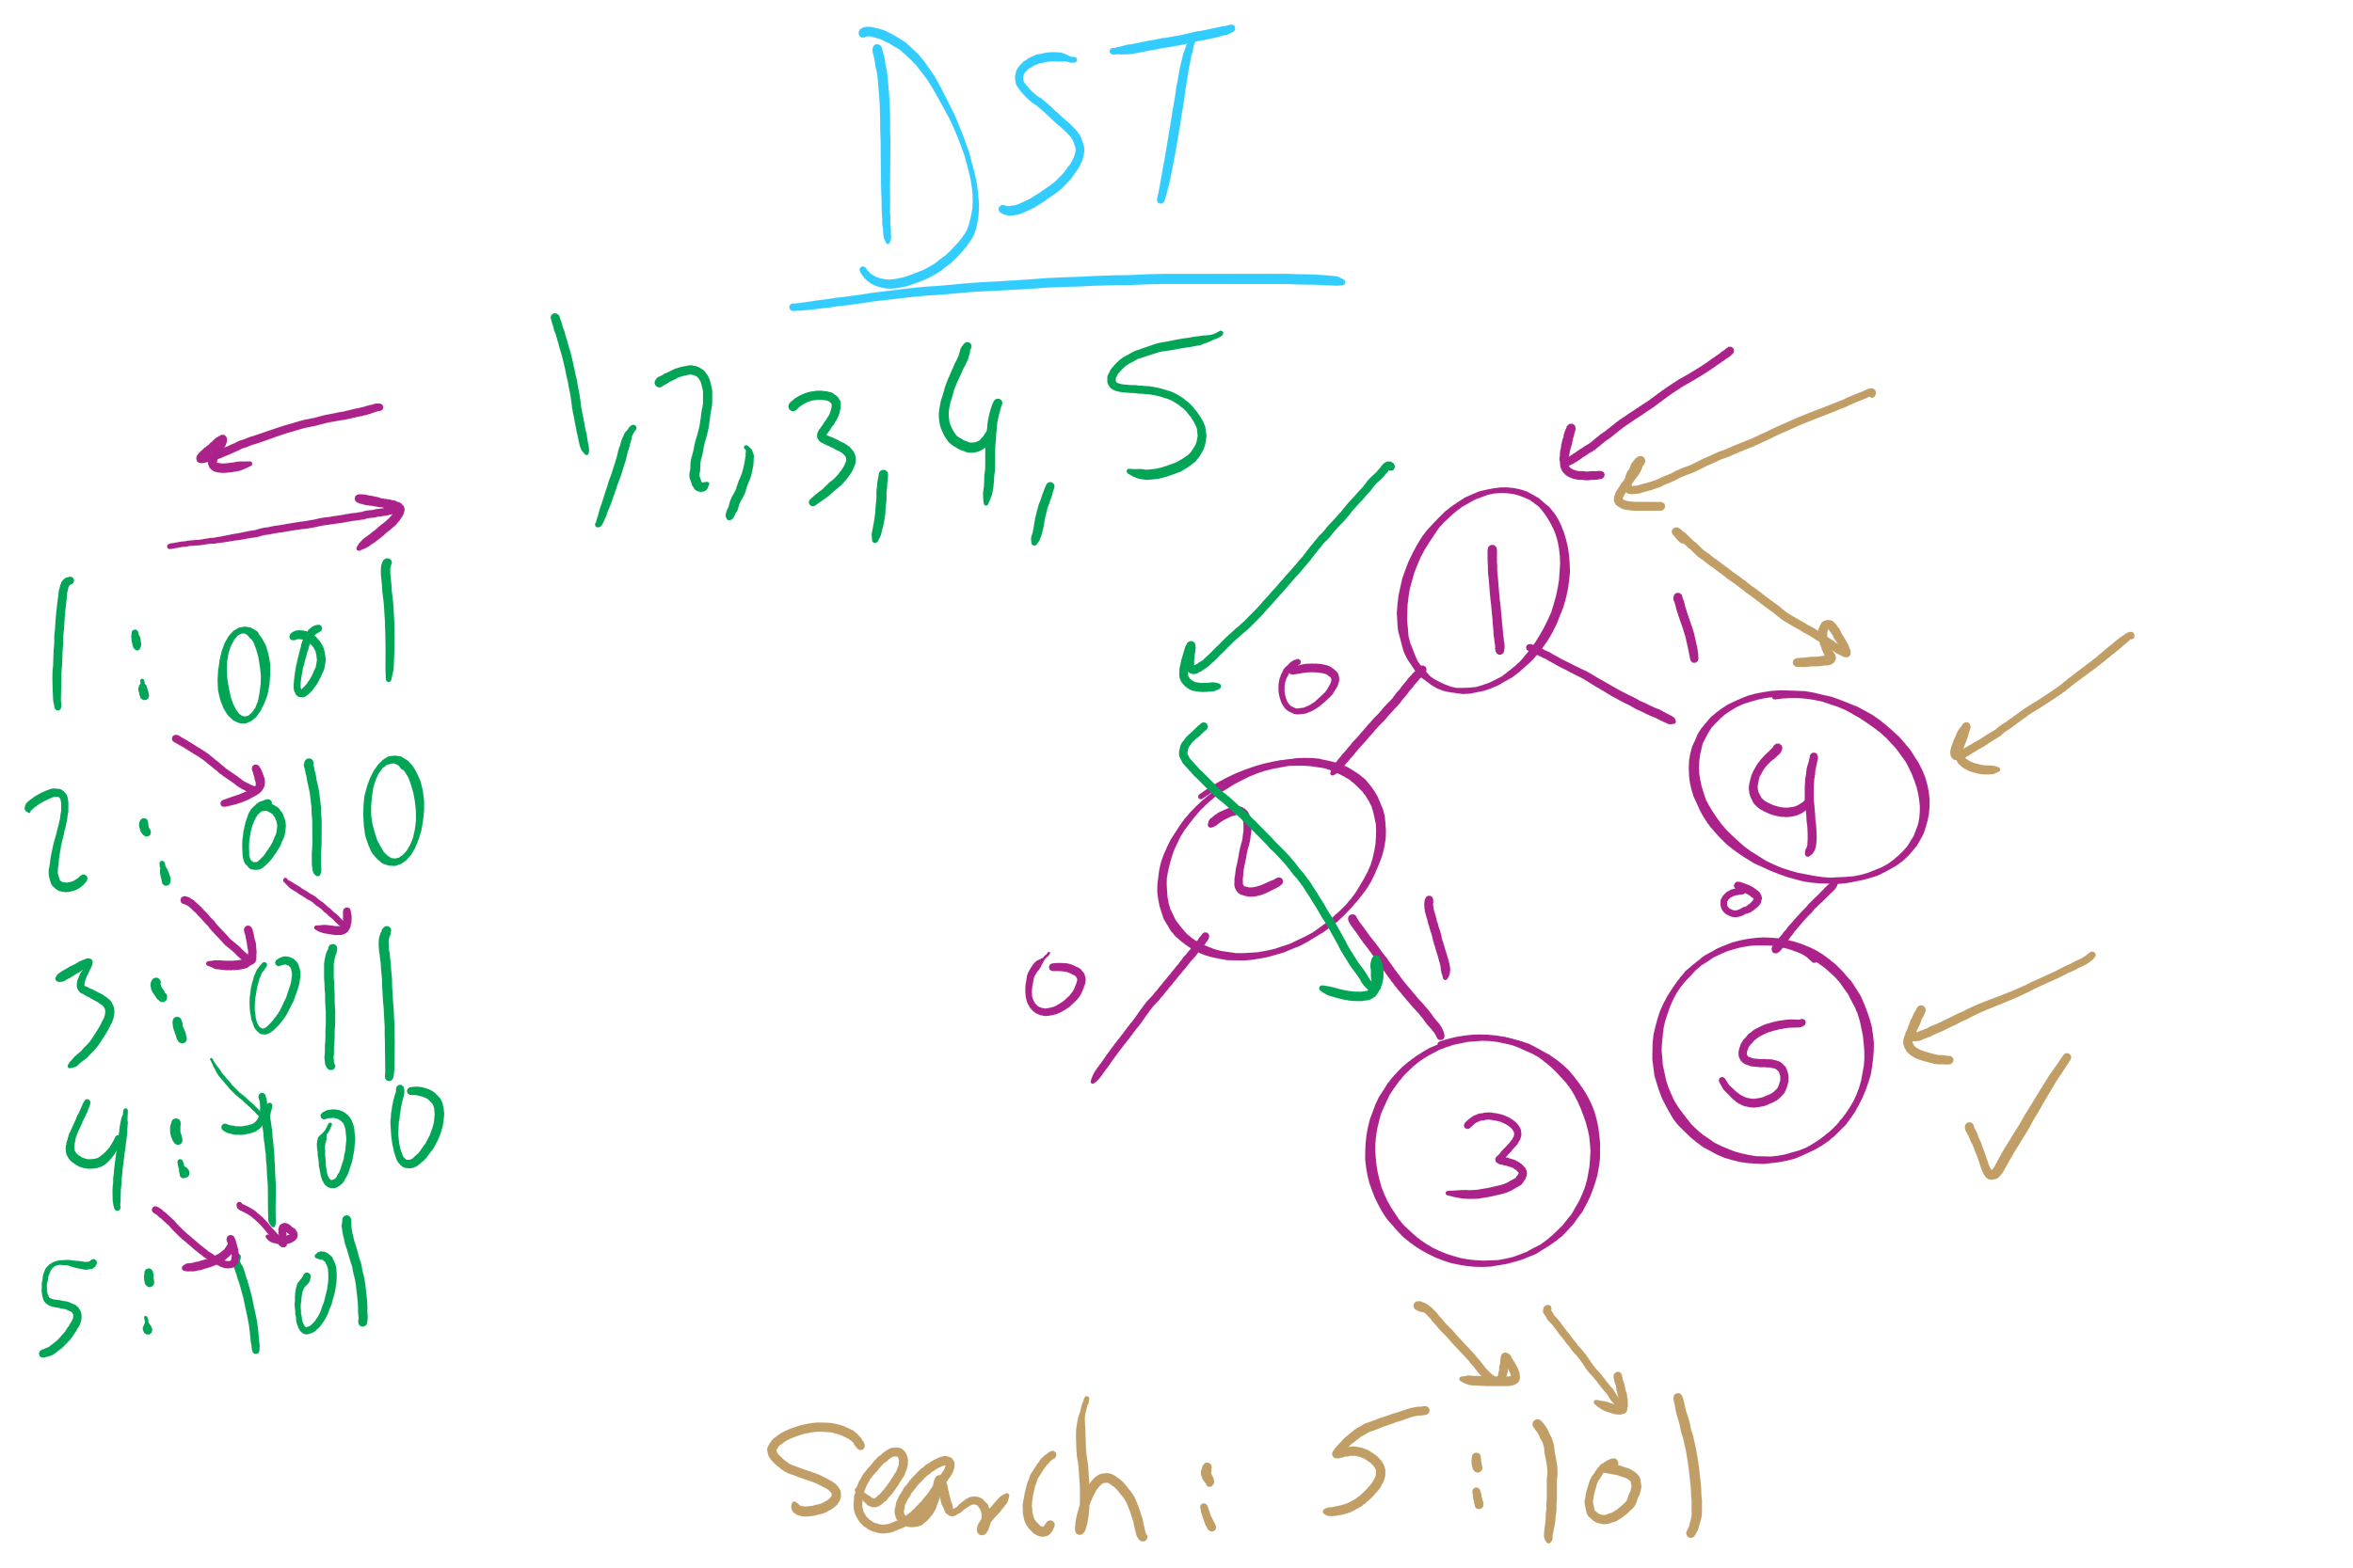
DST Operations

Slide 15
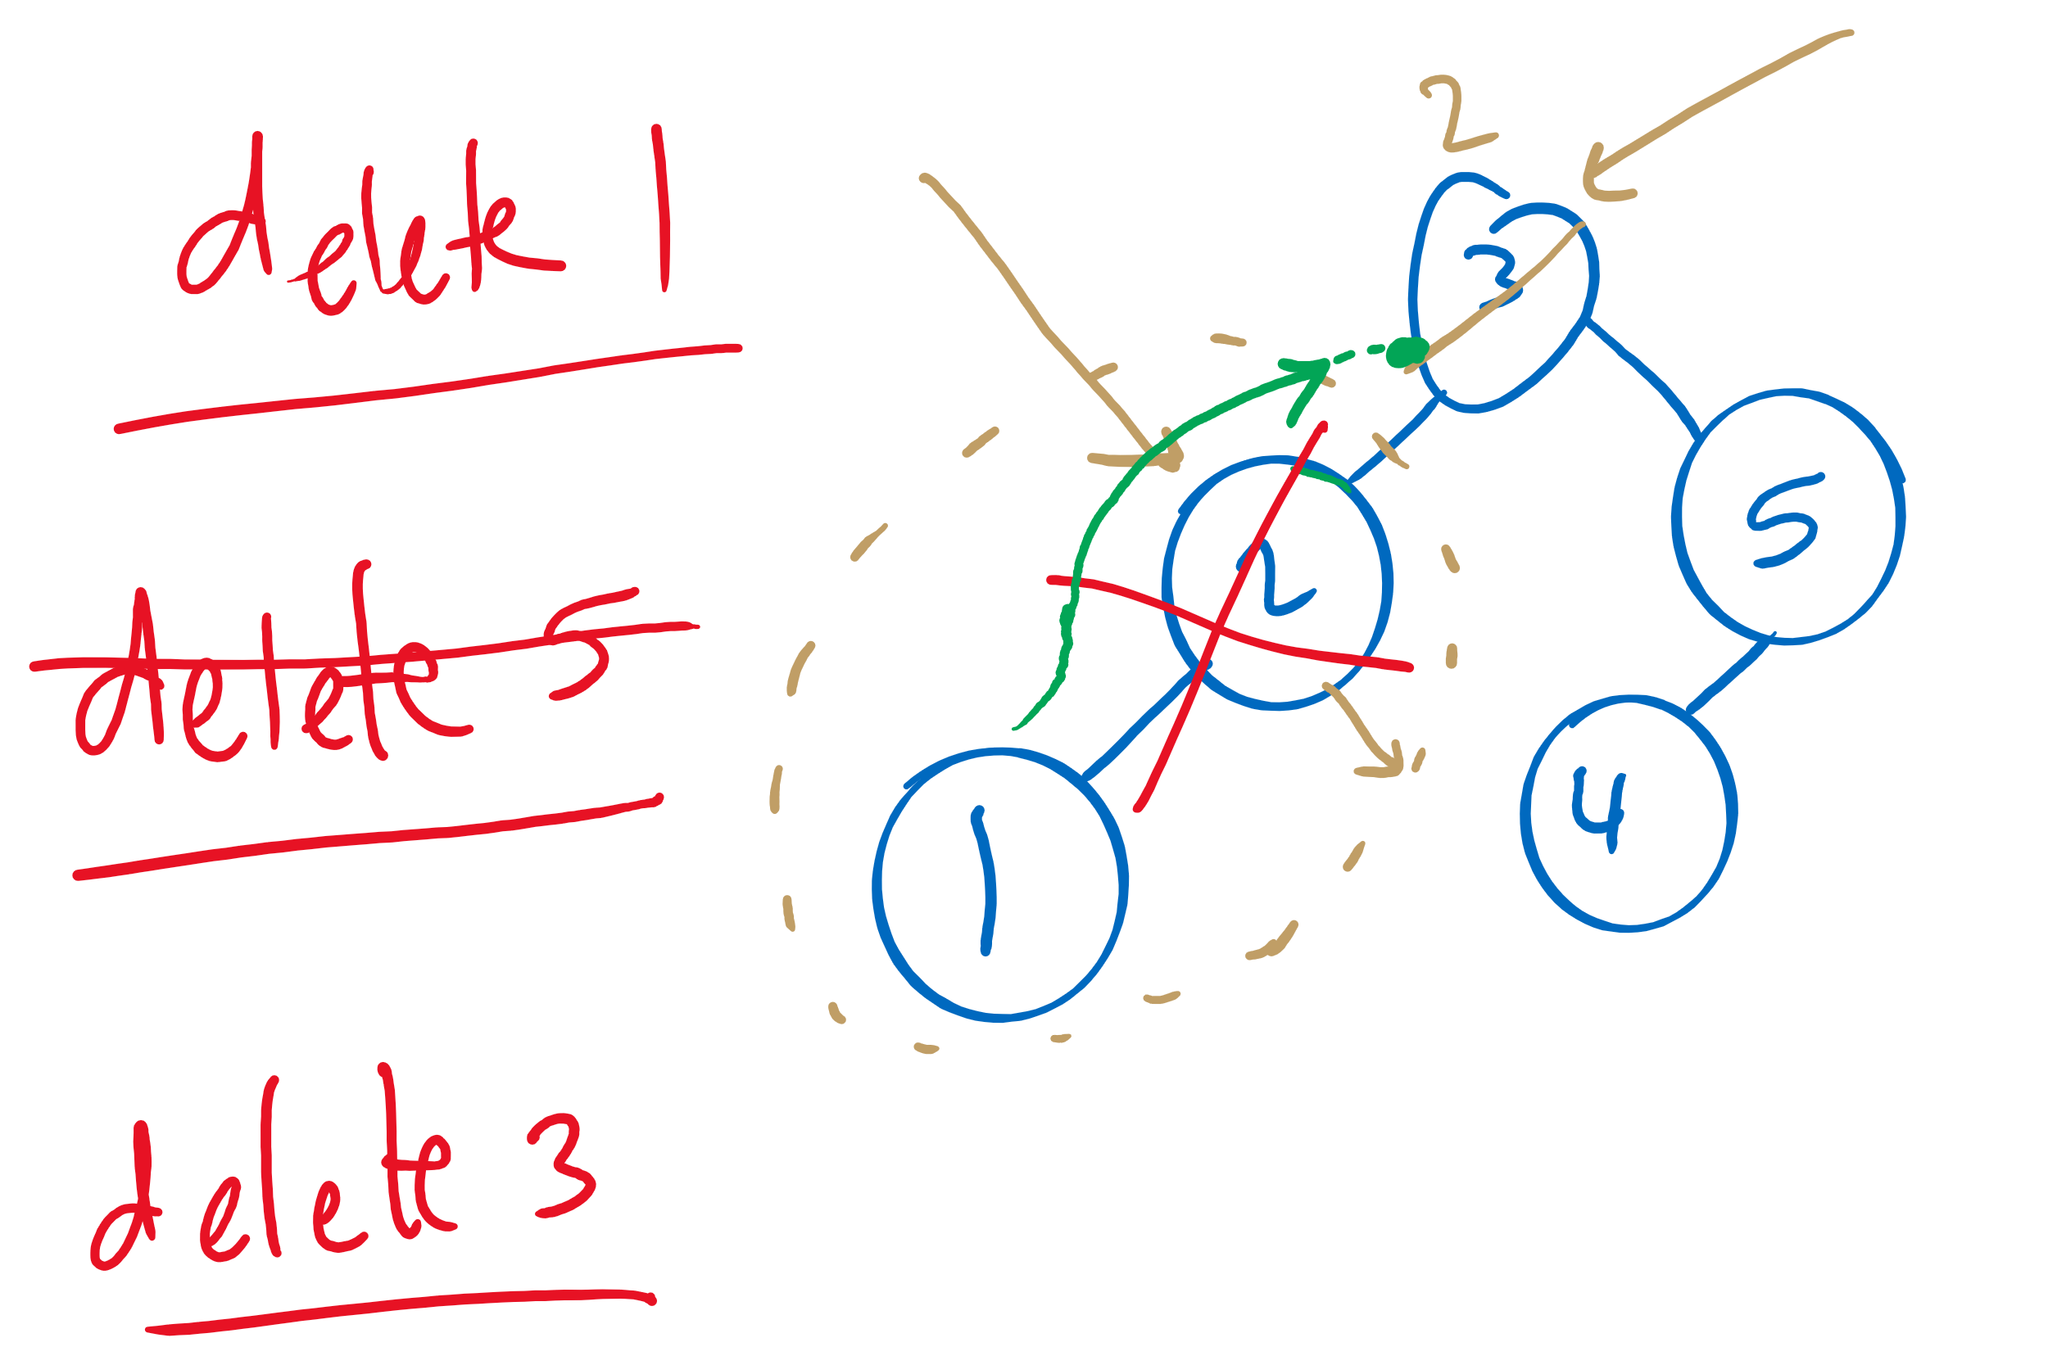
BST Delete

Slide 16
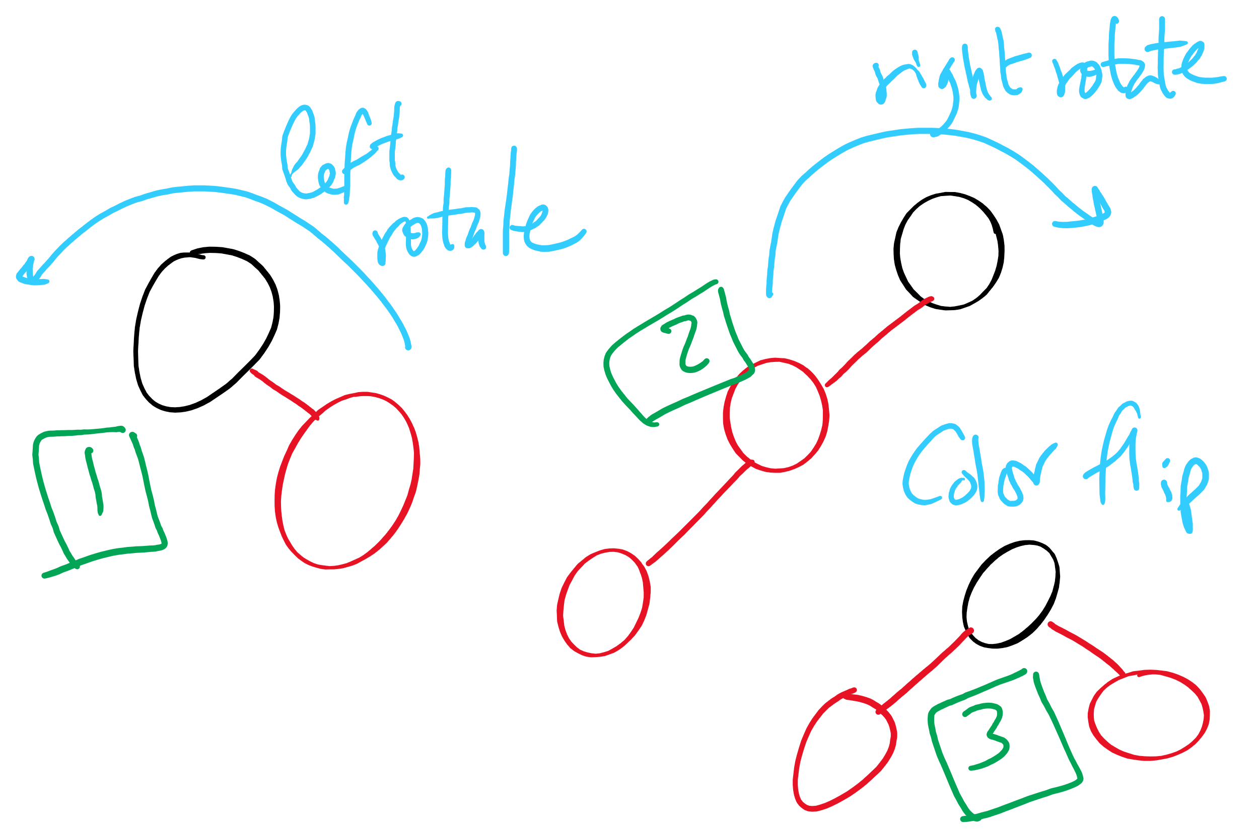
Red-Black BST Operations

Slide 17
Next …
radix search tries
multiway tries

Slide 18
Radix search tries (RSTs)
Trie as in retrieve, pronounced the same as “try”
Instead of storing keys as nodes in the tree, we store them implicitly as paths down the tree
Interior nodes of the tree only serve to direct us according to the bitstring of the key
Values can then be stored at the end of key’s bit string path

Slide 19
RST example
Insert:
4
0100
0
1
3
0011
2
0010
0
1
6
0110
0
1
0
1
5
0101
Search:
0
1
0
1
0
1
3
0011
V
V
V
V
V
7
0111
Notes:
V's just stand for values added as part of the symbol table

Slide 20
RST analysis
Runtime?
Would this structure work as well for other key data types?
Characters?
Strings?
Notes:
b, the bit length of the key
Worst case from DSTs
However, this time we don’t have full key comparisons
Characters are exactly the same as 8 bit ints (assuming simple ascii)
Strings would have huge bit lengths (go back to prev slide to hit this home)
Also vary in length, which we could handle with RSTs

Slide 21
Larger branching factor tries
In our binary-based Radix search trie, we considered one bit at a time
What if we applied the same method to characters in a string?
What would this new structure look like?
Let’s try inserting the following strings into an trie:
she, sells, sea, shells, by, the, sea, shore

Slide 22
Another trie example
b
s
t
y
e
h
h
a
l
e
o
e
l
l
r
s
l
e
s
Notes:
Instead of 1 bit per level, now looking at 8
How do we know where a string ends?
How do we know what keys are in the trie?
How do we store values in the trie?

Slide 23
Analysis
Runtime?
Notes:
Θ(w) where w is the character length of the string
Still constant!
So what do we really gain over RSTs?
For strings, w < b, and overall tree height is reduced

Slide 24
Further analysis
Miss times
Require an average of log_{R}(n) nodes to be examined
Where R is the size of the alphabet being considered
Proof in Proposition H of Section 5.2 of the text
Average # of checks with 2²⁰ keys in an RST?
With 2²⁰ keys in a large branching factor trie, assuming 8-bits at a time?
Notes:
Average # of checks with 2²⁰ keys in an RST?
lg(2²⁰) = 20
With 2²⁰ keys in an R-way trie, assuming 8-bit ASCII?
log₂₅₆(2²⁰) = 2.5

Slide 25
Implementation Concerns
See TrieSt.java
Implements an R-way trie
Basic node object:
private static class Node { private Object val; private Node[] next = new Node[R]; }
Where R is the branching factor
Non-null val means we have traversed to a valid key
Again, note that keys are not directly stored in the trie at all

Slide 26
Please submit your reflections by using the CourseMIRROR App
If you are having a problem with CourseMIRROR, please send an email to coursemirror.development@gmail.com
Notes:
All right!
Upcoming Due Dates at A Glance

