Slide 1

Algorithms and Data Structures 2 CS 1501
Fall 2021
Sherif Khattab
ksm73@pitt.edu
(Slides are adapted from Dr. Ramirez’s and Dr. Farnan’s CS1501 slides.)

Slide 2
Announcements
Upcoming deadlines:
Lab 4 and Homework 5 due on 10/15
Homework 6 and Lab 5 due on 10/22
Assignment 2 due on 10/25
Midterm on 10/13
In-class, paper-based exam

Slide 3
Last lecture …
DST
RST
Multi-way RST

Slide 4
CourseMIRROR Reflections

Slide 5
Today …
de la Briandais trees
Introduction to Compression

Slide 6
Another trie example
b
s
t
y
e
h
h
a
l
e
o
e
l
l
r
s
l
e
s
Notes:
Instead of 1 bit per level, now looking at 8
How do we know where a string ends?
How do we know what keys are in the trie?
How do we store values in the trie?

Slide 7
Analysis
Runtime?
Notes:
Θ(w) where w is the character length of the string
Still constant!
So what do we really gain over RSTs?
For strings, w < b, and overall tree height is reduced

Slide 8
Further analysis
Miss times
Require an average of log_{R}(n) nodes to be examined
Where R is the size of the alphabet being considered
Proof in Proposition H of Section 5.2 of the text
Average # of checks with 2²⁰ keys in an RST?
With 2²⁰ keys in a large branching factor trie, assuming 8-bits at a time?
Notes:
Average # of checks with 2²⁰ keys in an RST?
lg(2²⁰) = 20
With 2²⁰ keys in an R-way trie, assuming 8-bit ASCII?
log₂₅₆(2²⁰) = 2.5

Slide 9
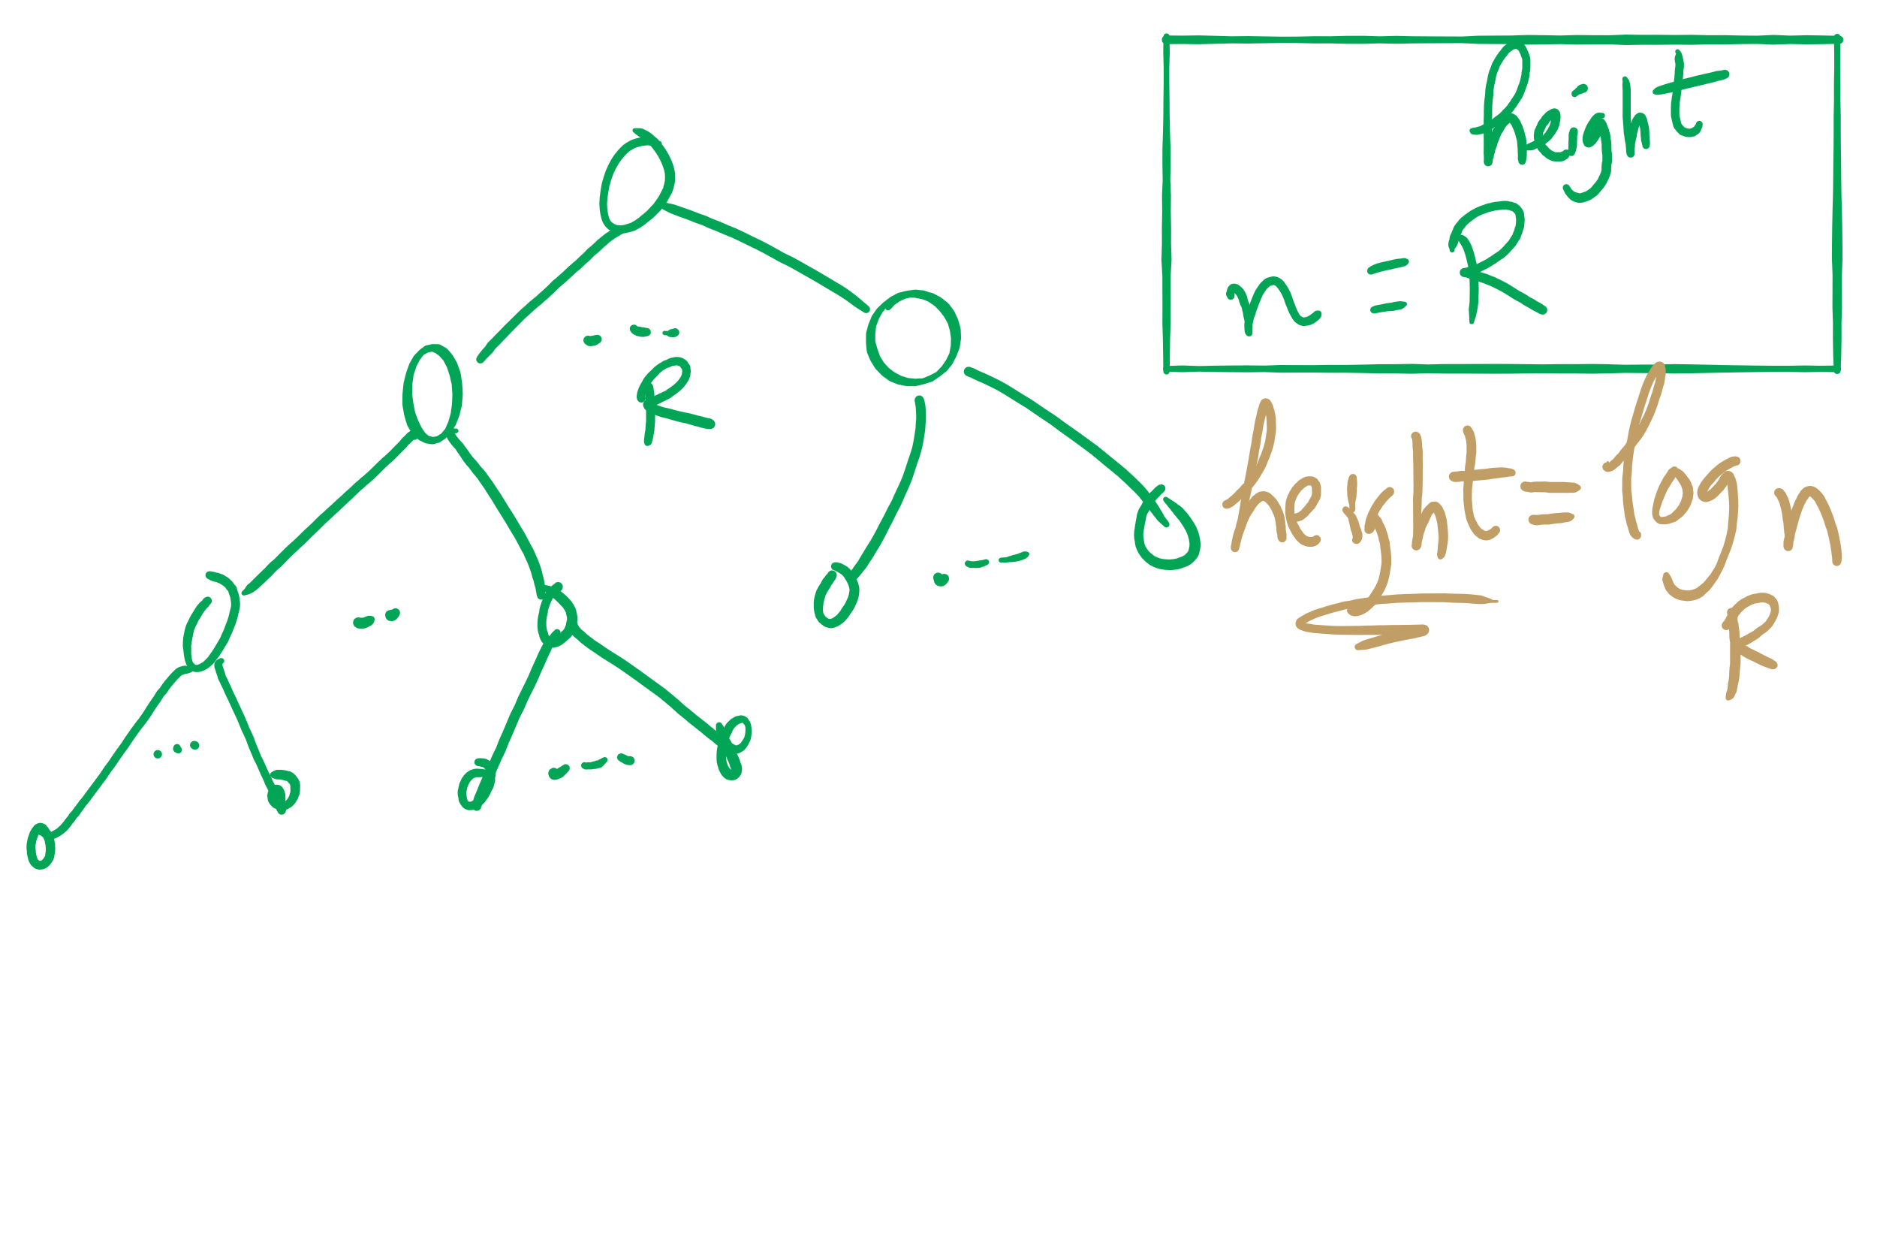
Search Miss

Slide 10
Implementation Concerns
See TrieSt.java
Implements an R-way trie
Basic node object:
private static class Node { private Object val; private Node[] next = new Node[R]; }
Where R is the branching factor
Non-null val means we have traversed to a valid key
Again, note that keys are not directly stored in the trie at all

Slide 11
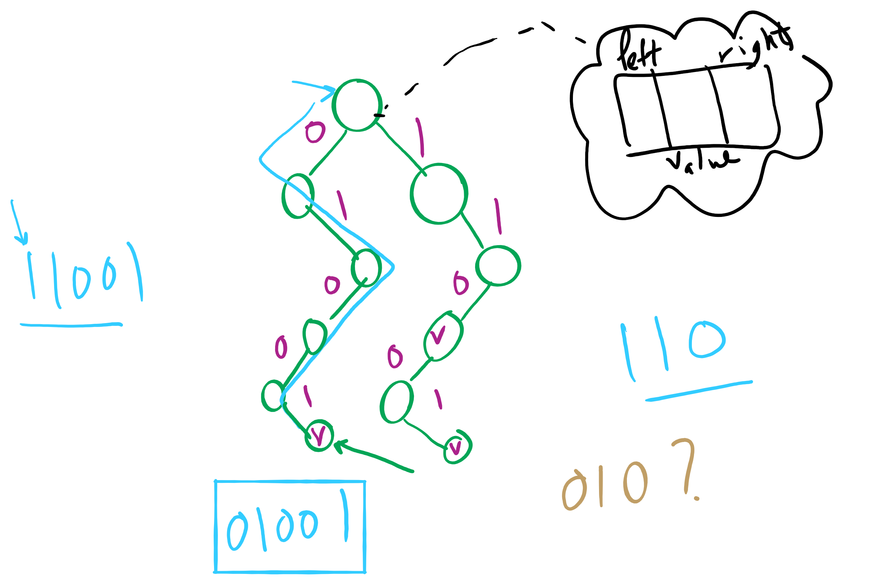
Binary RST

Slide 12
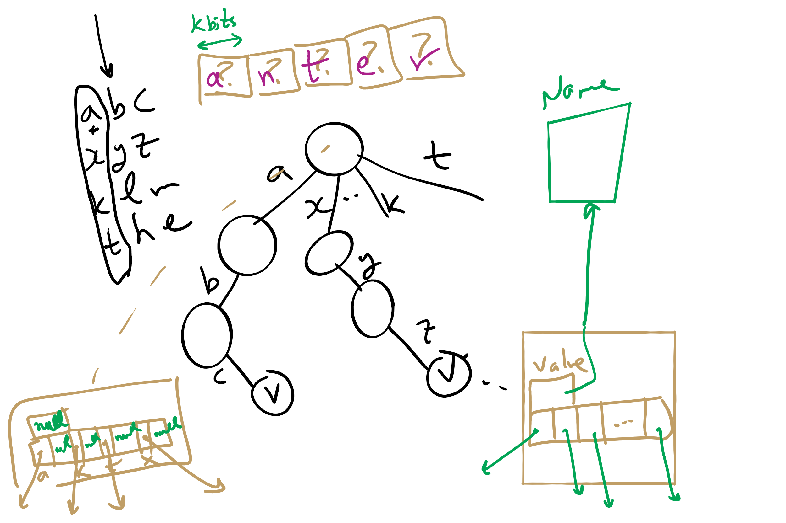
Multi-way RST

Slide 13
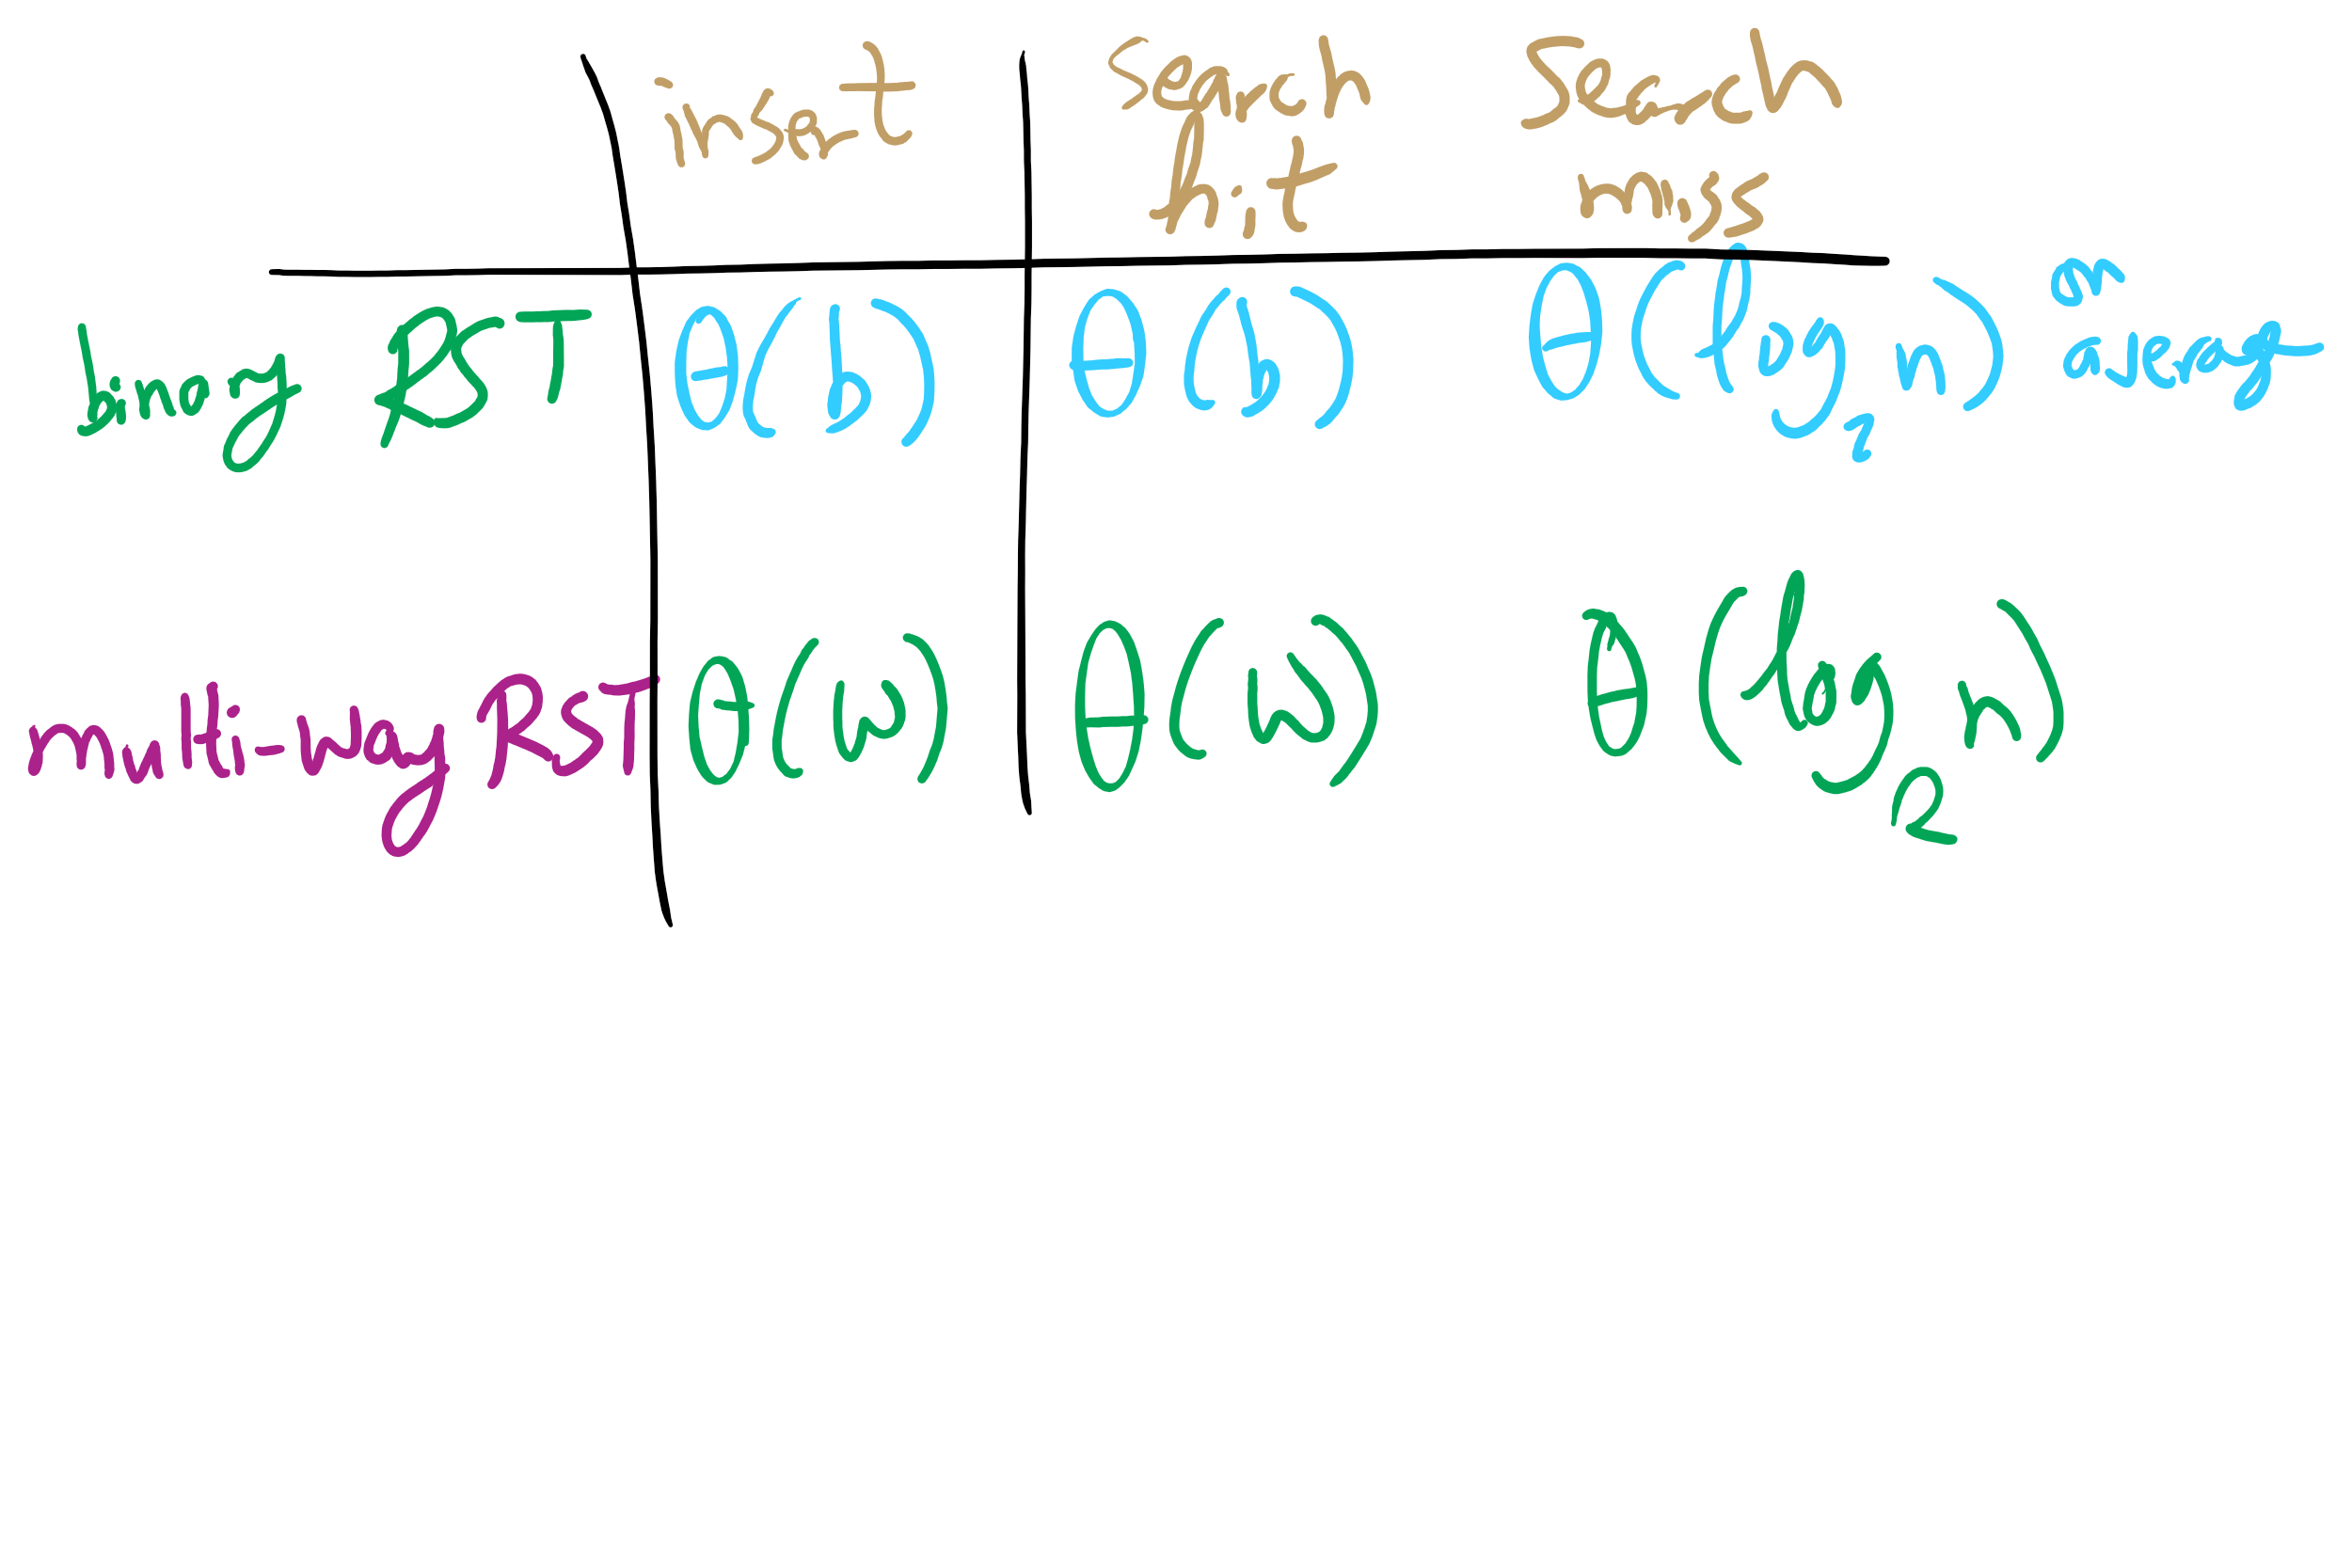
Summary of running time

Slide 14
R-way trie example
Val:
Next
A
B
C
D
E
F
G
H
I
J
K
L
M
N
O
P
Q
R
S
T
U
V
W
X
Y
Z
Val:
Next
A
B
C
D
E
F
G
H
I
J
K
L
M
N
O
P
Q
R
S
T
U
V
W
X
Y
Z
Val:
Next
A
B
C
D
E
F
G
H
I
J
K
L
M
N
O
P
Q
R
S
T
U
V
W
X
Y
Z
Val:
0
Next
A
B
C
D
E
F
G
H
I
J
K
L
M
N
O
P
Q
R
S
T
U
V
W
X
Y
Z
Val:
Next
A
B
C
D
E
F
G
H
I
J
K
L
M
N
O
P
Q
R
S
T
U
V
W
X
Y
Z
Val:
1
Next
A
B
C
D
E
F
G
H
I
J
K
L
M
N
O
P
Q
R
S
T
U
V
W
X
Y
Z

Slide 15
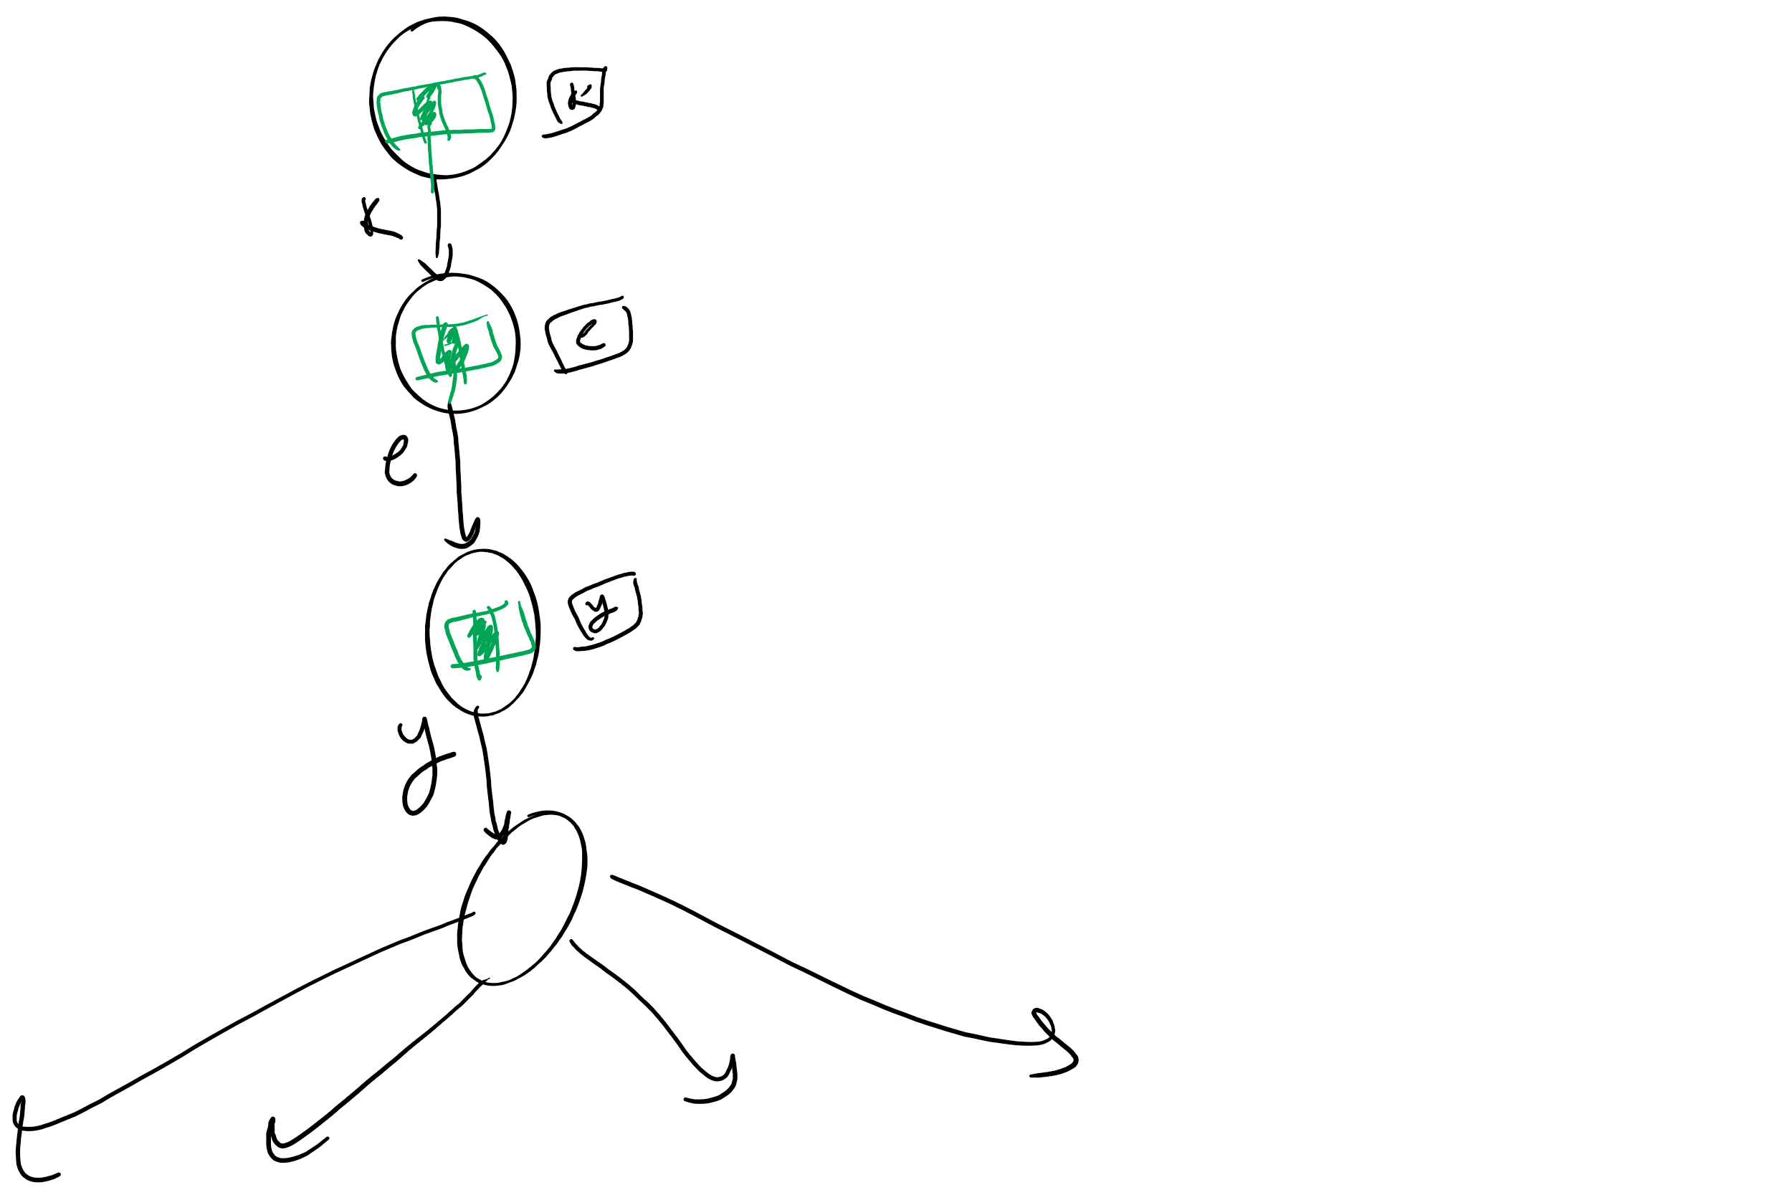
So what’s the catch?
Space!
Considering 8-bit ASCII, each node contains 2⁸ references!
This is especially problematic as in many cases, alot of this space is wasted
Common paths or prefixes for example, e.g., if all keys begin with “key”, thats 255*3 wasted references!
At the lower levels of the trie, most keys have probably been separated out and reference lists will be sparse

Slide 16
De La Briandais tries (DLBs)
Replace the .next array of the R-way trie with a linked-list

Slide 17
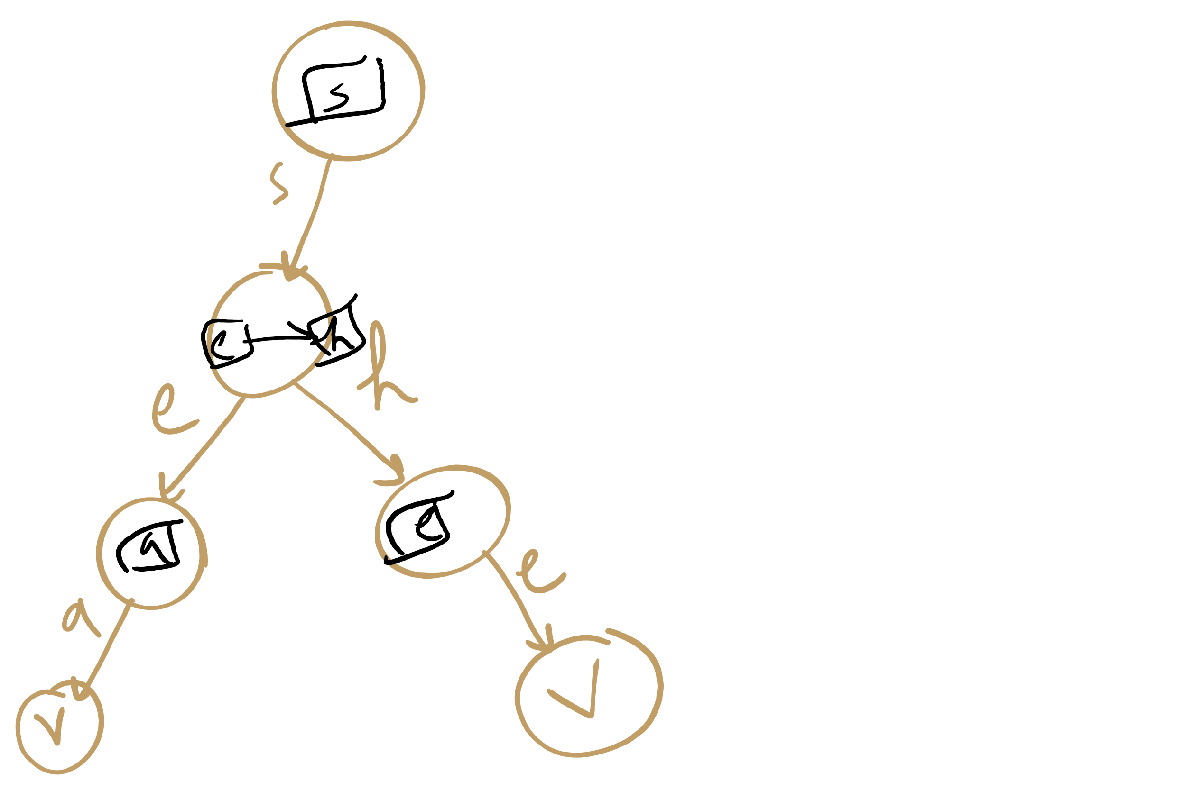
DLB Example

Slide 18
DLB Example 2
S
B
T
H
E
Y
H
E
L
A
^
E
^
L
L
^
^
L
S
S
^
^
Notes:
note here we use explicit termination character vs value check, can do either though

Slide 19
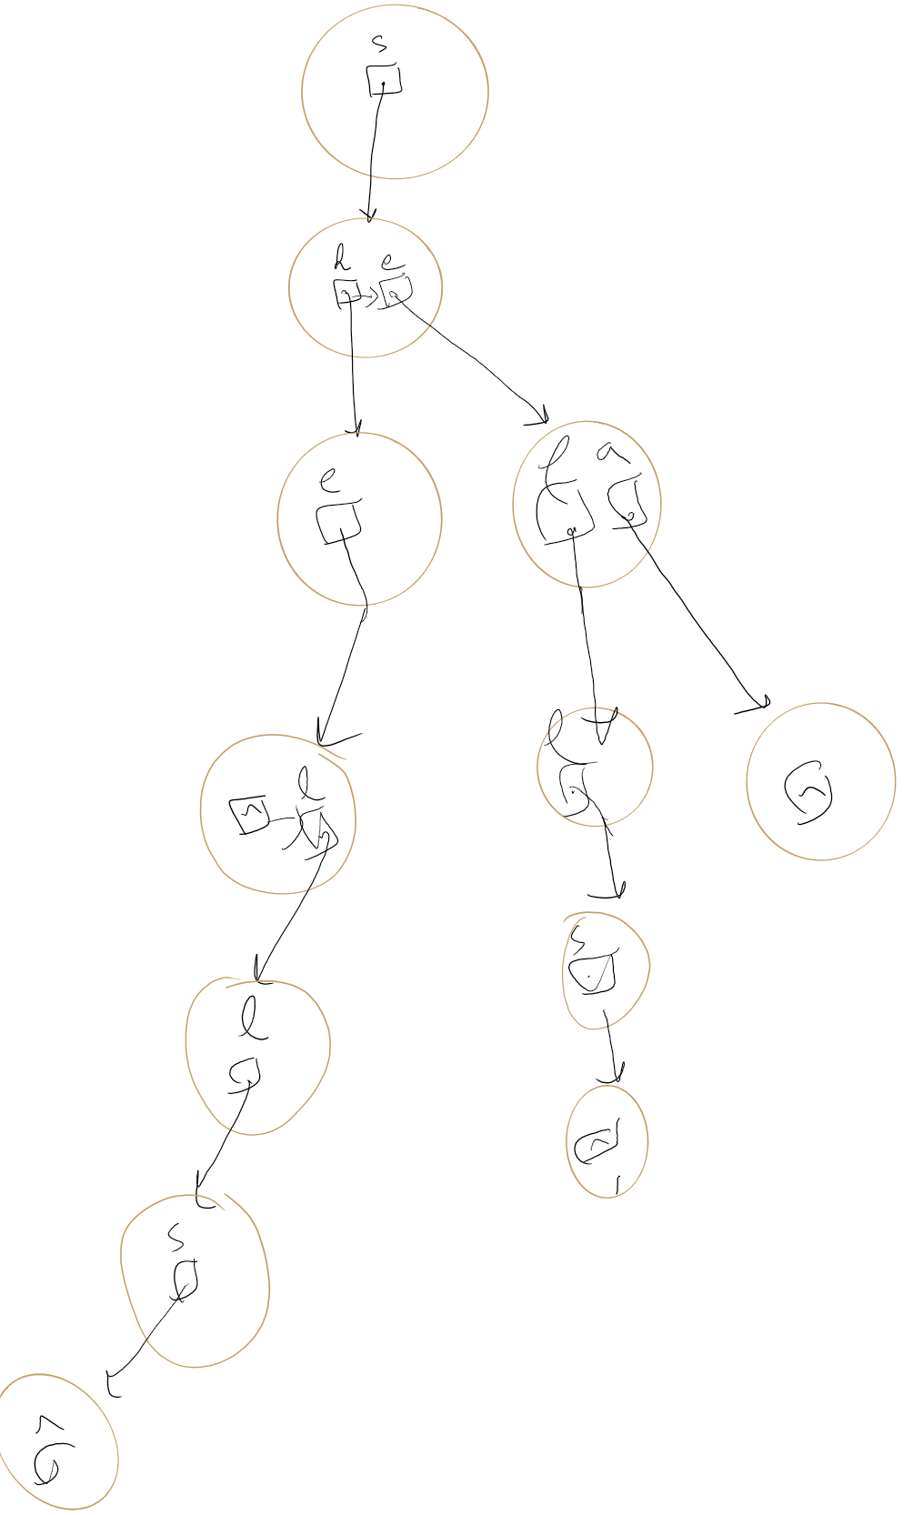
DLB Example 2

Slide 20
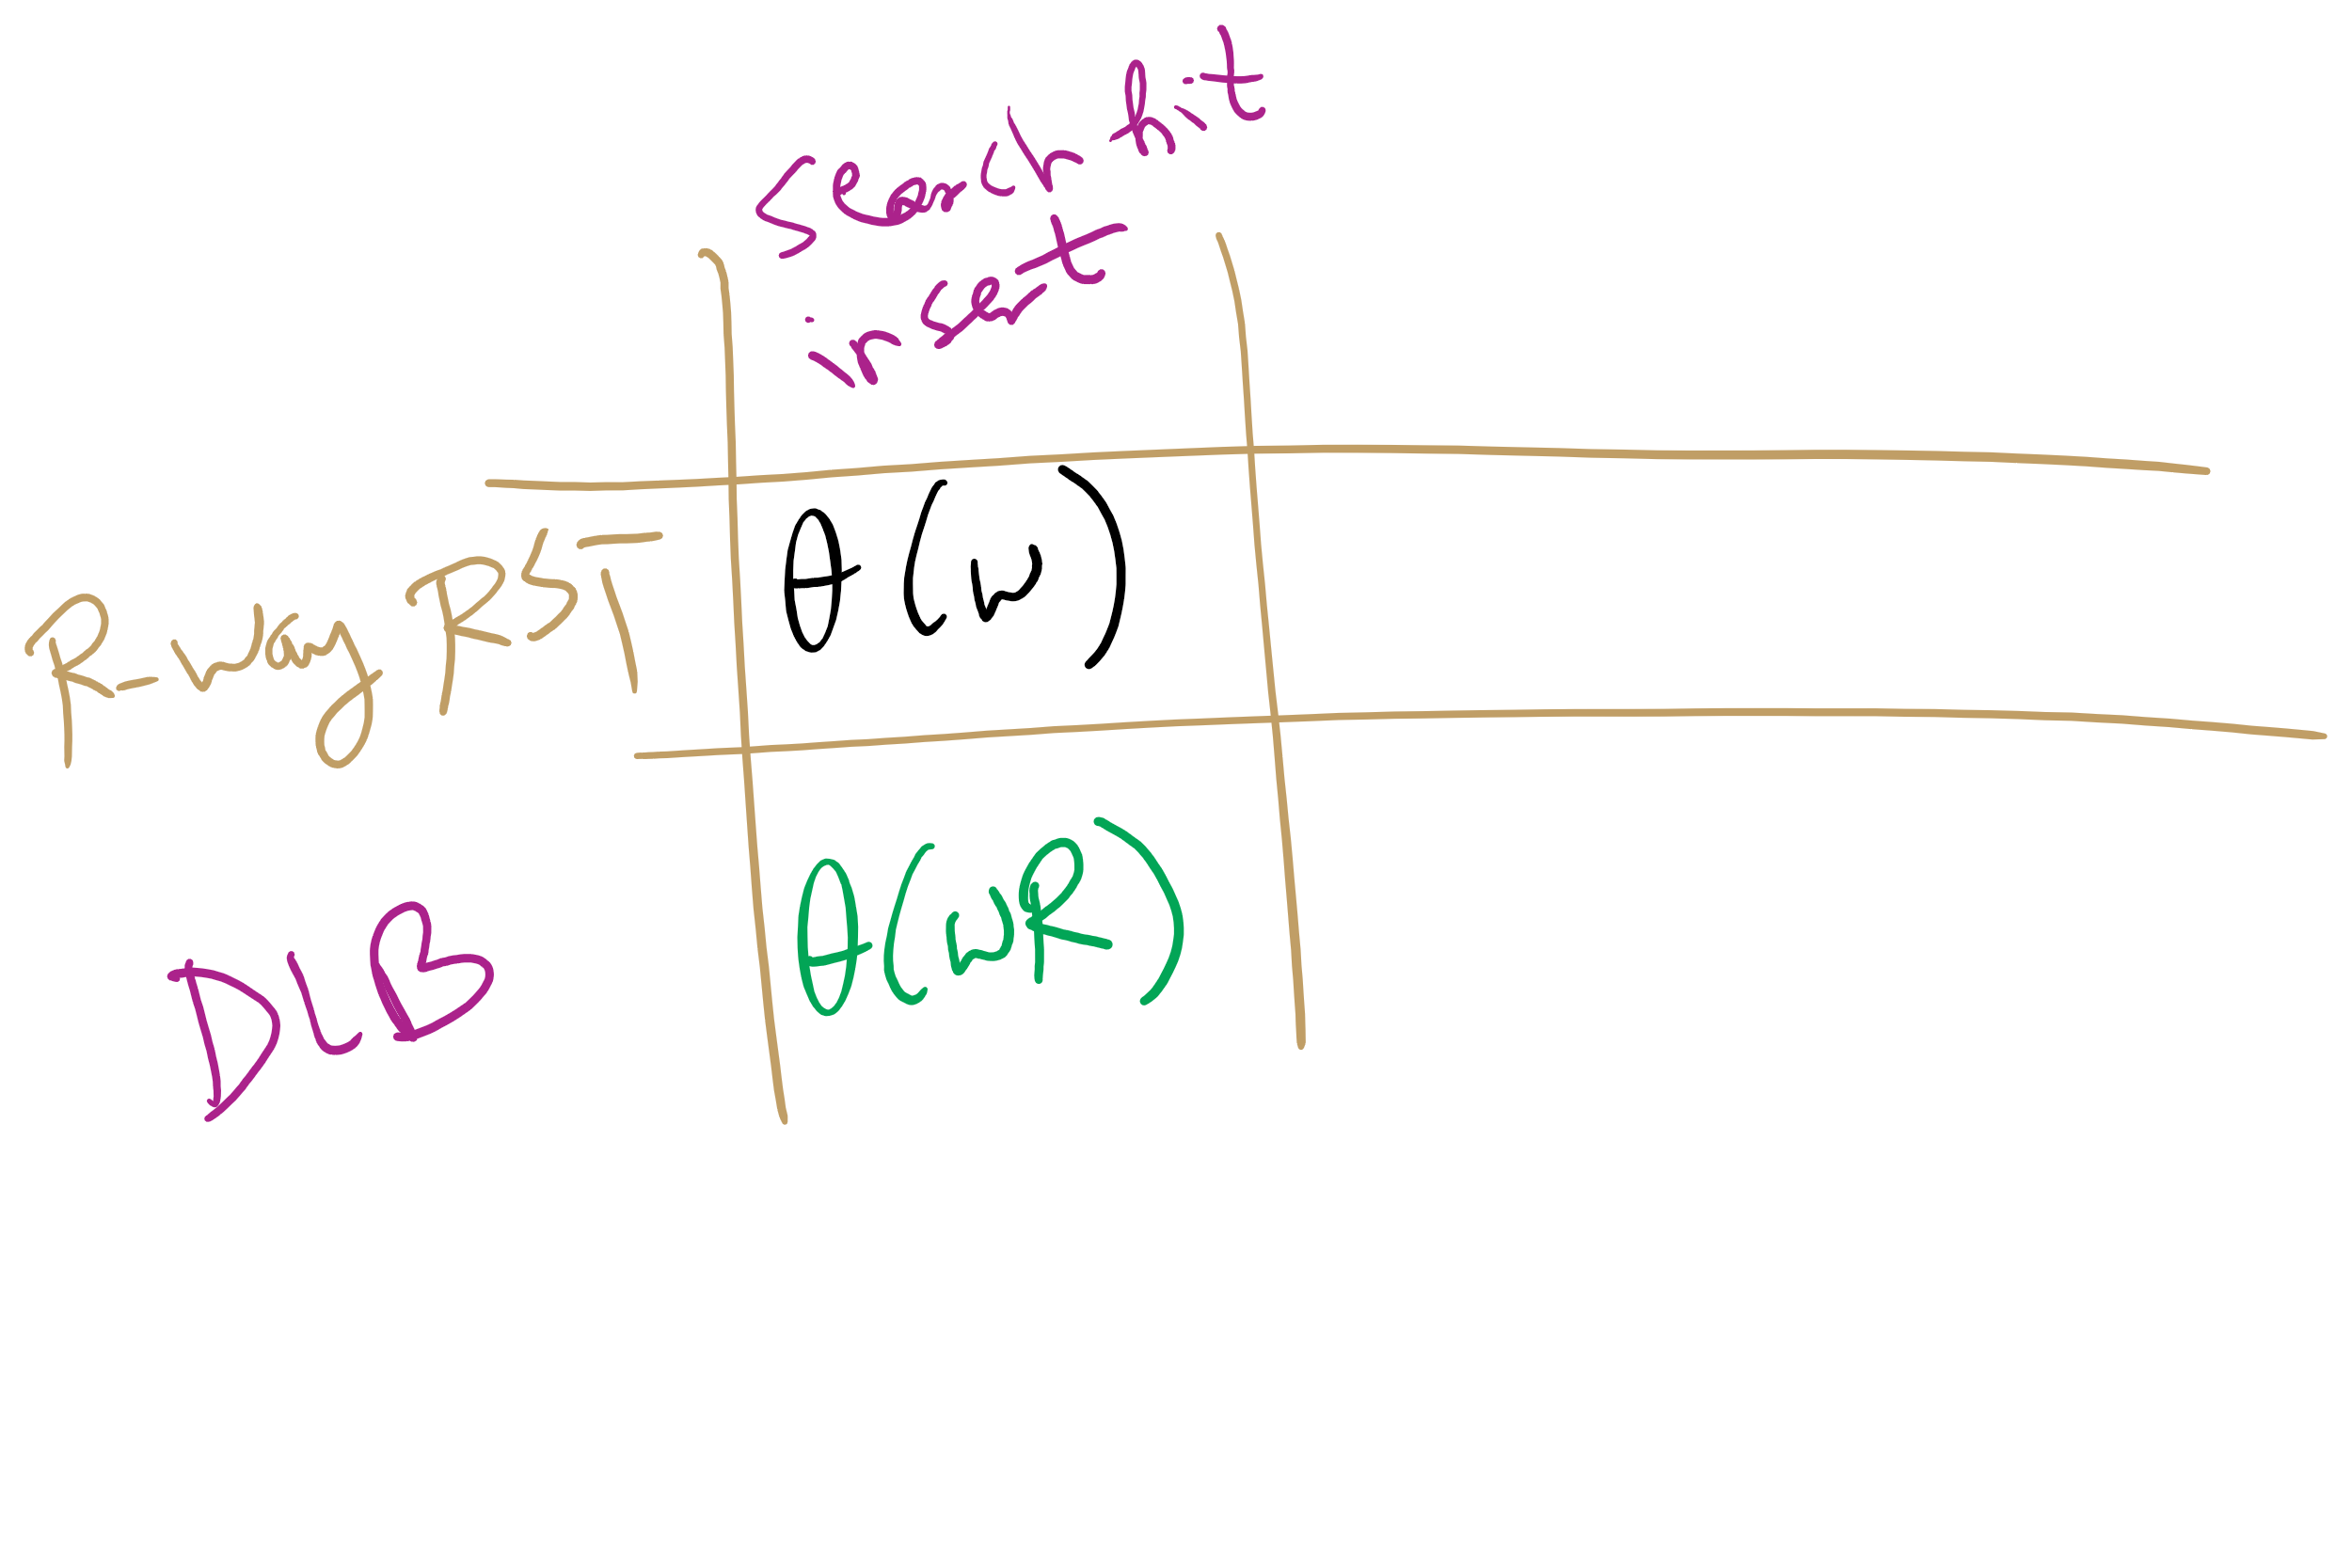
DLB analysis
How does DLB performance differ from R-way tries?
Which should you use?
Notes:
Differences:
No wasted space!
But search/insert are now Θ(wR)
In the worst case, we have to iterate through all R characters in the alphabet for each node
When to use one over another?
For implementations with alot of sparse nodes are expected, use a DLB
Runtime will still be close to Θ(w) for sparse nodes
For dense nodes, stick with R-way tries
If most of the alphabet is a valid reference for most nodes, you won’t get a whole lot of space savings with DLBs

Slide 21
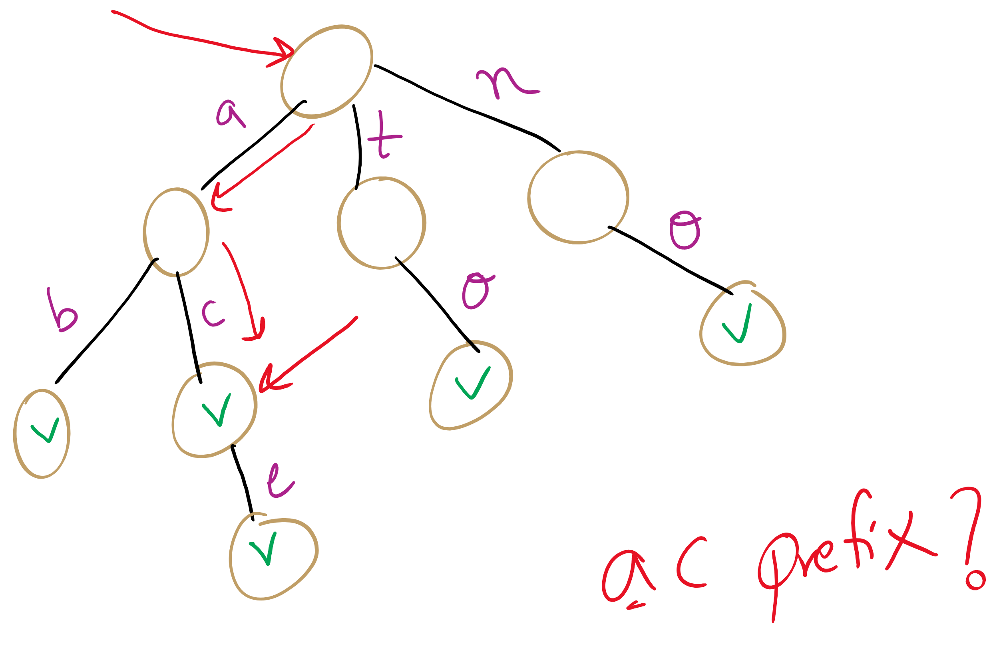
Searching
So far we’ve continually assumed each search would only look for the presence of a whole key
What about if we wanted to know if our search term was a prefix to a valid key?
Notes:
What structures would be amenable to this? Why?
Can implement another function that doesn’t require a non-null val, just a path through the entire key string
Are two functions really needed?
Could write a single function that returns 4 values
Word/prefix not found
Found as a prefix only, not a valid key
Found as a valid key, not a prefix to anything else
Found as a valid key, also a prefix

Slide 22
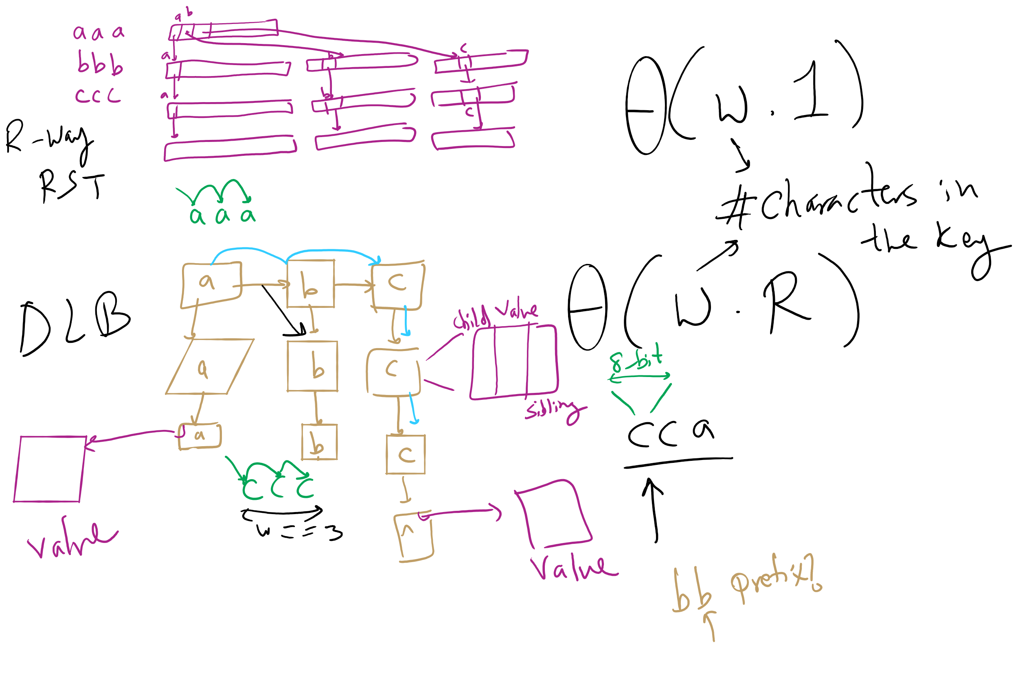
R-way RST vs. DLB

Slide 23
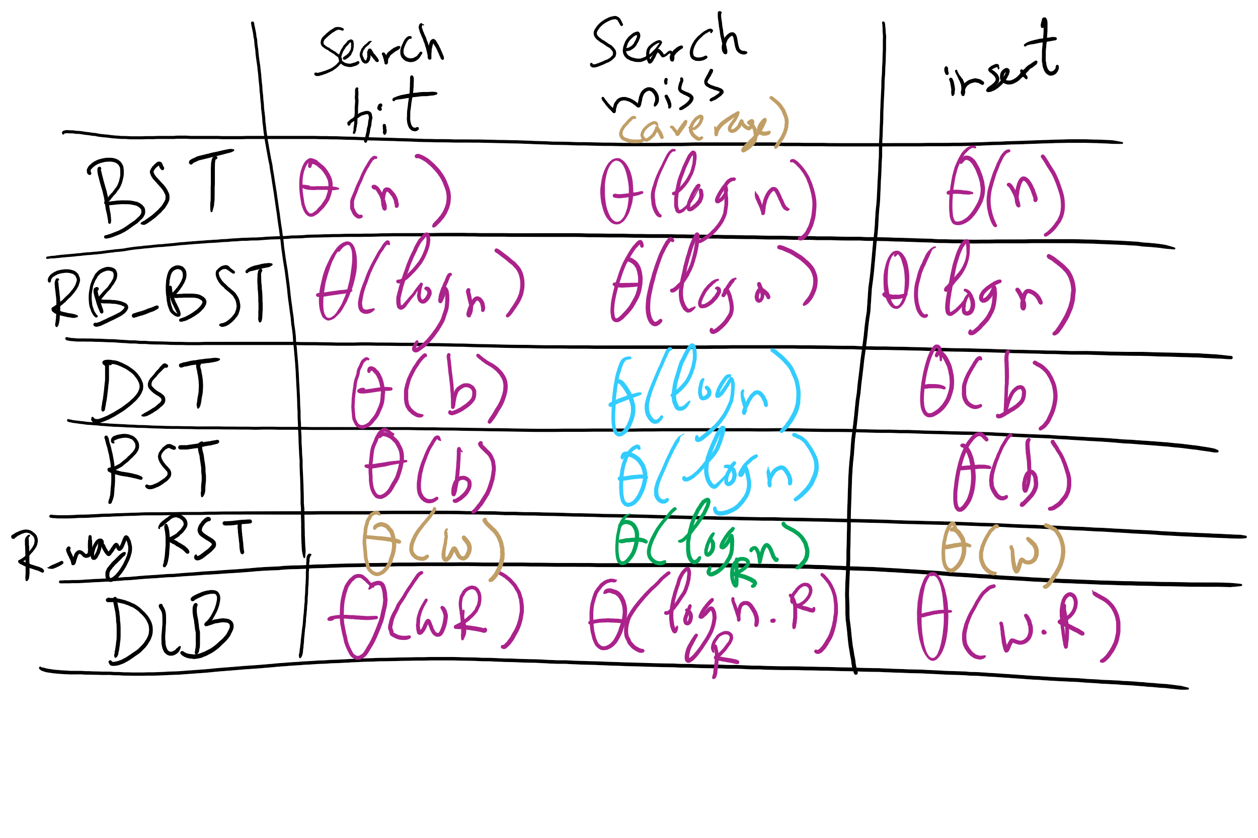
Runtime Comparison for Search Trees

Slide 24
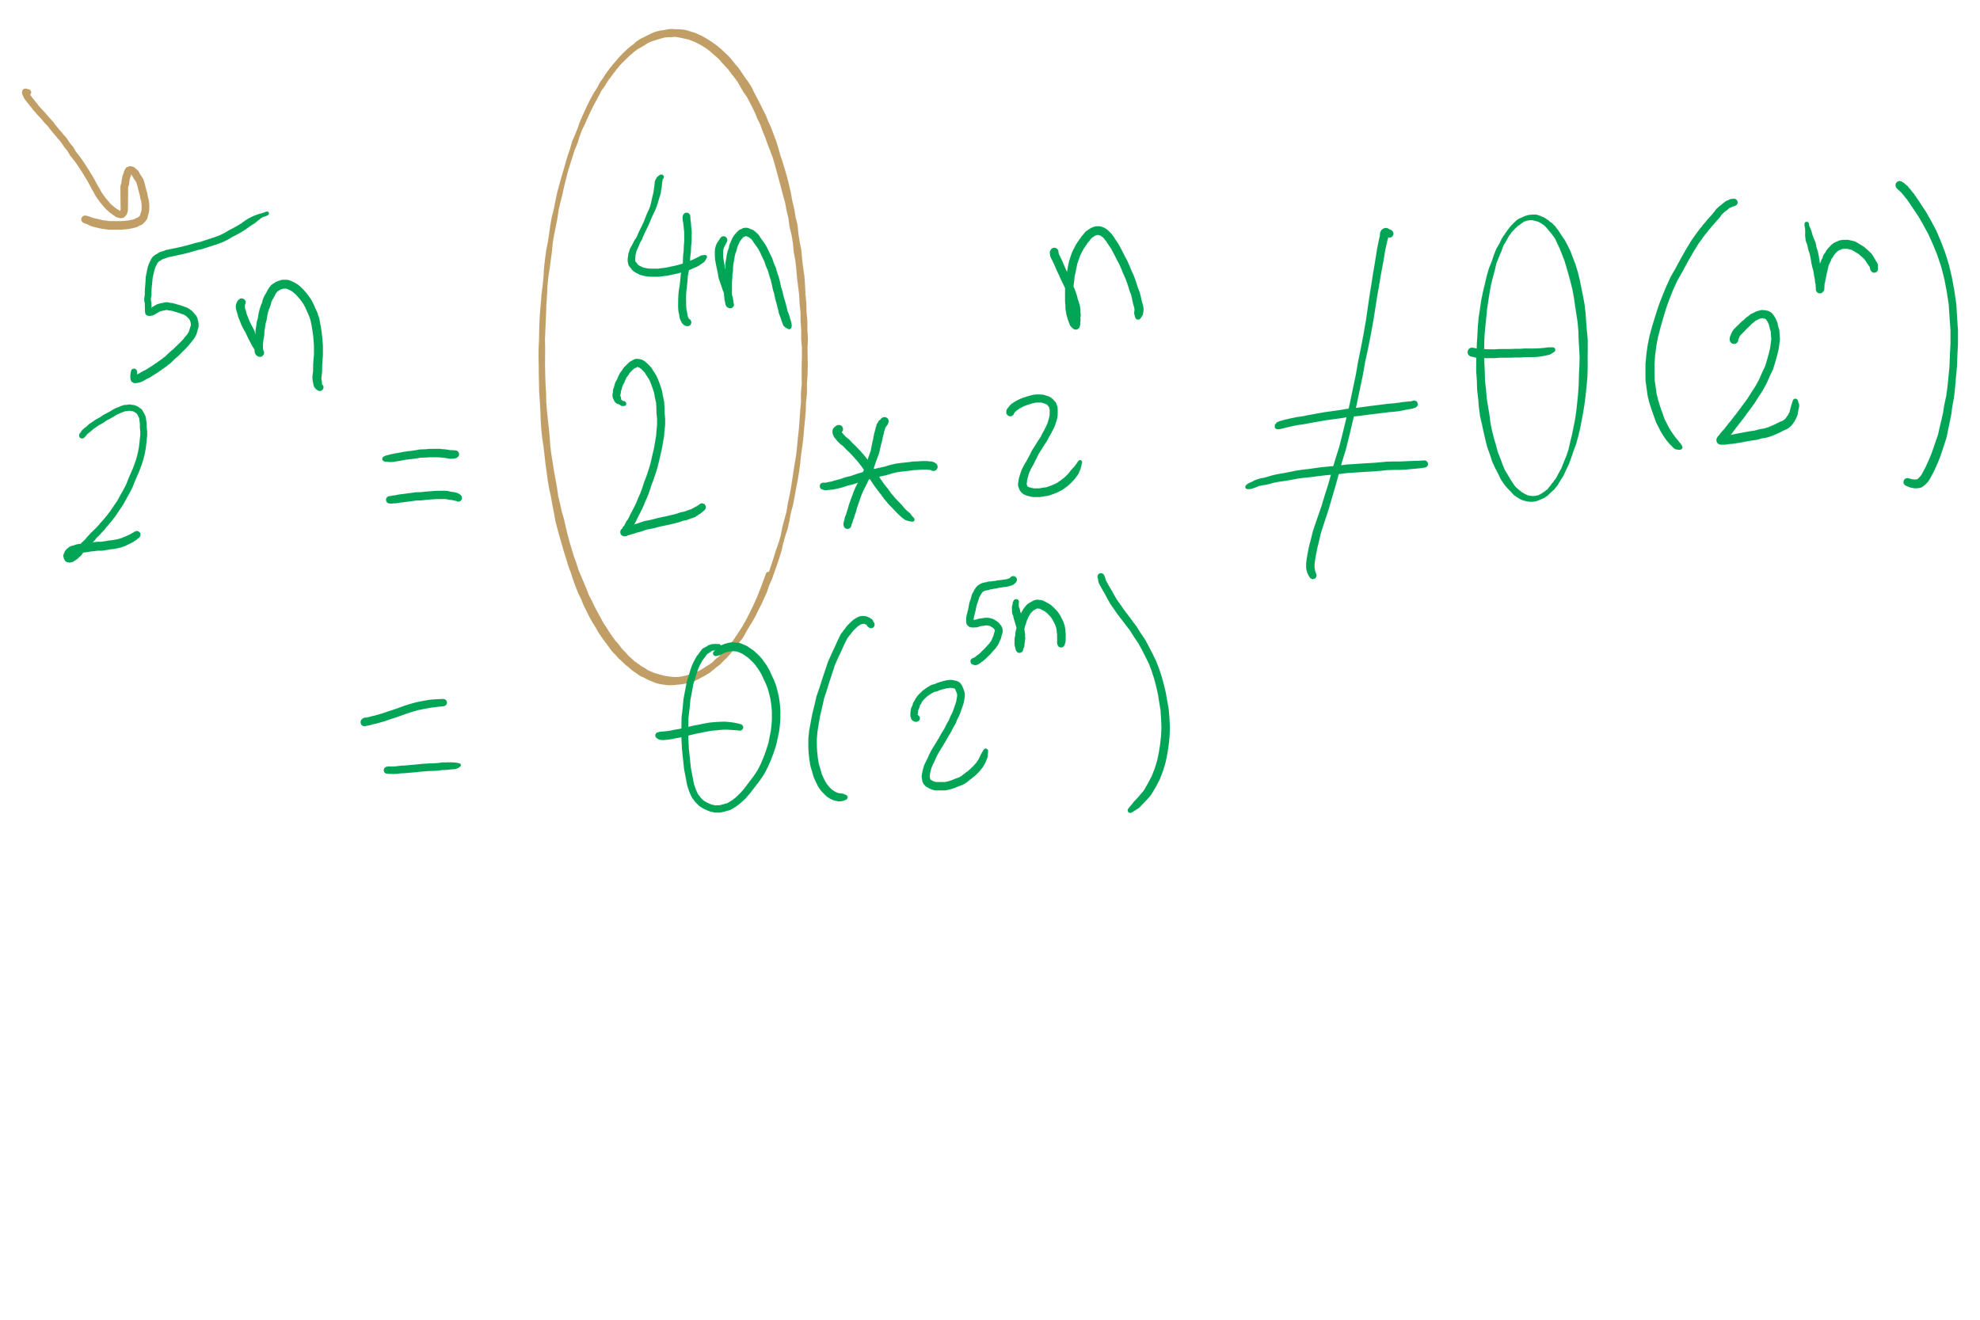
Big O Approximation

Slide 25
Final notes on Search Tree/Tries
We did not present an exhaustive look at search trees/tries, just the sampling that we’re going to focus on
Many variations on these techniques exist and perform quite well in different circumstances
Ternary search Tries
R-way tries without 1-way branching
See the table at the end of Section 5.2 of the text

Slide 26
Please submit your reflections by using the CourseMIRROR App
If you are having a problem with CourseMIRROR, please send an email to coursemirror.development@gmail.com
Notes:
All right!
Upcoming Due Dates at A Glance

