Slide 1

Algorithms and Data Structures 2 CS 1501
Fall 2021
Sherif Khattab
ksm73@pitt.edu
(Slides are adapted from Dr. Ramirez’s and Dr. Farnan’s CS1501 slides.)

Slide 2
Announcements
Upcoming deadlines:
10/25: Assignment 2 (Late penalty waived)
Lab 6 and Homework 7: 10/29

Slide 3
Last Lecture …
Compression
Huffman
Run-length encoding

Slide 4
CourseMIRROR Reflections

Slide 5
Today …
Compression
LZW

Slide 6
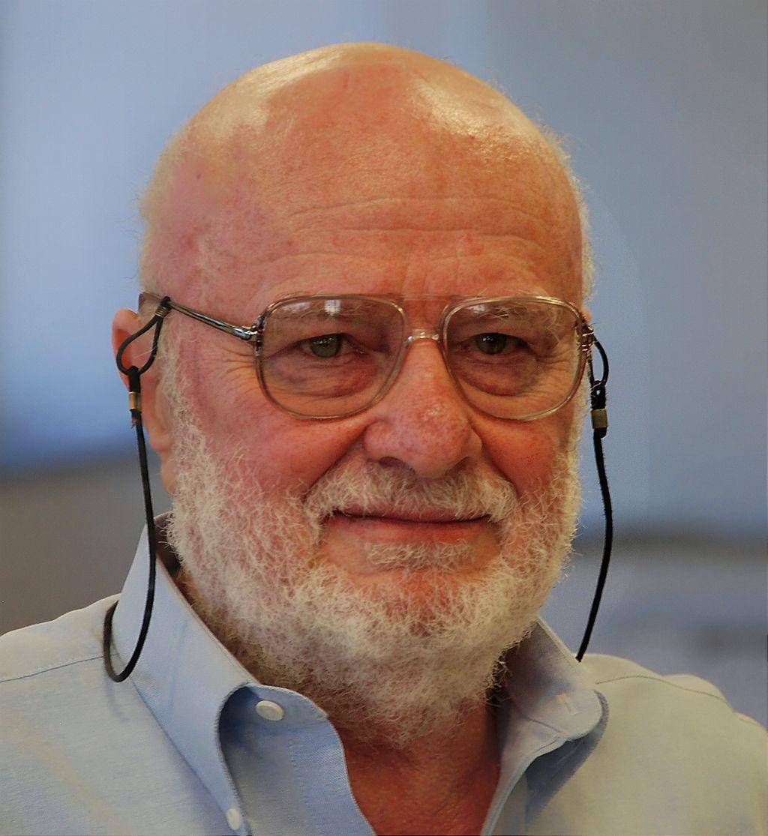
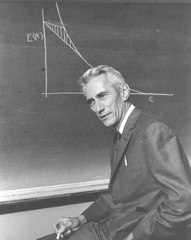
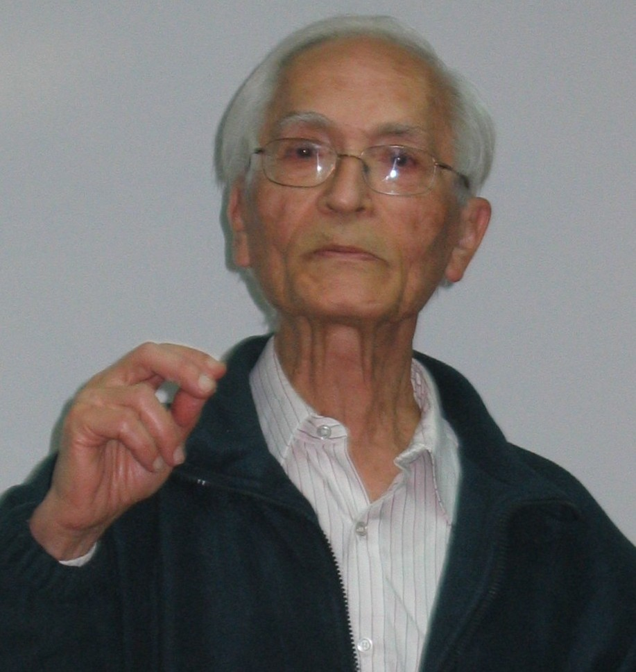
What else can we do to compress files?
Notes:
left to right:
Abraham Lempel, Jacob Ziv, and Claude Shannon

Slide 7
Patterns are compressible, need a general approach
Huffman used variable-length codewords to represent fixed-length portions of the input…
Let’s try another approach that uses fixed-length codewords to represent variable-length portions of the input
Idea: the more characters can be represented in a single codeword, the better the compression
Consider “the”: 24 bits in ASCII
Representing “the” with a single 12 bit codeword cuts the used space in half
Similarly, representing longer strings with a 12 bit codeword would mean even better savings!

Slide 8
How do we know that “the” will be in our file?
Need to avoid the same problems as the use of a static trie for Huffman encoding…
So use an adaptive algorithm and build up our patterns and codewords as we go through the file

Slide 9
LZW compression
Initialize codebook to all single characters
e.g., character maps to its ASCII value
While !EOF:
Match longest prefix in codebook
Output codeword
Take this longest prefix, add the next character in the file, and add the result to the dictionary with a new codeword

Slide 10
LZW compression example
Compress, using 12 bit codewords:
TOBEORNOTTOBEORTOBEORNOT
Cur
Output
Add
T
84
TT:264
T
84
TO:256
TO
256
TOB:265
O
79
OB:257
BE
258
BEO:266
B
66
BE:258
OR
260
ORT:267
E
69
EO:259
TOB
265
TOBE:268
O
79
OR:260
EO
259
EOR:269
R
82
RN:261
RN
261
RNO:270
N
78
NO:262
OT
263
--
O
79
OT:263

Slide 11
LZW expansion
Initialize codebook to all single characters
e.g., ASCII value maps to its character
While !EOF:
Read next codeword from file
Lookup corresponding pattern in the codebook
Output that pattern
Add the previous pattern + the first character of the current pattern to the codebook
Note this means no codebook addition after first pattern output!

Slide 12
LZW expansion example
Cur
Output
Add
84
T
263:OT
84
T
--
256
TO
264:TT
79
O
256:TO
258
BE
265:TOB
66
B
257:OB
260
OR
266:BEO
69
E
258:BE
265
TOB
267:ORT
79
O
259:EO
259
EO
268:TOBE
82
R
260:OR
261
RN
269:EOR
78
N
261:RN
263
OT
270:RNO
79
O
262:NO

Slide 13
How does this work out?
Both compression and expansion construct the same codebook!
Compression stores character string → codeword
Expansion stores codeword → character string
They contain the same pairs in the same order
Hence, the codebook doesn’t need to be stored with the compressed file, saving space

Slide 14
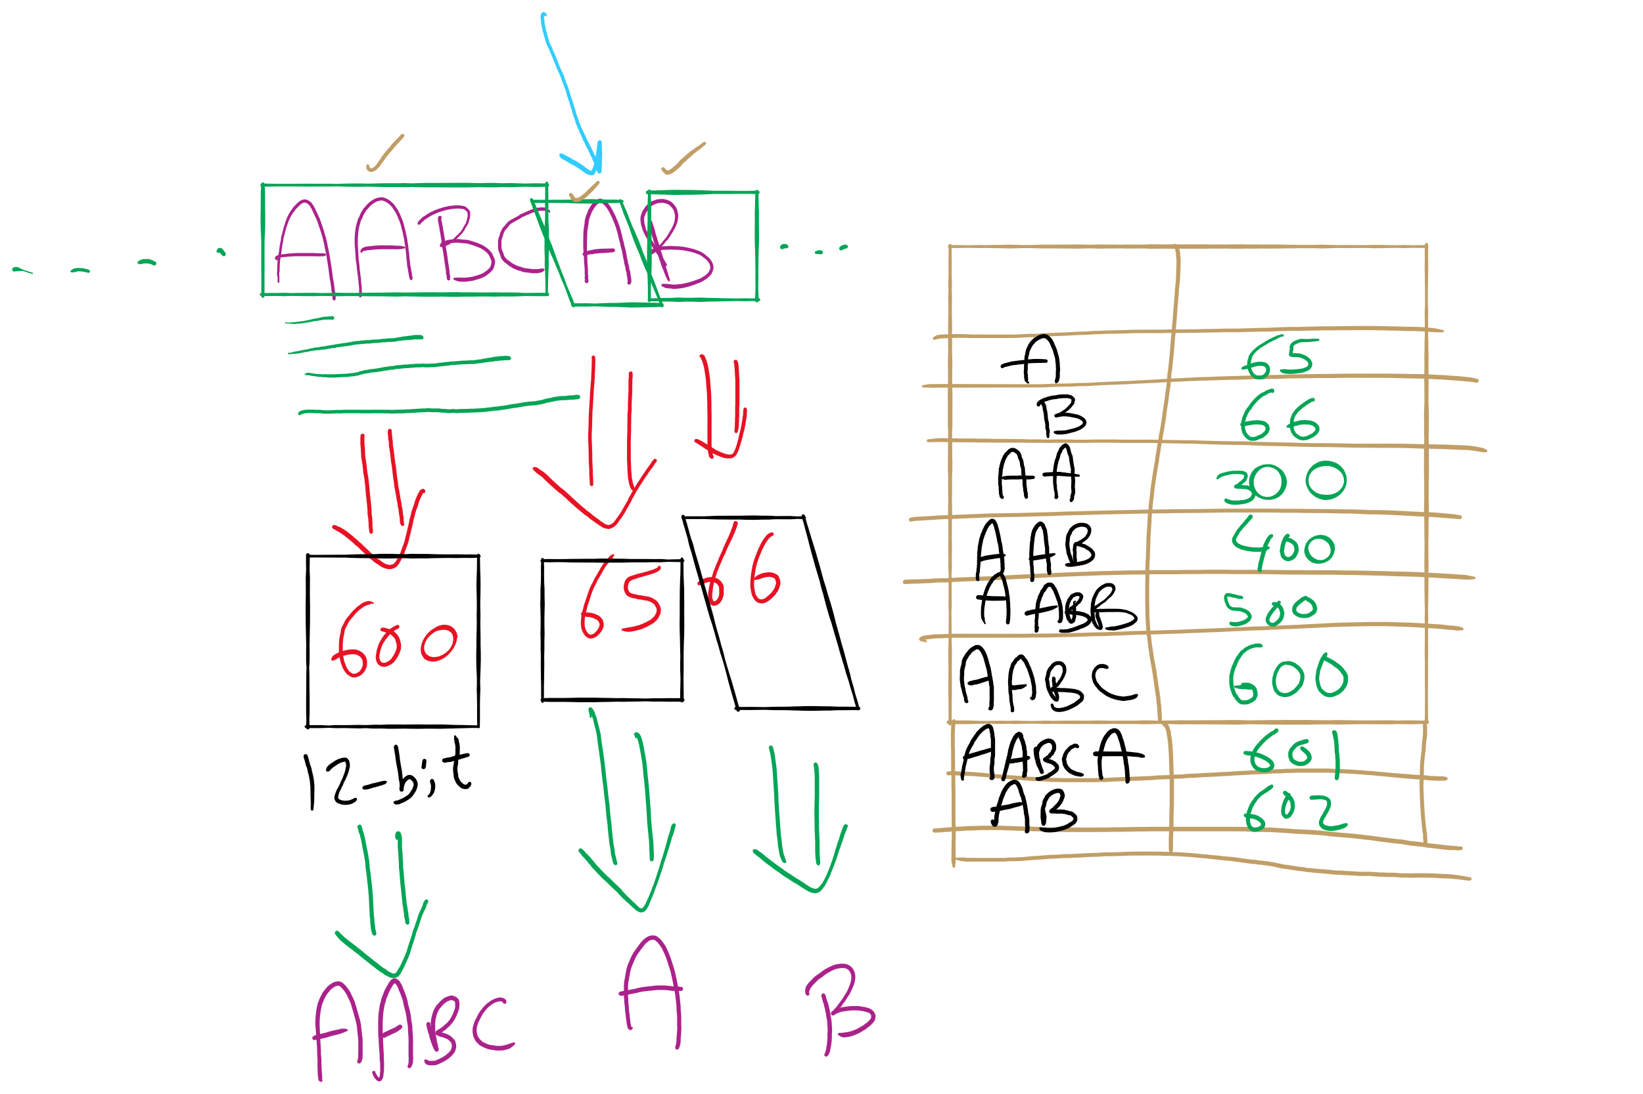
LZW Example

Slide 15
Just one tiny little issue to sort out...
Expansion can sometimes be a step ahead of compression…
If, during compression, the (pattern, codeword) that was just added to the dictionary is immediately used in the next step, the decompression algorithm will not yet know the codeword.
This is easily detected and dealt with, however

Slide 16
LZW corner case example
Compress, using 12 bit codewords: AAAAAA
Cur
Output
Add
A
65
AA:256
AA
256
AAA:257
AAA
257
--
Expansion:
Cur
Output
Add
65
A
--
256
AA
256:AA
257
AAA
257:AAA
Notes:
If a codeword is encountered that is not in the codebook, it must be:
prev_pattern + prev_pattern[0]

Slide 17
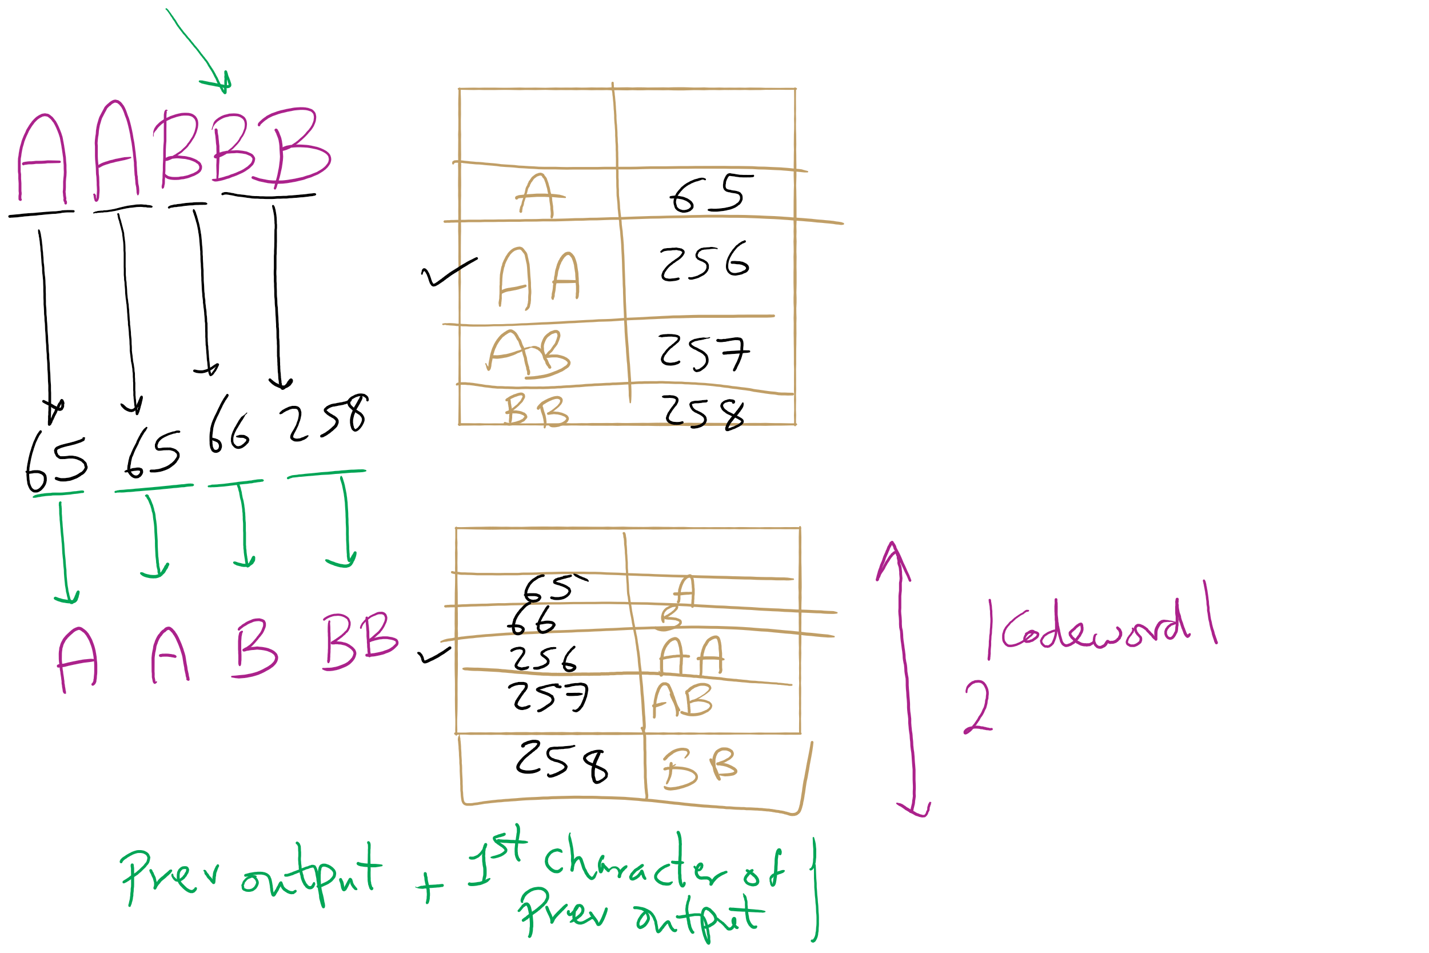
LZW Corner Case

Slide 18
Please submit your reflections by using the CourseMIRROR App
If you are having a problem with CourseMIRROR, please send an email to coursemirror.development@gmail.com
Notes:
All right!
Upcoming Due Dates at A Glance

