Slide 1

Algorithms and Data Structures 2 CS 1501
Fall 2021
Sherif Khattab
ksm73@pitt.edu
(Slides are adapted from Dr. Ramirez’s and Dr. Farnan’s CS1501 slides.)

Slide 2
Announcements
Upcoming deadlines:
10/25: Assignment 2 (Late penalty waived)
10/29: Lab 6 and Homework 7
11/15: Assignment 3

Slide 3
Previous Lecture …
LZW

Slide 4
Today…
LZW
Implementation issues
Shannon Entropy
Graph
definitions
representation

Slide 5
LZW implementation concerns: codebook
How to represent/store during:
Compression
Expansion
Considerations:
What operations are needed?
How many of these operations are going to be performed?
Discuss
Notes:
ENCODE: Two most likely candidates:
Trie or Hash Table
Both allow lookups in time proportional to string length, independent of the number of strings
Since the new keys are all prefixes already in the tree, and plus one additional character, and since we are searching for prefixes
The Trie would be a great choice
However, memory issues would make us prefer the DLB
Text LZW.java uses a ternary search trie (TST).
DECODE:
Now codewords are the key values, and the strings are returned
We can simply use the codeword values to index an array of strings
Gives us constant time lookup of the codewords
See LZW.java

Slide 6
Further implementation issues: codeword size
How long should codewords be?
Use fewer bits:
Gives better compression earlier on
But, leaves fewer codewords available, which will hamper compression later on
Use more bits:
Delays actual compression until longer patterns are found due to large codeword size
More codewords available means that greater compression gains can be made later on in the process

Slide 7
Variable width codewords
This sounds eerily like variable length codewords…
Exactly what we set out to avoid!
Here, we’re talking about a different technique
Example:
Start out using 9 bit codewords
When codeword 512 is inserted into the codebook, switch to outputting/grabbing 10 bit codewords
When codeword 1024 is inserted into the codebook, switch to outputting/grabbing 11 bit codewords…
Etc.

Slide 8
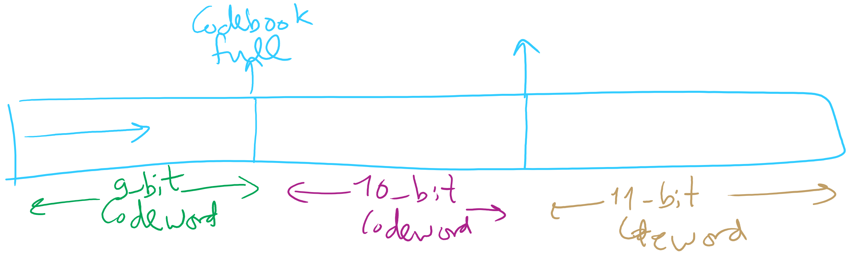
Adaptive Codeword Size

Slide 9
Even further implementation issues: codebook size
What happens when we run out of codewords?
Only 2^{n} possible codewords for n bit codes
Even using variable width codewords, they can’t grow arbitrarily large…
Two primary options:
Stop adding new keywords, use the codebook as it stands
Maintains long already established patterns
But if the file changes, it will not be compressed as effectively
Throw out the codebook and start over from single characters
Allows new patterns to be compressed
Until new patterns are built up, though, compression will be minimal

Slide 10
The showdown you’ve all been waiting for...
HUFFMAN vs LZW
In general, LZW will give better compression
Also better for compression archived directories of files
Why?
Very long patterns can be built up, leading to better compression
Different files don’t “hurt” each other as they did in Huffman
Remember our thoughts on using static tries?

Slide 11
So lossless compression apps use LZW?
Well, gifs can use it
And pdfs
Most dedicated compression applications use other algorithms:
DEFLATE (combination of LZ77 and Huffman)
Used by PKZIP and gzip
Burrows-Wheeler transforms
Used by bzip2
LZMA
Used by 7-zip
brotli
Introduced by Google in Sept. 2015
Based around a " … combination of a modern variant of the LZ77 algorithm, Huffman coding[,] and 2nd order context modeling … "
Notes:
also: lz4, lzham, bitknit as a close competitor to brotli

Slide 12
DEFLATE et al achieve even better general compression?
How much can they compress a file?
Better question:
How much can a file be compressed by any algorithm?
No algorithm can compress every bitstream
Assume we have such an algorithm
We can use to compress its own output!
And we could keep compressing its output until our compressed file is 0 bits!
Clearly this can’t work
Proofs in Proposition S of Section 5.5 of the text

Slide 13
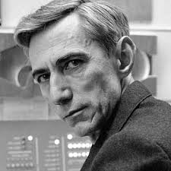
Can we reason about how much a file can be compressed?
Yes! Using Shannon Entropy
Notes:
brief bio:
1937 MIT masters thesis showed electromechanical telephone switching relays could be used to solve boolean algebra
foundation of digital circuit design
1940 PhD from MIT, became a researcher at Institute for Advanced Study in Princeton
WWII moved to Bell Labs to work on fire-control systems and crypto
Proved security of one-time pad ciphers here
1948 A Mathematical Theory of Communication
Developed High-Low blackjack card counting method with Ed Thorp
Credited with creating the first wearable computer to help calculate roulette odds
Shannon's Maxim is counterpoint of security through obscurity

Slide 14
Information theory in a single slide...
Founded by Claude Shannon in his paper “A Mathematical Theory of Communication”
Entropy is a key measure in information theory
Slightly different from thermodynamic entropy
A measure of the unpredictability of information content
By losslessly compressing data, we represent the same information in less space
Hence, 8 bits of uncompressed text has less entropy than 8 bits of compressed data
Notes:
1948

Slide 15
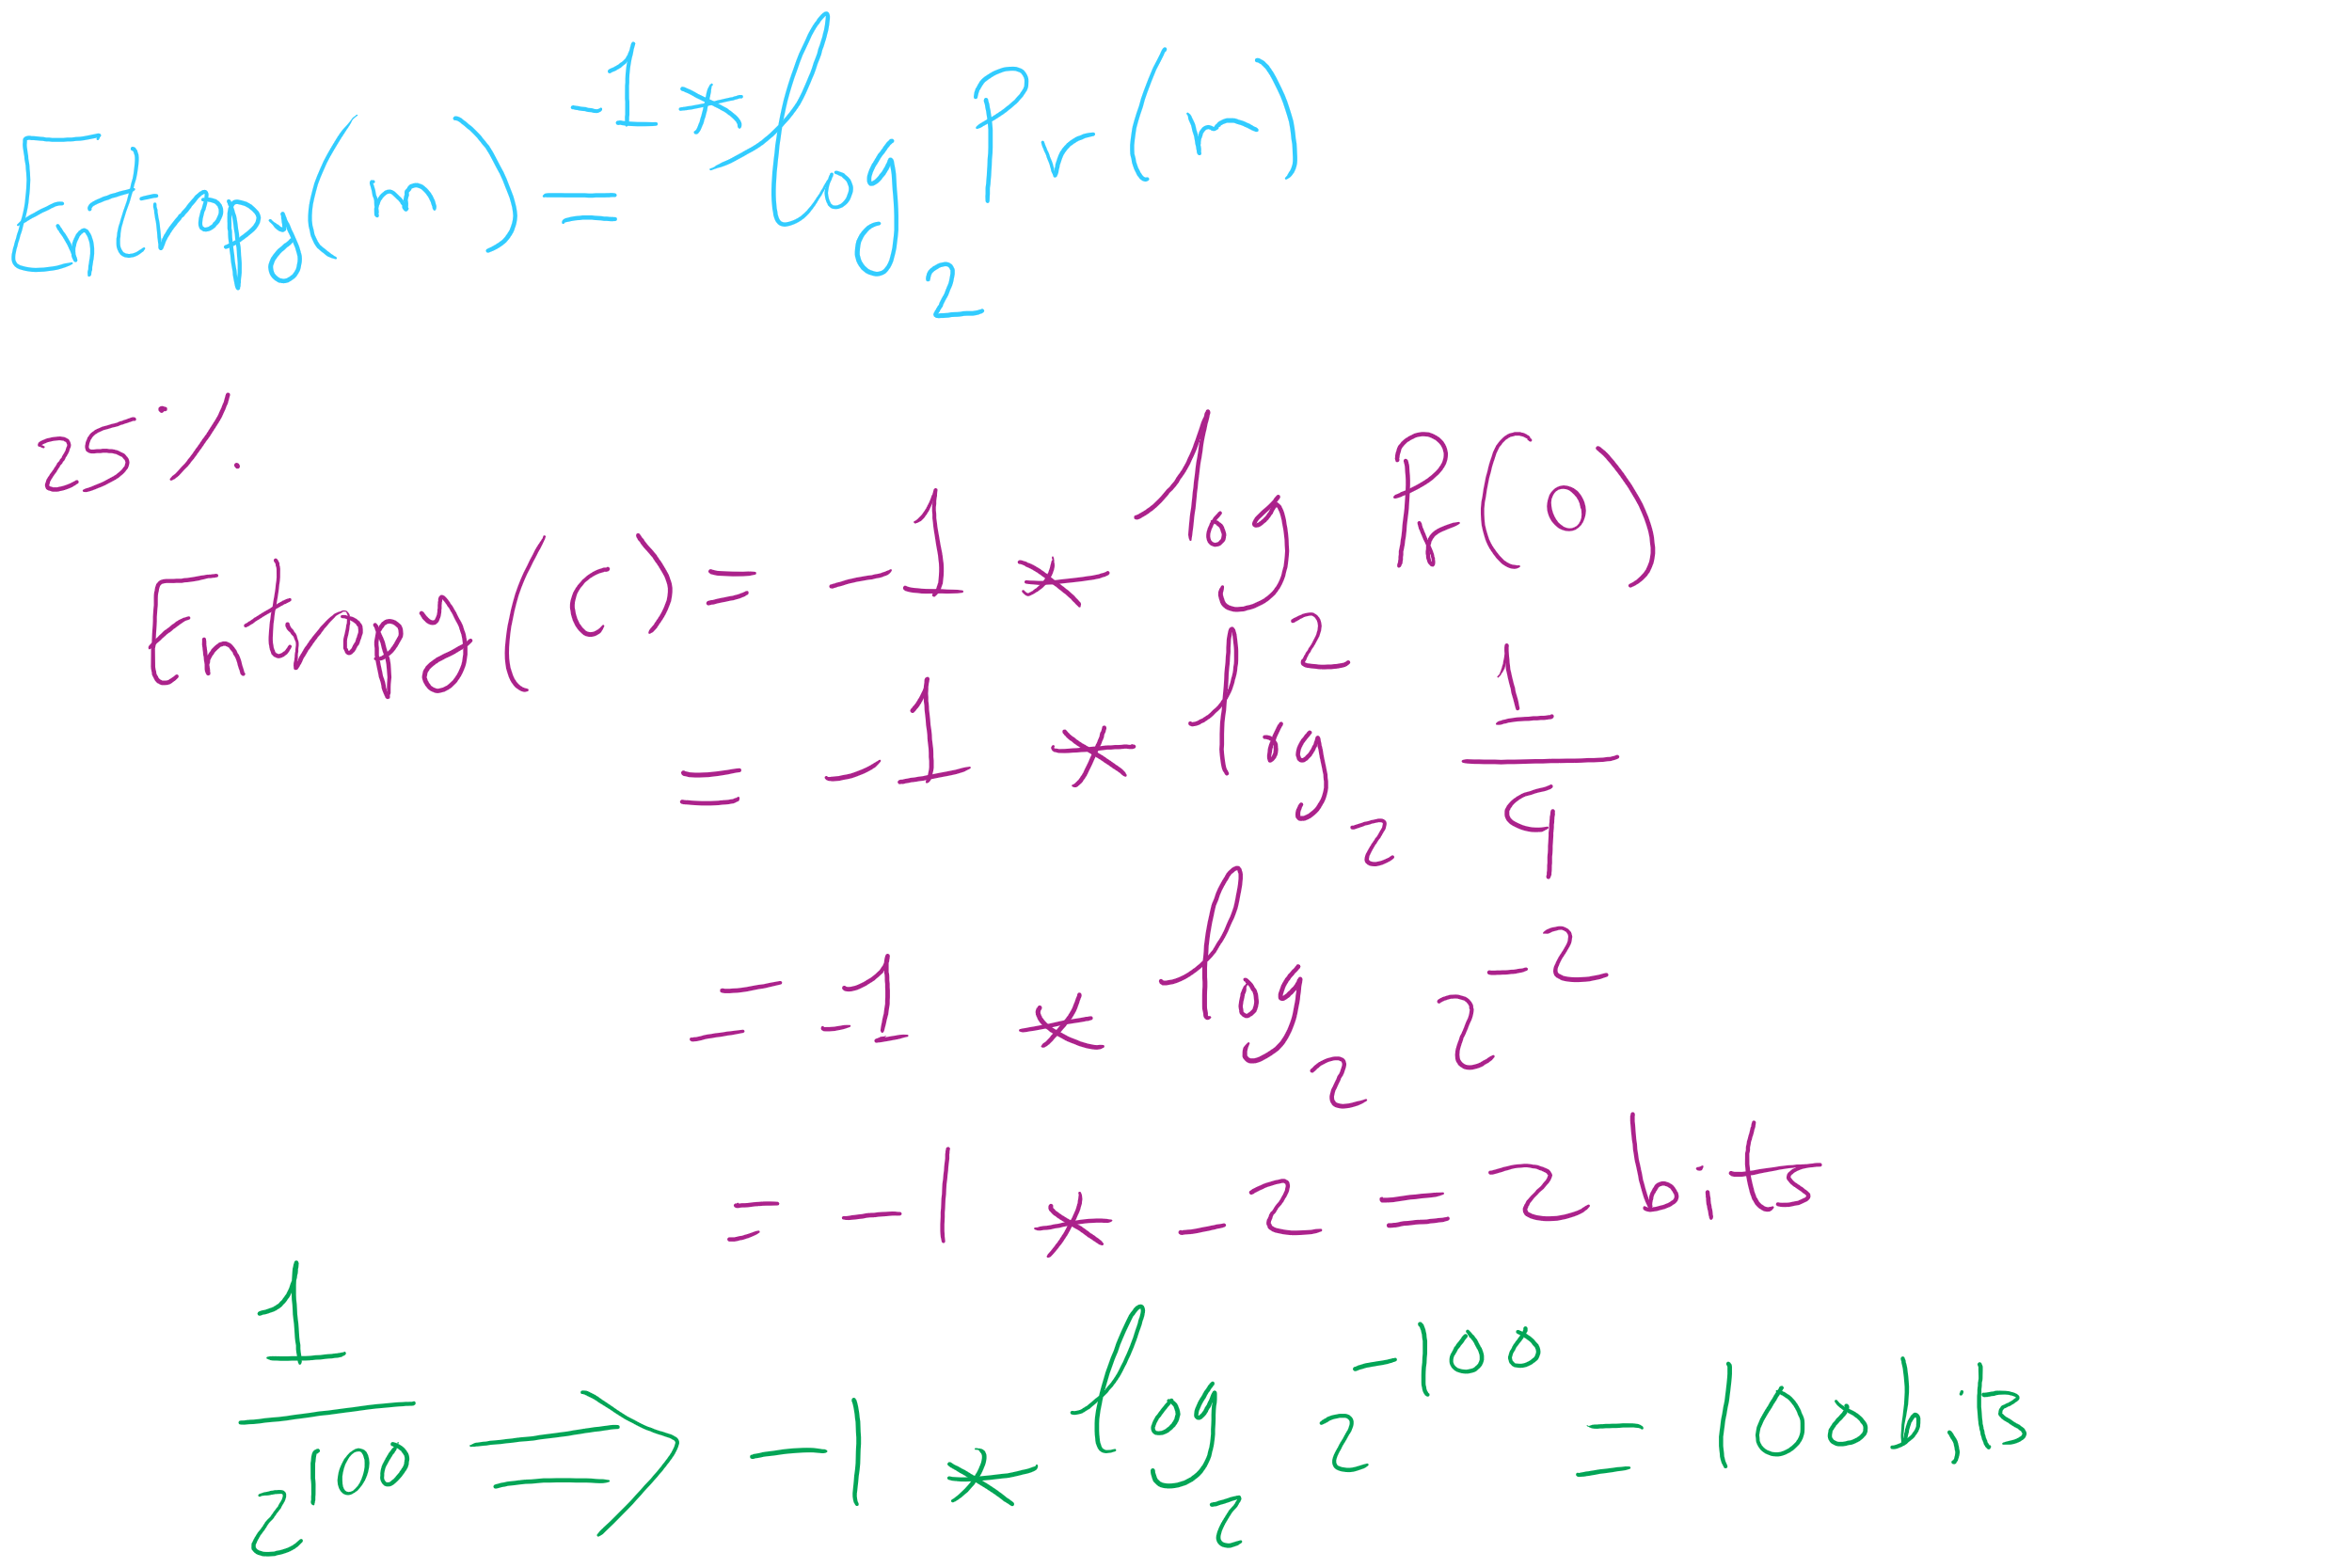
Entropy Equation

Slide 16
Entropy applied to language:
Translating a language into binary, the entropy is the average number of bits required to store a letter of the language
Entropy of a message * length of message = amount of information contained in that message
On average, a lossless compression scheme cannot compress a message to have more than 1 bit of information per bit of compressed message
Uncompressed, English has between 0.6 and 1.3 bits of entropy per character of the message

Slide 17
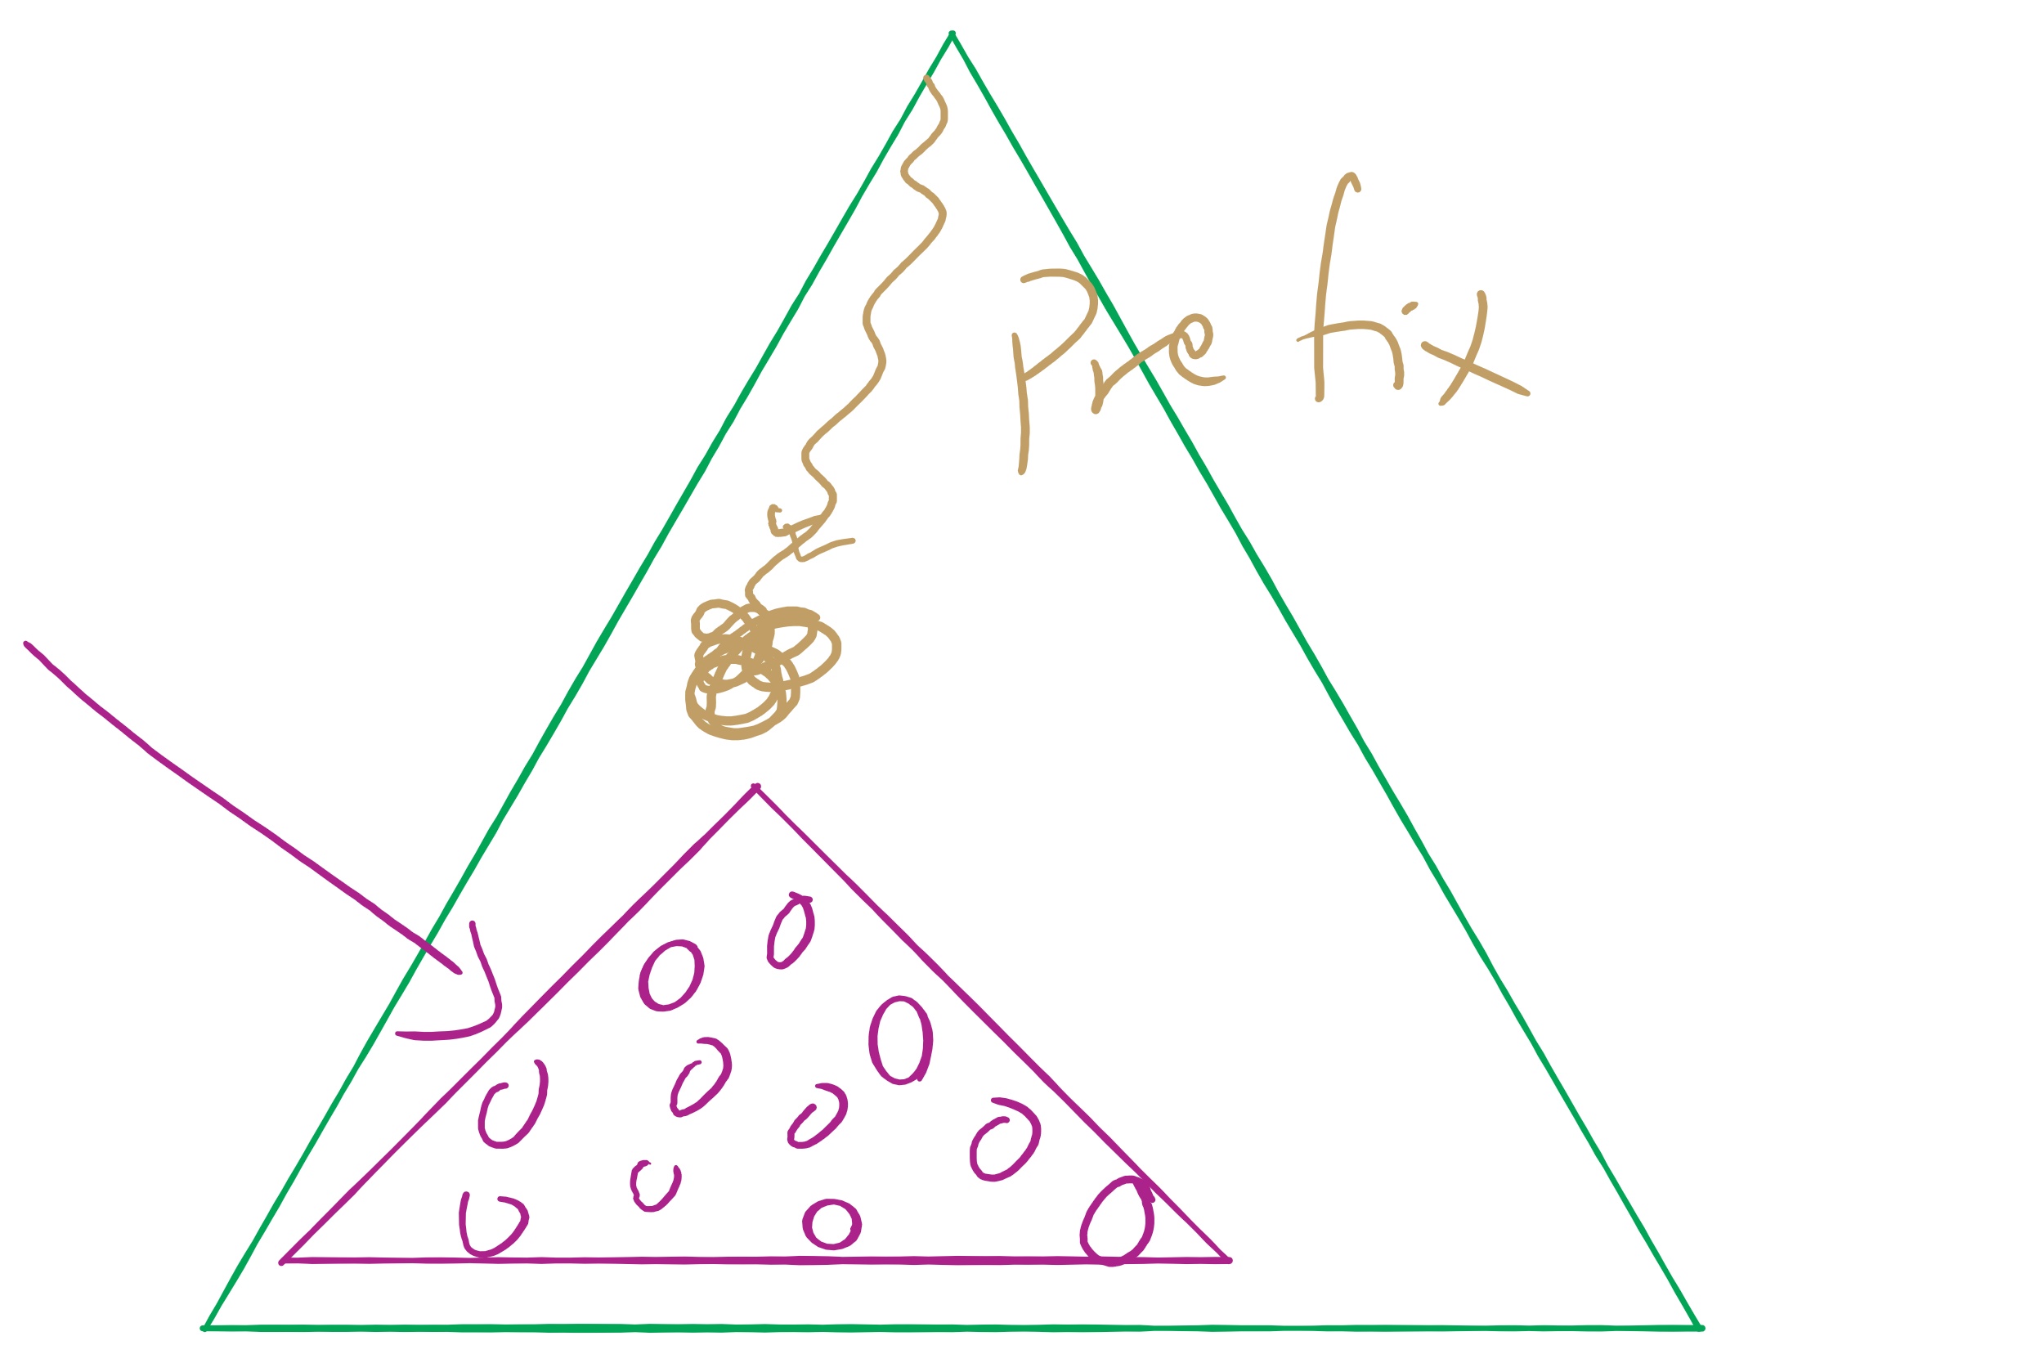
Assignment 2 runtime analysis

Slide 18
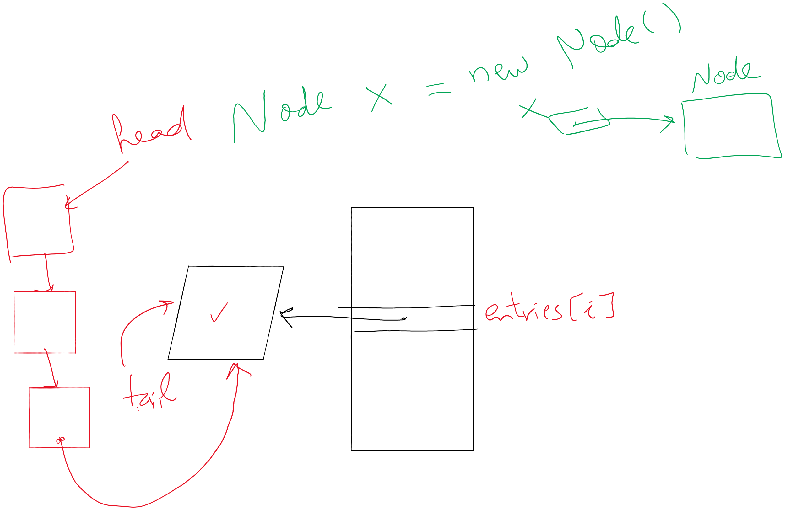
Lab 6

Slide 19

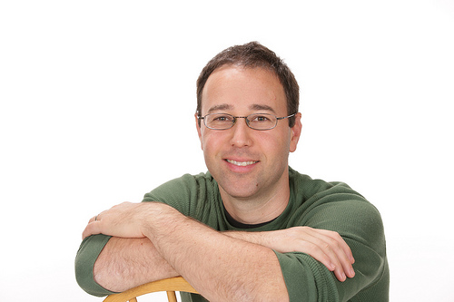
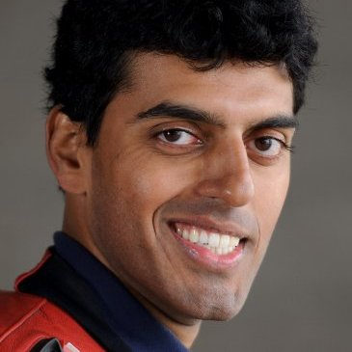
A final note on compression evaluation
"Weissman scores" are a made-up metric for Silicon Valley (TV)
Notes:
first: Prof. Tsachy (Itschak) Weissman (Stanford Dept. of EE)
second: Vinith Misra, advised by Weissman while getting his PhD from Stanford, now at IBM
Misra was a technical advisor to silicon valley team, made the shows technical contributions seem like something experts could watch a powerpoint on and buy

Slide 20
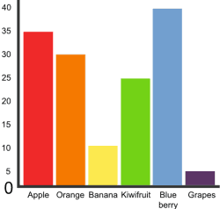
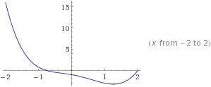
Graphs!
5
3
4
0
2
1

Slide 21
Graphs
A graph G = (V, E)
Where V is a set of vertices
E is a set of edges connecting vertex pairs
Example:
V = {0, 1, 2, 3, 4, 5}
E = {(0, 1), (0, 4), (1, 2), (1, 4), (2, 3), (3, 4), (3, 5)}
5
3
4
0
2
1

Slide 22
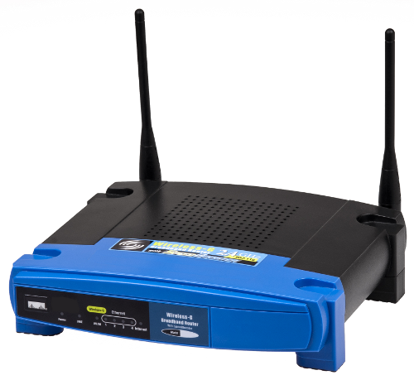
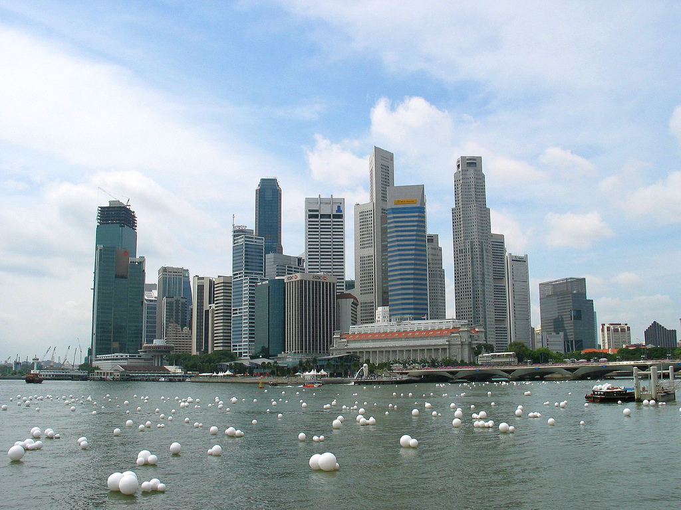
Why?
Can be used to model many different scenarios

Slide 23
Some definitions
Undirected graph
Edges are unordered pairs: (A, B) == (B, A)
Directed graph
Edges are ordered pairs: (A, B) != (B, A)
Adjacent vertices, or neighbors
Vertices connected by an edge

Slide 24
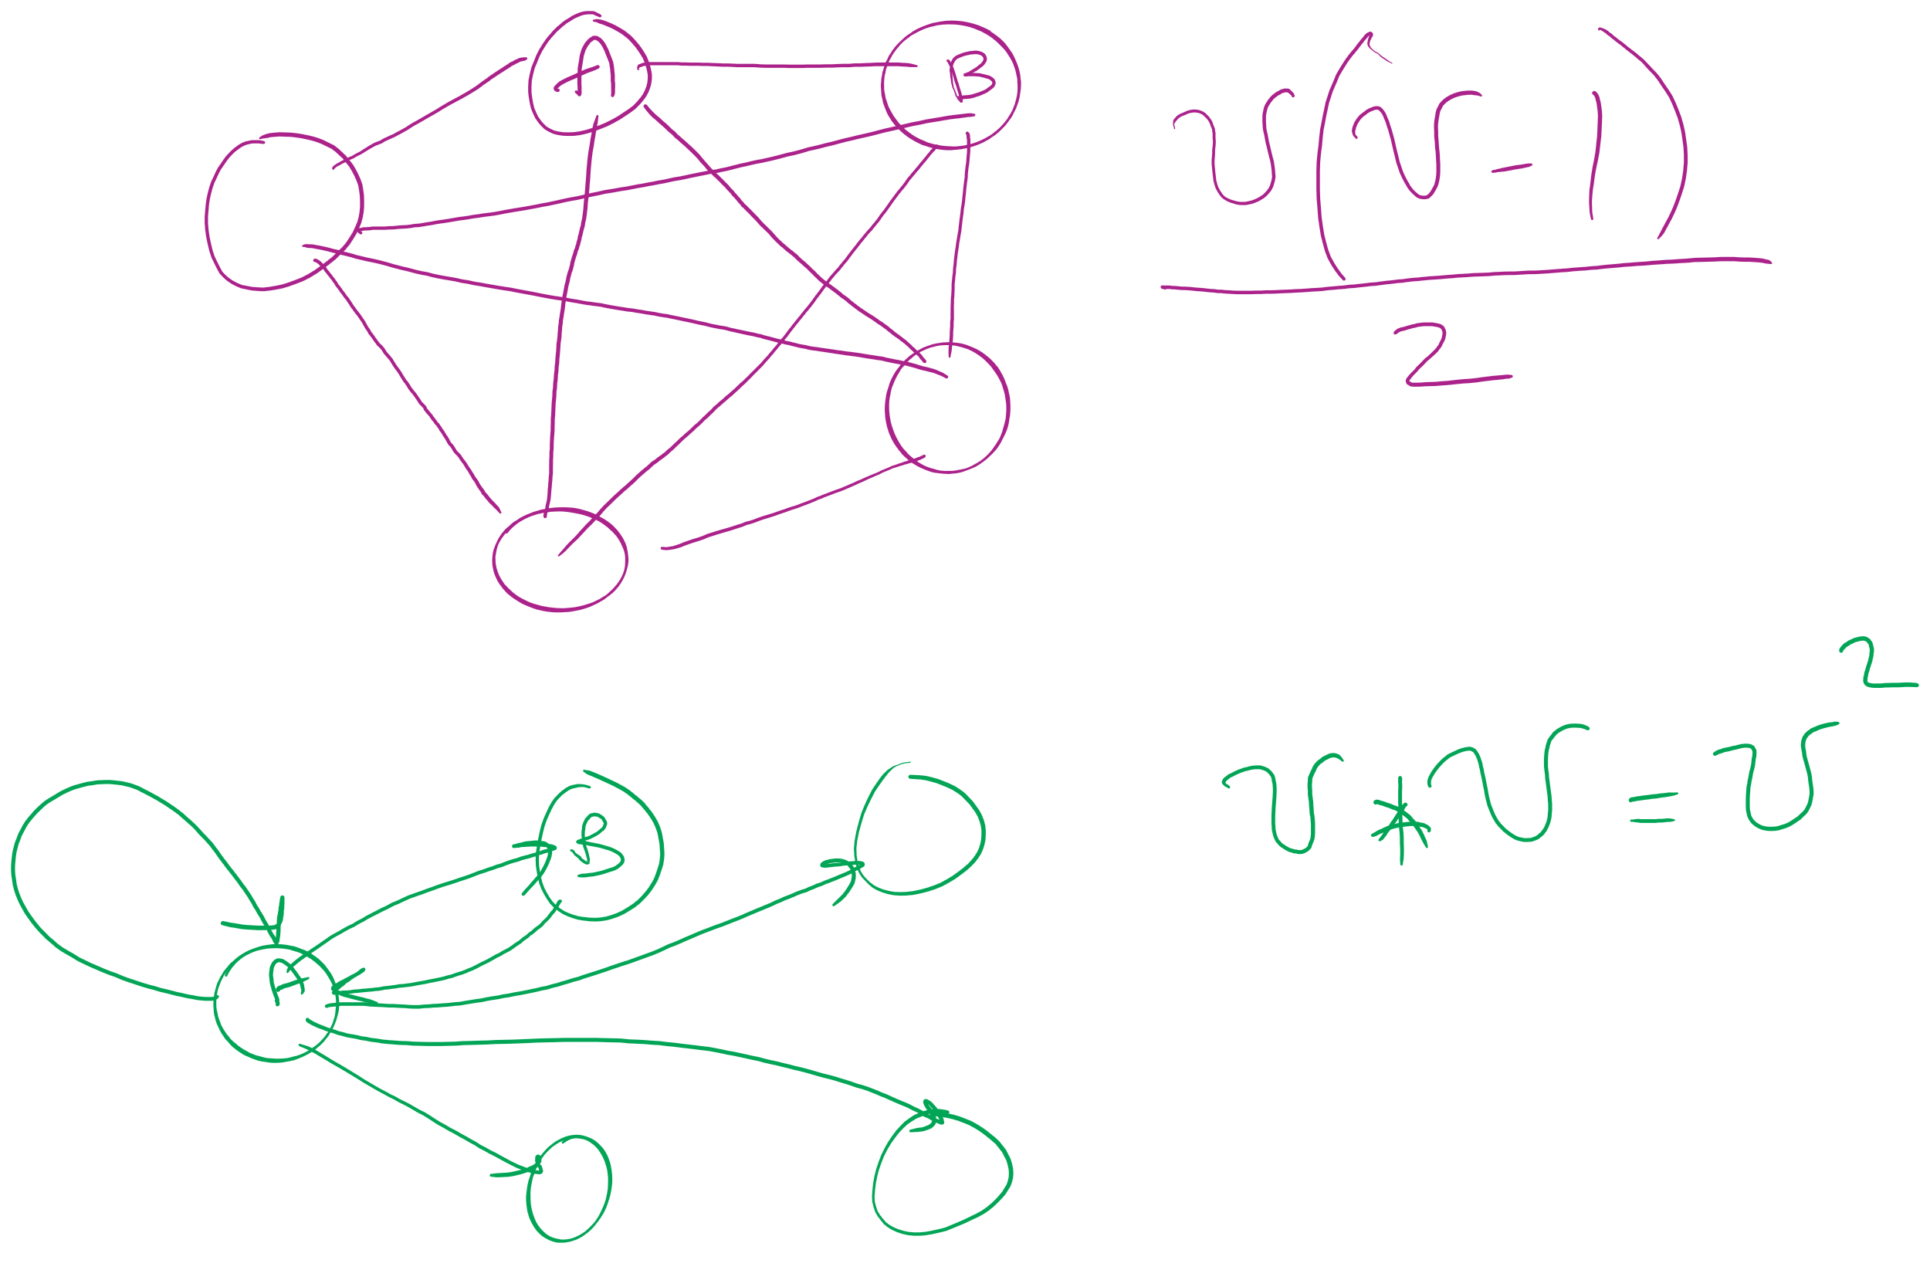
Graph sizes
Let v = |V|, and e = |E|
Given v, what are the minimum/maximum sizes of e?
Minimum value of e?
Definition doesn’t necessitate that there are any edges…
So, 0
Maximum of e?
Depends…
Are self edges allowed?
Directed graph or undirected graph?
In this class, we'll assume directed graphs have self edges while undirected graphs do not
Notes:
directed (w/ self edges)
v vertices each with edges to v vertices
v²
undirected (no self edges)
v vertices with edges to v-1 vertices
BUT remember for undirected, (1, 2) == (2, 1)
v(v - 1) / 2
(v² - v) / 2

Slide 25
More definitions
A graph is considered sparse if:
e <= v lg v
A graph is considered dense as it approaches the maximum number of edges
I.e., e == MAX - ε
A complete graph has the maximum number of edges
Notes:
v² - ε for directed
((v² - v) / 2) - ε for undirected
Have we seen “sparse” and dense before?
yes -- with tries, for sparse tries DLB is better; for dense, R-way tries are better

Slide 26
Question:
5
5
==
or
!=
3
4
4
3
0
0
2
1
1
2
?
Notes:
Different spatial representations of the same vertices/edges are considered the same graph

Slide 27
Representing graphs
Trivially, graphs can be represented as:
List of vertices
List of edges
Performance?
Assume we're going to be analyzing static graphs
I.e., no insert and remove
So what operations should we consider?
Notes:
We haven’t talked about problems to solve yet, but can you imagine tasks you might want to do with graphs?

Slide 28
Using an adjacency matrix
Rows/columns are vertex labels
M[i][j] = 1 if (i, j) ∈ E
M[i][j] = 0 if (i, j) ∉ E
 | 0 | 1 | 2 | 3 | 4 | 5
0 | 0 | 1 | 0 | 0 | 1 | 0
1 | 1 | 0 | 1 | 0 | 1 | 0
2 | 0 | 1 | 0 | 1 | 0 | 0
3 | 0 | 0 | 1 | 0 | 1 | 1
4 | 1 | 1 | 0 | 1 | 0 | 0
5 | 0 | 0 | 0 | 1 | 0 | 0

Slide 29
Please submit your reflections by using the CourseMIRROR App
If you are having a problem with CourseMIRROR, please send an email to coursemirror.development@gmail.com
Notes:
All right!
Upcoming Due Dates at A Glance

