Slide 1

Algorithms and Data Structures 2 CS 1501
Fall 2021
Sherif Khattab
ksm73@pitt.edu
(Slides are adapted from Dr. Ramirez’s and Dr. Farnan’s CS1501 slides.)

Slide 2
Announcements
Upcoming deadlines:
11/5: Lab 7 and Homework 8
11/9: Midterm-exam corrections
11/15: Assignment 3

Slide 3
Previous lecture …
Graphs!

Slide 4
CourseMIRROR Reflections

Slide 5
Today…
Graph Traversal
BFS
DFS
Articulation points

Slide 6
Using an adjacency matrix
Rows/columns are vertex labels
M[i][j] = 1 if (i, j) ∈ E
M[i][j] = 0 if (i, j) ∉ E
 | 0 | 1 | 2 | 3 | 4 | 5
0 | 0 | 1 | 0 | 0 | 1 | 0
1 | 1 | 0 | 1 | 0 | 1 | 0
2 | 0 | 1 | 0 | 1 | 0 | 0
3 | 0 | 0 | 1 | 0 | 1 | 1
4 | 1 | 1 | 0 | 1 | 0 | 0
5 | 0 | 0 | 0 | 1 | 0 | 0

Slide 7
Adjacency matrix analysis
Runtime?
Space?
Notes:
Time:
Check edge existence in Θ(1)
Θ(v) to find the neighbors of a vertex
Θ(v²) time to initialize
Space:
Θ(v²) memory
Regardless of |E|

Slide 8
Adjacency lists
Array of neighbor lists
A[i] contains a list of the neighbors of vertex i
0
1
2
3
4
5
1
0
1
2
0
3
4
2
3
4
1
4
5
3

Slide 9
Adjacency list analysis
Runtime?
Space?
Notes:
Time:
Θ(d) to check edge existence/find the neighbors of a vertex
Where d is the degree of a vertex
# of neighbors
Can be up to Θ(v) to check edge existence/find the neighbors of a vertex
Space:
Θ(v + e) memory
Plus overhead of node use
Could be much less than v²

Slide 10
Comparison
Where would we want to use adjacency lists vs adjacency matrices?
What about the list of vertices/list of edges approach?
Notes:
Adjacency matrix is better for dense graphs
Adjacency list is better for sparse graphs
Lists approach is bad
Aside from not storing redundant edge info for undirected graphs, worse than adj list

Slide 11
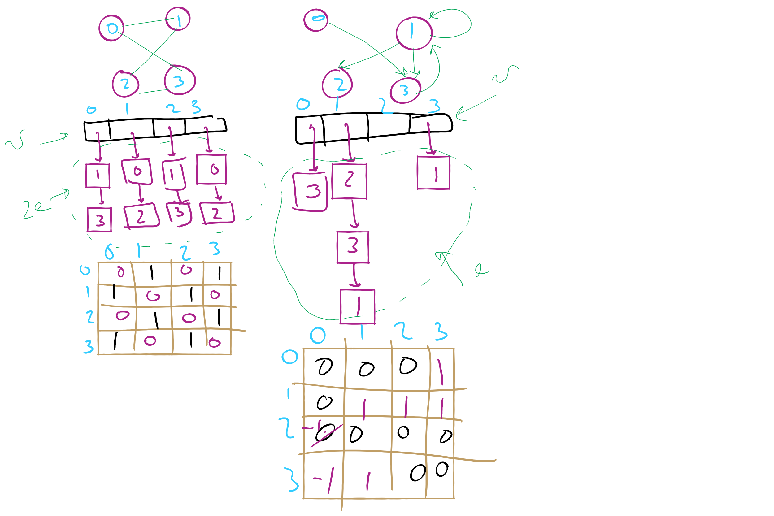
Graph Representation Example 1

Slide 12
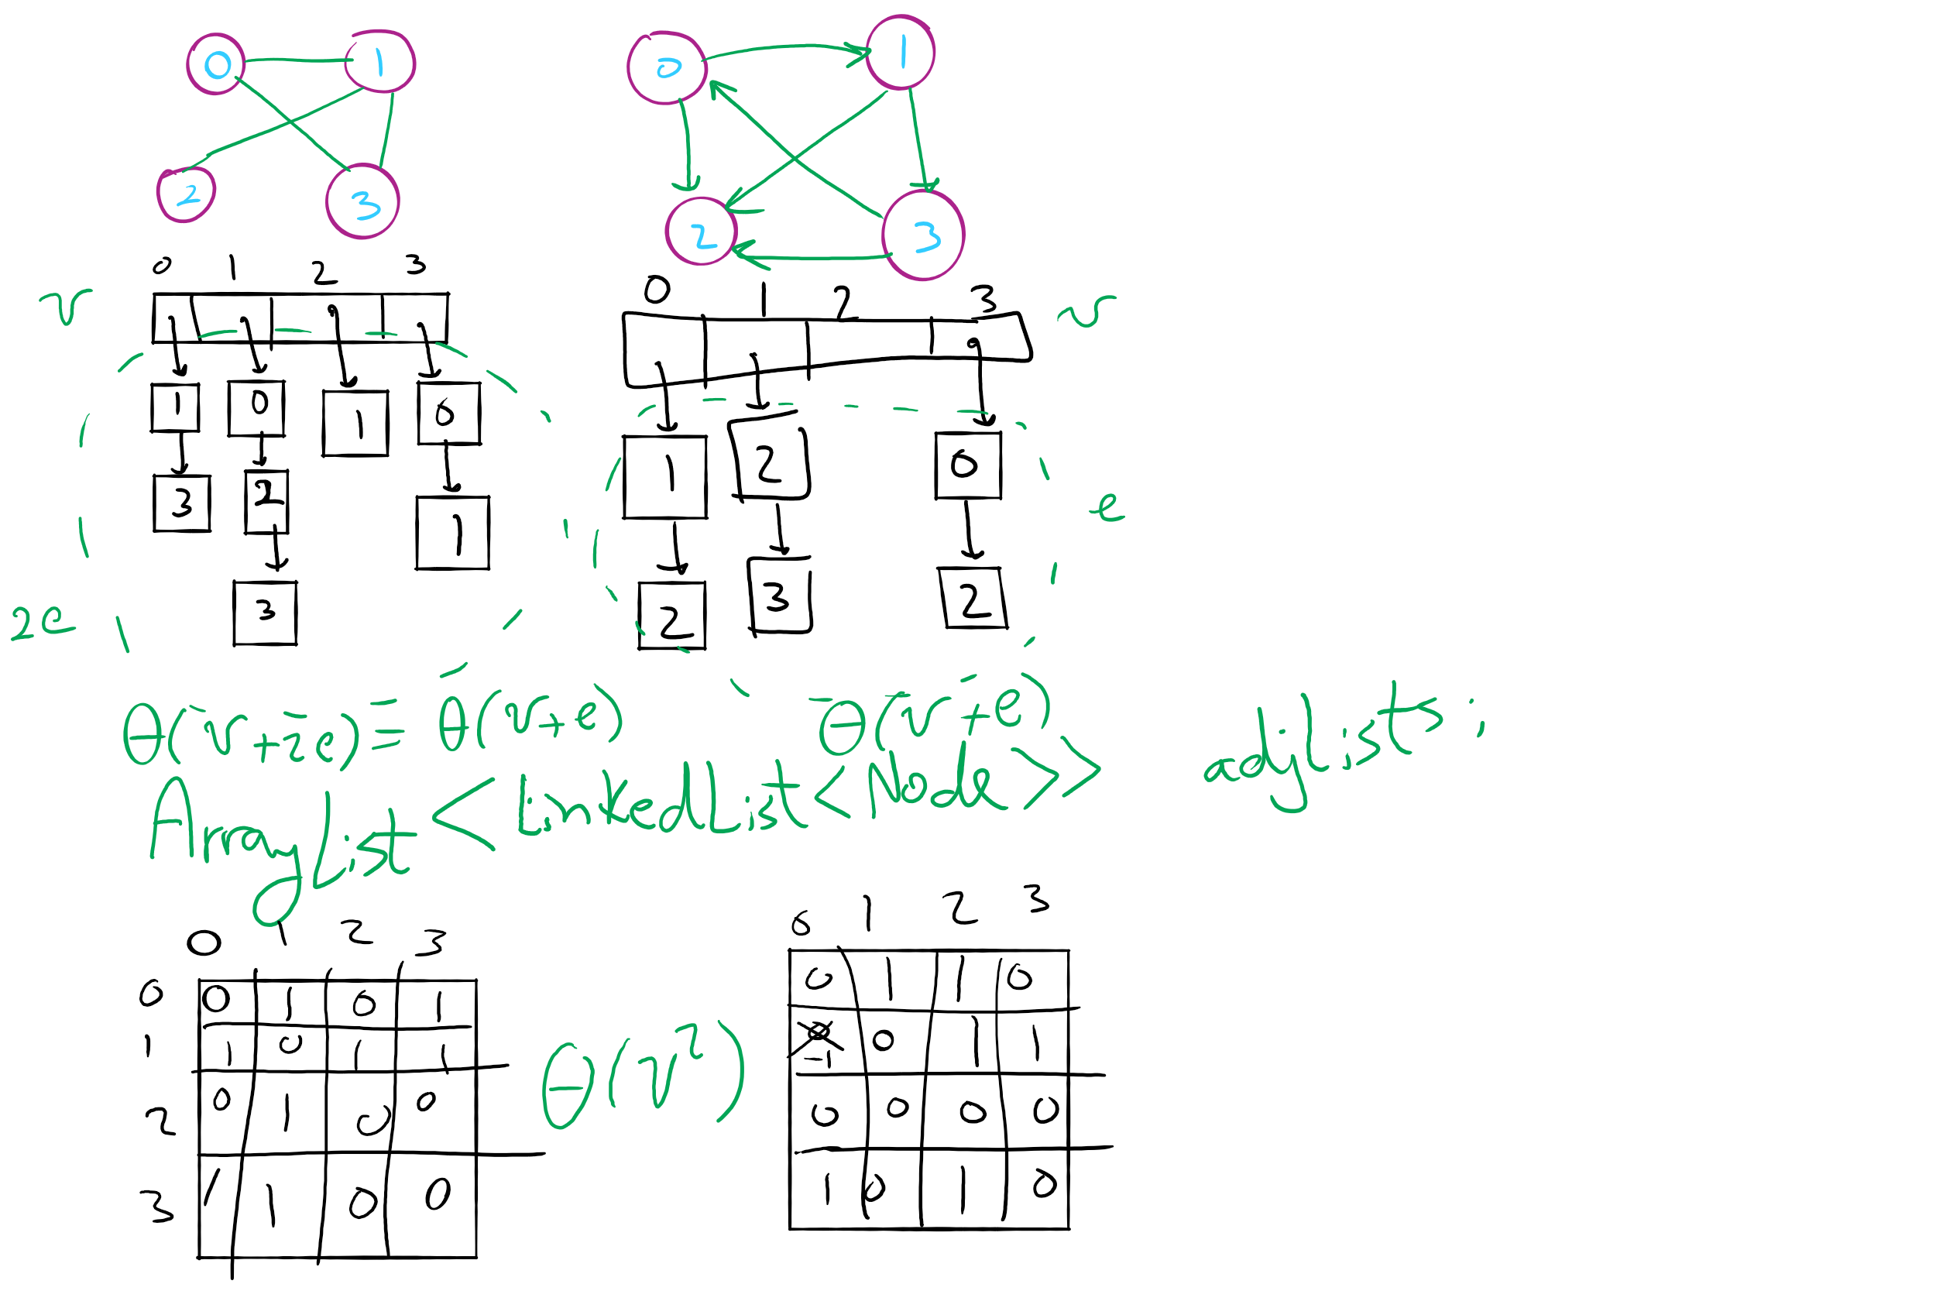
Graph Representation Example 2

Slide 13
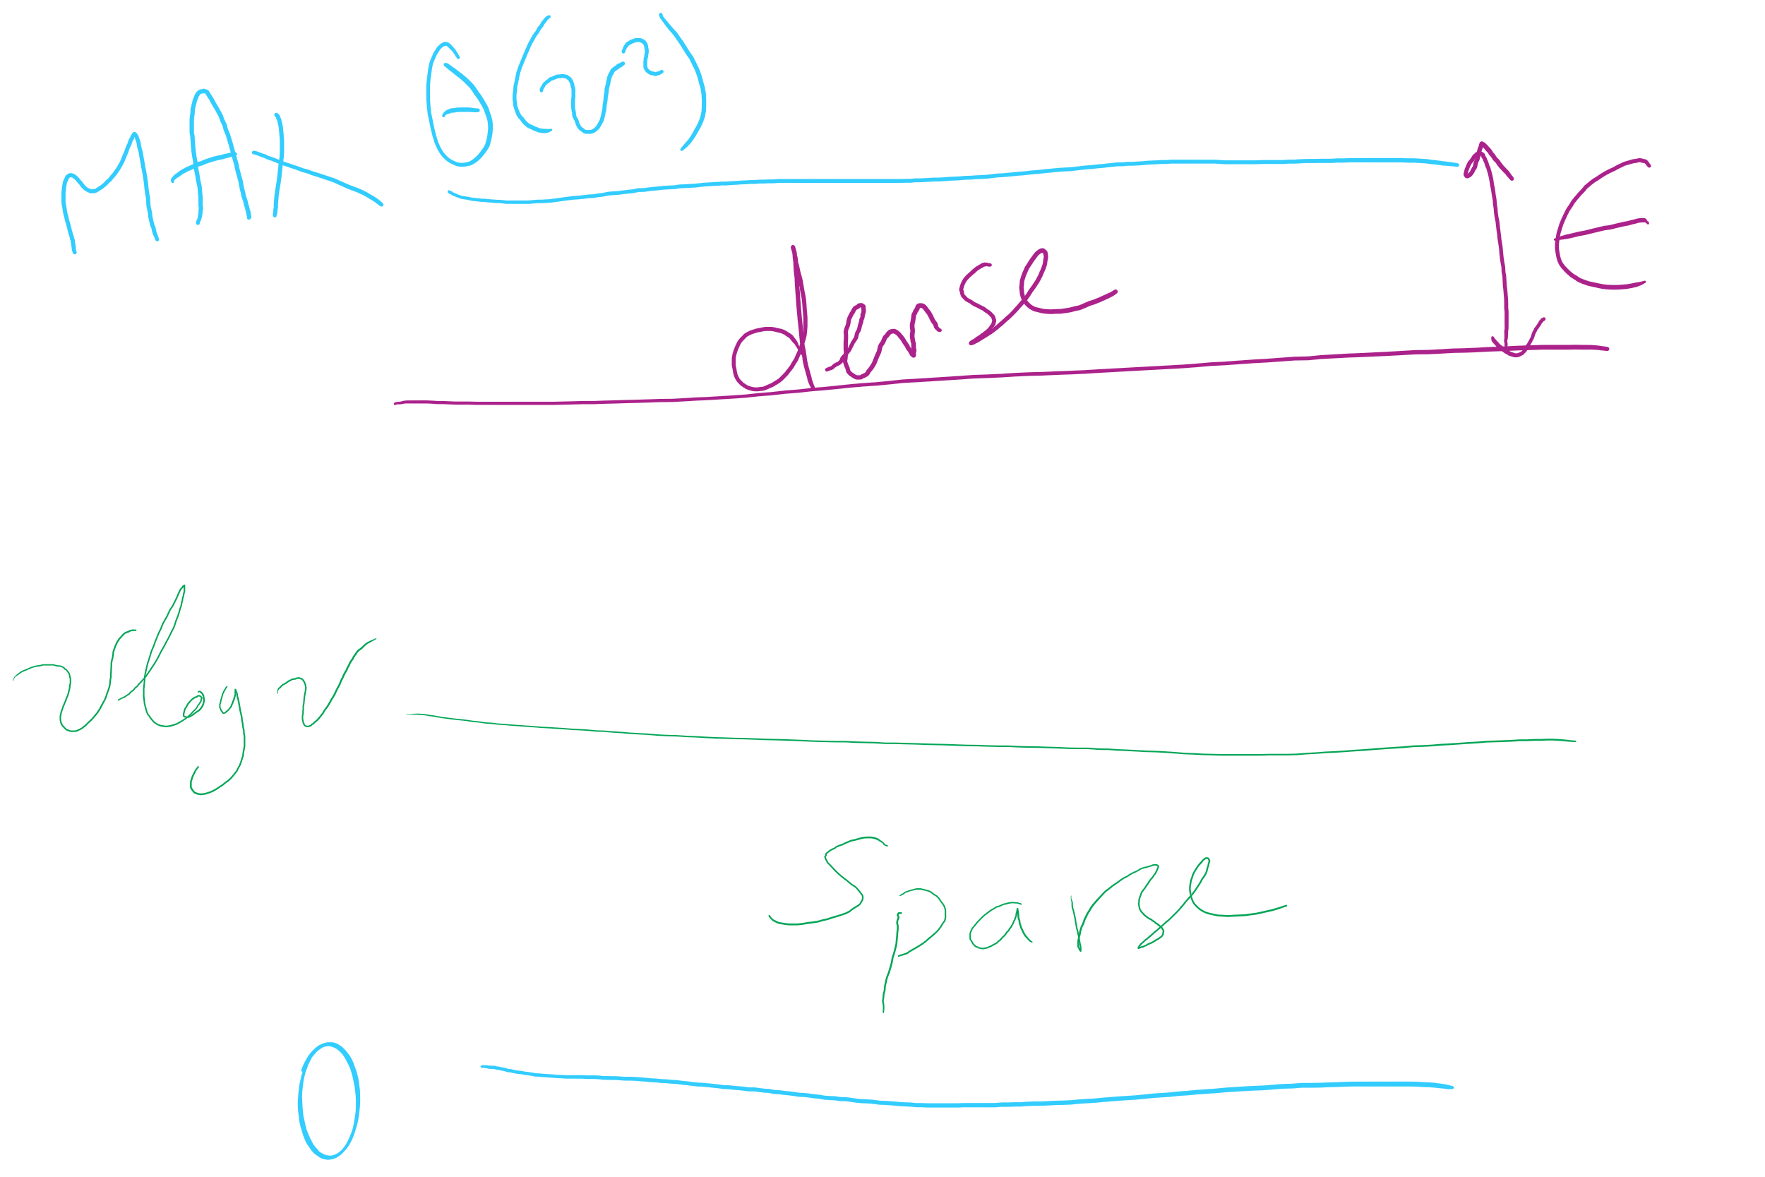
Graph Density

Slide 14
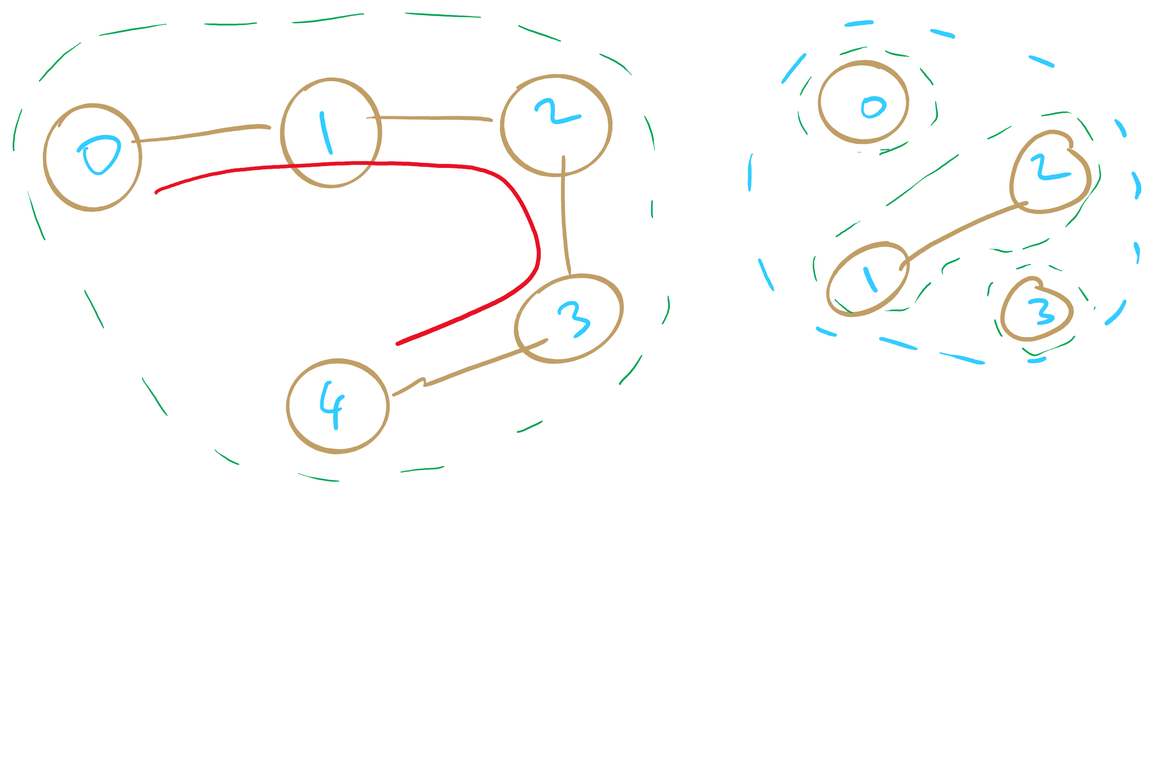
Sparse Graphs

Slide 15
Next …
Graph Traversal
BFS
DFS
Articulation points
Minimum Spanning Tree
Prim’s algorithm

Slide 16
Comparison
Where would we want to use adjacency lists vs adjacency matrices?
What about the list of vertices/list of edges approach?
Notes:
Adjacency matrix is better for dense graphs
Adjacency list is better for sparse graphs
Lists approach is bad
Aside from not storing redundant edge info for undirected graphs, worse than adj list

Slide 17
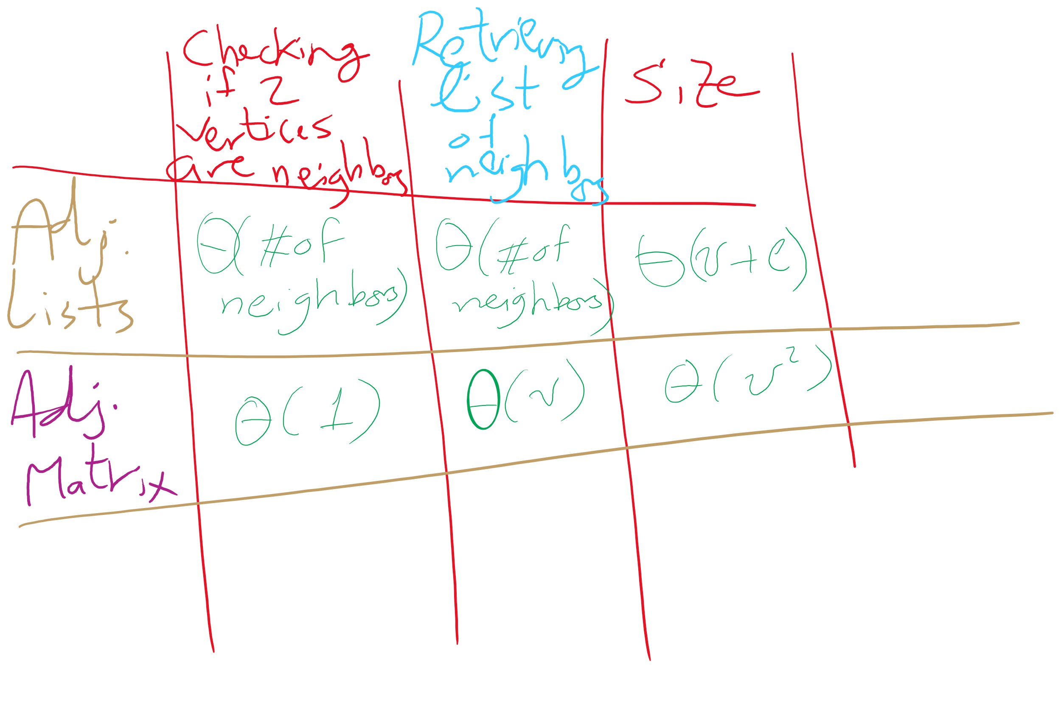
Adjacency Matrix vs. Adjacency Lists

Slide 18
Even more definitions
Path
A sequence of adjacent vertices
Simple Path
A path in which no vertices are repeated
Simple Cycle
A simple path with the same first and last vertex
Connected Graph
A graph in which a path exists between all vertex pairs
Connected Component
Connected subgraph of a graph
Acyclic Graph
A graph with no cycles
Tree
?
A connected, acyclic graph
Has exactly v-1 edges
Notes:
Difference between Connected graph and Complete graph?
Connected means there is a path from vertA to vertB
Complete means maximum number of edges in graph (so, vertA has edge to vertB)

Slide 19
Graph traversal
What is the best order to traverse a graph?
Two primary approaches:
Depth-first search (DFS)
“Dive” as deep as possible into the graph first
Branch when necessary
Breadth-first search (BFS)
Search all directions evenly
I.e., from i, visit all of i’s neighbors, then all of their neighbors, etc.

Slide 20
DFS
Already seen and used this throughout the term
For tries…
For Huffman encoding…
Can be easily implemented recursively
For each vertex, visit first unseen neighbor
Backtrack at deadends (i.e., vertices with no unseen neighbors)
Try next unseen neighbor after backtracking

Slide 21
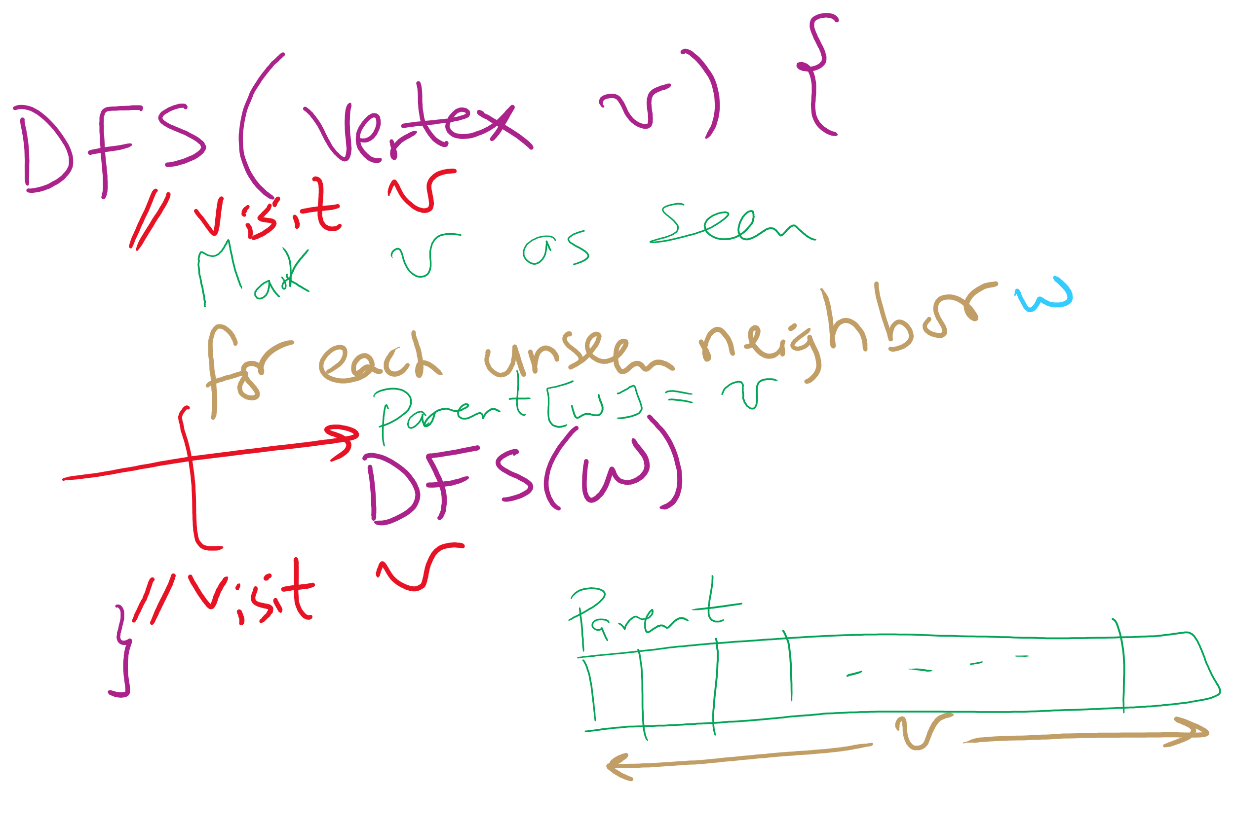
DFS Pseudo-code

Slide 22
DFS example
5
5
3
4
3
4
0
0
2
2
1
1

Slide 23
DFS example 2
0
0
2
1
2
1
3
3
6
6
4
5
4
5
7
7
9
9
8
8

Slide 24
BFS
Can be easily implemented using a queue
For each vertex visited, add all of its neighbors to the queue
Vertices that have been seen but not yet visited are said to be the fringe
Pop head of the queue to be the next visited vertex
See example

Slide 25
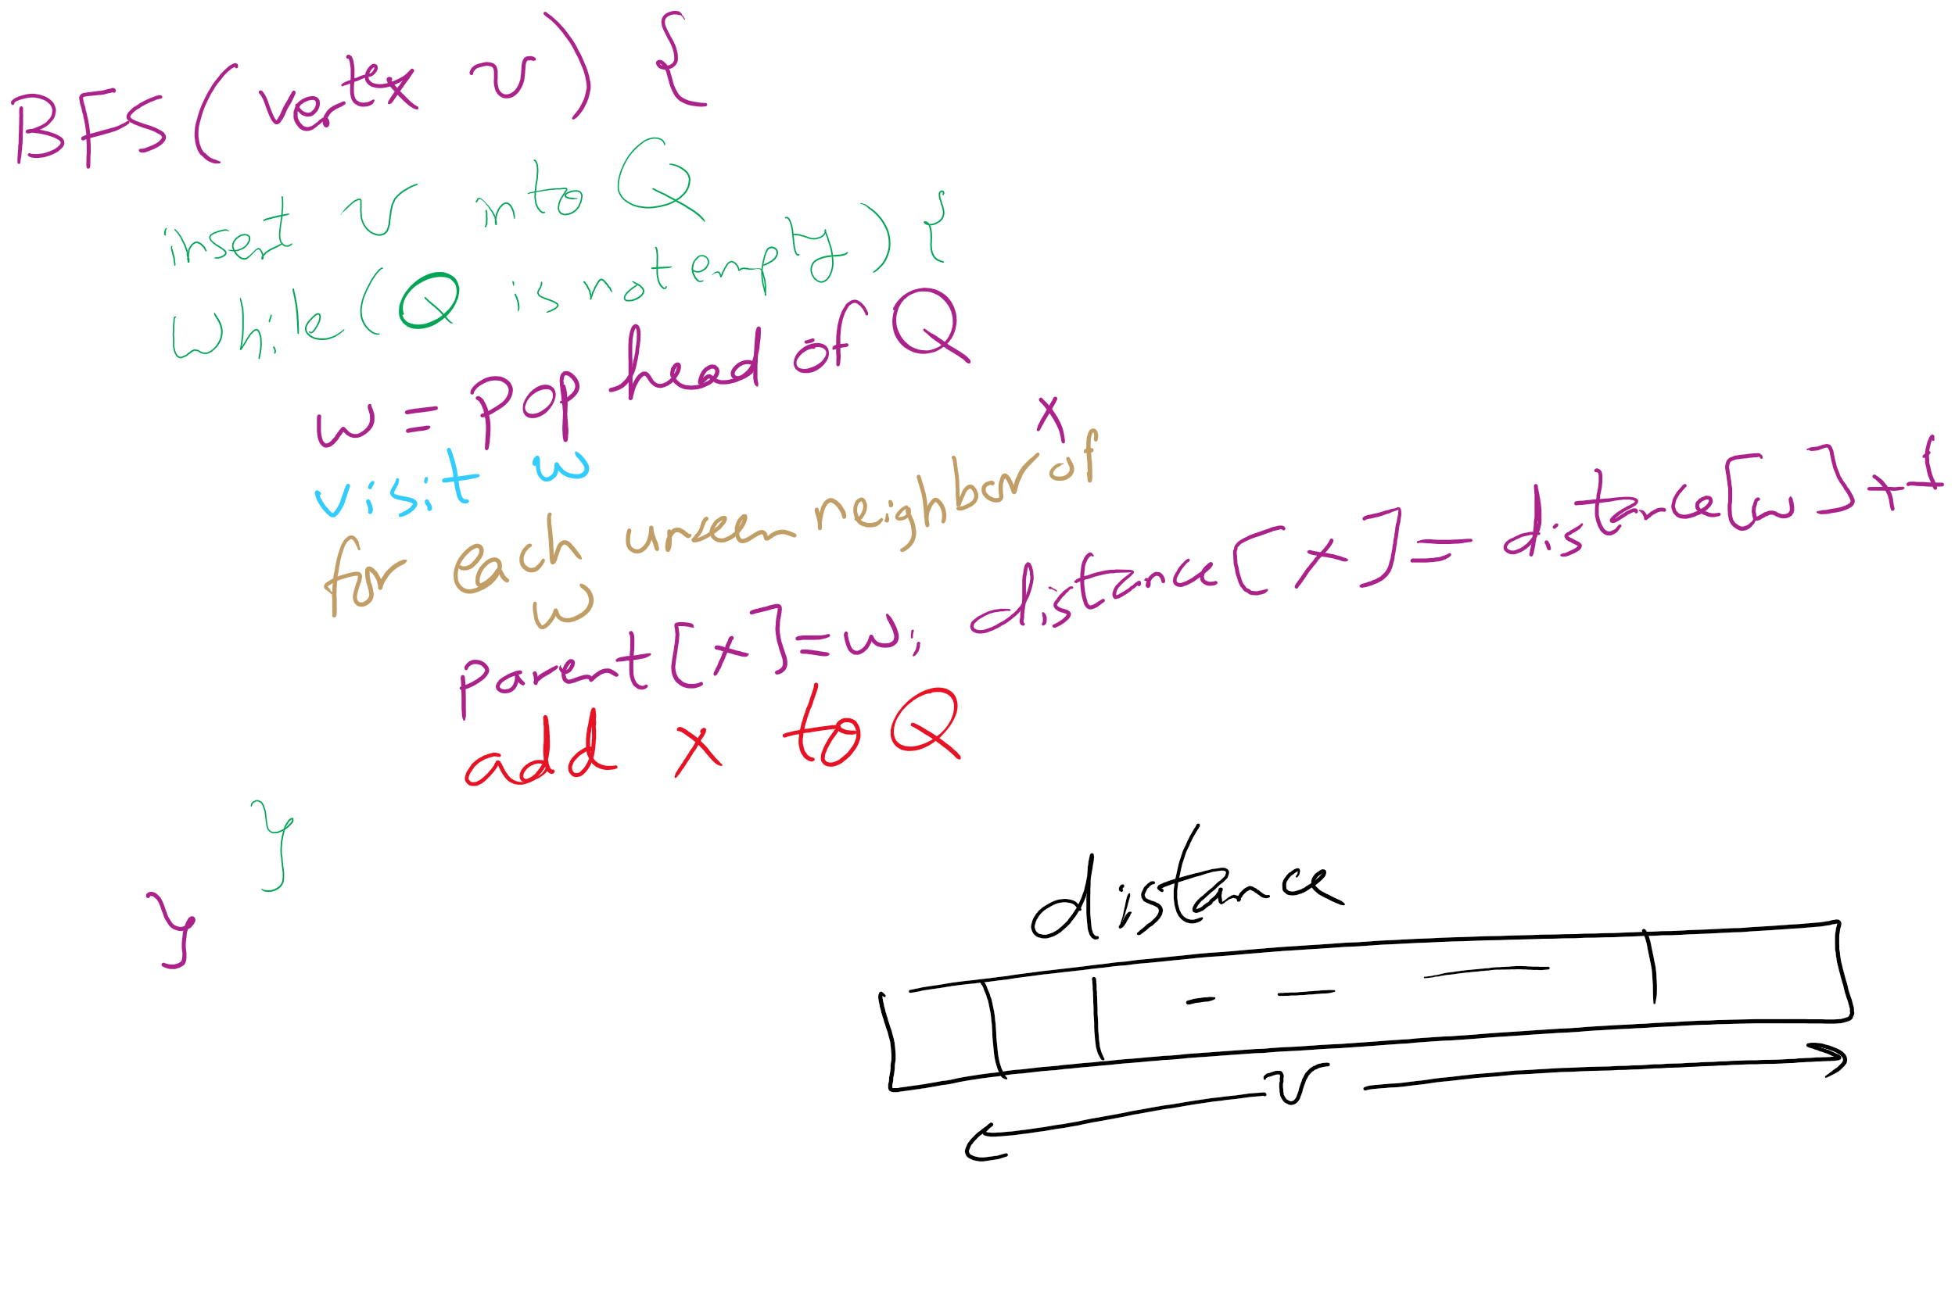
BFS Pseudo-code

Slide 26
BFS example
Q
0
0
1
7
2
1
2
1
2
9
3
3
6
6
3
8
4
5
4
5
4
7
7
5
9
9
6
8
8
Notes:
note that we are building connected, acyclic graphs with both bfs and dfs (will define on next slide)
get students to pick out that we are also doing shortest paths with bfs

Slide 27
Shortest paths
BFS traversals can further be used to determine the shortest path between two vertices

Slide 28
Analysis of graph traversals
At a high level, DFS and BFS have the same runtime
Each vertex must be seen and then visited, but the order will differ between these two approaches
How will the representation of the graph affect the runtimes of of these traversal algorithms?
Notes:
Adjacency matrix
Θ(v) to consider all neighbors
To traverse a row/column of the matrix
Doing this for each of v vertices leads to Θ(v²) runtime
Adjacency list
Must consider the neighbor list of each vertex in the array
So, we must visit every vertex in the whole adjacency list
Θ(v + e)

Slide 29
Please submit your reflections by using the CourseMIRROR App
If you are having a problem with CourseMIRROR, please send an email to coursemirror.development@gmail.com
Notes:
All right!
Upcoming Due Dates at A Glance

