Slide 1

Algorithms and Data Structures 2 CS 1501
Fall 2021
Sherif Khattab
ksm73@pitt.edu
(Slides are adapted from Dr. Ramirez’s and Dr. Farnan’s CS1501 slides.)

Slide 2
Announcements
Upcoming deadlines:
11/5: Lab 7 and Homework 8
11/9: Midterm-exam corrections
11/15: Assignment 3

Slide 3
Previous Lecture …
Graph traversal
DFS and BFS

Slide 4
CourseMIRROR Reflections

Slide 5
Today…
Articulation Points using DFS
Minimum Spanning Tree
Prim’s Algorithm

Slide 6
Analysis of graph traversals
At a high level, DFS and BFS have the same runtime
Each vertex must be seen and then visited, but the order will differ between these two approaches
How will the representation of the graph affect the runtimes of of these traversal algorithms?
Notes:
Adjacency matrix
Θ(v) to consider all neighbors
To traverse a row/column of the matrix
Doing this for each of v vertices leads to Θ(v²) runtime
Adjacency list
Must consider the neighbor list of each vertex in the array
So, we must visit every vertex in the whole adjacency list
Θ(v + e)

Slide 7
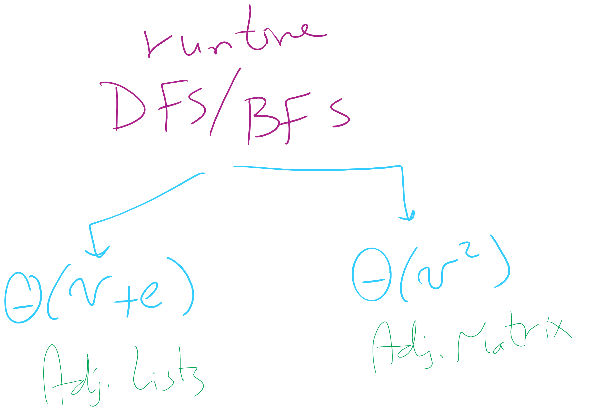
Runtime of BFS/DFS

Slide 8
DFS and BFS would be called from a wrapper function
If the graph is connected:
dfs()/bfs() is called only once and returns a spanning tree
Else:
A loop in the wrapper function will have to continually call dfs()/bfs() while there are still unseen vertices
Each call will yield a spanning tree for a connected component of the graph

Slide 9
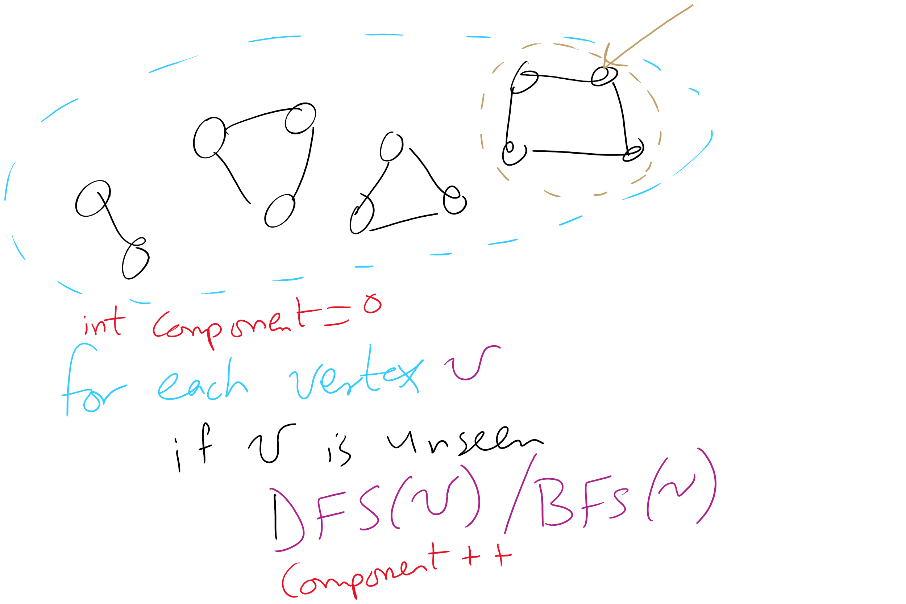
Wrapper function and connected components

Slide 10
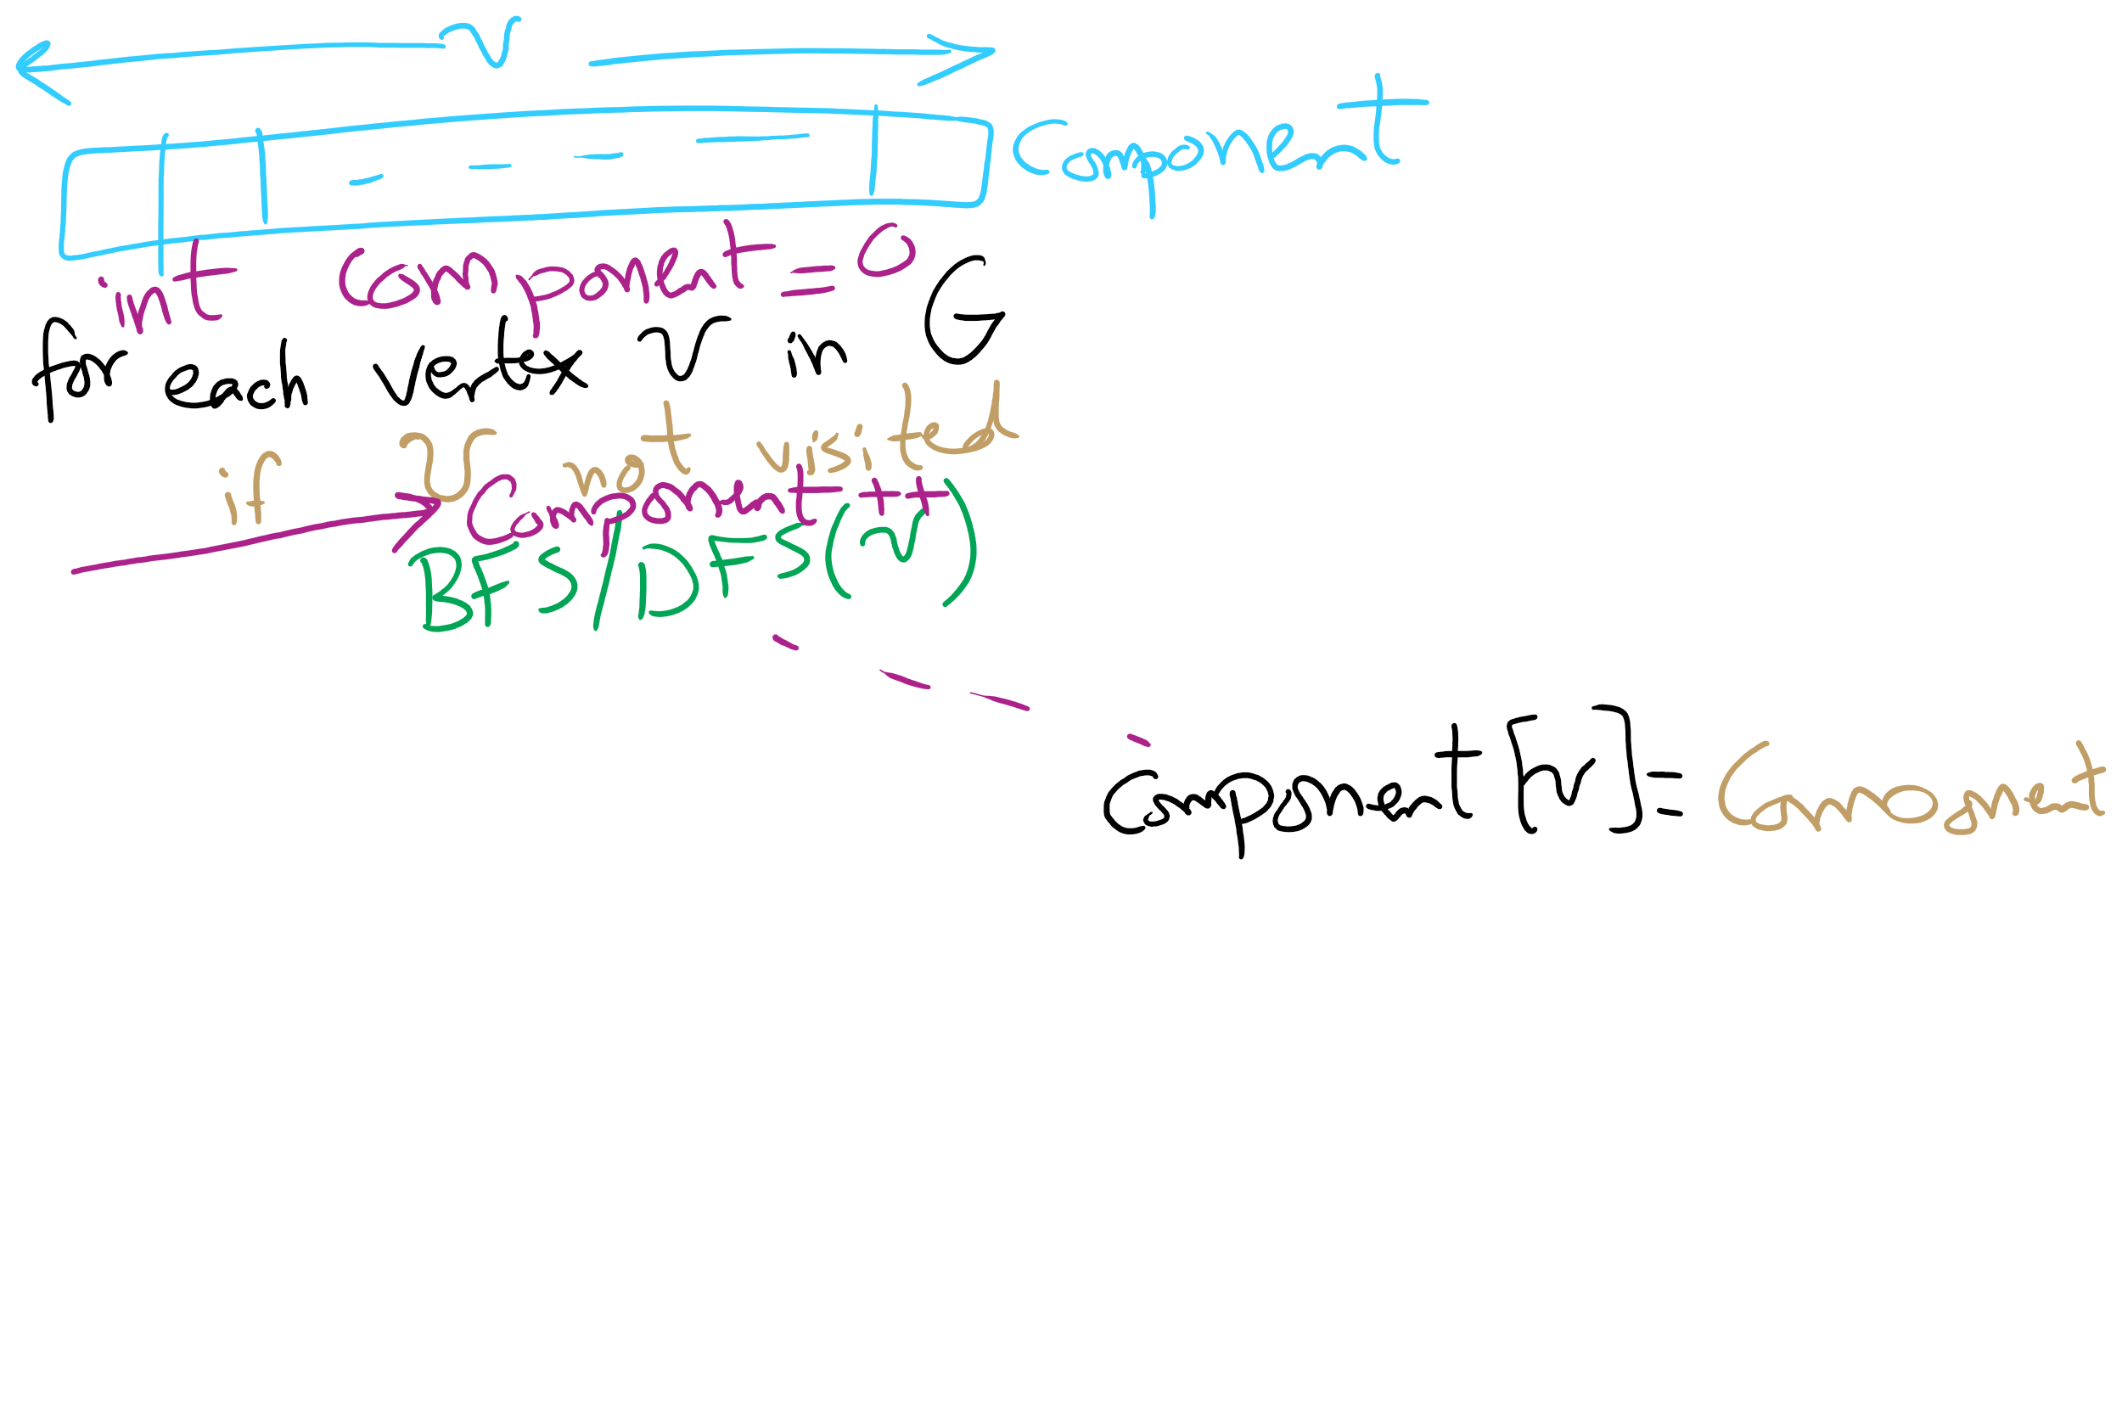
Wrapper function for DFS/BFS

Slide 11
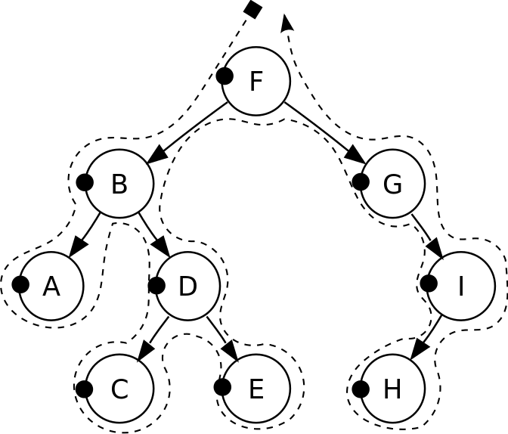
DFS pre-order traversal
Notes:
F, B, A, D, C, E, G, I, H
Seen before when we talked about marshalling huffman tries to the compressed file
Good for evaluating Polish notation

Slide 12
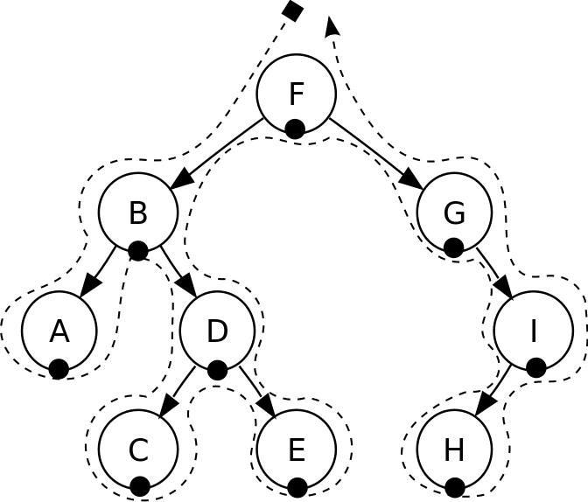
DFS in-order traversal
Notes:
A, B, C, D, E, F, G, H, I
Seen when we wanted to enumerate all values stored in a B-tree (motivating the need for a B+tree)
Good for sorted ordering (if dealing with sorted data structure)

Slide 13
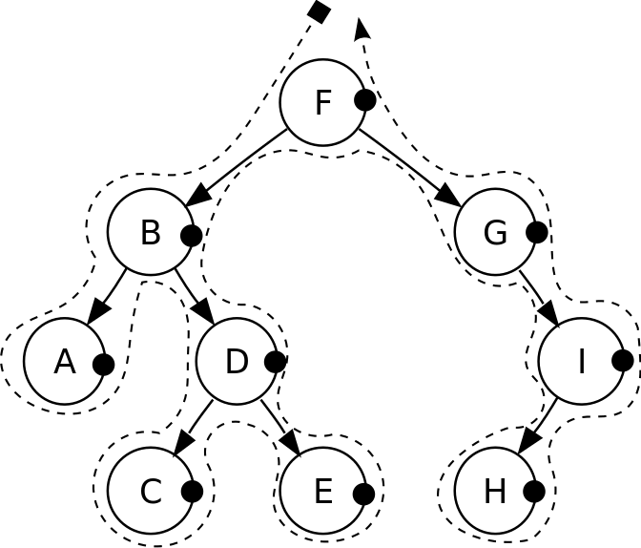
DFS post-order traversal
Notes:
A, C, E, D, B, H, I, G, F
Good for reverse Polish notation

Slide 14
Biconnected graphs
A biconnected graph has at least 2 distinct paths (no common edges or vertices) between all vertex pairs
Any graph that is not biconnected has one or more articulation points
Vertices, that, if removed, will separate the graph
Any graph that has no articulation points is biconnected
Thus we can determine that a graph is biconnected if we look for, but do not find any articulation points

Slide 15
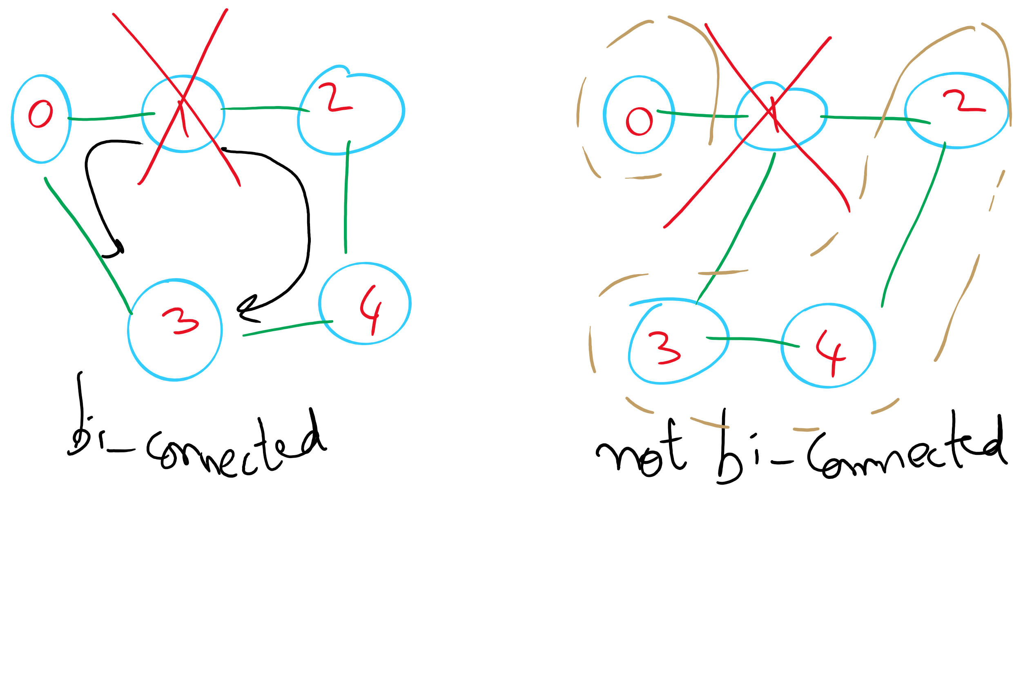
Bi-connected Graph

Slide 16
Finding articulation points
Variation on DFS
Consider building up the spanning tree
Have it be directed
Create “back edges” when considering a vertex that has already been visited in constructing the spanning tree
Label each vertex v with with two numbers:
num(v) = pre-order traversal order
low(v) = lowest-numbered vertex reachable from v using 0 or more spanning tree edges and then at most one back edge
Min of:
num(v)
Lowest num(w) of all back edges (v, w)
Lowest low(w) of all spanning tree edges (v, w)

Slide 17
Finding articulation points example
num
low
0
0
F
E
D
E
1
0
A
A
C
B
2
0
B
3
0
C
4
0
D
5
5
F
Notes:
what type of a traversal do we do to define low() values?
post-order
we're mapping out where there are multiple paths between vertices with back edges
there is a path 4 → 0 → 1 → 2, and 2 → 3 → 4 in this graph
what if we started at 3? how would the result change
root of spanning tree would have 2 children

Slide 18
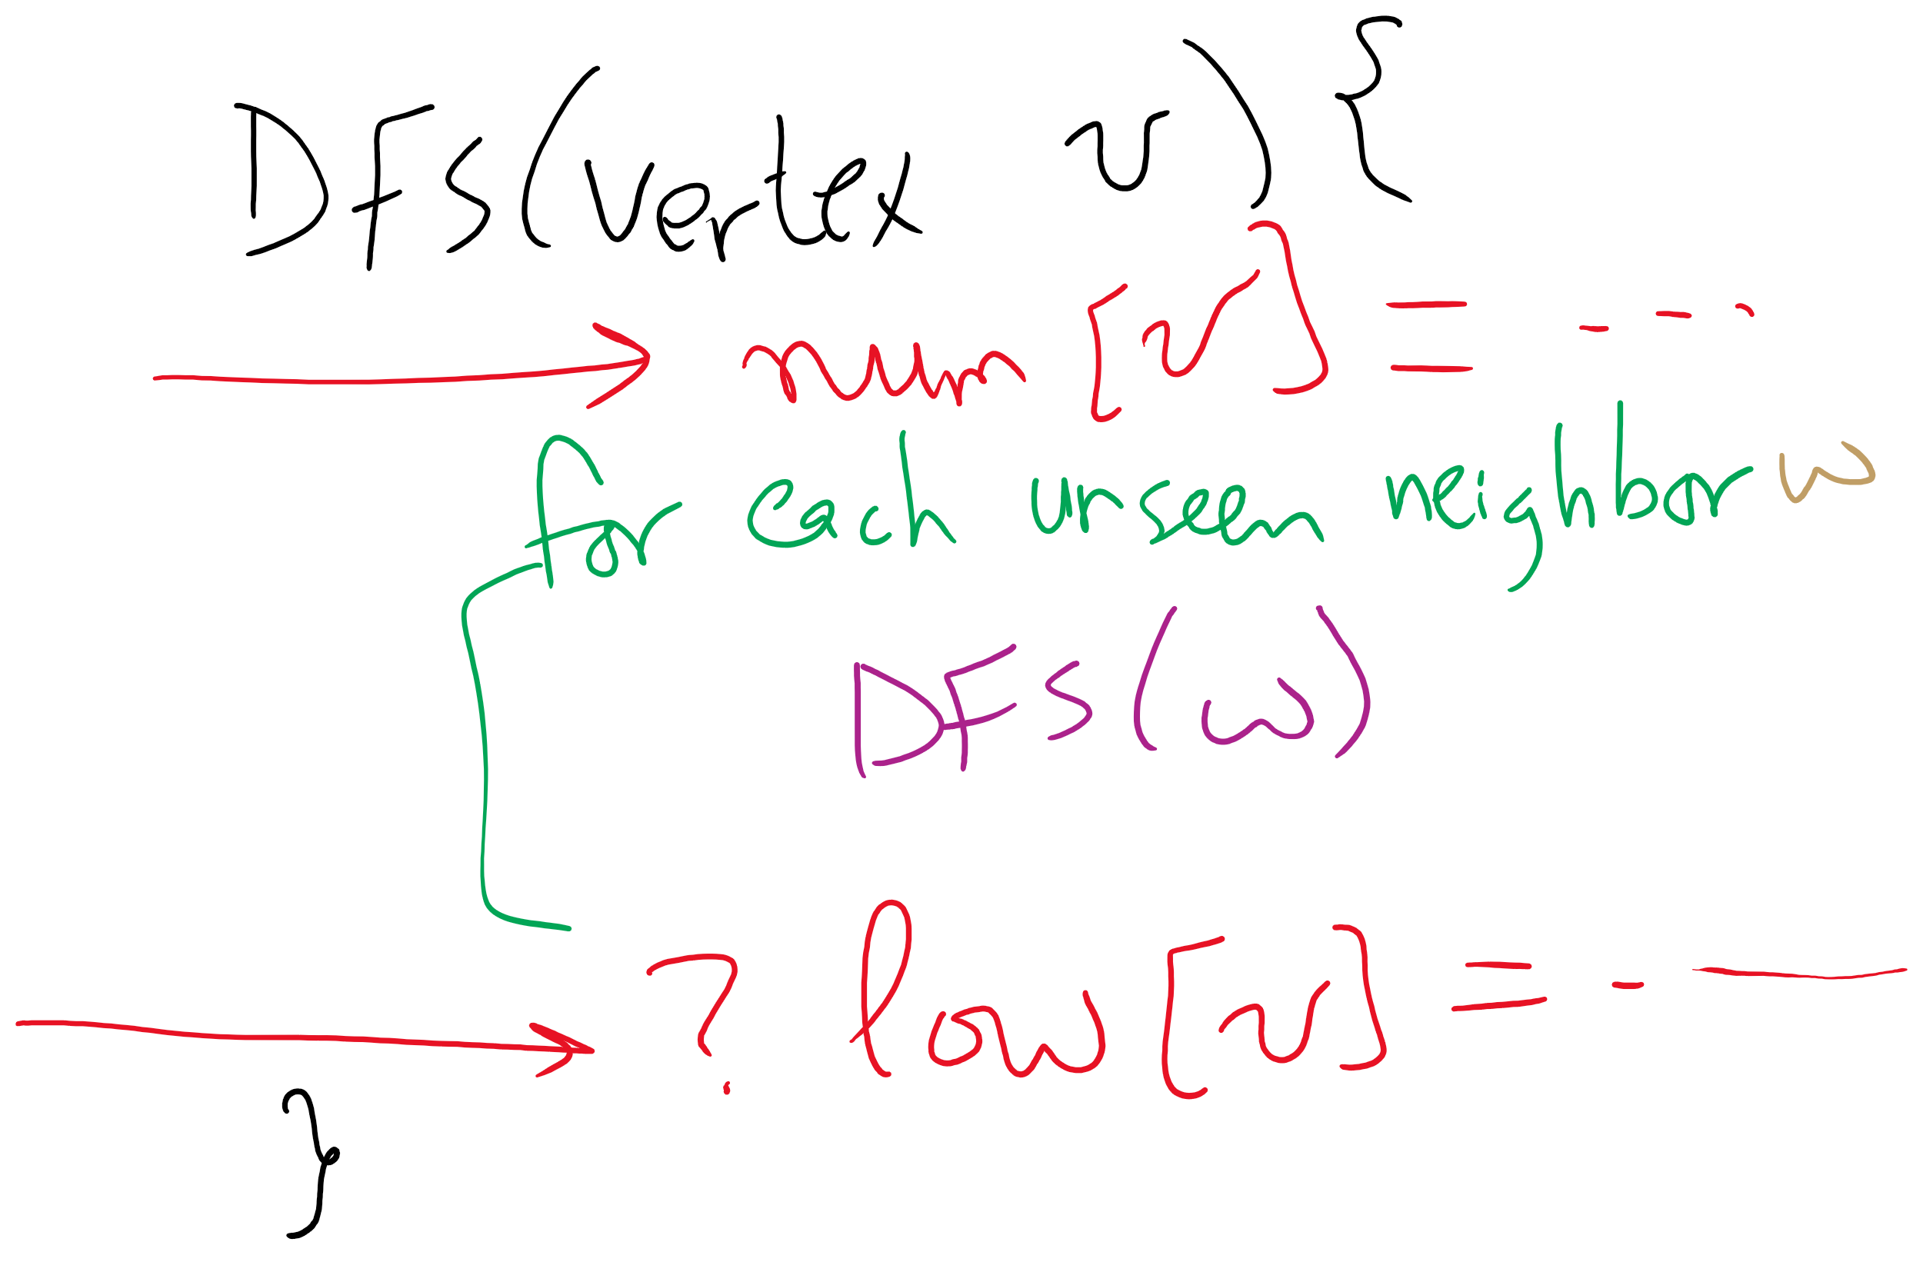
Using DFS to find articulation points

Slide 19
So where are the articulation points?
If any (non-root) vertex v has some child w such that low(w) ≥ num(v), v is an articulation point
What about if we start at an articulation point?
If the root of the spanning tree has more than one child, it is an articulation point
Notes:
does it matter if we add back edges that mirror spanning tree edges (e.g., 3 → 3, or 5 → 3)?
no, because we define low(w) must be less than or equal to num(v)

Slide 20
We said spatial layouts of graphs were irrelevant
We define graphs as sets of vertices and edges
However, we’ll certainly want to be able to reason about bandwidth, distance, capacity, etc. of the real world things our graph represents
Whether a link is 1 gigabit or 10 megabit will drastically affect our analysis of traffic flowing through a network
Having a road between two cities that is a 1 lane country road is very different from having a 4 lane highway
If two airports are 2000 miles apart, the number of flights going in and out between them will be drastically different from airports 200 miles apart

Slide 21
We can represent such information with edge weights
How do we store edge weights?
Adjacency matrix?
Adjacency list?
Do we need a whole new graph representation?
How do weights affect finding spanning trees/shortest paths?
The weighted variants of these problems are called finding the minimum spanning tree and the weighted shortest path
Notes:
Adjacency matrix:
Instead of 1, store the edge weight for all edges that exist
Adjacency list:
Add a field to list verticies to store the weight

Slide 22
Minimum spanning trees (MST)
Graphs can potentially have multiple spanning trees
MST is the spanning tree that has the minimum sum of the weights of its edges

Slide 23
Prim’s algorithm
Initialize T to contain the starting vertex
T will eventually become the MST
While there are vertices not in T:
Find minimum edge weight edge that connects a vertex in T to a vertex not yet in T
Add the edge with its vertex to T

Slide 24
Prim’s algorithm
10
1
4
1
4
4
6
8
7
0
9
5
0
3
6
3
6
2
9
8
2
2
2
5
5
1
Notes:
Green verticies/red edges in T
be sure to highlight the set of edges that could possibly be used to bring a vertex into T
grey edges that connect two green vertices dont need to be considered, thing to come back to when we talk about implementation, should we try to remove them from consideration?
not really, no asymptotic improvement for parent and best edge implementation
even with eager prims, that would just be more updates to try and avoid unneccesary removals, but both have the same asymptotic cost

Slide 25
Please submit your reflections by using the CourseMIRROR App
If you are having a problem with CourseMIRROR, please send an email to coursemirror.development@gmail.com
Notes:
All right!
Upcoming Due Dates at A Glance

