Slide 1

Algorithms and Data Structures 2 CS 1501
Fall 2021
Sherif Khattab
ksm73@pitt.edu
(Slides are adapted from Dr. Ramirez’s and Dr. Farnan’s CS1501 slides.)

Slide 2
Announcements
Homework 1 is due this Friday at 11:59 pm
Lab 1 posted on Canvas
Explained in recitations of this week
Github Classroom
Assignment 1

Slide 3
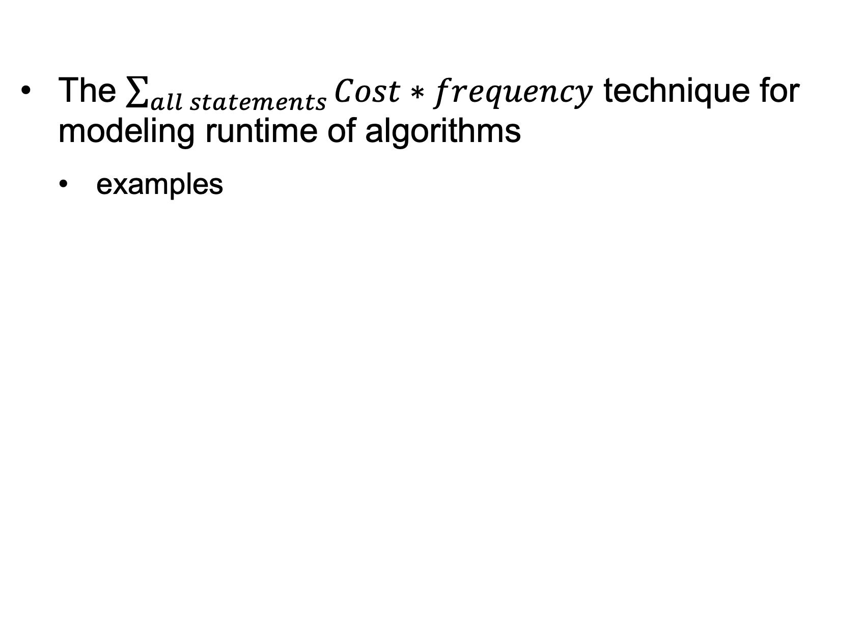
Last lecture …
The $\sum_{all statements}{Cost∗frequency}$ technique for modeling runtime of algorithms
examples

Slide 4
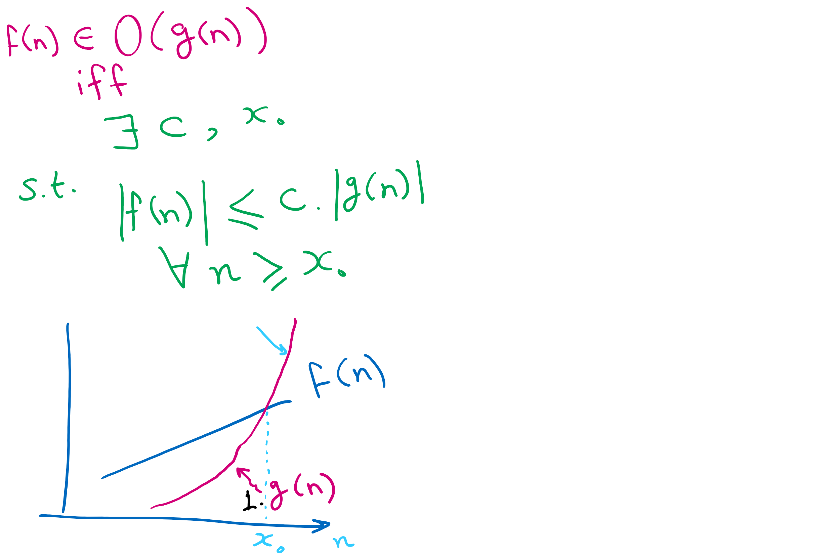
Formal Definition of Big-O functions

Slide 5
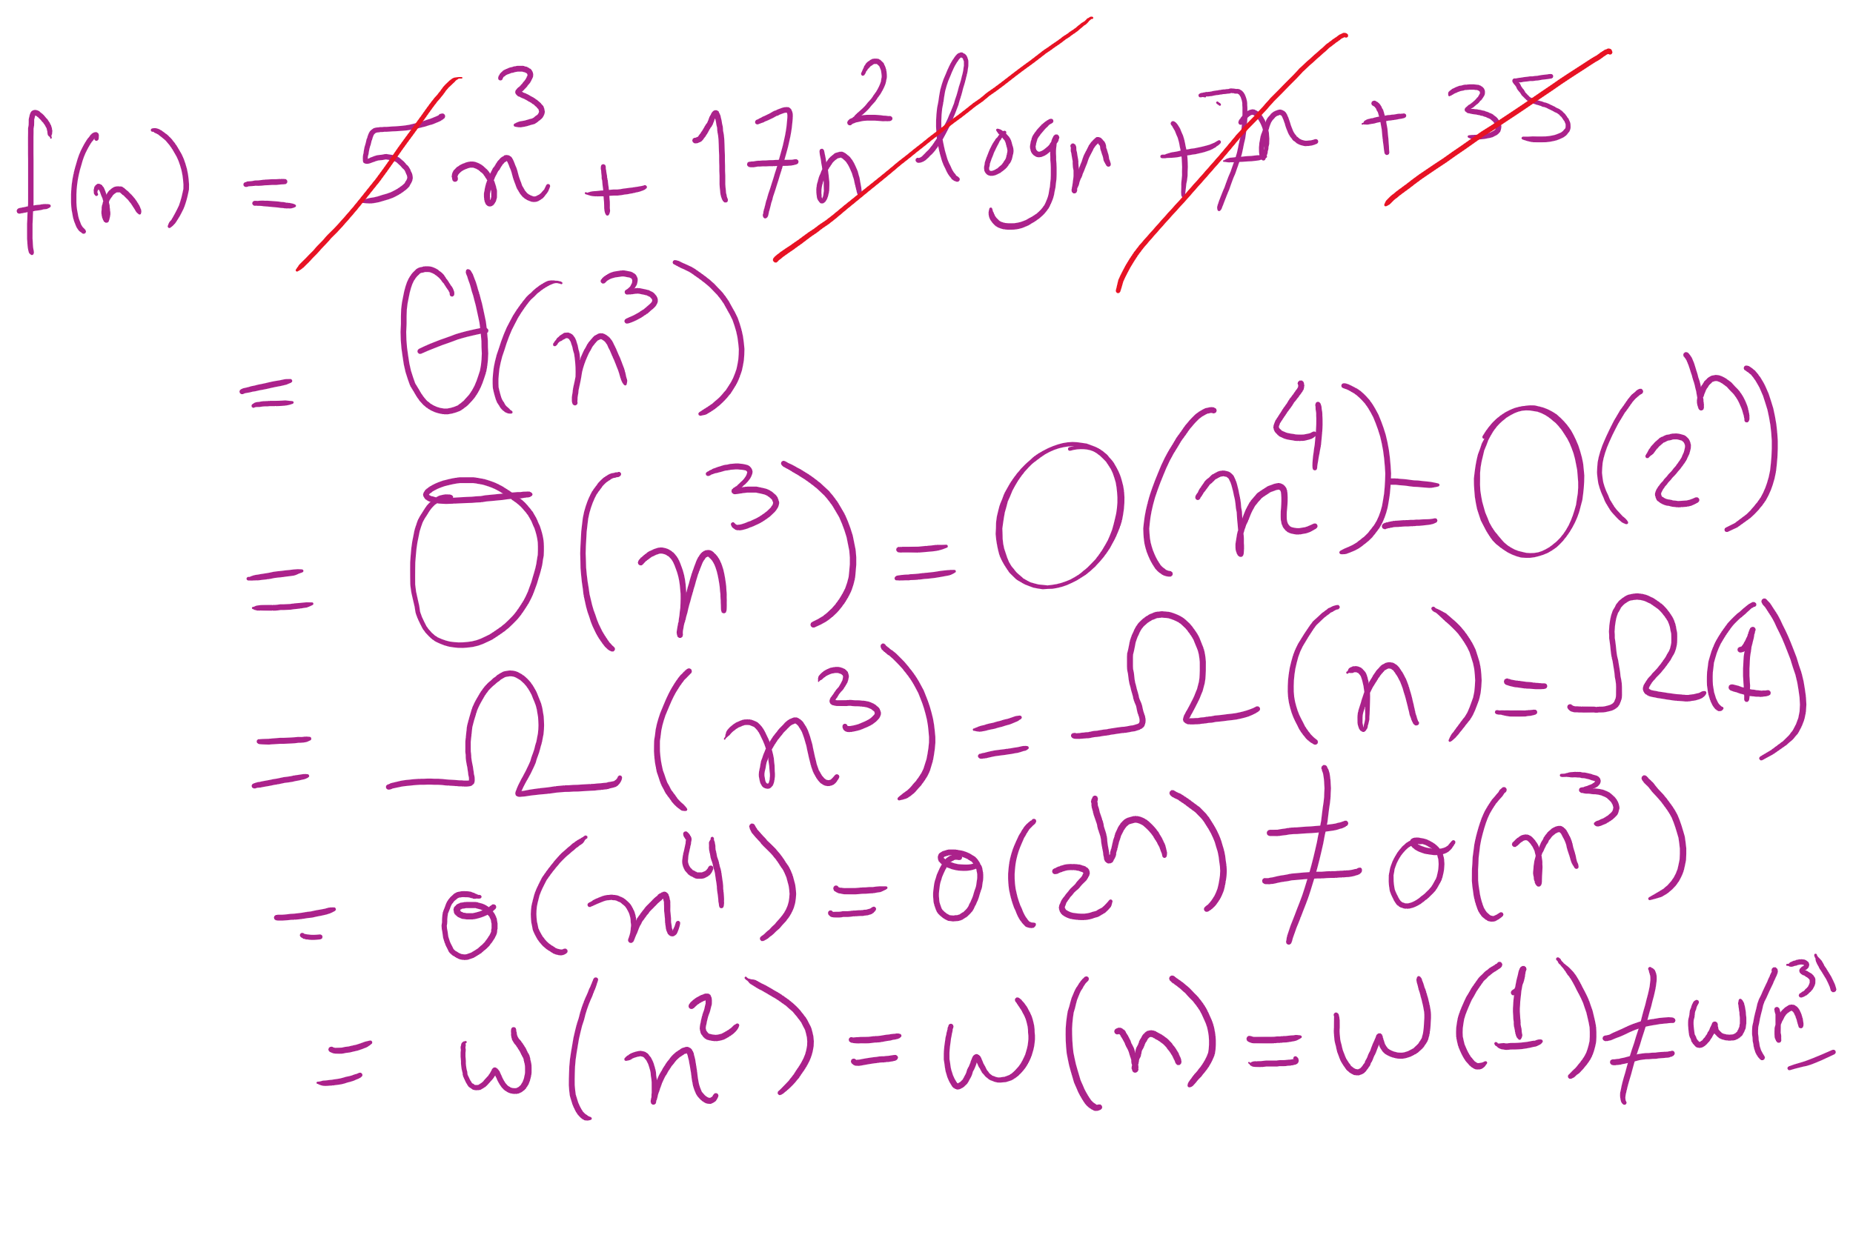
Big O vs Theta

Slide 6
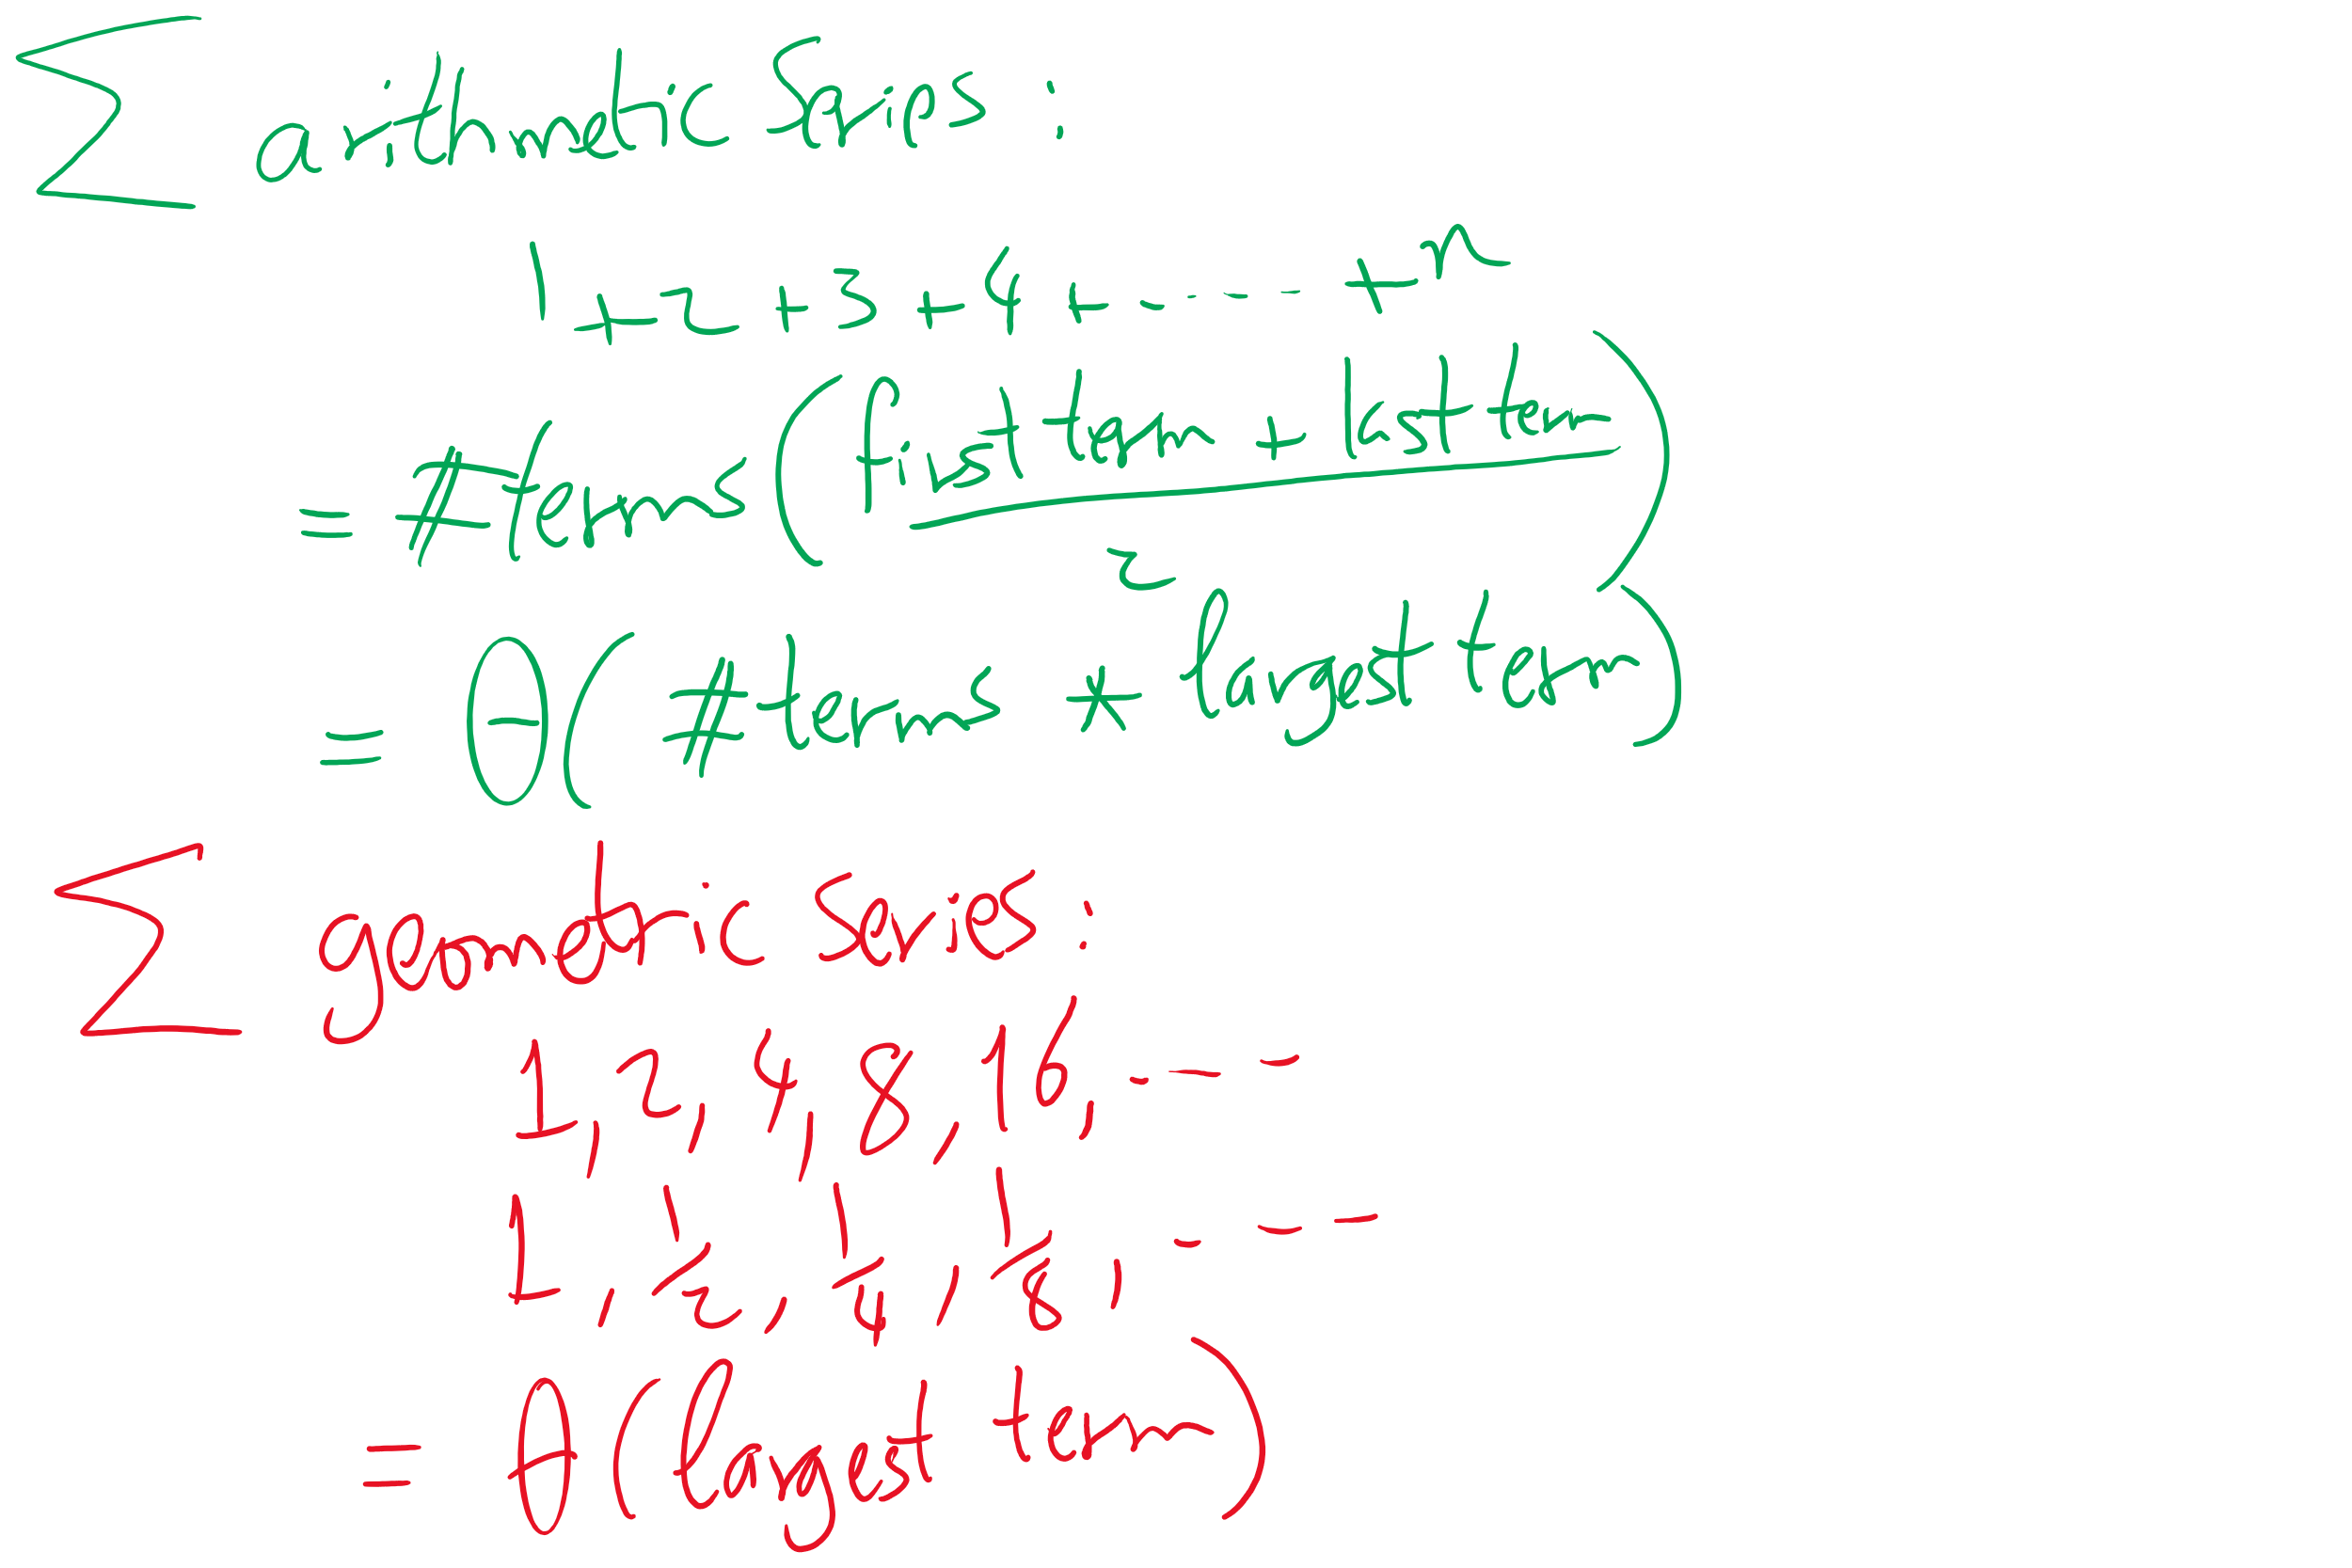
A couple useful Math formulae

Slide 7
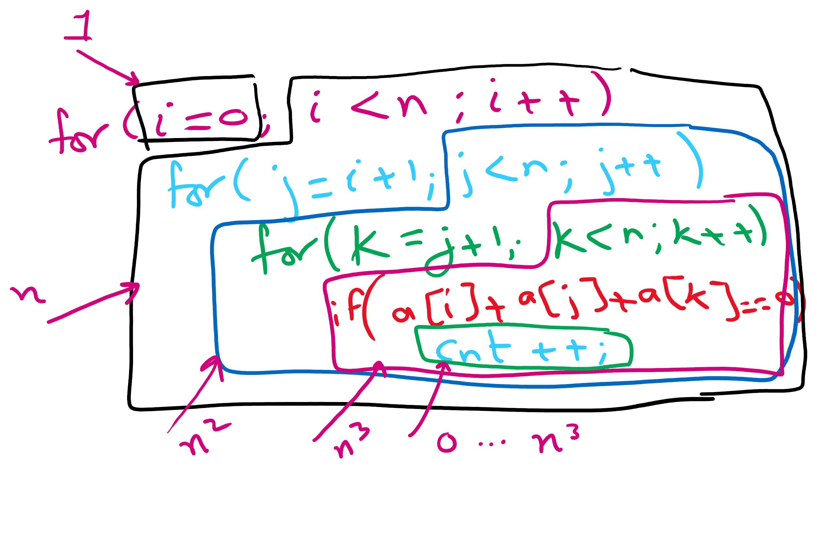
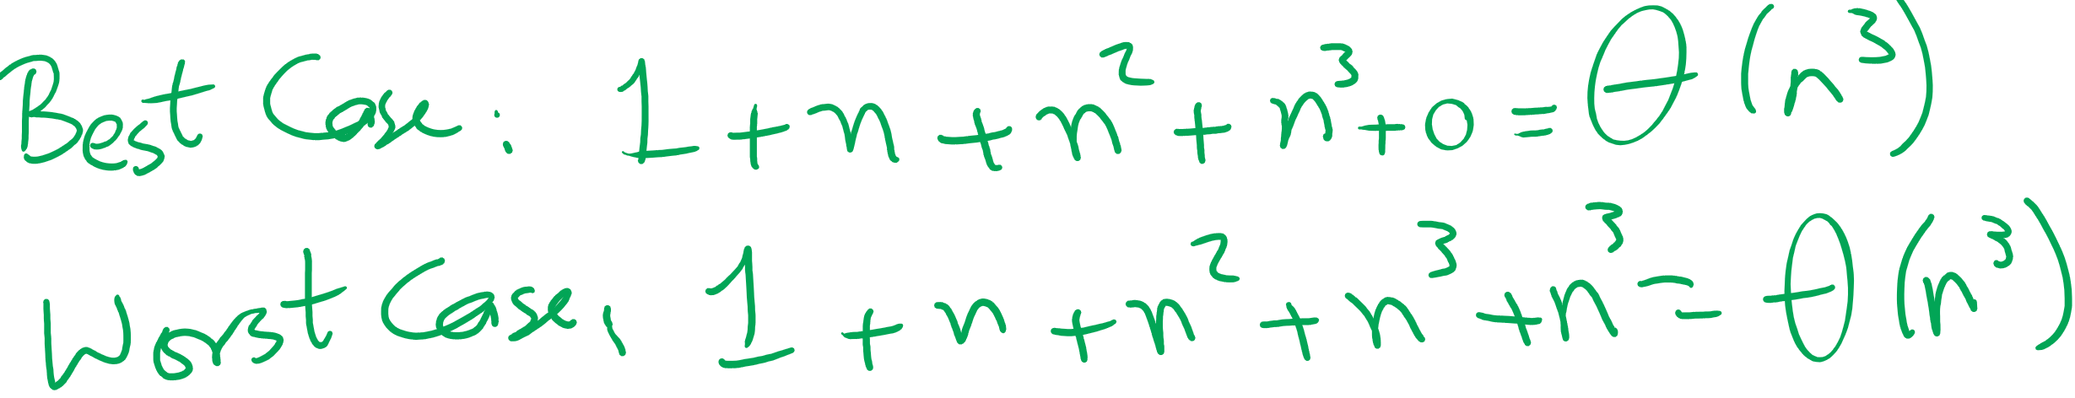
Runtime Analysis of 3-loop Algorithm for ThreeSum

Slide 8
In today’s lecture …
Exhaustive (brute-force) search algorithms
Search space
Size
As a tree
Pruning to reduce search space size
Backtracking algorithm
Overall (recursive) structure
Relationship to the search space tree
Examples
PIN/Password Cracking
8 Queens
Boggle game

Slide 9
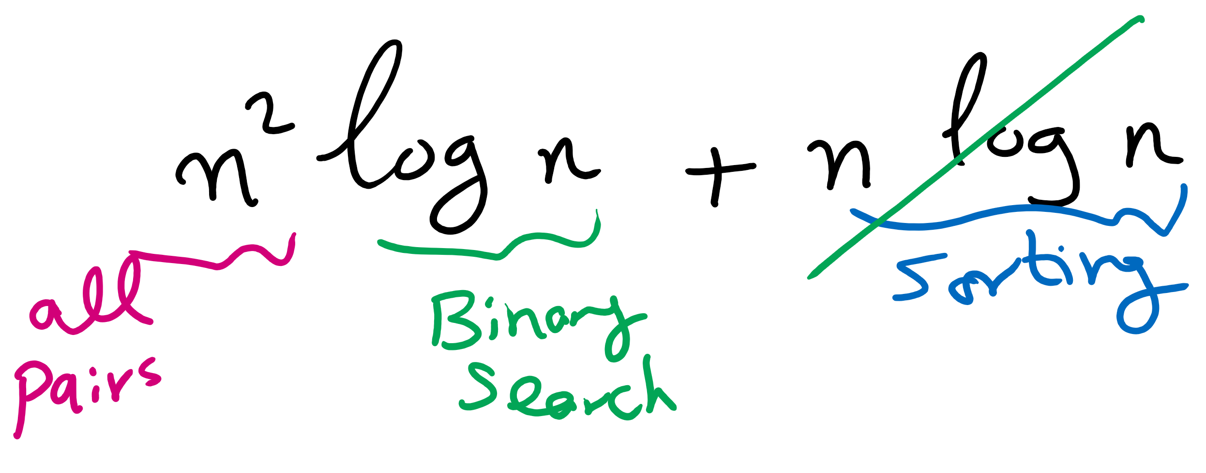
A better algorithm for ThreeSum
What if we sorted the array first?
Pick two numbers, then binary search for the third one that will make a sum of zero
a[i] = 10, a[j] = -7, binary search for -3
Still have two for loops, but we replace the third with a binary search
Runtime now?
What if the input data isn't sorted?
What about the sorting time?
Notes:
New runtime:
Θ(n² log n)
Sort time:
O(n log n)
done before our search, dominated by search time
Asymptotically insignificant

Slide 10
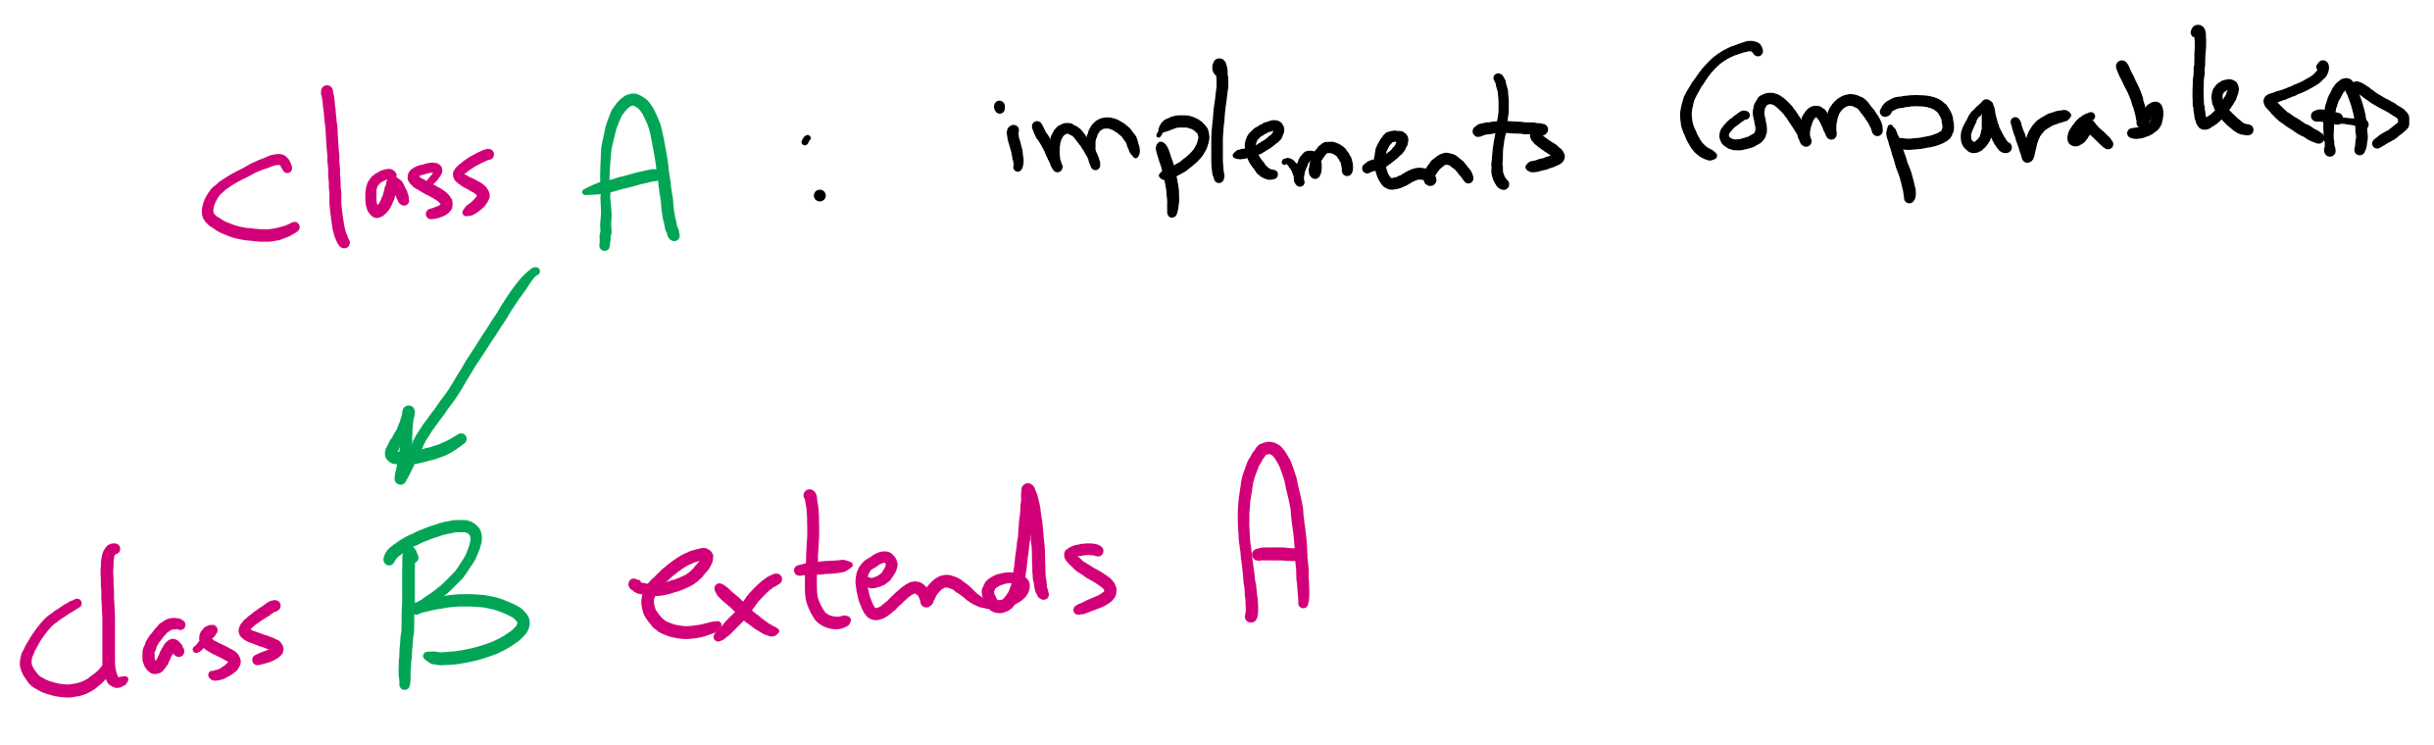
Bubble sort
Simply go through the array comparing pairs of items, swap them if they are out of order
Repeat until you make it through the array with 0 swaps
<T extends Comparable<? super T>> void bubbleSort(T [] a) {
boolean swapped;
do {
swapped = false;
for(int j = 1; j < a.length; j++) {
if (less(a[j], a[j-1]))
{ exch(a, j-1, j); swapped = true; }
}
} while(swapped);
}
Notes:
grey
t₃
1
yellow
t₂
x (x varies from 0 .. n)
red
t₁
sum i=1 to x (sum j=1 to n (1))
= n² (assuming x == n)
purple
t₀
y (y varies from 0 .. n²)

Slide 11
Bubble sort example
SWAPPED!
1
5
3
3
5
3
1
4
1
4
5
4
1
5
10

Slide 12
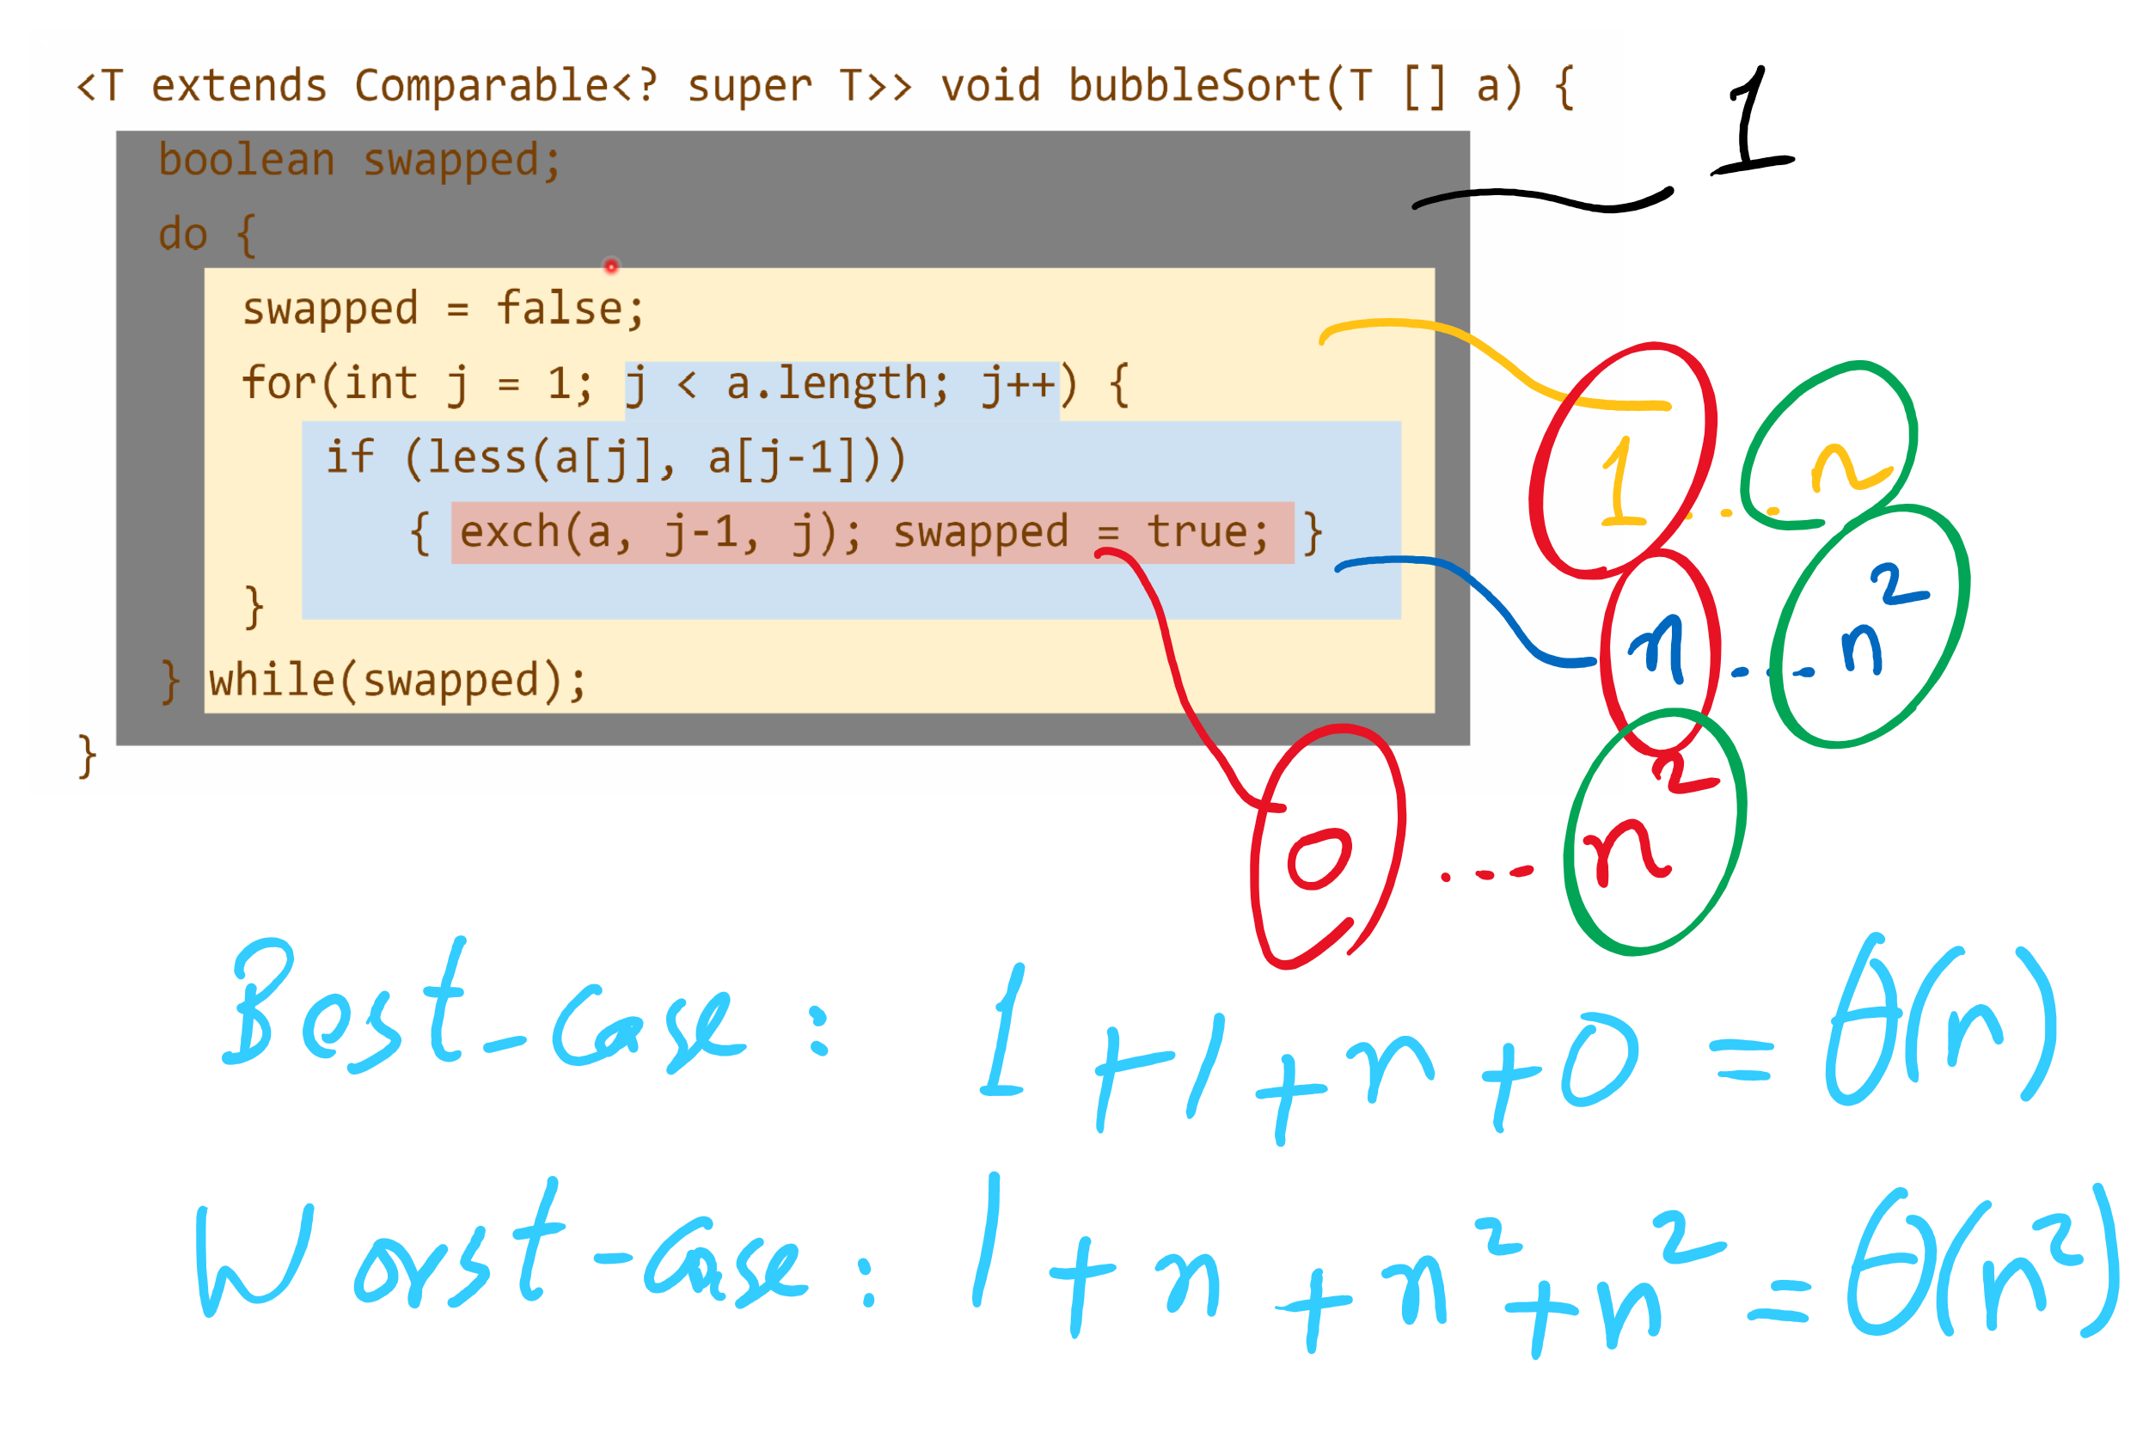
Runtime Modeling

Slide 13
“Improved” bubble sort
void bubbleSort(Comparable[] a) {
boolean swapped;
int to_sort = a.length;
do {
swapped = false;
for(int j = 1; j < to_sort; j++) {
if (less(a[j], a[j-1]))
{ exch(a, j-1, j); swapped = true; }
}
to_sort--;
} while(swapped);
}
Notes:
grey
t₃
1
yellow
t₂
x (x varies from 0 .. n)
red
t₁
sum i=1 to x (sum j=1 to n-i (1))
= n²/2 - n/2 (assuming x == n)
purple
t₀
y (y varies from 0 .. n²/2 - n/2)

Slide 14
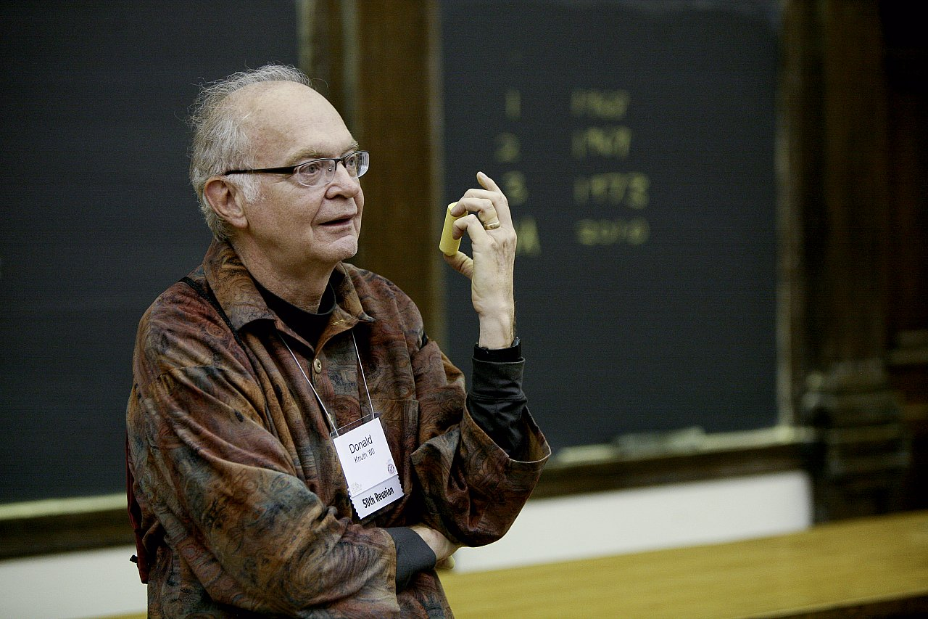
How bad is it?
Runtime:
O(n²)
"[A]lthough the techniques used in the calculations [to analyze the bubble sort] are instructive, the results are disappointing since they tell us that the bubble sort isn't really very good at all."
Donald Knuth
The Art of Computer Programming

Slide 15
Brute-force (or exhaustive) search
Find the solution to a problem by considering all potential solutions and selecting the correct one(s)
Run-time is bounded by the number of potential solutions
n³ potential solutions means cubic run-time
2^{n} potential solutions means exponential run-time

Slide 16
Password cracking
Brute force password attacks depend on the length of the password, hence the insecurity of short passwords
We can view the series of guesses we make as a tree
Each path from root to leaf is an attempted solution

Slide 17
PIN cracking example
Root
0
1
2
...
9
00
01
02
...
09
000
001
002
...
009
0000
0001
0002
...
0009

Slide 18
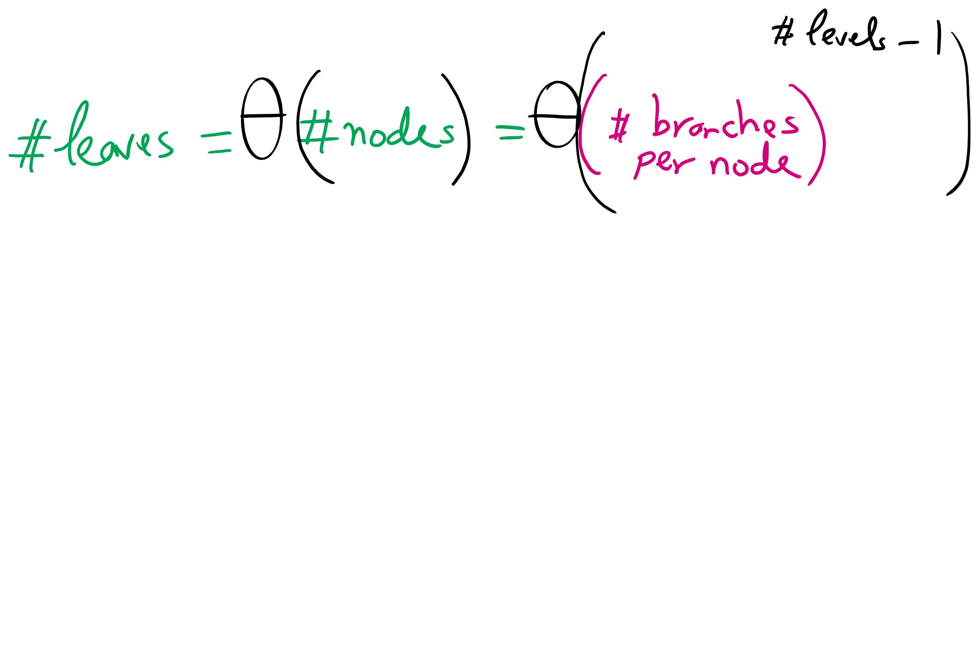
Tree Size

Slide 19
Search space size
This tree will enumerate 10^{n} different PINs
n is the length of the PIN
So for our case 10⁴ = 10,000 different PINs
Note that this is (for a computer) tiny
What would be a long password for a computer?
Say 128 bits long
2^{n} different passwords
2¹²⁸ = 340282366920938463463374607431768211456
Assuming a supercomputer can check 33860000000000 passwords per second...
And we’ll on average find the correct password after guessing half the possibilities…
We should be able to crack a 128 bit password on our supercomputer in 1.59 x 10¹⁷ years using brute force
Notes:
39-digit number
33 x 10¹²
Not all of those strings contain all valid characters though, so how can we cut down the number of checks?

Slide 20
PIN cracking example
Root
0
1
2
...
9
00
01
02
...
09
000
001
002
...
009
0000
0001
0002
...
0009

Slide 21
Back to our PIN cracking example
What if we have background knowledge that the PIN we’re trying to crack doesn’t have more than one 0?
Root
0
1
2
...
9
00
01
02
...
09
010
011
012
...
019
...

Slide 22
Pruning!
Removes entire subtrees of our search space exploration
When we can use it, it makes our algorithm practical for much larger values of n
Does not, however, affect the asymptotic performance of an algorithm
Still exponential time requirement for our PIN example
Notes:
For 128-bit binary password, if 8 bits are newline character, can prune since most won’t allow newline characters in password

Slide 23
How to enumerate all these possibilities?
For the PIN example a whole bunch of for loops would do
In general, exhaustive search trees can be easily traversed via recursion and backtracking
Recurse until its apparent no solution can be achieved along the current path
Undo the path to the point that you can start to move forward again

