Slide 1

Algorithms and Data Structures 2 CS 1501
Fall 2021
Sherif Khattab
ksm73@pitt.edu
(Slides are adapted from Dr. Ramirez’s and Dr. Farnan’s CS1501 slides.)

Slide 2
Announcements
Upcoming deadlines:
Lab 11: Friday 12/10
Lab 12 and Homework 12: Monday 12/20 at 5:00 pm
Assignment 4 and 5: Monday 12/20 at 5:00 pm
Bonus Opportunities
Bonus Homework: Monday 12/20 at 5:00 pm
OMETs: 1 bonus point for entire class when response rate >= 80%

Slide 3
Previous lecture …
Ford-Fulkerson MaxFlow Framework
Edmonds-Karp algorithms
BFS
PFS

Slide 4
CourseMIRROR Reflections

Slide 5
Today …

Slide 6
Flow edge implementation
For each edge, we need to store:
Start point, the from vertex
End point, the to vertex
Capacity
Flow
Residual capacities
For forwards and backwards edges

Slide 7
FlowEdge.java
public class FlowEdge {
private final int v; // from
private final int w; // to
private final double capacity; // capacity
private double flow; // flow
…
public double residualCapacityTo(int vertex) {
if (vertex == v) return flow;
else if (vertex == w) return capacity - flow;
else throw new
IllegalArgumentException("Illegal endpoint");
}
…
}

Slide 8
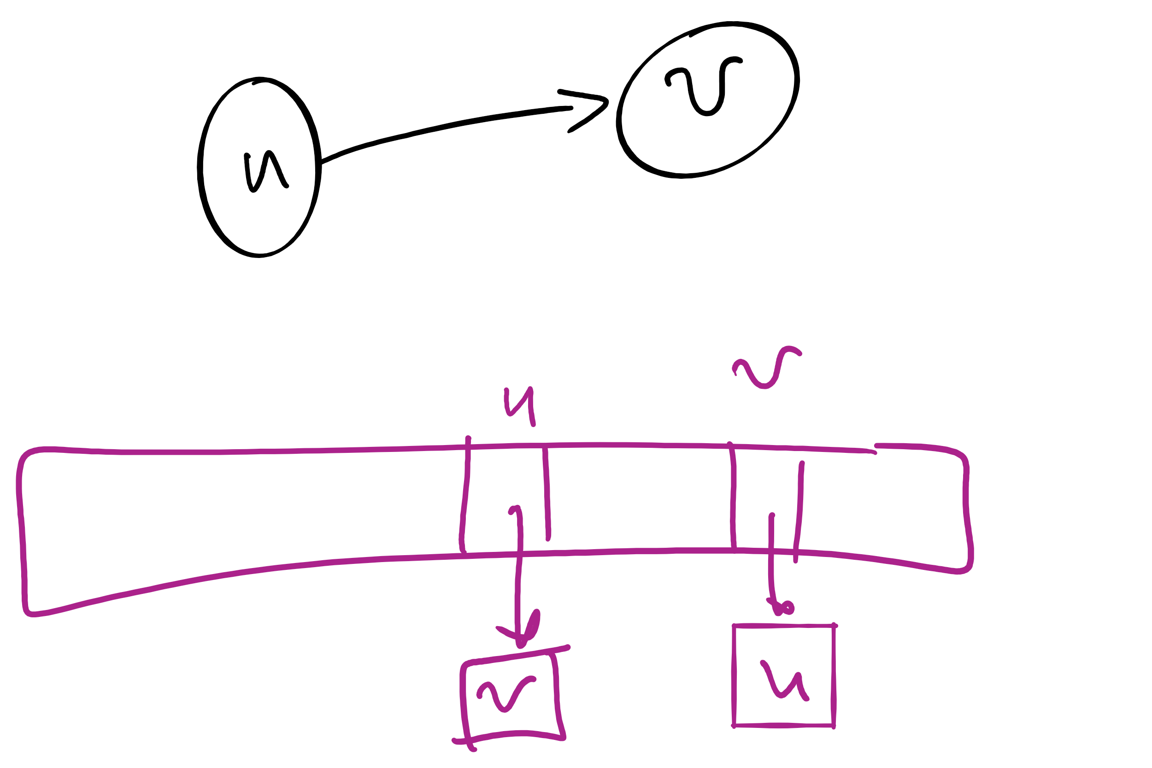
BFS search for an augmenting path (pseudocode)
edgeTo = [|V|]
marked = [|V|]
Queue q
q.enqueue(s)
marked[s] = true
while !q.isEmpty():
v = q.dequeue()
for each (v, w) in AdjList[v]:
if residualCapacity(v, w) > 0:
if !marked[w]:
edgeTo[w] = v;
marked[w] = true;
q.enqueue(w);
Each FlowEdge object is stored in the adjacency list twice:
Once for its forward edge
Once for its backward edge

Slide 9
Value of maxflow
Add up the flow increments in each iteration of Ford-Fulkerson
Add up the edge flows out of source
Add up the edge flows of the out of source

Slide 10
Let's separate the graph
An st-cut on G is a set of edges in G that, if removed, will partition the vertices of G into two disjoint sets
One contains s
One contains t
May be many st-cuts for a given graph
Let’s focus on finding the minimum st-cut
The st-cut with the smallest capacity
May not be unique

Slide 11
How do we find the min st-cut?
We could examine residual graphs
Specifically, try and allocate flow in the graph until we get to a residual graph with no existing augmenting paths
A set of saturated edges will make a minimum st-cut

Slide 12
Min cut example
A
1
/1
/3
1
3
/7
2
s
C
t
2
/5
5
/7
3
3
/9
B
Notes:
Will the max flow always be the edges going into or out of the source/sink?
No! get the students to imagine a graph where this is the case

Slide 13
Max flow == min cut
A special case of duality
I.e., you can look at an optimization problem from two angles
In this case to find the maximum flow or minimum cut
In general, dual problems do not have to have equal solutions
The differences in solutions to the two ways of looking at the problem is referred to as the duality gap
If the duality gap = 0, strong duality holds
Max flow/min cut uphold strong duality
If the duality gap > 0, weak duality holds

Slide 14
Determining a minimum st-cut
First, run Ford Fulkerson to produce a residual graph with no further augmenting paths
The last attempt to find an augmenting path will visit every vertex reachable from s
Edges with only one endpoint in this set comprise a minimum st-cut

Slide 15
Determining the min cut
A
A
/1
1
/3
2
3
/7
s
s
C
C
t
5
/5
/7
3
3
/9
Min Cut
B
B
Notes:
Green is the set of seen vertices reachable from s

Slide 16
Max flow / min cut on unweighted graphs
Is it possible?
How would we measure the Max flow / min cut?
What would an algorithm to solve this problem look like?

Slide 17
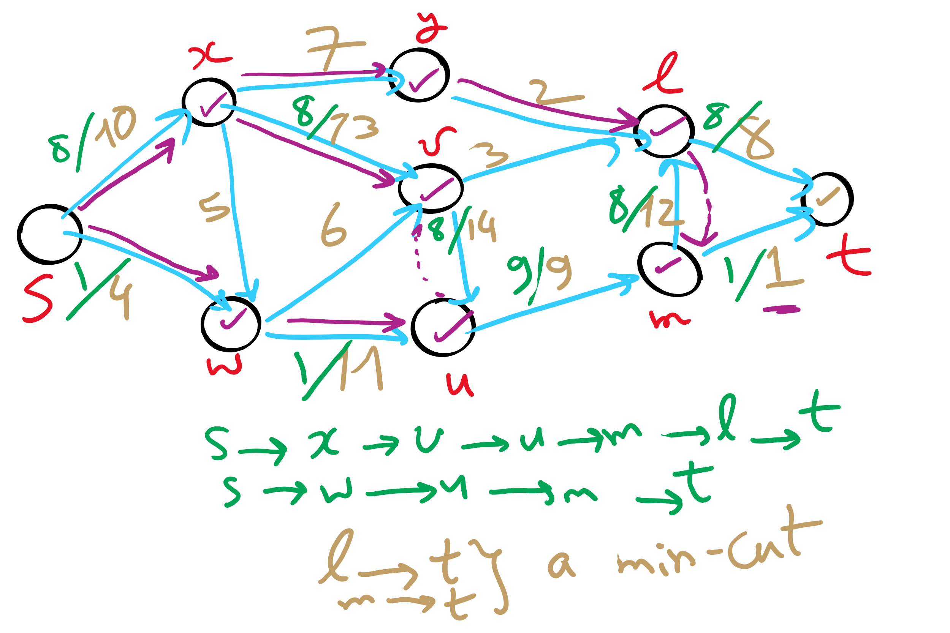
Min st-cut Example 1

Slide 18
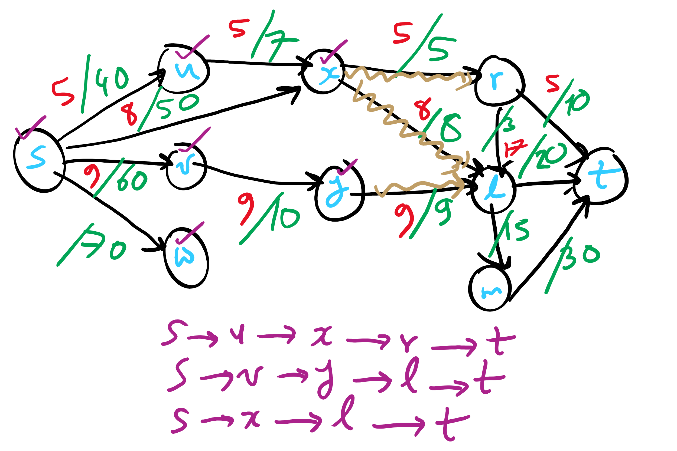
Min st-cut Example 2

Slide 19
Unweighted network flow
A
F
s
B
E
t
C
D
Notes:
Red: edge begin used in BFS pathfinding alg
Blue: edge has flow allocated to it

Slide 20
Please submit your reflections by using the CourseMIRROR App
If you are having a problem with CourseMIRROR, please send an email to coursemirror.development@gmail.com
Notes:
All right!
Upcoming Due Dates at A Glance

Slide 21
Karatsuba Example 1

Slide 22
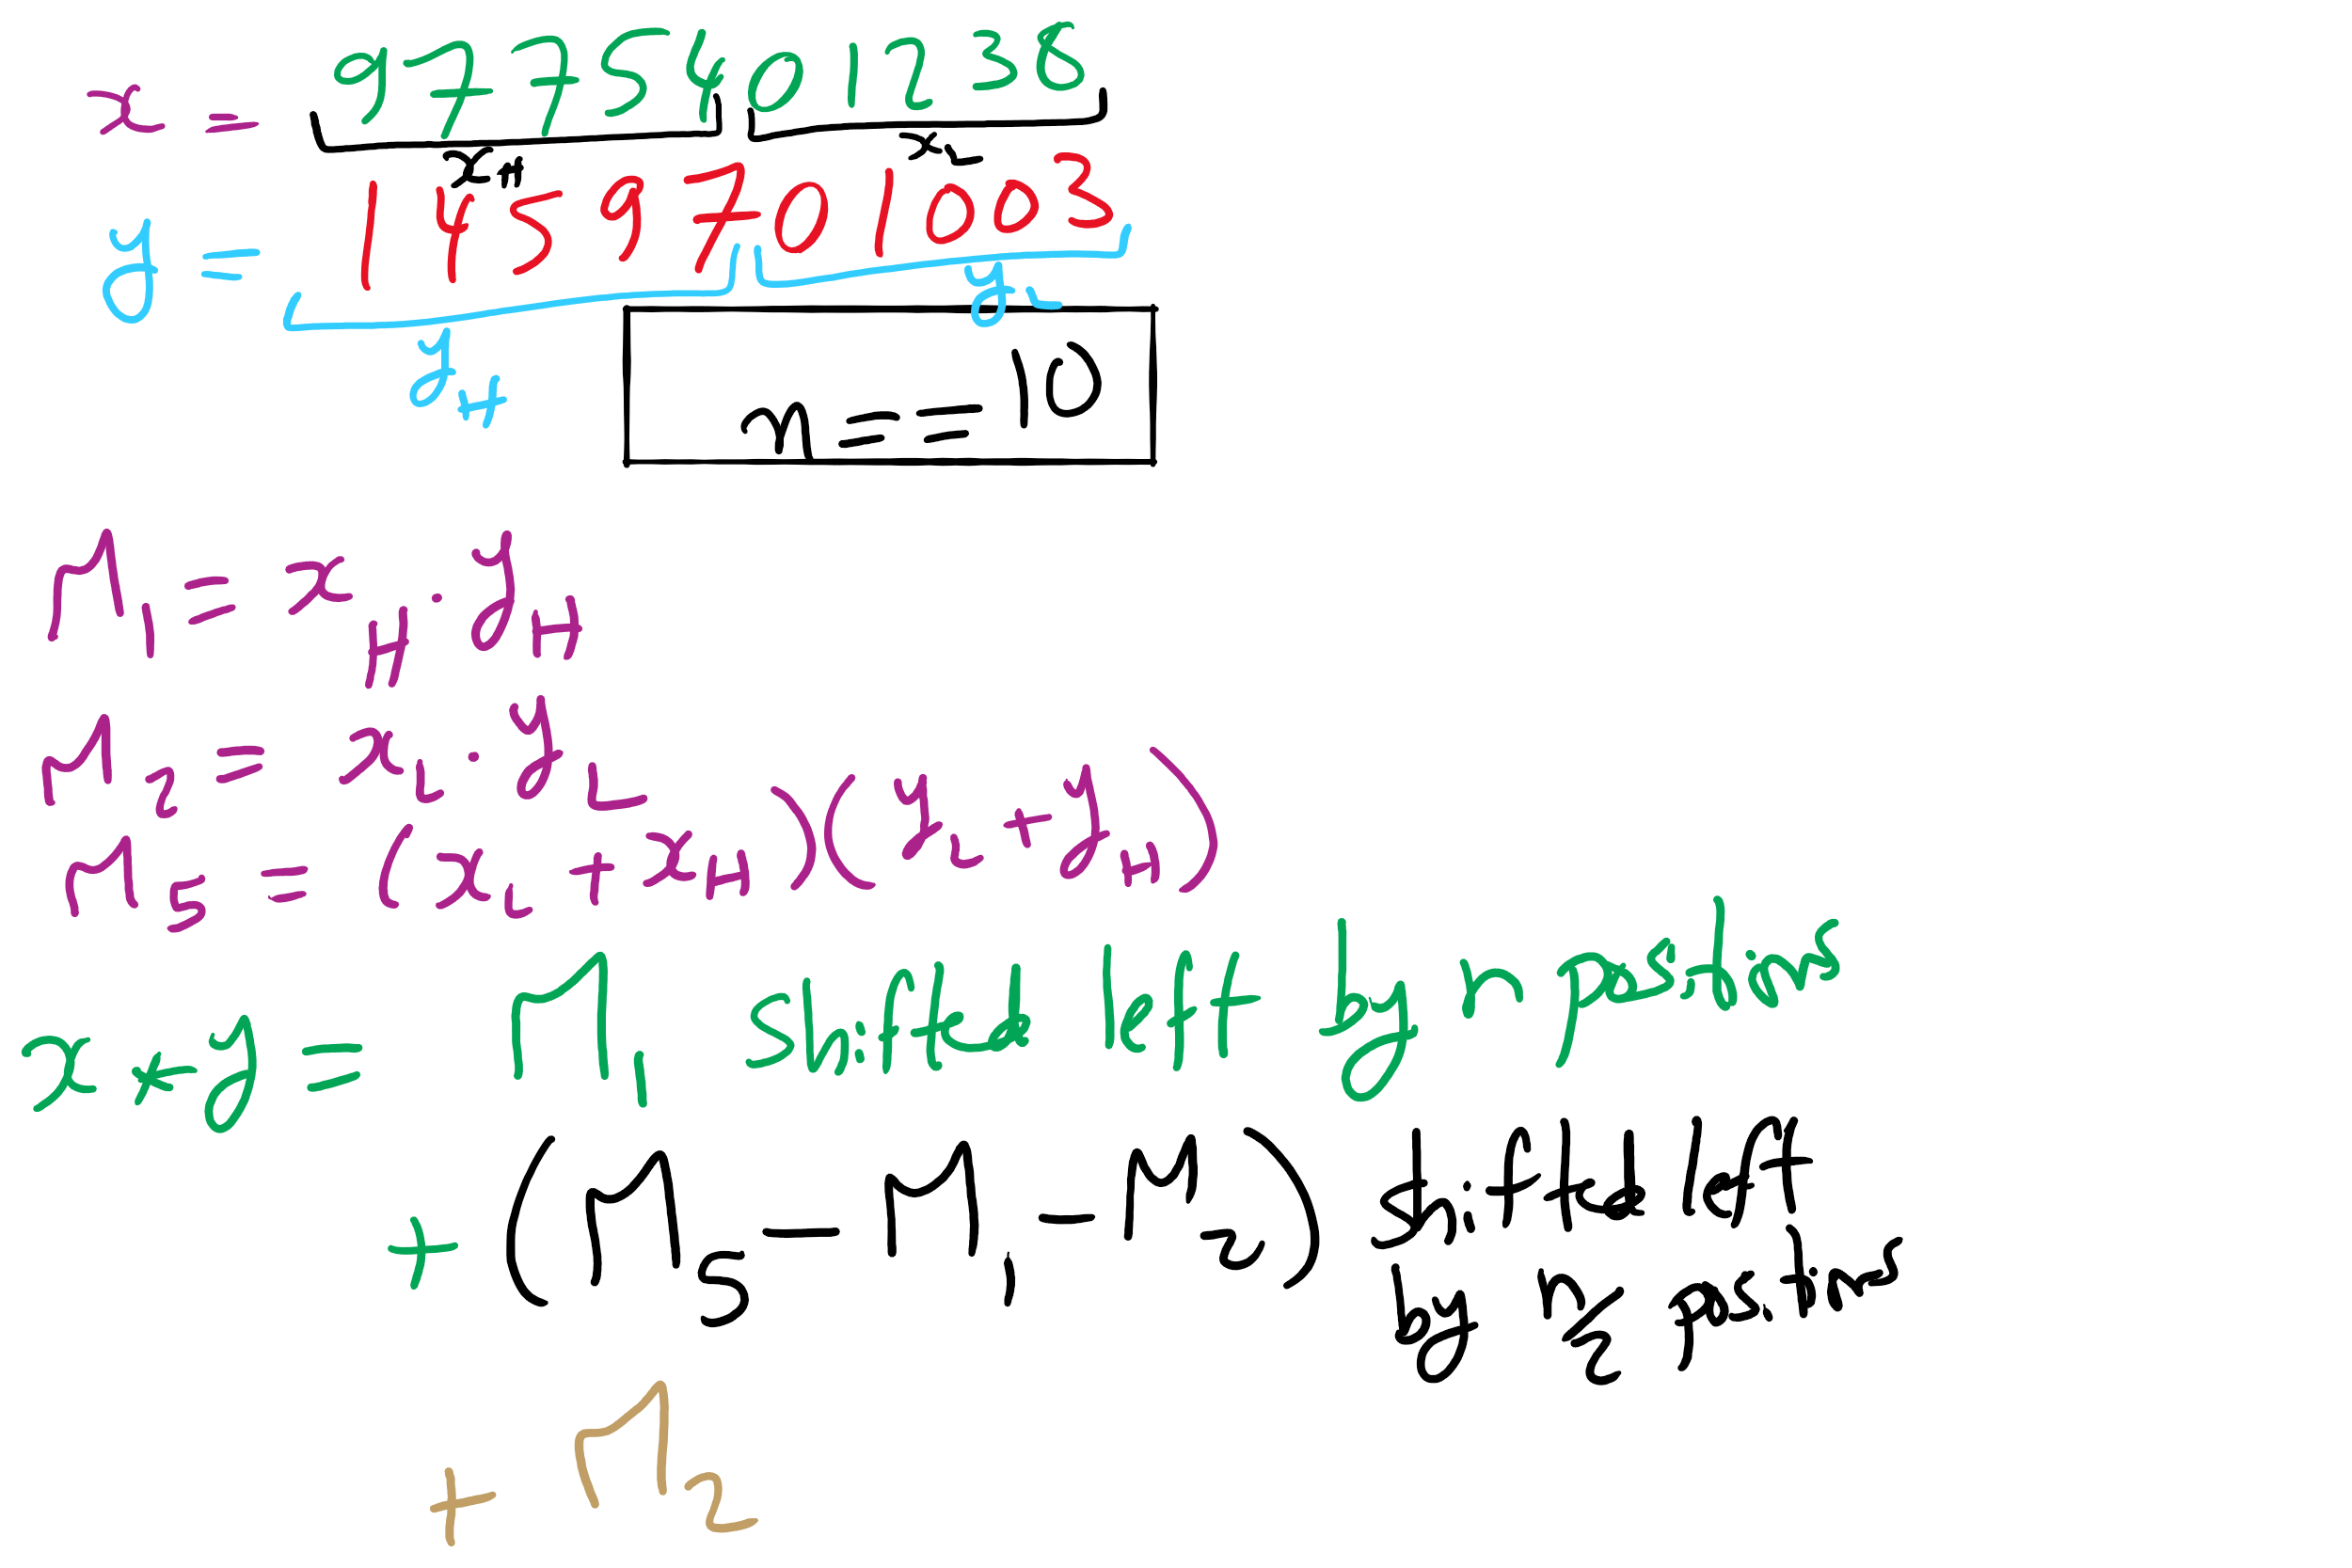
Karatsuba Example 2

Slide 23
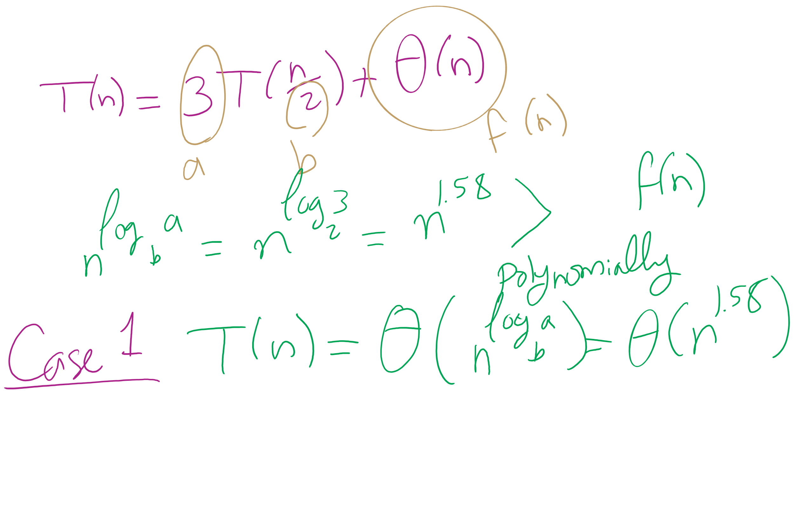
Karatsuba Runtime

Slide 24
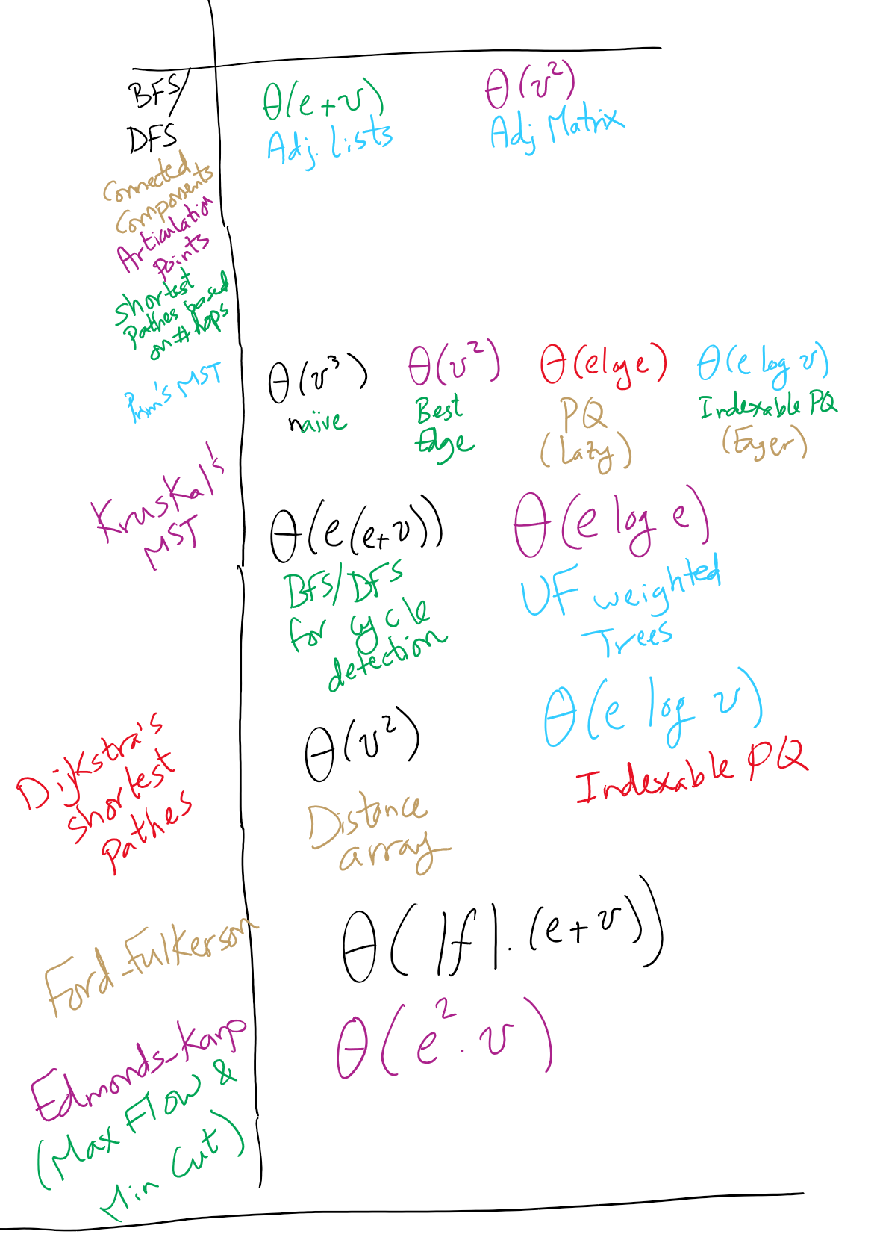
Graph Algorithms Runtime

Slide 25
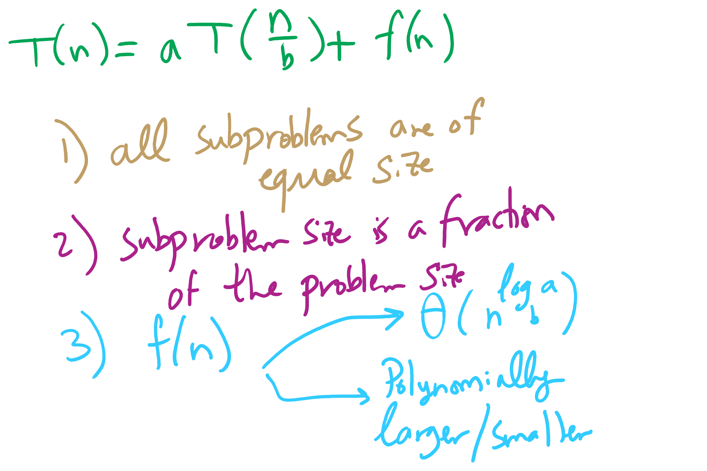
Master Theorem Conditions

Slide 26
This Lecture
(Big)Integer Algorithms
exponentiation
GCD
RSA encryption

Slide 27
This is way too long to do exponentiations!
So how do we do better?
Let’s try divide and conquer!
x^{y} = (x^{(y/2)})²
When y is even, (x^{(y/2)})² * x when y is odd
Analyzing a recursive approach:
Base case?
When y is 1, x^{y} is x; when y is 0, x^{y} is 1
Runtime?

Slide 28
Building another recurrence relation
x^{y} = (x^{(y/2)})² = x^{(y/2)} * x^{(y/2)}
Similarly, (x^{(y/2)})² * x = x^{(y/2)} * x^{(y/2)} * x
So, our recurrence relation is:
T(n) = T(n-1) + ?
How much work is done per call?
1 (or 2) multiplication(s)
Examined runtime of multiplication last lecture
But how big are the operands in this case?

Slide 29
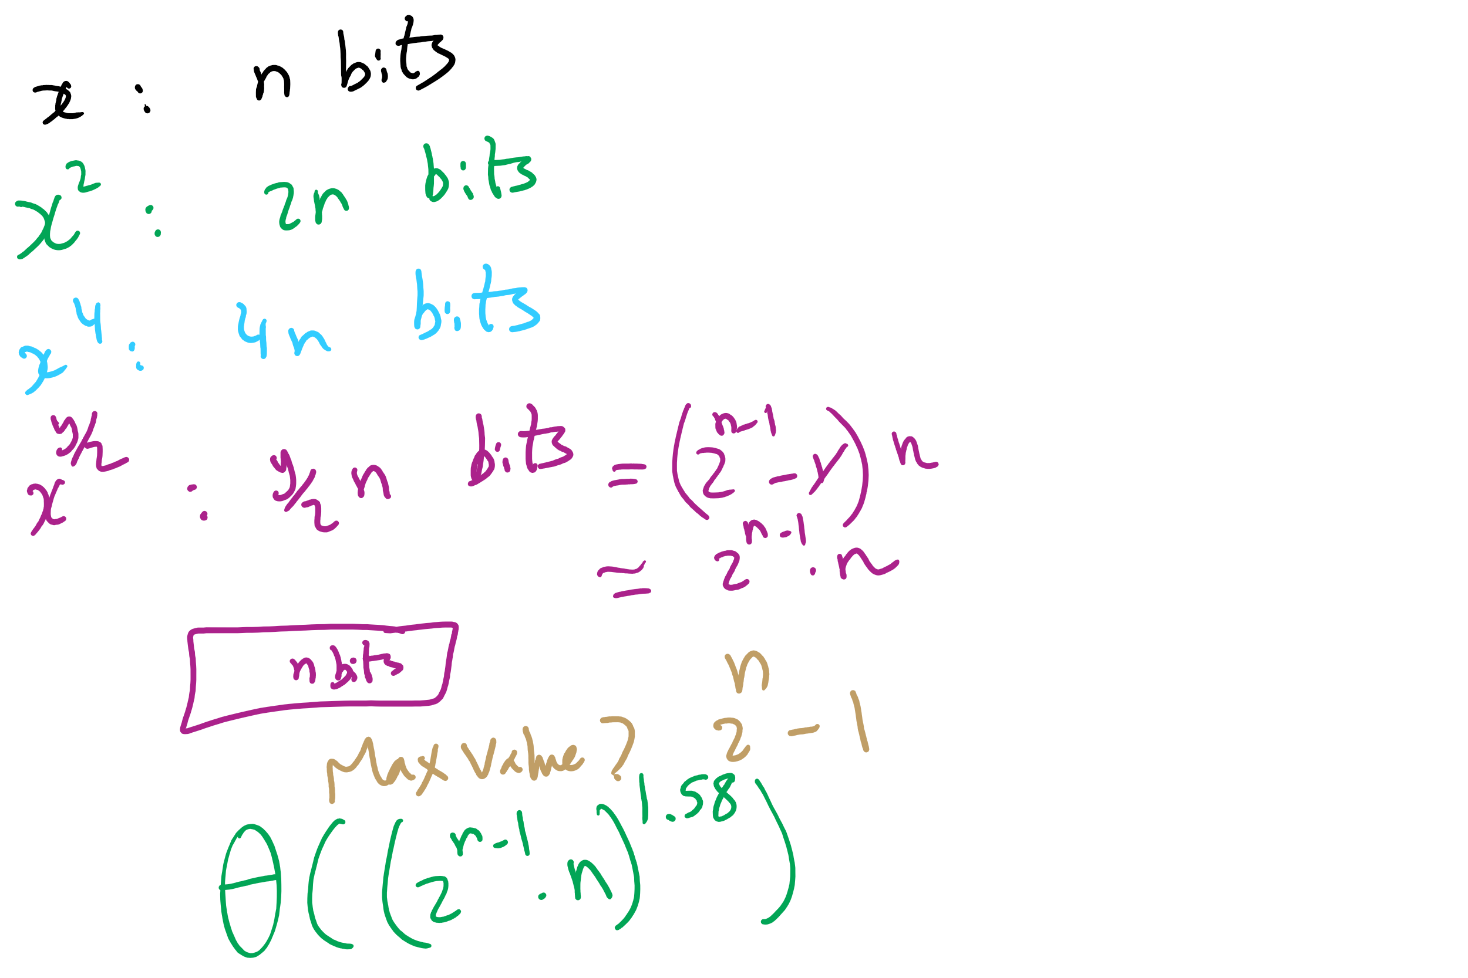
Non-recursive Work

Slide 30
Determining work done per call
Base case returns x
n bits
Base case results are multiplied: x * x
n bit operands
Result size?
2n
These results are then multiplied: x² * x²
2n bit operands
Result size?
4n bits
…
x^{(y/2)} * x^{(y/2)}?
(y / 2) * n bit operands = 2^{(n-1)} * n bit operands
Result size? y * n bits = 2^{n} * n bits

Slide 31
Multiplication input size increases throughout
Our recurrence relation looks like:
T(n) = T(n-1) + Θ((2^{(n-1)} * n)²)
squared from the use of the gradeschool algorithm
multiplication input size

Slide 32
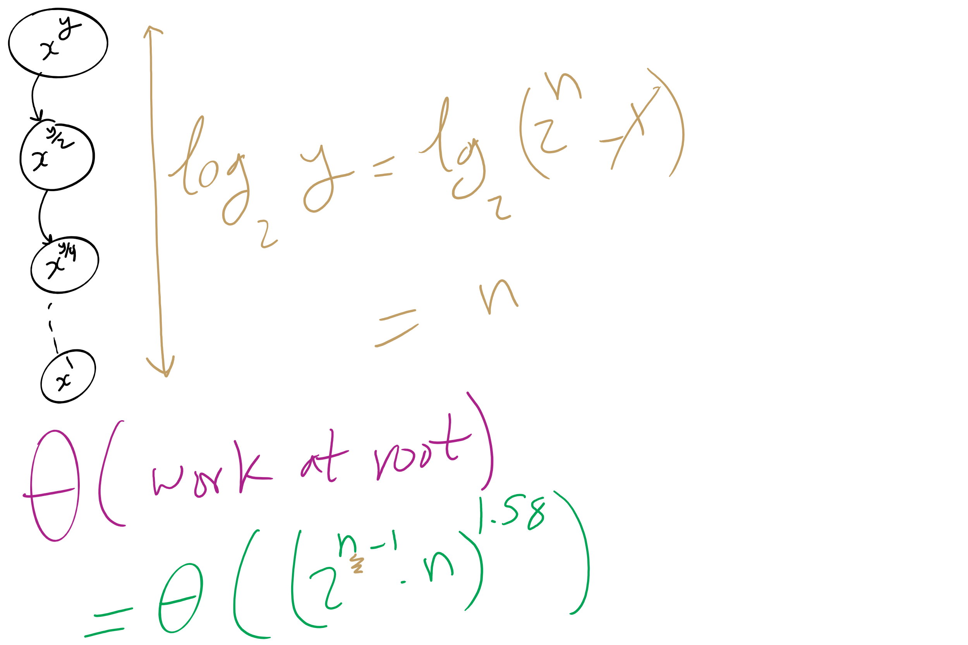
Runtime Analysis

Slide 33
Runtime analysis
Can we use the master theorem?
Nope, we don’t have a b > 1
OK, then…
How many times can y be divided by 2 until a base case?
lg(y)
Further, we know the max value of y
Relative to n, that is:
2^{n}
So, we have, at most lg(y) = lg(2^{n}) = n recursions

Slide 34
But we need to do expensive mult in each call
We need to do Θ((2^{(n-1)} * n)²) work in just the root call!
Our runtime is dominated by multiplication time
Exponentiation quickly generates HUGE numbers
Time to multiply them quickly becomes impractical

Slide 35
Can we do better?
We go “top-down” in the recursive approach
Start with y
Halve y until we reach the base case
Square base case result
Continue combining until we arrive at the solution
What about a “bottom-up” approach?
Start with our base case
Operate on it until we reach a solution

Slide 36
A bottom-up approach
To calculate x^{y}
ans = 1
foreach bit in y:
ans = ans²
if bit == 1:
ans = ans * x
From most to least significant

Slide 37
Bottom-up exponentiation example
Consider x^{y} where y is 43 (computing x⁴³)
Iterate through the bits of y (43 in binary: 101011)
ans = 1
ans = 1² = 1
ans = 1 * x = x
ans = x² = x²
ans = (x²)² = x⁴
ans = x⁴ * x = x⁵
ans = (x⁵)² = x¹⁰
ans = (x¹⁰)² = x²⁰
ans = x²⁰ * x = x²¹
ans = (x²¹)² = x⁴²
ans = x⁴² * x = x⁴³
Notes:
3⁴³ = 328256967394537077627

Slide 38
Does this solve our problem with mult times?
Nope, still squaring ans everytime
We’ll have to live with huge output sizes
This does, however, save us recursive call overhead
Practical savings in runtime

Slide 39
Greatest Common Divisor
GCD(a, b)
Largest int that evenly divides both a and b
Easiest approach:
BRUTE FORCE
i = min(a, b)
while(a % i != 0 || b % i != 0):
i--
Runtime?
Θ(min(a, b))
Linear!
In value of min(a, b)...
Exponential in n
Assuming a, b are n-bit integers

Slide 40
Euclid’s algorithm
b
GCD(a, b) = GCD(b, a % b)
a % b
a
Notes:
GCD(1071, 462) = 21
If students don't believe me, tell them to make a 1071 x 462 pixel image in paint and try it out

Slide 41
Euclidean example 1
GCD(30, 24)
= GCD(24, 30 % 24)
= GCD(24, 6)
= GCD(6, 24 % 6)
= GCD(6, 0)...
Base case! Overall GCD is 6

Slide 42
Euclidean example 2
= GCD(99, 78)
99 = 78 * 1 + 21
= GCD(78, 21)
78 = 21 * 3 + 15
= GCD(21, 15)
21 = 15 * 1 + 6
= GCD (15, 6)
15 = 6 * 2 + 3
= GCD(6, 3)
6 = 3 * 2 + 0
= 3

Slide 43
Analysis of Euclid’s algorithm
Runtime?
Tricky to analyze, has been shown to be linear in n
Where, again, n is the number of bits in the input

Slide 44
Extended Euclidean algorithm
In addition to the GCD, the Extended Euclidean algorithm (XGCD) produces values x and y such that:
GCD(a, b) = i = ax + by
Examples:
GCD(30,24) = 6 = 30 * 1 + 24 * -1
GCD(99,78) = 3 = 99 * -11 + 78 * 14
Can be done in the same linear runtime!

Slide 45
Extended Euclidean example
= GCD(99, 78)
99 = 78 * 1 + 21
= GCD(78, 21)
78 = 21 * 3 + 15
= GCD(21, 15)
21 = 15 * 1 + 6
= GCD (15, 6)
15 = 6 * 2 + 3
= GCD(6, 3)
6 = 3 * 2 + 0
= 3
3 = 15 - (2 * 6)
6 = 21 - 15
3 = 15 - (2 * (21 - 15))
= 15 - (2 * 21) + (2 * 15)
= (3 * 15) - (2 * 21)
15 = 78 - (3 * 21)
3 = (3 * (78 - (3 * 21))) - (2 * 21)
= (3 * 78) - (11 * 21)
21 = 99 - 78
3 = (3 * 78) - (11 * (99 - 78))
= (14 * 78) - (11 * 99)
= 99 * -11 + 78 * 14
Notes:
Solve for 3 (the end result and GCD)
Then solve for 6, substitute into prev result
Then solve for 15, substitute into prev result
Then solve for 21, substitute into prev result

Slide 46
OK, but why?
This and all of our large integer algorithms will be handy when we look at algorithms for implementing…
CRYPTOGRAPHY

Slide 47
Introduction to crypto
Cryptography - enabling secure communication in the presence of third parties
Alice wants to send Bob a message without anyone else being able to read it
Alice
M
Encrypt
C
Decrypt
M
Bob

Slide 48
Enter the adversary
Consider the adversary to be anyone that could try to eavesdrop on Alice and Bob communicating
People in the same coffee shop as Alice or Bob as they talk over WiFi
Admins operating the network between Alice and Bob
And mirroring their traffic to the NSA…
Will have access to:
The ciphertext
The encrypted message
The encryption algorithm
At least Alice and Bob should assume the adversary does
The key material is the only thing Bob knows that the adversary does not

Slide 49
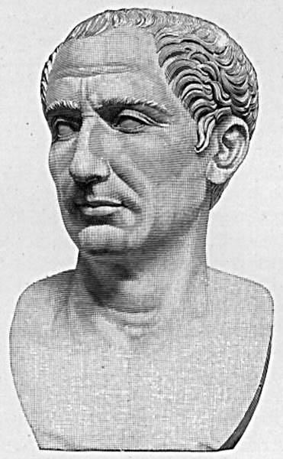
Cryptography has been around for some time
Early, classic encryption scheme:
Caesar cipher:
“Shift” the alphabet by a set amount
Use this shifted alphabet to send messages
The “key” is the amount the alphabet is shifted
Yes, that Caesar
Alphabet
ABCDEFGHIJKLMNOPQRSTUVWXYZ
XYZABCDEFGHIJKLMNOPQRSTUVW
Shift 3
Notes:
ROT3(OVALTINE) = LSXIQFKB

Slide 50
By modern standards, incredibly easy to crack
BRUTE FORCE
Try every possible shift
25 options for the English alphabet
255 for ASCII
OK, let's make it harder to brute force
Instead of using a shifted alphabet, let's use a random permutation of the alphabet
Key is now this permutation, not just a shift value
R size alphabet means R! possible permutations!

Slide 51
By modern standards, incredibly easy to crack
Just requires a bit more sophisticated of an algorithm
Analyzing encrypted English for example
Sentences have a given structure
Character frequencies are skewed
Essentially playing Wheel of Fortune

Slide 52
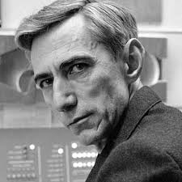
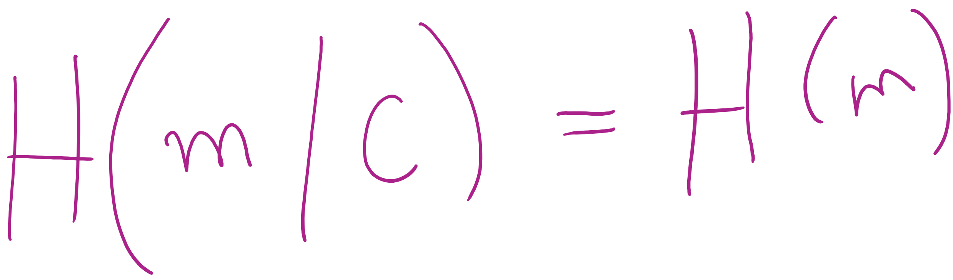
So what is a good cipher?
One-time pads
List of one-time use keys (called a pad) here
To send a message:
Take an unused pad
Use modular addition to combine key with message
For binary data, XOR
Send to recipient
Upon receiving a message:
Take the next pad
Use modular subtraction to combine key with message
For binary data, XOR
Read result
Proven to provide perfect secrecy

Slide 53
One-time pad example
Encoding:
0 1 2 3 4 5 6 7 8 9 10 11 12 13 14 15 16 17 18 19 20 21 22 23 24 25
A B C D E F G H I J K L M N O P Q R S T U V W X Y Z
Message:
H E L L O
Pad:
Q J C W T
7 4 11 11 14
16 9 2 22 19
+
16 9 2 22 19
(mod 26)
23 13 13 7 7
Encrypted Message:
X N N H H
23 13 13 7 7
-
16 9 2 22 19
(mod 26)
7 4 11 11 14
H E L L O
Notes:
Live demo perfect forward secrecy. Have students pick any other 5 character string and find the codeword.
Ex: WORLD = (22, 14, 17, 11, 3)
pad should be (1, 25, 22, 22, 4) = BZWWE

Slide 54
Difficulties with one-time pads
Pads must be truly random
Both sender and receiver must have a matched list of pads in the appropriate order
Once you run out of pads, no more messages can be sent

