Slide 1

Algorithms and Data Structures 2 CS 1501
Fall 2021
Sherif Khattab
ksm73@pitt.edu
(Slides are adapted from Dr. Ramirez’s and Dr. Farnan’s CS1501 slides.)

Slide 2
Announcements
Homework 2 and Lab 1 due this Friday
Lab 1 had a typo: please use nextCoords. instead of nextCoordinates.
Assignment 1 due on 10/1
Code handouts on Canvas
Isabella Mailer created a GroupMe for this class for students to discuss content and plan study sessions
https://groupme.com/join_group/70805571/tsR1V68z
Michael G. Wells Competition
https://www.innovation.pitt.edu/michael-g-wells-competition/
Games 4 Social Impact Hackathon
https://www.games4socialimpact.pitt.edu/
Get (Re)involved on Campus
https://www.pitt.edu/pittwire/features-articles/get-reinvolved-campus

Slide 3
Last lecture …
Brute force
Solution Tree
Pruning
PIN Cracking Example

Slide 4
How to enumerate all these possibilities?
For the PIN example a whole bunch of for loops would do
In general, exhaustive search trees can be easily traversed via recursion and backtracking
Recurse until its apparent no solution can be achieved along the current path
Undo the path to the point that you can start to move forward again

Slide 5
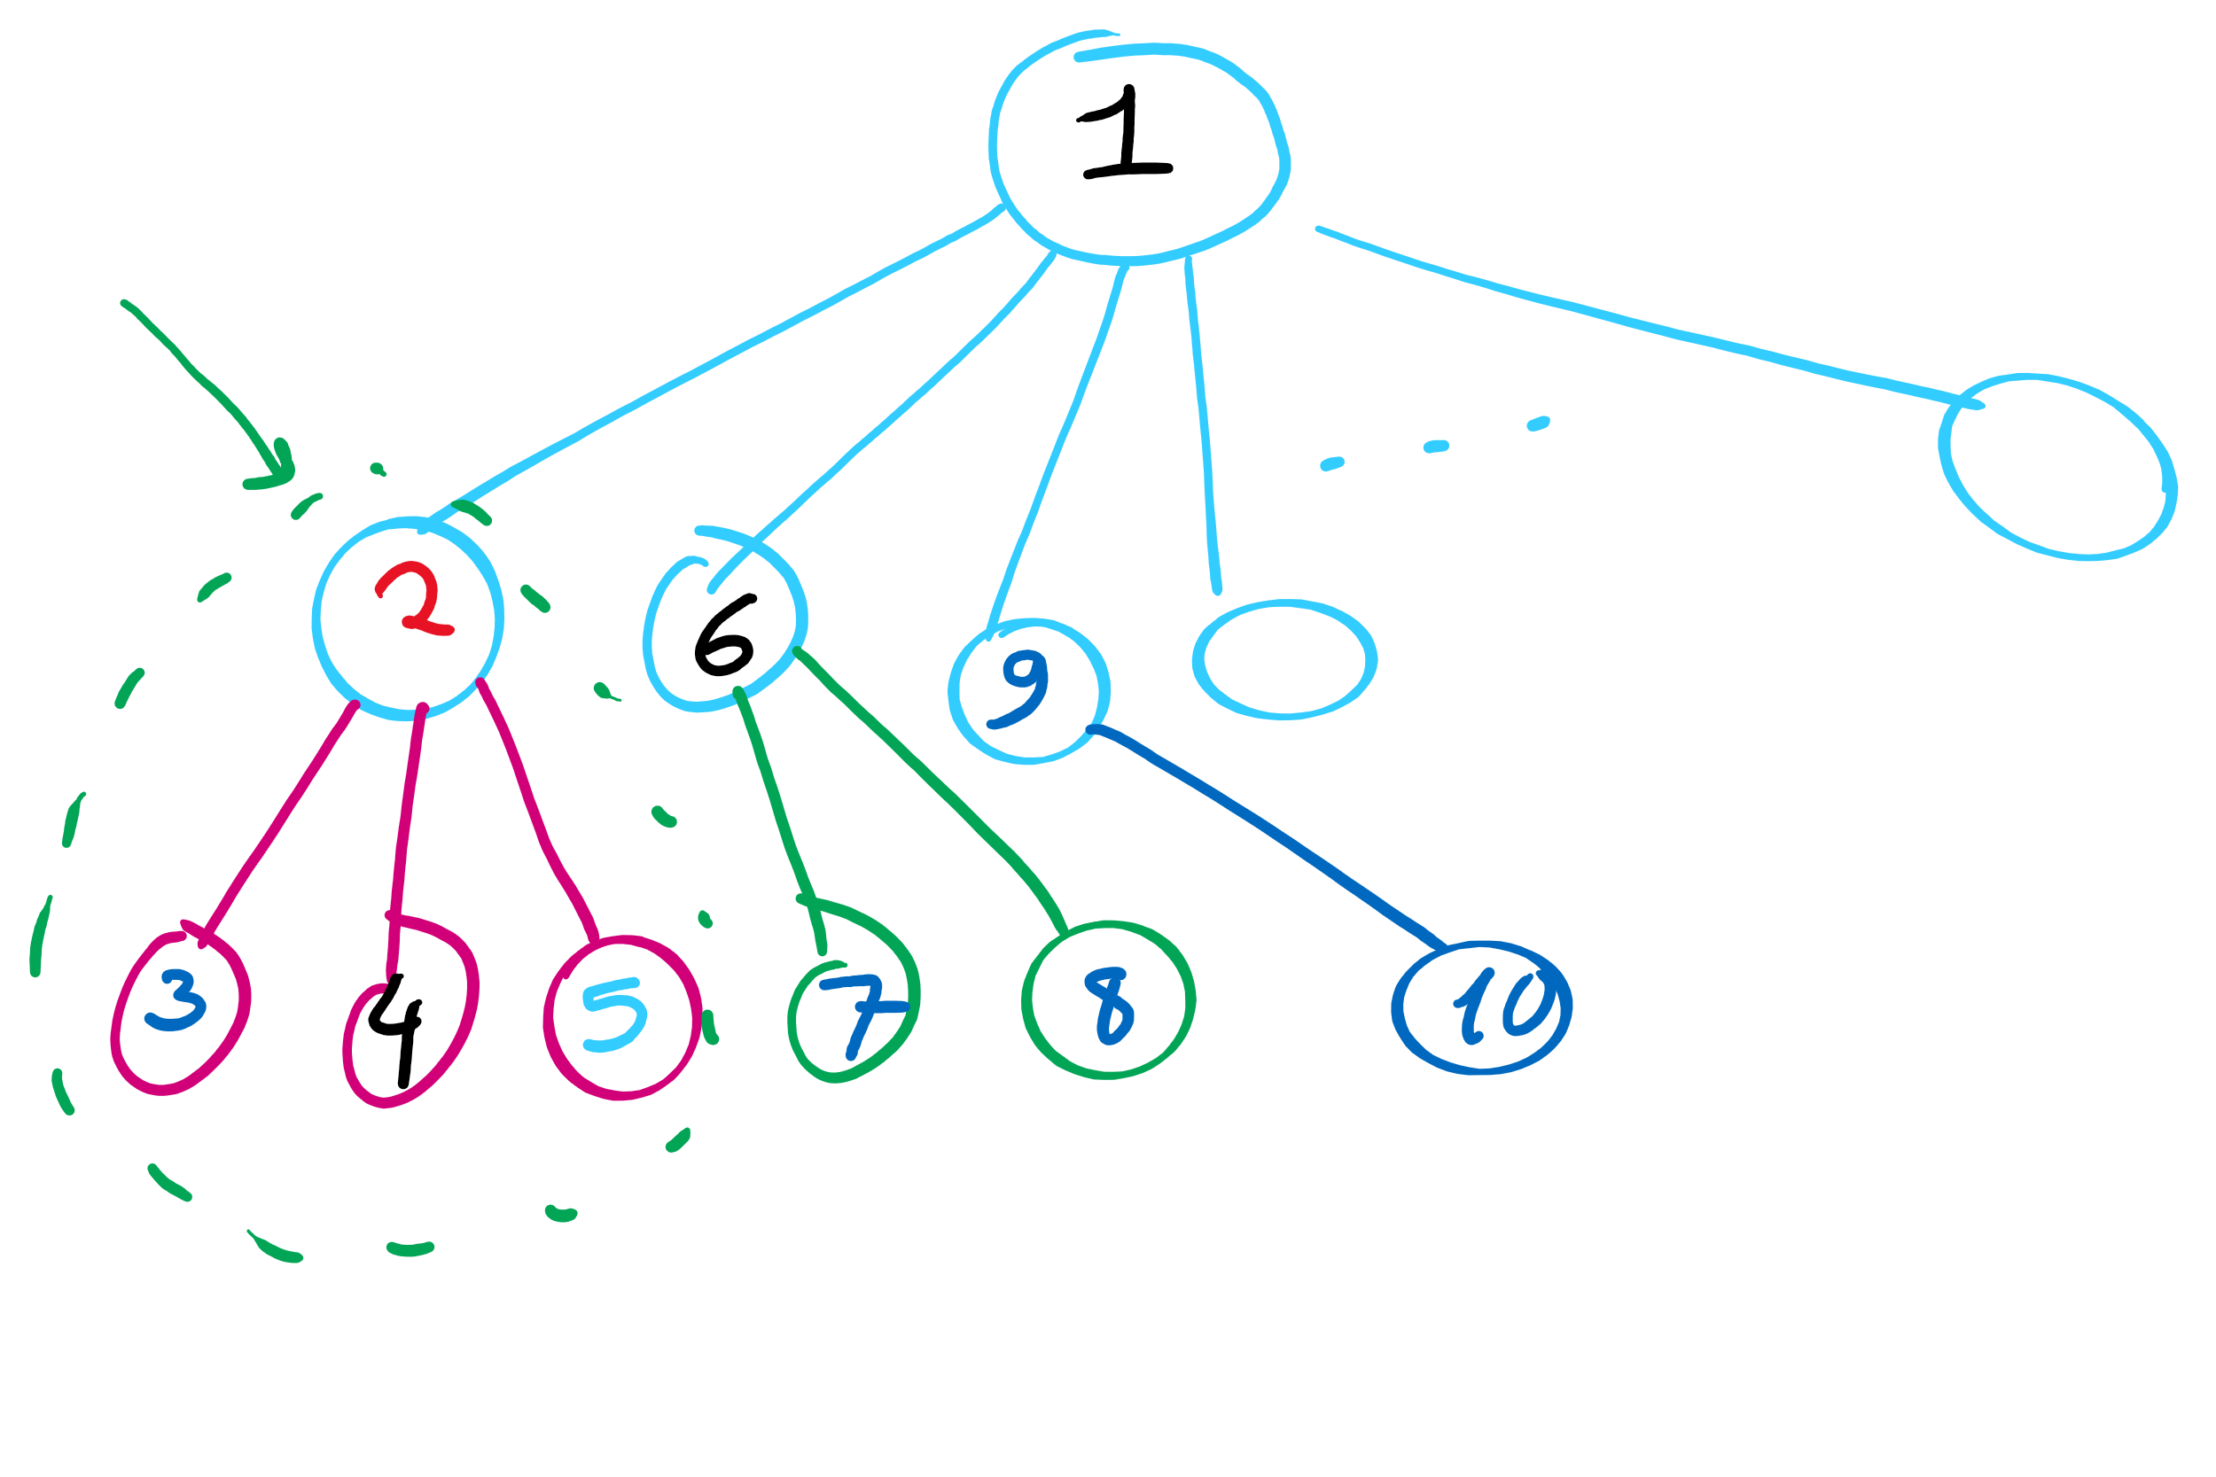
Tree Traversal Order in Backtracking

Slide 6
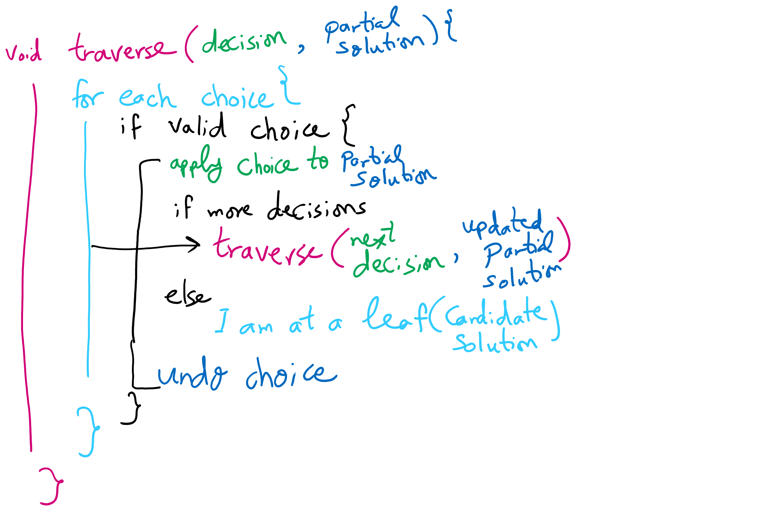
Backtracking Algorithm

Slide 7
8 queens problem
Place 8 queens on a chessboard such that no queen can take another
Queens can move horizontally, vertically, and diagonally
How many ways can you place 8 pieces on a chess board?
64 C 8
= 64! / (8! * (64-8)!)
= 4,426,165,368
Meaning 35,409,322,944 total queen placements
Do we really need to look through all of these options?

Slide 8
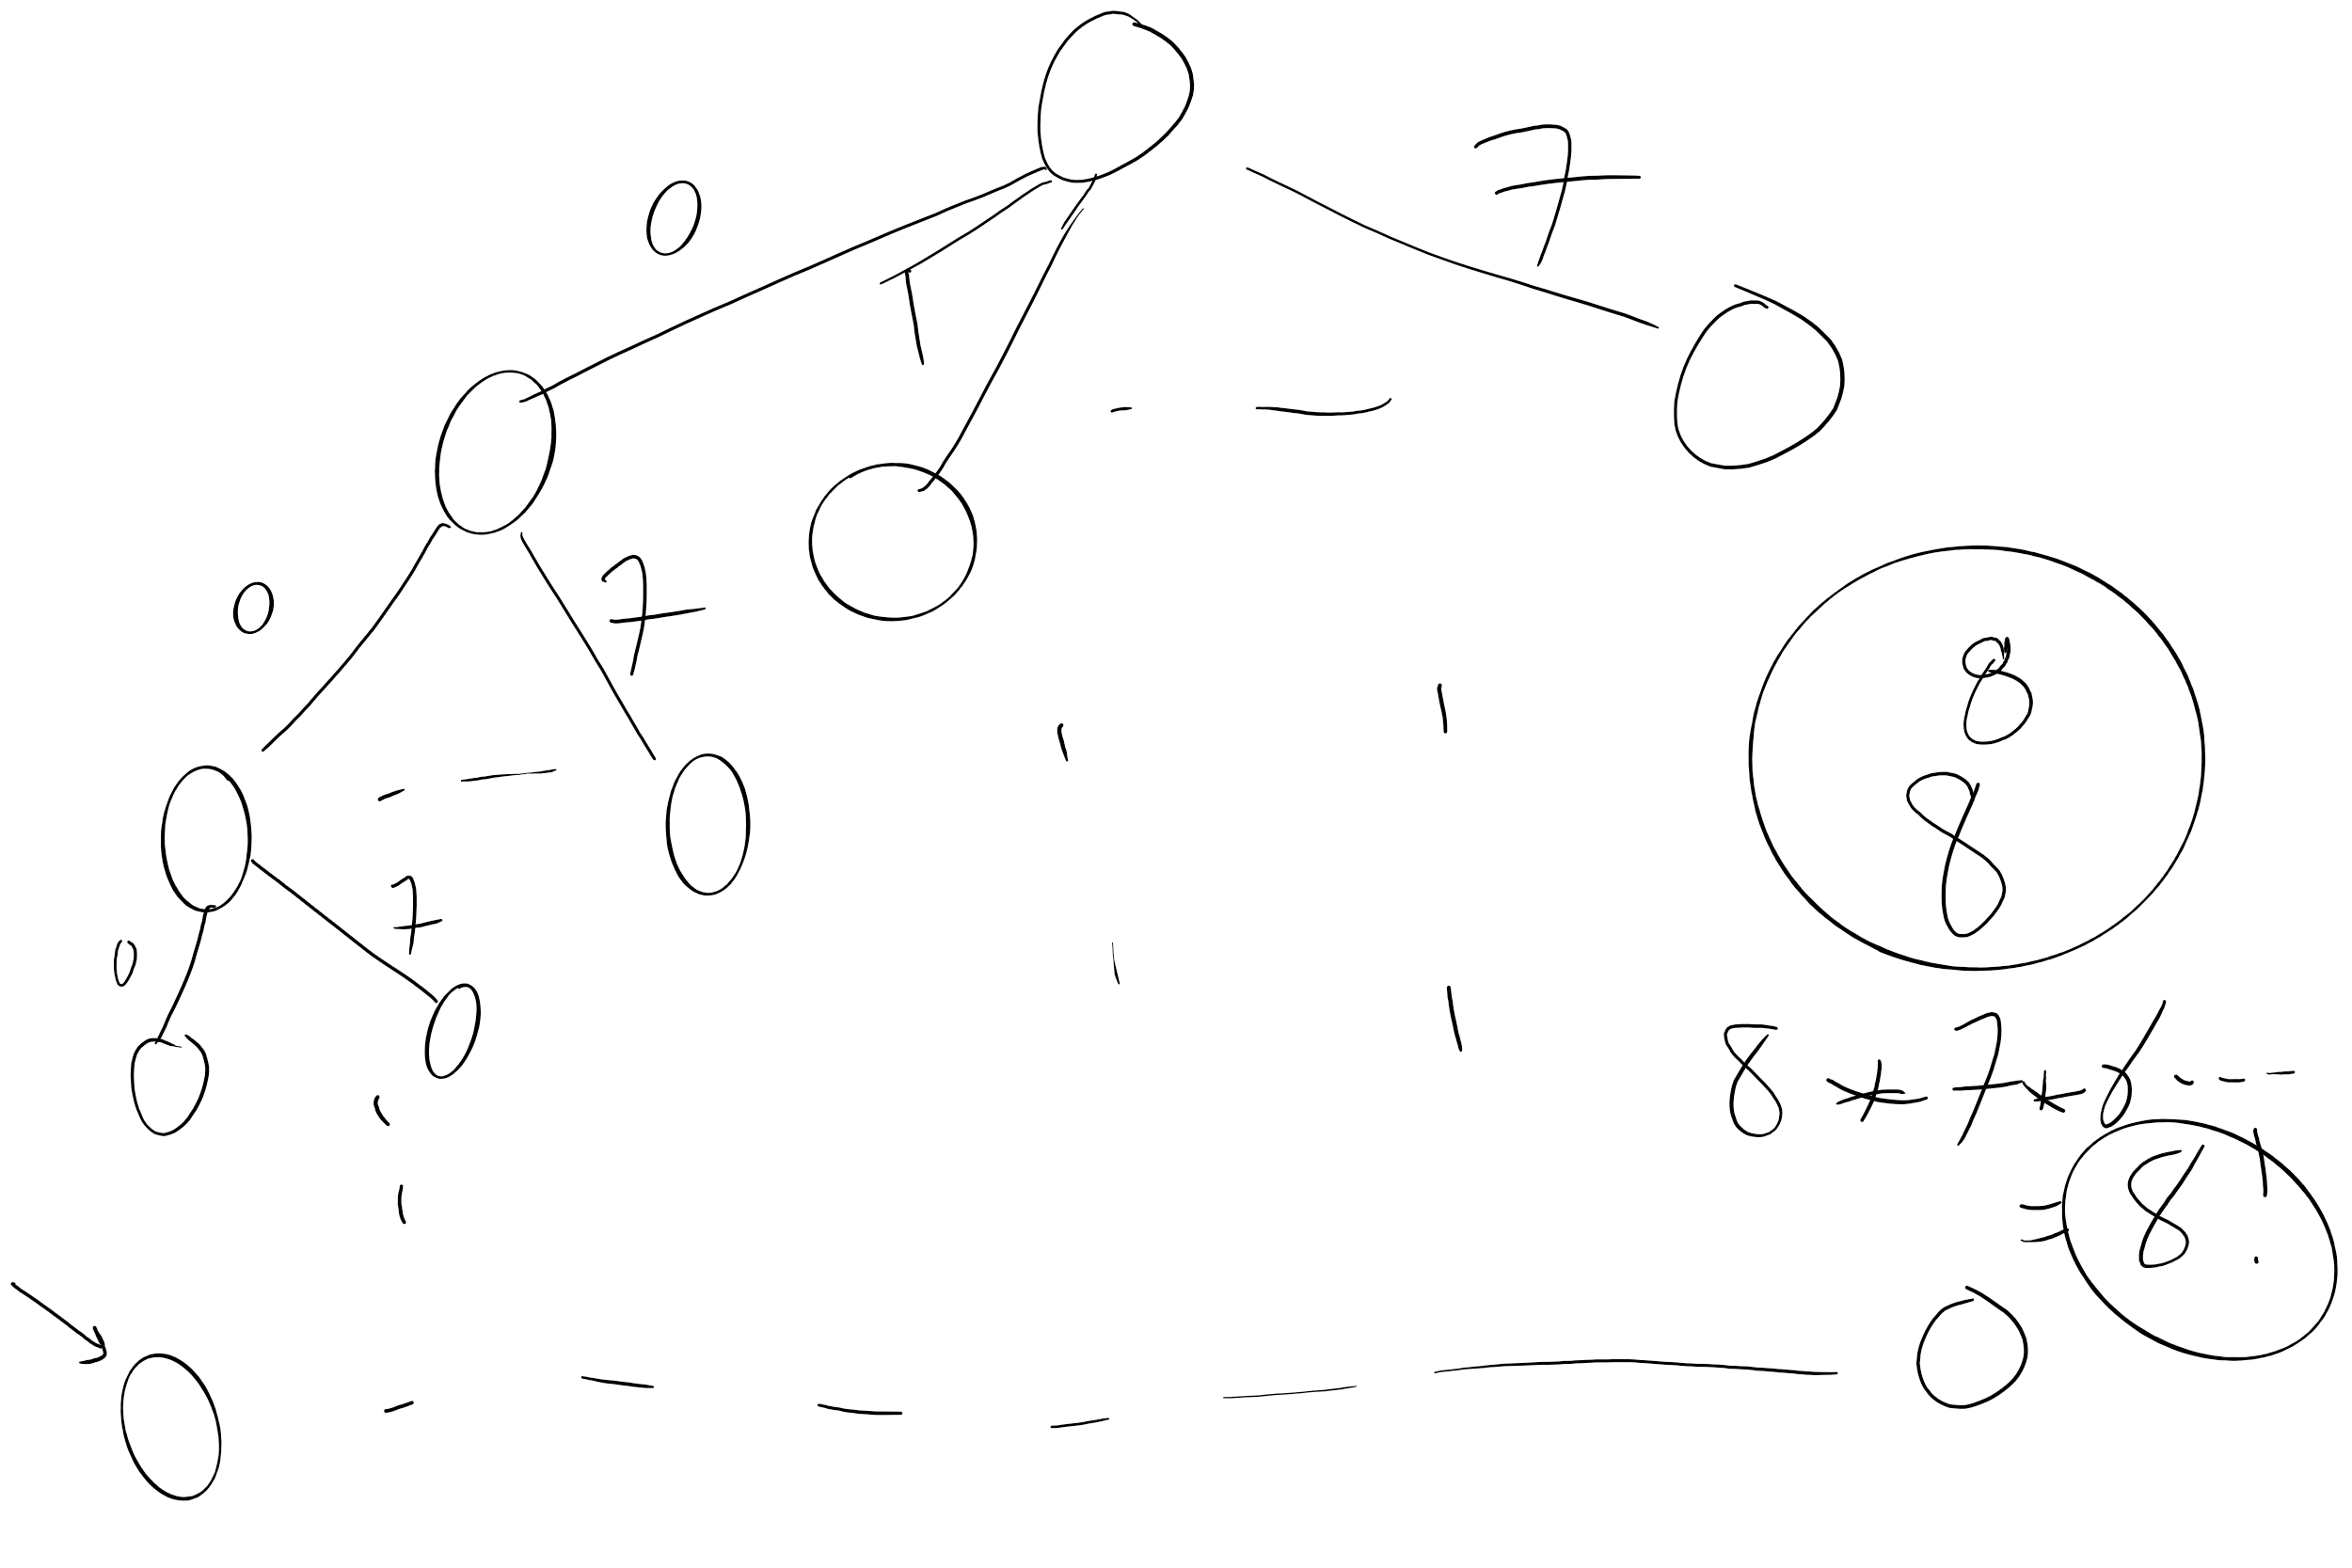
Search Space

Slide 9
8 queens problem
Solutions only have one queen per column
Still 8⁸ = 16,777,216 possible combinations
Solutions only have one queen per row
Combining these two observations, only 8! = 40,320
Looking quite feasible!
Finally, prune subtrees with queens on the same diagonal

Slide 10
Backtracking Solution to 8 Queens
Basic idea:
Recurse over columns of the board
Each recursive call iterates through the rows of the board
Check rows/diagonals
Are they currently safe?
Place a queen in the current row/col
If you are at the end of the board, you've found a solution!
Otherwise, try recursive call for the next column
If they are not currently safe
Continue to the next row in the current recursive call

Slide 11
8 Queens
8
Q
7
Q
6
Q
5
Q
4
Q
3
2
1
Q
A
B
C
D
E
F
G
H

Slide 12
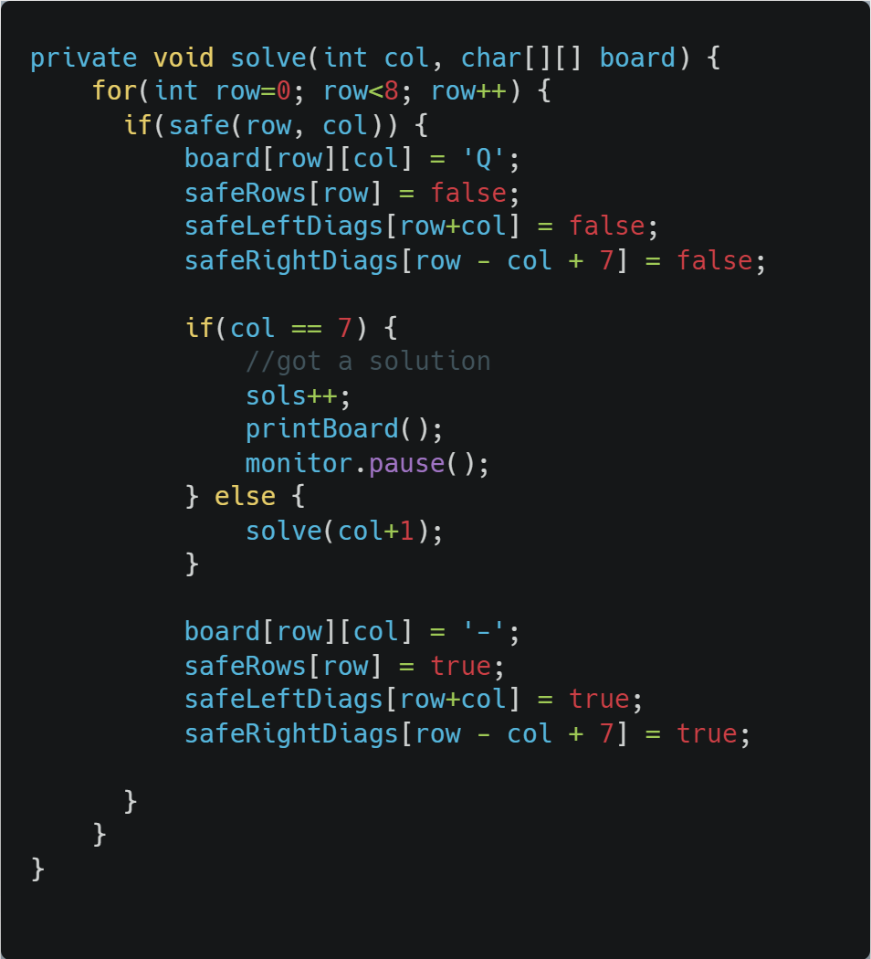
Eight Queens

Slide 13
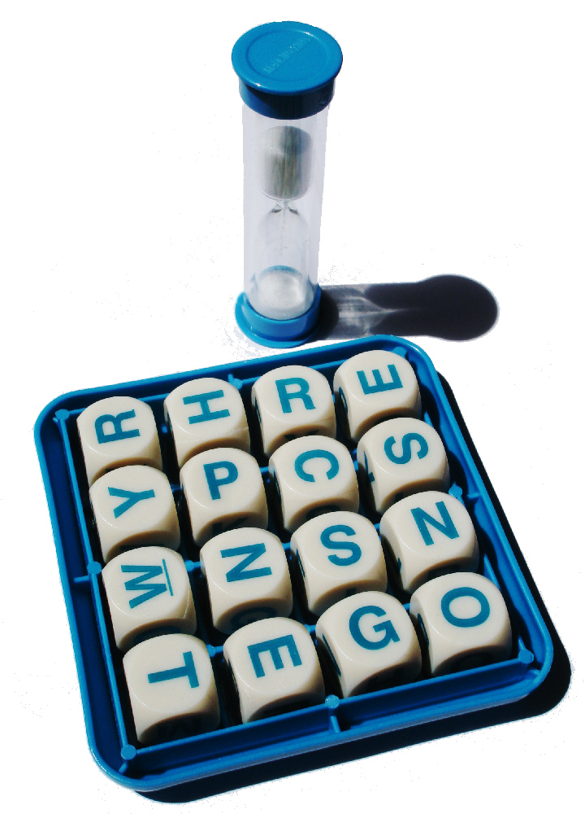
Another problem: Boggle
Words at least 3 adjacent letters long must be assembled from a 4x4 grid
Adjacent letters are horizontally, vertically, or diagonally neighboring
Any cube in the grid can only be used once per word

Slide 14
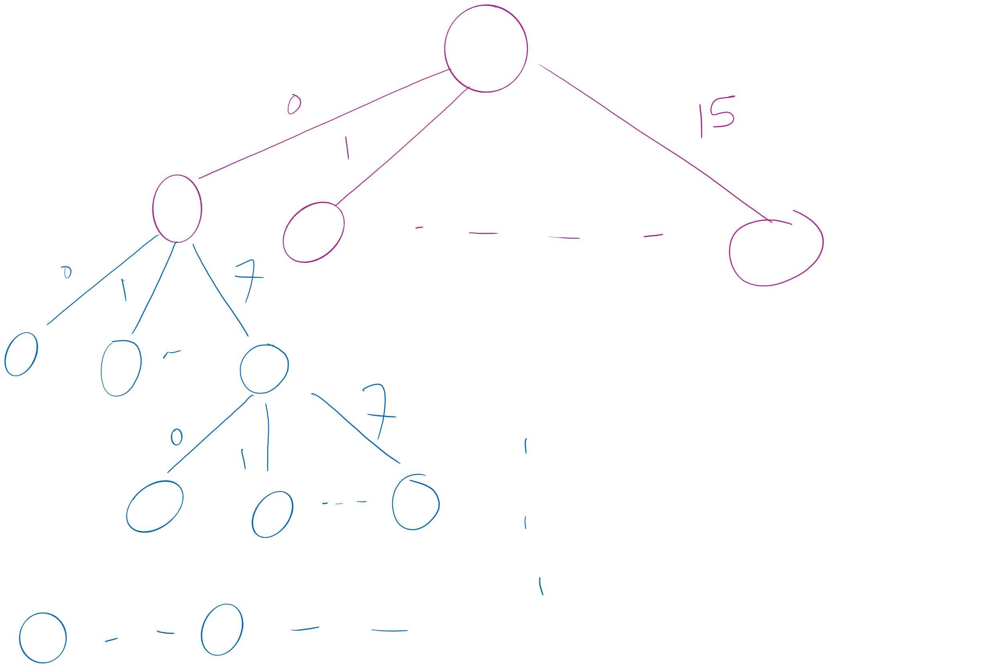
Search Space

Slide 15
Recursing through Boggle letters
Have 8 different options from each cube
From B[i][j]:
B[i-1][j-1]
B[i-1][j]
B[i-1][j+1]
B[i][j-1]
B[i][j+1]
B[i+1][j-1]
B[i+1][j]
B[i+1][j+1]
Naively, the runtime here would be 16!
= 20,922,789,888,000

Slide 16
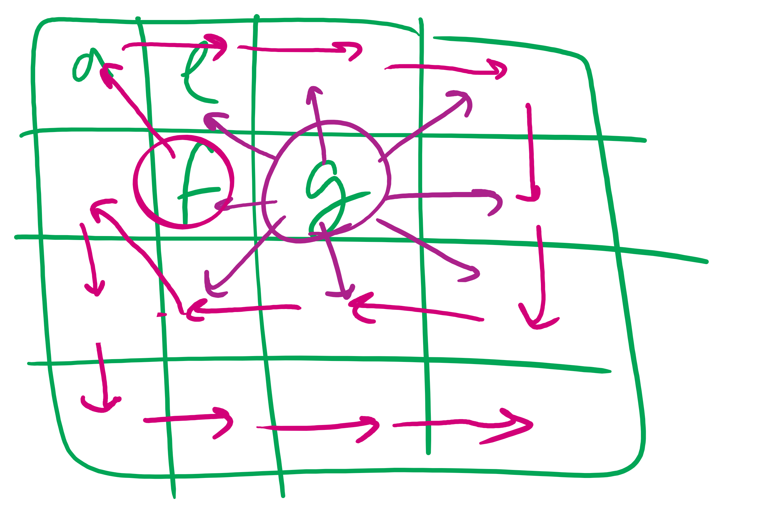
Boggle Question

Slide 17
Where do we prune?
Can’t go past the edge of the board
Can’t reuse the same cells in the board
Each letter added must lead to the prefix of an actual word
Check the dictionary for each letter recursed to, if there is no word with the currently constructed string as a prefix, backtrack
Practically, this can be used for huge savings
Notes:
Need to define pruning rules
Can’t go past the edge of the board
Can’t reuse the same cells in the board
Each letter added must lead to the prefix of an actual word
Check the dictionary for each letter recursed to, if there is no word with the currently constructed string as a prefix, backtrack
Practically, this can be used for huge savings

Slide 18
Please submit your reflections by using the CourseMIRROR App
If you are having a problem with CourseMIRROR, please send an email to coursemirror.development@gmail.com
Notes:
All right!
Upcoming Due Dates at A Glance

