Slide 1

Algorithms and Data Structures 2 CS 1501
Fall 2021
Sherif Khattab
ksm73@pitt.edu
(Slides are adapted from Dr. Ramirez’s and Dr. Farnan’s CS1501 slides.)

Slide 2
Announcements
Upcoming deadlines:
9/24: Homework 3
10/1: Assignment 1

Slide 3
Last lecture …
TreeADT
Basic definitions
Tree traversal

Slide 4
This Lecture
TreeADT Implementation
TreeInterface and BinaryTreeInterface
Linked Implementation
BinaryNode
BinaryTree
BinarySearchTree
SearchTreeInterface
BinarysearchTree

Slide 5
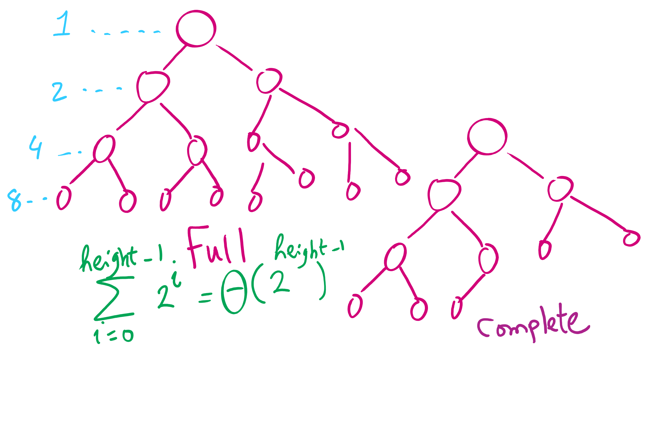
Full vs. Complete Tree

Slide 6
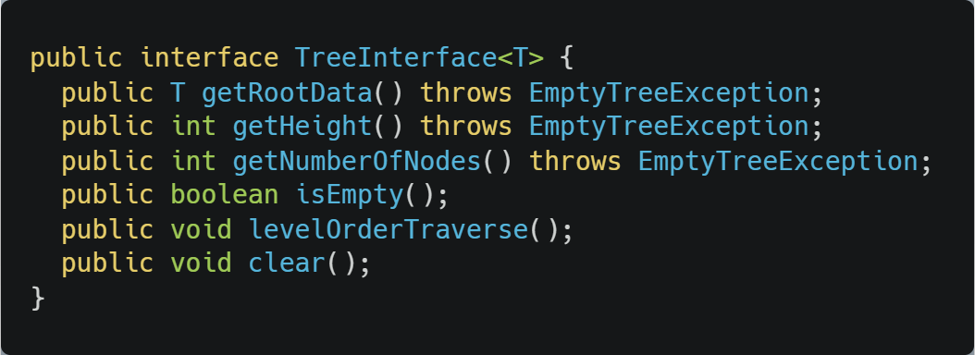
Tree Interface

Slide 7
Code Walkthrough
Available online at:
https://cs1501-2221.github.io/handouts/CodeHandouts/TreeADT/Slides
The slides are under the CodeHandouts/TreeADT/slides folder in the handout repository
https://github.com/cs1501-2221/handouts

Slide 8
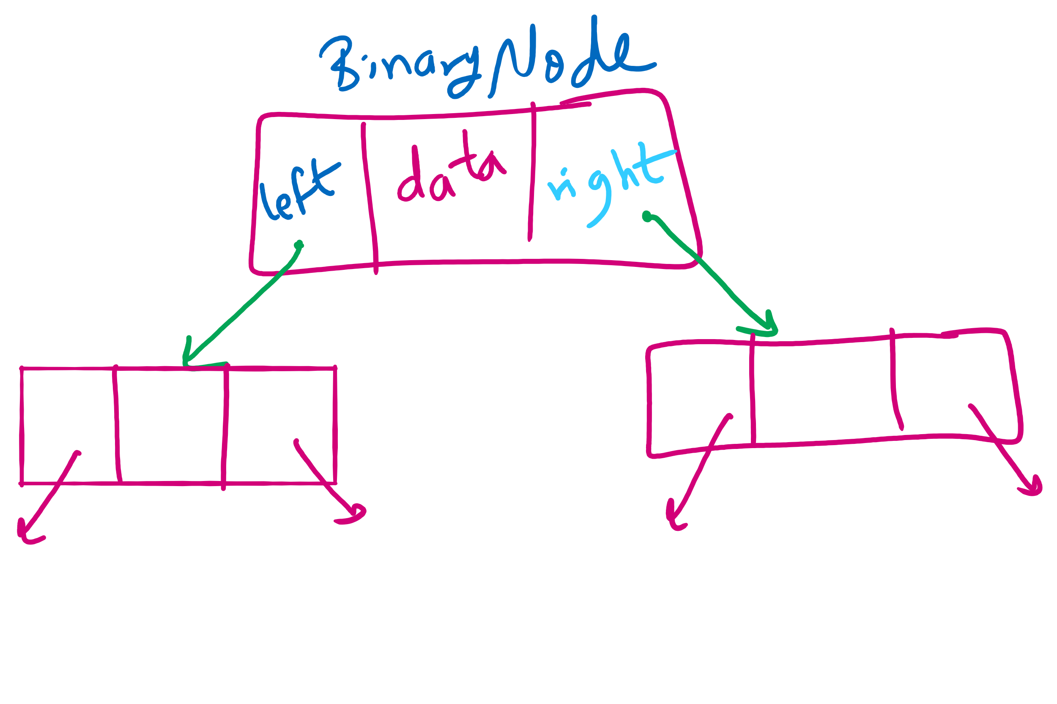
BinaryNode

Slide 9
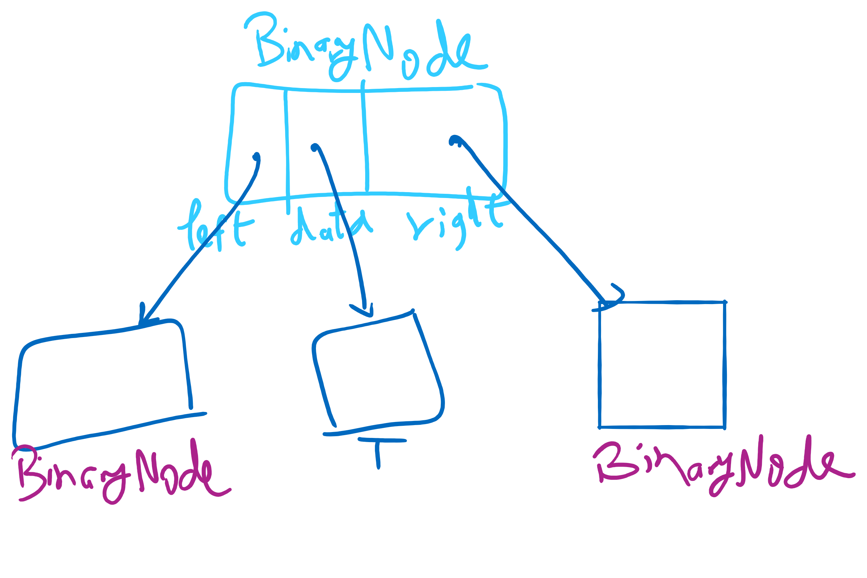
BinaryNode

Slide 10
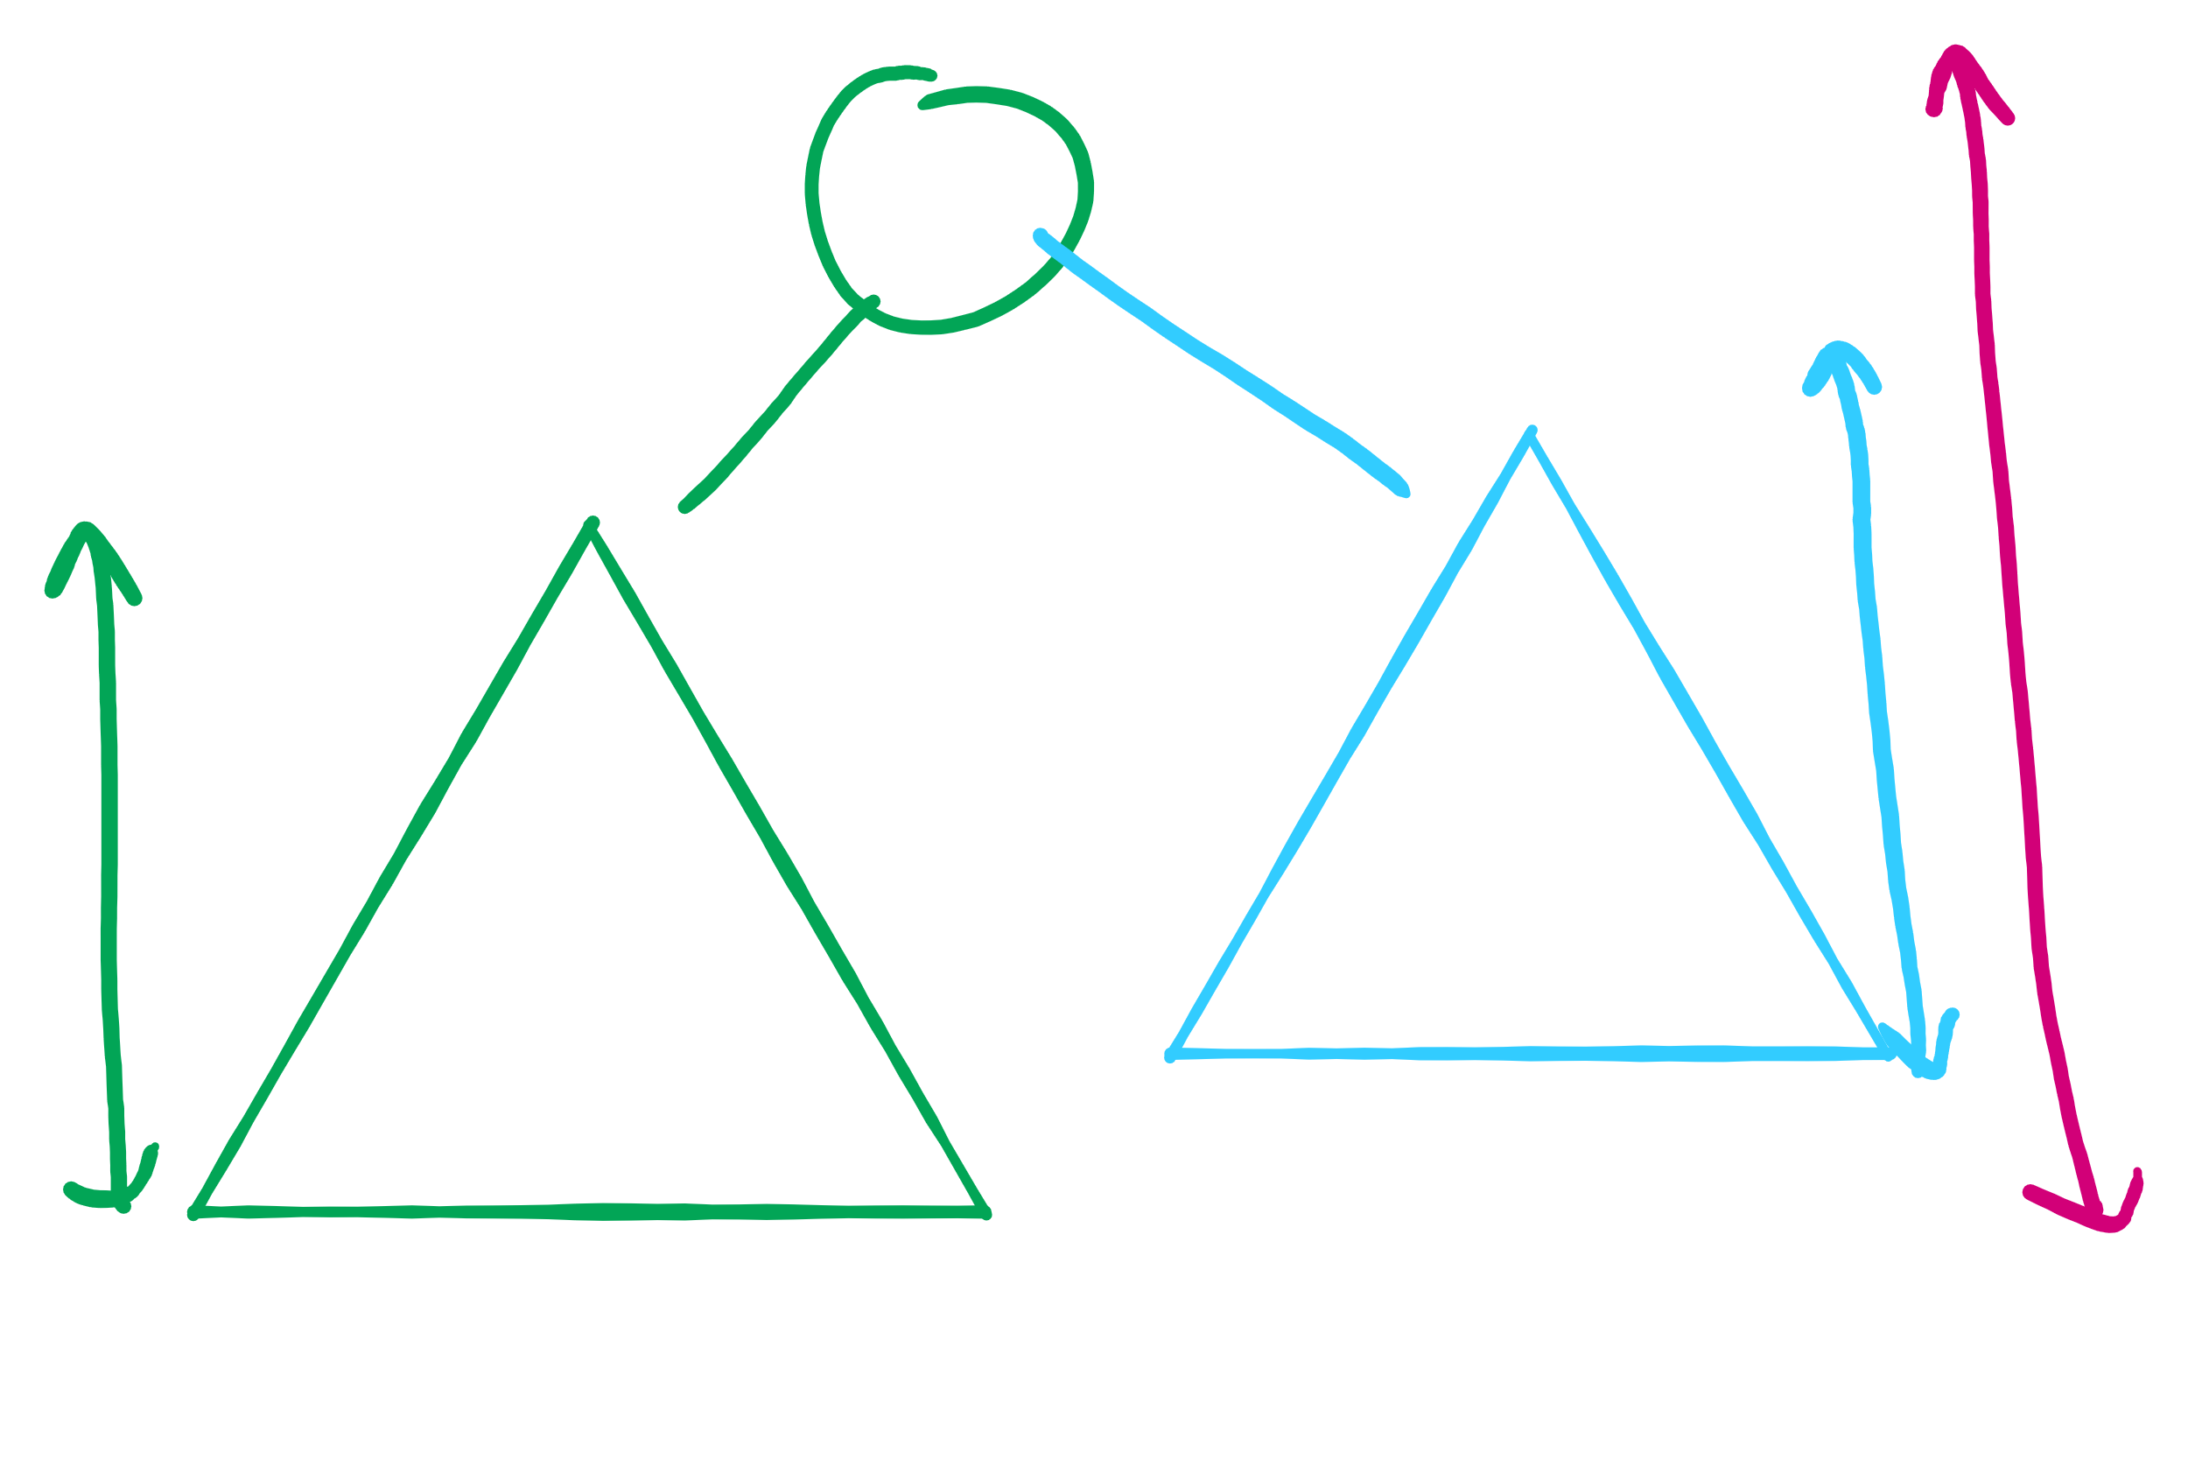
Tree Height

Slide 11
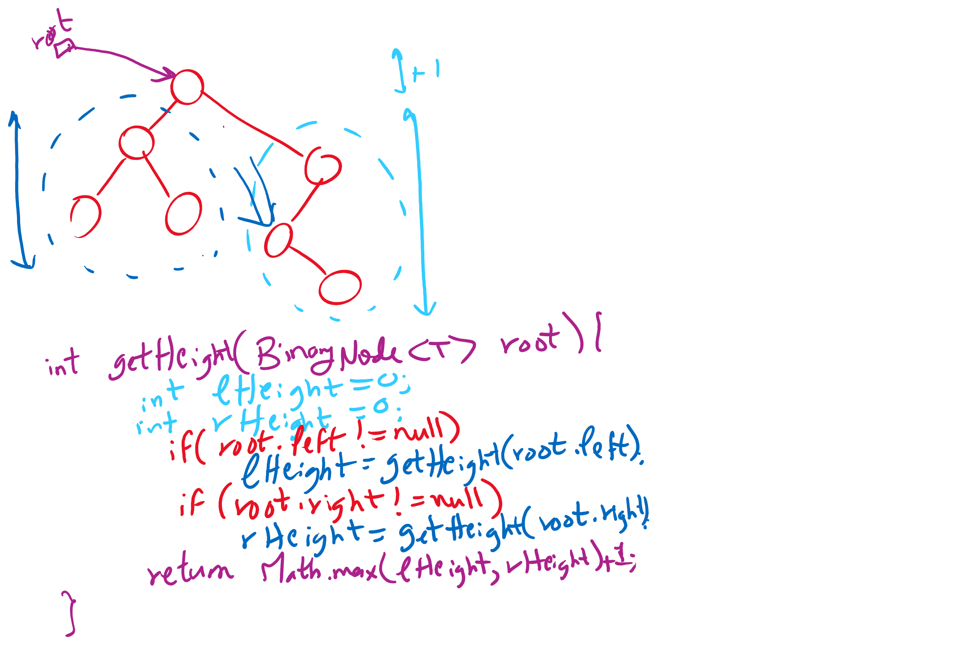
getHeight

Slide 12
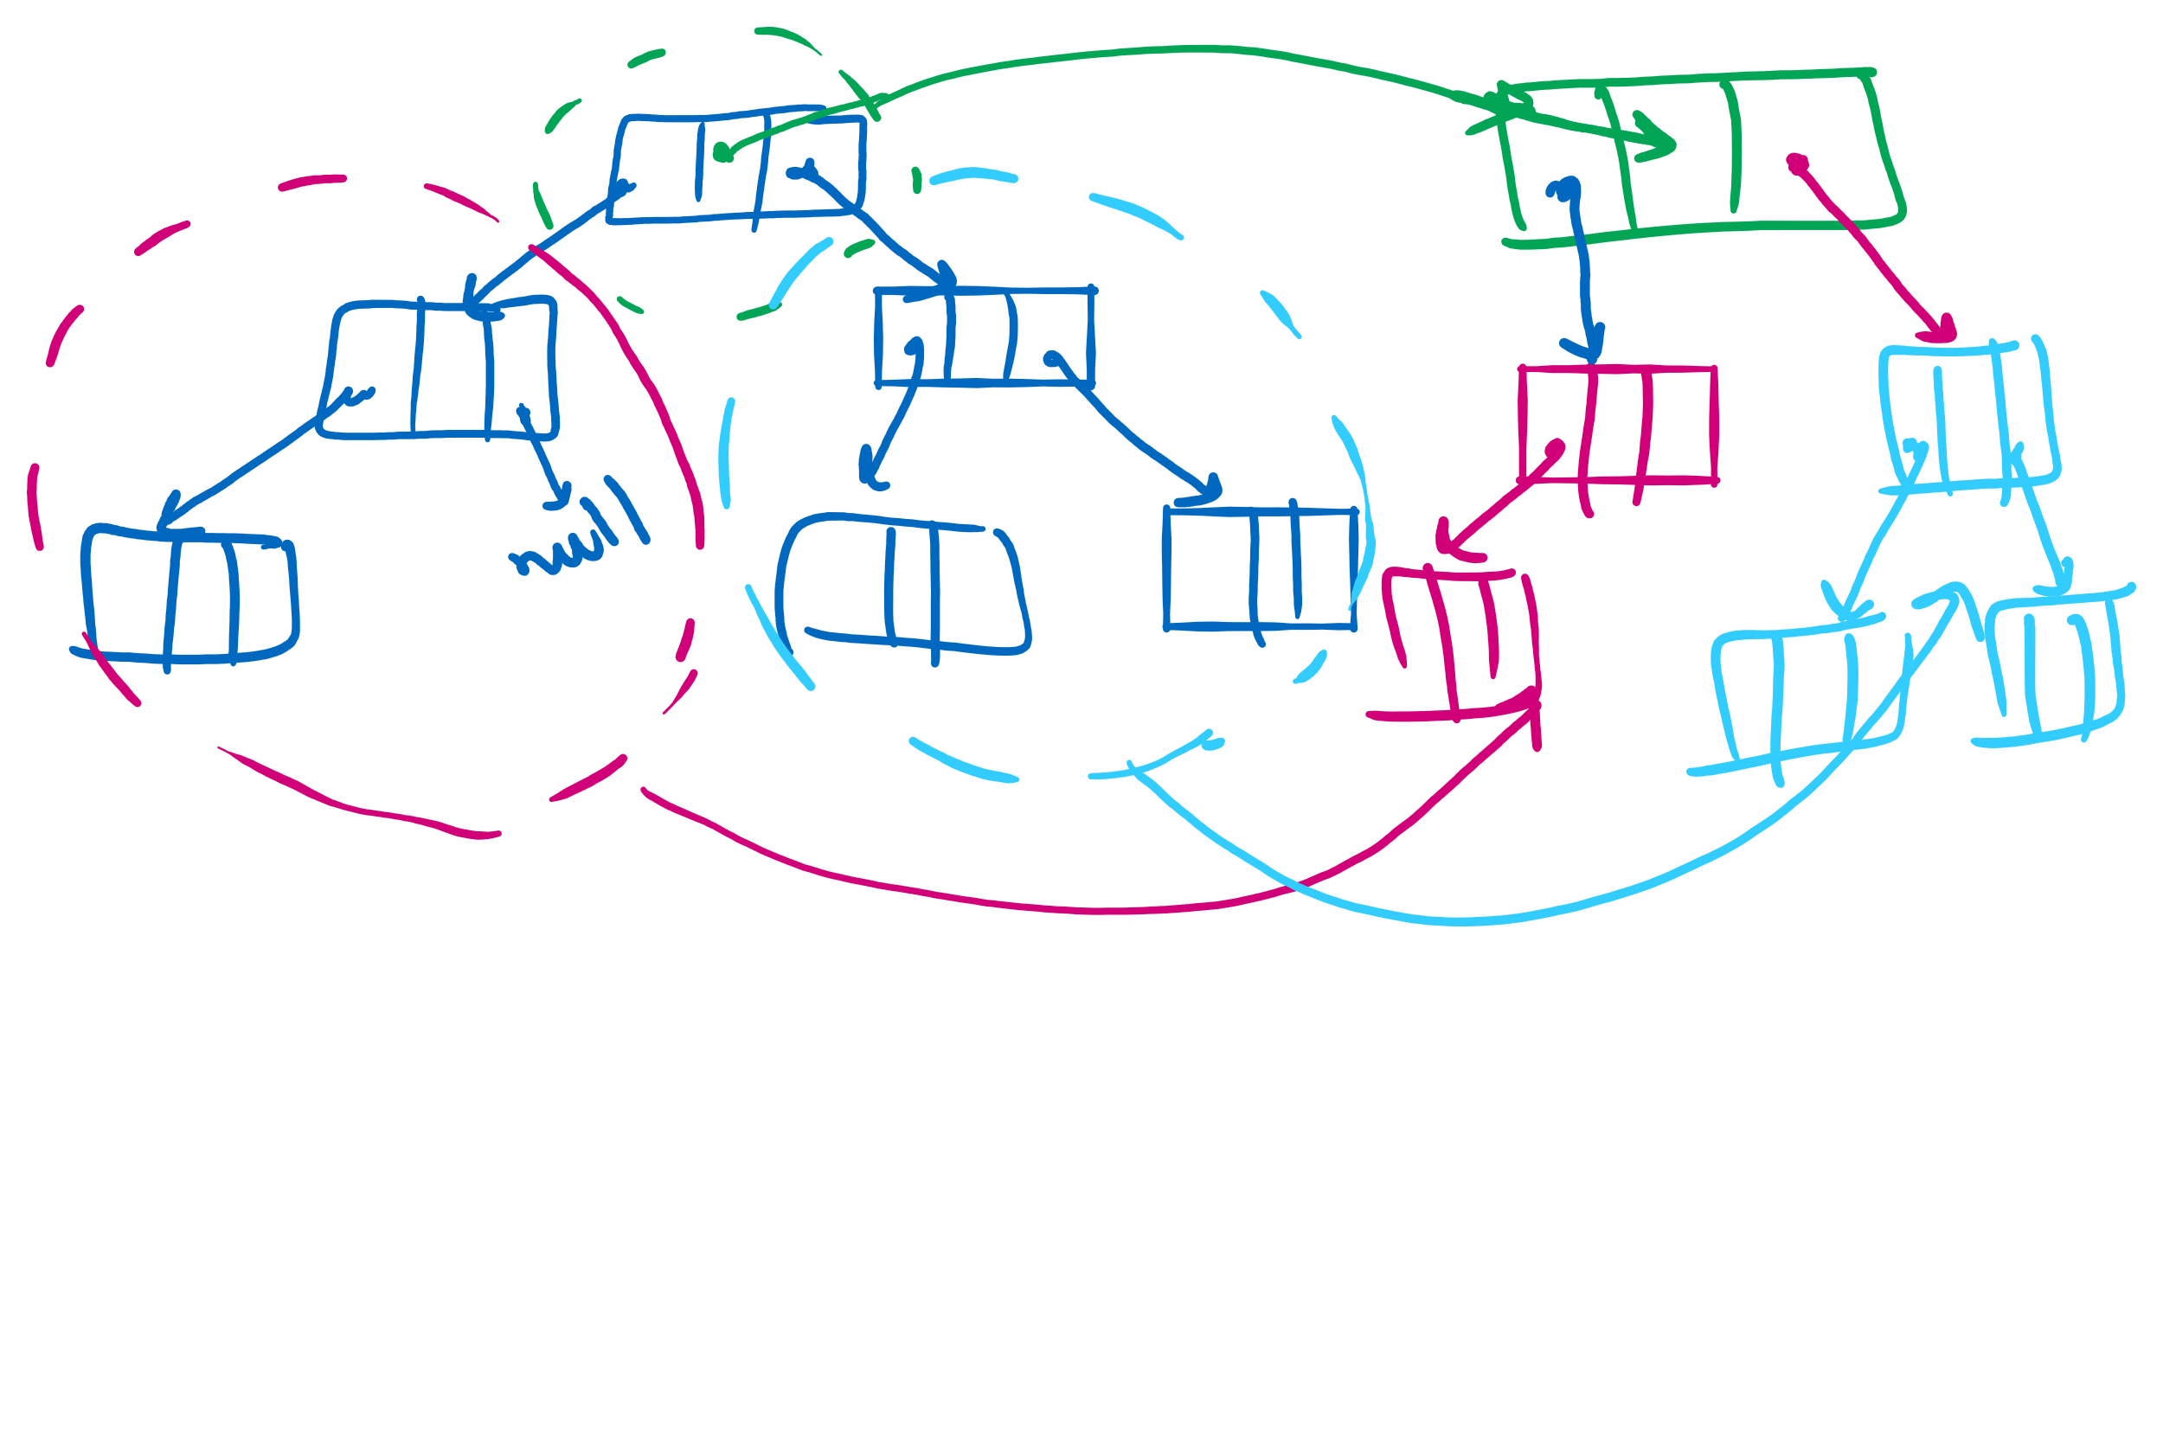
BinaryNode.copy

Slide 13
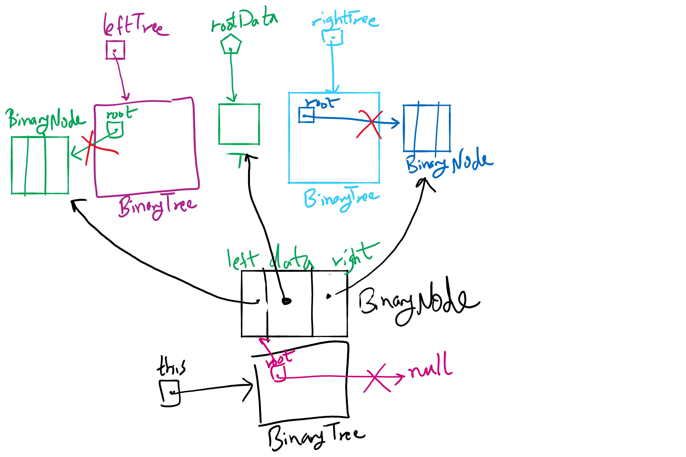
privateBuildTree Method

Slide 14
Please submit your reflections by using the CourseMIRROR App
If you are having a problem with CourseMIRROR, please send an email to coursemirror.development@gmail.com
Notes:
All right!
Upcoming Due Dates at A Glance

