Slide 1

Algorithms and Data Structures 2 CS 1501
Fall 2021
Sherif Khattab
ksm73@pitt.edu
(Slides are adapted from Dr. Ramirez’s and Dr. Farnan’s CS1501 slides.)

Slide 2
Announcements
Upcoming deadlines:
9/24: Homework 3
10/1: Assignment 1
Traversals of general trees:
Level-order, pre-order, and post-order

Slide 3
Last lecture …
BinaryNode
BinaryTree

Slide 4
This Lecture
BinaryTree (continued)
privateBuildTree and its cases
BinarySearchTree
SearchTreeInterface
Search, add, delete (to be completed today)
Run-time of search, add, and delete
Order operations overview
rank, select, range query
Red-Black BST (Balanced BST)
definition and basic operations
run-time of search, add, and delete
add
delete overview

Slide 5
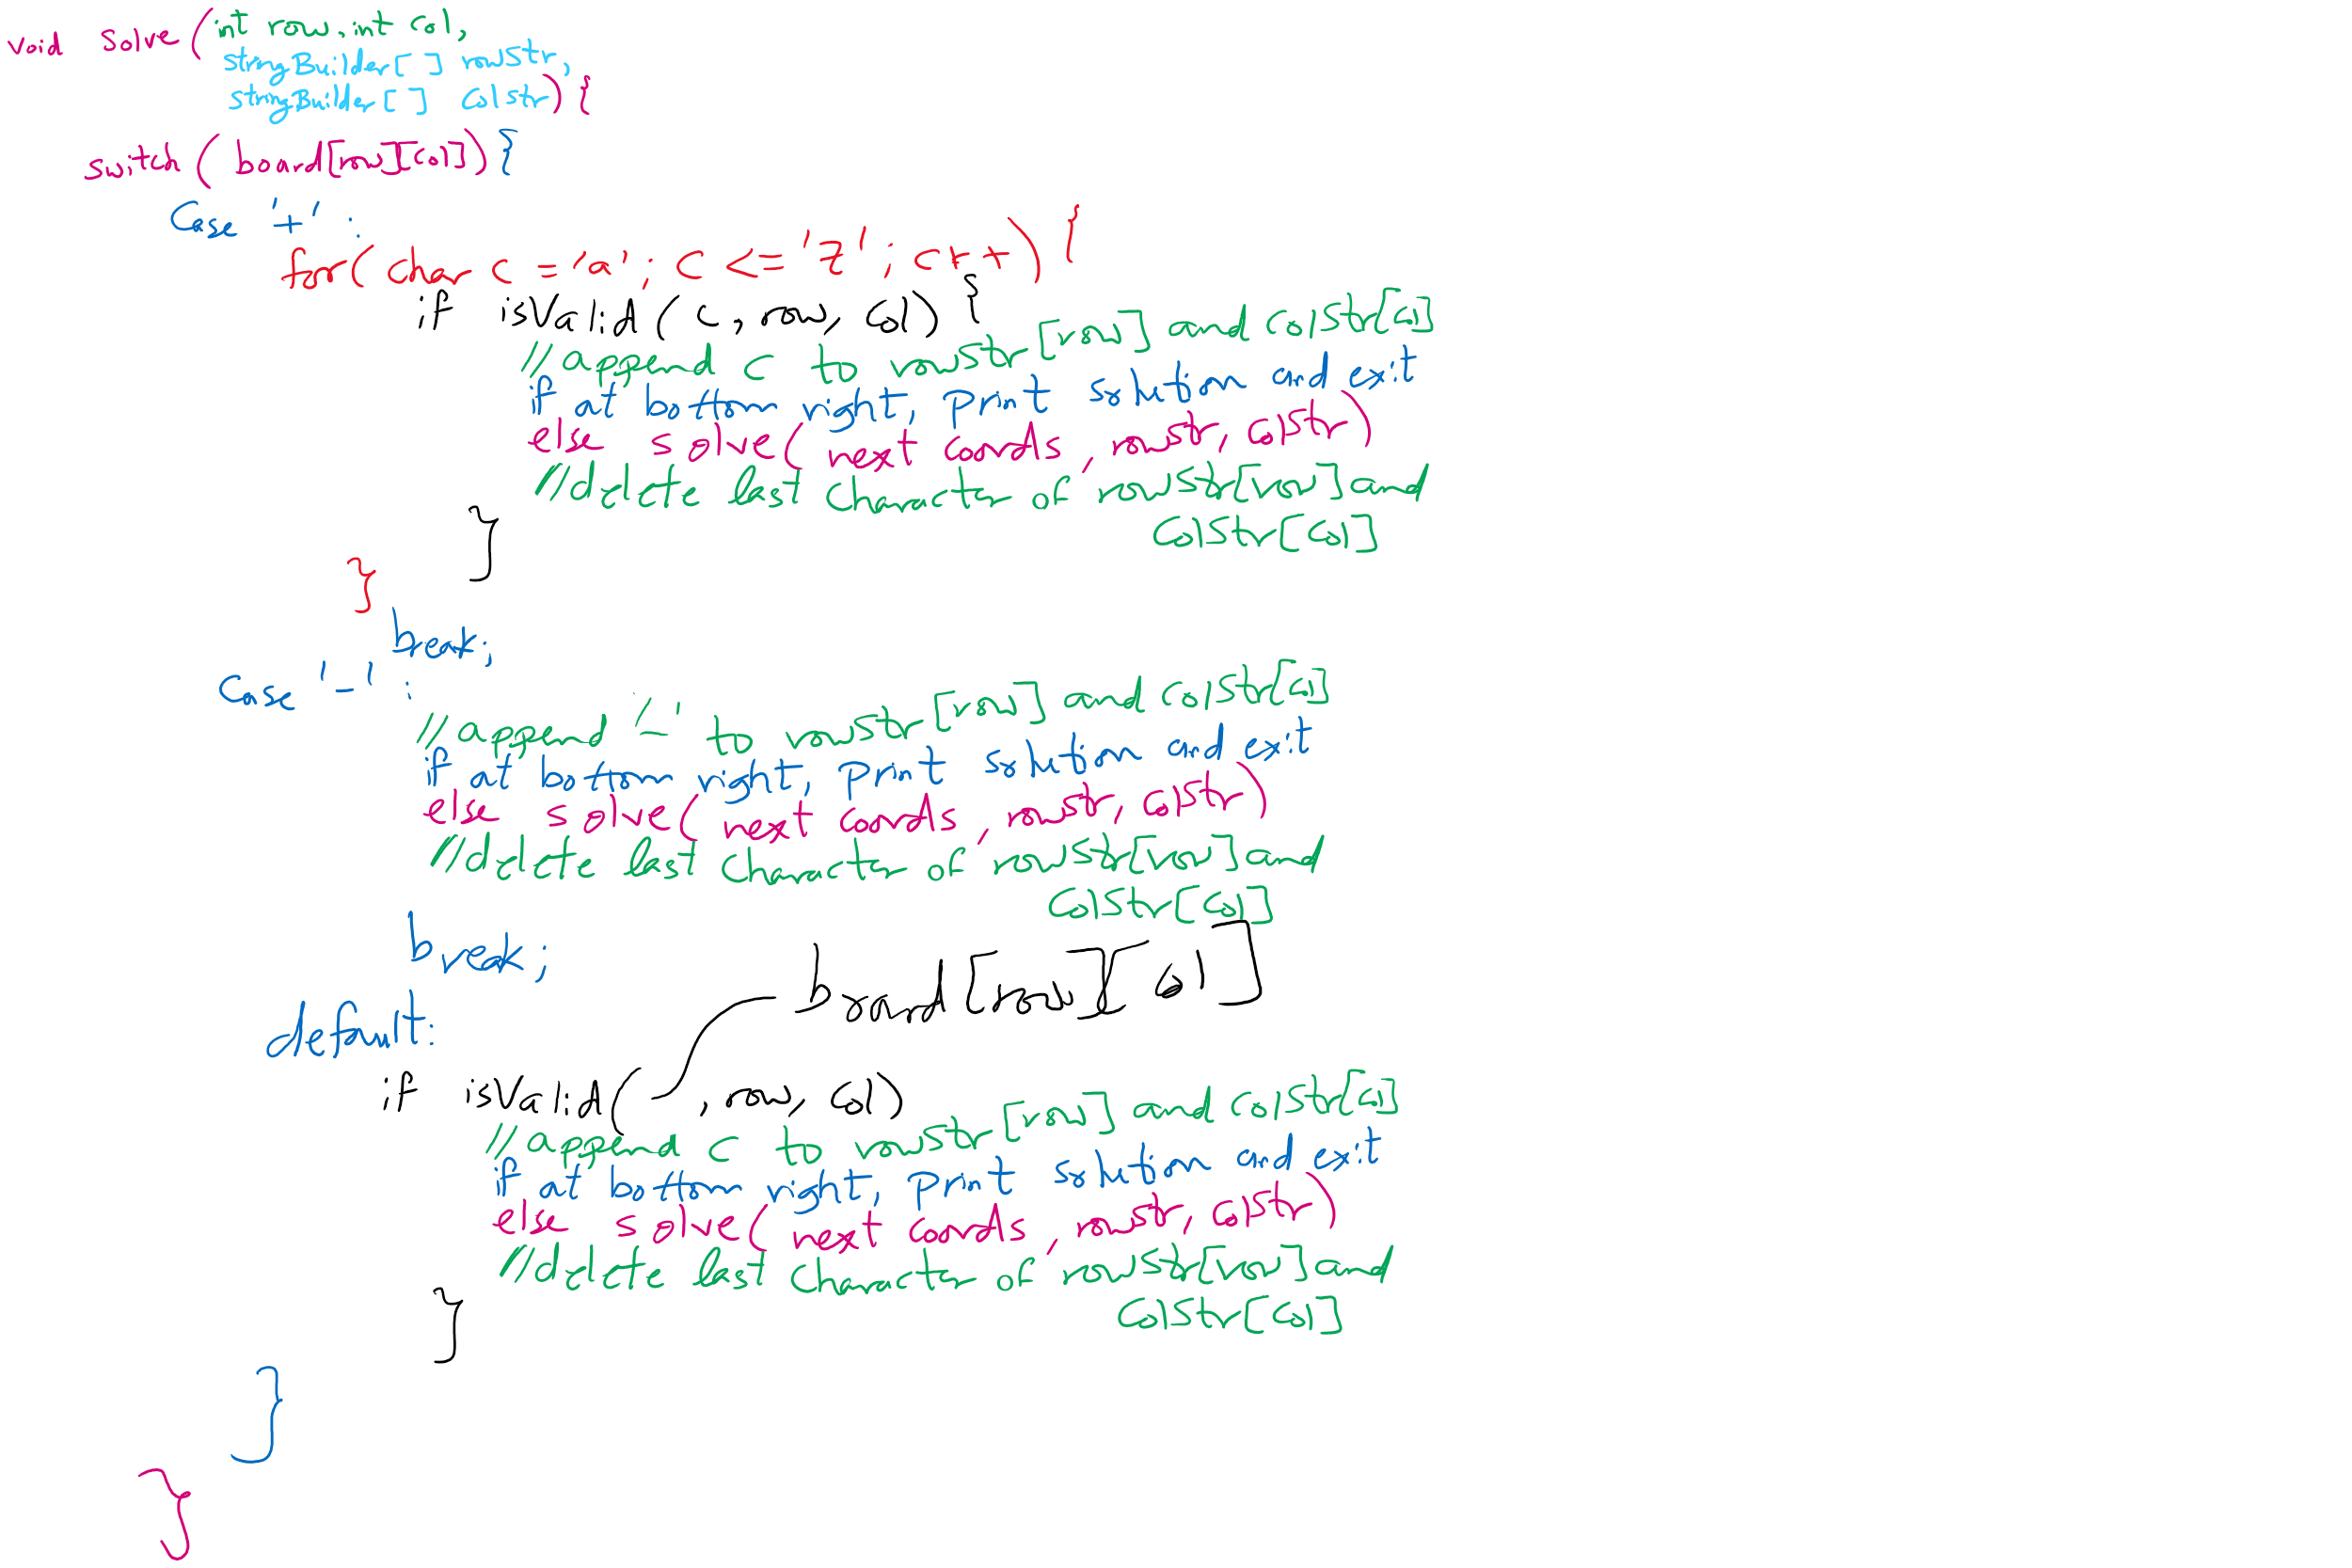
Assignment 1 Hints

Slide 6
Code Walkthrough
Available online at:
https://cs1501-2221.github.io/handouts/CodeHandouts/TreeADT/Slides
The slides are under the CodeHandouts/TreeADT/slides folder in the handout repository
https://github.com/cs1501-2221/handouts

Slide 7
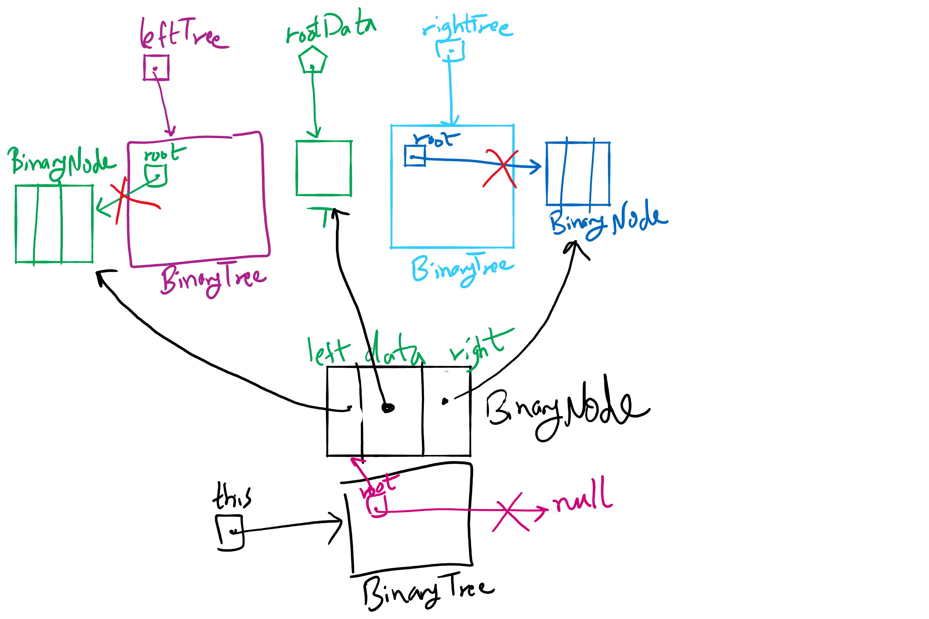
privateBuildTree Method

Slide 8
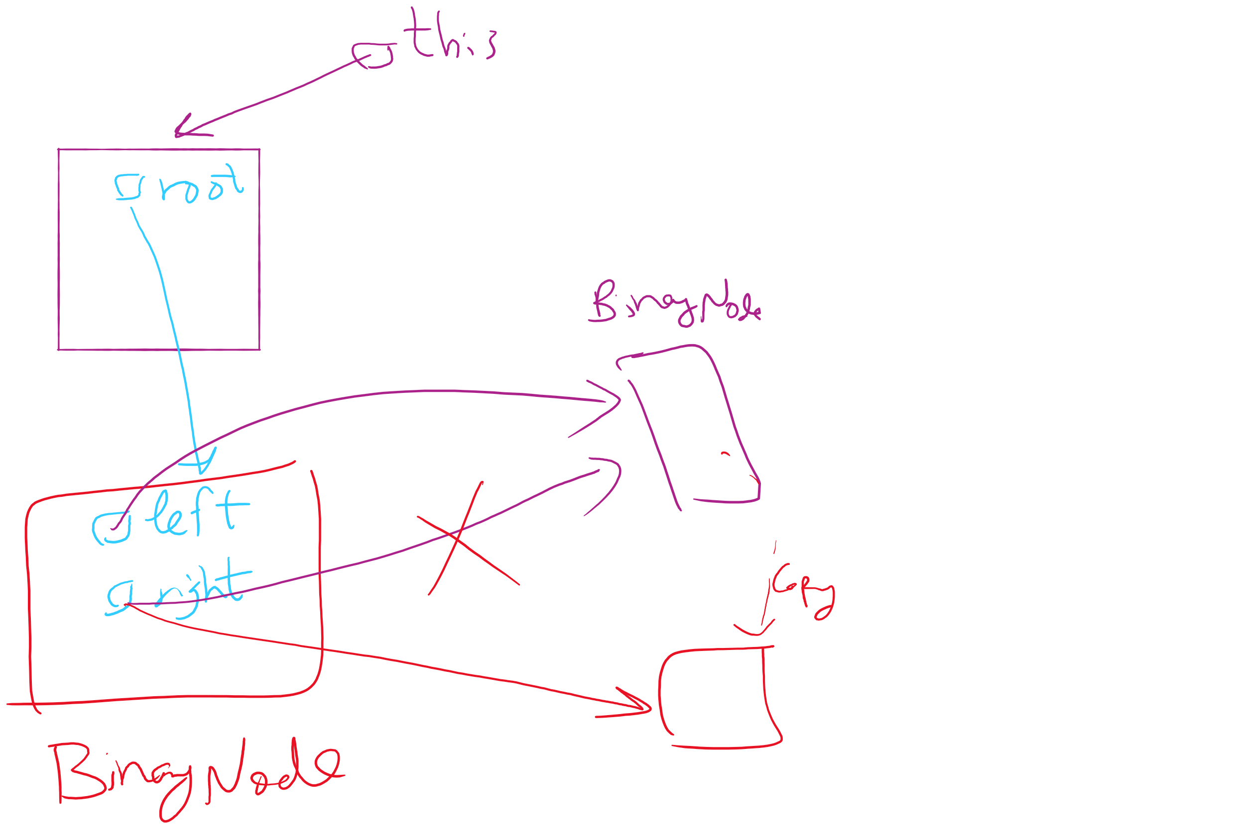
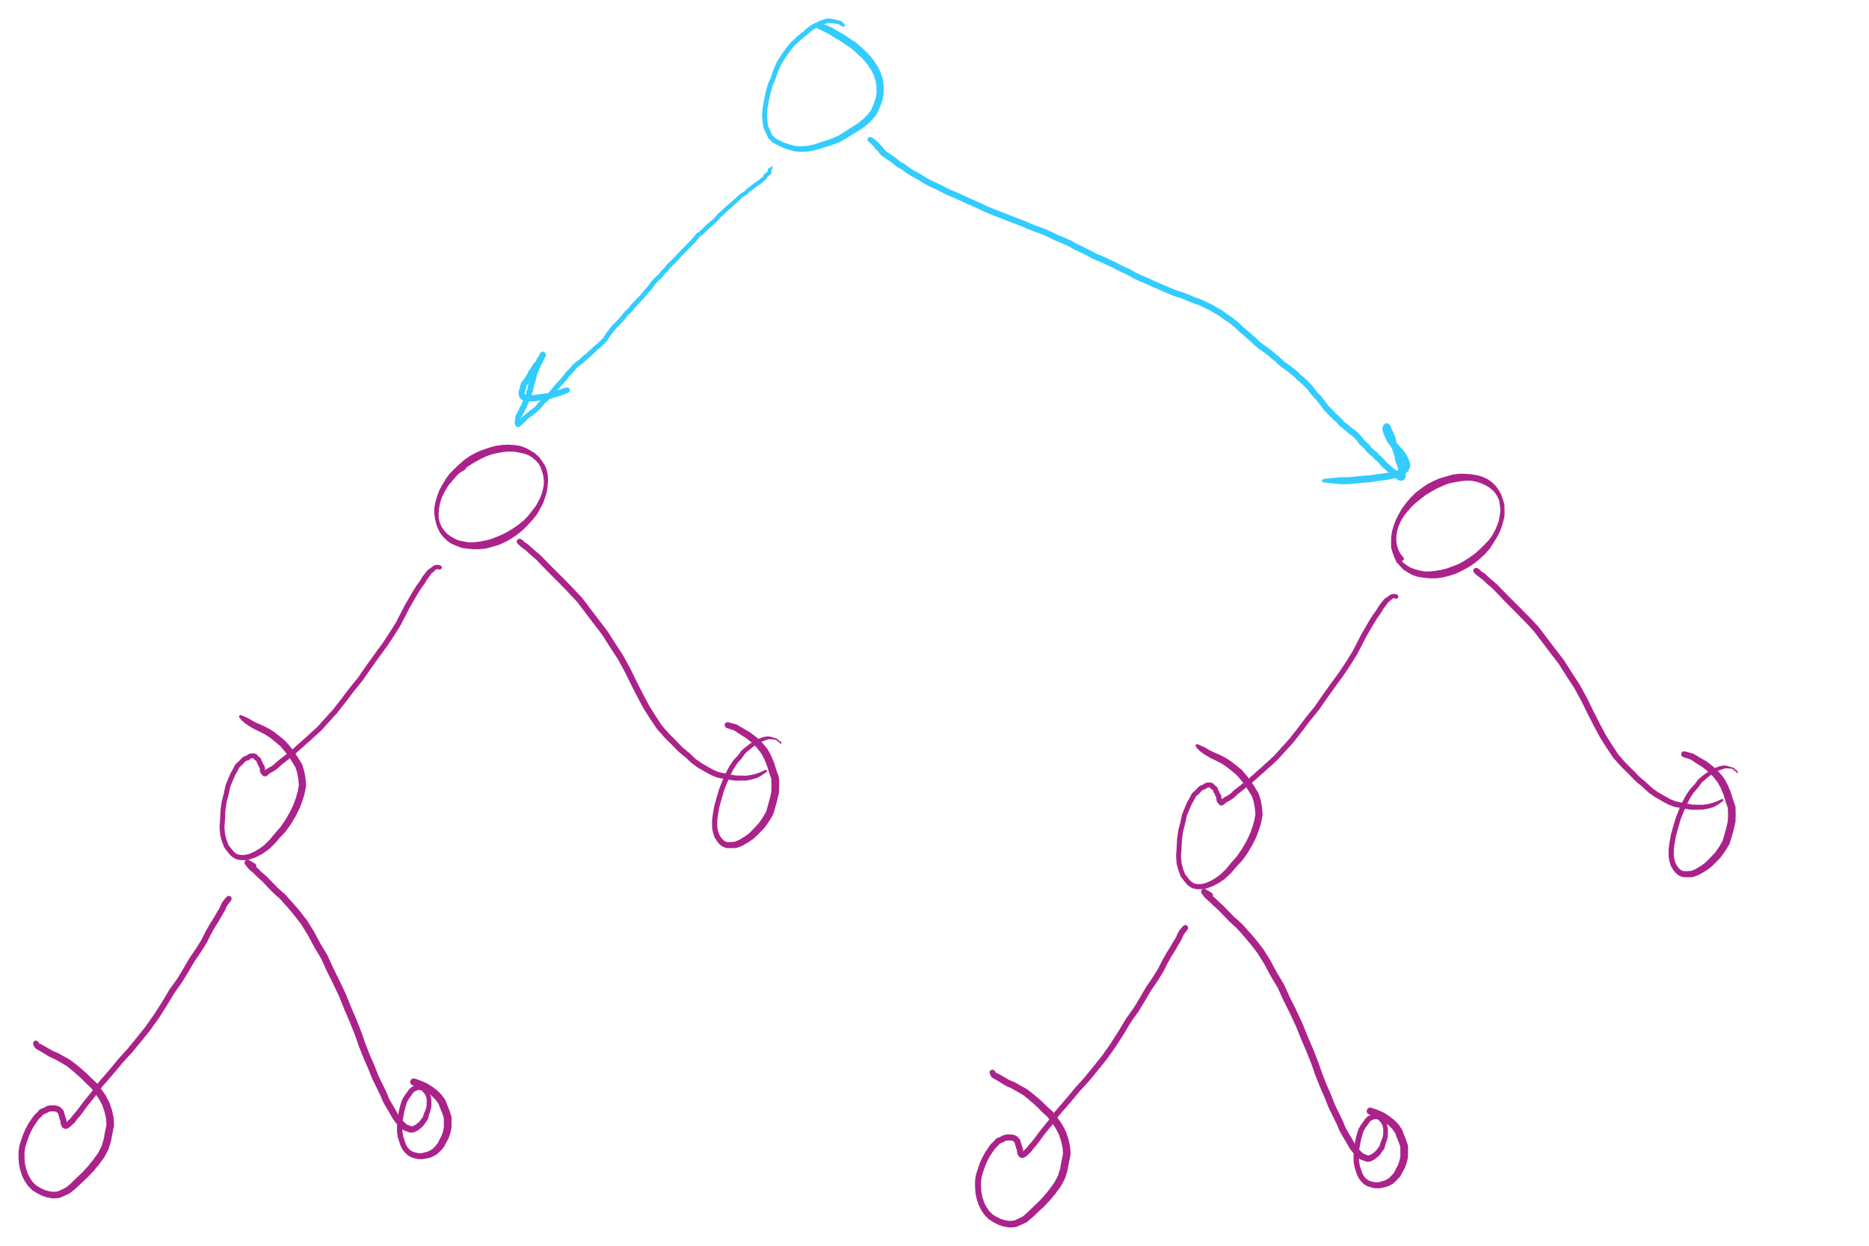
privateBuildTree Special Case #1
leftTree == rightTree

Slide 9
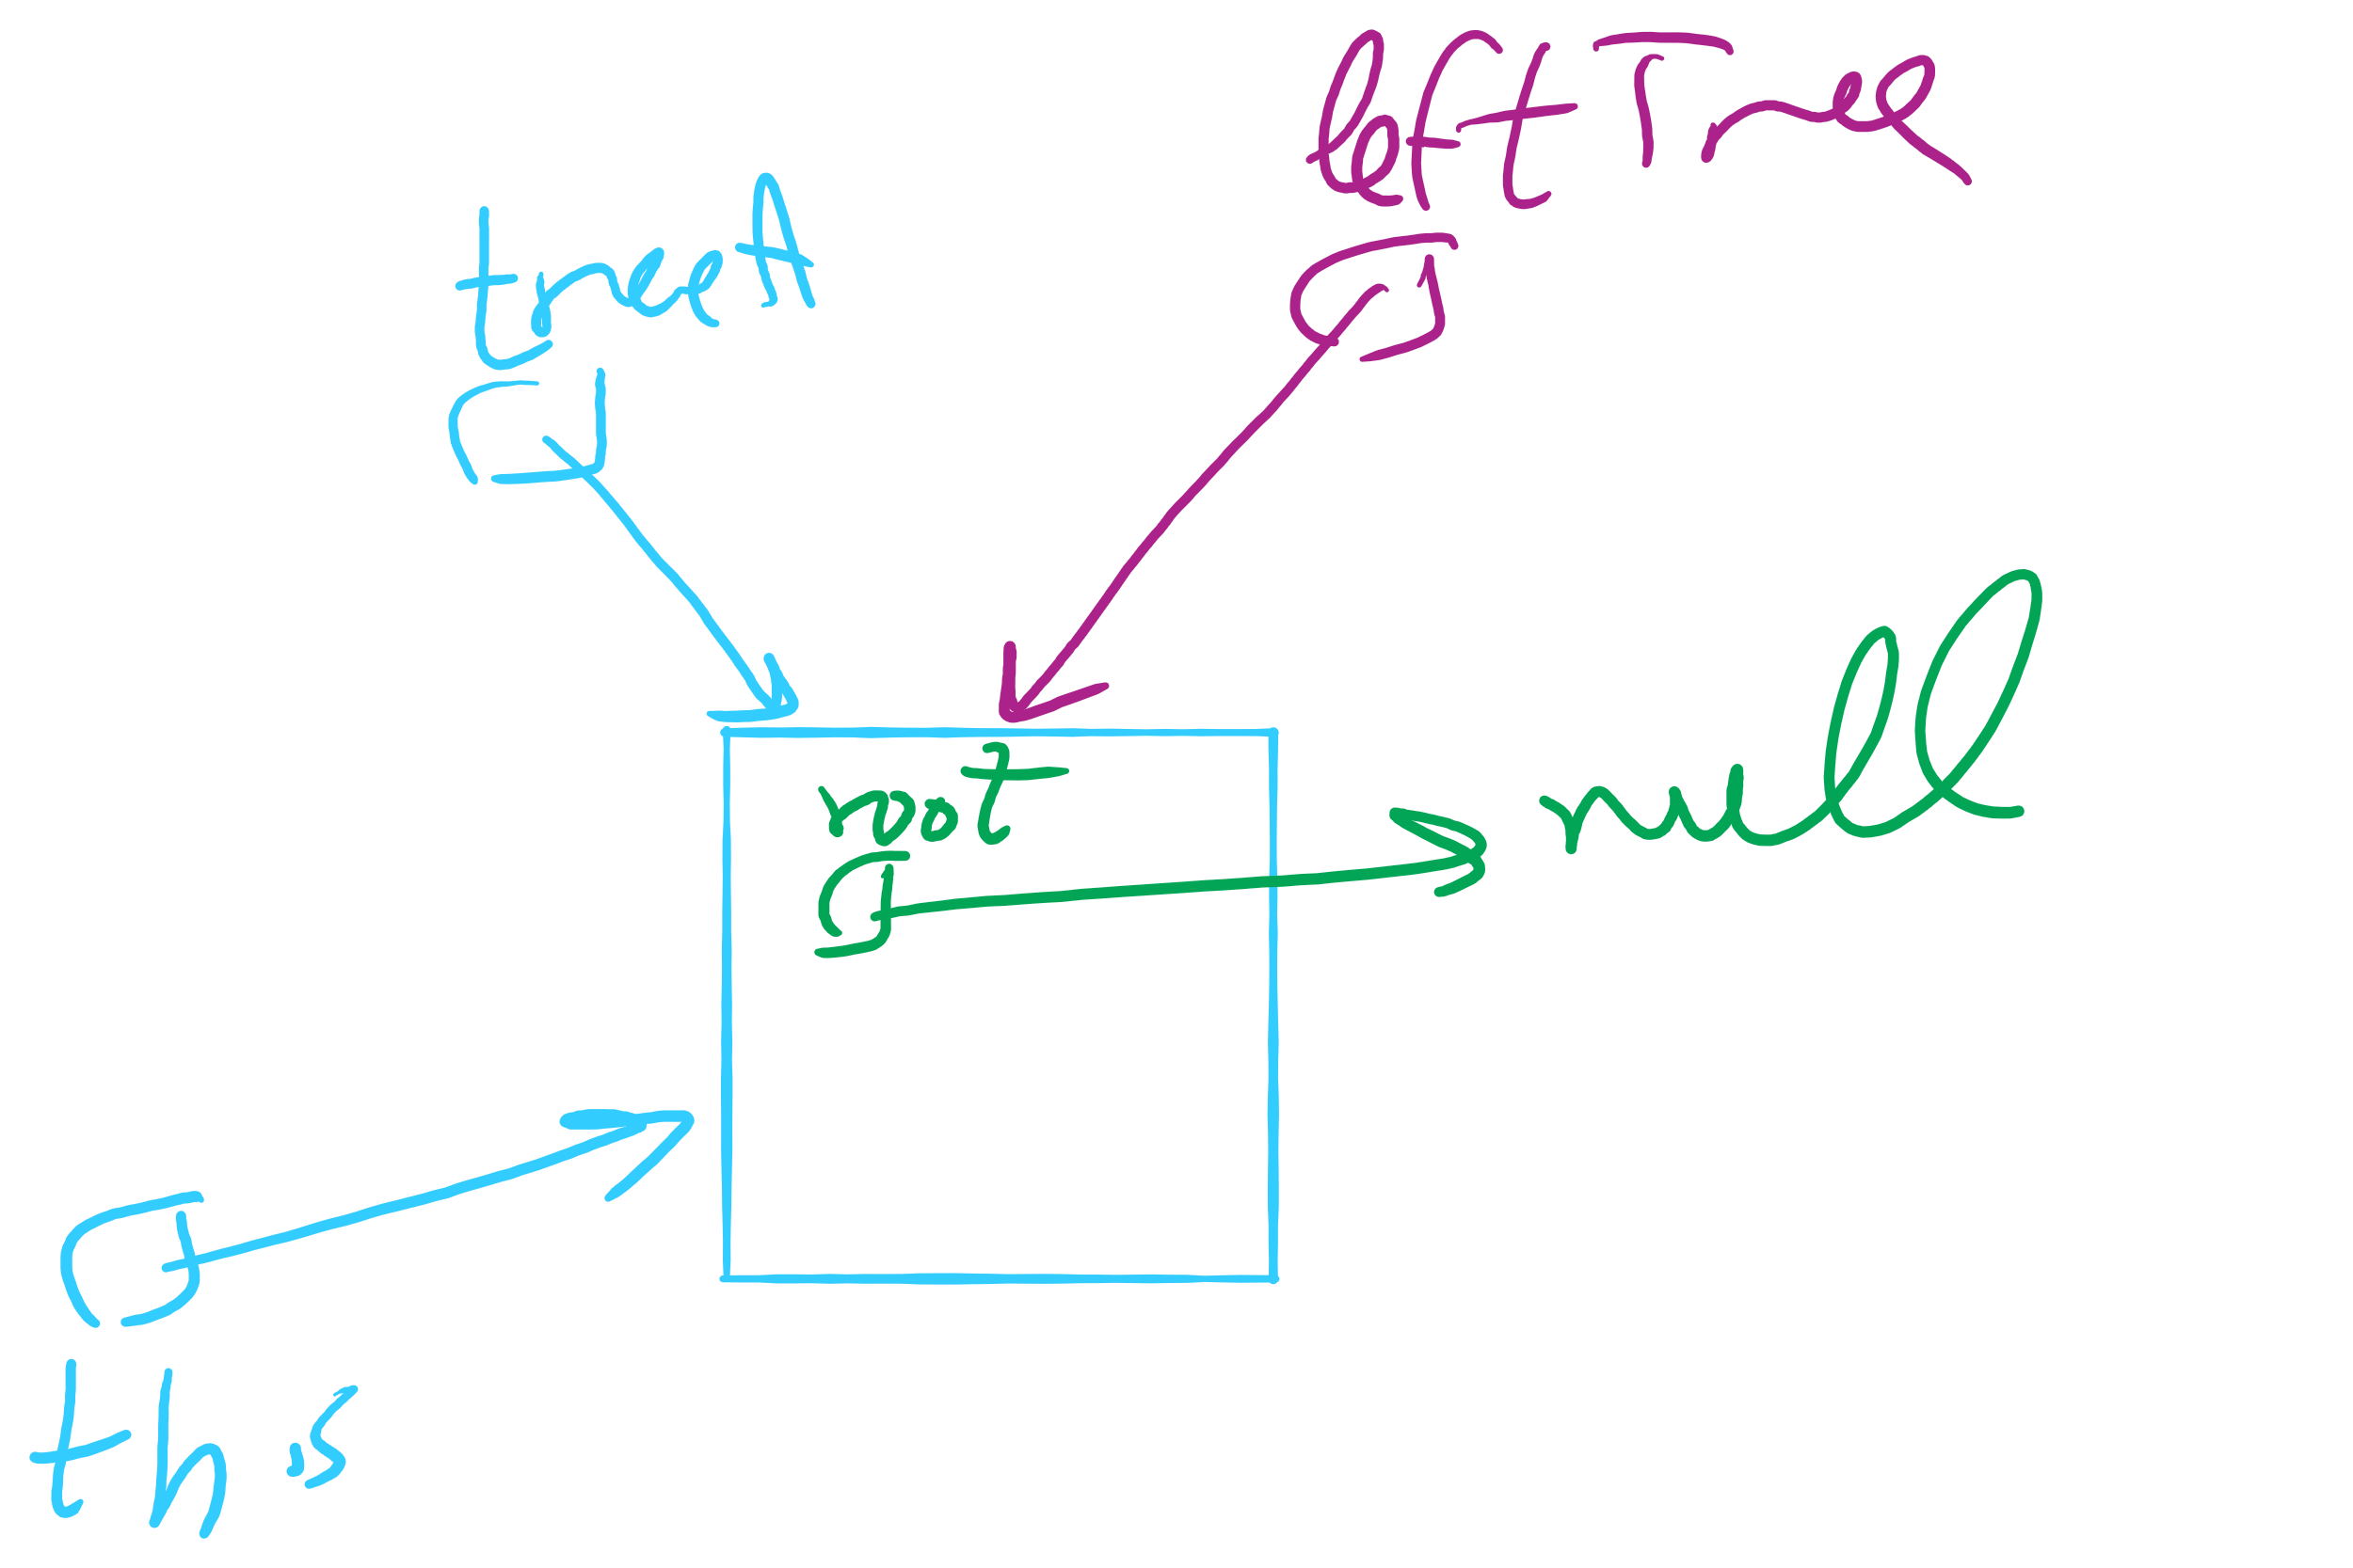
privateBuildTree Special Case #2
leftTree (or rightTree or both) == this

Slide 10
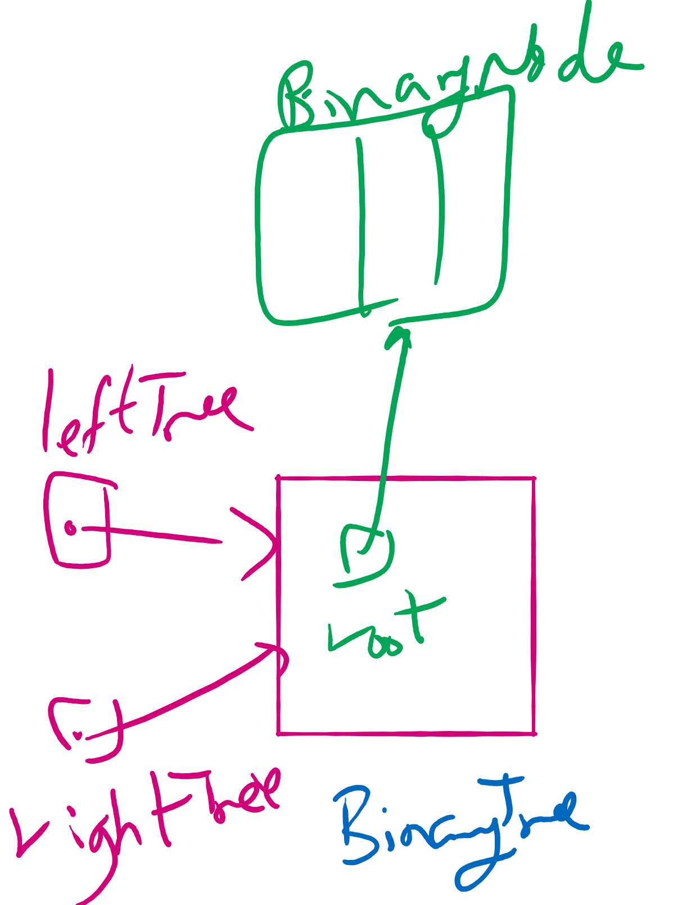
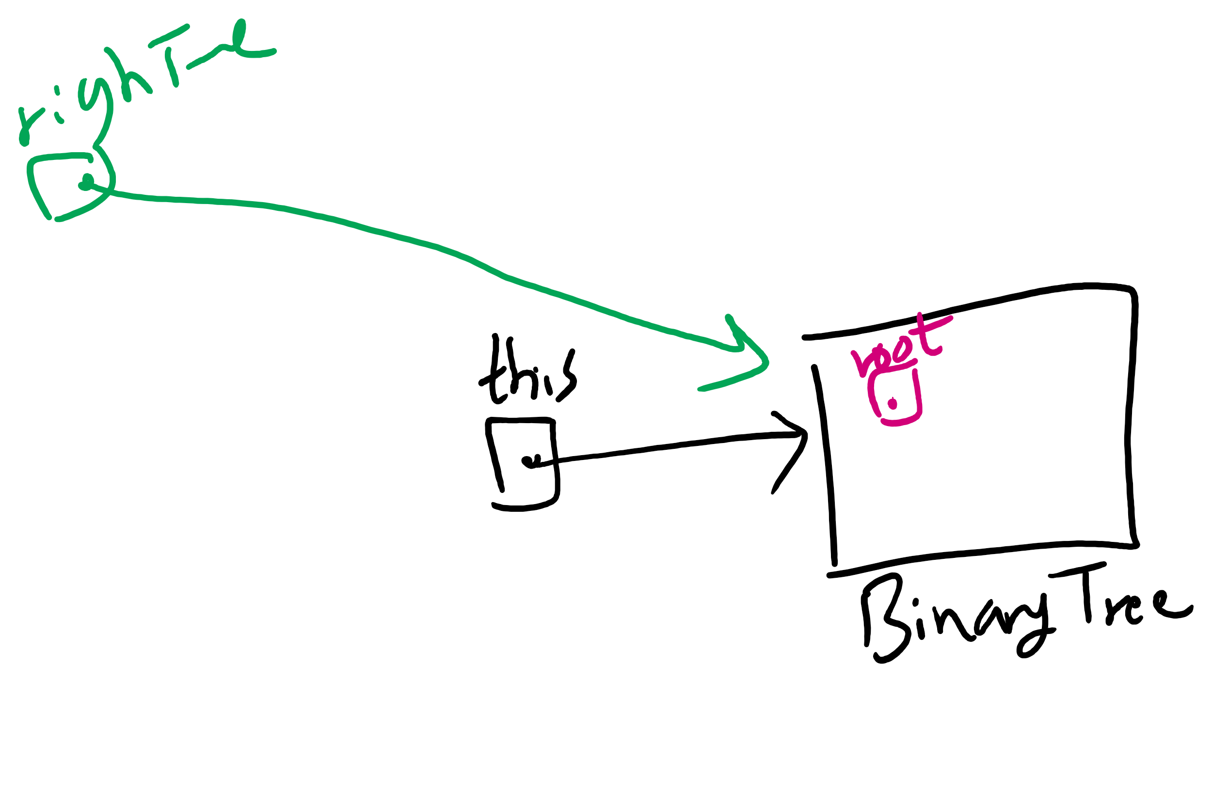
privateBuildTree Corner Cases

Slide 11
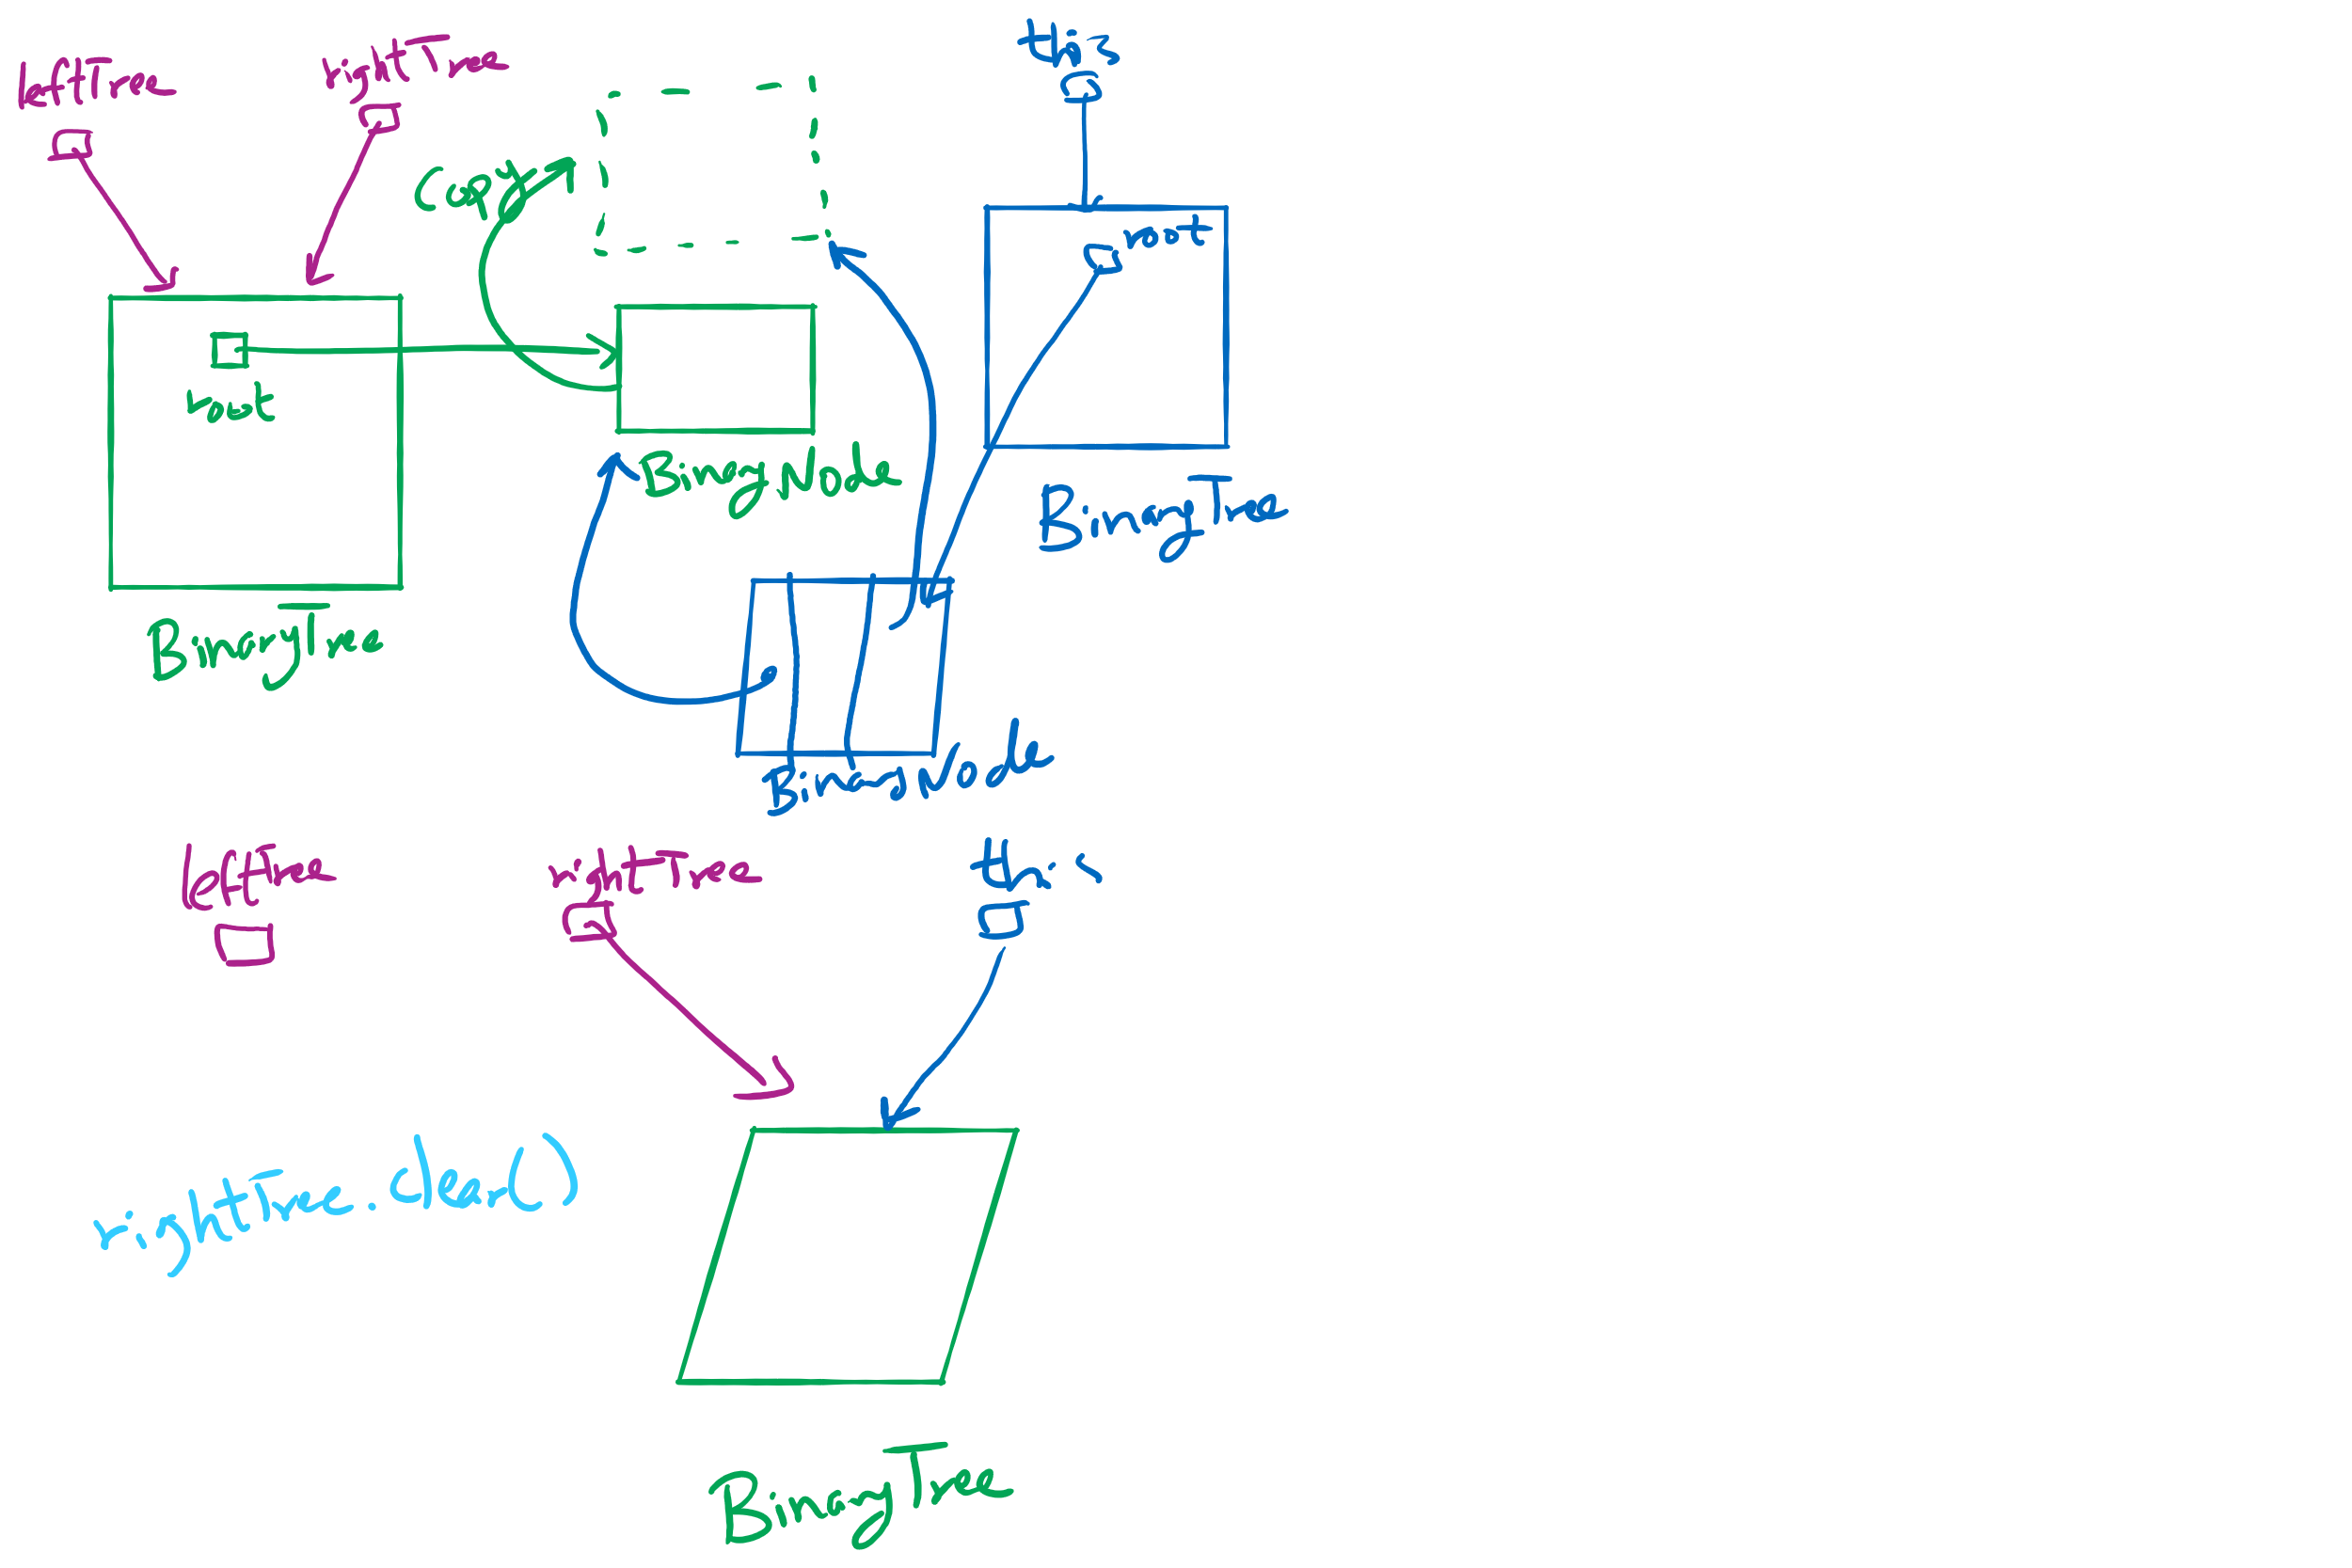
privateBuildTree Special Cases

Slide 12
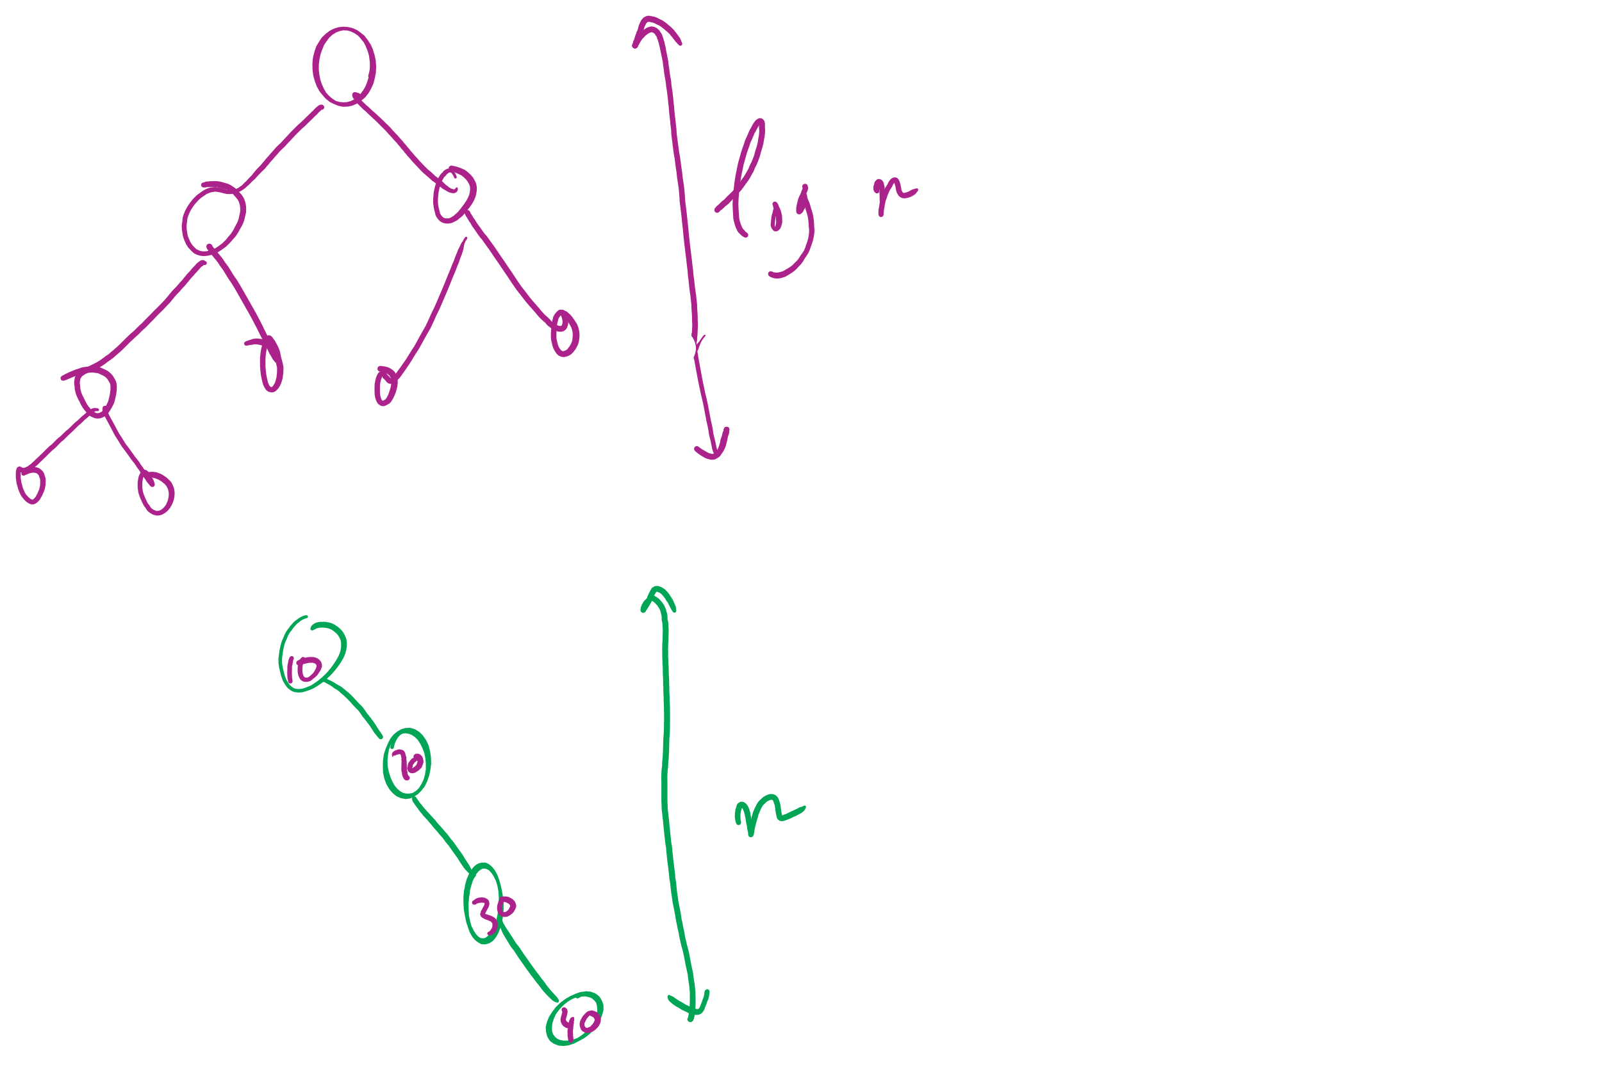
BSTs with varying heights

Slide 13
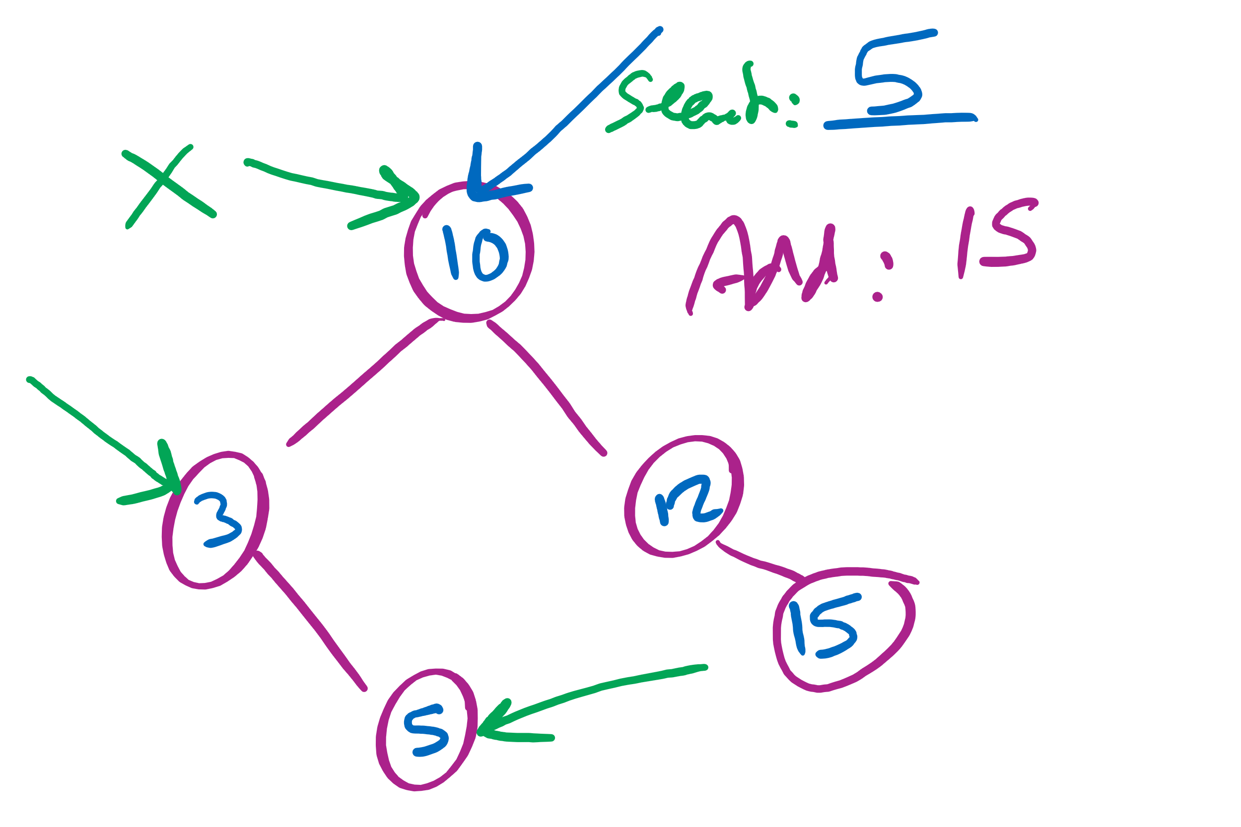
Searching in and insertion to a BST

