Slide 1

Algorithms and Data Structures 2 CS 1501
Fall 2021
Sherif Khattab
ksm73@pitt.edu
(Slides are adapted from Dr. Ramirez’s and Dr. Farnan’s CS1501 slides.)

Slide 2
Announcements
Upcoming deadlines:
10/1: Assignment 1, Lab 3, and Homework 4
Please make good use of the office hours of the entire teaching team. We are all here to help you.
Measuring runtime using System.nanoTime()
Debugging using JDB

Slide 3
Last lecture …
BinarySearchTree (BST)
Search tree property
Add and search

Slide 4
CourseMIRROR Reflections

Slide 5
Today …
BinarySearchTree (BST)
delete (continued)
Run-time of search, add, and delete
Order operations overview
rank, select, range query
Red-Black BST (Balanced BST)
definition and basic operations
run-time of search, add, and delete
add
delete overview

Slide 6
Code Walkthrough
Available online at:
https://cs1501-2221.github.io/handouts/CodeHandouts/TreeADT/Slides
The slides are under the CodeHandouts/TreeADT/slides folder in the handout repository
https://github.com/cs1501-2221/handouts

Slide 7
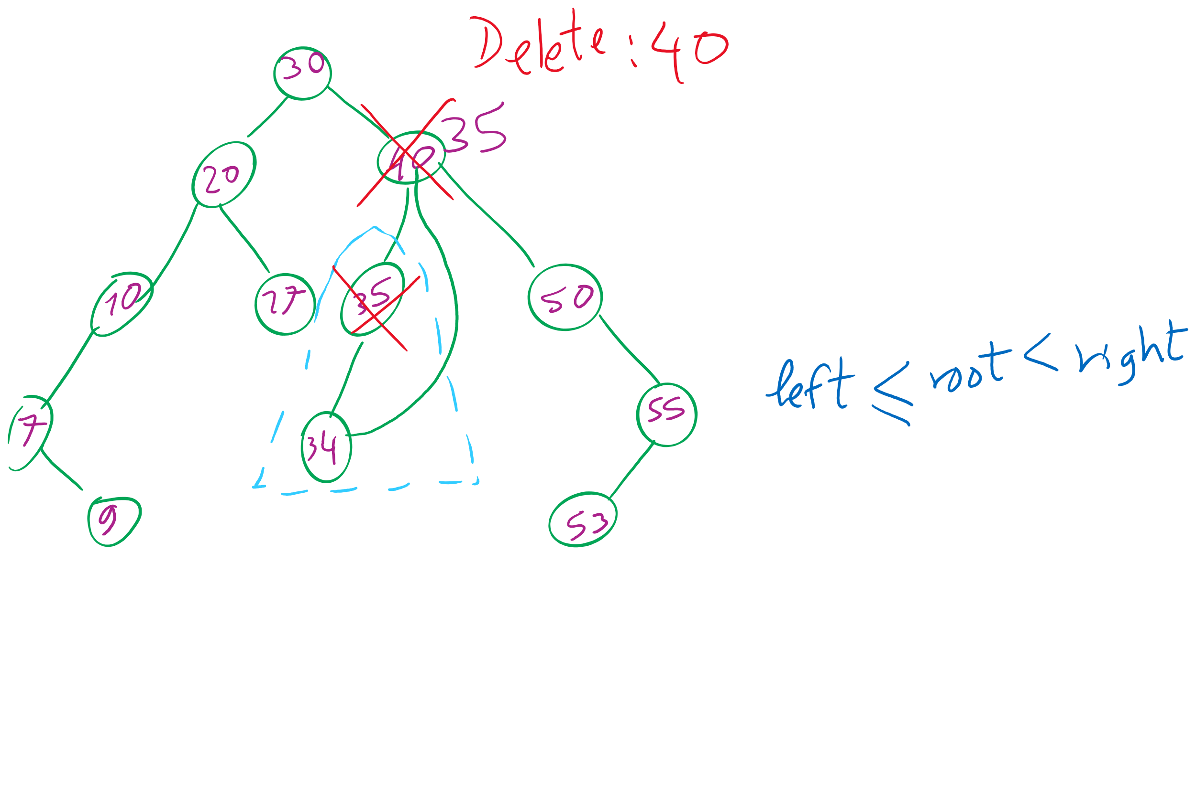
BinarySearchTree

Slide 8
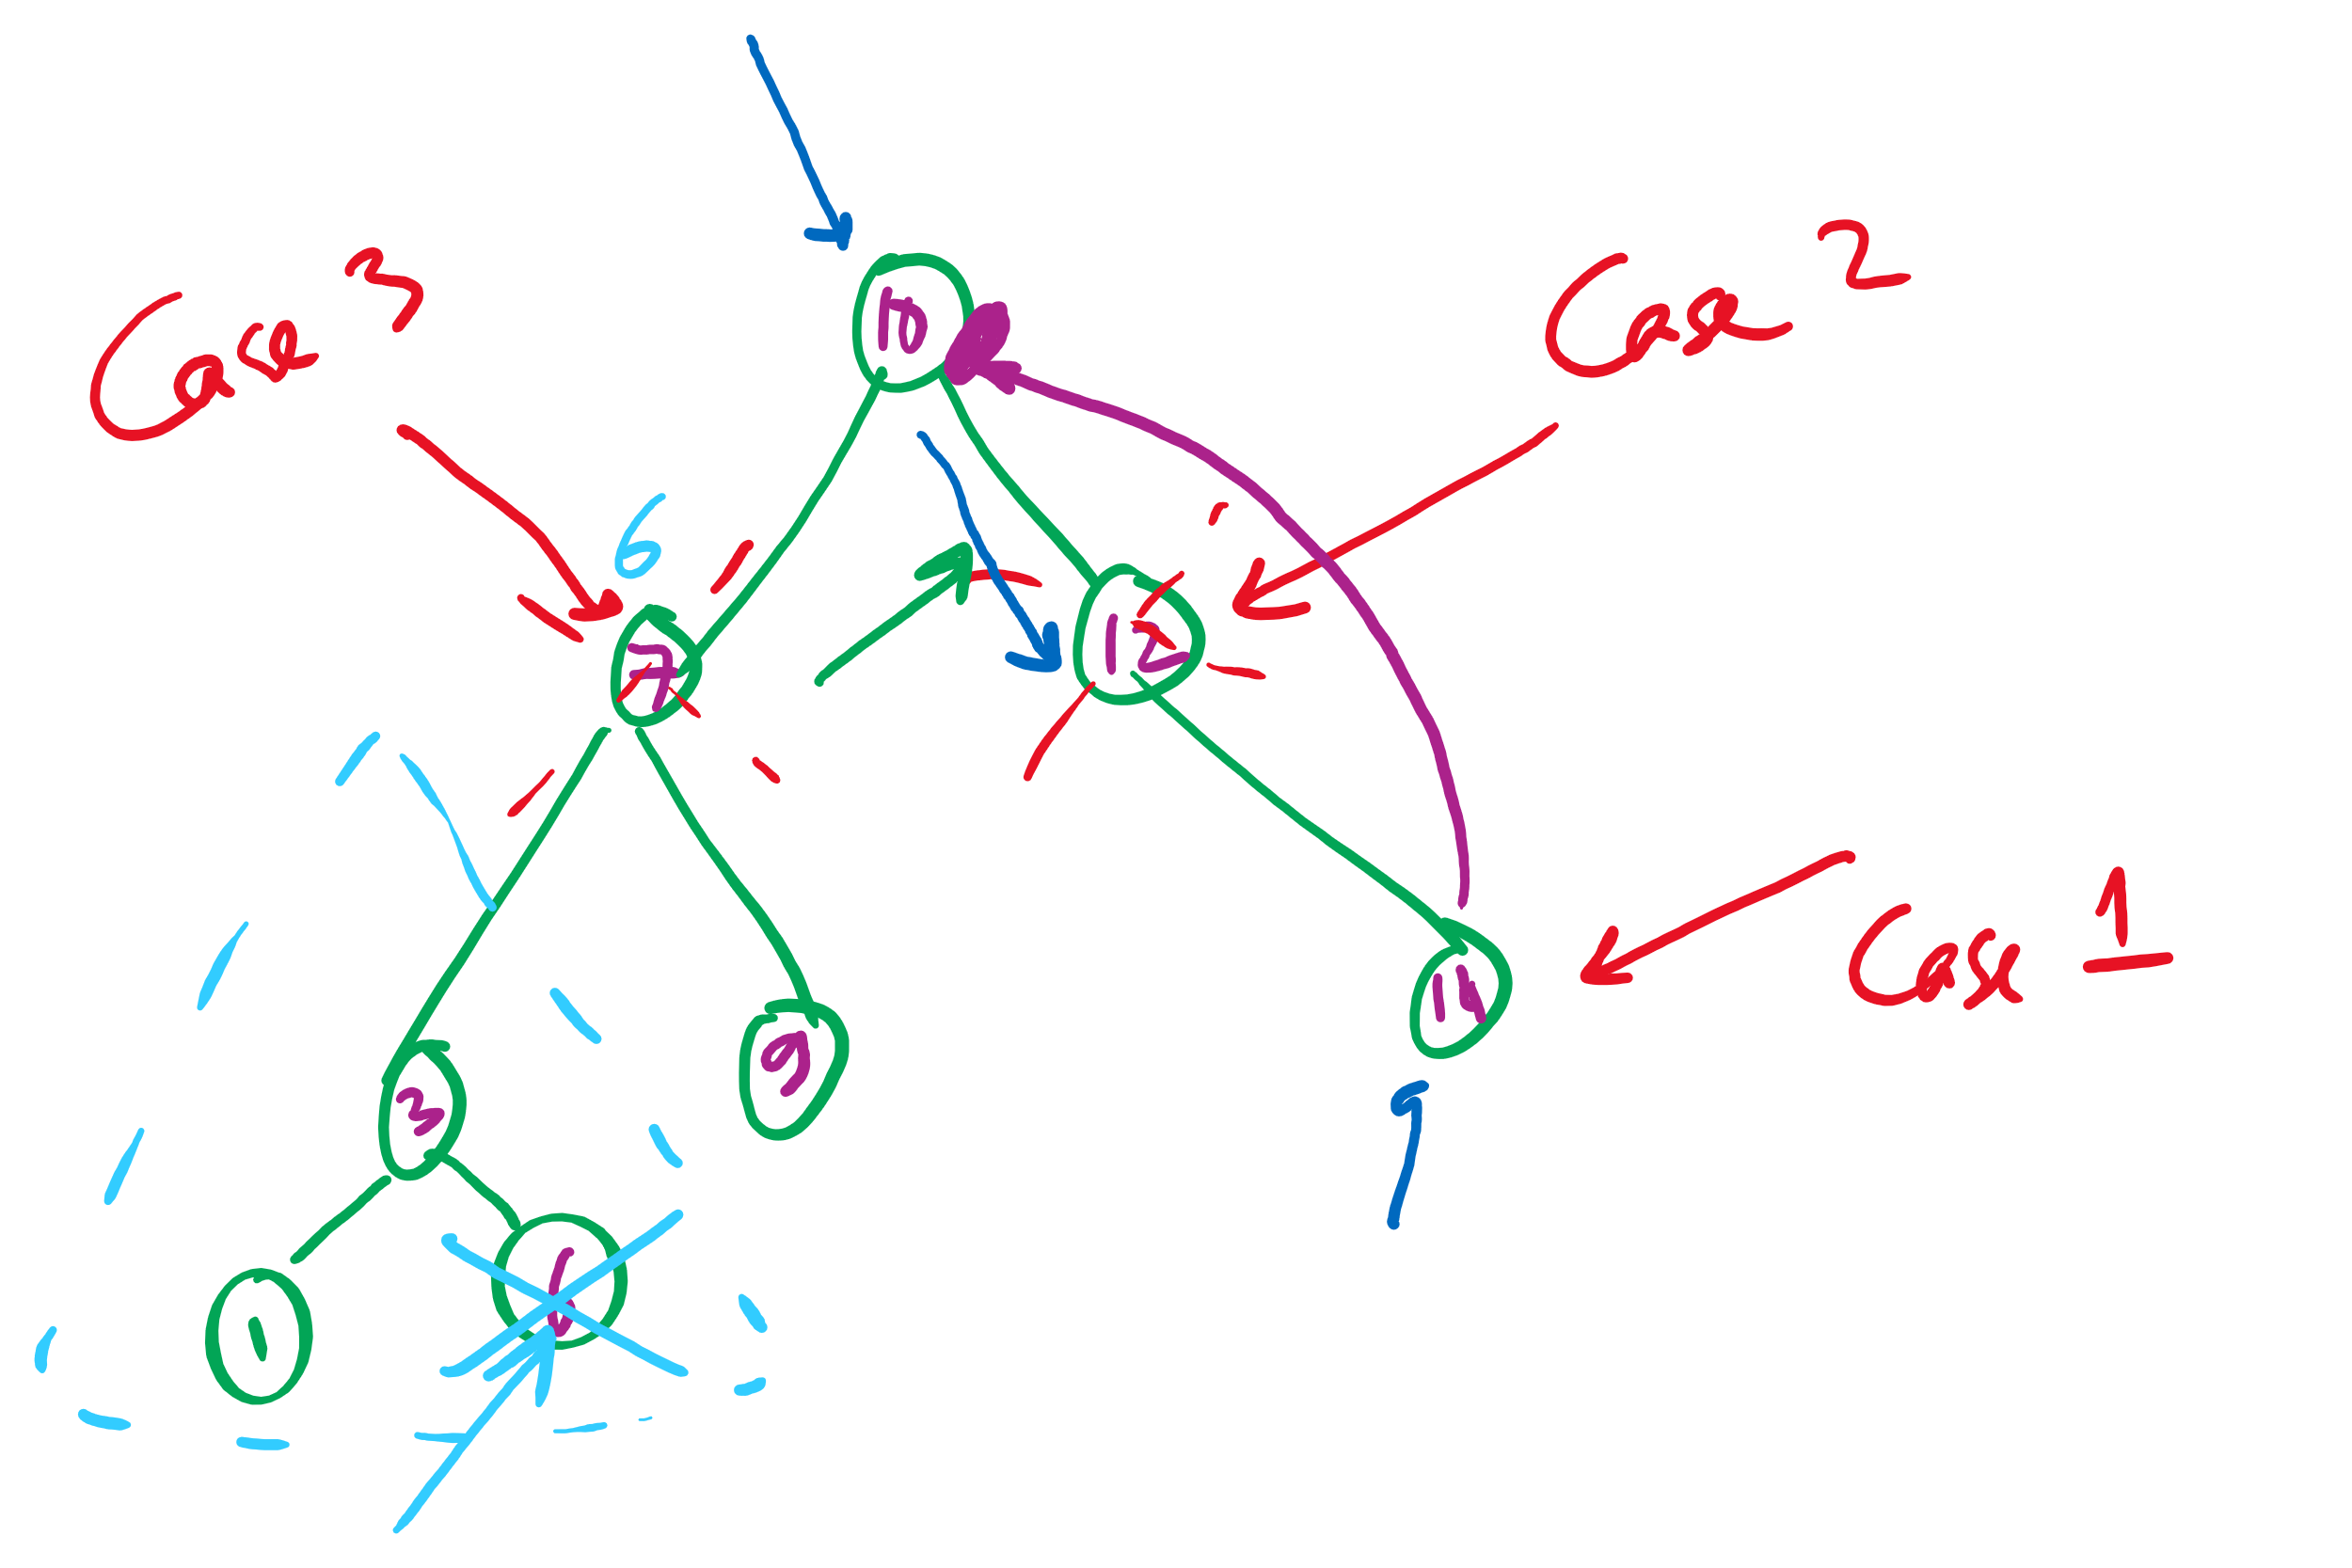
3 cases of deleting from a BST

Slide 9
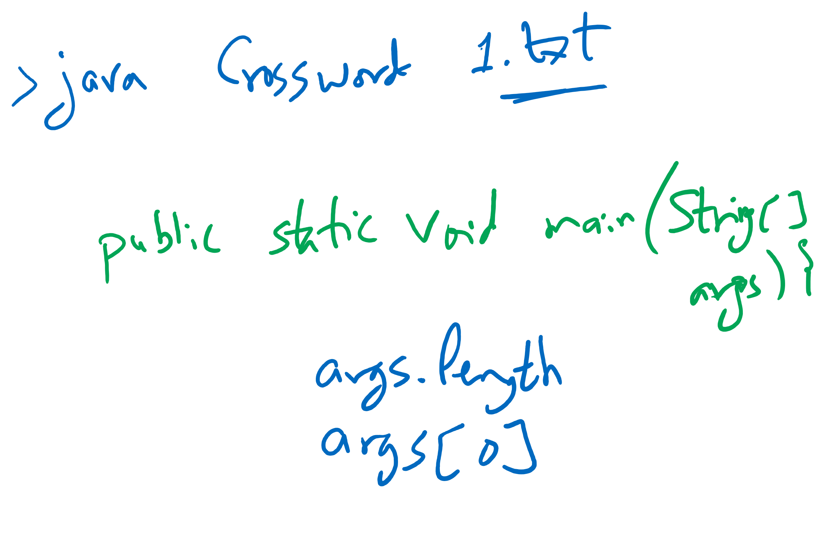
Java command-line arguments

Slide 10
Red-Black BST
Definition
two colors for links (nodes)
red links are always to the left children
at most one red-link per node
all black-link paths are the same
root node is always black
Why?
maximum height = 2*log n !!
Basic operations
rotate left
rotate right
flip color
preserve the properties of the red-black BST!

Slide 11
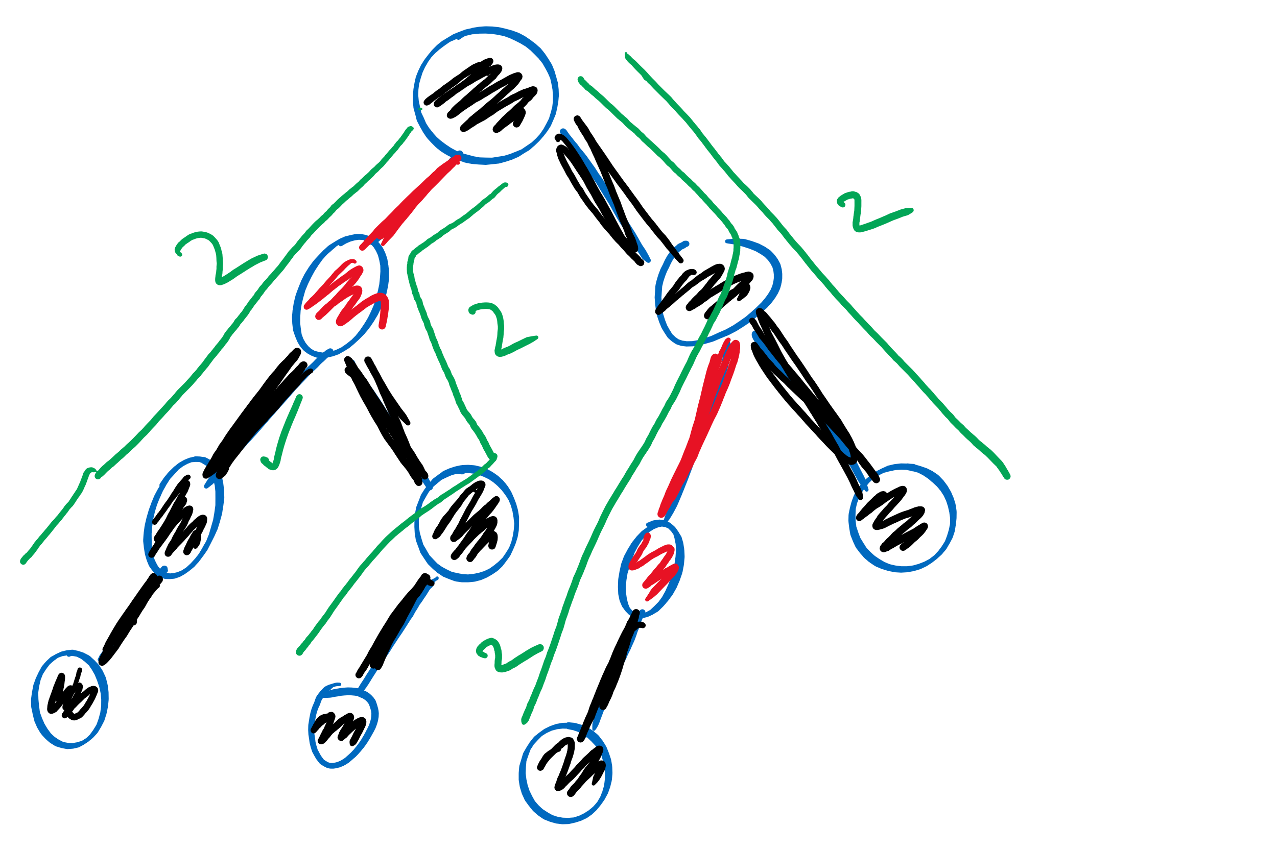
Red-black BST example

