Slide 1

Algorithms and Data Structures 2 CS 1501
Fall 2021
Sherif Khattab
ksm73@pitt.edu
(Slides are adapted from Dr. Ramirez’s and Dr. Farnan’s CS1501 slides.)

Slide 2
Announcements
Upcoming deadlines:
10/1: Assignment 1, Lab 3, and Homework 4
Please make good use of the office hours of the entire teaching team. We are all here to help you.
Measuring runtime using System.nanoTime()
Debugging using JDB

Slide 3
Last lecture …
BST Implementation
Search, add, delete
Red Black BST
definition

Slide 4
Today …
Red-Black BST Operations

Slide 5
Red-Black BST
Definition
two colors for links (nodes)
red links are always to the left children
at most one red-link per node
all black-link paths are the same
root node is always black
Why?
maximum height = 2*log n !!
Basic operations
rotate left
rotate right
flip color
preserve the properties of the red-black BST!

Slide 6
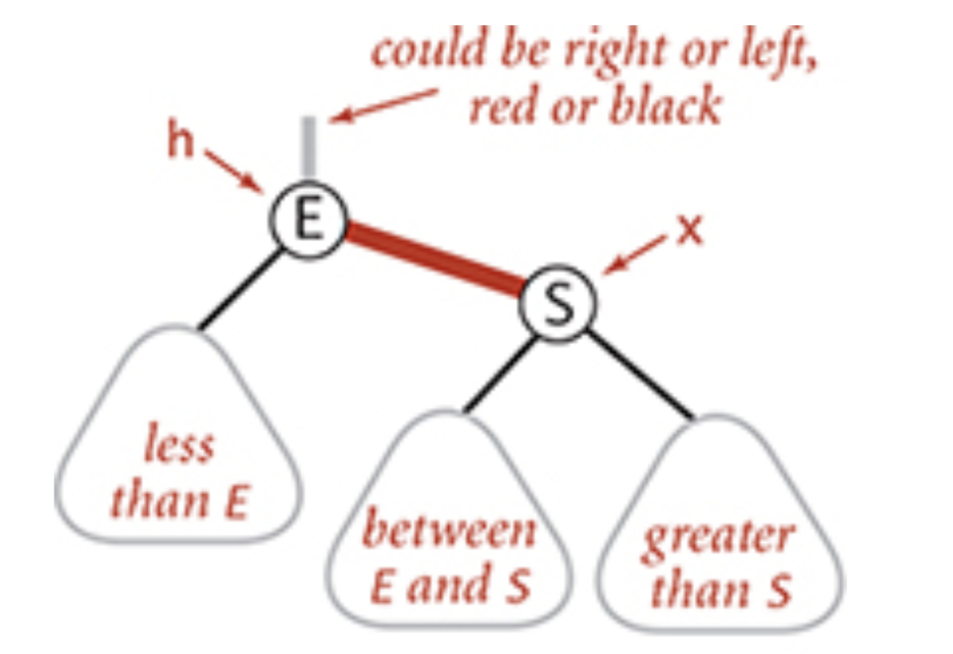
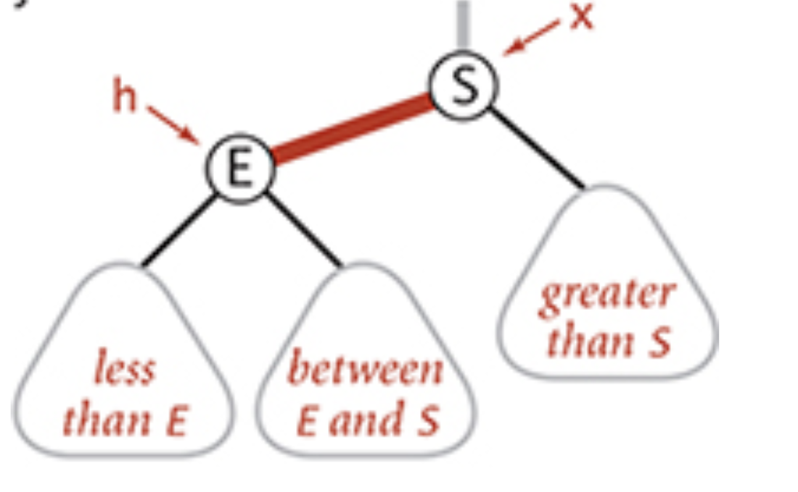
rotateLeft

Slide 7
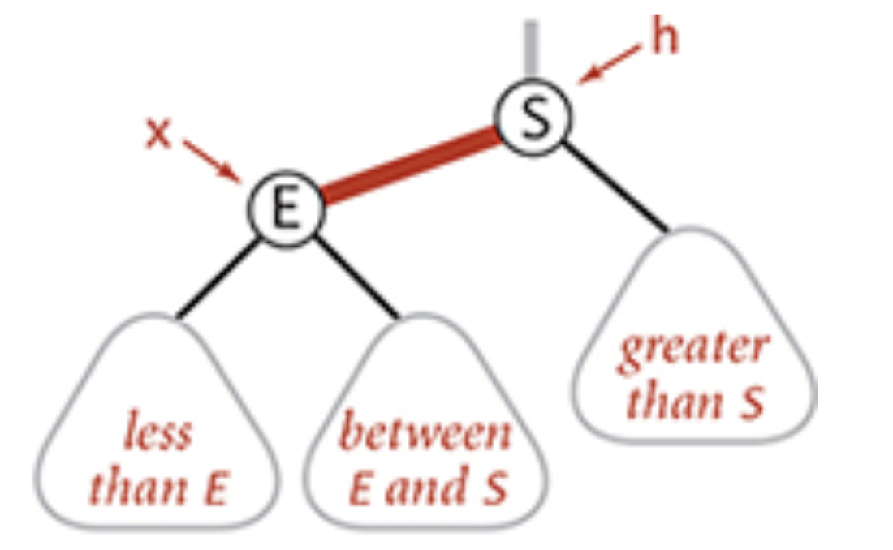
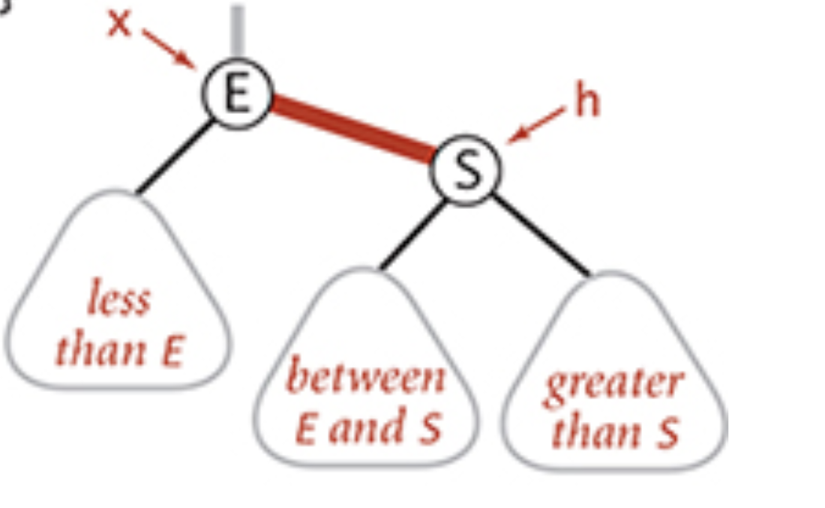
rotateRight

Slide 8
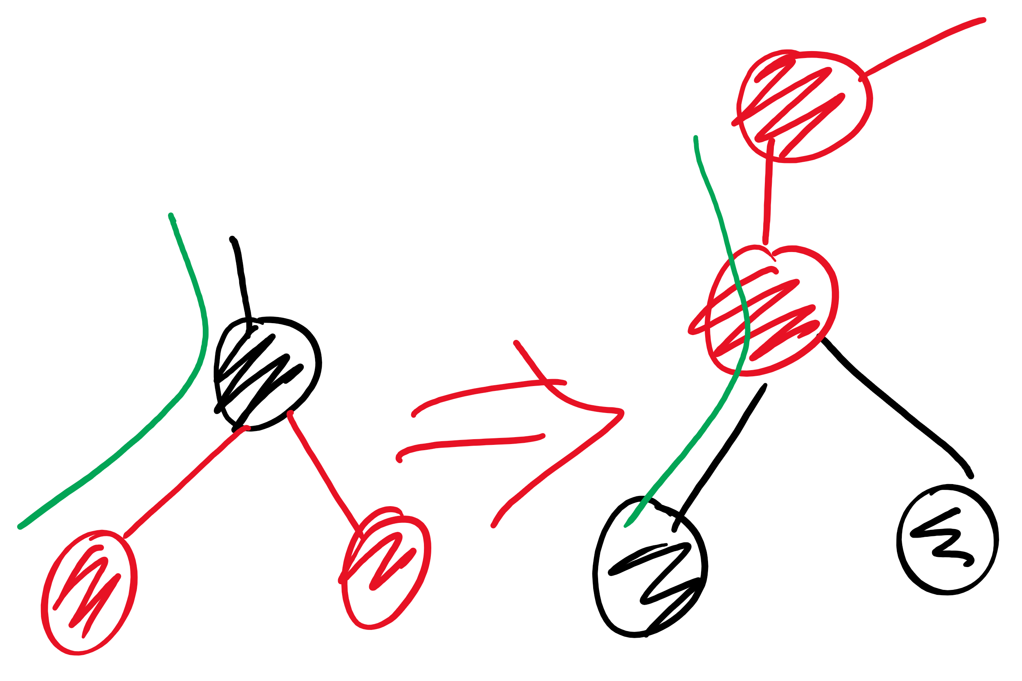
colorFlip

Slide 9
Adding to a red-black BST
new node is always red (at least initially)
if properties violated, correct using one or more of the basic operations
Violations that can happen:
red link to the right child
two red links connected to the same node
root node is red
Correcting a violation may result in a violation up the tree
Corrections happen as we climb back up the tree
That is, after the recursive call

Slide 10
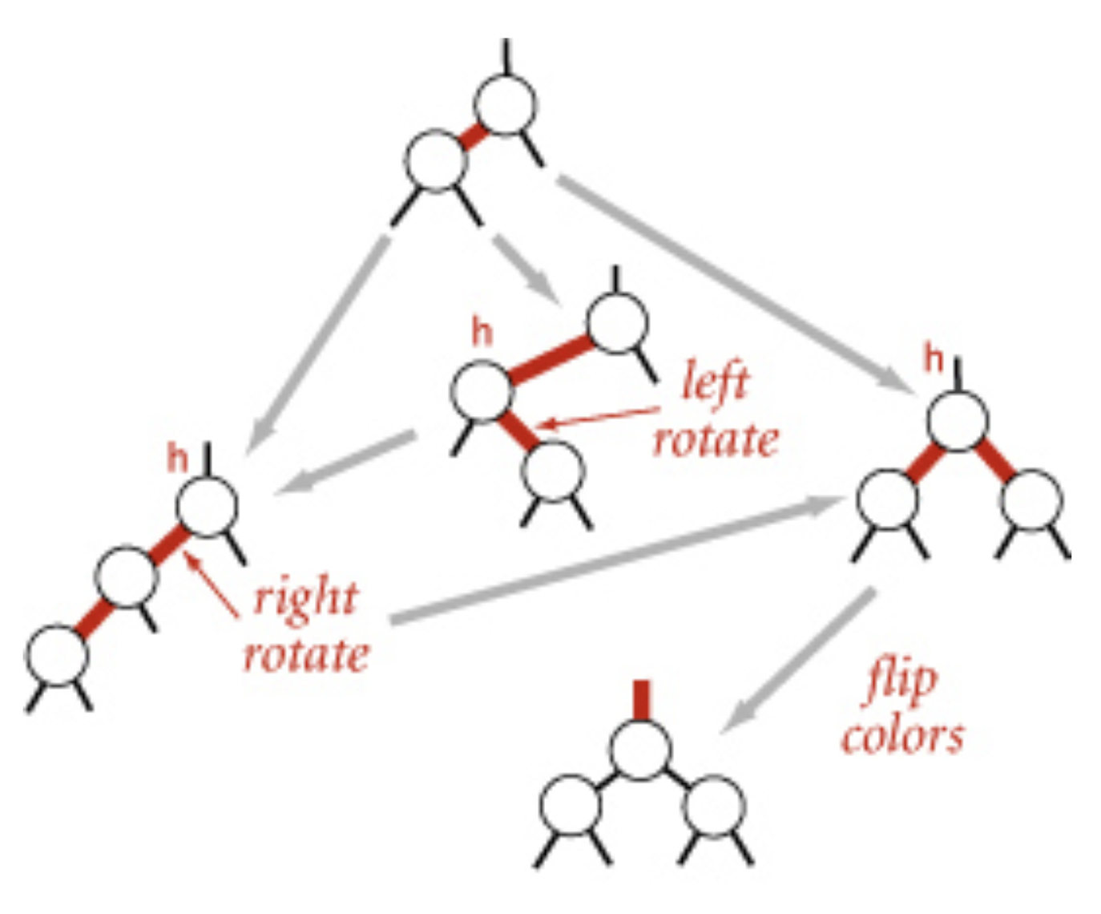
Dependencies between corrections!

Slide 11
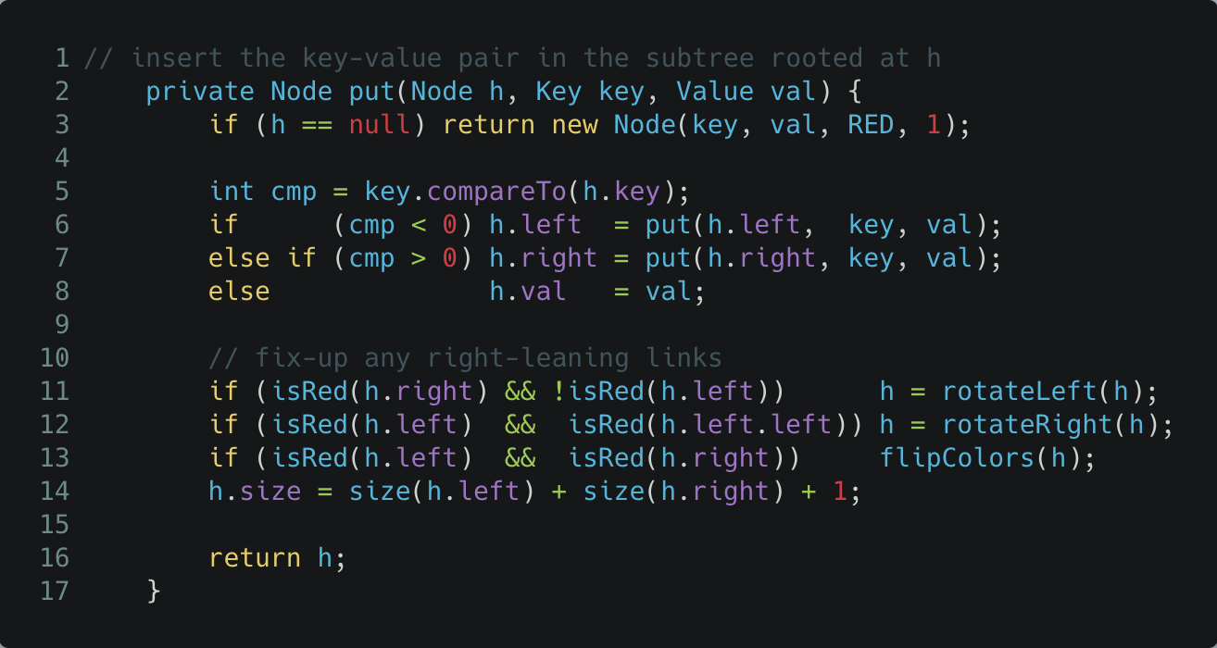
Which violations to check for first?

Slide 12
Deleting a node
Make sure that we are not deleting a black node
as we go down the tree, make sure that the next node down is red
using certain operations
as we go back up the tree, correct any violations
same as we did while adding
if deleting a node with 2 children
replace with minimum of right subtree
similar trick to delete in regular BST

Slide 13
Other operations
rank, select, range query, …
Same code as regular BST!
worst-case runtime = Theta(log n)!!

Slide 14
Please submit your reflections by using the CourseMIRROR App
If you are having a problem with CourseMIRROR, please send an email to coursemirror.development@gmail.com
Notes:
All right!
Upcoming Due Dates at A Glance

