Slide 1

Algorithms and Data Structures 2 CS 1501
Fall 2021
Sherif Khattab
ksm73@pitt.edu
(Slides are adapted from Dr. Ramirez’s and Dr. Farnan’s CS1501 slides.)

Slide 2
Announcements
Upcoming deadlines:
Lab 11: Friday 12/10
Lab 12 and Homework 12: Monday 12/20 at 5:00 pm
Assignment 4 and 5: Monday 12/20 at 5:00 pm
Bonus Opportunities
Bonus Homework: Monday 12/20 at 5:00 pm
OMETs: 1 bonus point for entire class when response rate >= 80%

Slide 3
Previous lecture …
Ford-Fulkerson MaxFlow Framework
Edmonds-Karp algorithms
BFS
PFS

Slide 4
CourseMIRROR Reflections

Slide 5
Today …

Slide 6
Please submit your reflections by using the CourseMIRROR App
If you are having a problem with CourseMIRROR, please send an email to coursemirror.development@gmail.com
Notes:
All right!
Upcoming Due Dates at A Glance

Slide 7
Karatsuba Example 1

Slide 8
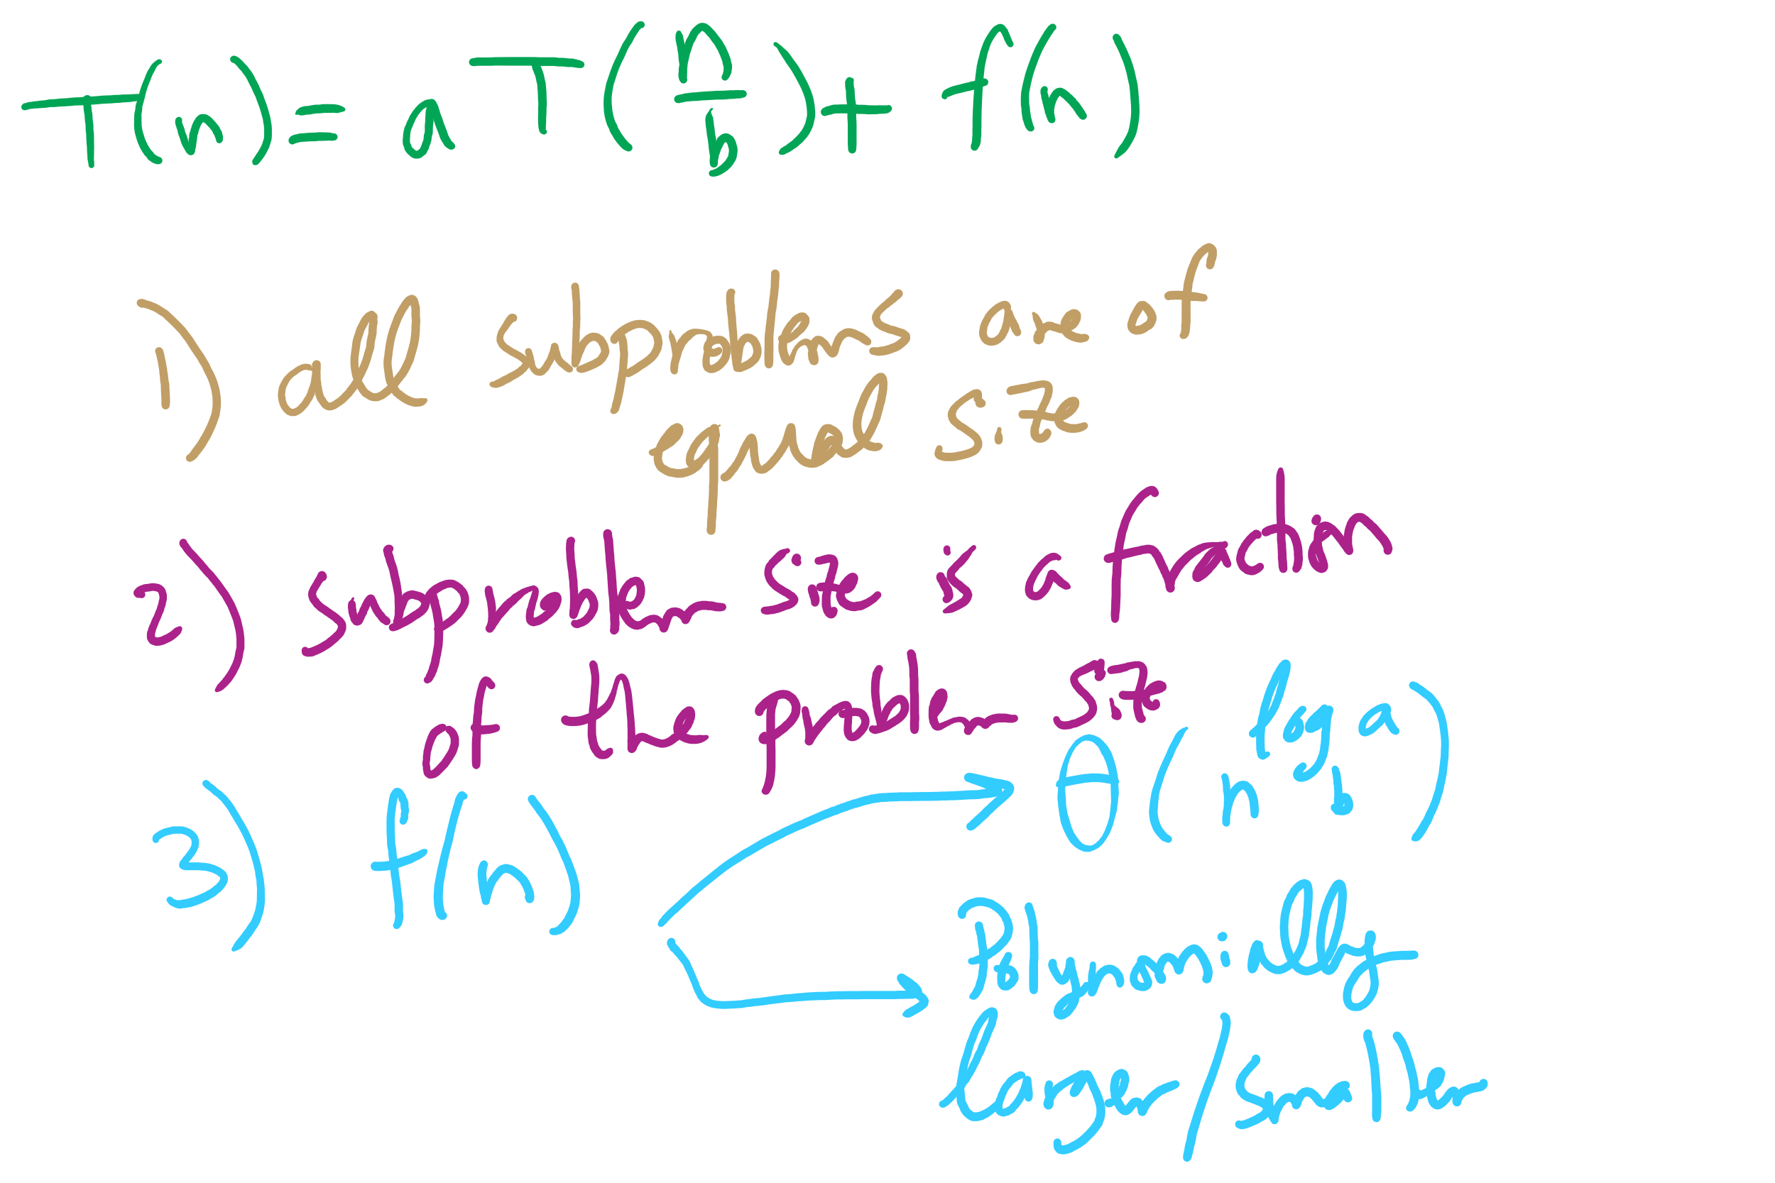
Master Theorem Conditions

Slide 9
This Lecture
(Big)Integer Algorithms
exponentiation
GCD
RSA encryption

Slide 10
Building another recurrence relation
x^{y} = (x^{(y/2)})² = x^{(y/2)} * x^{(y/2)}
Similarly, (x^{(y/2)})² * x = x^{(y/2)} * x^{(y/2)} * x
So, our recurrence relation is:
T(n) = T(n-1) + ?
How much work is done per call?
1 (or 2) multiplication(s)
Examined runtime of multiplication last lecture
But how big are the operands in this case?

Slide 11
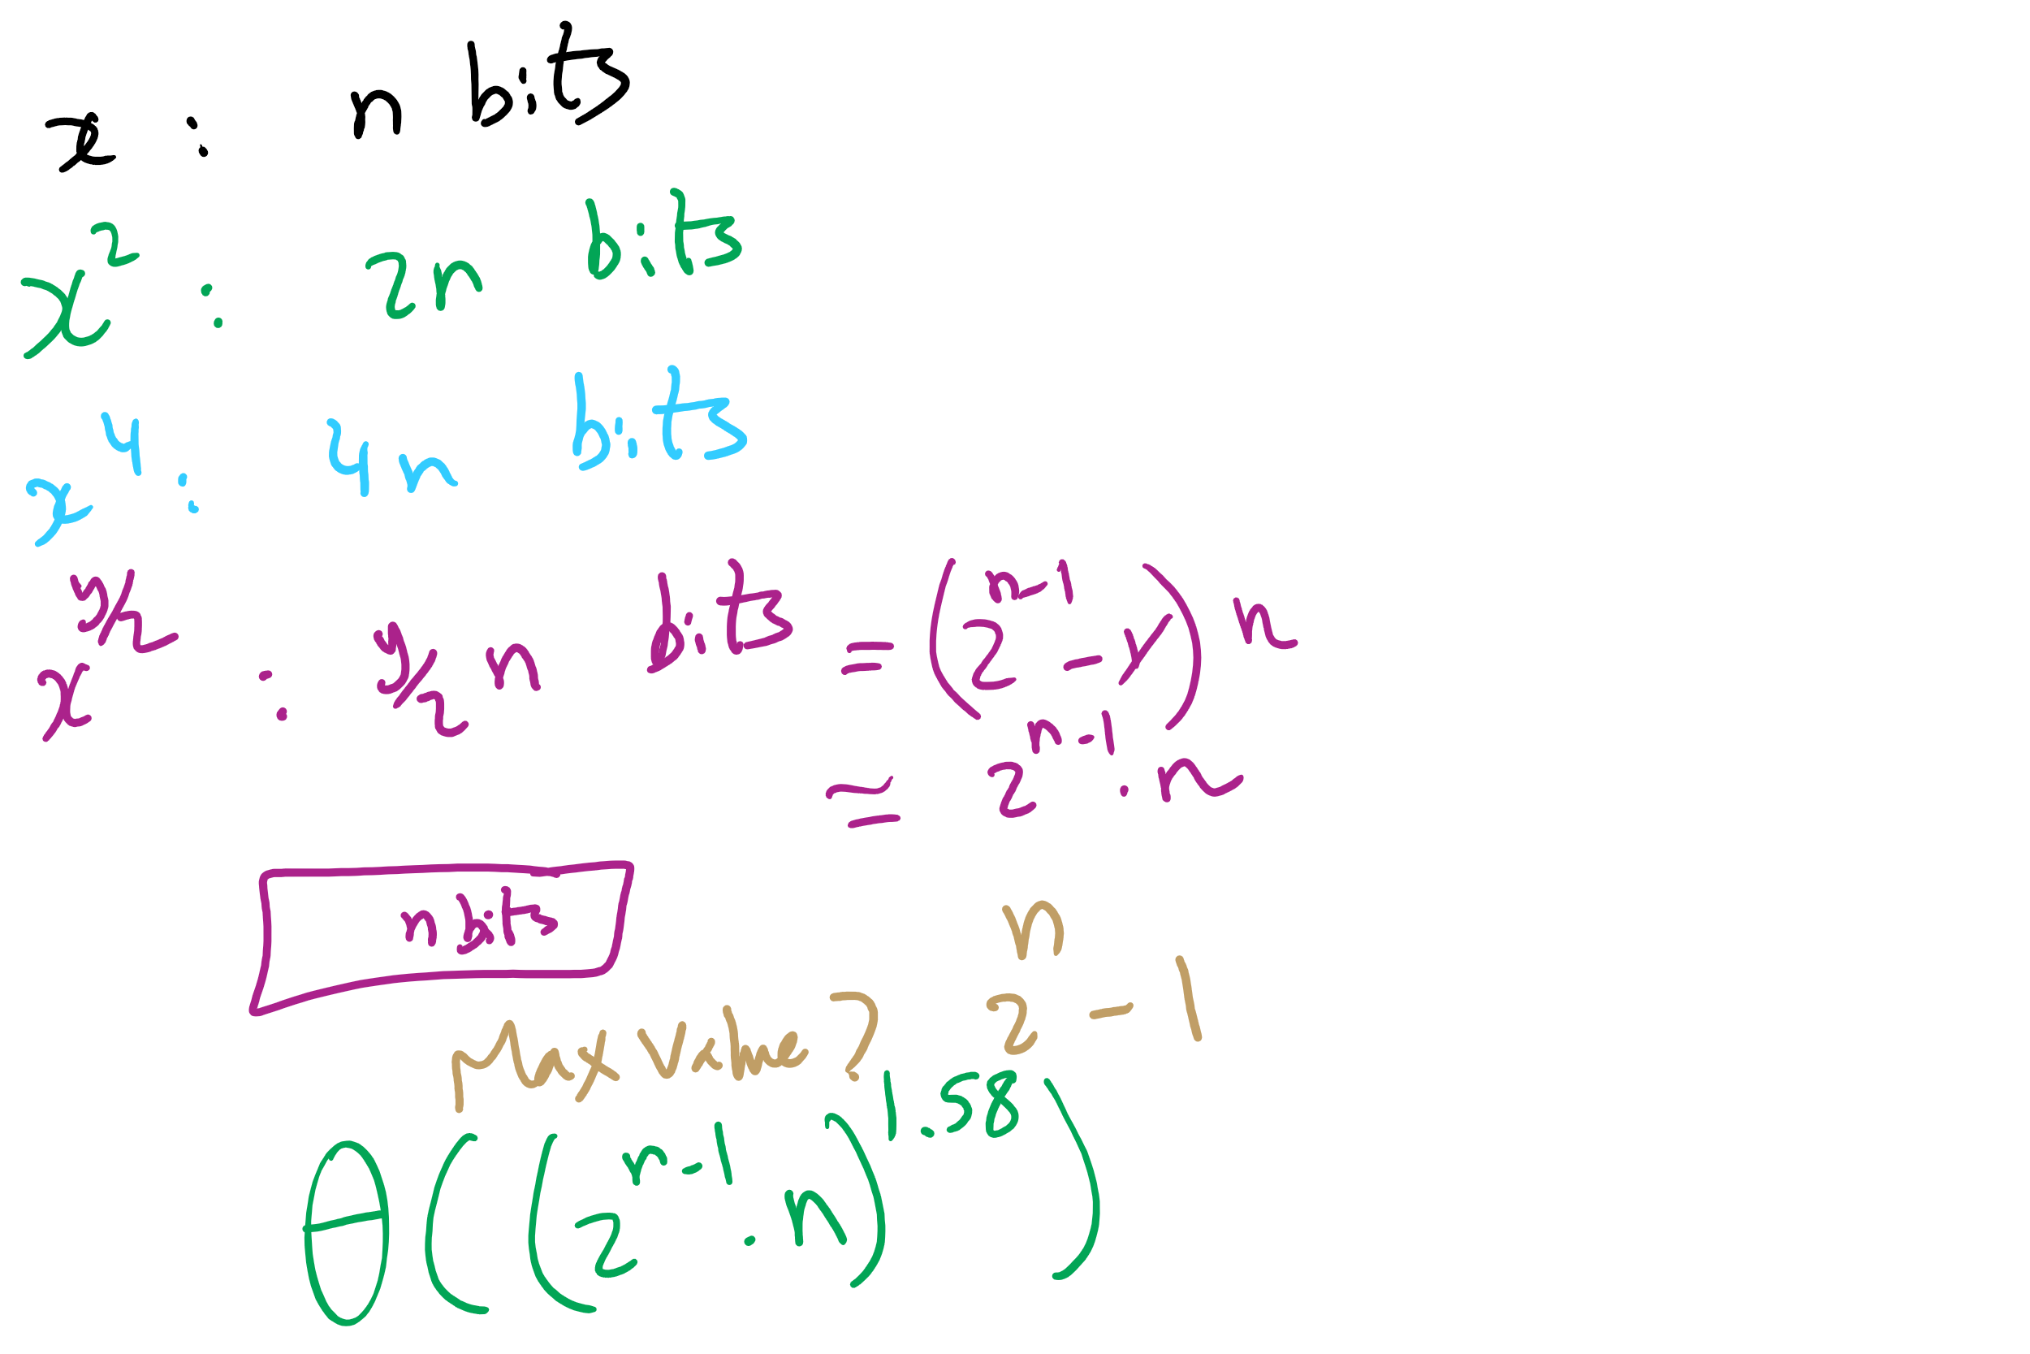
Non-recursive Work

Slide 12
Determining work done per call
Base case returns x
n bits
Base case results are multiplied: x * x
n bit operands
Result size?
2n
These results are then multiplied: x² * x²
2n bit operands
Result size?
4n bits
…
x^{(y/2)} * x^{(y/2)}?
(y / 2) * n bit operands = 2^{(n-1)} * n bit operands
Result size? y * n bits = 2^{n} * n bits

Slide 13
Multiplication input size increases throughout
Our recurrence relation looks like:
T(n) = T(n-1) + Θ((2^{(n-1)} * n)²)
squared from the use of the gradeschool algorithm
multiplication input size

Slide 14
Runtime analysis
Can we use the master theorem?
Nope, we don’t have a b > 1
OK, then…
How many times can y be divided by 2 until a base case?
lg(y)
Further, we know the max value of y
Relative to n, that is:
2^{n}
So, we have, at most lg(y) = lg(2^{n}) = n recursions

