Slide 1

Algorithms and Data Structures 2 CS 1501
Spring 2022
Sherif Khattab
ksm73@pitt.edu
(Slides are adapted from Dr. Ramirez’s and Dr. Farnan’s CS1501 slides.)

Slide 2
Announcements
Upcoming deadlines:
Assignment 2 late due date on 3/30
Lab 9 due on 4/1
Homework 10 due on 4/4
Assignment 3 and 4 due on 4/18
Used to be one assignment

Slide 3
Previous lecture …
Dynamic Connectivity Problem
Union/Find data structure

Slide 4
CourseMIRROR Reflections (most confusing)
I still found the heap sort confusing. Going through another example would help
at the end of making the heap array, why do we switch the first item and the item at the boundary?
I am still confused why we have to sort the Heap in descending order
Personally, I feel like the class has gotten very fast lately, it’s become harder to keep up with the new material
The difference between storing UF as an array or as a tree
using Union/find with Kruskals
The union part was a bit confusing.
I was confused on the runtime breakdowns for different prims algorithms
The most confusing part of class today was applying a priority queue for Lazy Prim’s and Eager Prim’s algorithms.
The middle part of lecture. The PQ and lazy/eager implementations were gone over very quickly. Going through an example would help

Slide 5
CourseMIRROR Reflections (most interesting)
Applicability of more complicated algorithms to help improve prim’s and kruskal’s
I found it interesting how a priority queue could improve Prims Algorithm
Eager prim for improved runtime
The runtime efficiency.
Dynamic connectivity problem
The connectivity problem and how a graph is a good approach to solving
Connections of groups and the array of IDs
The most interesting part of today’s class was Union/Find ADT.
The union examples were fun to walk through
The new problem of the day, iterative graph building via unions/merges, seems interesting
code for union find API

Slide 6
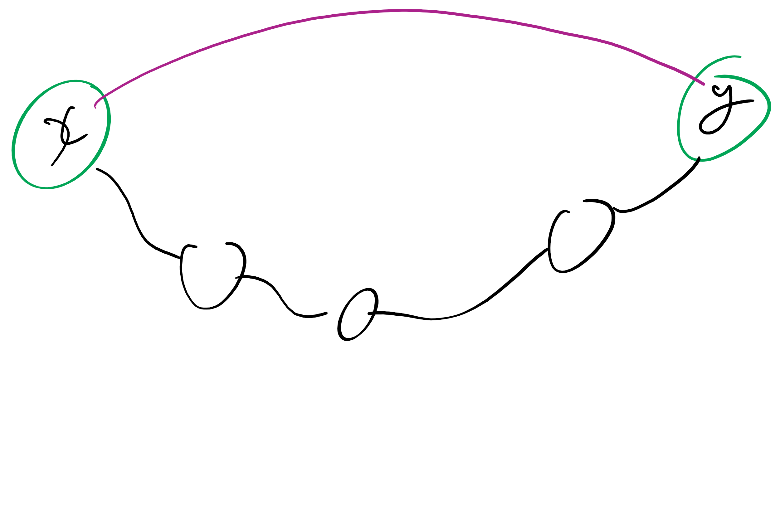
Problem of the Day: Dynamic connectivity problem
Input:
A set of items initially in separate groups and
a sequence of merge/union operations, each operation mering two items
Output:
At any point of time, we can be asked if two items are in the same group
Initially, the answer will be NO for any two items because they start in separate groups
For a given graph G, can we determine whether or not two vertices are connected in G?
Can also be viewed as checking subset membership
Important for many practical applications
Notes:
after describing the problem (bullet 1), ask for a solution
Work towards getting BFS approach
Runtime?
θ(e) using adj list
How can we do better? UF

Slide 7
Tree example
1
4
3
0
2
5
7
1
3
6
2
7
0
1
2
3
4
5
6
7

Slide 8
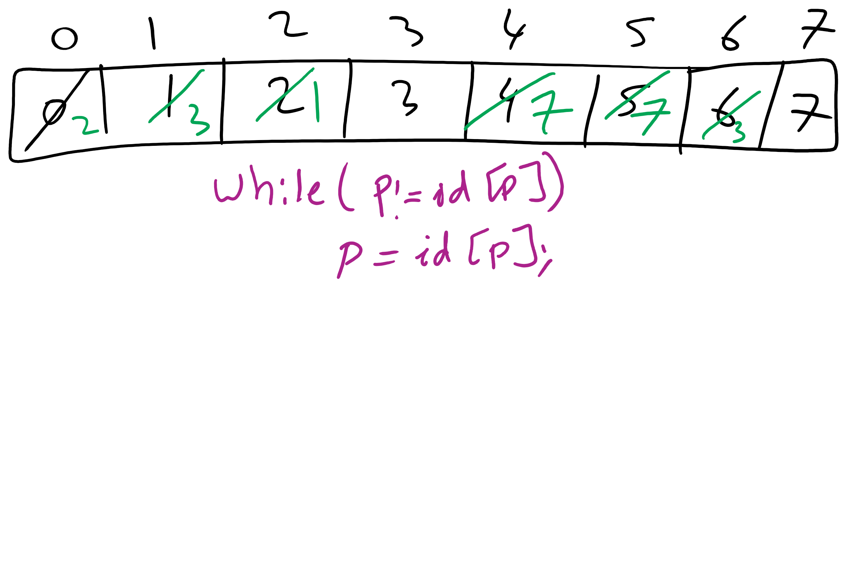
Forest of Trees Implementation
1
4
3
0
2
5
7
1
3
6
2
7
0
1
2
3
4
5
6
7

Slide 9
Implementation using the same id array
public int find(int p) {
while (p != id[p]) p = id[p];
return p;
}
public void union(int p, int q) {
int i = find(p);
int j = find(q);
if (i == j) return;
id[i] = j;
count--;
}

Slide 10
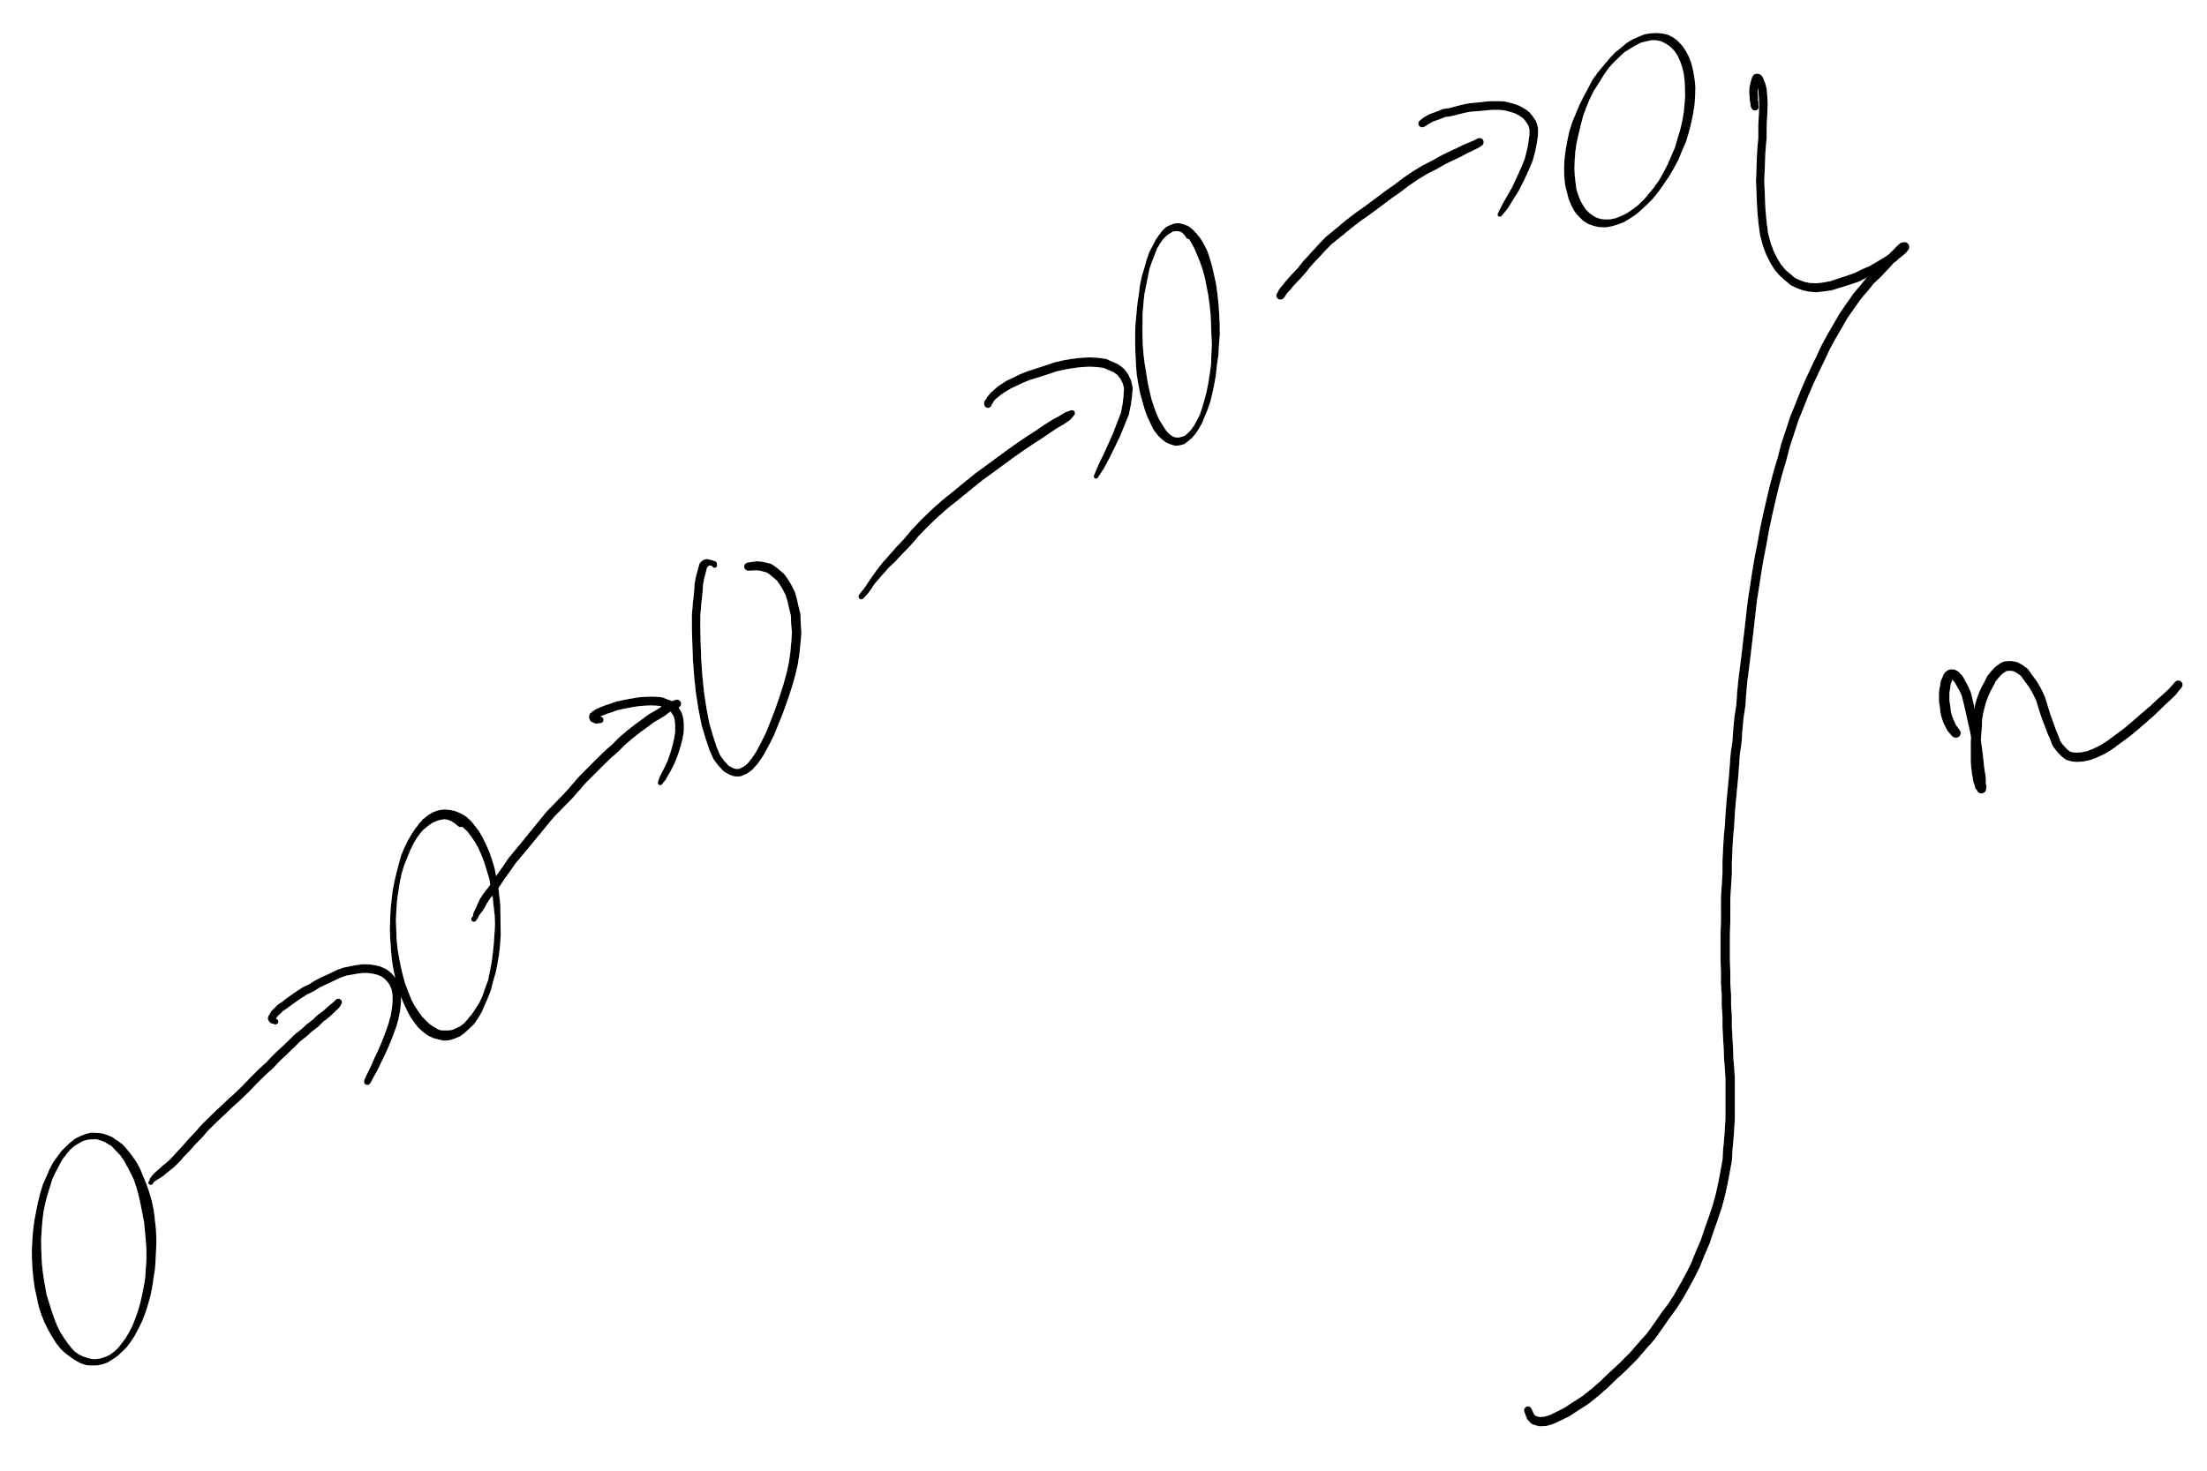
Forest of trees implementation analysis
Runtime?
find():
Bound by the height of the tree
union():
Bound by the height of the tree
What is the max height of the tree?
Can we modify our approach to cap its max height?

Slide 11
Weighted tree example
1
4
0
2
5
7
3
6
2
7
0
1
2
3
4
5
6
7

Slide 12
Weighted trees
public UF(int n) {
count = n;
id = new int[n];
sz = new int[n];
for (int i = 0; i < n; i++) { id[i] = i; sz[i] = 1; }
}
public void union(int p, int q) {
int i = find(p), j = find(q);
if (i == j) return;
if (sz[i] < sz[j]) { id[i] = j; sz[j] += sz[i]; }
else { id[j] = i; sz[i] += sz[j]; }
count--;
}

Slide 13
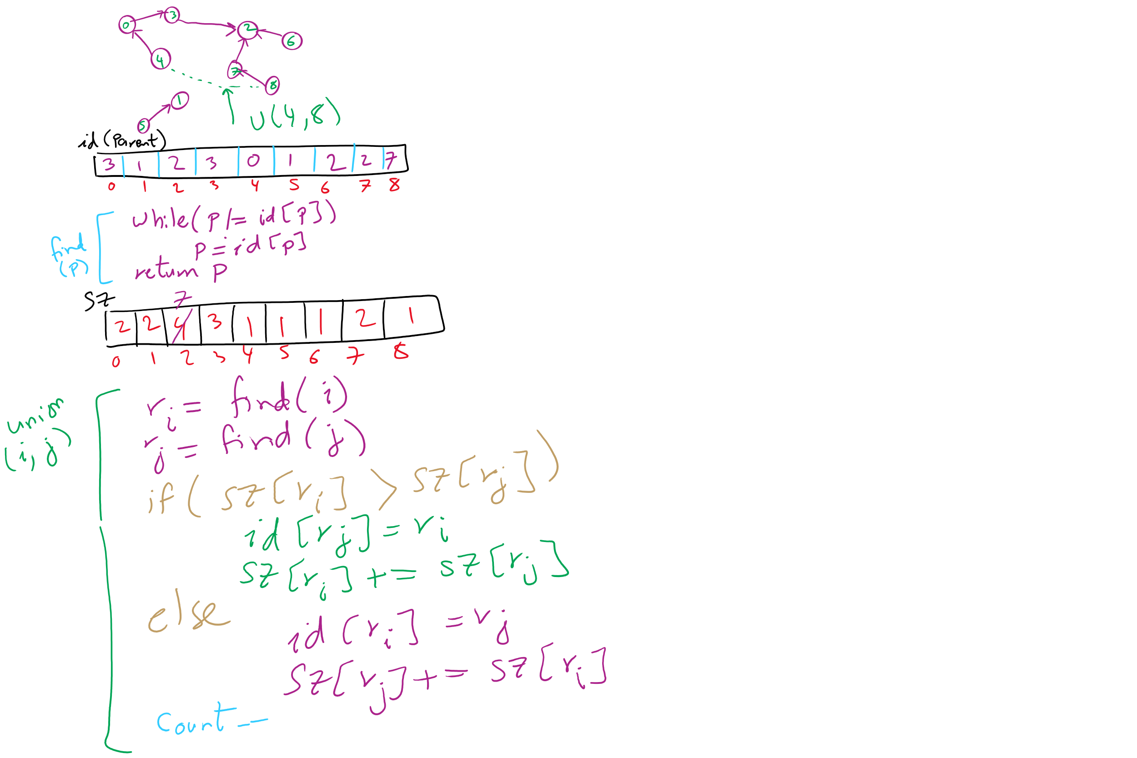
Weighted Trees Union-Find Example

Slide 14
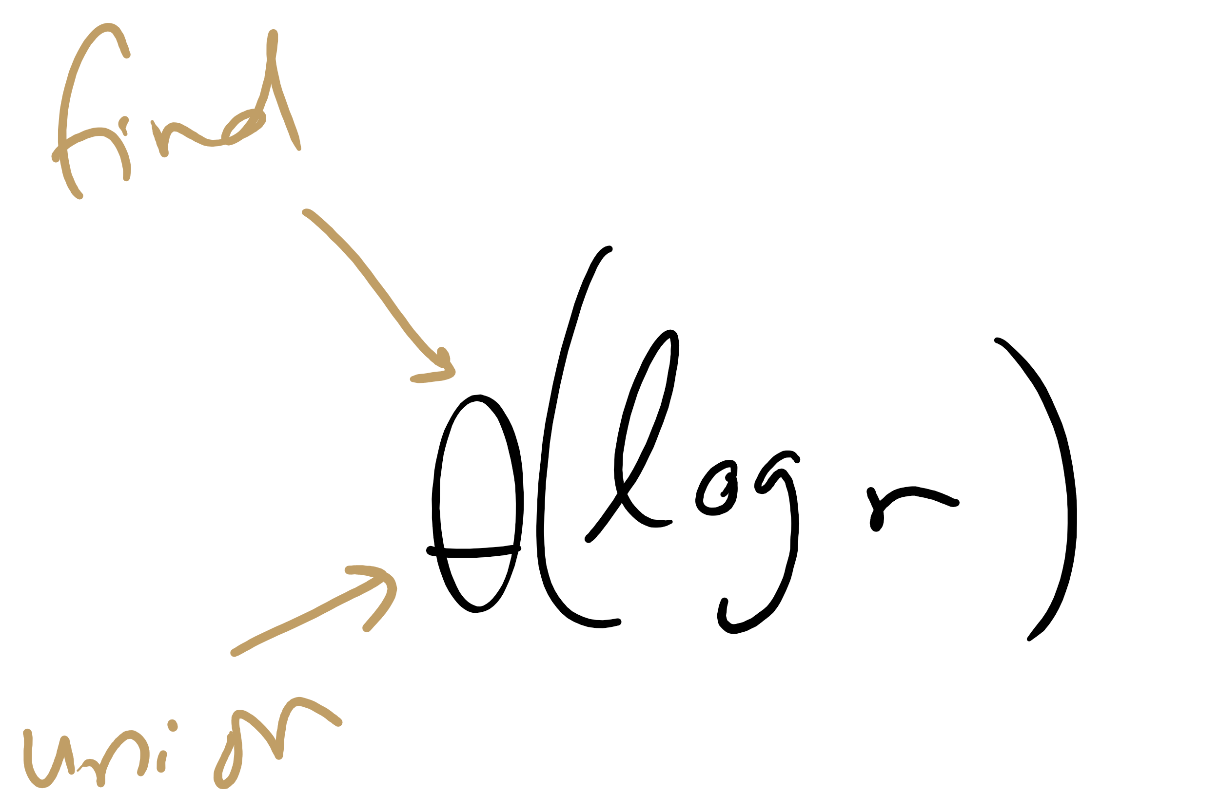
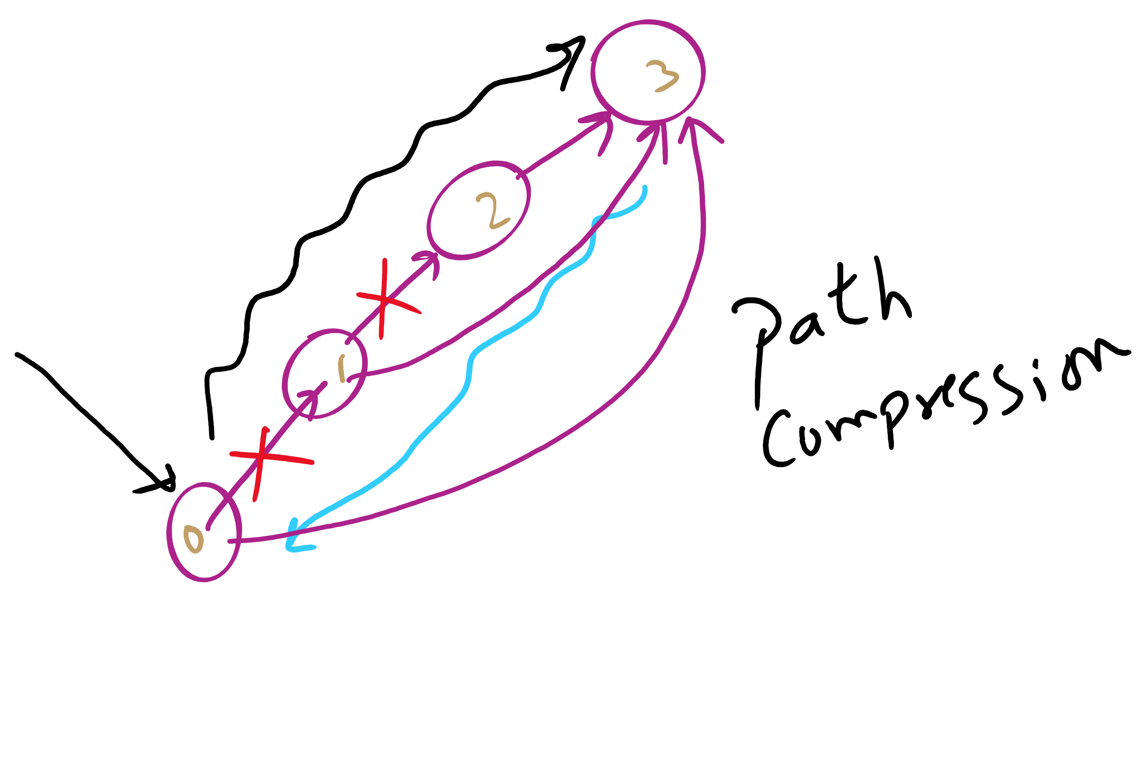
Weighted tree approach analysis
Runtime?
find()?
union()?
Can we do any better?
Notes:
Both find and union:
Θ(log v)
Trees were so flat in this example, why log v?
Because we didn't build up independent connected components
Can do better with path compression, where another loop is added to find() to link everything we come across directly back to the root
this is optimal, but not quite constant time
direct students to exercised in section 1.5 of the text

Slide 15
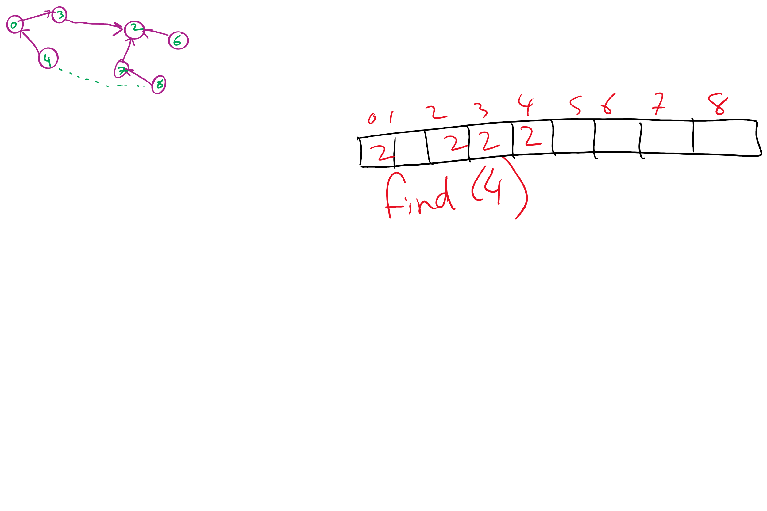
Path Compression Example

Slide 16
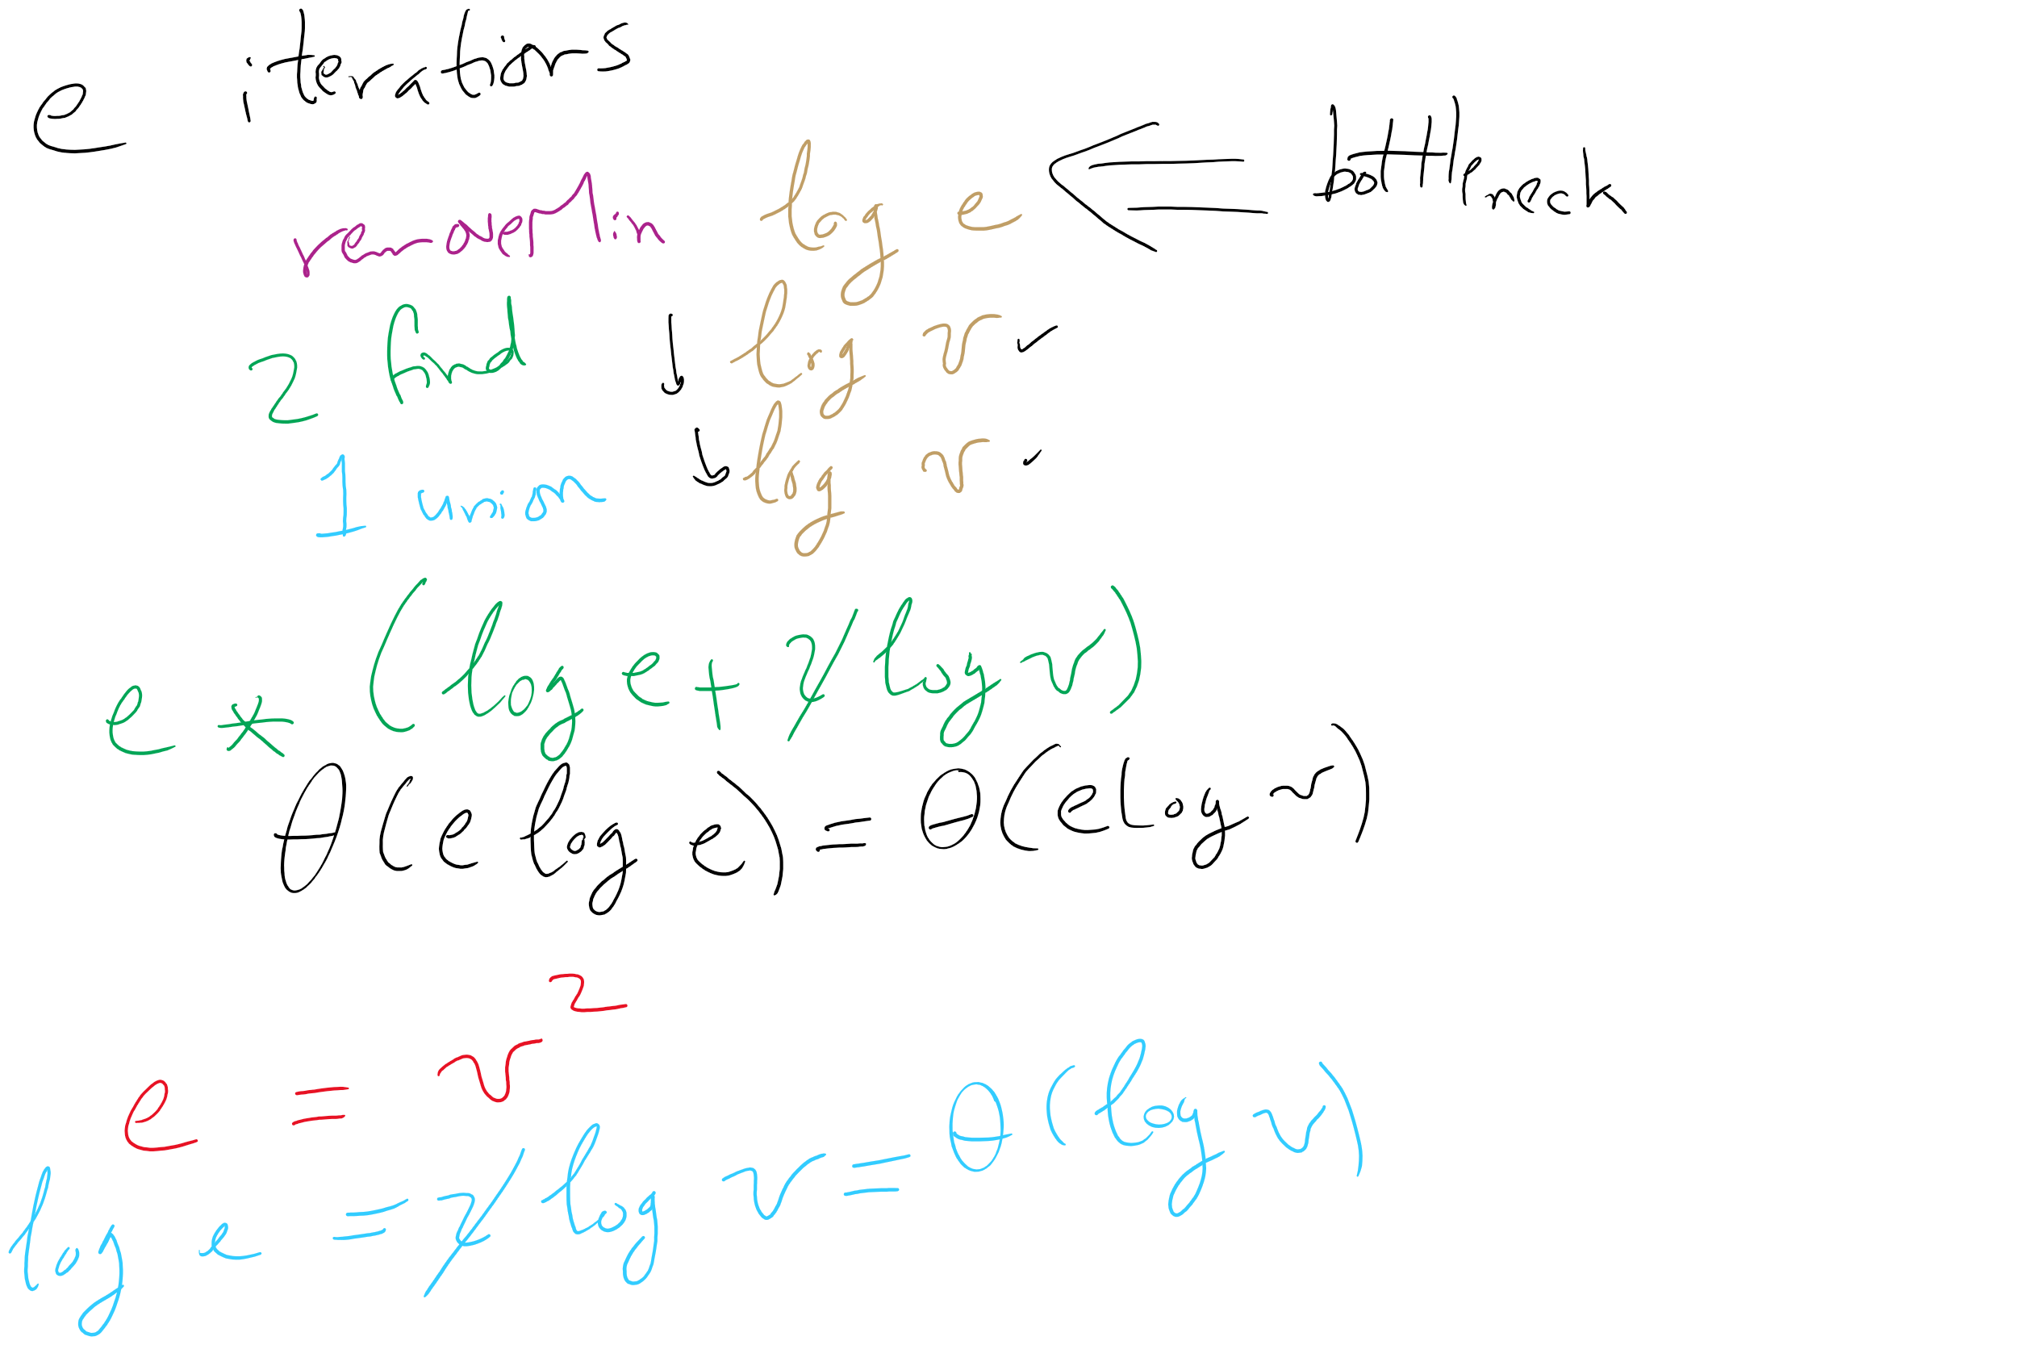
Kruskal’s algorithm, once again
What is the runtime of Kruskal’s algorithm??

Slide 17
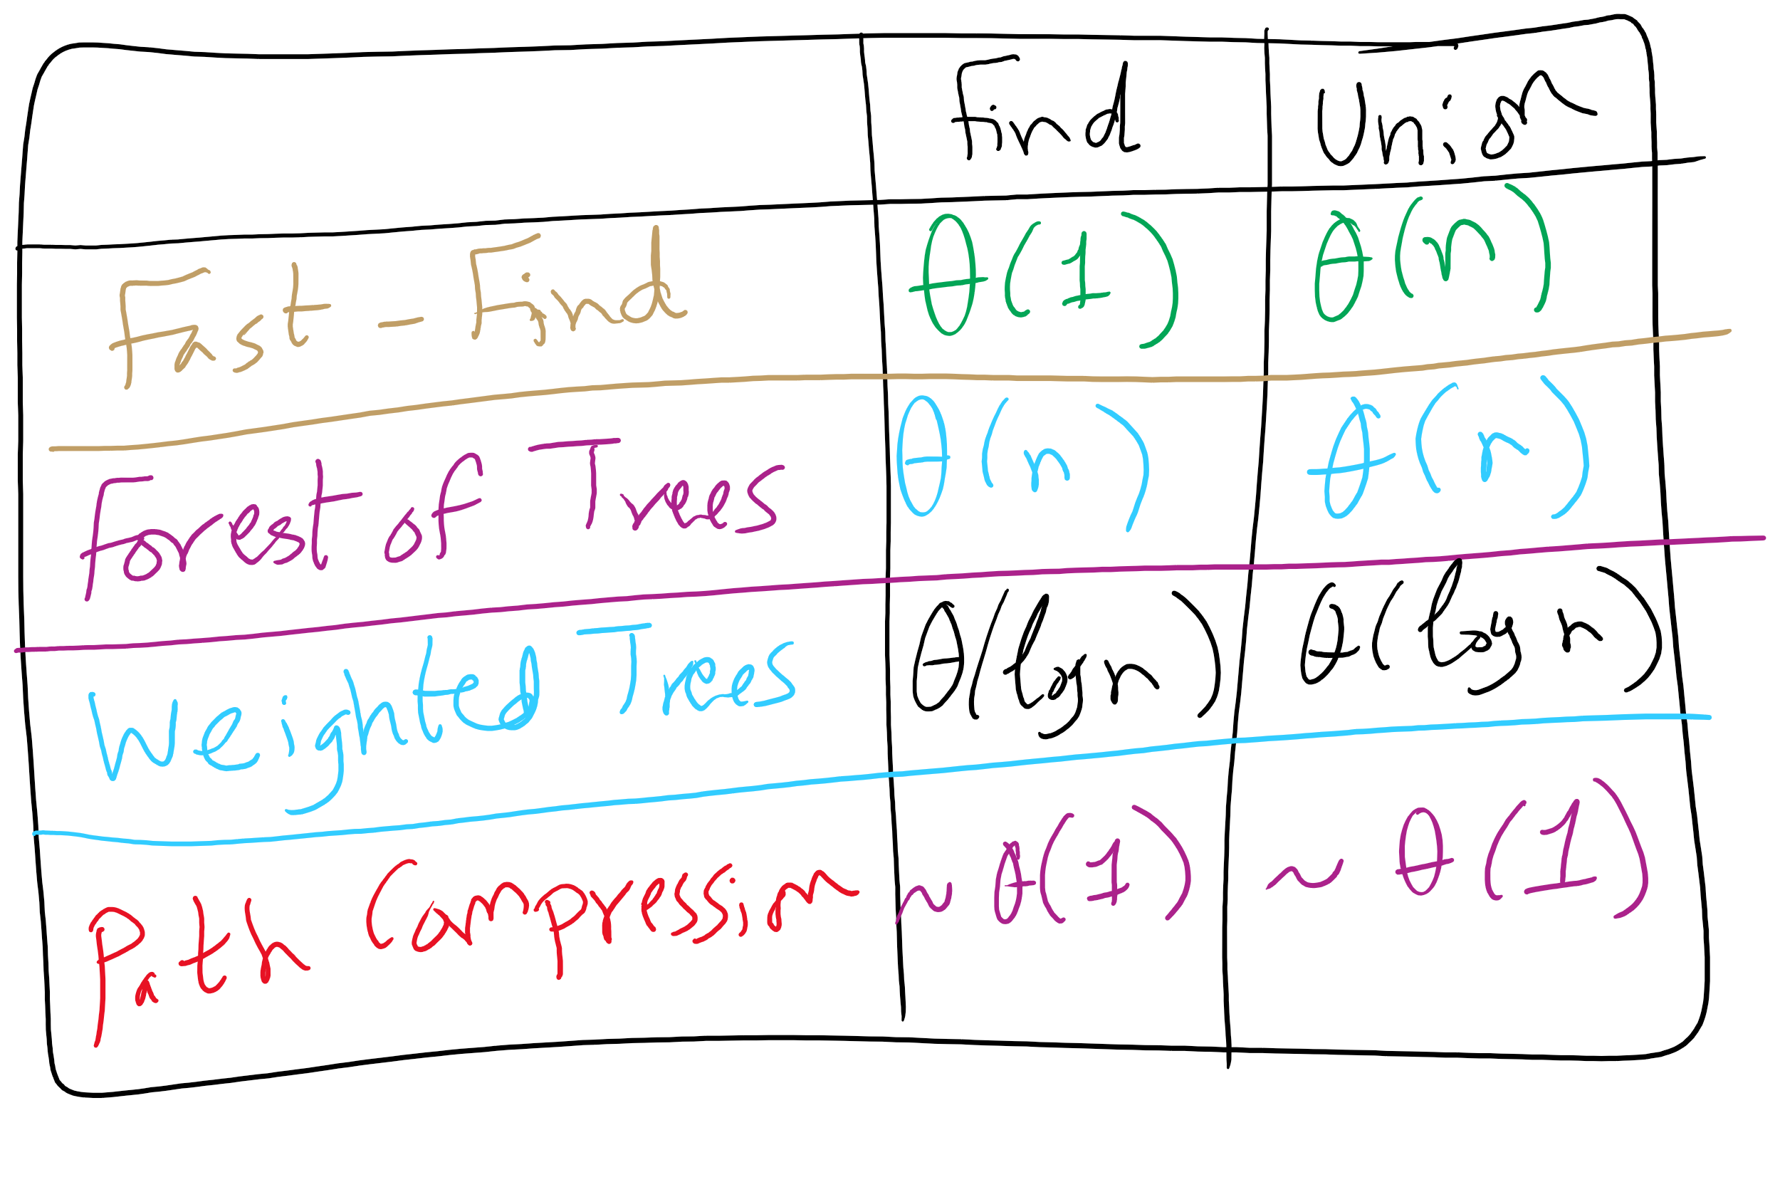
Union-Find Implementations

Slide 18
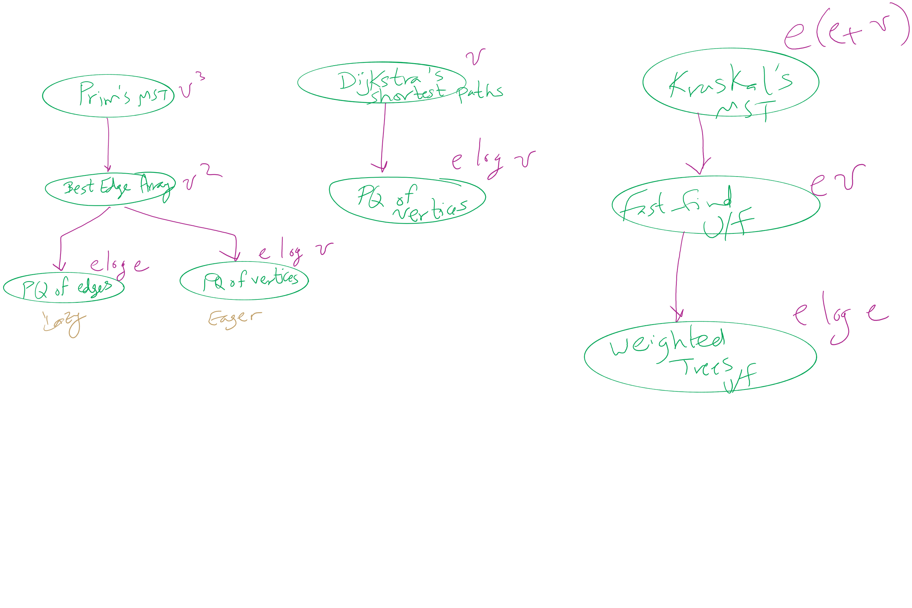
Algorithm Optimizations
2

Slide 19
Problem of the Day 1: Weighted Shortest Path
Input:
A road network
Road segments and intersections
Road segments are labeled by travel time
From length and maximum speed
How do we get max speed?
Starting address and destination address
Output:
A shortest path from source to destination

Slide 20
Weighted shortest path
Dijkstra’s algorithm:
Set a distance value of MAX_INT for all vertices but start
Set cur = start
While destination is not visited:
For each unvisited neighbor of cur:
Compute tentative distance from start to the unvisited neighbor through cur
Update any vertices for which a lesser distance is computed
Mark cur as visited
Let cur be the unvisited vertex with the smallest tentative distance from start

Slide 21
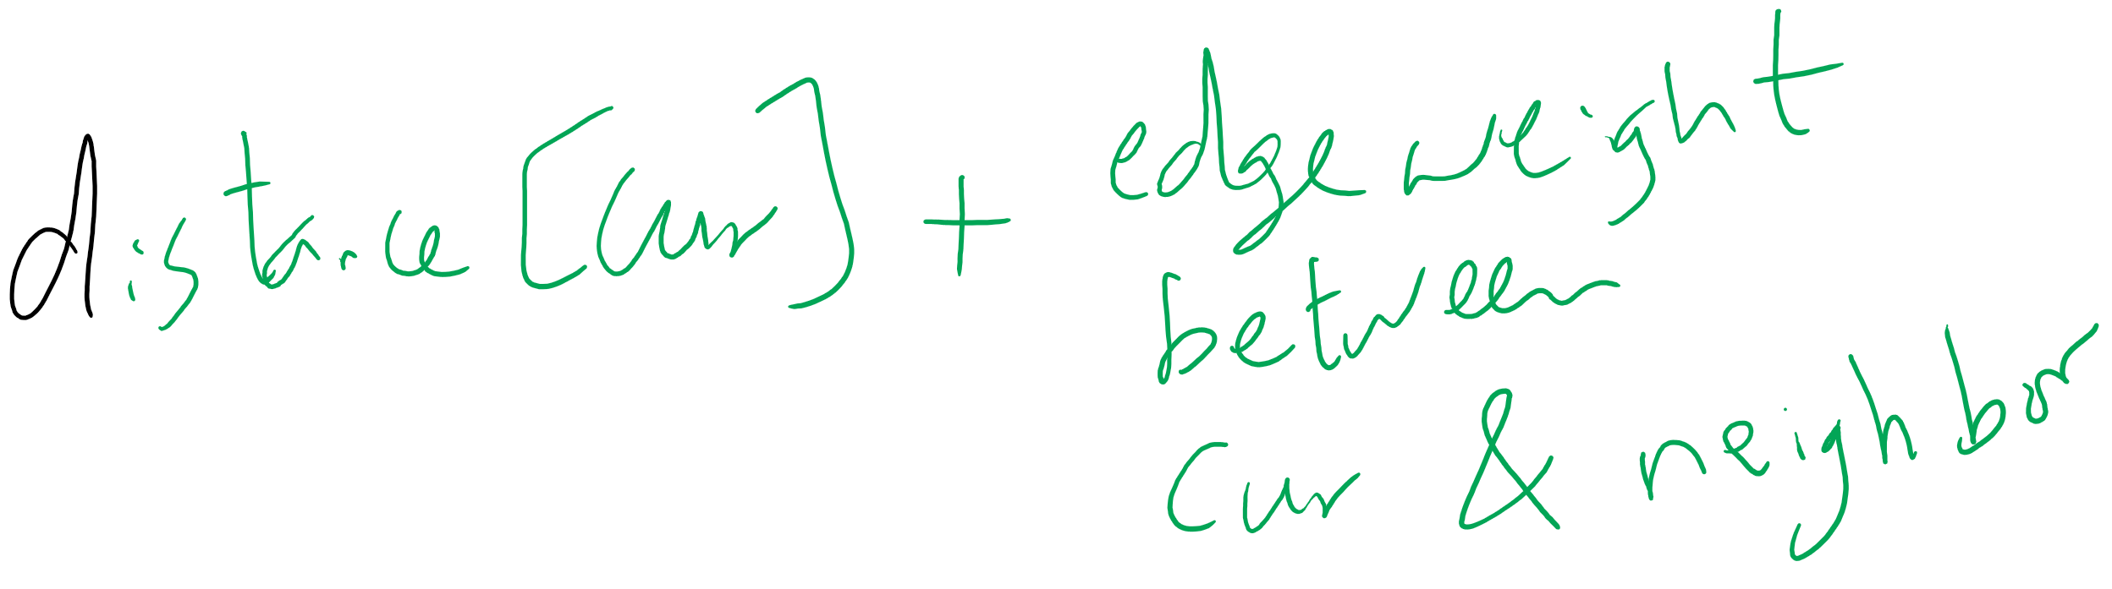
Tentative Distance

Slide 22
Dijkstra's example
0
0
Distance
Parent
7
14
0
0
--
1
9
3
1
3
1
∞
7
--
0
2
∞
9
--
10
2
0
2
2
3
11
∞
14
2
--
15
0
9
4
22
21
∞
1
2
--
12
13
5
∞
22
20
--
2
3
4
5
4
5
2

Slide 23
Analysis of Dijkstra’s algorithm
How to implement?
Best path/parent array?
Runtime?
PQ?
Turns out to be very similar to Eager Prims
Storing paths instead of edges
Runtime?

Slide 24
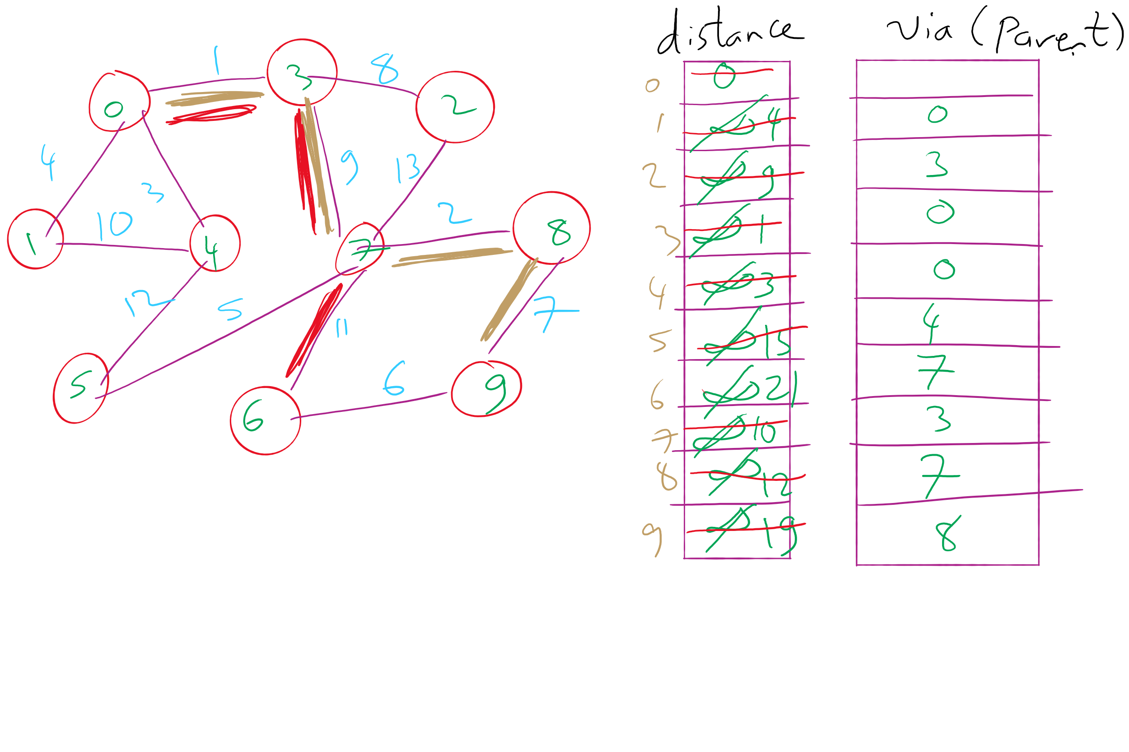
Dijkstra’s Shortest Paths Example 1

Slide 25
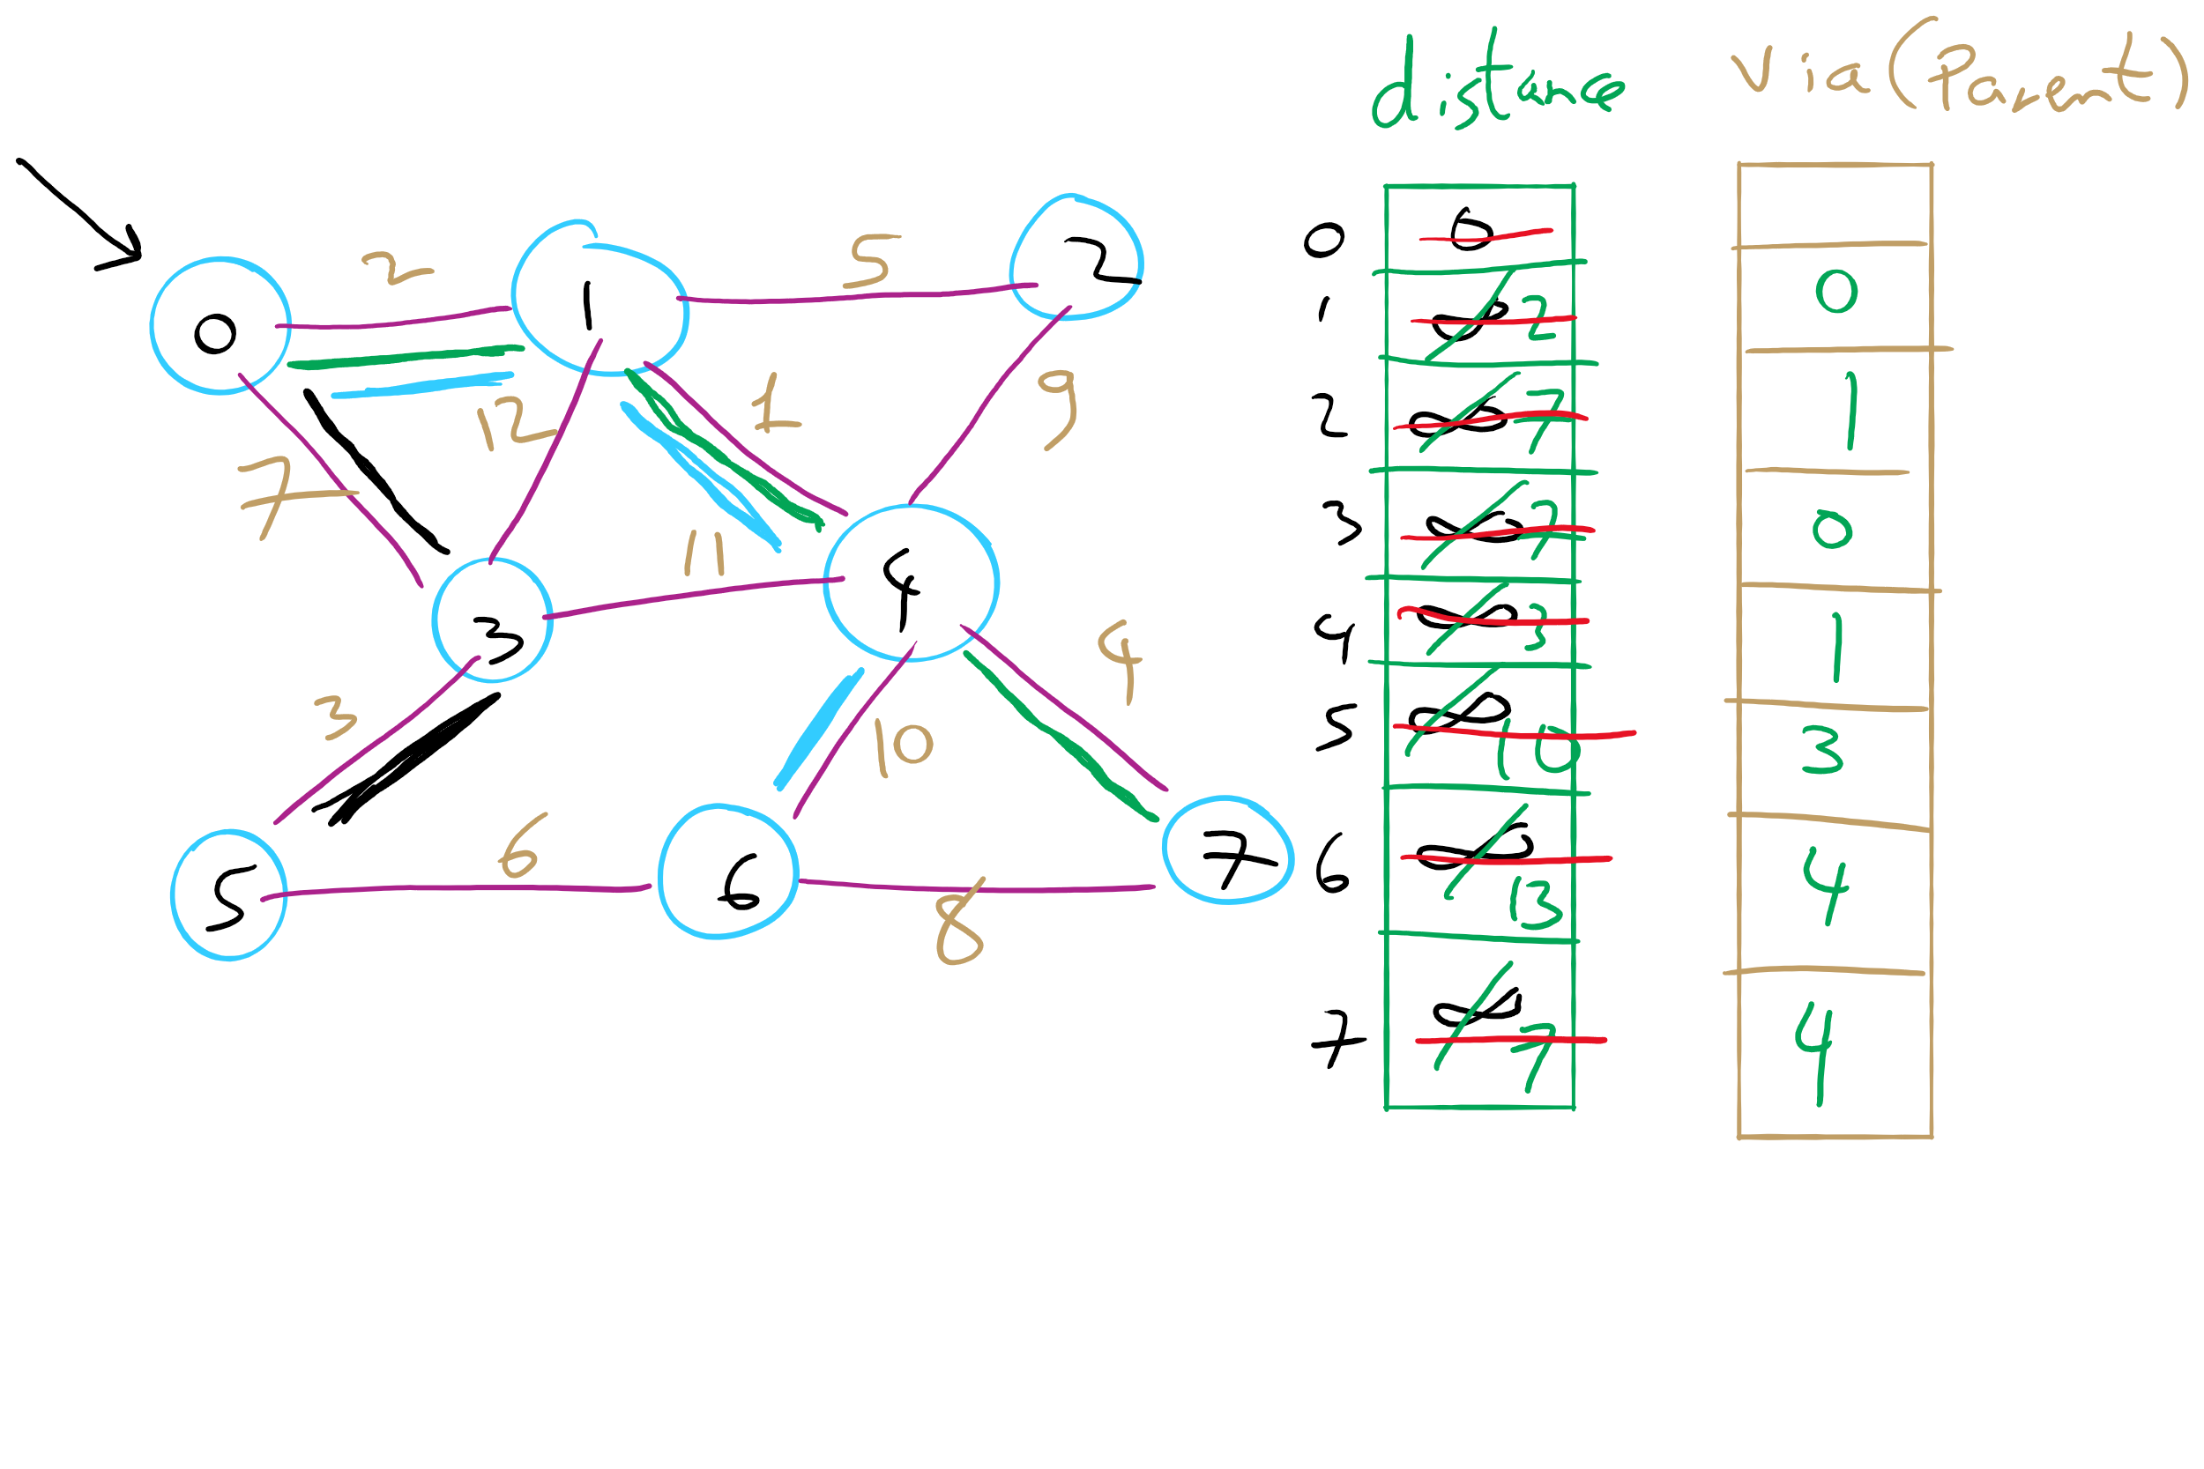
Dijkstra’s Shortest Paths Example 2

Slide 26
Please submit your reflections by using the CourseMIRROR App
If you are having a problem with CourseMIRROR, please send an email to coursemirror.development@gmail.com
Notes:
All right!
Upcoming Due Dates at A Glance

