Slide 1

Algorithms and Data Structures 2 CS 1501
Fall 2021
Sherif Khattab
ksm73@pitt.edu
(Slides are adapted from Dr. Ramirez’s and Dr. Farnan’s CS1501 slides.)

Slide 2
Announcements
Lab 0 is due this Friday (not graded)
Recitations start this week
Homework 1 will be assigned this Friday
JDB Example available on Canvas
Draft slides and handouts available on Canvas
CourseMIRROR pre-survey and consent form

Slide 3
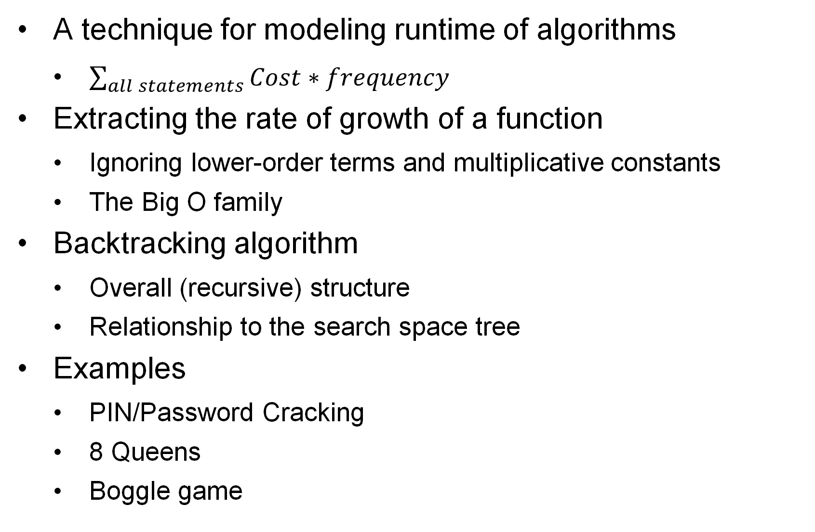
Today’s Agenda
A technique for modeling runtime of algorithms
$\sum_{all statements}{Cost∗frequency}$
Extracting the rate of growth of a function
Ignoring lower-order terms and multiplicative constants
The Big O family
Backtracking algorithm
Overall (recursive) structure
Relationship to the search space tree
Examples
PIN/Password Cracking
8 Queens
Boggle game

Slide 4
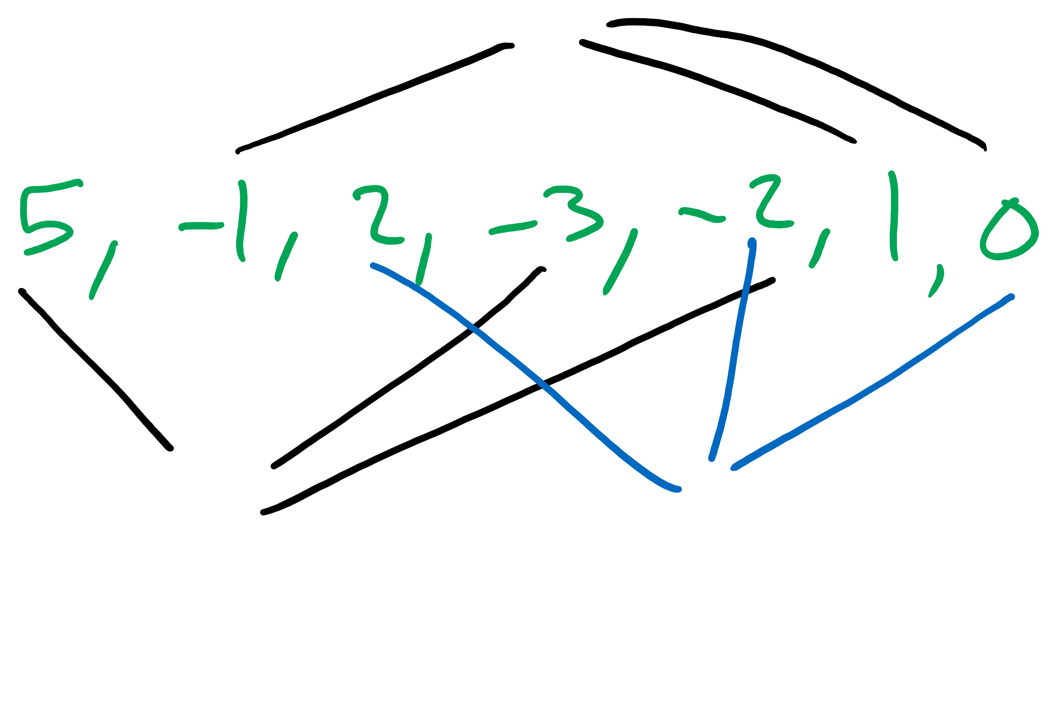
Let’s consider ThreeSum problem from text
3-sum Problem:
Given a set of arbitrary integers find out how many distinct triples sum to exactly zero
do you have questions on the problem specification?
Example input:
5, -1, 2, -3, -2, 1, 0
what should the output be?

Slide 5
Brute-force solution
Enumerate all possible distinct triples and check their sums
cnt = 0
for each distinct triple
if sum of triple equals zero increment cnt
Notes:
What's your analysis of this algorithm?
O(n³)?
Runtime?
How do we measure memory usage?
Wait, not all 3 loops go 0 to n…
Still O(n³)?
How???

Slide 6
Brute-force solution
public static int count(int[] a) { int n = a.length; int cnt = 0; for (int i = 0; i < n; i++) { for (int j = i+1; j < n; j++) { for (int k = j+1; k < n; k++) { if (a[i] + a[j] + a[k] == 0) { cnt++; } } } } return cnt; }
Notes:
What's your analysis of this algorithm?
O(n³)?
Runtime?
How do we measure memory usage?
Wait, not all 3 loops go 0 to n…
Still O(n³)?
How???

Slide 7
Mathematically modelling runtime
Runtime primarily determined by two factors:
Cost of executing each statement
Determined by machine used, environment running on the machine
Frequency of execution of each statement
Determined by program and input
Notes:
Knuth's approach to modelling runtime

Slide 8
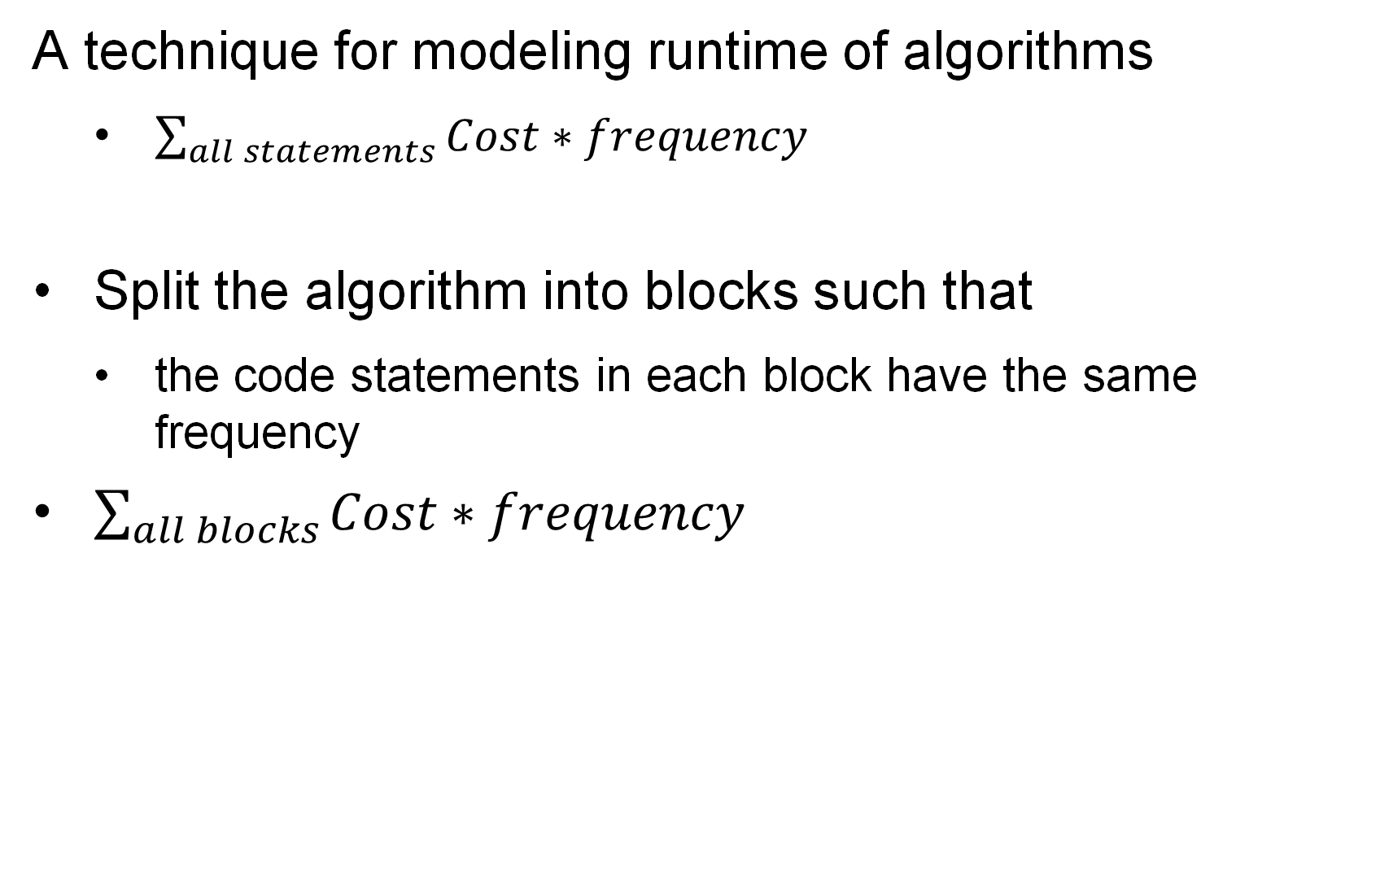
What is the runtime?
A technique for modeling runtime of algorithms
$\sum_{all statements}{Cost∗frequency}$
Split the algorithm into blocks such that
the code statements in each block have the same frequency
$\sum_{all blocks}{Cost∗frequency}$
Notes:
grey:
time: t₄
freq: 1
yellow:
time: t₃
freq: n
blue:
time: t₂
freq: sum i=0 to n-1 ( sum j=i+1 to n-1 (1))
= n²/2 - n/2
red:
time: t₁
freq: sum i=0 to n-1 ( sum j=i+1 to n-1 ( sum k=j+1 to n-1 (1)))
= n³/6 - n²/2 + n/3
purple
time: t₀
freq: x (depends on if statement, min 0 max same as red)
SUM UPPER BOUNDS: INCLUSIVE

Slide 9
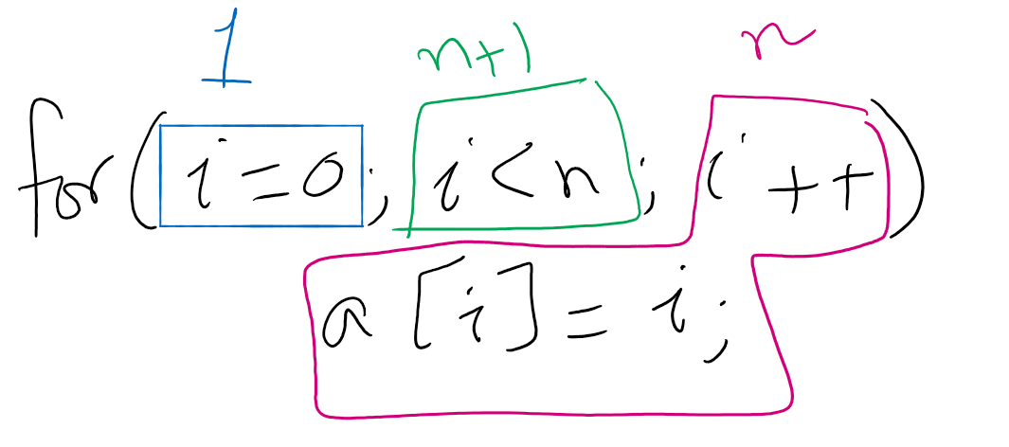
Algorithm Analysis Example 1

Slide 10
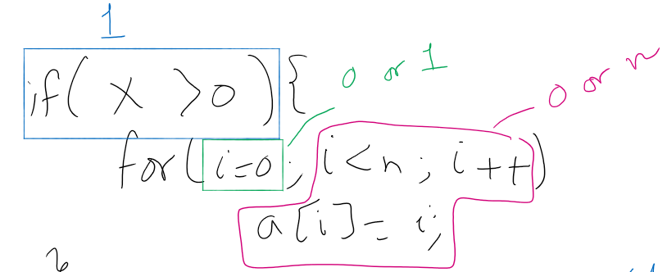
Algorithm Analysis Example 2

Slide 11
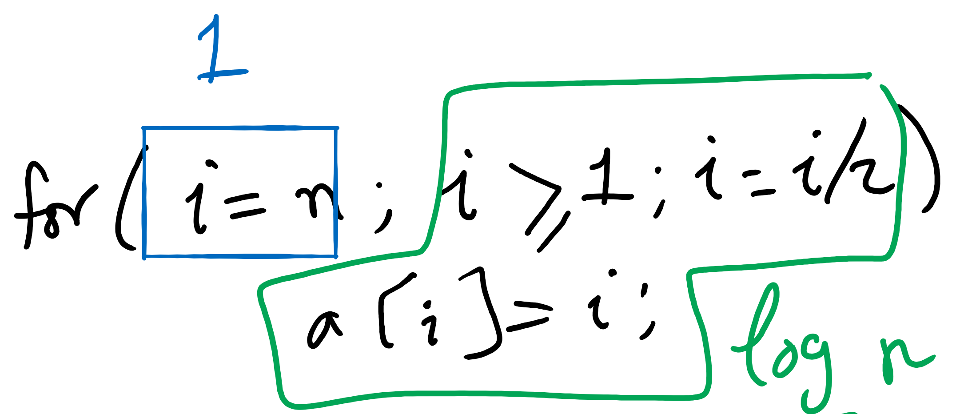
Algorithm Analysis Example 3

Slide 12
What is the runtime?
public static int count(int[] a) { int n = a.length; int cnt = 0; for (int i = 0; i < n; i++) { for (int j = i+1; j < n; j++) { for (int k = j+1; k < n; k++) { if (a[i] + a[j] + a[k] == 0) { cnt++; } } } } return cnt; }
Notes:
grey:
time: t₄
freq: 1
yellow:
time: t₃
freq: n
blue:
time: t₂
freq: sum i=0 to n-1 ( sum j=i+1 to n-1 (1))
= n²/2 - n/2
red:
time: t₁
freq: sum i=0 to n-1 ( sum j=i+1 to n-1 ( sum k=j+1 to n-1 (1)))
= n³/6 - n²/2 + n/3
purple
time: t₀
freq: x (depends on if statement, min 0 max same as red)
SUM UPPER BOUNDS: INCLUSIVE

Slide 13
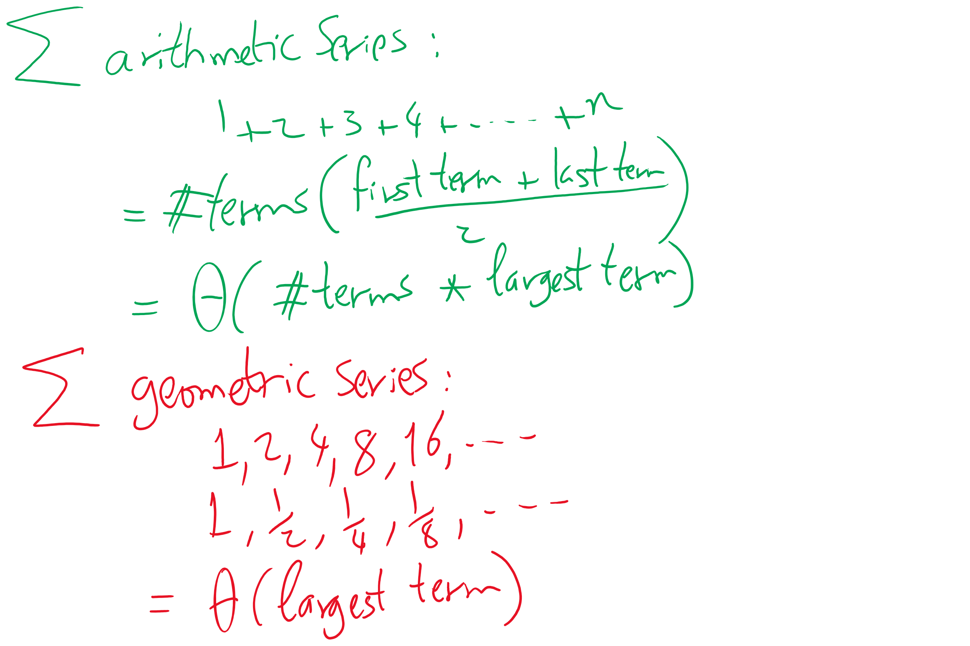
A couple useful Math formulae

Slide 14
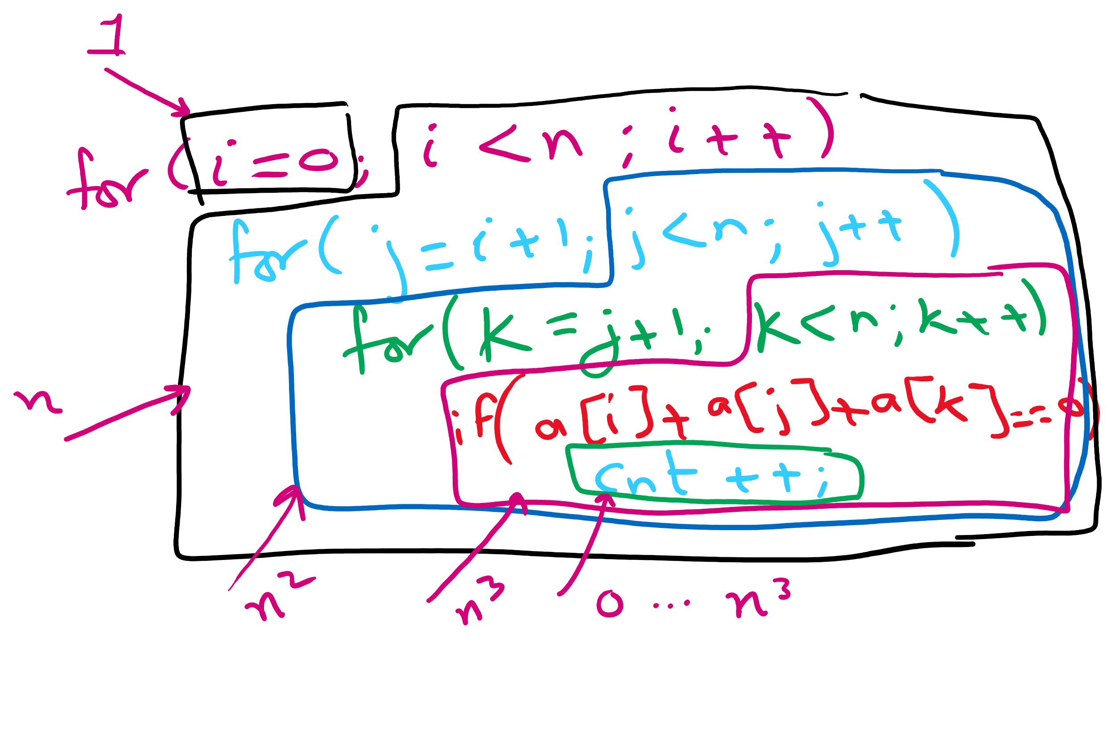
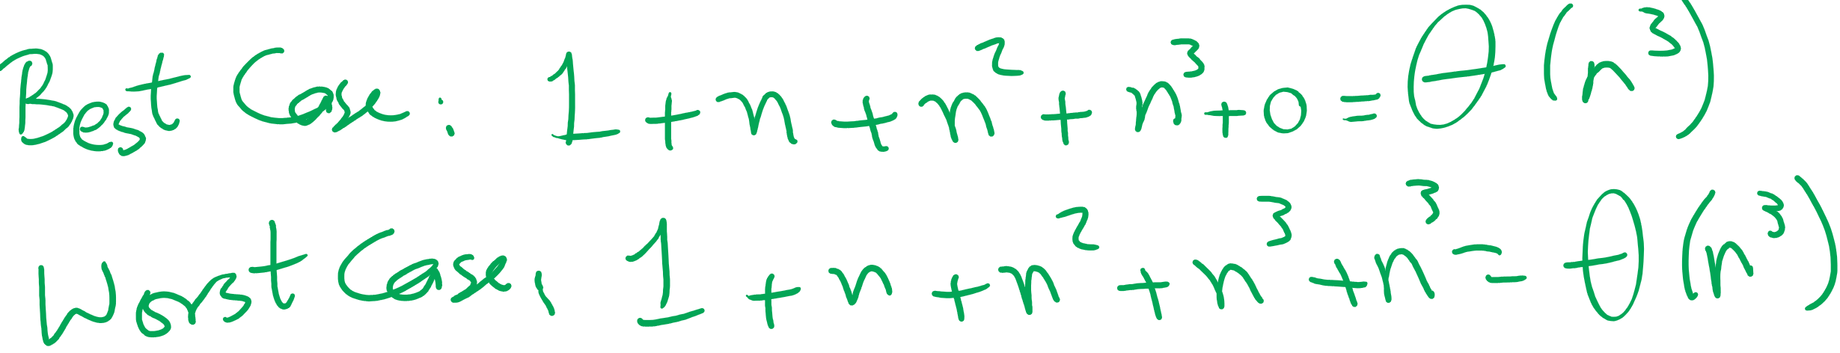
Runtime Analysis of 3-loop Algorithm for ThreeSum

Slide 15
Enter Asymptotic Analysis
Algorithm Analysis
Determine resource usage as a function of input size
Measure asymptotic performance
Performance as input size increases to infinity
Notes:
Storytime:
Implemented a new algorithm and it runs forever
Problem with the algorithm?
Or just a bug?
What if the implementation doesn't end up being worth it?
What if the algorithm is infeasible?
STILL USEFUL!
Experimental evaluation
Benchmarking

Slide 16
Asymptotic performance
Focus on the order of growth not on exact values
How fast the function value increases when the input increases

Slide 17
Common orders of growth
Constant - 1
Logarithmic - log n
Linear - n
Linearithmic - n log n
Quadratic - n²
Cubic - n³
Exponential - 2^{n}
Factorial - n!

Slide 18

Side note
What does $\log_{2}n$ mean?

Slide 19
Quick algorithm analysis
How can we determine the order of growth of a function?
Ignore lower-order terms
Ignore multiplicative constants
Notes:
Wait, we just compared some function (e.g., n³) to the function modelling our runtime??
Can we use O for other resources??
YES! memory!

Slide 20
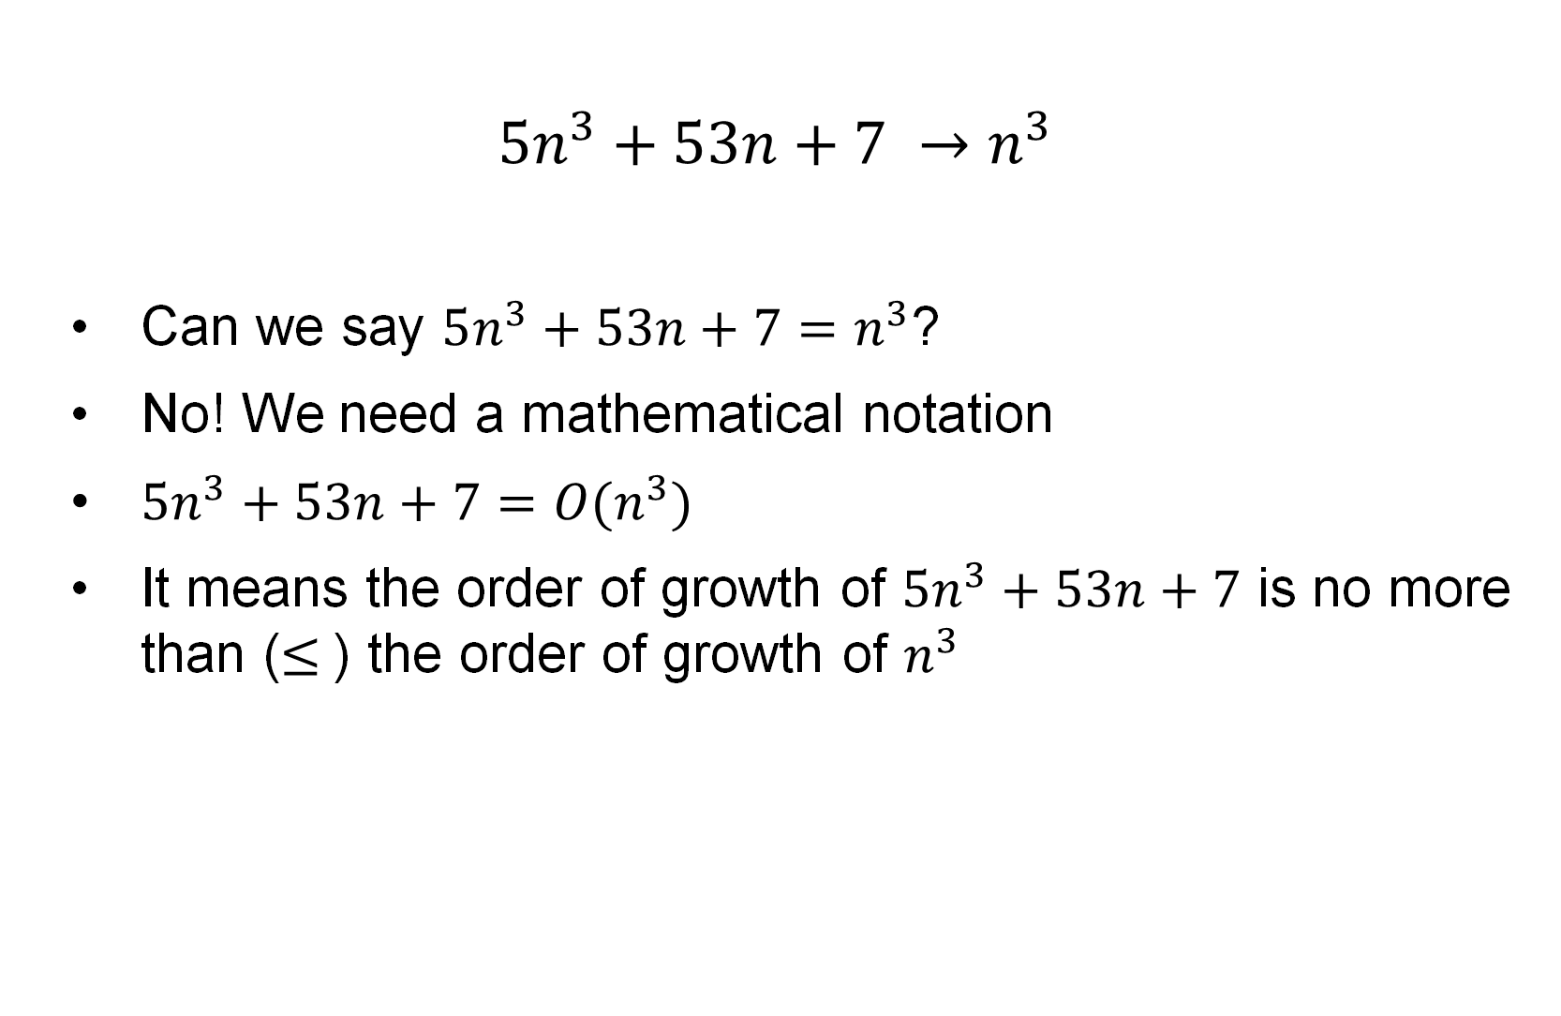
Example
$$5n^{3}+53n+7 →n^{3}$$
Can we say $5n^{3}+53n+7=n^{3}$?
No! We need a mathematical notation
$5n^{3}+53n+7=O(n^{3})$
It means the order of growth of $5n^{3}+53n+7$ is no more than ($≤$) the order of growth of $n^{3}$

Slide 21
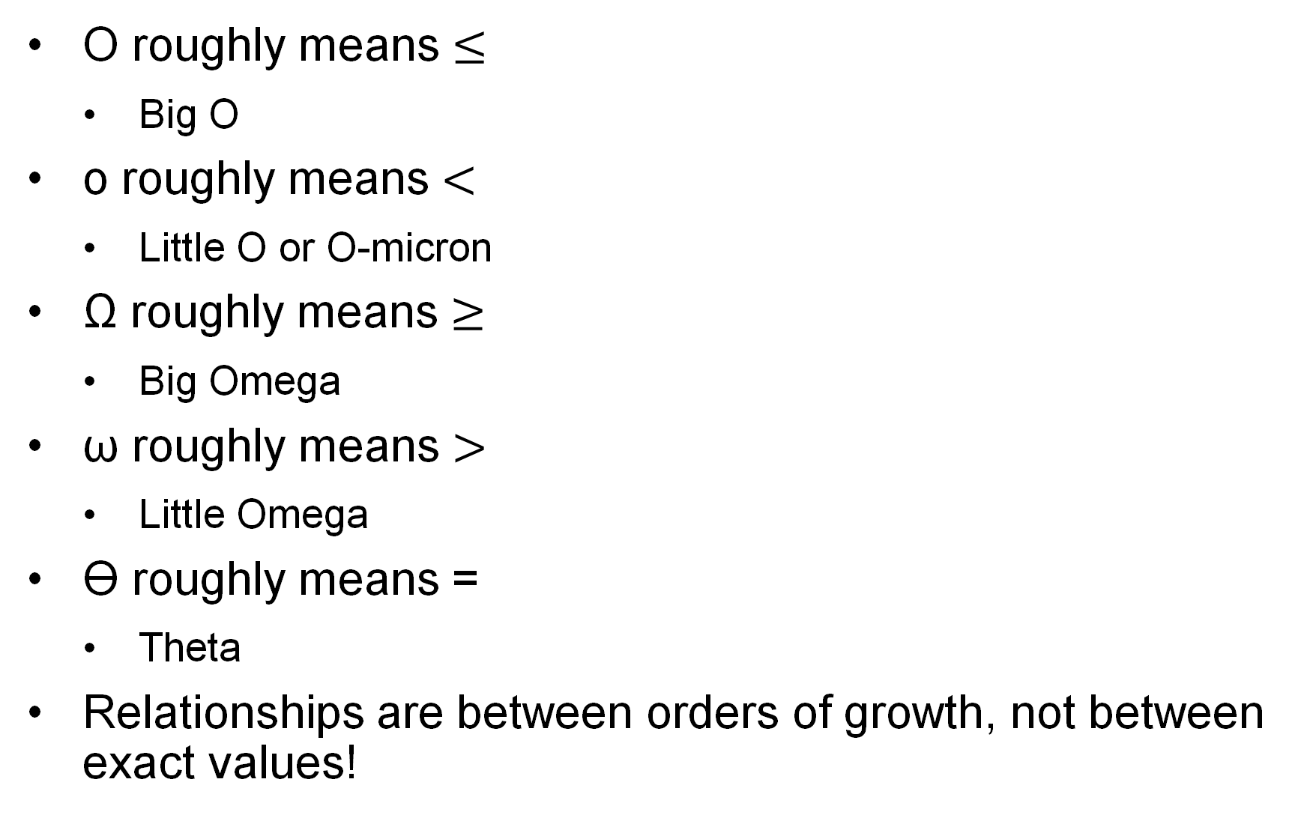
The Big O Family
O roughly means $≤$
Big O
o roughly means $<$
Little O or O-micron
Ω roughly means $≥$
Big Omega
ω roughly means $>$
Little Omega
ϴ roughly means =
Theta
Relationships are between orders of growth, not between exact values!

Slide 22
Formal Definitions
May also see:
f(x) ∈ O(g(x)) or
f(x) = O(g(x))
used to mean that f(x) is O(g(x))
Same for the other functions

Slide 23
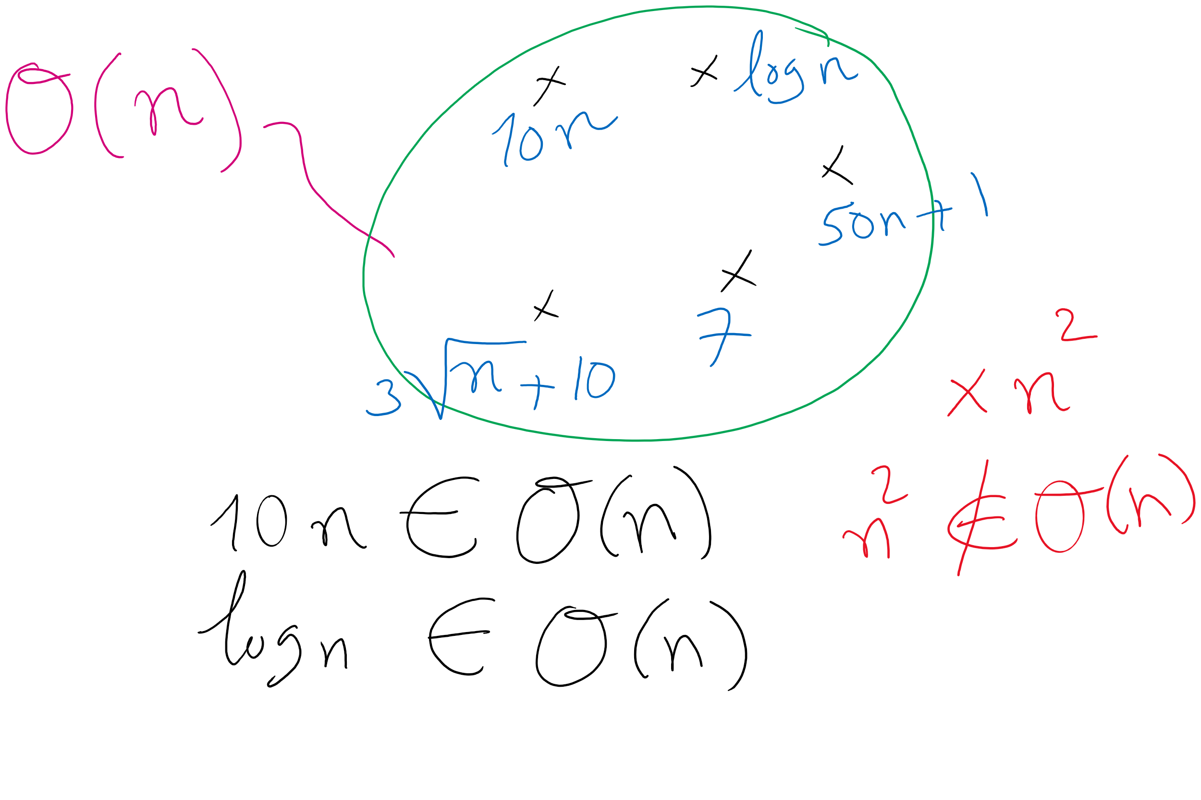
Formal definitions

Slide 24
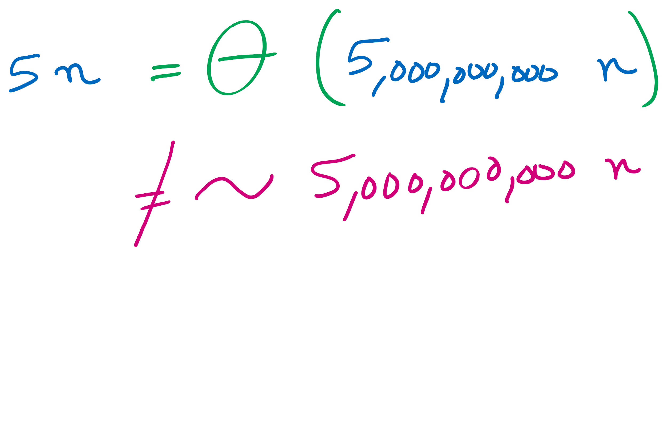
Theta vs. Tilde
Tilde approximation (~)
Same as Theta but keeps constant factors
Two functions are Tilde of each other is they have the same order of growth and the same constant of the largest term

Slide 25
Wait…
Assuming that definition…
Is ThreeSum O(n⁴)?
What about O(n⁵)?
What about O(3^{n})??
If all of these are true, why was O(n³) what we jumped to to start?
Notes:
Yes!
Yes!
YES!
That's the tightest upper bound we can trivially see to be true

Slide 26
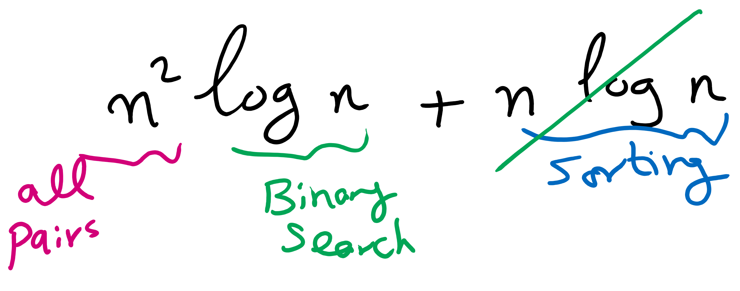
A better algorithm for ThreeSum
What if we sorted the array first?
Pick two numbers, then binary search for the third one that will make a sum of zero
a[i] = 10, a[j] = -7, binary search for -3
Still have two for loops, but we replace the third with a binary search
Runtime now?
What if the input data isn't sorted?
What about the sorting time?
Notes:
New runtime:
Θ(n² log n)
Sort time:
O(n log n)
done before our search, dominated by search time
Asymptotically insignificant

Slide 27
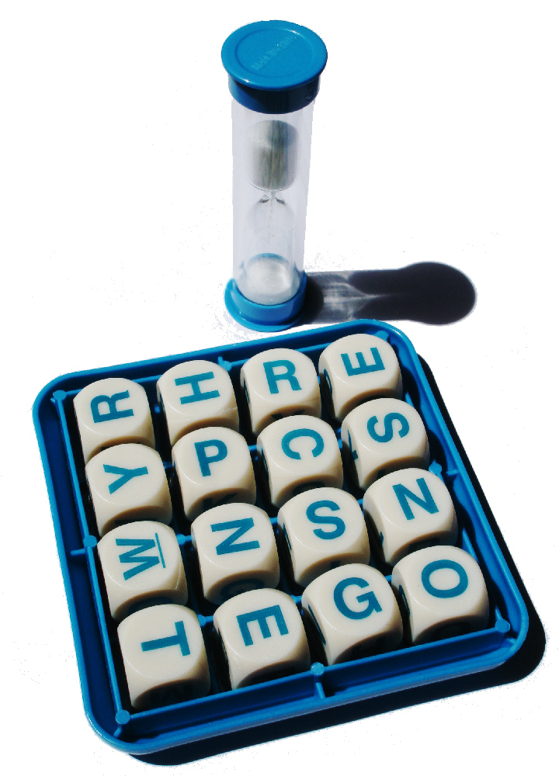
Another problem: Boggle
Words at least 3 adjacent letters long must be assembled from a 4x4 grid
Adjacent letters are horizontally, vertically, or diagonally neighboring
Any cube in the grid can only be used once per word

Slide 28
Recursing through Boggle letters
Have 16 different options to start from
Have 8 different options from each cube
From B[i][j]:
B[i-1][j-1]
B[i-1][j]
B[i-1][j+1]
B[i][j-1]
B[i][j+1]
B[i+1][j-1]
B[i+1][j]
B[i+1][j+1]

Slide 29
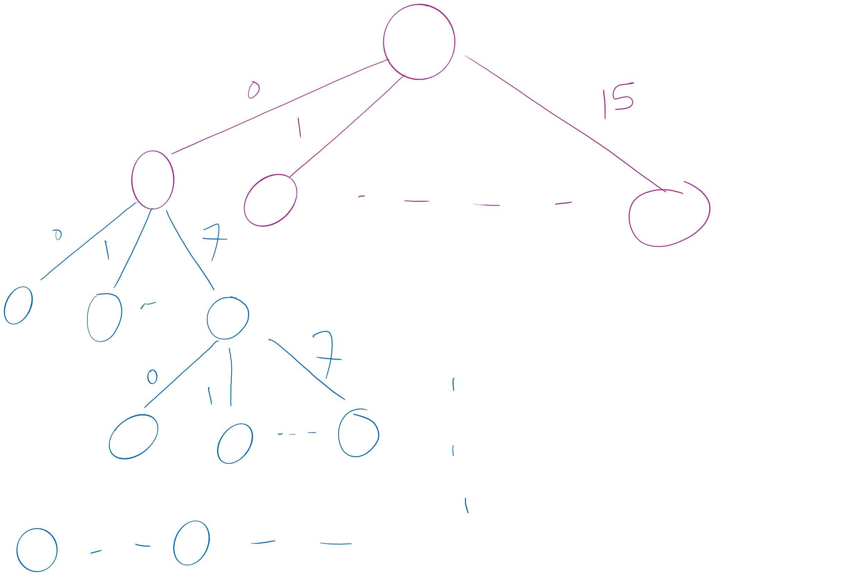
Search Space

Slide 30
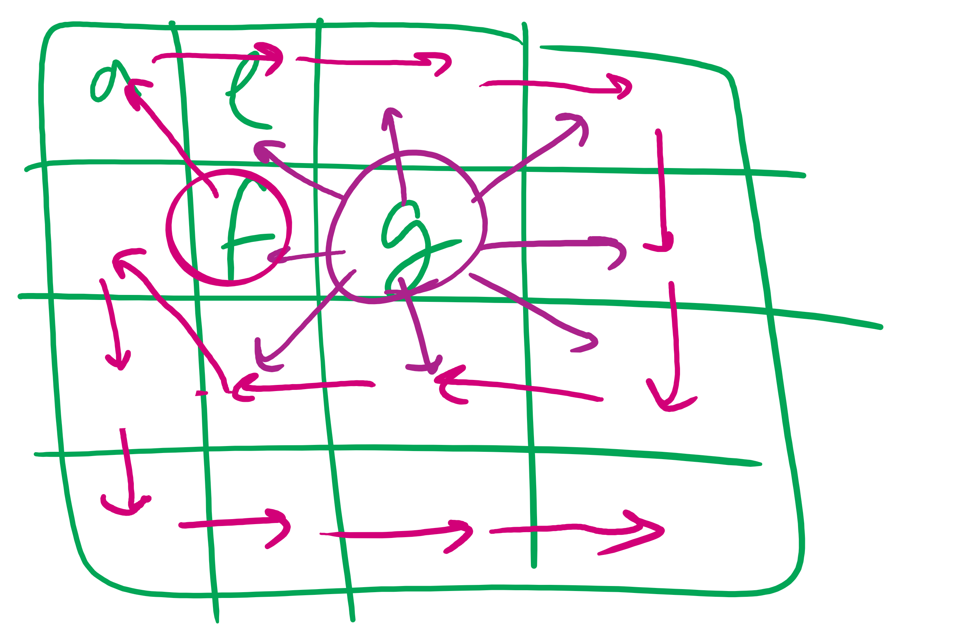
Boggle Question

Slide 31
Are all 8 options valid?
Can’t go past the edge of the board
Can’t reuse the same cells in the board
Each letter added must lead to the prefix of an actual word
Check the dictionary as we add each letter, if there is no word with the currently constructed string as a prefix, don’t go further down this way
Practically, this can be used for huge savings
This is called pruning!
Notes:
Need to define pruning rules
Can’t go past the edge of the board
Can’t reuse the same cells in the board
Each letter added must lead to the prefix of an actual word
Check the dictionary for each letter recursed to, if there is no word with the currently constructed string as a prefix, backtrack
Practically, this can be used for huge savings

Slide 32
Please submit your reflections by using the CourseMIRROR App
If you are having a problem with CourseMIRROR, please send an email to coursemirror.development@gmail.com
Notes:
All right!
Upcoming Due Dates at A Glance

