Slide 1

Algorithms and Data Structures 2 CS 1501
Fall 2021
Sherif Khattab
ksm73@pitt.edu
(Slides are adapted from Dr. Ramirez’s and Dr. Farnan’s CS1501 slides.)

Slide 2
Announcements
Upcoming deadlines:
Homework 4 due on 10/8
Assignment 2 due on 10/25
Midterm on 10/13
In-class, paper-based exam

Slide 3
Last lecture …
Iterative search and traversals

Slide 4
CourseMIRROR Reflections

Slide 5
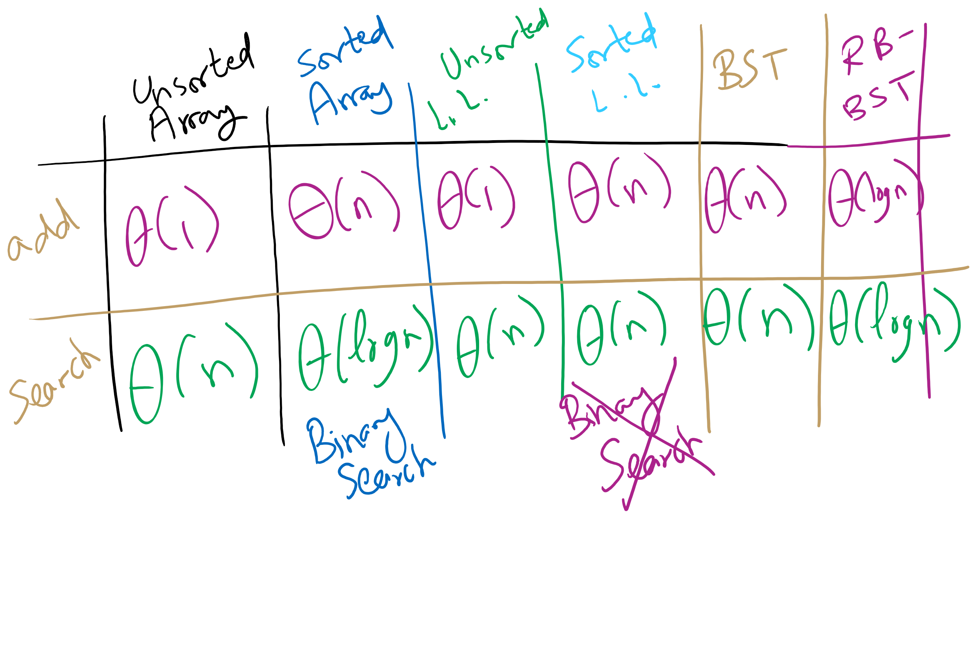
Symbol Table Implementations

Slide 6
A closer look
Can we do better than these?
These methods depend on comparisons against other keys
I.e., k is compared against other keys in the data structure
4 options at each node in a BST:
Node ref is null, k not found
k is equal to the current node's key, k is found
k is less than current key, continue to left child
k is greater than the current key, continue to right child

Slide 7
Please submit your reflections by using the CourseMIRROR App
If you are having a problem with CourseMIRROR, please send an email to coursemirror.development@gmail.com
Notes:
All right!
Upcoming Due Dates at A Glance

