Slide 1

Algorithms and Data Structures 2 CS 1501
Fall 2021
Sherif Khattab
ksm73@pitt.edu
(Slides are adapted from Dr. Ramirez’s and Dr. Farnan’s CS1501 slides.)

Slide 2
Announcements
Upcoming deadlines:
Lab 4 and Homework 5 due on 10/15
Homework 6 and Lab 5 due on 10/22
Assignment 2 due on 10/25
Midterm on 10/13
In-class, paper-based exam

Slide 3
Last lecture …
DST
RST
Multi-way RST

Slide 4
CourseMIRROR Reflections

Slide 5
Today …
de la Briandais trees
Introduction to Compression

Slide 6
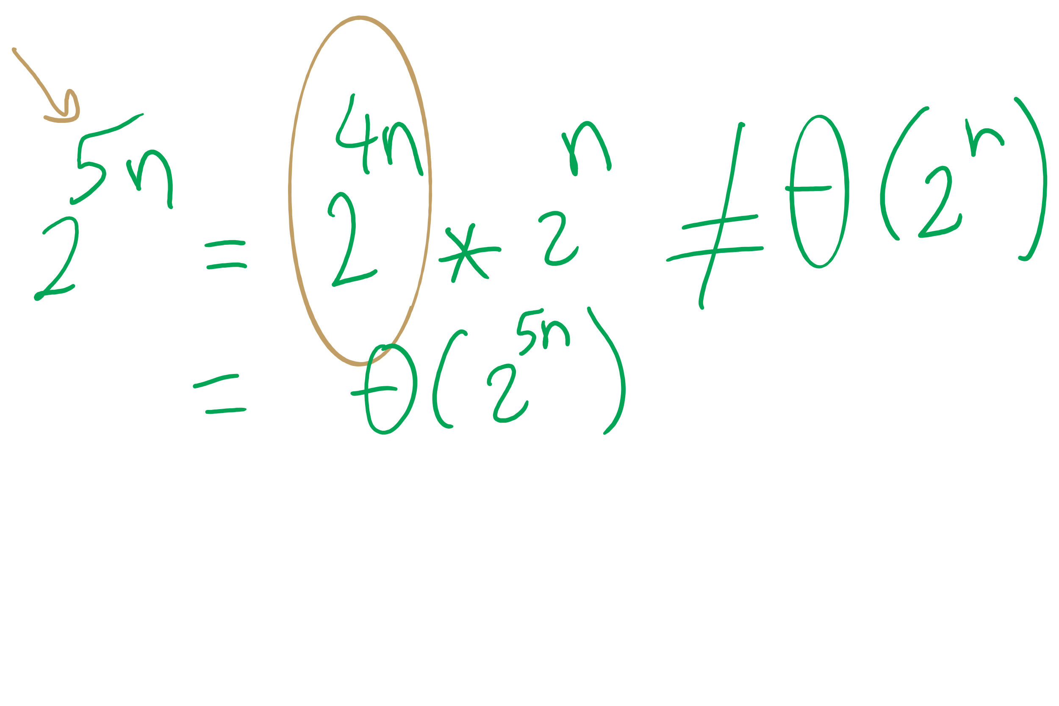
Big O Approximation

Slide 7
Please submit your reflections by using the CourseMIRROR App
If you are having a problem with CourseMIRROR, please send an email to coursemirror.development@gmail.com
Notes:
All right!
Upcoming Due Dates at A Glance

