Slide 1

Algorithms and Data Structures 2 CS 1501
Fall 2021
Sherif Khattab
ksm73@pitt.edu
(Slides are adapted from Dr. Ramirez’s and Dr. Farnan’s CS1501 slides.)

Slide 2
Announcements
Upcoming deadlines:
11/9: Midterm-exam corrections
11/12: Lab 9 and Homework 9
11/15: Assignment 3

Slide 3
Previous lecture …
Using DFS to find articulation points in a graph
Prim’s Minimum Spanning Tree (MST) Algorithm

Slide 4
CourseMIRROR Reflections

Slide 5
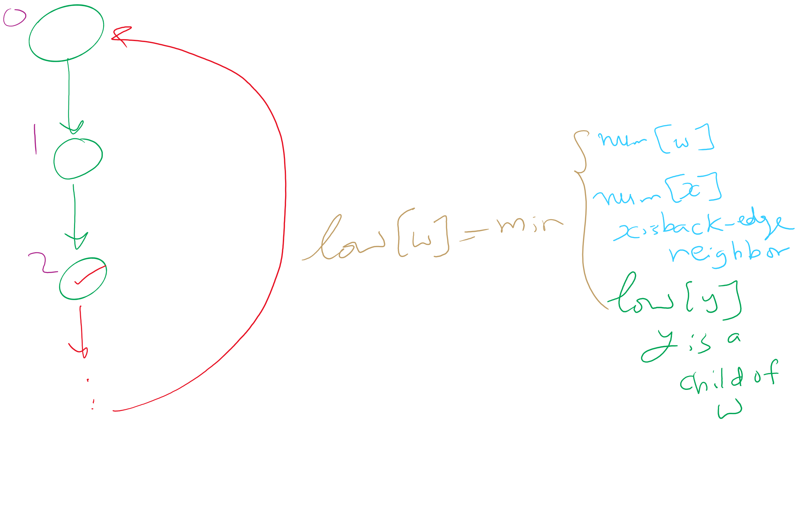
Articulation Points Algorithm

Slide 6
Today…
Prim’s analysis
Priority Queue
Definition
Operations
Heap implementation
Heap Sort
Heapify

Slide 7
Prim’s algorithm
Initialize T to contain the starting vertex
T will eventually become the MST
While there are vertices not in T:
Find minimum edge weight edge that connects a vertex in T to a vertex not yet in T
Add the edge with its vertex to T

Slide 8
Prim’s algorithm
10
1
4
1
4
4
6
8
7
0
9
5
0
3
6
3
6
2
9
8
2
2
2
5
5
1
Notes:
Green verticies/red edges in T
be sure to highlight the set of edges that could possibly be used to bring a vertex into T
grey edges that connect two green vertices dont need to be considered, thing to come back to when we talk about implementation, should we try to remove them from consideration?
not really, no asymptotic improvement for parent and best edge implementation
even with eager prims, that would just be more updates to try and avoid unneccesary removals, but both have the same asymptotic cost

Slide 9
Runtime of Prim’s
At each step, check all possible edges
For a complete graph:
First iteration:
v - 1 possible edges
Next iteration:
2(v - 2) possibilities
Each vertex in T shared v-1 edges with other vertices, but the edges they shared with each other already in T
Next:
3(v - 3) possibilities
…
Runtime:
Σ_{i = 1 to v} (i * (v - i))
Evaluates to Θ(v³)
Notes:
naively what we did on the previous slide looking at the images

Slide 10
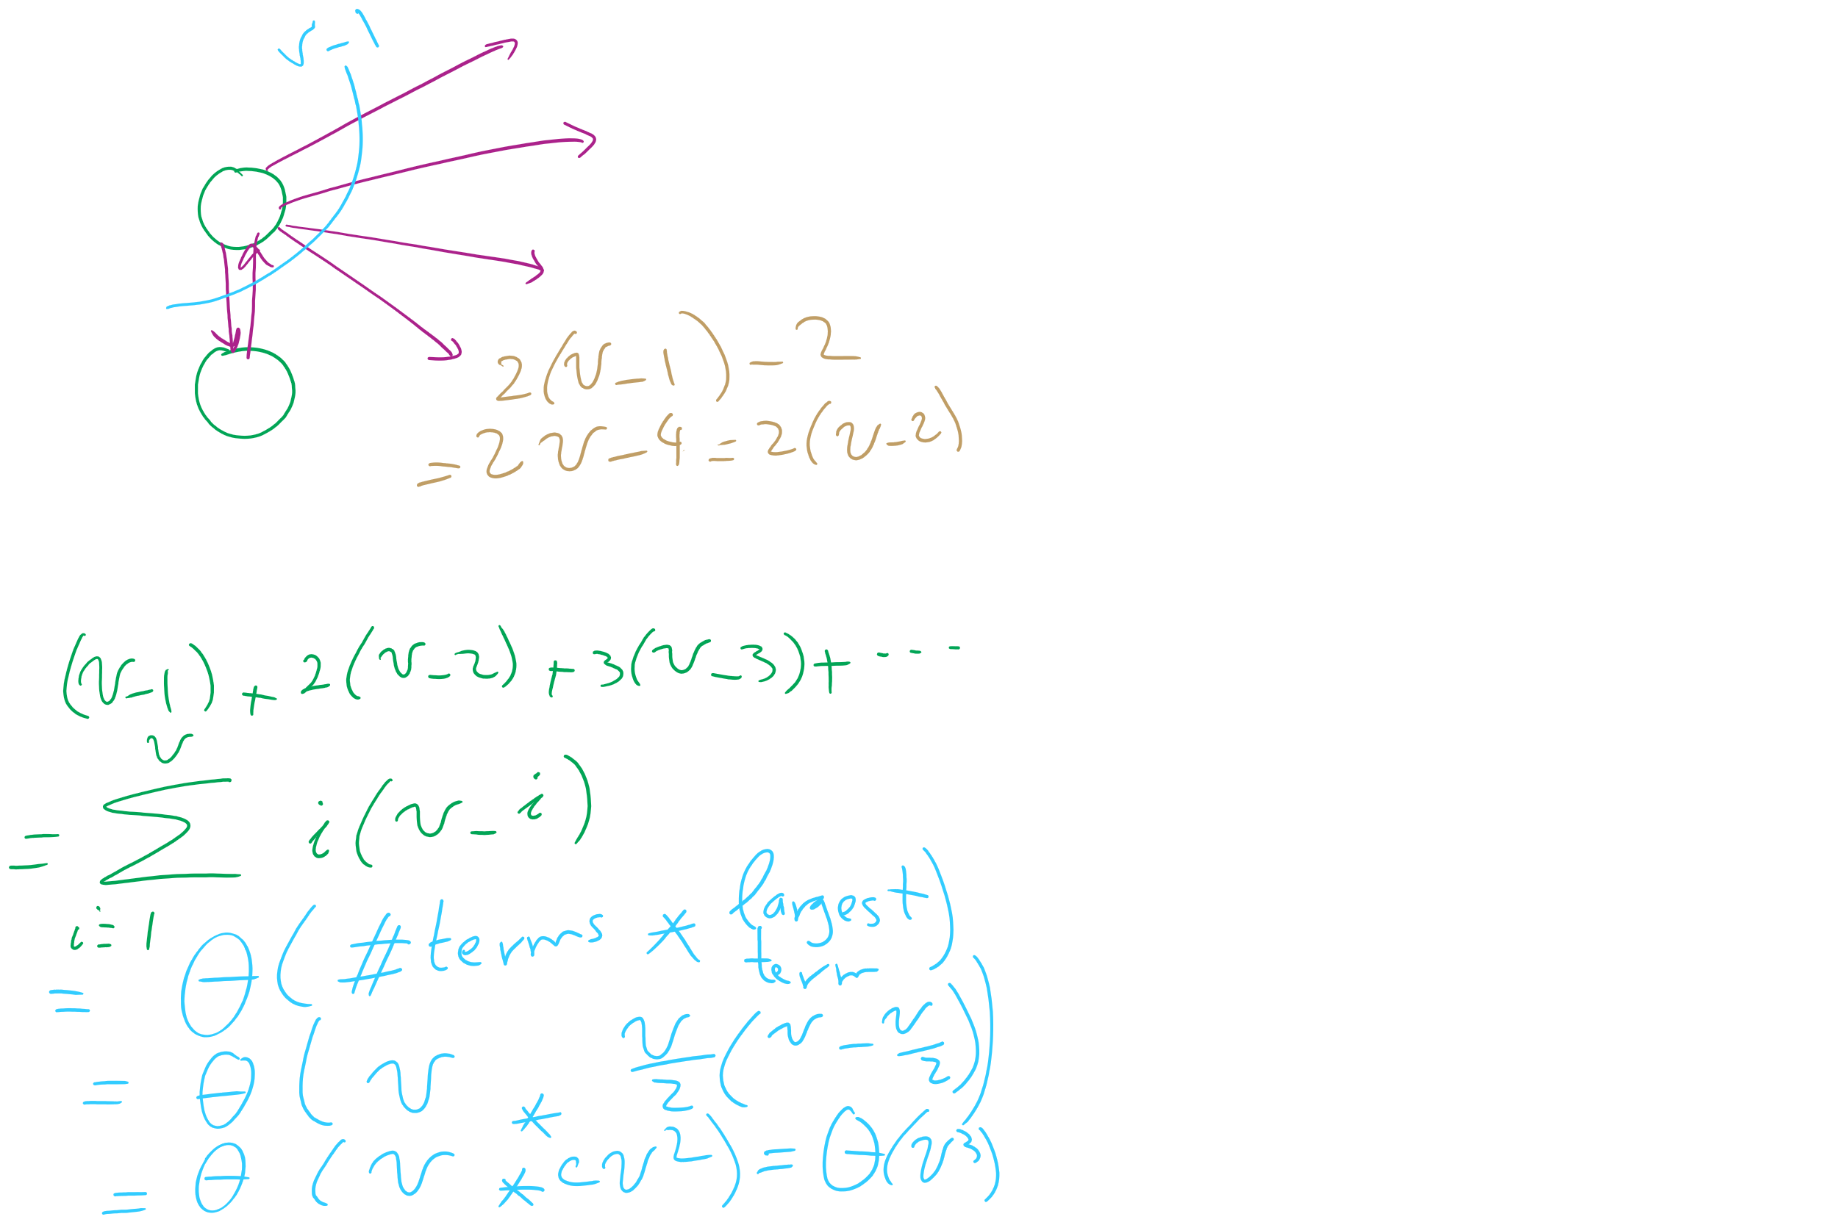
Analysis of Naïve implementation of Prim’s MST Algorithm

Slide 11
Do we need to look through all remaining edges?
No! We only need to consider the best edge possible for each vertex!

Slide 12
Prim’s algorithm
10
1
4
1
4
4
6
8
7
0
9
5
0
3
6
3
6
2
9
8
2
2
2
5
5
1
0
1
2
3
4
5
6
Parent:
--
--
--
--
--
--
--
0
0
2
1
1
5
2
5
Best Edge:
∞
0
∞
∞
∞
∞
∞
∞
4
8
2
8
10
5
1
2
Notes:
Green vertices/red edges in T

Slide 13
OK, so what's our runtime?
For every vertex we add to T, we’ll need to check all of its neighbors to check for edges to add to T next
Let's assume we use an adjacency matrix:
Takes Θ(v) to check the neighbors of a given vertex
Time to update parent/best edge arrays?
Time to pick next vertex?
What about with an adjacency list?
Notes:
v vertices will be added to T, so we do the following v times:
Search through the neighbors of the next vertex to adjust the parent and best edge arrays as needed
Constant time to update parent/best edge arrays
Neighbor enumeration:
Matrix:
Θ(v)
List:
Θ(degree)
Search through the best_edge array to find the next addition to T
Θ(v)
So, matrix:
We do v * 2 * Θ(v) work
Θ(v²)
List:
We do v * Θ(v) * degree work
Θ(v²)

Slide 14
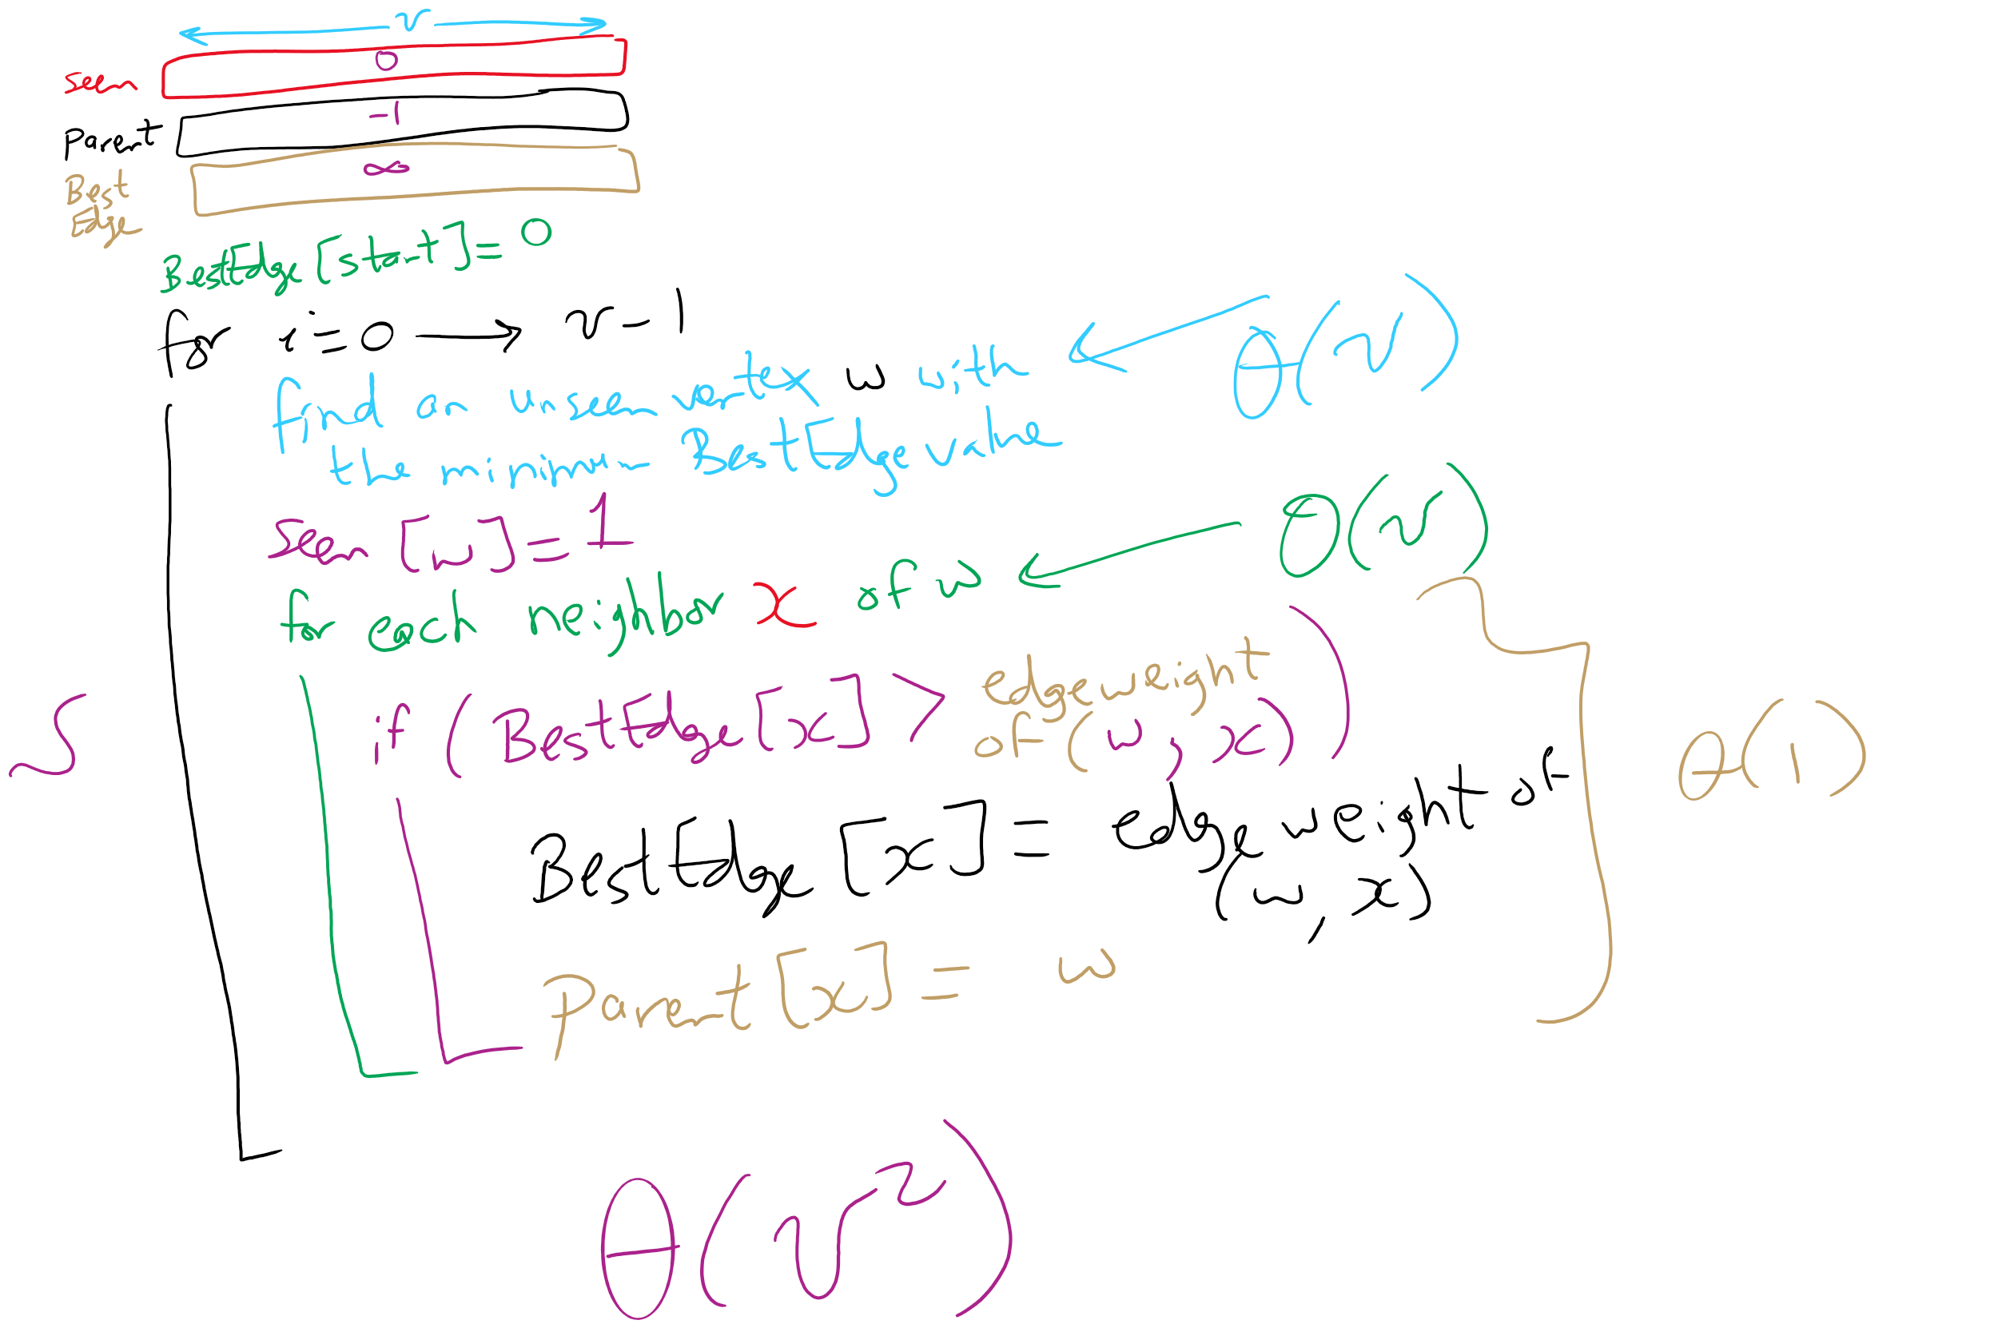
Prim’s MST Algorithm

Slide 15
Priority Queue
Can we do better?
Yes! Use a priority queue instead of an array for BestEdge!

Slide 16
We mentioned priority queues in building Huffman tries
Primary operations they needed:
Insert
Find item with highest priority
E.g., findMin() or findMax()
Remove an item with highest priority
E.g., removeMin() or removeMax()
How do we implement these operations?
Simplest approach: arrays

Slide 17
Unsorted array PQ
Insert:
Add new item to the end of the array
Θ(1)
Find:
Search for the highest priority item (e.g., min or max)
Θ(n)
Remove:
Search for the highest priority item and delete
Θ(n)
Runtime for use in Huffman tree generation?
Notes:
Θ(k²)
have to perform 2*k removals

Slide 18
Sorted array PQ
Insert:
Add new item in appropriate sorted order
Θ(n)
Find:
Return the item at the end of the array
Θ(1)
Remove:
Return and delete the item at the end of the array
Θ(1)
Runtime for use in Huffman tree generation?
Notes:
Θ(k²)
Have to insert n initial trees

Slide 19
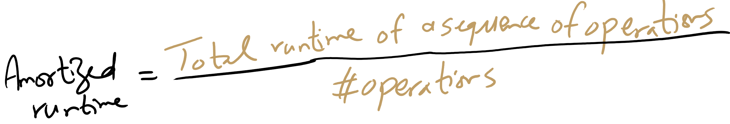
Amortized Runtime

Slide 20
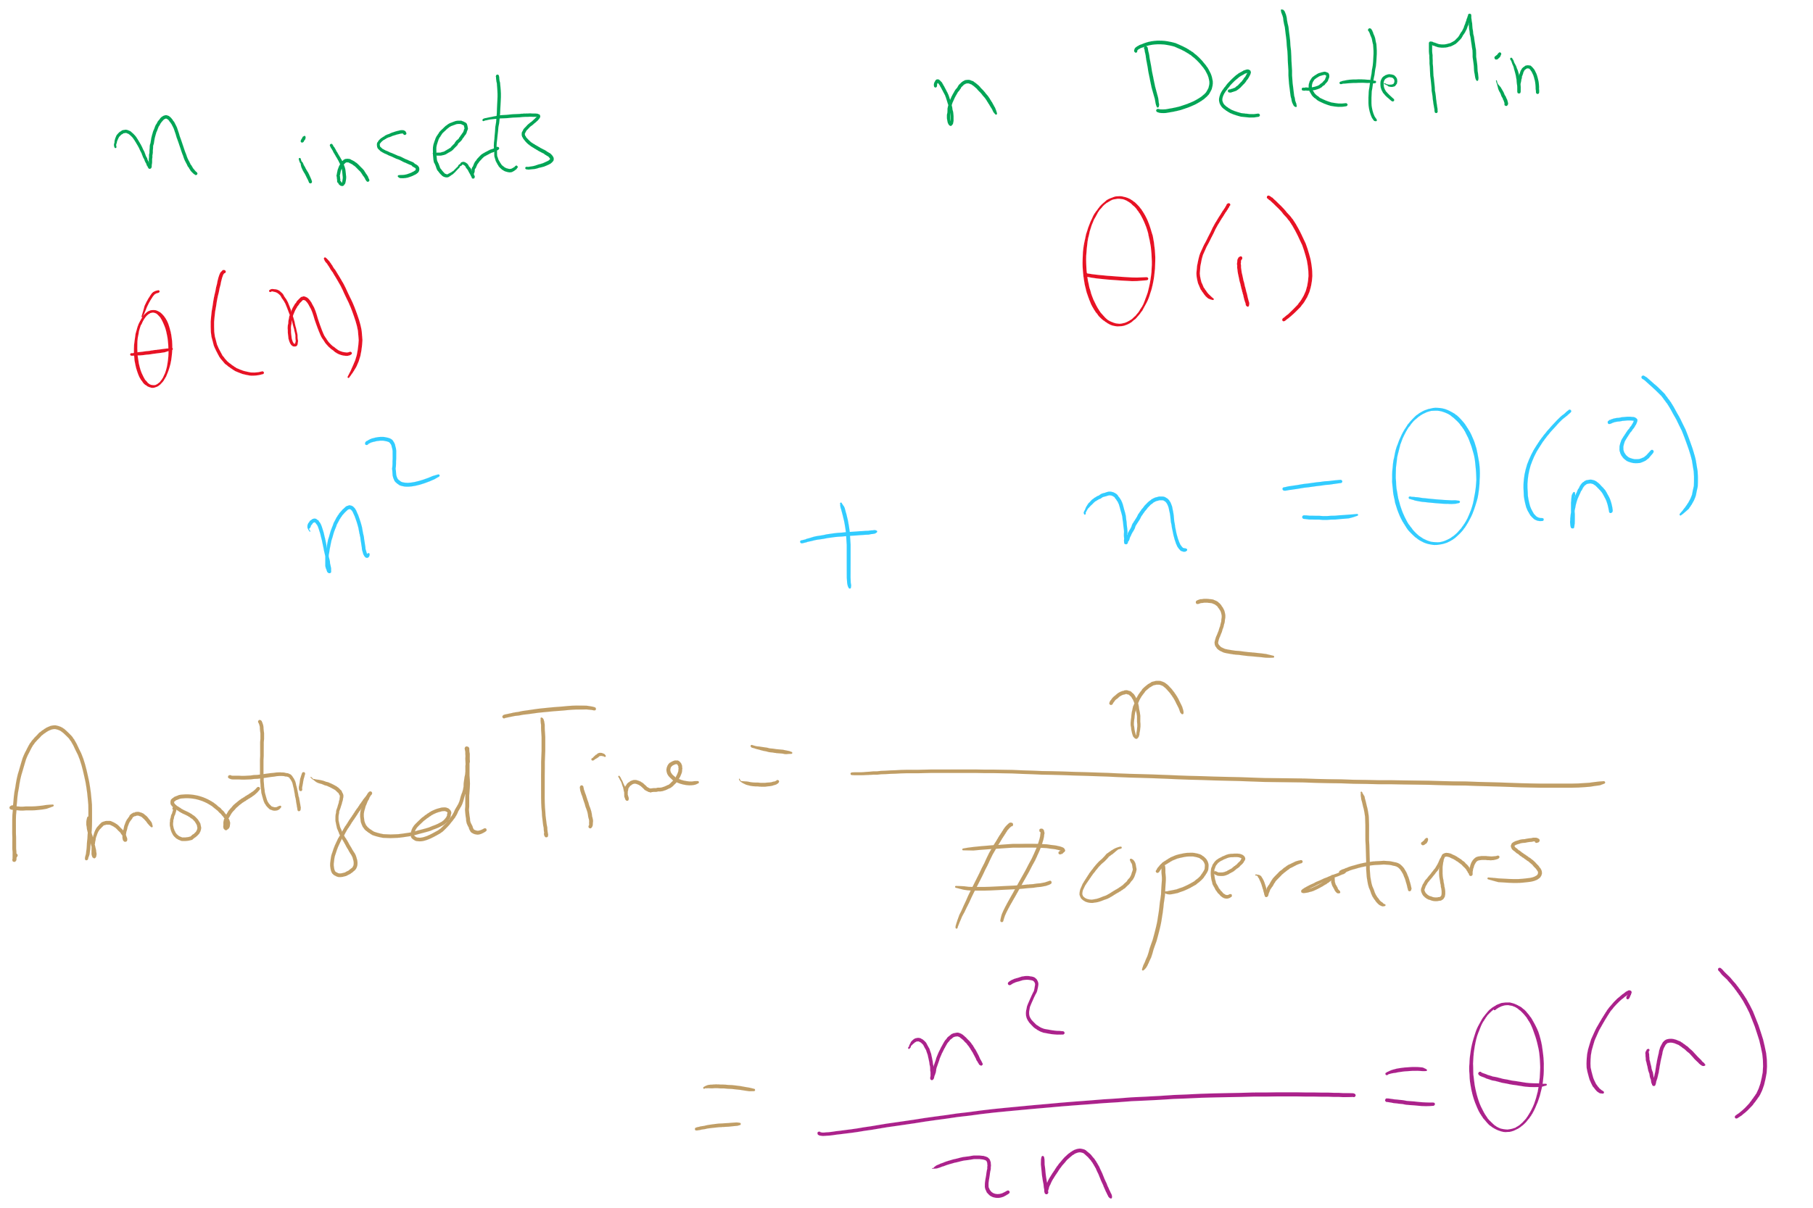
Amortized Time

Slide 21
So what other options do we have?
What about a binary search tree?
Insert
Average case of Θ(lg n), but worst case of Θ(n)
Find
Average case of Θ(lg n), but worst case of Θ(n)
Remove
Average case of Θ(lg n), but worst case of Θ(n)
OK, so in the average case, all operations are Θ(lg n)
No constant time operations
Worst case is Θ(n) for all operations

Slide 22
Is a BST overkill?
Our find and remove operations only need the highest priority item, not to find/remove any item
Can we take advantage of this to improve our runtime?
Yes!

Slide 23
The heap
A heap is complete binary tree such that for each node T in the tree:
T.item is of a higher priority than T.right_child.item
T.item is of a higher priority than T.left_child.item
It does not matter how T.left_child.item relates to T.right_child.item
This is a relaxation of the approach needed by a BST
The heap property

Slide 24
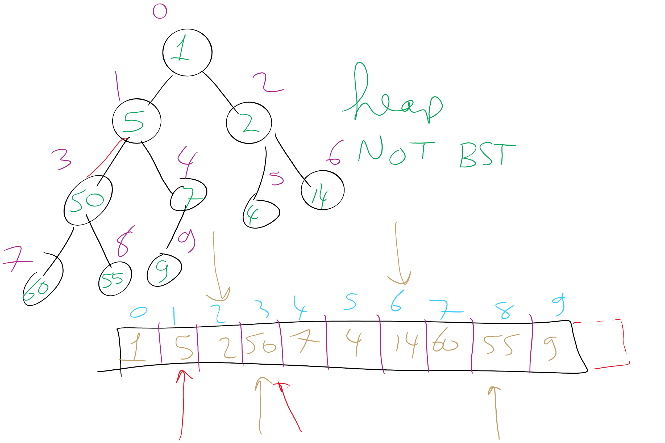
Heap Example

Slide 25
Heap PQ runtimes
Find is easy
Simply the root of the tree
Θ(1)
Remove and insert are not quite so trivial
The tree is modified and the heap property must be maintained

Slide 26
Heap insert
Add a new node at the next available leaf
Push the new node up the tree until it is supporting the heap property

Slide 27
Min heap insert
Insert: 7, 42, 37, 5, 8, 15, 12, 9, 3
7
5
3
3
5
15
7
12
5
42
37
42
37
15
3
5
7
9
8
15
12
9
42
9
3
Notes:
Insert: 7, 42, 37, 5, 8, 15, 12, 9, 3

Slide 28
Please submit your reflections by using the CourseMIRROR App
If you are having a problem with CourseMIRROR, please send an email to coursemirror.development@gmail.com
Notes:
All right!
Upcoming Due Dates at A Glance

