Slide 1

Algorithms and Data Structures 2 CS 1501
Spring 2022
Sherif Khattab
ksm73@pitt.edu
(Slides are adapted from Dr. Ramirez’s and Dr. Farnan’s CS1501 slides.)

Slide 2
Announcements
Upcoming deadlines:
Homework 4 is due on 2/14
Lab 4 is due on 2/18
Homework 5 is due on 2/21

Slide 3
Previous lecture …
Binary Tree Traversal
Pre-order
In-order
Post-order
Level order
Searching in a BST
Recursive and iterative

Slide 4
CourseMIRROR Reflections: Most Interesting
I found the different traversal interesting instead of just a top to bottom concept.
Giving candies
The stack implementation was interesting and how it compares to the recursion
The contour paths of the different traversal types. Very helpful for remember the differences!
Ways of traversing a BST
Relating code for traversal with a visual description of what’s happening
how inorder traversal returns the tree in a sorted order

Slide 5
CourseMIRROR Reflections: Most Confusing
how the stack works in relation to the traversals. The traversals make sense but the order of push and pop does not.
How the call stack works with traversing (it felt like we went through the material kind of fast)
if you could provide typed Java code for iterative traversal instead of handwritten pseudocode that would make it more clear to understand
The post order traversing! I am confused on the place to push, is all of the x will be in the visit listing for next second?
Developing iterative code from recursive code; how to get from recursive to iterative
I would like to go over DFS and BFS more

Slide 6
Prefix Searching Problem
Input:
a (large) dynamic set of data items in the form of
n (key, value) pairs; key is a string from an alphabet of size R
Each key has b bits or w characters (the chars are from the alphabet)
What is the relationship between b and w?
a target string
Output:
0: string is not a prefix of nor equal to any of the keys
1: string is a prefix of at least one key but not equal to any
2: string is not a prefix of any key but is equal to a key
3: string is both a prefix of at least one key and equal to one of the keys

Slide 7
Let’s create an ADT!
The Prefix Symbol Table ADT
A set of (key, value) pairs
Operations of the PST ADT
insert
delete
prefixSearch
search

Slide 8
Prefix Symbol Table Implementations
Array
Unsorted
Sorted
Linked List
Unsorted
Sorted
Binary Search Tree
Red-Black Binary Search Tree

Slide 9
Digital Search Trees (DSTs)
Instead of looking at less than/greater than, lets go left right based on the bits of the key, so we again have 4 options:
Node ref is null, k not found
k is equal to the current node's key, k is found
current bit of k is 0, continue to left child
current bit of k is 1, continue to right child

Slide 10
DST example
Insert:
4
0100
4
3
0011
0
1
2
0010
3
6
0110
0
1
2
6
5
0101
Search:
0
1
0
1
5
3
0011
0
1
7
0111
Notes:
how to turn this into a symbol table?

Slide 11
Analysis of digital search trees
Runtime?
We end up doing many comparisons against the full key, can we improve on this?
Notes:
Average case is the same as BST: lg(n)
Given a truly random set of n keys, branching according to a 0 or 1 is equally likely and the tree should be well balanced
What about the worst case?
Bound by the bit length, b, of the key
Constant lookup time in the number of bits, an improvement over BST
How is this OK?
Compare log(n) with b over all possible values of n
Harken back to radix sort discussion

Slide 12
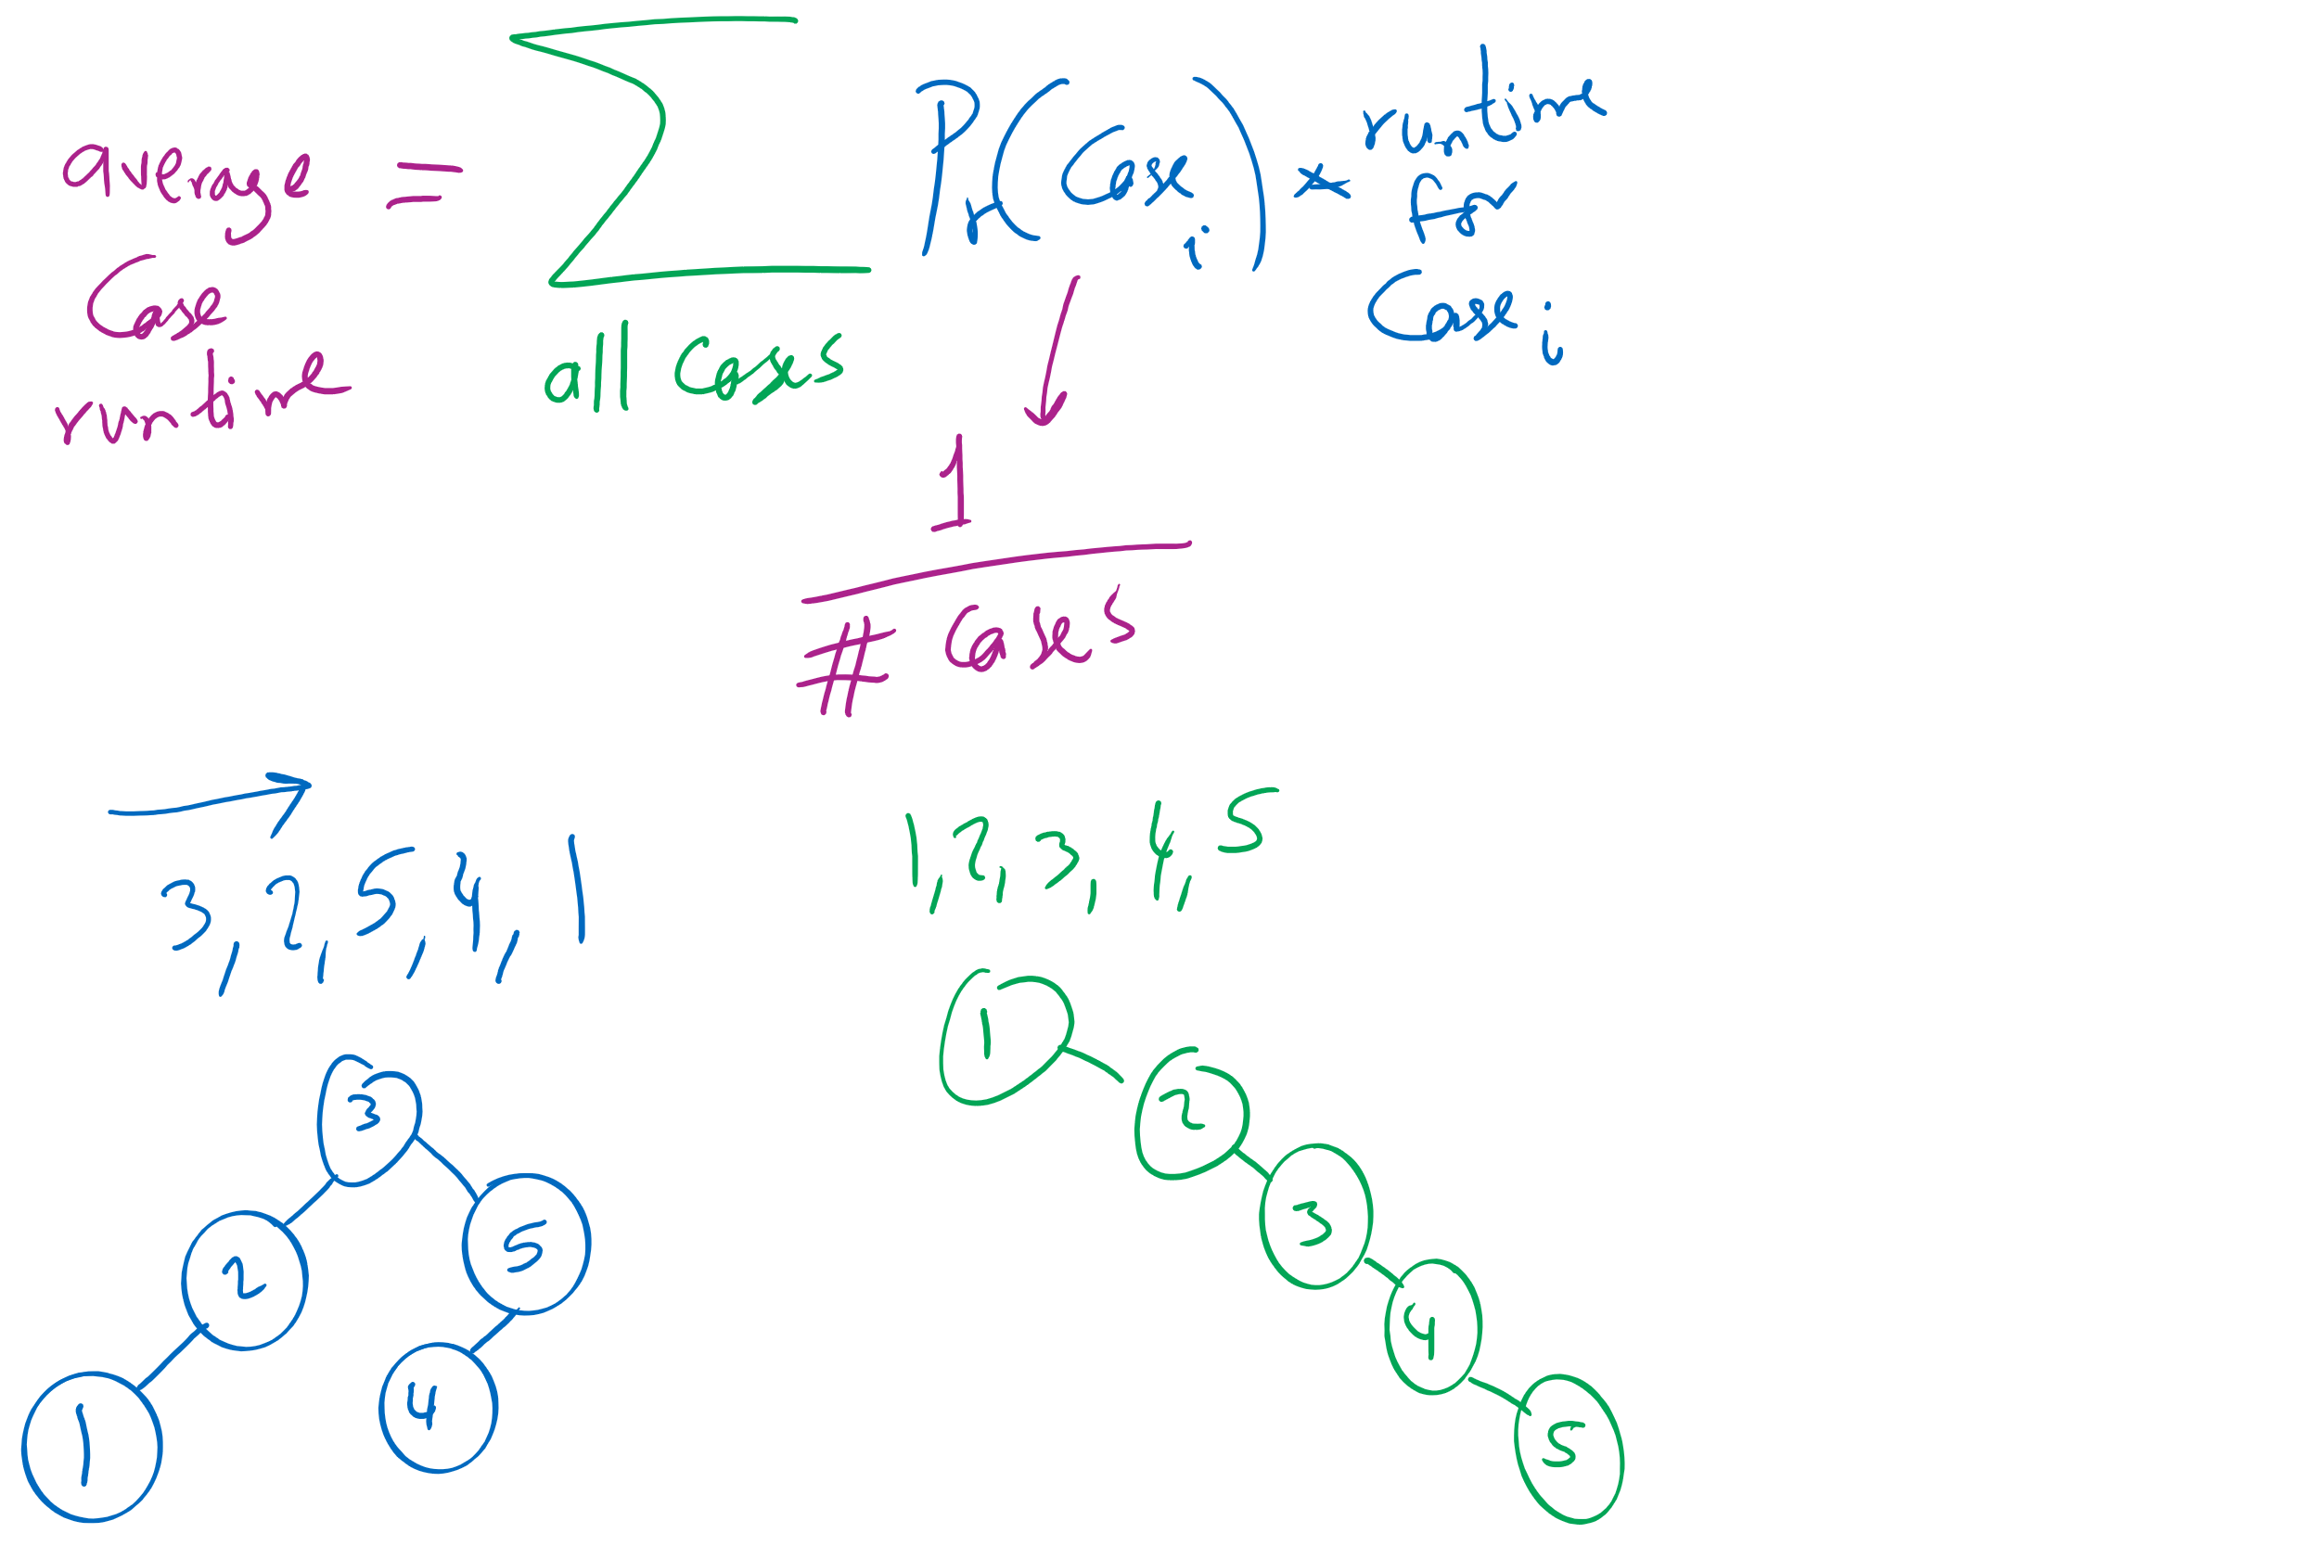
Average-case vs. Worst-case

Slide 13
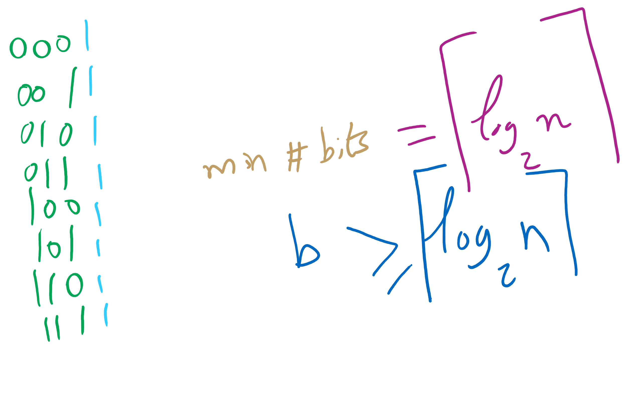
n vs. bit length

Slide 14
Let’s create an ADT!
The Prefix Symbol Table ADT
A set of (key, value) pairs
Operations of the PST ADT
insert
delete
prefixSearch
search

Slide 15
Radix search tries (RSTs)
Trie as in retrieve, pronounced the same as “try”
Instead of storing keys as nodes in the tree, we store them implicitly as paths down the tree
Interior nodes of the tree only serve to direct us according to the bitstring of the key
Values can then be stored at the end of key’s bit string path

Slide 16
RST example
Insert:
4
0100
0
1
3
0011
2
0010
0
1
6
0110
0
1
0
1
5
0101
Search:
0
1
0
1
0
1
3
0011
V
V
V
V
V
7
0111
Notes:
V's just stand for values added as part of the symbol table

Slide 17
RST analysis
Runtime?
Would this structure work as well for other key data types?
Characters?
Strings?
Notes:
b, the bit length of the key
Worst case from DSTs
However, this time we don’t have full key comparisons
Characters are exactly the same as 8 bit ints (assuming simple ascii)
Strings would have huge bit lengths (go back to prev slide to hit this home)
Also vary in length, which we could handle with RSTs

Slide 18
Larger branching factor tries
In our binary-based Radix search trie, we considered one bit at a time
What if we applied the same method to characters in a string?
What would this new structure look like?
Let’s try inserting the following strings into an trie:
she, sells, sea, shells, by, the, sea, shore

Slide 19
Another trie example
b
s
t
y
e
h
h
a
l
e
o
e
l
l
r
s
l
e
s
Notes:
Instead of 1 bit per level, now looking at 8
How do we know where a string ends?
How do we know what keys are in the trie?
How do we store values in the trie?

Slide 20
Analysis
Runtime?
Notes:
Θ(w) where w is the character length of the string
Still constant!
So what do we really gain over RSTs?
For strings, w < b, and overall tree height is reduced

Slide 21
Further analysis
Miss times
Require an average of log_{R}(n) nodes to be examined
Where R is the size of the alphabet being considered
Proof in Proposition H of Section 5.2 of the text
Average # of checks with 2²⁰ keys in an RST?
With 2²⁰ keys in a large branching factor trie, assuming 8-bits at a time?
Notes:
Average # of checks with 2²⁰ keys in an RST?
lg(2²⁰) = 20
With 2²⁰ keys in an R-way trie, assuming 8-bit ASCII?
log₂₅₆(2²⁰) = 2.5

Slide 22
Implementation Concerns
See TrieSt.java
Implements an R-way trie
Basic node object:
private static class Node { private Object val; private Node[] next = new Node[R]; }
Where R is the branching factor
Non-null val means we have traversed to a valid key
Again, note that keys are not directly stored in the trie at all

Slide 23
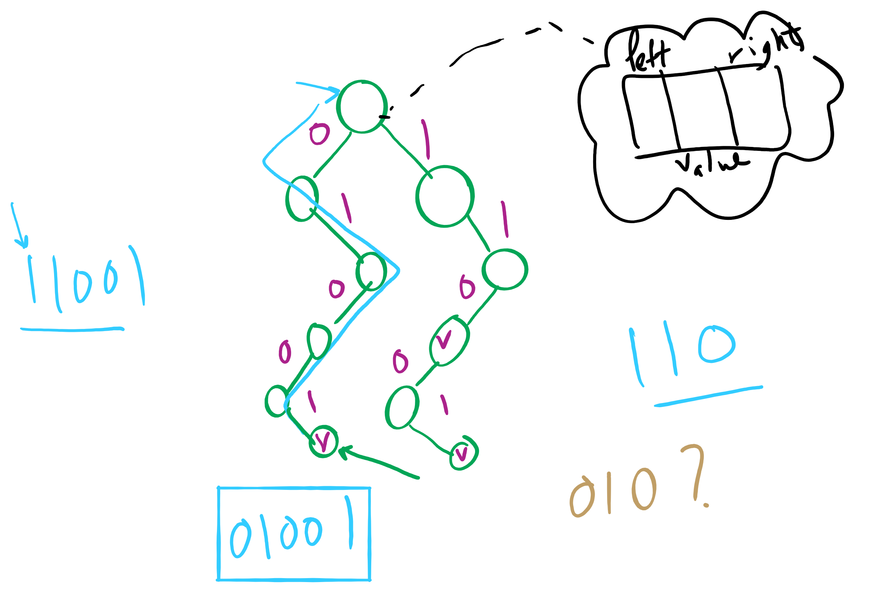
Binary RST

Slide 24
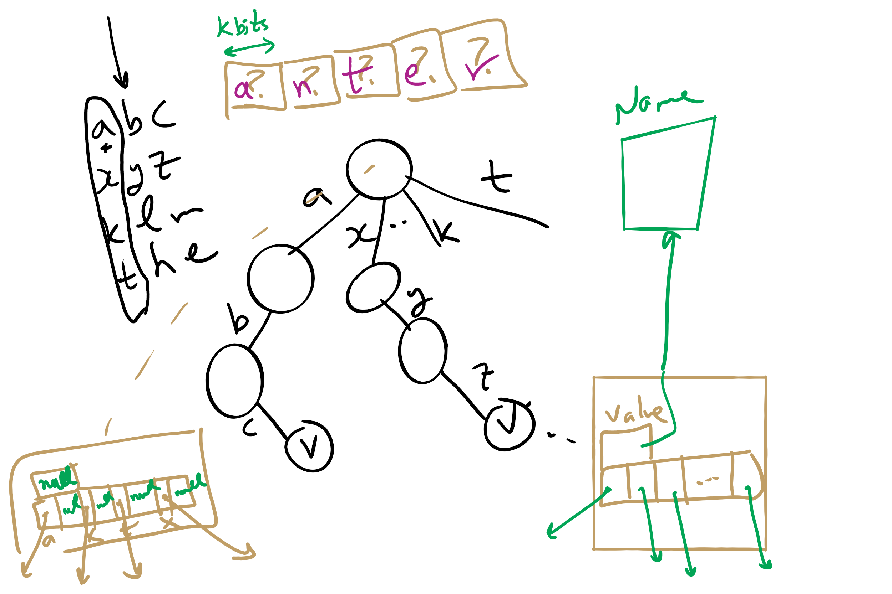
Multi-way RST

Slide 25
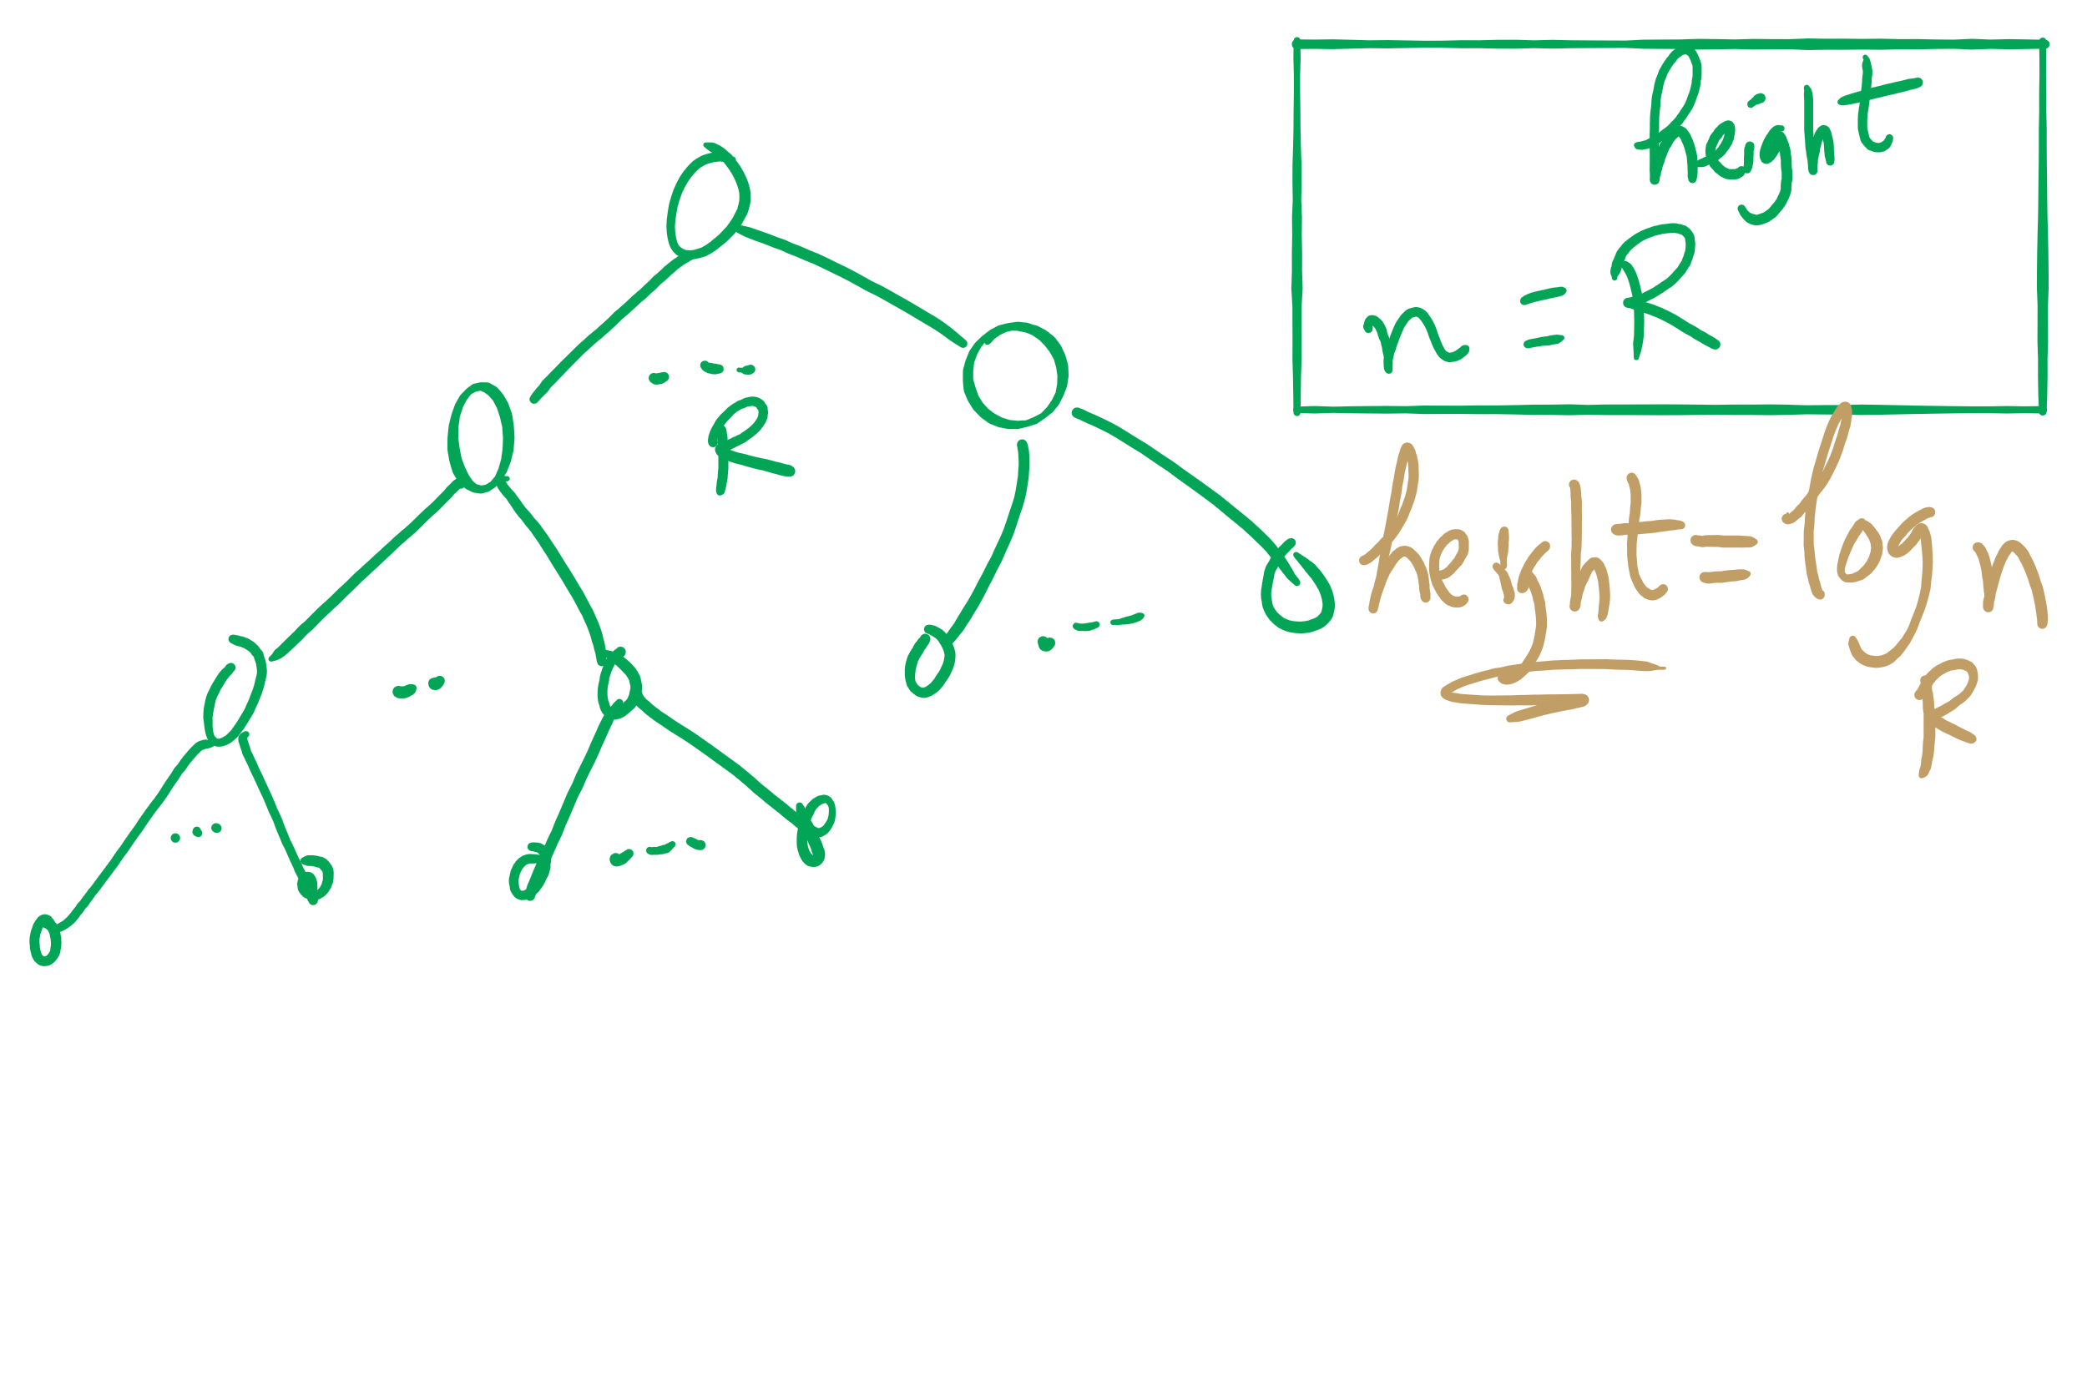
Search Miss

Slide 26
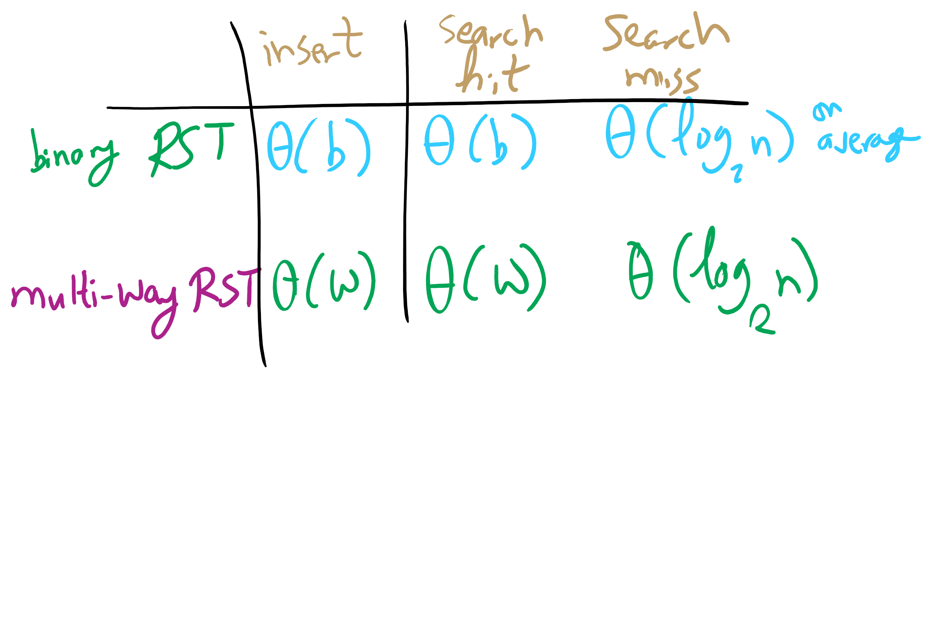
Summary of running time

Slide 27
R-way trie example
Val:
Next
A
B
C
D
E
F
G
H
I
J
K
L
M
N
O
P
Q
R
S
T
U
V
W
X
Y
Z
Val:
Next
A
B
C
D
E
F
G
H
I
J
K
L
M
N
O
P
Q
R
S
T
U
V
W
X
Y
Z
Val:
Next
A
B
C
D
E
F
G
H
I
J
K
L
M
N
O
P
Q
R
S
T
U
V
W
X
Y
Z
Val:
0
Next
A
B
C
D
E
F
G
H
I
J
K
L
M
N
O
P
Q
R
S
T
U
V
W
X
Y
Z
Val:
Next
A
B
C
D
E
F
G
H
I
J
K
L
M
N
O
P
Q
R
S
T
U
V
W
X
Y
Z
Val:
1
Next
A
B
C
D
E
F
G
H
I
J
K
L
M
N
O
P
Q
R
S
T
U
V
W
X
Y
Z

Slide 28
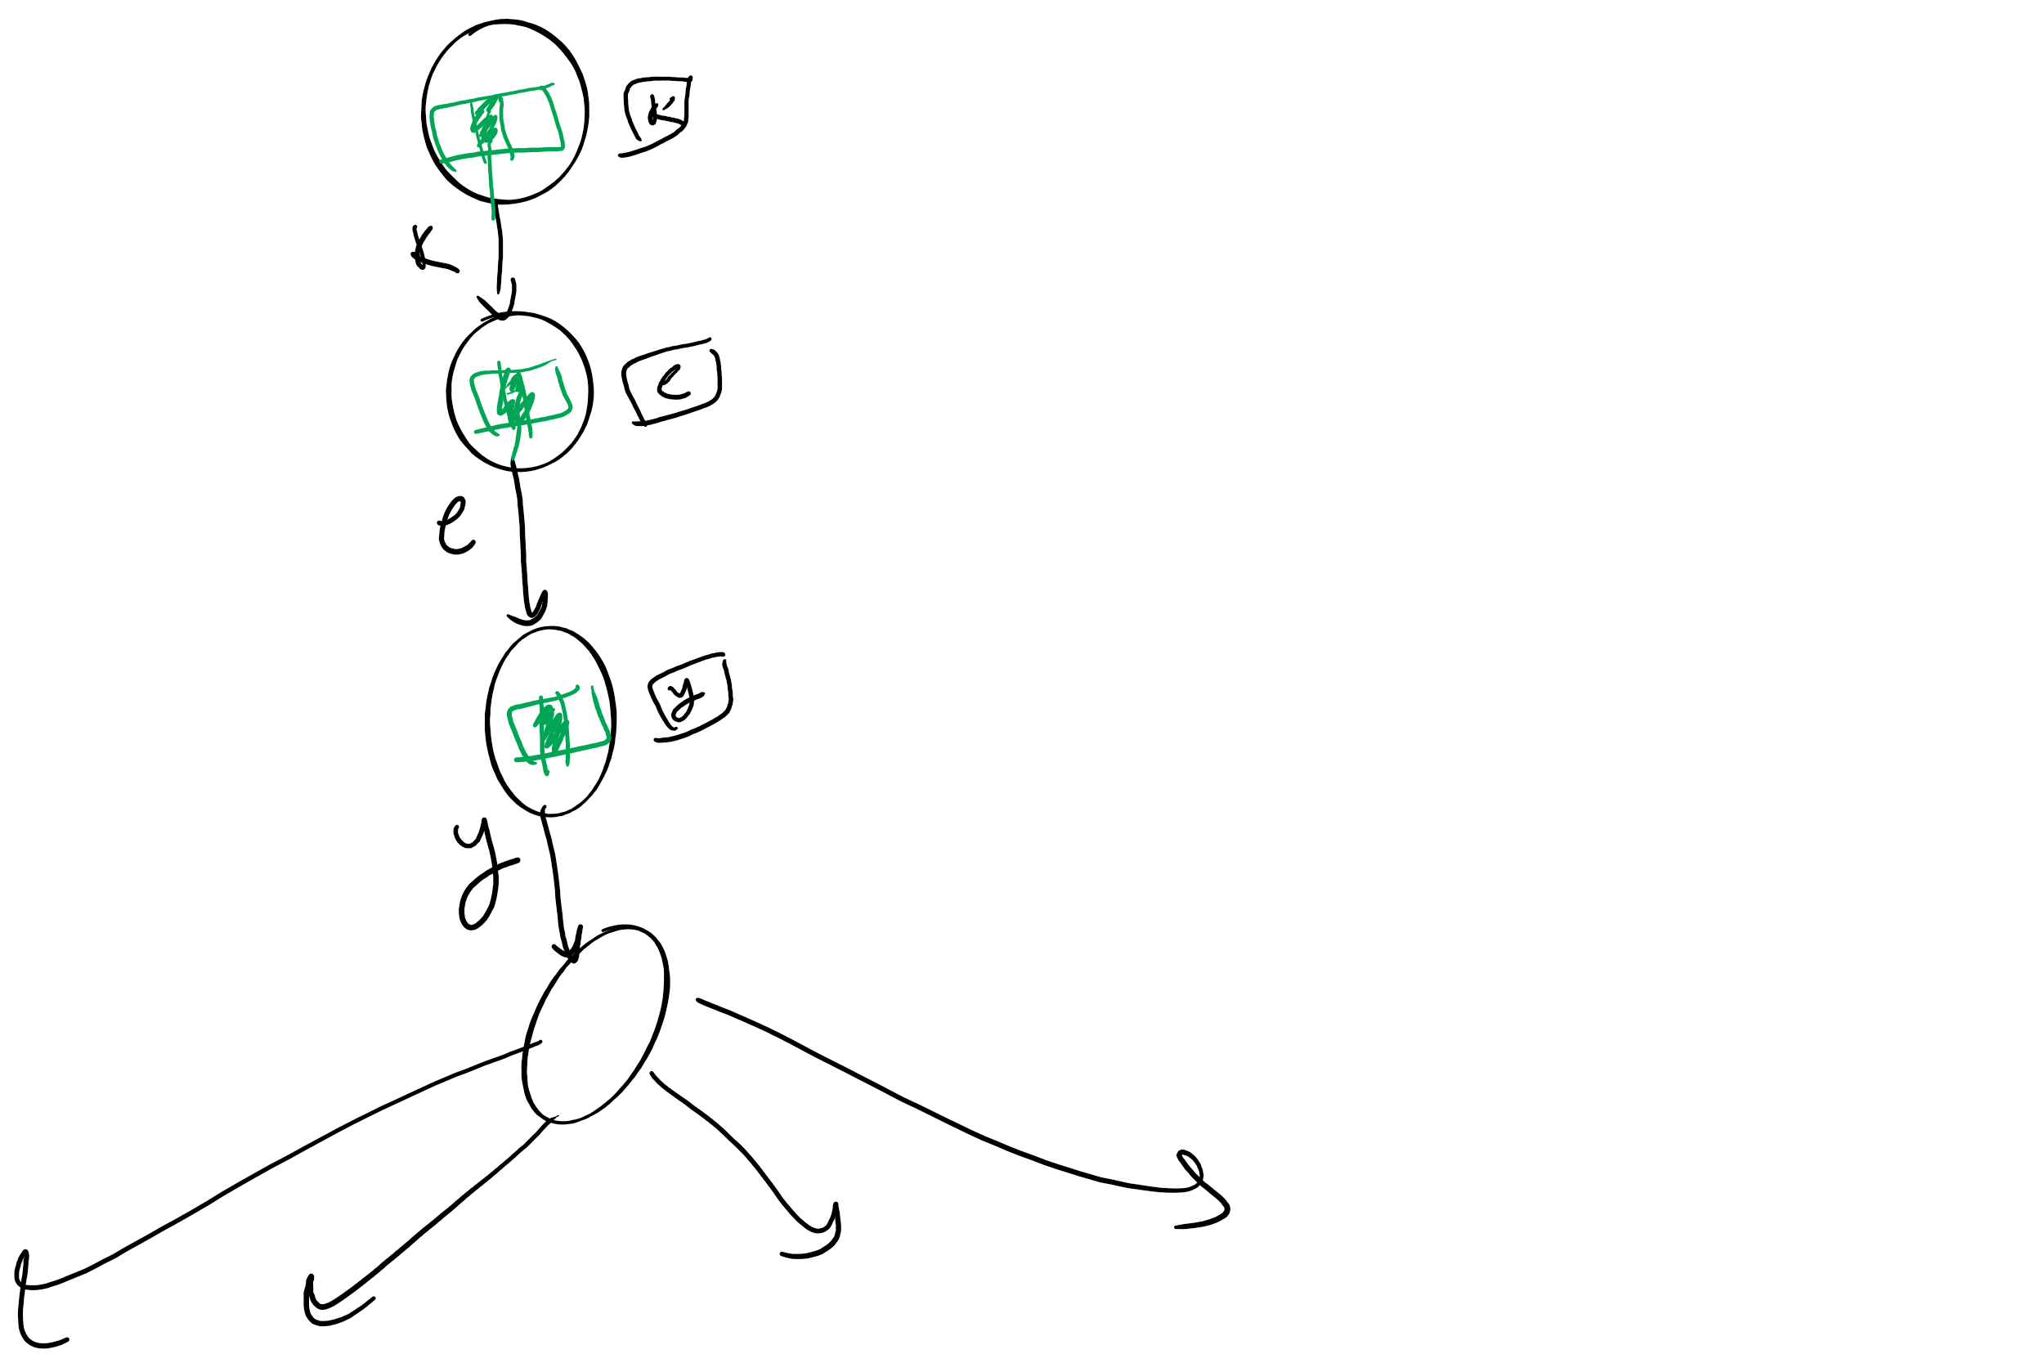
So what’s the catch?
Space!
Considering 8-bit ASCII, each node contains 2⁸ references!
This is especially problematic as in many cases, alot of this space is wasted
Common paths or prefixes for example, e.g., if all keys begin with “key”, thats 255*3 wasted references!
At the lower levels of the trie, most keys have probably been separated out and reference lists will be sparse

Slide 29
De La Briandais tries (DLBs)
Replace the .next array of the R-way trie with a linked-list

Slide 30
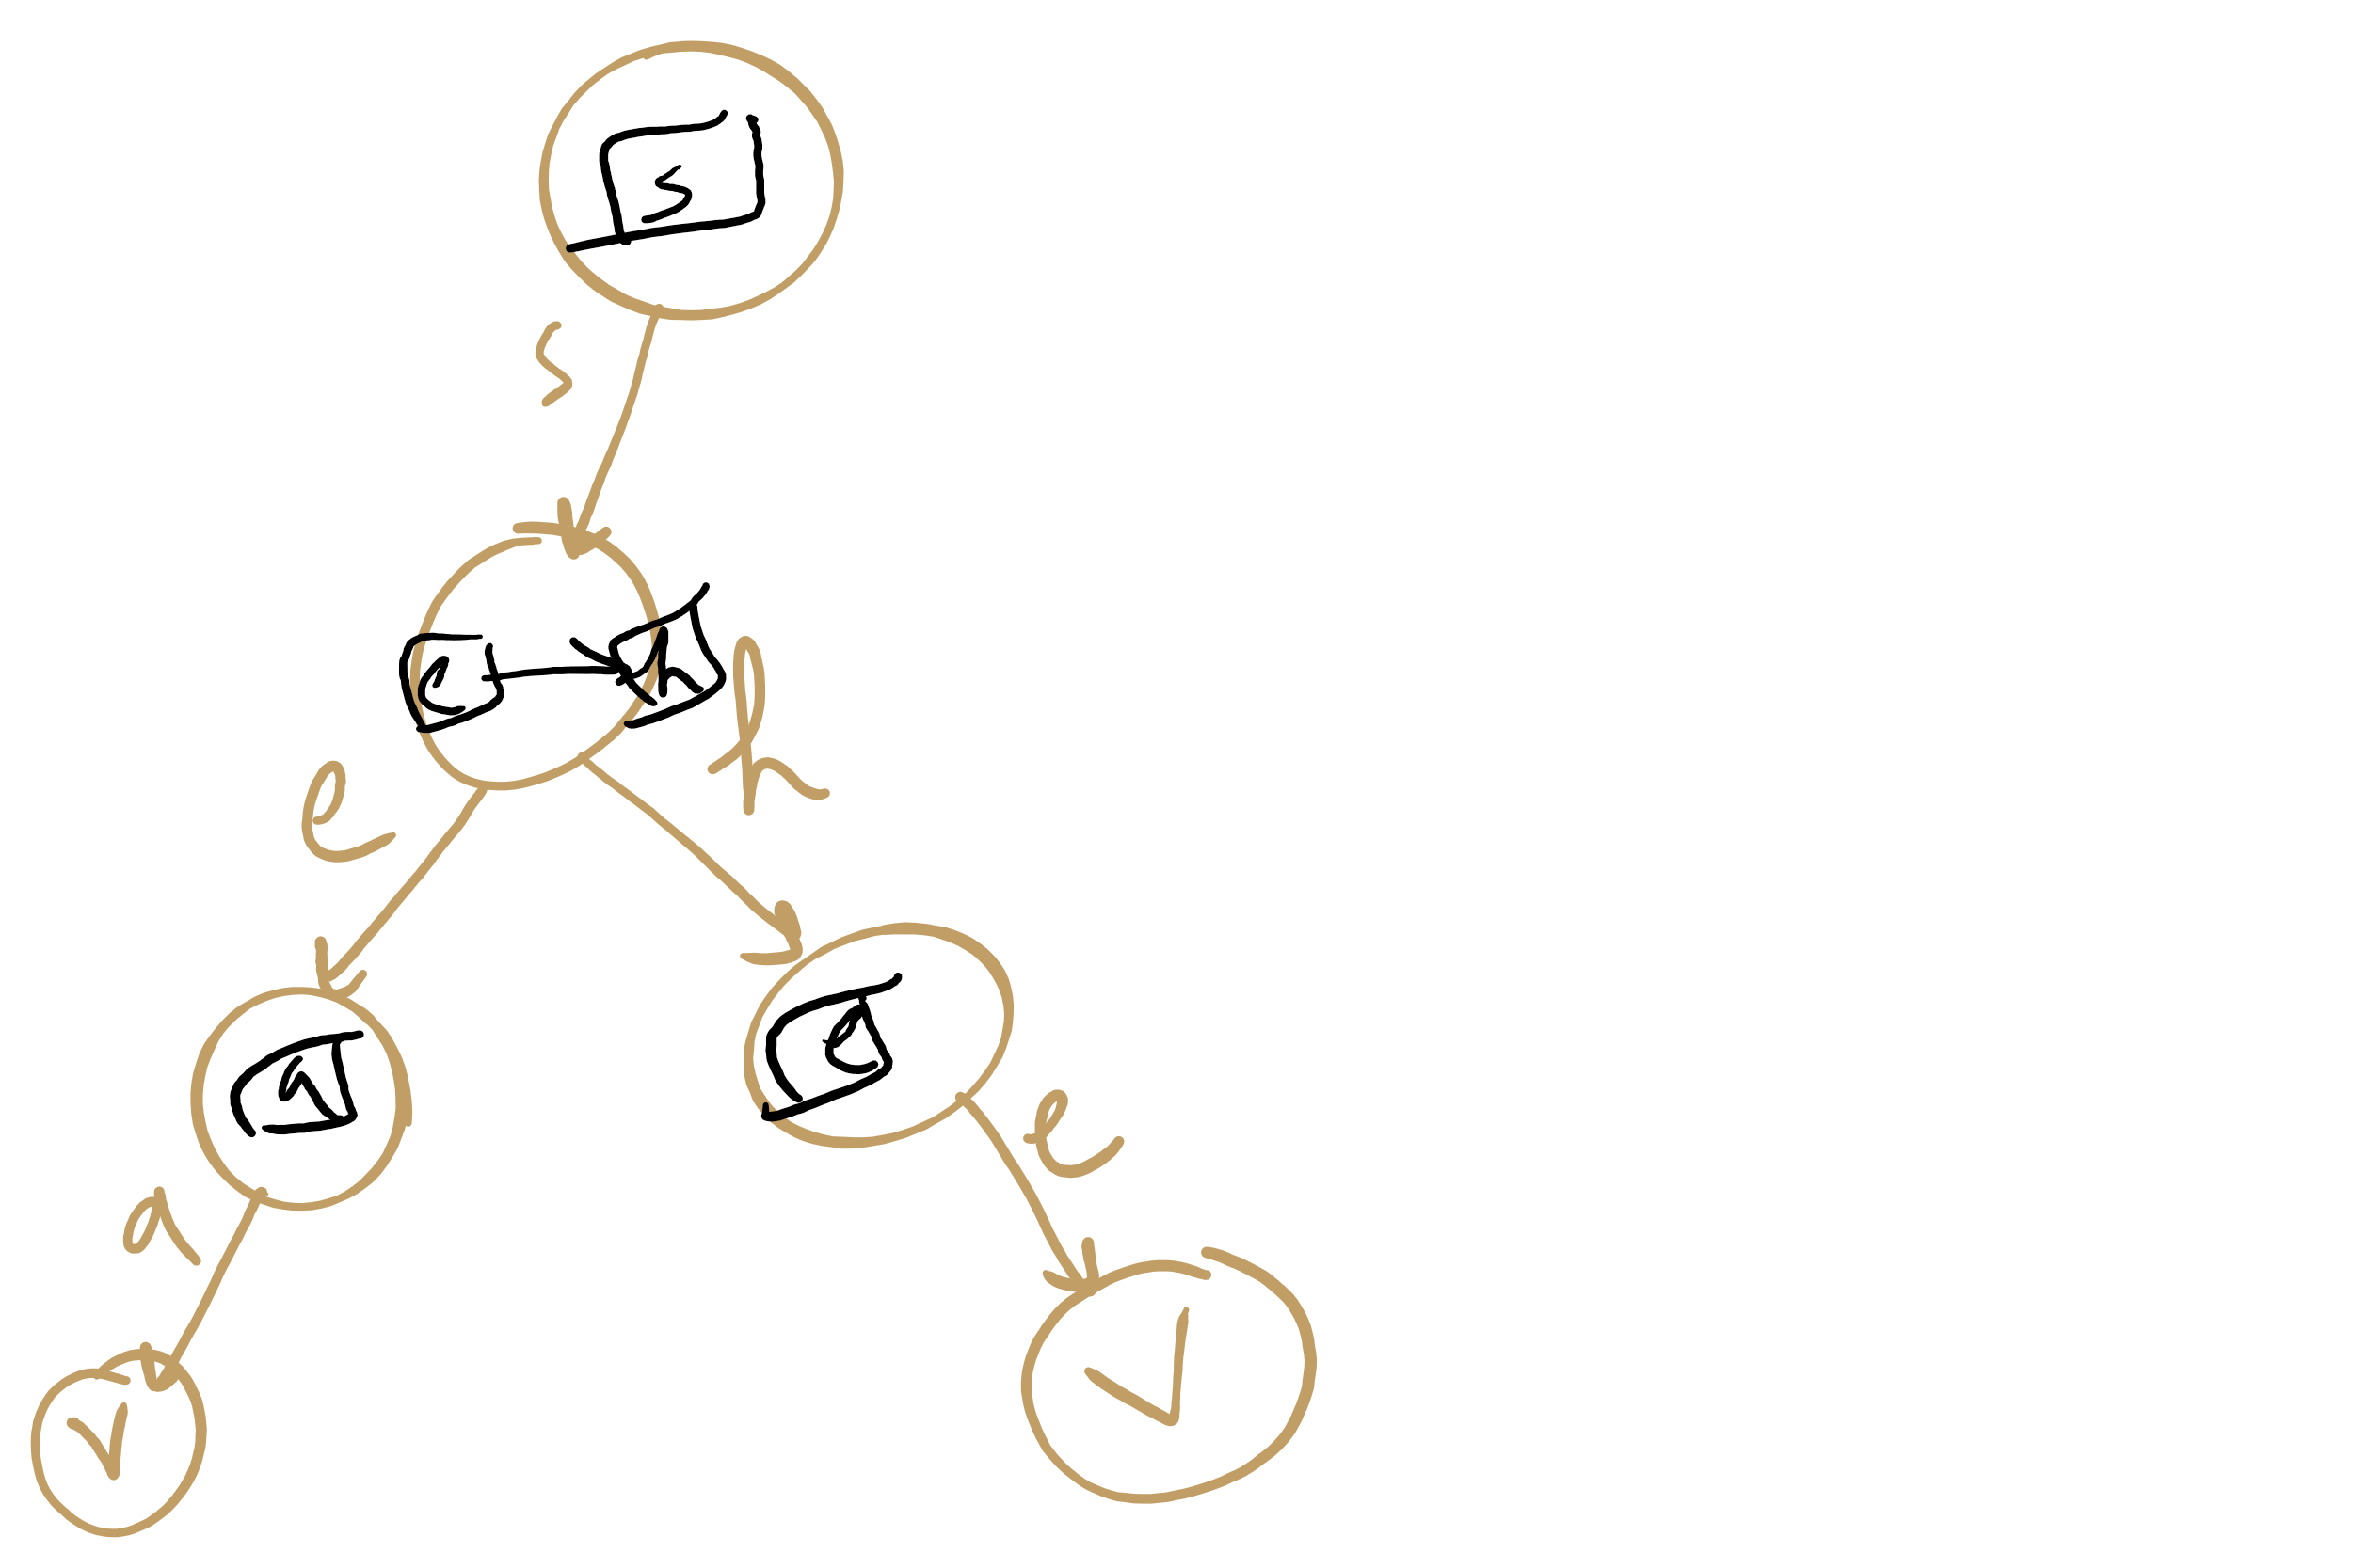
DLB Example

Slide 31
DLB Example 2: nodes vs. nodelets
S
B
T
H
E
Y
H
E
L
A
^
E
^
L
L
^
^
L
S
S
^
^
Notes:
note here we use explicit termination character vs value check, can do either though

Slide 32
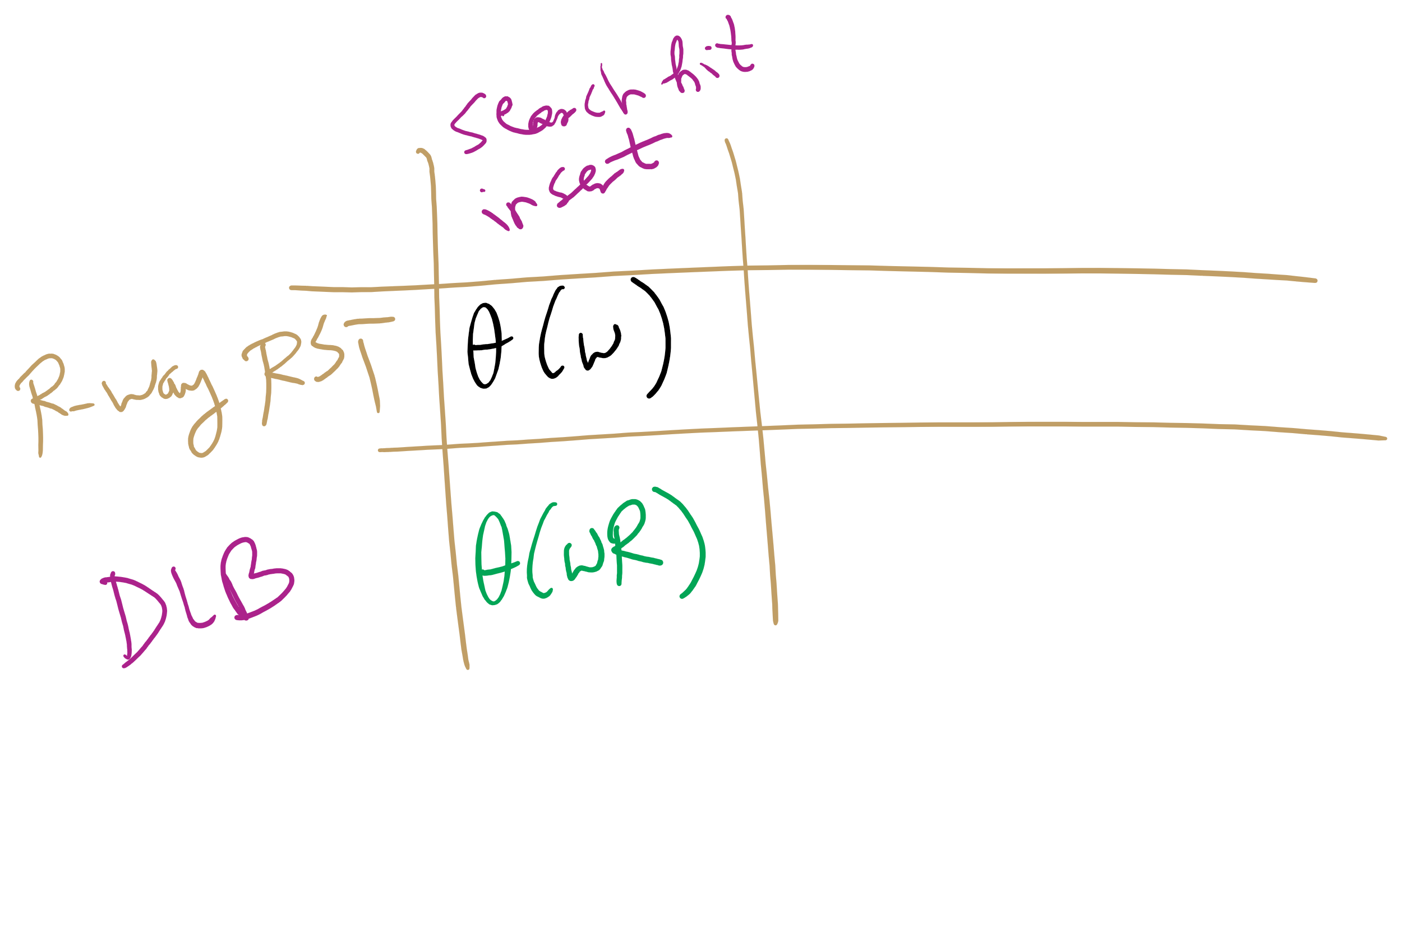
DLB analysis
How does DLB performance differ from R-way tries?
Which should you use?
Notes:
Differences:
No wasted space!
But search/insert are now Θ(wR)
In the worst case, we have to iterate through all R characters in the alphabet for each node
When to use one over another?
For implementations with alot of sparse nodes are expected, use a DLB
Runtime will still be close to Θ(w) for sparse nodes
For dense nodes, stick with R-way tries
If most of the alphabet is a valid reference for most nodes, you won’t get a whole lot of space savings with DLBs

Slide 33
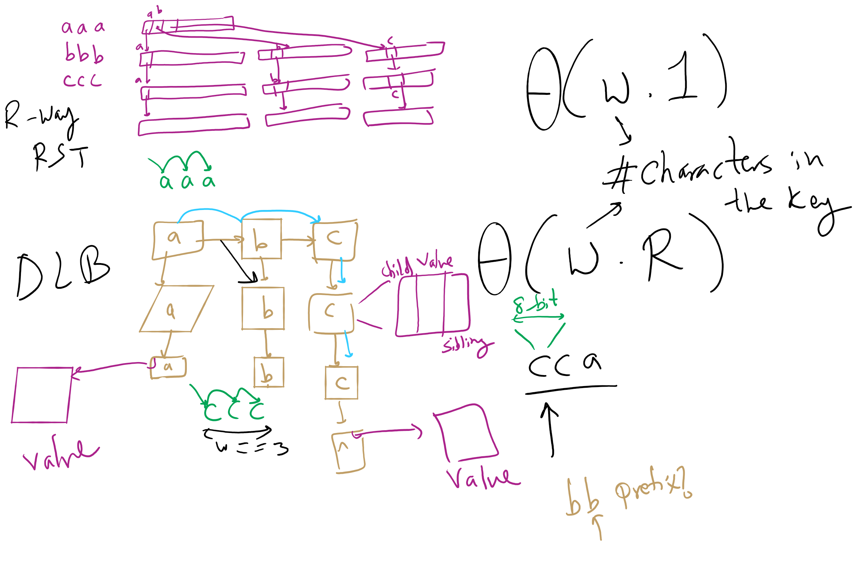
R-way RST vs. DLB

Slide 34
Let’s go back to our Prefix Symbol Table an ADT!
The Prefix Symbol Table ADT
A set of (key, value) pairs
Operations of the PST ADT
insert
delete
prefixSearch
search
How can we implement prefixSearch?

Slide 35
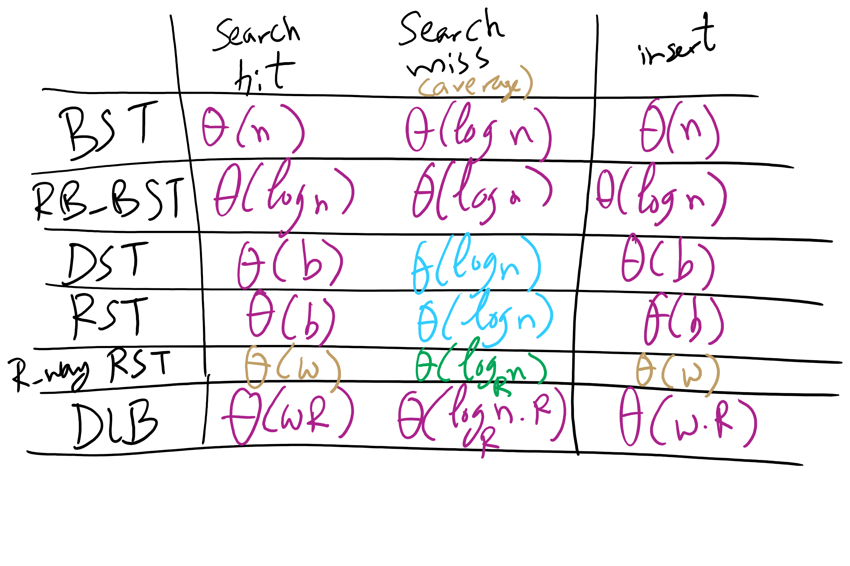
Runtime Comparison for Search Trees/Tries

Slide 36
Final notes on Search Tree/Tries
We did not present an exhaustive look at search trees/tries, just the sampling that we’re going to focus on
Many variations on these techniques exist and perform quite well in different circumstances
Ternary search Tries
R-way tries without 1-way branching
See the table at the end of Section 5.2 of the text

Slide 37
Please submit your reflections by using the CourseMIRROR App
If you are having a problem with CourseMIRROR, please send an email to coursemirror.development@gmail.com
Notes:
All right!
Upcoming Due Dates at A Glance

