Slide 1

Algorithms and Data Structures 2 CS 1501
Spring 2022
Sherif Khattab
ksm73@pitt.edu
(Slides are adapted from Dr. Ramirez’s and Dr. Farnan’s CS1501 slides.)

Slide 2
Announcements
Upcoming deadlines:
Homework 3 is due on 2/7
Homework 4 is due on 2/14
Lab 3 is due on 2/11

Slide 3
Previous lecture …
How to add and delete from a Binary Search Tree (BST)
Red-Black BST

Slide 4
CourseMIRROR Reflections

Slide 5
This Lecture
How to add and delete from a Red-Black BST
How to traverse a Binary Tree

Slide 6
Red-Black BST
Definition
two colors for links (nodes)
a node has the same color as the link to its parent
root node is always black
null leaves are always black
red links are always to the left children
at most one red-link per node
all root-to-null-leaf paths have the same number of black nodes
Why?
maximum height = 2*log n !!
Basic operations
rotate left
rotate right
flip color
preserve the properties of the red-black BST!

Slide 7
Adding to a RB-BST
Ok, so we add a red leaf node!
What can go wrong then?
The new node is a right child
The parent of the new node is also red
The sibling of the new node is also red

Slide 8
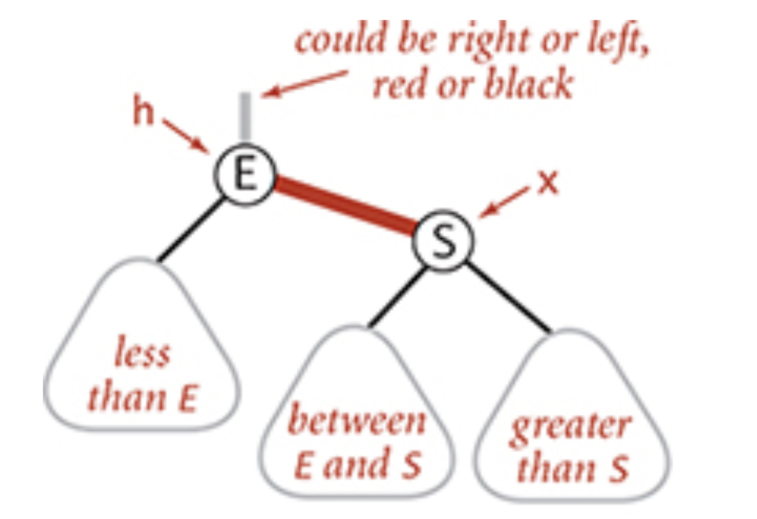
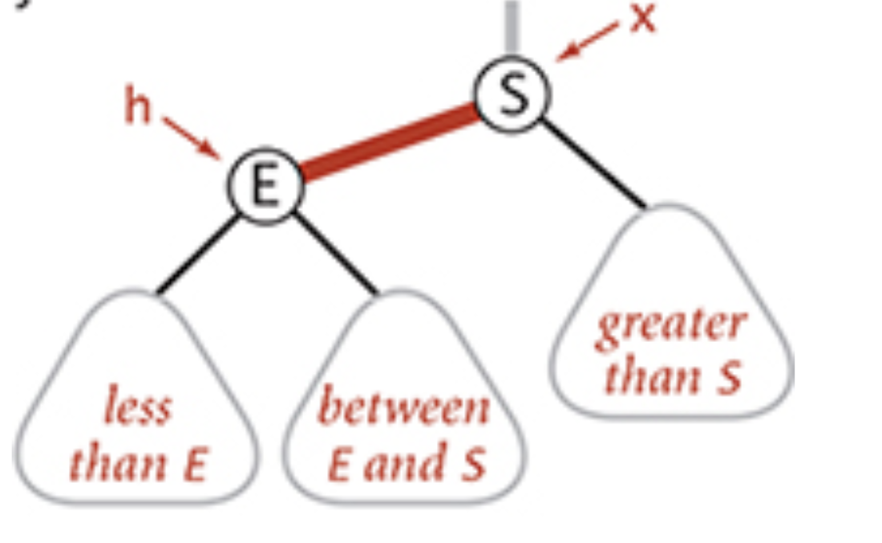
What if the new red node is a right child?

Slide 9
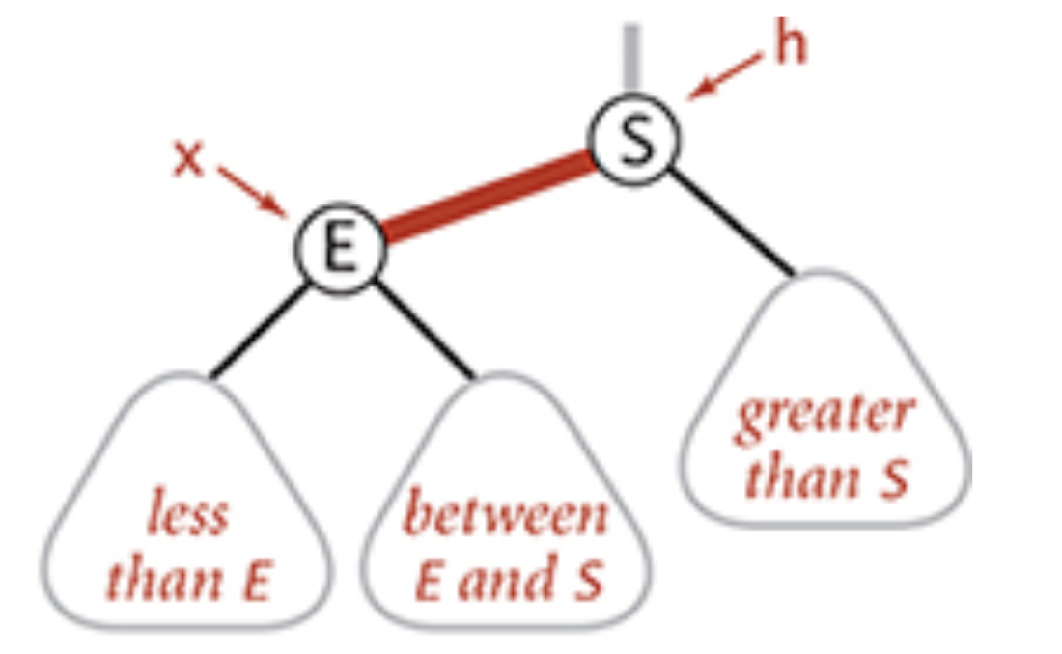
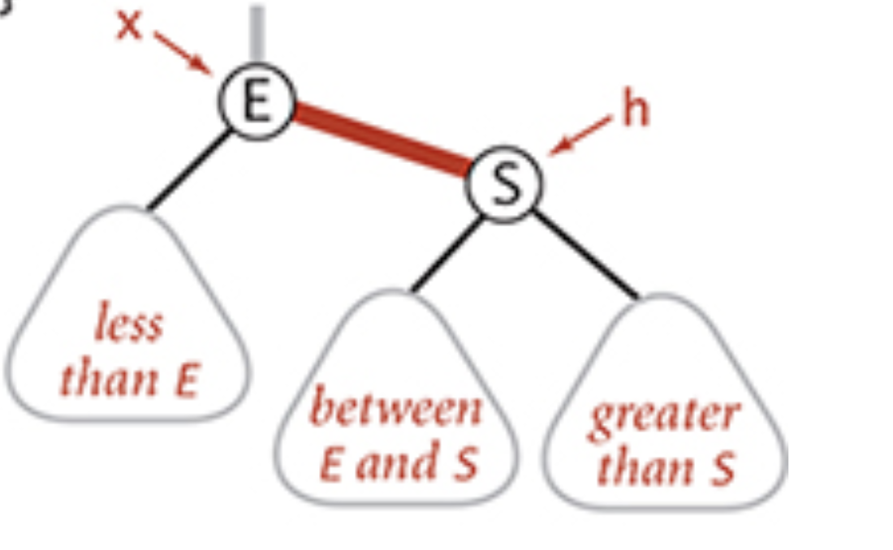
rotateRight

Slide 10
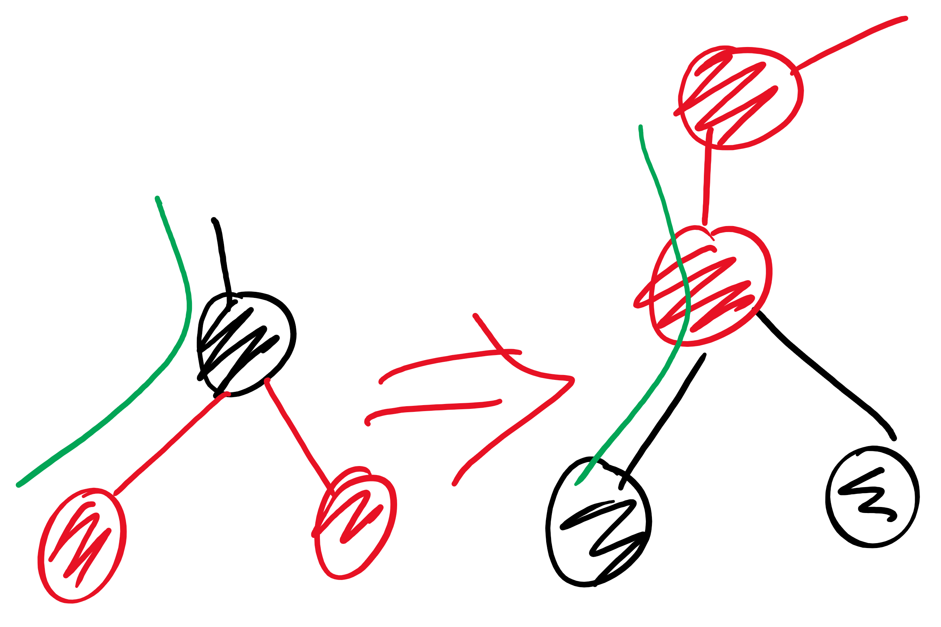
colorFlip

Slide 11
Adding to a red-black BST
new node is always red (at least initially)
if properties violated, correct using one or more of the basic operations
Violations that can happen:
red link to the right child
two red links connected to the same node
root node is red
Correcting a violation may result in a violation up the tree
Corrections happen as we climb back up the tree
That is, after the recursive call

Slide 12
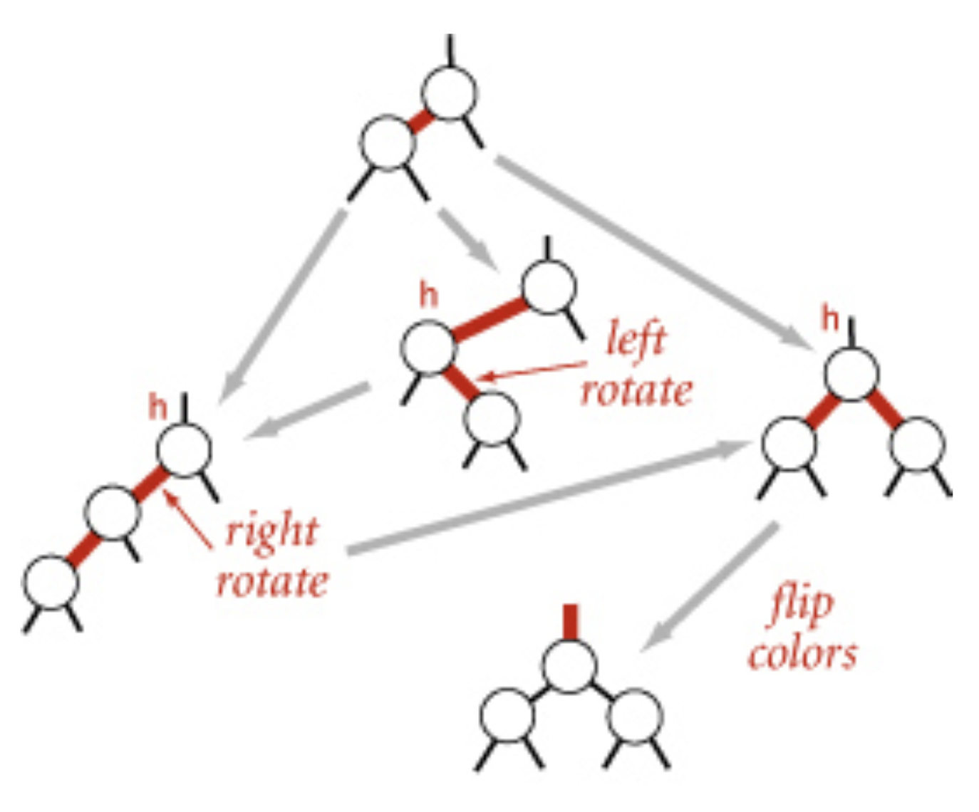
Dependencies between corrections!

Slide 13
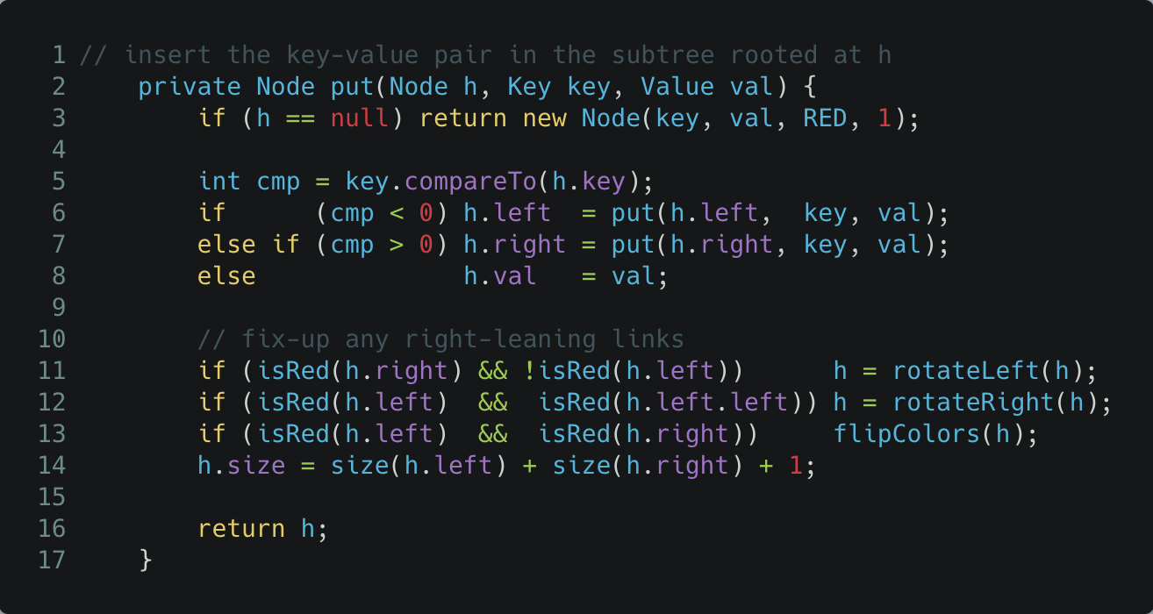
Which violations to check for first?

Slide 14
Deleting a node
Make sure that we are not deleting a black node
as we go down the tree, make sure that the next node down is red
using certain operations
as we go back up the tree, correct any violations
same as we did while adding
if deleting a node with 2 children
replace with minimum of right subtree
similar trick to delete in regular BST

Slide 15
Other operations
rank, select, range query, …
Same code as regular BST!
worst-case runtime = Theta(log n)!!

Slide 16
Please submit your reflections by using the CourseMIRROR App
If you are having a problem with CourseMIRROR, please send an email to coursemirror.development@gmail.com
Notes:
All right!
Upcoming Due Dates at A Glance

